Slide 1
SUPER
SENIORS

Slide 2
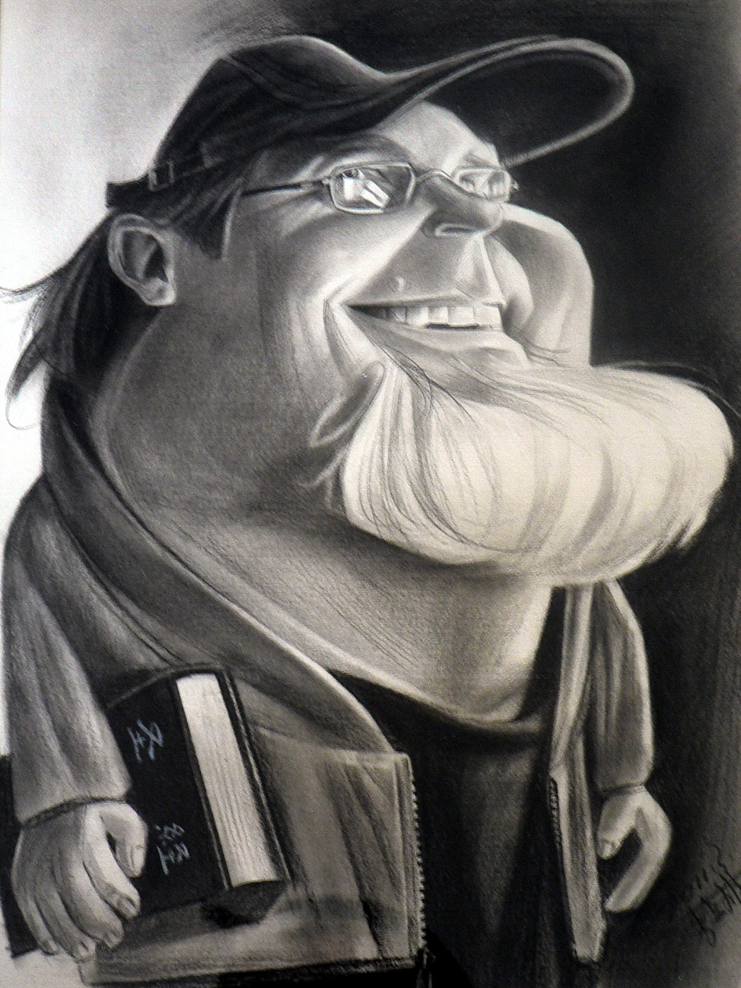
Have some fun with this lesson.
Johnnie Achord
Shifus.org

Slide 3

Do you think you are TOO OLD to be a
SUPERHERO ?
Super
Seniors

Slide 4
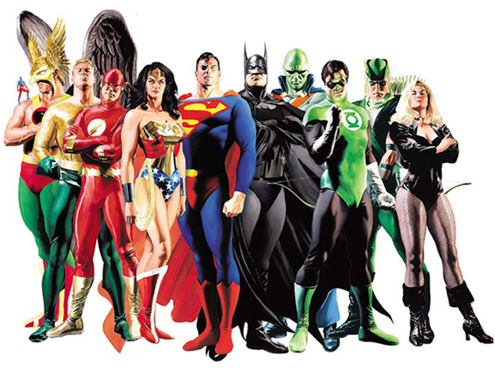
NAME THAT SUPERHERO

Slide 5
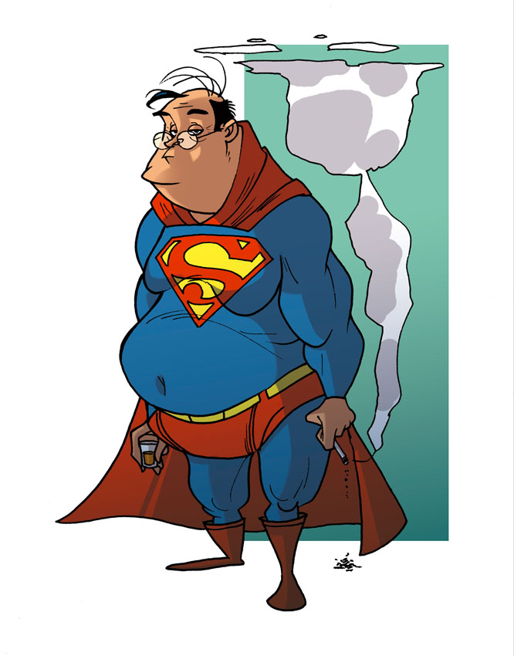
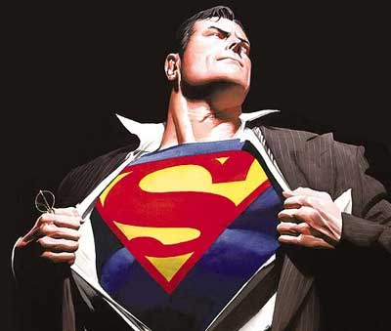
Superman

Slide 6
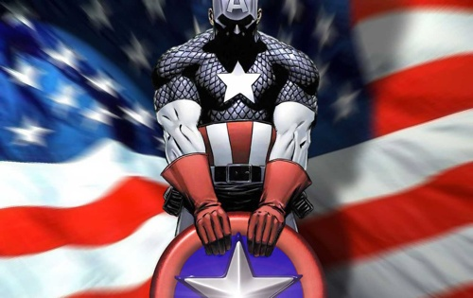
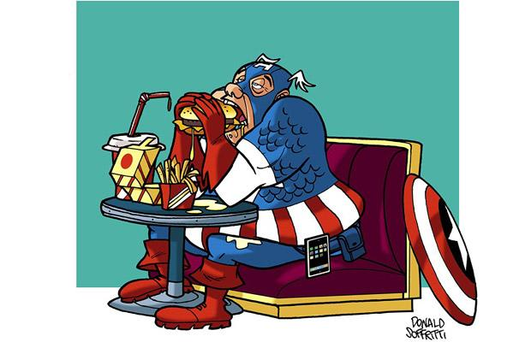
Captain America

Slide 7
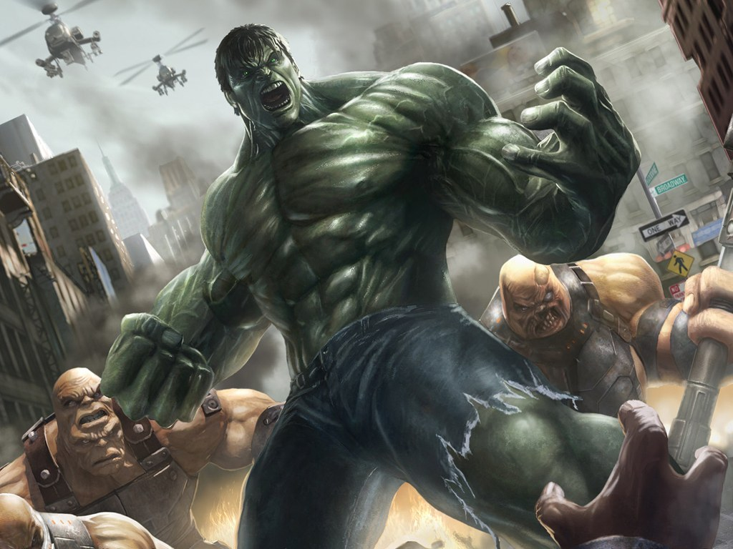
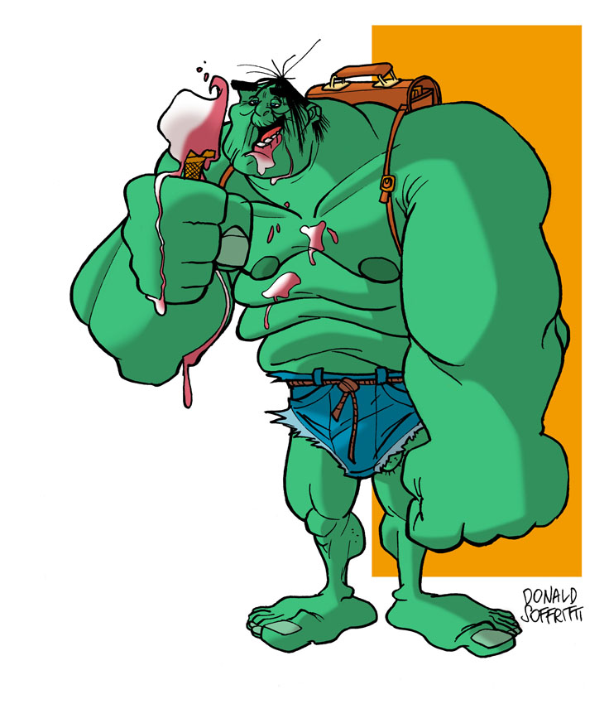
HULK

Slide 8
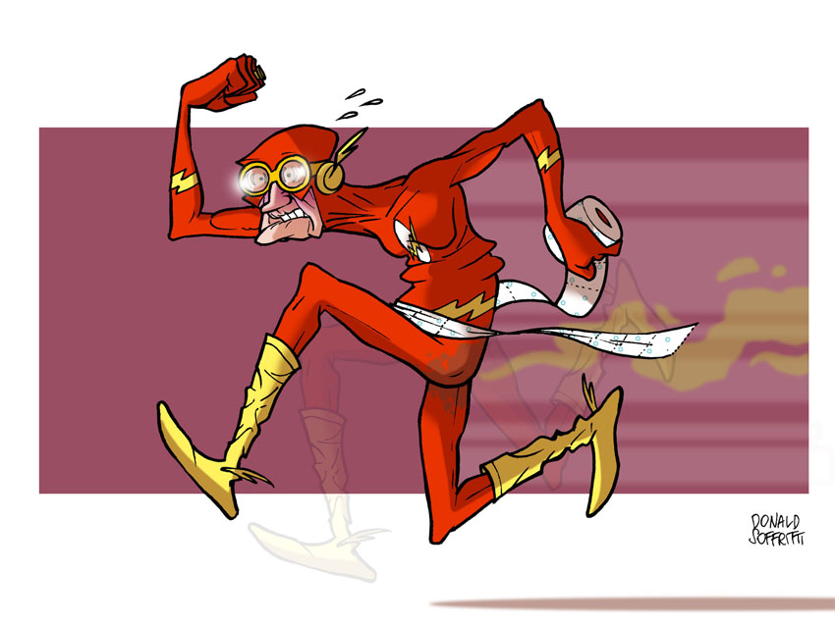

The FLASH

Slide 9
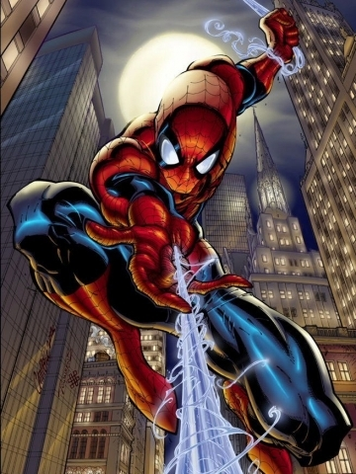
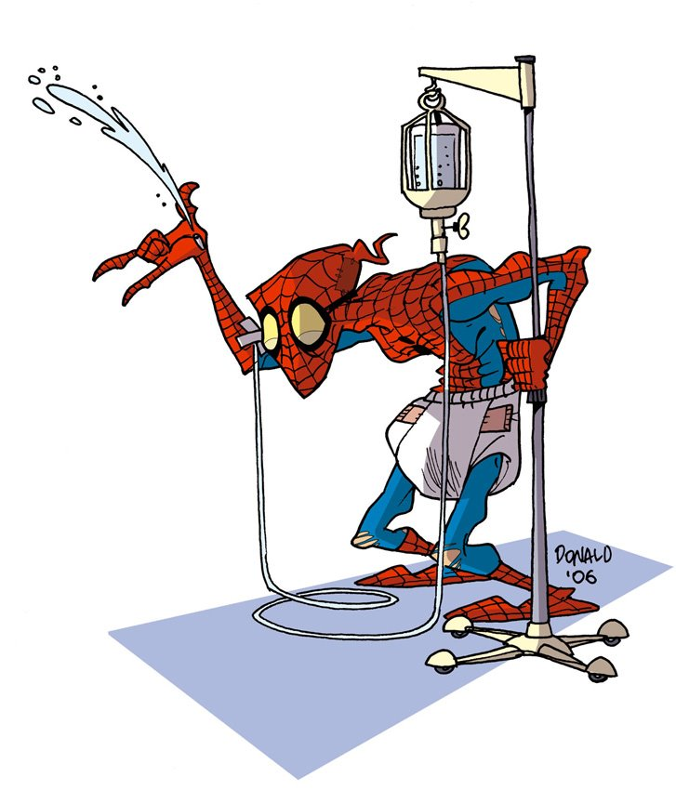
Spiderman

Slide 10
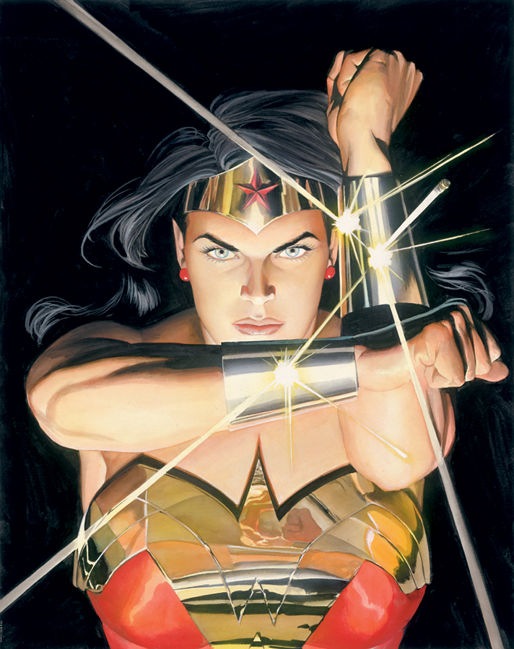
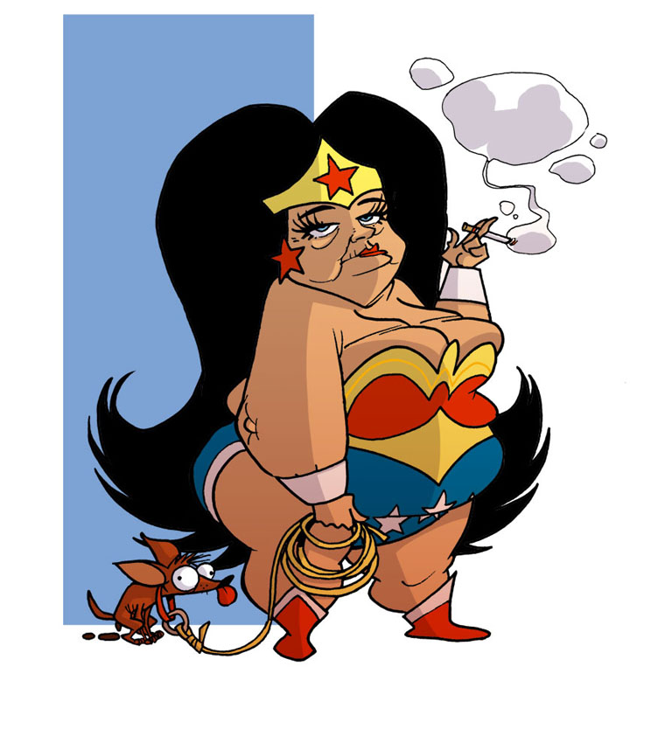
Wonder Woman

Slide 11
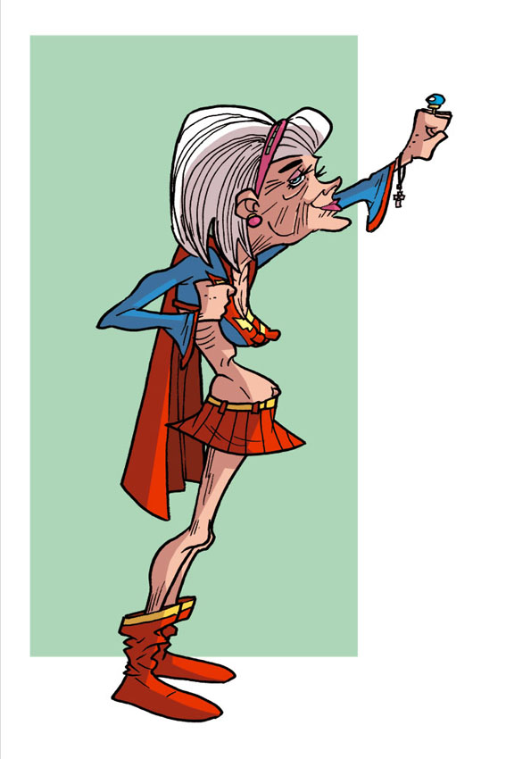
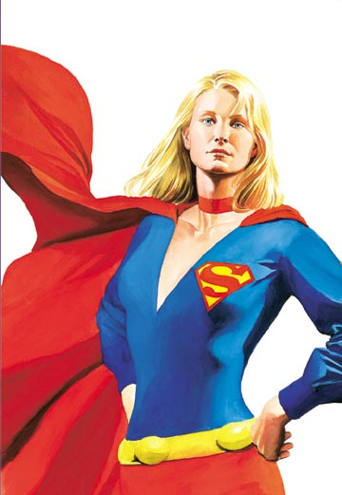
Supergirl

Slide 12
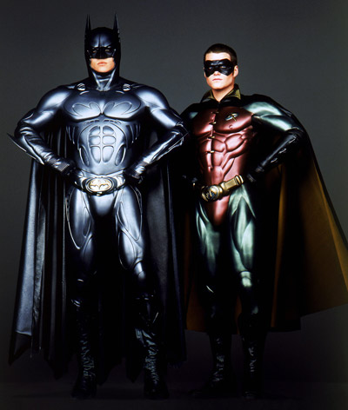
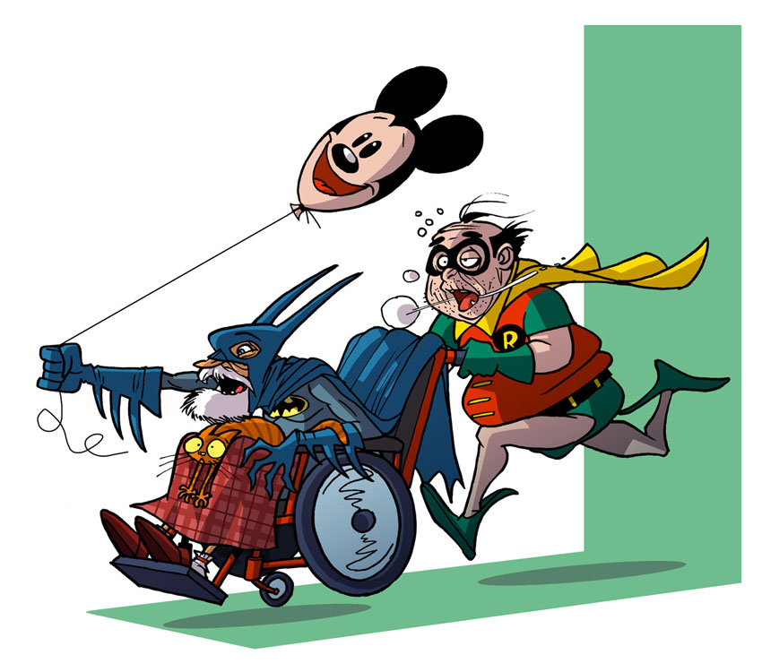
Batman & Robin

Slide 13
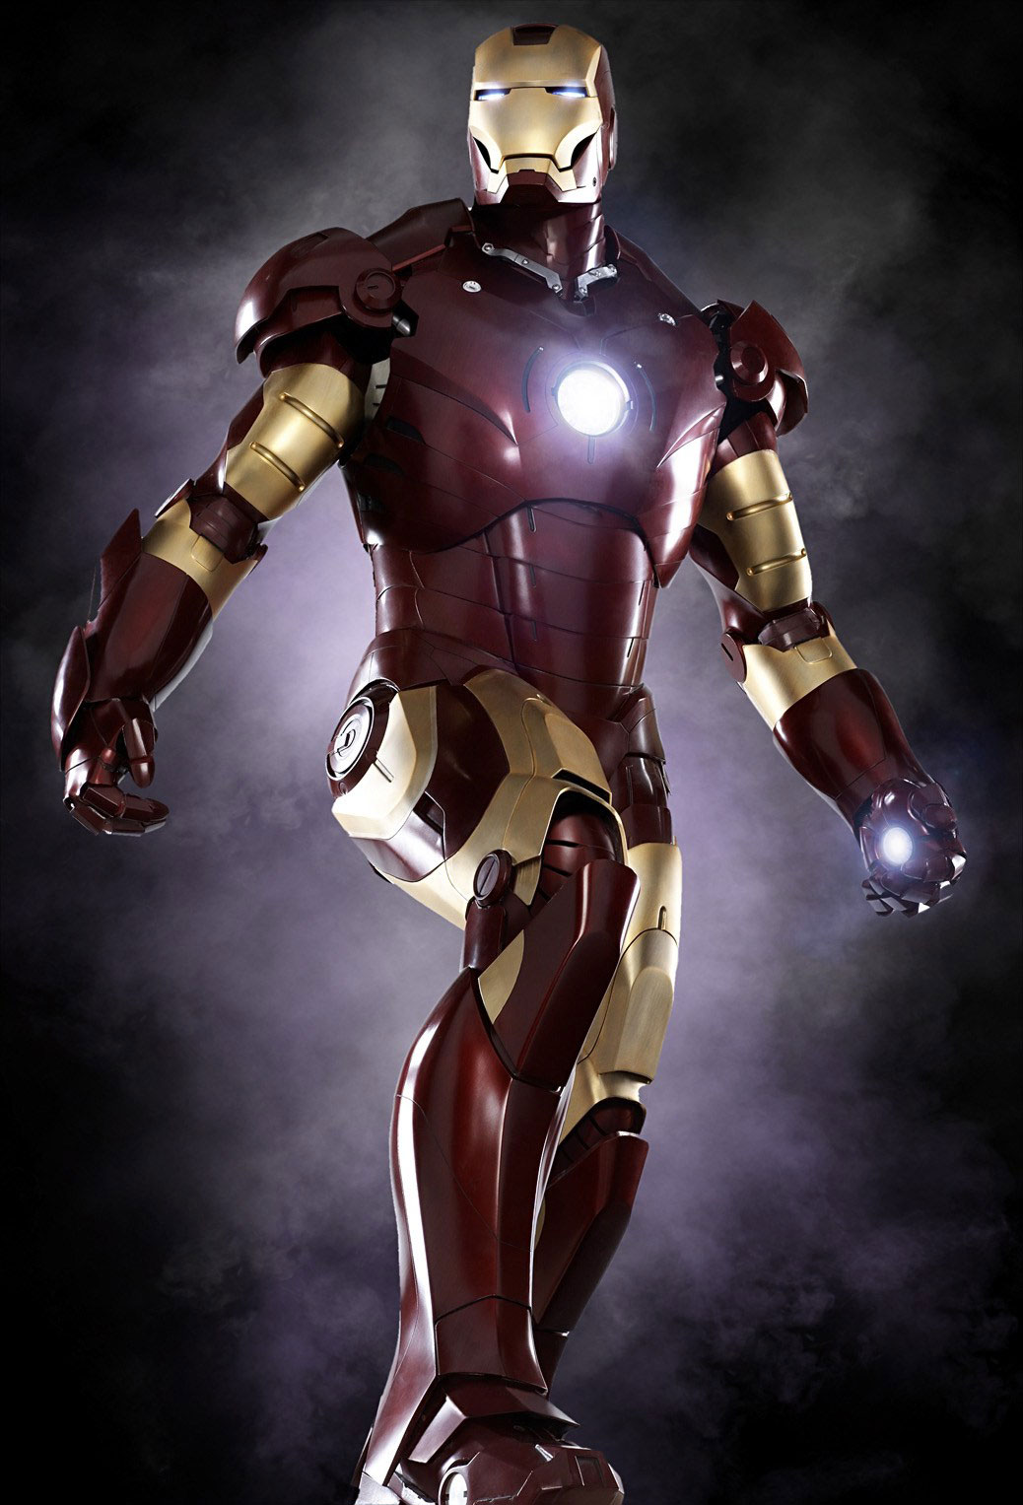
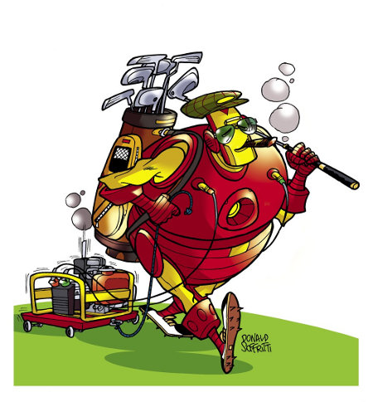
Ironman

Slide 14
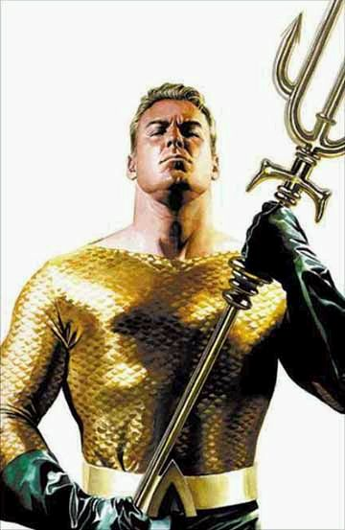
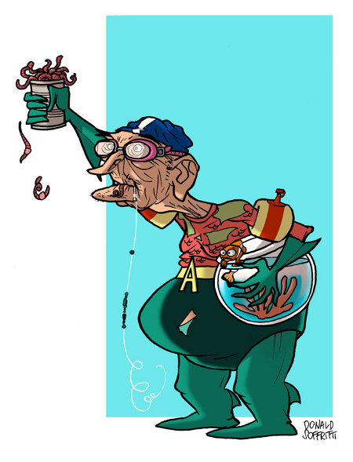
Aquaman

Slide 15

You’re NEVER
TOO OLD to be a
SUPERHERO !

Slide 16
TRIVIA: How old was…
MOSES
when he led the people out of Egypt?
JOHN
when he wrote his books?
NOAH
when God called him to build the ark?
SARAH
when she gave birth to Isaac?
JOSHUA
when he led the people into the new Land?
80
80s
500
90
60+

Slide 17

Did you know…?
America is now the oldest society in the history of the world. There has never been a society with this percentage of older people. Material comfort, medical care and a low birth rate have led America to what is called the graying of America and an old population.
By the year 2018, 1 out of every 5 people was over 65. 1 in 10 was over 80.
Older women outnumber older men at 22.7 million older women to 16.8 million older men
Half of older women age 75+ live alone

Slide 18

Ecclesiastes 12:1-7 “Remember your Creator in the days of your youth, before the days of trouble come and the years approach when you will say, “I find no pleasure in them”— ² before the sun and the light and the moon and the stars grow dark, and the clouds return after the rain; ³ when the keepers of the house tremble, and the strong men stoop, when the grinders cease because they are few, and those looking through the windows grow dim; ⁴ when the doors to the street are closed and the sound of grinding fades; when people rise up at the sound of birds, but all their songs grow faint; ⁵ when people are afraid of heights and of dangers in the streets; when the almond tree blossoms and the grasshopper drags itself along and desire no longer is stirred. Then people go to their eternal home and mourners go about the streets. ⁶ Remember him—before the silver cord is severed, and the golden bowl is broken; before the pitcher is shattered at the spring, and the wheel broken at the well, ⁷ and the dust returns to the ground it came from, and the spirit returns to God who gave it.” .
Too old to do what you enjoy
Times get bleak
Arms get weak
Legs get weak
Loosing teeth
Eyes begin to fail
Begin to lose hearing
Less able to defend yourself
Hair gets grey
Loss of sex drive
Death
Spine weakens
Brain starts to go
The heart gives out
Veins clog
WE ALL DIE

Slide 19
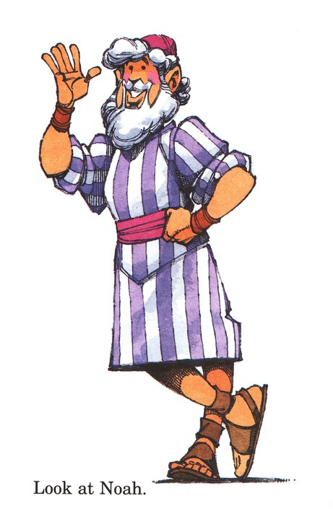
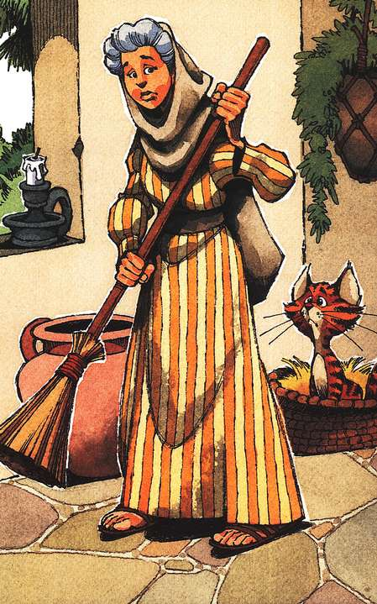
EXAMPLES in Scripture

Slide 20
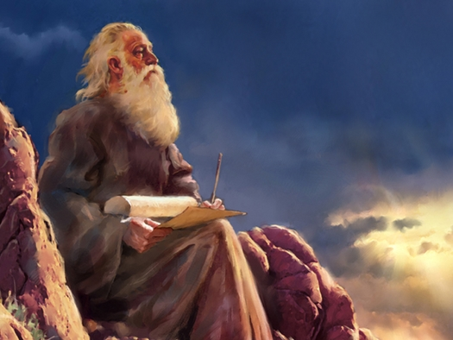
MOSES (120)
At 40, he gave up great wealth to become a shepherd (Training Time)
At 80, he led God’s people out of Egypt (Action Time)
From 80-120, he led God’s nation towards their Promised Land.
God spoke through Moses and allowed him to compile the first 5 Books of the Bible.

Slide 21
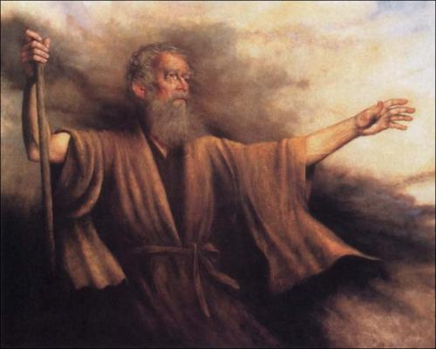
CALEB (85)
One of 2 spies out of 12 who said they could defeat Jericho. (Great faith)
Caleb, “quieted the people before Moses”, and said, “Let us go up at once, and occupy it; for we are well able to overcome it” Num 13:30
Stood for God even when God’s people wanted to kill him for it.
Had to wander 40 years

Slide 22
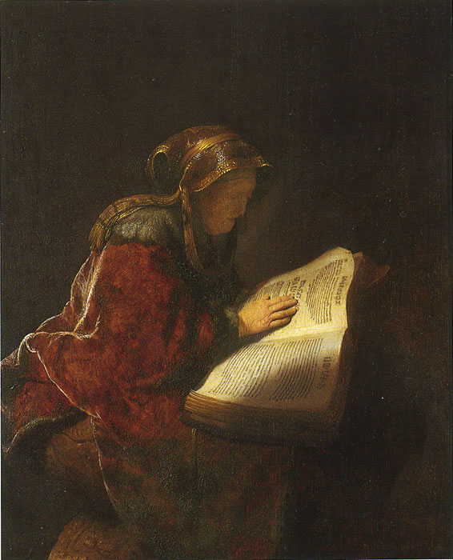
ELIZABETH (old)
LK 1:6 "Zechariah and Elizabeth were upright in the sight of God, observing all the Lord's commandments and regulations blamelessly.“
Woman of Faith: Called God “Lord” and “Savior”
Gave birth to John the Baptist as a senior citizen

Slide 23
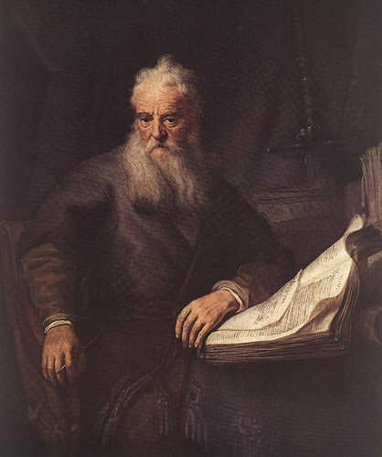
JOHN (94)
Long time follower of Jesus Christ
Jesus’ best friend; called ‘the beloved’
Wrote 5 Bible books
Tortured as a senior by boiling in oil; survived
Exiled to an island cave
Jesus met with him to give him the Revelation
Last surviving apostle

Slide 24
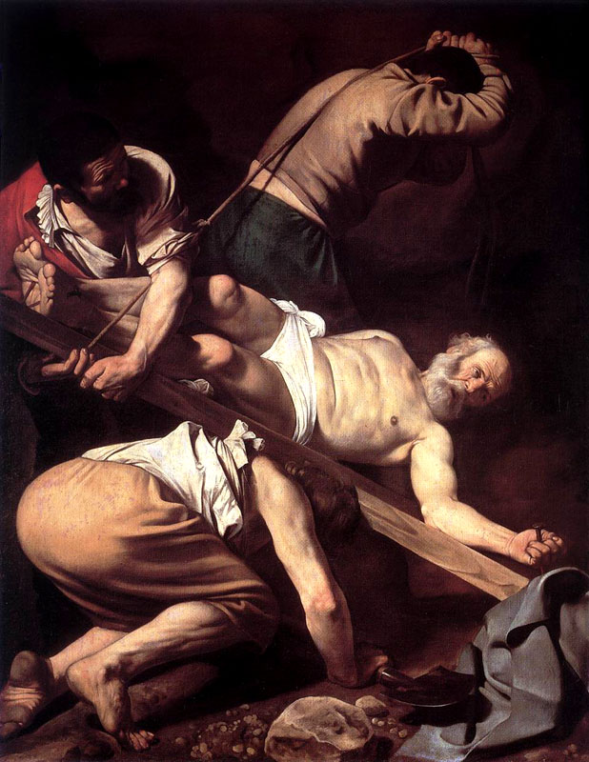
PETER (68)
Original apostle
Founded the church in Antioch (pastored for 25 years there)
Wrote 2 Bible books
Walked on water; denied Jesus; went to the cross and the tomb;
Crucified upside down by request at age 68
Buried under St. Peter’s basilica

Slide 25
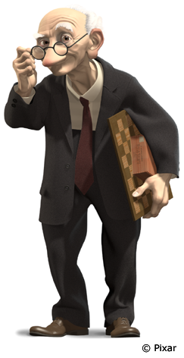
What about people who are NOT in the Bible?

Slide 26
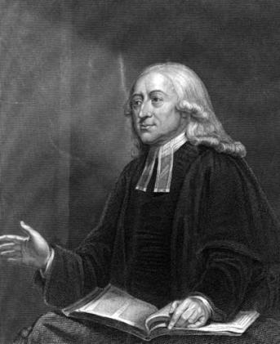
John Wesley
He traveled 250,000 miles by horseback or on foot to preach. He preached 40,000 sermons, produced 400 books and knew 10 languages. At 83 he was annoyed that he couldn't write for more than 15 hours a day without hurting his eyes. At 86 he was ashamed that he couldn't preach more than twice a day. He said, since his 86th birthday, he had to admit there was an increasing tendency to lie in bed until 5:30 A.M.

Slide 27
God doesn’t expect everyone to be a
“John Wesley”.
So what DOES God expect from
“older” saints?

Slide 28
How old is ‘OLDER’?
50+
According to writings in Paul’s day…

Slide 29
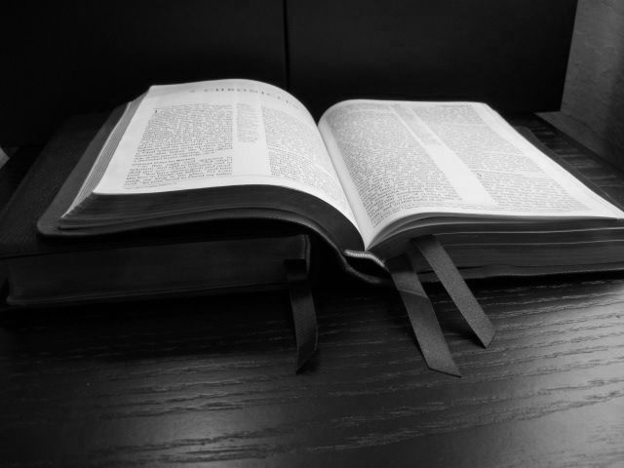
Turn in your Bible to…
Titus 2:2-3

Slide 30
God’s Plan for Older Men
Sober (nēphalios: literally: abstaining from the use of much alcohol. Metaphorically: moderate; not self indulgent; not extravagant in spending)
Grave (semnos: serious, worthy of respect, mature)
Temperate (sōphrōn: a sound mind, sane, in one's senses; curbing desires and impulses, self-controlled)
Sound in Faith (pistiis: strong, stable, unshakable faith)
Charitable (agape: demonstrating God’s love to all)
Patient (hypomone: not swerved from purpose and faith and piety by even the greatest trials and sufferings
Titus 2:2 "That the aged men be sober, grave, temperate, sound in faith, in charity, in patience."

Slide 31
God’s Plan for Older Women
Holy Behavior (katastēma: holy, priest-like, sacred, able to enter God’s presence, fit for their husbands)
Not False Accusers (diabolos: slanderers, 34x = Satan)
Not given to much wine (me douloo polys oinos: not drinking enough wine to get drunk on; sober)
Teachers of good things (kalodidaskalos: teach good)
That they may teach the young women (by example, too) to be sober, to love their husbands, to love their children, To be discreet, chaste, keepers at home, good, obedient to their own husbands, so God’s Word is not blasphemed.
Titus 2:3 "The aged women likewise, that they be in
behavior as becomes holiness, not false accusers,
not given to much wine, teachers of good things."

Slide 32
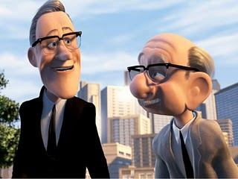
The Bible says…
Job 12:12 "Wisdom is with aged men, With long life is understanding.”
Psalm 71:18 “And even when I am old and gray, O God, do not forsake me, Until I declare Thy strength to this generation, Thy power to all who are to come.”
2 Corinthians 4:16 “Therefore we do not lose heart, but though our outer man is decaying, yet our inner man is being renewed day by day.”
Isaiah 46:4 “Even to your old age, I shall be the same; And even to your graying years I shall bear you! I have done it, and I shall carry you; And I shall bear you, and I shall deliver you.”

Slide 33
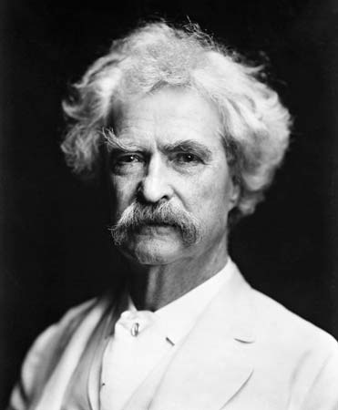
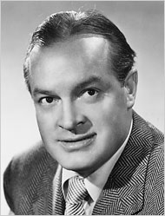
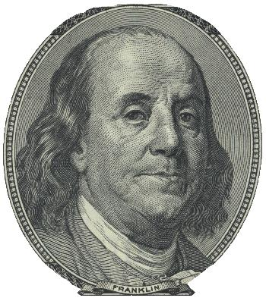
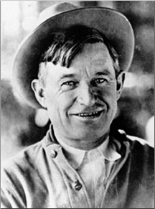
Quotes
“Age is an issue of mind over matter.
If you don't mind, it doesn't matter.”
“Middle age is when your age starts to show around your middle.”
“ At 20 years of age the will reigns; at 30 the wit; at 40 the judgment.”
"Some people try to turn back their odometers. Not me, I want people to know 'why' I look this way.
I've traveled a long way and some of the roads weren't paved."

Slide 34
Summary…
Super
Seniors
We ALL get older every day. Embrace the strengths of age (wisdom, experience, etc.) and trust God to be alongside you for the difficult times.
Be available to teach the younger people but don’t force their hand. They also must learn through the same mistakes you did.
You are NEVER too old to be used of God in mighty ways. History books and Bible passages are filled with Senior Superheroes!

