Slide 1
The ROLE & QUALIFICATIONS of an
ELDER

Slide 2
Christian men are called by Christ to be leaders in their homes and churches.
In this study, we will ‘raise the bar’ by examining the Biblical qualifications of Elders and Deacons.

Slide 3
What are some of the qualification YOU would want or expect from a leader before you would follow them whole heartedly?

Slide 4
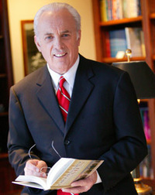
DESCRIPTION OF AN ELDER
“The strength, productivity, health, and fruitfulness of a church directly reflect the quality of its leadership”
-John MacArthur

Slide 5
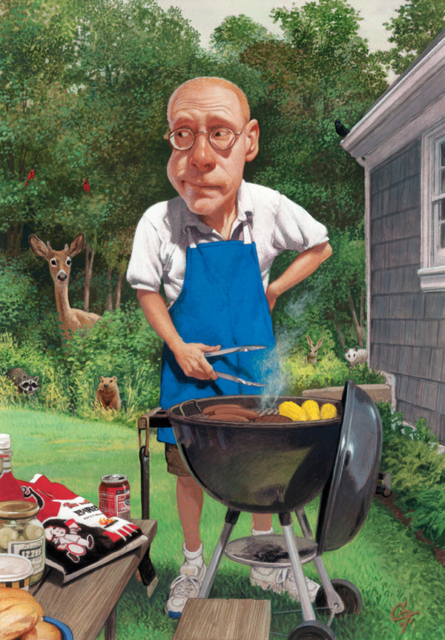
.
.
“God’s standards for church leaders should be the aspiration for all men who seek to be the man God made them to be”
-Dr. Jay BarLeon

Slide 6
1 TIMOTHY 3:1-7
”¹It is a trustworthy statement: if any man aspires to the office of overseer, it is a fine work he desires to do. ² An overseer, then, must be above reproach, the husband of one wife, temperate, prudent, respectable, hospitable, able to teach, ³ not addicted to wine or pugnacious, but gentle, peaceable, free from the love of money. ⁴ He must be one who manages his own household well, keeping his children under control with all dignity ⁵ (but if a man does not know how to manage his own household, how will he take care of the church of God?), ⁶ and not a new convert, so that he will not become conceited and fall into the condemnation incurred by the devil. ⁷ And he must have a good reputation with those outside the church, so that he will not fall into reproach and the snare of the devil.”

Slide 7
TITUS 1:5-9
”⁵For this reason I left you in Crete, that you would set in order what remains and appoint elders in every city as I directed you, ⁶ namely, if any man is above reproach, the husband of one wife, having children who believe, not accused of dissipation or rebellion. ⁷ For the overseer must be above reproach as God’s steward, not self-willed, not quick-tempered, not addicted to wine, not pugnacious, not fond of sordid gain, ⁸ but hospitable, loving what is good, sensible, just, devout, self-controlled, ⁹ holding fast the faithful word which is in accordance with the teaching, so that he will be able both to exhort in sound doctrine and to refute those who contradict.”

Slide 8
INTRODUCTION
What is an elder?
Old Testament Understanding of Elders
New Testament Understanding of Elders
Difference Between Elders & Deacons
The Role of Elders
Biblical Qualification to Lead

Slide 9
WHAT IS AN ELDER?
Elders are those who are charged with teaching, feeding, and protecting the church
Elders are accountable to God on behalf of the church.
Elders are required to meet a high standard given in Scripture before accepting the responsibilities.
ELDER RULE is the only pattern for church leadership given in the New Testament.
THE BIBLICAL NORM for church leadership is a plurality of God-ordained elders.
NOWHERE IN SCRIPTURE do we find a local assembly ruled by majority opinion of a congregation

Slide 10
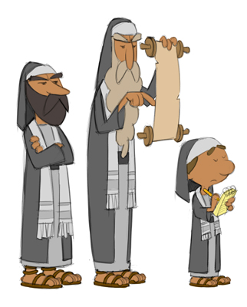
What Is The
Old Testament Understanding
Of The Term
”ELDER”?
zaqen
sab

Slide 11
The Hebrew word zaqen refers to a special category of men who were set apart for LEADERSHIP in Israel.
They were charged with the responsibility of judging the people.
Moses communicated through them (Ex.19:7).
They led Passover (Ex. 12:21) and other elements of worship.
Their function was decision making--applying wisdom to the lives of the people in resolving conflicts, giving direction, and generally overseeing the details of an orderly society.
CALLED…
"elders of Israel" (1 Sam. 4:3);
"elders of the land" (1 Kings 20:7);
"elders of Judah" (2 Kings 23:1);
"elders...of each city" (Ezra 10:14);
"elders of the congregation" (Judges 21:16).

Slide 12
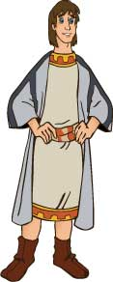
Another Hebrew word for elder is sab
Used only five times in the Old Testament (all in the book of Ezra)
There it refers to the group of Jewish leaders in charge of rebuilding the Temple after the Exile.

Slide 13
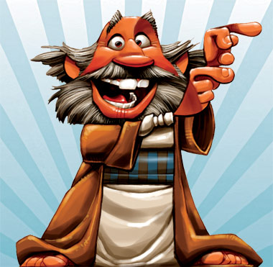
What Is The
New Testament Understanding
Of The Term
”ELDER”?
presbuteros
episkopos
poimen

Slide 14
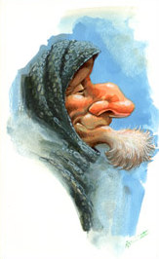
The Greek word presbuteros:
used about 70x in the N.T. referring to MATURE AGE.
Ie: Acts 2:17, Peter quotes Joel 2:28: "And your old men shall dream dreams."
The Hebrew word used for "old men" in Joel is zaqen, and the Greek word used in Acts is presbuteros.
1st Peter 5:5 "You younger men… be subject to your elders."
Used in that sense, elder does not constitute an official title; it simply means "an older man."

Slide 15
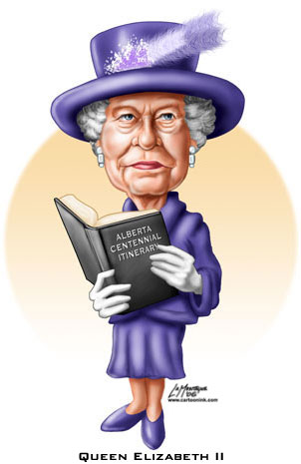
In 1 Tim.5:2,
the feminine form of presbuteros is used to refer to older women contrasted with younger ones. In that context, the term again signifies only mature age, not an office in the church.

Slide 16
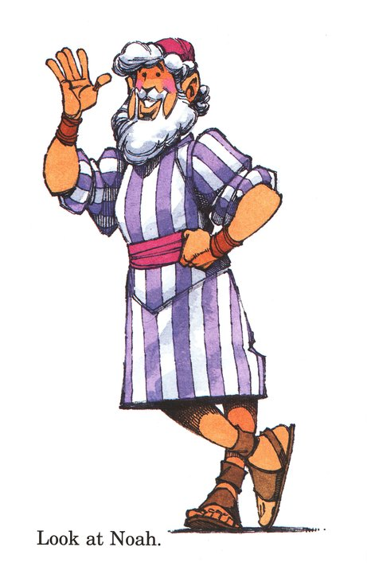
In the time of Christ, presbuteros was a familiar term.
Used 28x in the N.T. to refer to a group of recognized spiritual leaders of Israel:
"the chief priests and elders"
(Matt. 27:3)
"the scribes and elders"
(27:41)
"officers of the temple and elders“
(Luke 22:52)
"rulers and elders of the people"
(Acts 4:8).
"tradition of the elders“
(Matt. 15:2; Mark 7:5)

Slide 17
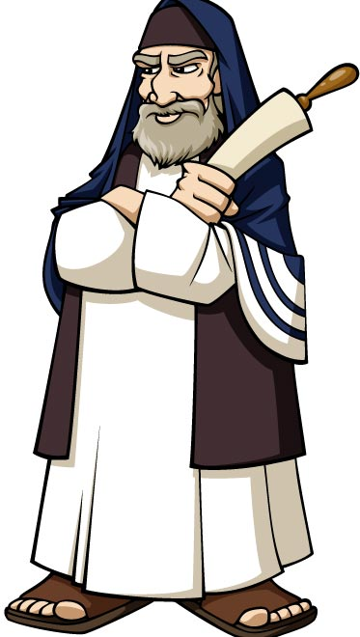
The N.T. church was initially mostly Jewish, so it would be natural for it to adopt the concept of elder rule for use in the early church.
Elder was the only commonly used Jewish term for leadership that was free from any connotation of either the monarchy or the priesthood.
So of all the Jewish concepts of leadership, the elder exemplifies the kind of leadership ordained for the church.

Slide 18
Presbuteros is used nearly 20x in Acts and the Epistles in reference to a unique group of spiritually mature church leaders with responsibility for the assembly.
IE: THE CHURCH AT ANTIOCH (Acts 11:29-30):
Where believers were first called "Christians,“
Sent Barnabas and Saul to the elders at Jerusalem with a gift to be distributed to the needy brethren in Judea.
That demonstrates both that elders existed in the church at that very early date, and that the believers at Antioch recognized their authority.
Since the church at Antioch grew out of the ministry at Jerusalem, elders probably existed there as well.
It is likely that Paul himself functioned as an elder at Antioch, before he stepped out in the role of an apostle.
He is listed in Acts 13:1 as one of that church's teachers.

Slide 19
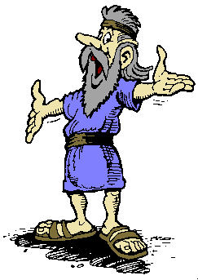
As Paul began to reach new areas, and as the church grew, the process of identifying church leaders became more clearly defined.
In the N.T., as the church developed, leaders were regularly called elders.

Slide 20
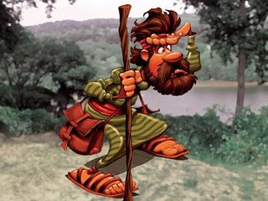
Ie: Elders played a key role in the Jerusalem Council (Acts 15)
Ie: In Acts 14, one of the key steps in establishing a new church was to identify and appoint elders for church leadership.
"When they had appointed elders for them in every church, having prayed with fasting, they commended them to the Lord in whom they had believed" (Acts 14:23).

Slide 21
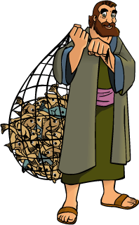
Acts 20:17 "From Miletus he sent to Ephesus and called to him the elders (plural) of the church.“
Ie: Peter wrote to the scattered believers in the territories of Pontus, Galatia, Cappadocia, Asia, and Bithynia, "I exhort the elders (plural) among you...shepherd the flock of God" (1 Peter 5:1-2).
Peter was writing to a number of churches scattered all over Asia.
All of them had multiple elders.

Slide 22
EPISKOPOS: (bishop) ="overseer," or "guardian"
5 times in the N.T.
In 1 Peter 2:25, Jesus Christ is the episkopos
("the Shepherd and Guardian of [our] souls.“)
4x, episkopos have reference to Church Leaders
Specifically responsible for teaching (1 Tim.3:2), feeding, protecting, and generally nurturing the flock (Acts 20:28).
Episkopos emphasizes the function;
presbuteros, the character.

Slide 23
POIMEN: “Pastor” or “Shepherd”
Eph. 4:11 is the only place in the KJV where it is translated "pastor”
Every other time it appears in the Greek texts, it is translated "shepherd" in the English version.
2 of 3 times it appears in the epistles, poimen refers to Christ
Heb. 13:20-21 "Now the God of peace, who brought up from the dead the great Shepherd [poimen] of the sheep through the blood of the eternal covenant, even Jesus our Lord, equip you in every good thing to do His will."
1st Peter 2:25 "For you were continually straying like sheep, but now you have returned to the Shepherd [poimen] and Guardian [episkopos] of your souls.“

Slide 24
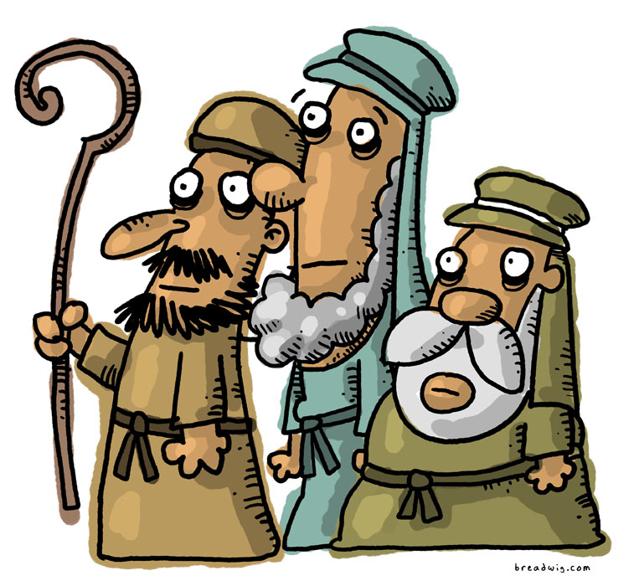
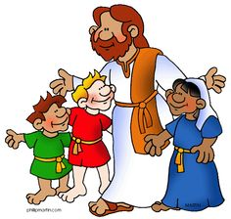
Poimen emphasizes the pastoral role of caring, feeding, shepherding. To be qualified as a pastor, a man must have a shepherd's caring heart..
In Eph. 4:11, pastor [poimen] is used with teacher [didaskalos]
The Greek construction there indicates that the two terms go together-- ("pastor-teacher").
The emphasis is on the pastor's ministry of teaching.

Slide 25
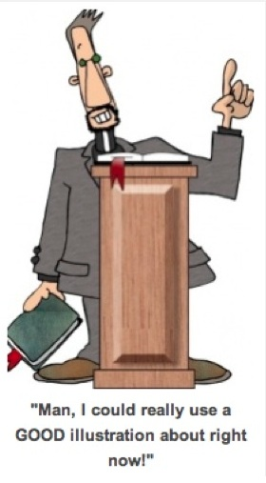
All 3 terms are used of the same church leaders, and all 3 identify those who feed & lead the church, but each has a unique emphasis.
ELDER = WHO THE MAN IS.
BISHOP = WHAT HE DOES.
PASTOR = HOW HE LEADS.

Slide 26
Presbuteros: ELDER
Episkopos:
BISHOP
Poimen:
PASTOR
Bishops and pastors are not distinct from elders
All three terms (presbuteros, episkopos, poimen) refer to the same office.
The qualifications for a bishop, (1 Tim. 3:1-7) and those for an elder (Titus 1:6-9) are unmistakably parallel.
In Titus, Paul uses both terms to refer to the same man (1:5, 7)

Slide 27
1st Peter 5:1-2 brings all three terms together.
Peter instructs elders to be good bishops as they pastor:
"Therefore, I exhort the elders [presbuteros] among you, as your fellow elder and witness of the sufferings of Christ, and a partaker also of the glory that is to be revealed, shepherd [pomaino] the flock of God among you, exercising oversight [episkopeo] not under compulsion, but voluntarily, according to the will of God."
presbuteros
episkopos
poimen

Slide 28
ACTS 20 also uses all three terms interchangeably.
In verse 17, Paul assembles all the elders [presbuteros] of the church to give them his farewell message.
In verse 28, he says,
"Be on guard for yourselves and for all the flock, among which the Holy Spirit has made you overseers [episkopos], to shepherd [pomaino] the church of God."
presbuteros
episkopos
poimen

Slide 29
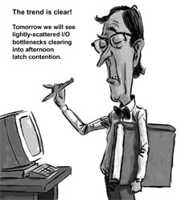
What is the difference between elders and deacons?
DEACONS are as equally qualified, honored, and respected as the elders in terms of character and spiritual life.
The one main difference between their qualifications is that the elder must be able to teach, but the deacon doesn't have to be.
Elders have the primary responsibility of teaching the Word
Deacons relieve those who are more skilled in teaching so those men may be free to pray and study the Word.

Slide 30
In a special sense, the deacon's task sums up the essence of spiritual greatness. Our Lord said, "Whoever wishes to become great among you shall be your servant, and whoever wishes to be first among you shall be your slave; just as the Son of Man did not come to be served, but to serve" (Matt. 20:26-28).

Slide 31
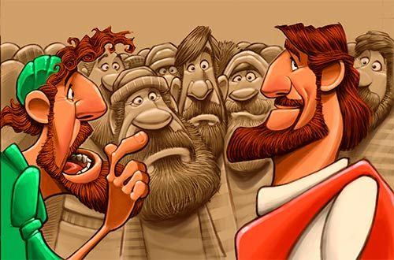
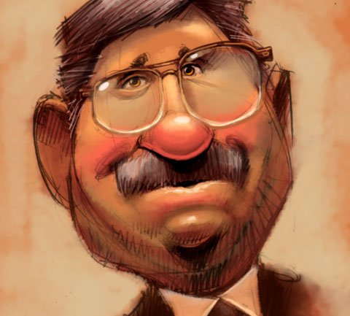
Jesus Himself is the model for deacons. It is a role of service, sacrifice, and commitment to others' needs. The reward of the deacon's office is not the temporal glory or human adulation, but rather the eternal blessing that comes from living a life of spiritual service to the glory of God.

Slide 32
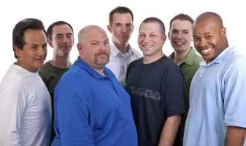
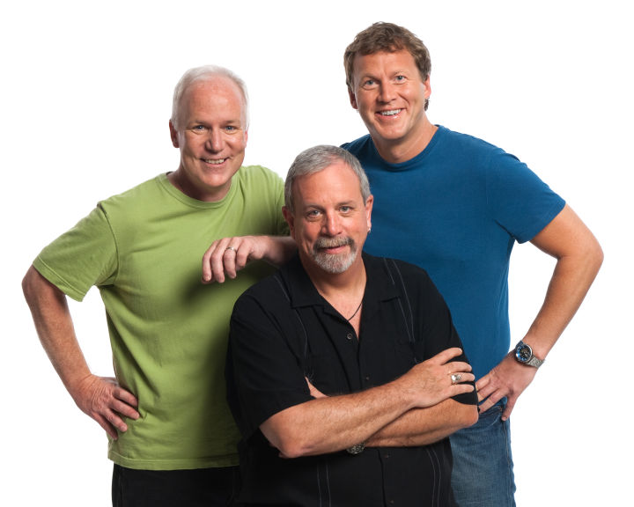
THE ROLE OF AN ELDER
ELDER RULE is the pattern for church leadership given in the New Testament.

Slide 33
OVERSEE THE AFFAIRS OF THE CHURCH
1st Tim. 5:17 "The elders who rule well are to be considered worthy of double honor(arium)."
The Greek word translated "rule" in that verse is proistemi
Literally means "to stand first"
Speaks of general oversight common to all elders.
It is used to speak of the elders' responsibilities…
4x in 1 Tim. (3:4,5,12; 5:17)
1x in 1 Thess. 5:12 (translated "have charge over")
1x in Rom. 12:8 (ruling is listed as a spiritual gift)
Their authority over the church is not by force or dictatorial power, but by teaching and example…
”Remember your leaders, who spoke the Word of God to you. Consider the outcome of their way of life and imitate their faith.” Hebrews 13:7

Slide 34
ELDERS ARE NOT TO OPERATE BY MAJORITY VOTE.
If all the elders are guided by the same Spirit and the mind of Christ, there should be UNANIMITY in the decisions they make
If there is division, all the elders should study, pray, and seek the will of God together until consensus is achieved.
1 Cor. 1:10 ”I appeal to you, brothers and sisters, in the name of our Lord Jesus Christ, that all of you agree with one another in what you say and that there be no divisions among you, but that you be perfectly united in mind and thought”
Eph. 4:3 “Make every effort to keep the unity of the Spirit through the bond of peace”
Phil.1:27 “Whatever happens, conduct yourselves in a manner worthy of the gospel of Christ. Then, whether I come and see you or only hear about you in my absence, I will know that you stand firm in the one Spirit, striving together as one for the faith of the gospel
Phil. 2:2 “Then make my joy complete by being like-minded, having the same love, being one in spirit and of one mind”

Slide 35
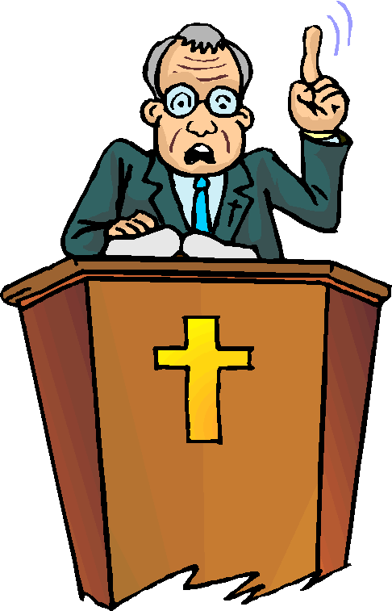
PREACH & TEACH GOD’S WORD
1 Tim. 5:17 “The elders who direct the affairs of the church well are worthy of double honor, especially those whose work is preaching and teaching”
1st Tim.3:2-7 gives only one qualification that relates to a specific function: he must be "able to teach." All the other qualifications are personal character qualities.
James 3:1 "Let not many of you become teachers, my brethren, knowing that as such we will incur a stricter judgment.”

Slide 36
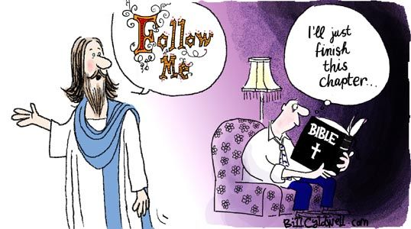
DETERMINE DOCTRINAL ISSUES
Titus 1:9 An elder “must hold firmly to the trustworthy message as it has been taught, so that he can encourage others by sound doctrine and refute those who oppose it.”

Slide 37
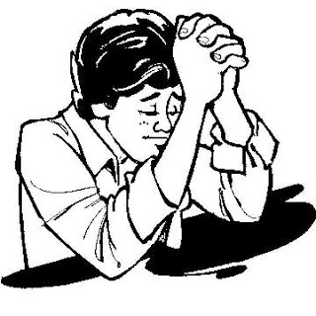
PRAY WITH HIS CHURCH FAMILY
James 5:14 "Is anyone among you sick? Then he must call for the elders of the church, and they are to pray over him, anointing him with oil in the name of the Lord".
They are to devote themselves first of all to prayer and to the ministry of the Word, and select deacons to handle the maintenance matters (Acts 6:3-4).

Slide 38
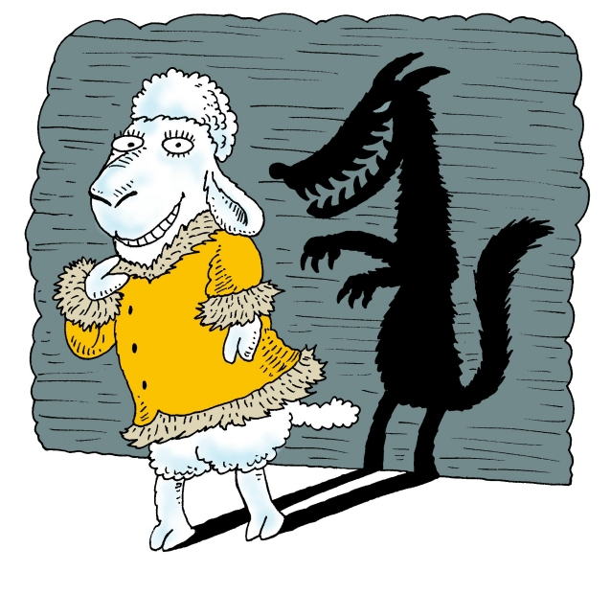
PROTECT THE FLOCK
Acts 20:28 "Keep watch
over yourselves and all the flock
of which the Holy Spirit has
made you overseers.
Be shepherds of the church
of God, which he bought with
his own blood. I know that
after I leave, savage wolves will come in among you
and will not spare the flock. Even from your own
number men will arise and distort the truth in order to draw away disciples after them.”

Slide 39
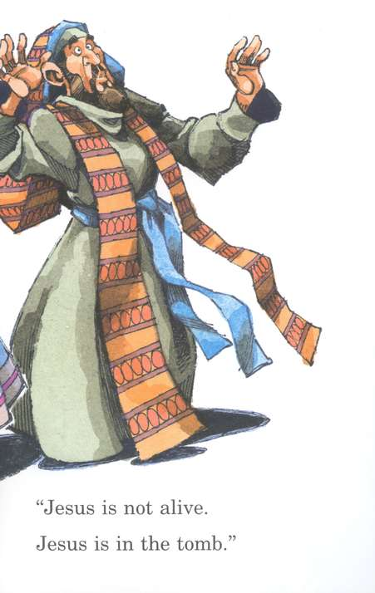
CARE FOR THE CHURCH
Never in Scripture is it spoken of as "his flock"
It is the "flock of God" and elders are merely stewards -- caretakers for God’s flock.
1 Peter 5:2, “Be shepherds of God’s flock that is under your care, watching over them—not because you must, but because you are willing, as God wants you to be; not pursuing dishonest gain, but eager to serve”
1st Tim. 3:5, Paul says that the work of an episkopos is to "take care of the church of God."

Slide 40
QUALIFICATIONS OF AN ELDER

Slide 41
TURN OFF YOUR CELL PHONES

Slide 42
REVIEW QUIZ
1) Which of the following is a word for a church ELDER?
Presbuteros
Episkopos
Poimen
2) Which represents the shepherd’s heart of an Elder?
Presbuteros
Episkopos
Poimen
3) Which word depicts the Elders’ function as Guardian?
Presbuteros
Episkopos
Poimen

Slide 43
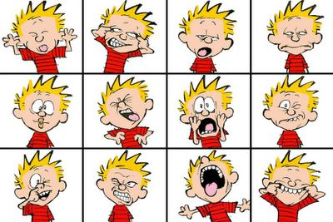
REVIEW QUIZ
4) Elders are responsible to…
Govern the church
Protect the church
Clean the church
Teach the church
Fix the church
Love the church
Pray for the church

Slide 44
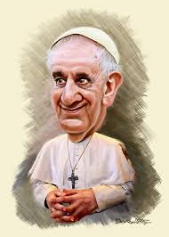
REVIEW QUIZ
5) The Biblical pattern for Church Leadership is…
A Senior Pastor and a Deacon Board
A Senior Pastor and an Elder Board
Congregational Rule with a Senior Pastor
Multiple Elders Rule
A Pope, Cardinals, Bishops and Priests
Whatever each church decides
When we teach on Ecclesiology (study of the Church) we will see…Who chooses the elders? What forms of church government do different denominations use? Which ones work and which ones don’t? Why do we need denominations? When should congregations vote? Who holds elders accountable?

Slide 45
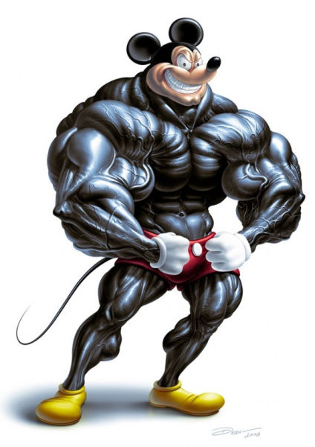
REVIEW QUIZ
6) Which are qualifications of an elder?
Good reputation with Non-Christians
One woman man
Hospitable to strangers
Short hair and a non-smoker
7) The 2 qualifications required of Elders but not Deacons are…
To be blameless and non-violent
Ability to teach and to govern
Husband of one wife and not a new convert
Deacons can get drunk and elders can’t

Slide 46
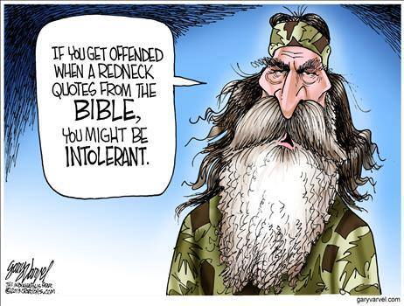
TODAY… What should a man look like? We’re not talking about physical appearance, y’all.

Slide 47
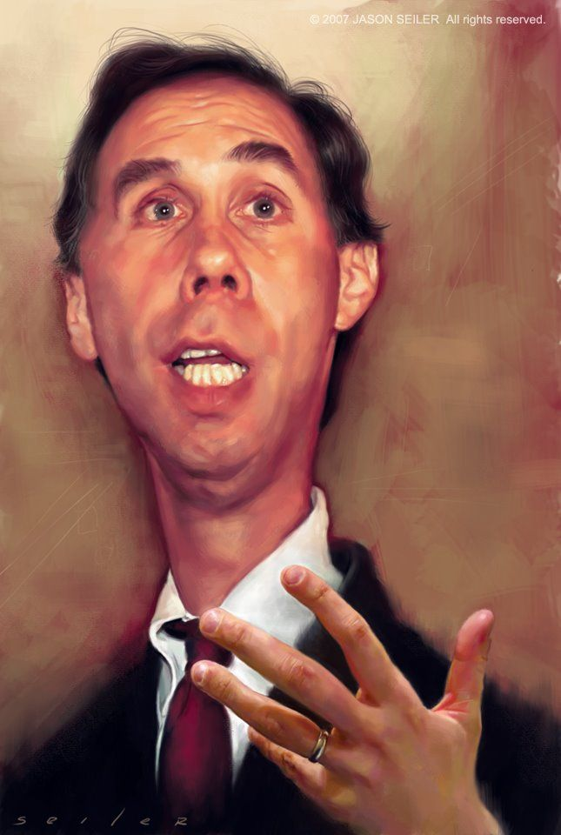
QUALIFICATIONS OF AN ELDER
“God’s standards for church leaders should be the aspiration for all men who seek to be the man God made them to be”
-Dr. Jay BarLeon
picture

Slide 48
1 TIMOTHY 3:1-7
”¹It is a trustworthy statement: if any man aspires to the office of overseer, it is a fine work he desires to do. ² An overseer, then, must be above reproach, the husband of one wife, temperate, prudent, respectable, hospitable, able to teach, ³ not addicted to wine or pugnacious, but gentle, peaceable, free from the love of money. ⁴ He must be one who manages his own household well, keeping his children under control with all dignity ⁵ (but if a man does not know how to manage his own household, how will he take care of the church of God?), ⁶ and not a new convert, so that he will not become conceited and fall into the condemnation incurred by the devil. ⁷ And he must have a good reputation with those outside the church, so that he will not fall into reproach and the snare of the devil.”

Slide 49
TITUS 1:5-9
”⁵For this reason I left you in Crete, that you would set in order what remains and appoint elders in every city as I directed you, ⁶ namely, if any man is above reproach, the husband of one wife, having children who believe, not accused of dissipation or rebellion. ⁷ For the overseer must be above reproach as God’s steward, not self-willed, not quick-tempered, not addicted to wine, not pugnacious, not fond of sordid gain, ⁸ but hospitable, loving what is good, sensible, just, devout, self-controlled, ⁹ holding fast the faithful word which is in accordance with the teaching, so that he will be able both to exhort in sound doctrine and to refute those who contradict.”

Slide 50
NOT ADDICTED TO WINE
MAN
FIRM FAITH
NOT PUGNACIOUS
DESIRES THE OFFICE
SOUND DOCTRINE
GENTLE
ABOVE REPROACH
ABLE TO REFUTE
FALSE TEACHERS
NOT QUARRELSOME
ONE WOMAN MAN
NOT QUICK TEMPERED
NOT A MONEY LOVER
TEMPERATE
NO DISHONEST GAIN
MANAGES FAMILY WELL
PRUDENT
LOVES GOOD
CHILDREN UNDER CONTROL
RESPECTABLE
JUST
NOT RECENT CONVERT
HOSPITABLE
DEVOUT
GOOD REPUTATION
WITH OUTSIDERS
ABLE TO TEACH
SELF-CONTROLLED
CHILDREN BELIEVE

Slide 51
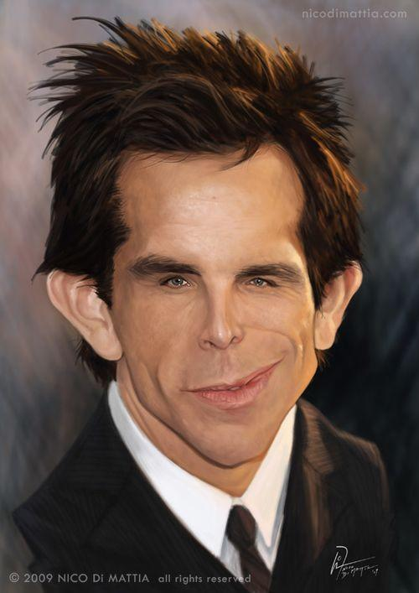
“If any man…” (1 Tim. 3:1; Titus 1:6)
Does the Bible really teach that only men can be pastors and elders?

Slide 52
CHAUVINISM
Men are leaders in the church because they are greater than women.
BIBLICAL VIEW: COMPLIMENTARIANISM
3 MAIN VIEWS
Men and women are equal in God’s eyes but are given complimentary roles in the family and church.
EGALITARIANISM
Women have all the same roles and gifts as men in church leadership.

Slide 53
EGALITARIAN ARGUMENTS
PRO: “One of the Judges, Deborah, was a woman”
PRO: “Being a woman shouldn’t exclude you from leadership”
PRO: “The word man just means person in 1 Timothy 3”
PRO: “To HAVE authority literally means to USURP authority.”
PRO: “1 Tim. 2:11-14 was just a cultural directive” ⁽A woman should learn in quietness and full submission. I do not permit a woman to teach or to have authority over a man; she must be silent (in the church)
6) PRO: “Phoebe was a teaching pastor in Romans 16:1”
7) PRO: “We no longer live in a Patriarchal society”
8) PRO: “Priscilla and Aquila educated Apollos. She is listed first and therefore did most of the teaching”
9) PRO: “Romans 16:7 mentions a woman apostle named Junia”
10) PRO: “1 Tim. 5:14 tells women to be the master of their house”

Slide 54
EGALITARIAN ARGUMENTS
PRO: “One of the Judges, Deborah, was a woman”
CON: “She was a political leader, not a church elder.”
PRO: “Being a woman shouldn’t exclude you from leadership”
CON: “Only a small percentage of men are qualified to be elders.
There are leadership positions in the church other than elder.”
PRO: “The word man just means person in 1 Timothy 3”
CON: “Husband; one woman man; controller of household”
PRO: “To HAVE authority literally means to USURP authority.”
CON: “Regardless…the rest of the verse clarifies the intent.”

Slide 55
PRO: “1 Tim. 2:11-14 was just a cultural directive”
“A woman should learn in quietness and full submission. I do not permit a woman to teach or to have authority over a man; she must be silent (in the church).”
CON: Paul gives Timothy TWO reasons…
For Adam was formed first, then Eve.
Adam was not the one deceived; Have these changed?
PRO: “Romans 16:1 calls Phoebe a diakonos which is often translated in Scripture as minister. She was a teaching pastor.”
CON: “Deacon (diakonos: one who executes the commands of a master, a servant, attendant, minister; the servant of a king; a waiter who serves food and drink; a deacon, one who, by virtue of the office assigned to him by the church, cares for the poor and distributes the money collected for their use)

Slide 56
PRO: “We no longer live in a Patriarchal society”
CON: “Bible principles do not apply to only one form of society.”
PRO: “Priscilla and Aquila educated Apollos. She is listed first and therefore did most of the teaching”
CON: “Priscilla was Aquila’s helpmeet in training an individual. She has NO leadership or teaching position in the church.”
.
PRO: “Romans 16:7 says, ‘Salute Andronicus and Junia, my kinsmen, and my fellow prisoners, who are of note among the apostles, who also were in Christ before me.’ Junia, a woman, was an apostle.”
CON: “First, there is no evidence Junia was a woman as the name is neutral. Second, among (en in Greek) is better translated “by’. Junia was well known BY the apostles.”

Slide 57
PRO: “1 Tim. 5:14 tells women to be the master of their house. “So I counsel younger widows to marry, to have children, to manage their homes...” Manage (oikodespoteō) means “to be the master; to rule.” and is translated in some passages as ‘despot’ or ‘ruler’.
CON: “Oikodespoteō is also translated as ‘manage’ or ‘guide’. The Thayer’s Lexicon which narrows the focus of Greek words, translates this passage as ‘manages’ and refers to those under her charge, not those over her.
WARNING:
DO NOT TRY TO MANIPULATE SCRIPTURE TO FALL IN LINE WITH YOUR OPINION. ALTER YOUR OPINION TO FALL IN LINE WITH SCRIPTURE.

Slide 58
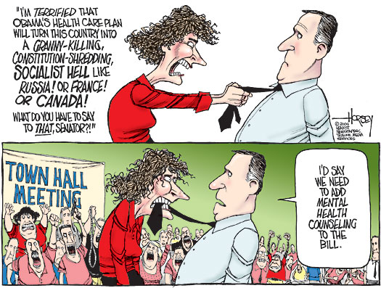
Those verses are only for the old days and for a different culture!
You can’t keep me off this board!
Uh…Yeah.
You will fit right in on this elder board…
ELDER BOARD MEETING

Slide 59
DISCUSSION TIME

Slide 60
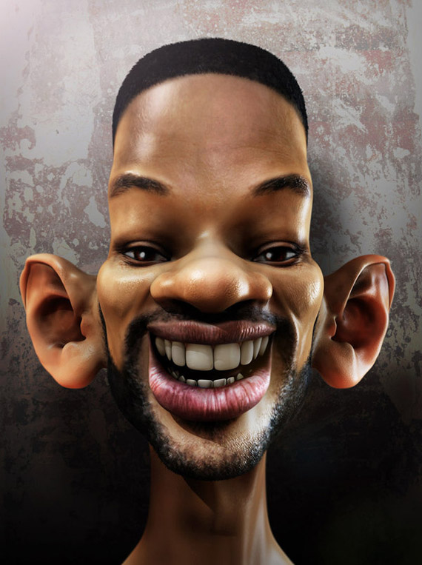
“…aspires to the office of overseer, it is a fine work he desires to do” (1 Tim. 3:1)
Oregō: to stretch one's self out in order to touch or to grasp something; to reach after or desire something
Do I have a strong desire to lead in the church?
“Don’t call the trained… TRAIN THE CALLED”
picture

Slide 61
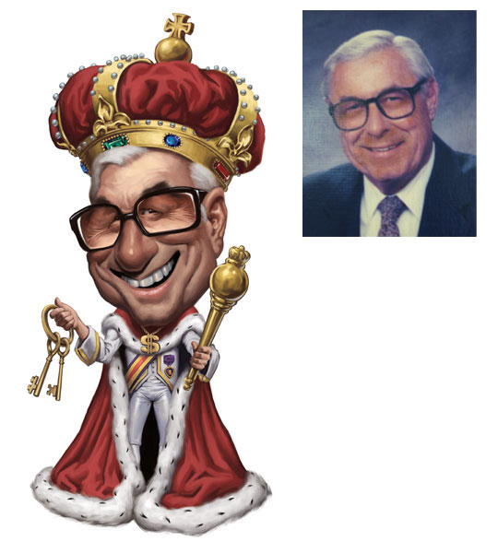
It is an ambition that has been cleansed of self-seeking, one that seeks only the glory of God and the well being of others.
(2) It is an ambition that seeks not position, praise, power, prestige, or popularity, but service to God and ministry to men.
(3) It is an ambition that has at its center the three important Es which define the purpose of the church:
the Exaltation of God,
the Edification of the body of Christ,
the Evangelization of the lost.

Slide 62
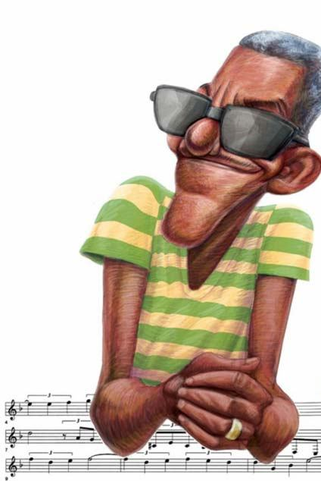
Should every man desire the office of elder?
Motive: Why do you want (or not want) to be an elder?
What are some GOOD motives to be an elder?
What are some WRONG motives to be an elder?
Understanding: Do you clearly know the roles and limitations of an elder?
Should every man desire to be an elder?
Should every man desire to reach the standard set for elders in the church?

Slide 63
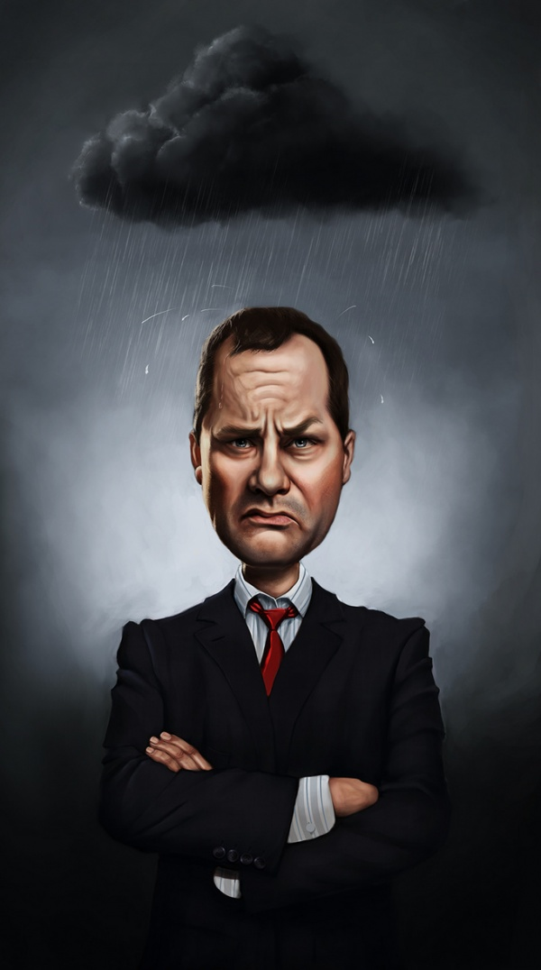
ABOVE REPROACH (1 Tim. 3:2; Titus 1:6) “No one has a valid accusation against me”
anepilēmptos: cannot charge, censure or reprehend; blameless
His life is free of blame. False accusations are easily refuted.
picture

Slide 64
"WHAT DOES IT MEAN TO BE ABOVE REPROACH / BLAMELESS?
The dictionary defines “reproach” as shame or disgrace or that which brings rebuke or censure upon a person.
A leader’s interactions with others, are to be of such moral quality that they do not bring shame or in any way disgrace the body of Christ or the name of Jesus. This holds true not only within the church, but outside it as well.
The word “must” is emphasizing an unconditional prerequisite for a leadership role in the church.
Above reproach, however, does not mean without sin. No Christian lives an entirely sinless life, nor will we until we reach the glorified state in heaven.

Slide 65
Above reproach means that the overseer’s life is free from sinful habits or behaviors that would impede his setting the highest Christian standard and model for the church to emulate
Similarly, the overseer must not give cause for those outside the church to impugn its reputation.
It means that no one can bring a charge or accusation against him
Leaders are to be men of good character and reputation; men whose character is unimpeachable; who are esteemed highly within their community; known for a wholesome life and untarnished integrity.
Being above reproach should be an ongoing aim of all believers
LOOK UP THE VERSES
Acts 25:7
1 Peter 3:13-17
Colossians 3:7-10
Hebrews 13:7
1 Peter 5:1-7

Slide 66
What is the general ‘word on the street’ about me?
Do people accuse me of something regularly?
What would be some ‘disqualifying’ accusations?
Is there an area of my life known only to me that, if people found out about it, they would be valid in their accusations against me?
For those who do not want to be an elder, how does this verse apply?
Could I handle life ‘in a fishbowl’?

Slide 67
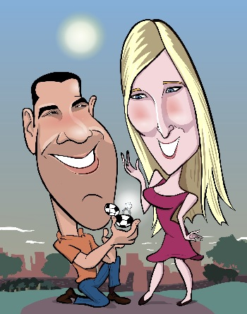
ONE WOMAN MAN (1 Tim. 3:2; Titus 1:6) “I am completely devoted to my wife; no others”
“Husband of one wife”
Literally:
aner mia gyne: “a one woman man”
His focus is on NO MORE THAN
one woman

Slide 68
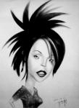
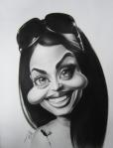
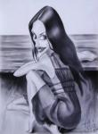
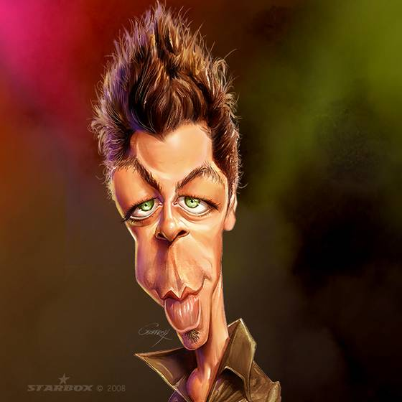
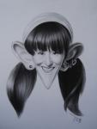
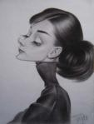
DOES THIS EXCLUDE…
Polygamists?
Concubinage?
Unfaithful men?
Porn addicts?
Flirtatious men?
Single men?
Widowers?
Divorcees?

Slide 69
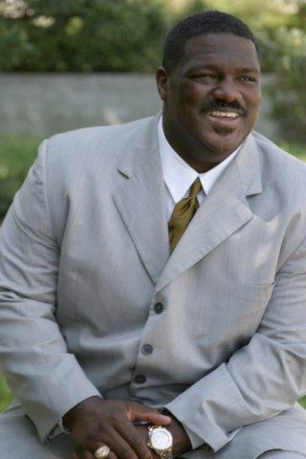
Recommended:
VODDIE
BAUCHAM
“Biblical
Manhood”
https://www.youtube.com/watch?v=TkavVrx77Zw

Slide 70
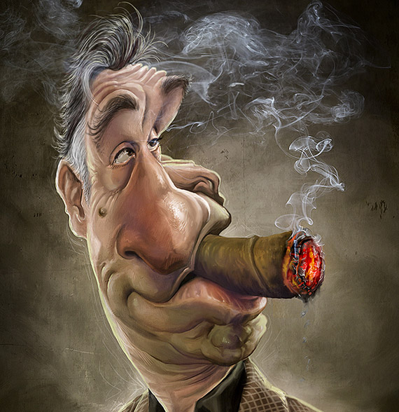
TEMPERATE (1 Tim. 3:2) “I avoid addictions and excessive habits”
nephalios: abstaining from the abuse of wine (or other addictions)
What habits should you personally break?
picture

Slide 71
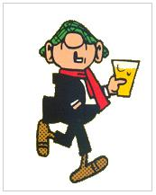
Some were told to abstain from ALL use of wine
Leviticus 10:9 (To priests while performing duties)
Numbers 6:3 (To those taking Nazarite vows)
Proverbs 31:4 (To kings and other rulers)
Does the Bible say Christians can’t drink?
What restrictions does the Bible put on alcohol?
Why must leaders avoid mind altering situations?
What are some other things that would exclude us on the basis of this word?

Slide 72
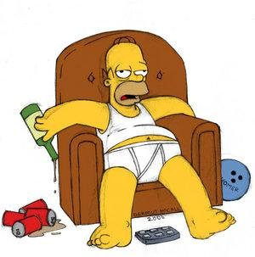
nephalios: Used as a metaphor to mean “alert; watchful; clear minded; vigilant; exercising self-control”
If we are addicted to alcohol, drugs, or any other mind altering substance, we are unable to make clear thinking decisions regarding the church and ministry.
1 Peter 4:7; 5:8
Titus 2:2,4,6,12
2 Peter 1:5-9
Proverbs 23:21
Eph. 5:18

Slide 73
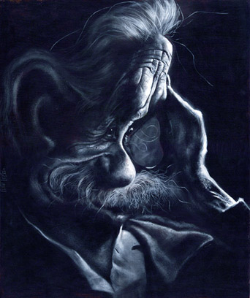
PRUDENT (1 Tim. 3:2) “I set and keep wise priorities”
sophron: well disciplined; able to correctly order his priorities; sound mind; sane; able to curb one’s desires and impulses; self-controlled
Can you control your desires and temptations?
picture

Slide 74
What are some examples of a leader having his priorities OUT OF BALANCE?
What area of life is easiest for YOU to lose balance?
1 Samuel 16:18
Proverbs 16:13
Proverbs 14:8
Proverbs 18:15
1 Cor. 9:25-27

Slide 75
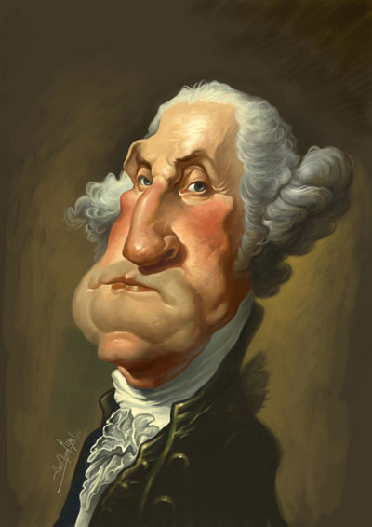
RESPECTABLE (1 Tim. 3:2) “I am well respected by others”
kosmios: well respected by others for his well-ordered life; modest; well behaved
Do other people express respect for your disciplined and purposeful lifestyle?

Slide 76
The same word is translated “modest” when referring to women’s clothing
What would be an example of an immodest life?
“The ministry is no place for a man whose life is a continual confusion of unaccomplished plans and unorganized activities.” –Homer Kent
“A leader who fails to plan, set visions, inspire his followers into service but instead just does what is necessary to survive is unqualified to lead the greatest collective on earth…the Bride of Christ.” –Dr. Jay BarLeon

Slide 77
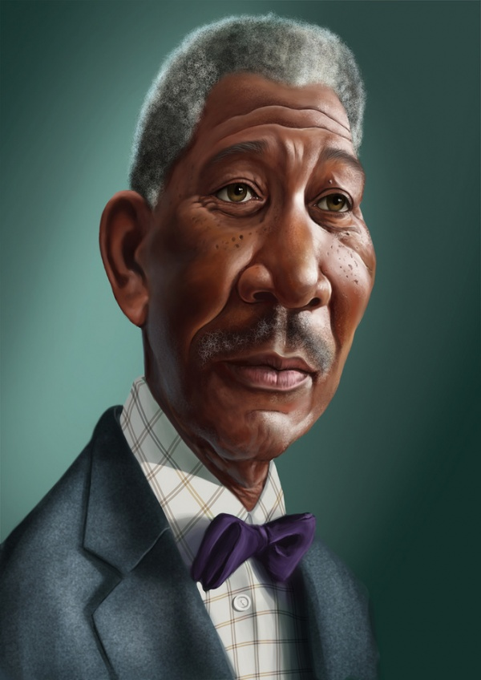
HOSPITABLE (1 Tim. 3:2; Titus 1:8) “I demonstrate love for strangers”
philoxenos: generous to strangers and guests; hospitable
Do you show hospitality to strangers or only to those you know?

Slide 78
Romans 12:9-13
Hebrews 13:1-2
1 Peter 4:8-10
Luke 14:12-14
What are some different ways for men to show hospitality?
What are some signs that a man is inhospitable and therefore ineligible for leadership in the church?

Slide 79
ABLE TO TEACH (1 Tim. 3:2) “I am skillful at teaching. I am also teachable”
didaktikos: skillful in teaching;
Am I able to communicate truth effectively?

Slide 80
This one is a function of all elders and not necessarily a requirement for all men.
Can you understand Biblical doctrines?
Do you knowhow to study Scripture?
Can you communicate truth effectively?
Do others enjoy your teaching style?
Do people apply your lessons to life?
Do you spend a lot of time in preparation?
How can we become better teachers?
Can you clearly communicate difficult truths?

Slide 81
RECOMMENDED READING

Slide 82
RECOMMENDED READING

Slide 83
1 Tim. 4:6,11,13,16
1 Tim. 5:17
2 Tim. 2:15
2 Tim. 2:24-25
Titus 2:1
Ephesians 4:11-14
1 Cor. 12:29

Slide 84
NOT ADDICTED TO WINE (1 Tim. 3:3; Titus 1:7) “I am not addicted to alcohol”
paronios:
not a drunkard; does not crave or abuse alcohol
Do you feel a
need for alcohol?

Slide 85
Isaiah 28:7
Ephesians 5:18
Proverbs 20:1
Isaiah 5:11 & 22
Psalms 104:14-15
Romans 14:21
Genesis 27:28
Ecclesiastes 9:7
Luke 7:34
Proverbs 31:6
Matt. 11:18-19
Joel 2:24
Proverbs 3:10
Genesis 14:18
What is the difference between ‘drunkard’ and ‘alcoholic’?
What are some of the arguments you have heard from the “Christians should never drink” and the “Christians have freedom to drink” camps?
What should be the Christian elder’s view of alcohol?

Slide 86
NOT PUGNACIOUS (1 Tim. 3:3; Titus 1:7) “I am not physically violent or abusive”
plektes: pugilistic; not a “giver of blows”; striker or hitter; not violent;
When did you last strike someone?

Slide 87
This does not disqualify boxers and martial artists. This is a passage about violent attitudes, not sporting preferences.

Slide 88
Romans 12:8
John 2:15
Luke 4:18
Proverbs 3:31
James 1:19-20
Have you ever reacted with violence to a situation?
Is there ever a time for violent interaction?
What is Paul trying to tell Timothy with this disqualifier?
Describe the results of having a pugnacious elder on the board making decisions for the church.
How does God view violent men according to Ps. 11:5?
What reason does Jam. 1:19-20 for being slow to wrath?

Slide 89
GENTLE (1 Tim. 3:3) “I will give up my rights to help others”
epieikes: equitable, mild, fair, gentle
Do you insist on everything being your own way or can you give up your rights?

Slide 90
Titus 3:2
1 Peter 3:15
2 Tim. 2:24-26
James 3:17
1 Tim. 6:11
Contrast a gentle man’s reactions to a pugnacious man.
What’s the difference between ‘meek’ and ‘mild’ men?
What are some practical ways to respond to criticism, personal attacks, even physical provocation?
How does one become gentle? (Gal. 5:22-23)
Why is it necessary for elders to be gentle?
How does gentleness help the restoration process? (Gal. 6:1)
In what ways was Jesus gentle? (Matt. 11:29)

Slide 91
NOT QUARRELSOME (1 Tim. 3:3) “I can discuss my opinions without arguing”
amachos: not verbally abusive; contentious , argumentative ; quarrelsome
Do others see you as argumentative?
Can you listen without objecting to opposing views?

Slide 92
How can we vocally stand up for truth without being amachos?
(verbally abusive; contentious, argumentative; quarrelsome)
What are some ways to express ourselves when we feel as if we are not being heard (that others are ignoring our valid points)?

Slide 93
APPLY THESE VERSES TO A BOARD MEETING
Proverbs 15:18: A hot-tempered man stirs up dissension, but a patient man calms a quarrel.
Proverbs 20:3: It is to a man's honor to avoid strife, but every fool is quick to quarrel.
Ecclesiastes 7:9: Do not be quickly provoked in your spirit, for anger resides in the lap of fools.
2 Timothy 2:23-24: Don't have anything to do with foolish and stupid arguments, because you know they produce quarrels. And the Lord's servant must not quarrel; instead, he must be kind to everyone, able to teach, not resentful.

Slide 94
Colossians 3:7-8 “You used to walk in these ways, in the life you once lived. But now you must rid yourselves of all such things as these: anger, rage, malice, slander…” HOW can we get rid these things in our lives? God’s part? Our part?
Colossians 3:21: “Fathers, do not embitter your children, or they will become discouraged.” What would you say to a young man about to get married about this verse? What would you have done differently in this regard?
Proverbs 16:32: “Better a patient man than a warrior, a man who controls his temper than one who takes a city.” In what ways do you think David is referring when he says ‘better’?
Proverbs. 30:33: “For as churning the milk produces butter, and as twisting the nose produces blood, so stirring up anger produces strife..” What stirs up your anger?

Slide 95
NOT A LOVER OF MONEY (1 Tim. 3:2; Titus 1:7) “I do not covet or love money”
aphilargyros: does not love money; can be content with little; is not motivated by greed or income;
Would you be a pastor if there were no pay?
How important is money in your decision making?

Slide 96
Read the verse aloud
1 Timothy 6:9-10
Proverbs 28:25
Hebrews 13:5
Luke 12:15
Proverbs 11:24
1 John 2:16
Matthew 6:24
James 4:3
Psalm 10:3
Ecclesiastes 5:10
Colossians 3:5

Slide 97
NOT A LOVER OF MONEY (1 Tim. 3:2; Titus 1:7) “I do not covet or love money”
What is a good attitude to have regarding money?
What harm could it do a church if one of their leaders was a lover of money?
How can our future be negatively affected if we are a lover of money?

Slide 98
MANAGES HIS FAMILY WELL (1 Tim. 3:4; Titus 1:6) “I mange my family affairs well”
proïstēmi idios oikos kalōs: to watch over, guard, care for and give attention to those members of his family living in his home in an honorable, excellent and pure manner.

Slide 99
MANAGES HIS FAMILY WELL (1 Tim. 3:4; Titus 1:6) “I mange my family affairs well”
Do you provide for all of the needs of your children?
Would your wife say she feels loved and cared for?
Does your family feel secure or afraid around you?
How much time do you spend with your wife & kids?
Would your wife say you love her as Christ loves the church?
Do you neglect your family in the name of God and the church?

Slide 100
CHILDREN UNDER CONTROL (1 Tim. 3:4-5; Titus 1:6) “My children obey me out of respect, not fear”
teknon en hypotagē meta pas semnotēs: his children obey his words out of respect and are thus seen as dignified, pure and honorable. He maintains control.
Do your children ignore you or tell you ‘NO’ when you tell them to do something?
Do you keep them in control or let them do as they please?

Slide 101
The reason is given in verse 5…
If anyone does not know how to manage his own family, how can he take care of God's church?

Slide 102
Proverbs 13:24
Hebrews 12:5-11
Proverbs 23:13-15
Proverbs 22:6
Ephesians 6:4
Proverbs 29:17
Ephesians 6:1-4
Revelation 3:19
What two pendulum extremes must be avoided when it comes to controlling children?
What are the dangers of not having your children under control?
How does this quality relate to leading a church or business?

Slide 103
NOT A RECENT CONVERT (1 Tim. 3:6) “I have been a Christian for a lengthy time”
me neophytos: not a new Christian; must be spiritually mature
How long have you been a Christian?
Would your pastor say you are well discipled?

Slide 104
The reason is given in verse 6,,,
he may become conceited
(proud; puffed up) and fall under the same judgment (condemnation) as the devil (false accuser).

Slide 105
Have you ever known a proud young preacher?
How does spiritual maturity protect a church?
What advice would you give to a young man (who is a fairly new convert) who tells you he believes God is telling him to start a church?
What are some of the things you would look for in determining whether or not a man is mature enough to be one of your church leaders?
What areas do you still need to grow before you would ever consider yourself spiritually mature enough to be a church leader?

Slide 106
GOOD REPUTATION WITH OUTSIDERS (1 Tim. 3:7) “I have a good reputation among Non-Christians”
kalos martyria apo exothen: good testimony with non-Christians
”MUST HAVE”; non- negotiable
This does not say, “Not have a bad reputation”, but “must have a good reputation.”

Slide 107
The reason is given in verse 7…
“so that he will not fall into (be overtaken by) disgrace (reproach; verbal attacks)
and into the devil's trap (snares set by the
false accuser).”

Slide 108
Do you have many non-Christian friends?
What would they say about you if I were to interview them?
What are some benefits of having non- Christian friends?
What are some dangers of having non- Christian friends?
Why is it required in order to be an elder?
How can we fall into disgrace and “the devil’s trap” if we have no unbelieving friends?

Slide 109
What are some of the ways we can develop friendships outside of our church family?

Slide 110
CHILDREN BELIEVE (Titus 1:6) “My children at home are all Christians”
teknon pistos: children are faithful; trusting
“a man whose children believe and are not open to the charge of being wild and disobedient.”

Slide 111
If your preacher’s kids are rebellious, what would it say about your pastor and his wife?
How could having kids guilty of this charge of “being disobedient” effect your ministry?
Why do so many P.K.s get a bad reputation?
Have you ever known a pastor or elder to get replaced because his kids were wild/unruly?

Slide 112
When the Scriptures were given to the Jews… Deut. 6:1-9
“These are the commands, decrees and laws the LORD your God directed me to teach you to observe in the land that you are crossing the Jordan to possess, so that you, your children and their children after them may fear the LORD your God as long as you live by keeping all his decrees and commands that I give you, and so that you may enjoy long life. Hear, Israel, and be careful to obey so that it may go well with you and that you may increase greatly in a land flowing with milk and honey, just as the LORD, the God of your ancestors, promised you. Hear, O Israel: The LORD our God, the LORD is one. Love the LORD your God with all your heart and with all your soul and with all your strength. These commandments that I give you today are to be on your hearts. Impress them on your children. Talk about them when you sit at home and when you walk along the road, when you lie down and when you get up. Tie them as symbols on your hands and bind them on your foreheads. Write them on the doorframes of your houses and on your gates.

Slide 113
NOT QUICK TEMPERED (Titus 1:7) “I am patient and do not get angered easily”
me orgilos: not prone to or easily angry
Referring to propensity, not occasional outbursts.
ie: “Short fuse”;

Slide 114
2 Tim. 2:24
1 Tim. 3:3
James 1:19-20
Eph.4:26-31
Prov. 29:11
Eccl. 7:9
Prov. 15:1, 18
Matt. 5:22

Slide 115
HOLD FIRMLY TO HIS FAITH (Titus 1:9) “I stand firm in God’s Word”
“He must hold firmly to the trustworthy message as it has been taught, SO THAT he can encourage others by sound doctrine and refute those who oppose it.”

Slide 116
antecho pistos logos kata didache: cleave to the faithful Word of God as he has been taught….
SO THAT…

Slide 117
CAN ENCOURAGE WITH SOUND DOCTRINE (Titus 1:9) “I can recognize needs and Biblically encourage others”
parakaleō en hygiainō didaskalia: to come alongside and exhort, encourage, teach and strengthen others with errorless teachings from the Word…

Slide 118
REFUTE FALSE TEACHERS (Titus 1:9-10) “I can identify and Biblically refute false teachings”
elegchō antilegō: expose, convict and refute those who deny, disobey or misinterpret truth by bringing the truth of God’s Word to light.
picture

Slide 119
HOLD ON TIGHT TO THE TRUTH
ENCOURAGE WITH SOUND DOCTRINE
REFUTE FALSE TEACHINGS

Slide 120
The reason is given in verses 10-11…
“For there are many rebellious people, mere talkers and deceivers, especially those of the circumcision group. They must be silenced, because they are ruining whole households by teaching things they ought not to teach—and that for the sake of dishonest gain.”

Slide 121
For there are many (not just a few)
rebellious people, (do not abide by orthodox doctrine)
mere talkers (give opinion, not the Word of God)
and deceivers (they get others to believe their lies)
especially those of the circumcision group (especially legalists; the one group Jesus rebuked constantly)
They must be silenced (MUST; one of the jobs of Christian leaders is to expose false teachers)
because they are ruining whole households (divide families as some wander from the truth; itching ears)
by teaching things they ought not to teach— (false teachers; heretics; note: these are the teachers)
and that for the sake of dishonest gain.” (to get money; Health, Wealth & Prosperity teachers)

Slide 122
LOVING WHAT IS GOOD (Titus 1:8) “I love the pure things, not the impure”
philagathos: loving the good things and people
What good things are in your life?
What bad things are in your life?

Slide 123
JUST (Titus 1:8) “I am consistently fair with others”
dikaios: obedient to God’s commands; upright; holy; righteous life; innocent; faultless; guiltless; Christ-like
In what ways are you NOT like Jesus?

Slide 124
DEVOUT (Titus 1:8) “I live a holy life before the Lord”
Hosios: holy; free from wickedness; religiously observing moral obligations to remain pure
Not perfect, but striving for it
Would your family say this describes you?

Slide 125
NOT PURSUING DISHONEST GAIN (Titus 1:7) “I do not make any money dishonestly”
me aischrokerdēs: not greedy for money; not using the ministry to get wealth
Pastors should be paid well but not become a pastor for that reason
Do you ever get money dishonestly?

Slide 126
Gal. 6:6 ”One who is taught the Word must share all good things with the one who teaches.”
1 Tim. 5:17-18 ”Let the elders who rule well be considered worthy of double honor (literally: “of the price paid; honorarium”) especially those who labor in preaching and teaching. For the Scripture says, “You shall not muzzle an ox when it treads out the grain,” and, “The laborer deserves his wages.”
1 Cor. 9:14 ”In the same way, the Lord commanded that those who proclaim the gospel should get their living by the gospel.”
1 Thess.5:12-13 ”We ask you, brothers, to respect those who labor among you and are over you in the Lord and admonish you, and to esteem them very highly in love because of their work.”

Slide 127
SELF CONTROLLED (Titus 1:8) “I do not indulge in lust or pornography”
egkratēs: Disciplined life; having power over temptations; mastering himself
What temptations do you give into most regularly?

