Slide 1
TRINITY

Slide 2
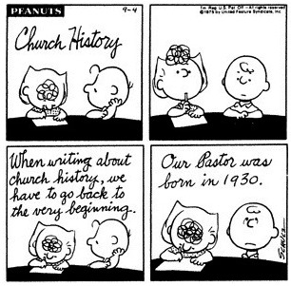

Slide 3
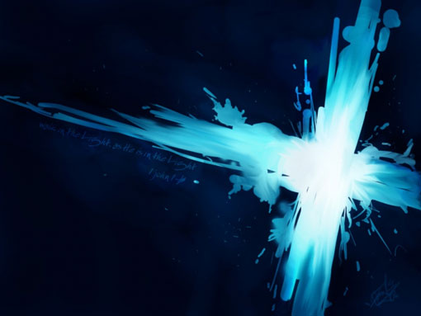
TRINITY
TRINITY
There is ONE GOD
Three Separate Persons
Historical Evidence for the Trinity
False Views of the Trinity
Illustrations of the Trinity
God the Father
God the Son
God the Spirit
Three in One
GOD THE 3 in 1

Slide 4
TRINITY
There is ONE GOD
Three Separate Persons
Historical Evidence for the Trinity
False Views of the Trinity
Illustrations of the Trinity
GOD THE 3 in 1

Slide 5



FATHER
IS
IS NOT
IS NOT
GOD
IS
IS
JESUS
SPIRIT
IS NOT

Slide 6
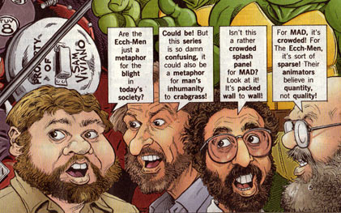
COMMON MISCONCEPTIONS
THREE GODS?
THREE GUYS AND A GOD?
ONE MAN AND TWO SPIRITS?
SAME GOD IN THREE FORMS?

Slide 7
5 COMMON MISCONCEPTIONS
MISUNDERSTANDING #1: The Father, Son and Spirit are just different titles for the 3 different ways God revealed Himself.
The Oneness Pentecostals today teach this.
O.T. = Father; Gospels = Jesus; Now = Spirit
BUT…THE THREE INTERACT WITH EACH OTHER.
The Father sends the Son (Gal. 4:4)
The Father sends the Spirit (John 14:26)
The Son speaks on the Father’s behalf (John 8:28)
The Spirit speaks on Jesus’ behalf (John 16:13-15)
The Father and Son love each other (John 3:35; 5:20)
The Father and the Son count as 2 witnesses (John 5:31-37)
The Father and the Son glorify each other (John 17:1-5)
The Son is our advocate before the Father (1 John 2:1)
Jesus is called the Son OF the Father (2 John 3)

Slide 8
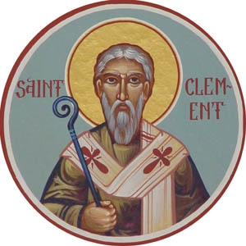
5 COMMON MISCONCEPTIONS
MISUNDERSTANDING #2: The word ‘trinity’ does not appear in the Bible; It is a belief invented by 4th Century Christians.
The word ‘trinity’ does not occur in the Bible (nor do the words rapture or incarnation but the concepts are Biblical nonetheless)
One word summaries were eventually given to each doctrine
Theophilus (6th Bishop of Antioch) is the 1st person known to have used the word ‘trinity’ in his ‘Refutation of Autolycus’ (A.D. 168)
Many Christians defended the Trinity long before the 4th Century
A.D. 96 Clement, 3rd Bishop of Rome
A.D. 90-100 The Didache (Teachings of the 12 Apostles)
A.D. 90 Ignatius, Bishop of Antioch
A.D. 155 Justin Marty, great Christian writer
A.D. 168 Theophilus, 6th Bishop of Antioch
A.D. 177 Athenagoras, theologian
A.D. 180 Irenaeus, Bishop of Lyons
A.D. 197 Tertullian, early church leader
A.D. 264 Gregory Thaumaturgus, early church leader

Slide 9

5 COMMON MISCONCEPTIONS
MISUNDERSTANDING #3: Christians believe there are 3 Gods.
THE TRUTH IS: Christians believe in only ONE GOD
Because the Bible teaches that the Father, Son and Spirit are three distinct persons, many call that 3 gods.
GOD IS NOT
1+1+1=3
GOD IS
1+1+1=1

Slide 10
5 COMMON MISCONCEPTIONS
MISUNDERSTANDING #4: Jesus is not God
Jesus claimed to forgive sins (Mark 2:5-12; Luke 5:21)
He accepted worship and claimed to deserve the same honor as the Father (Matt. 14:33; 28:17-18; John 5:22-23)
He claimed to be the divine Son of God (John 5:17-18)
ACTS | GOD | JESUS
CREATED HEAVEN AND EARTH | Gen. 1:1; Psalm 102:25 | John 1; Col. 1:16
THE FIRST AND THE LAST | Isaiah 44:6 | Rev. 1:17; 22:13
LORD OF LORDS | Deut. 10:17; Psalm 136:3 | 1 Tim. 6:15; Rev 16:14
UNCHANGING AND ETERNAL | Psalm 94:2; 102:26, 27 | John 8:58; Col. 1:17
JUDGE OF ALL PEOPLE | Gen. 18:25; Psalm 94:2 | John 5:22; Acts 17:31
ONLY SAVIOR; NO OTHER | Is. 43:11; 45:21; Hosea 13:4 | John 4:42; Acts 4:12
REDEEMS A PEOPLE FOR HIMSELF | Ex 19:5; Psalm 130:7 | Titus 2:14
HEARS AND ANSWERS PRAYER | Psalm 86:5-8; Isaiah 55:6 | John 14:14; Rom 10:12-13
ONLY GOD HAS DIVINE GLORY | Isaiah 42:8; 48:11 | John 17:5
WORSHIPPED BY ANGELS | Psalm 97:7 | Heb. 1:6

Slide 11
5 COMMON MISCONCEPTIONS
MISUNDERSTANDING #5: Jesus is a lesser God than the Father
FALSE: Jesus was the ‘Firstborn’ and therefore created (Col. 1:15)
TRUE: Firstborn (protokos) can mean ‘heir’ or ‘preeminent’ (Col. 1:16-17)
FALSE: Jesus was ‘begotten’ so He had a beginning (John 3:16)
TRUE: ‘Only Begotten’ means unique (Heb 11:17 used of Isaac despite Ishmael)
FALSE: Jesus said ‘the Father is greater than I’ (John 14:28)
TRUE: Temporarily limited Himself then was restored to prior Glory (John 17:5)
FALSE: Jesus was subject to the Father so He was not God (1 Cor. 15:28)
TRUE: Voluntary subjection while on earth (Phil 2:5-11) while still co-equal
FALSE: Jesus didn’t know when He would return (Mark 13:32). God knows all.
TRUE: Jesus limited His omniscience (John 16:30) while on earth

Slide 12

TRINITY TRUTH
There are three persons in the Godhead:
the Father, the Son,
and the Holy Spirit;
and these three are one God, the same in essence, equal in power and glory.

Slide 13
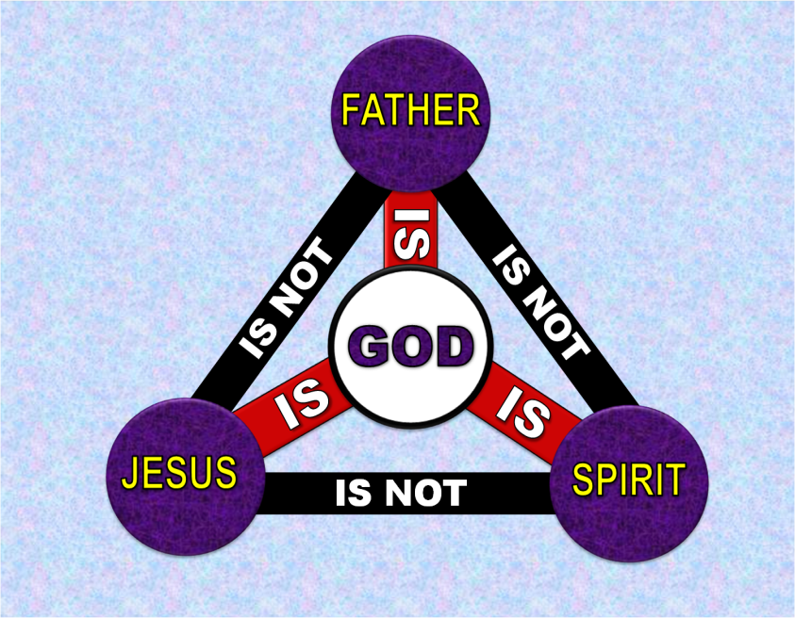
THERE IS ONLY ONE GOD
Deut. 6:4, “Hear, O Israel: The LORD our God, the LORD is one”
Jer. 10:10, “But the LORD is the true God; He is the living God, the eternal King.”
Isaiah 44:6,8,45a, “I am the first and I am the last; apart from me there is no God… Is there any God besides me? No, there is no other Rock; I know not one. I am the LORD,
and there is no other; apart
from me there is no God.”

Slide 14
THE FATHER IS GOD
1 Cor. 8:6, “…yet for us there is but one God, the Father, from whom all things came and for whom we live…”
Eph. 4:4-6, “There is one body and one Spirit, just as you were called to one hope when you were called; one Lord, one faith, one baptism; one God and Father of all, who is over all and through all and in all.”

Slide 15
JESUS IS GOD
John 1:1-5,14, “In the beginning was the Word, and the Word was with God, and the Word was God..Word became flesh and made His dwelling among us. We have seen His glory, the glory of the one and only Son, who came from the Father…”
John 20:28, “Thomas said to Him, “My Lord and my God!”
John 10:30-33, “I and the Father are one.” Again his Jewish opponents picked up stones to stone him… “We are not stoning you for any good work,” they replied, “but for blasphemy, because you, a mere man, claim to be God.”

Slide 16
THE HOLY SPIRIT IS GOD
Acts 5:3-4, “Then Peter said, “Ananias, how is it that Satan has so filled your heart that you have lied to the Holy Spirit… You have not lied just to human beings but to God.”
2 Cor. 3:17, “Now the Lord is the Spirit, and where the Spirit of the Lord is, there is freedom.”
  HE IS CALLED…
    Spirit of God Gen. 1:2
    Spirit of Yahweh Judges 3:10
    Holy Spirit Isa. 63:10
    Spirit of Christ Rom. 8:9
    Holy Spirit of God Eph. 4:30.

Slide 17
MORE THAN 60 PASSAGES MENTION THE THREE PERSONS TOGETHER.
Matt. 3:16-17, “As soon as Jesus was baptized, He went up out of the water. At that moment heaven was opened, and He saw the Spirit of God descending like a dove and alighting on Him. And a voice from heaven said, “This is my Son, whom I love; with Him I am well pleased.”
Matt. 28:19, “Therefore go and make disciples of all nations, baptizing them in the name of the Father and of the Son and of the Holy Spirit,”
2 Cor. 13:14, “May the grace of the Lord Jesus Christ, and the love of God, and the fellowship of the Holy Spirit be with you all.”

Slide 18
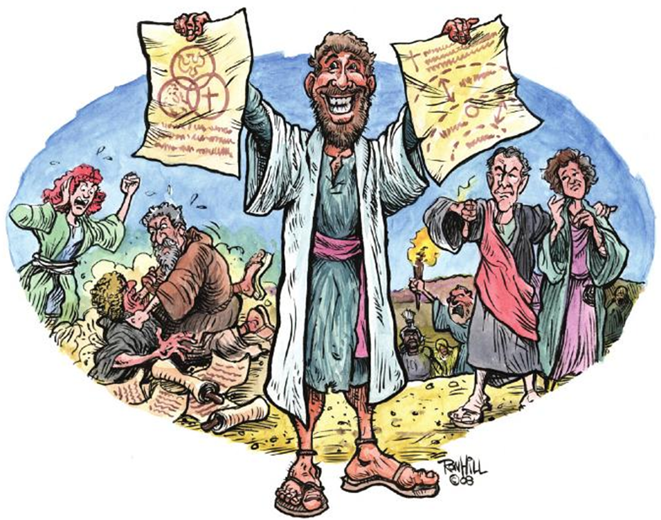
CREEDS

Slide 19

APOSTLES CREED
“I BELIEVE in God the Father almighty
And in Christ Jesus, His only Son, our Lord
Who was born of the Holy Spirit and the Virgin Mary
Who was crucified under Pontius Pilate
and was buried
And the third day rose from the dead
Who ascended into heaven
And sitteth on the right hand of the Father
Whence He cometh to judge the living and the dead.
And in the Holy Spirit - The holy church
The remission of sins - The resurrection of the flesh
The life everlasting.”

Slide 20
NICENE CREED (325 A.D.)
“We believe in one God, the Father, the Almighty, maker of heaven and earth, of all that is, seen and unseen. We believe in one Lord, Jesus Christ, the only Son of God, eternally begotten of the Father, God from God, Light from Light, true God from true God, begotten, not made, of one being with the Father. Through Him all things were made. For us and for our salvation He came down from heaven: by the power of the Holy Spirit He became incarnate from the Virgin Mary, and was made man. For our sake He was crucified under Pontius Pilate; He suffered death and was buried. On the third day He rose again in accordance with the Scriptures; He ascended into heaven and is seated at the right hand of the Father. He will come again in glory to judge the living and the dead, and His kingdom will have no end. We believe in the Holy Spirit, the Lord, the giver of life, who proceeds from the Father [and the Son]. With the Father and the Son He is worshipped and glorified. He has spoken through the Prophets. We believe in one holy catholic and apostolic Church. We acknowledge one baptism for the forgiveness of sins. We look for the resurrection of the dead, and the life of the world to come.”

Slide 21
ATHANASIAN CREED (400 A.D.)
The beginning of the creed reads as follows…
“Whosoever will be saved, before all things it is necessary that he hold the Catholic (Universal Christian) Faith. Which Faith except everyone do keep whole and undefiled, without doubt he shall perish everlastingly. And the Catholic Faith is this: That we worship one God in Trinity, and Trinity in Unity, Neither confounding the Persons, nor dividing the Substance [Essence]. For there is one Person of the Father, another of the Son, and another of the Holy Ghost. But the Godhead of the Father, of the Son, and of the Holy Ghost, is all one, the Glory equal, the Majesty co-eternal. Such as the Father is, such is the Son, and such is the Holy Ghost. The Father uncreated, the Son uncreated, and the Holy Ghost uncreated. The Father incomprehensible, the Son incomprehensible, and the Holy Ghost incomprehensible. The Father eternal, the Son eternal, and the Holy Ghost eternal. And yet they are not three eternals, but one eternal. As also there are not three incomprehensibles, nor three uncreated, but one uncreated, and one incomprehensible. So likewise the Father is Almighty, the Son Almighty, and the Holy Ghost Almighty. And yet they are not three Almighties, but one Almighty… (Continued on next page)
Notes:
..

Slide 22
ATHANASIAN CREED (cont.)
So the Father is God, the Son is God, and the Holy Ghost is God. And yet they are not three Gods, but one God. So likewise the Father is Lord, the Son Lord, and the Holy Ghost Lord. And yet not three Lords, but one Lord. For like as we are compelled by the Christian verity: to acknowledge every Person by himself to be both God and Lord, So are we forbidden by the Catholic Religion, to say, There be [are] three Gods, or three Lords. The Father is made of none, neither created, nor begotten. The Son is of the Father alone, not made, nor created, but begotten. The Holy Ghost is of the Father and of the Son, neither made, nor created, nor begotten, but proceeding. So there is one Father, not three Fathers; one Son, not three Sons; one Holy Ghost, not three Holy Ghosts. And in this Trinity none is afore, or after other; none is greater, or less than another [there is nothing before, or after: nothing greater or less]; But the whole three Persons are co-eternal together and co-equal. So that in all things, as is aforesaid, the Unity in Trinity and the Trinity in Unity is to be worshipped. He therefore that will be saved must [let him] thus think of the Trinity…”

Slide 23
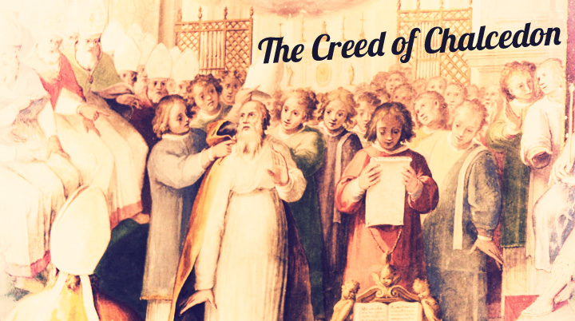
CHALCEDONIAN CREED (451 A.D.)
The Council of Chalcedon—the 4th ecumenical Council of the church—dealt specifically with the relationship between this divine 2nd person of the Godhead and the human person Jesus Christ. The Council asked, did God become human? 370+ members met at Chalcedon in 451 in order to develop a coherent Christological position that would avoid the Nestorian heresy (which posited two persons in Christ) and the Eutychean heresy (which reduced Christ to only one nature).

Slide 24
CHALCEDONIAN CREED (451 A.D.)
We, then, following the holy Fathers, all with one consent, teach men to confess one and the same Son, our Lord Jesus Christ, the same perfect in Godhead and also perfect in manhood; truly God and truly man, of a reasonable [rational] soul and body; consubstantial with the Father according to the Godhead, and consubstantial with us according to the Manhood; in all things like unto us, without sin; begotten before all ages of the Father according to the Godhead, and in these latter days, for us and for our salvation, born of the Virgin Mary, the Mother of God, according to the Manhood; one and the same Christ, Son, Lord, only begotten, to be acknowledged in two natures, inconfusedly, unchangeably, indivisibly, inseparably; the distinction of natures being by no means taken away by the union, but rather the property of each nature being preserved, and concurring in one Person and one Subsistence, not parted or divided into two persons, but one and the same Son, and only begotten, God the Word, the Lord Jesus Christ; as the prophets from the beginning [have declared] concerning Him, and the Lord Jesus Christ Himself has taught us, and the Creed of the holy Fathers has handed down to us.”

Slide 25
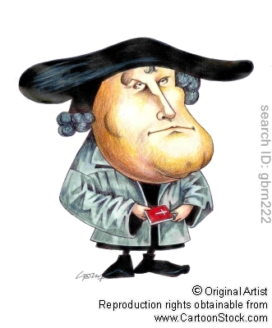
Theological Terms: HYPOSTATIC UNION
The hypostatic union is the term used to describe how God the Son, Jesus Christ, took on a human nature, yet remained fully God at the same time. Jesus always had been God, but at the incarnation Jesus became a human being. The addition of the human nature to the divine nature is Jesus, the God-man. This is the hypostatic union, Jesus Christ, one Person, fully God and fully man.

Slide 26

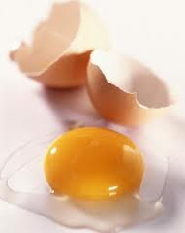
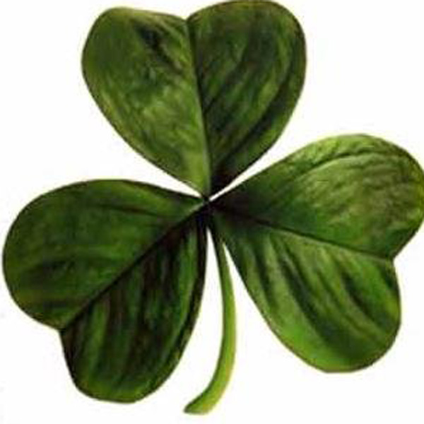
ILLUSTRATIONS
ALL illustrations of the Trinity are inadequate.
Be careful sharing when sharing illustrations that you do not mislead or further confuse those you are trying to convince.
Examples include…

Slide 27

ILLUSTRATIONS
One of the better illustrations…
Height is not Depth
Depth is not Width
Width is not Height
Take ANY of the 3 away and ALL 3 disappear
HEIGHT
DEPTH
WIDTH

Slide 28
TEACHING CHILDREN ABOUT THE TRINITY
1. Read the Bible with your children: Expose children to the Bible and let the truth of the Triune God soak into them via the Bible’s stories, letters, songs, and dialogues, they will gradually absorb the truth that God is one, but exists in three persons.
2. Encourage your children to experience the Trinity: I encourage my children to speak to each of the three persons of the Trinity and to build a relationship with each of them together.
3. Focus your children on Christ: Jesus is God’s image and the one who communicates God (John 1:18). As He is the only way to God, the more we know Christ, the more we will know His Father and His Spirit. In John’s Gospel Jesus speaks of His relationship to His Father and His Spirit in the most simple yet profound words.

Slide 29
TEACHING CHILDREN ABOUT THE TRINITY
4. Pray for your children: Without the illumination of the Holy Spirit they will never understand God. They need their eyes opened, their minds renewed, and their hearts changed. No amount of our instruction can substitute for that. And while you’re at it, pray for faith to believe that God can teach our children the most complex truths far more effectively than we can.
5. Excite our children: By the way you talk about God, worship God, and serve God, communicate to your children just how wonderful God is and how much you enjoy knowing Him and loving Him. If we are passionate and enthusiastic about knowing God, our children will catch that from us and be motivated to seek Him for themselves.

Slide 30
“If you deny the Trinity, you will lose your soul. Try to explain the Trinity, you will lose your mind.”

