Slide 1
PREACHING SEMINAR
高级讲道
训练班

Slide 2
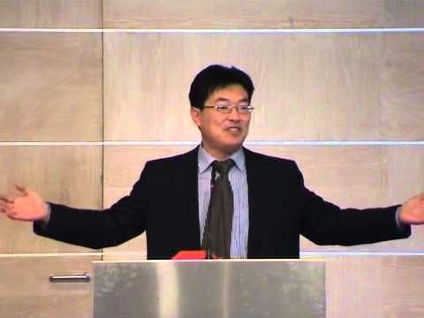
HOMILETICS SEMINARS
高级讲道训练班

Slide 3
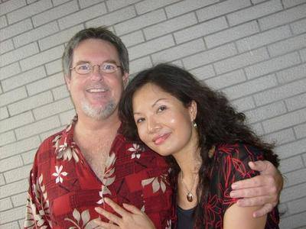
介绍
INTRODUCTIONS

Slide 4
介绍
不钻研讲道学问的借口。
Excuses for NOT studying Homiletics.
回顾课程大纲。
Review Session Outlines
预备心灵,聆听上帝。
Preparing our hearts to listen to God.
INTRODUCTION

Slide 5
本周大纲
简要课程指南 (QUICK REFERENCE GUIDE)
为何要讲道? (WHY should we preach?)
谁应讲道? (WHO should preach?)
何时应讲道? (WHEN should we preach? Short)
应在何处讲道? (WHERE should we preach? Short)
我们应讲什么? (WHAT should we preach?)
应如何讲道?预备 (HOW should we preach? Preparation)
应如何讲道?呈现 (HOW should we preach? Presentation)
(Outline for this Week)

Slide 6
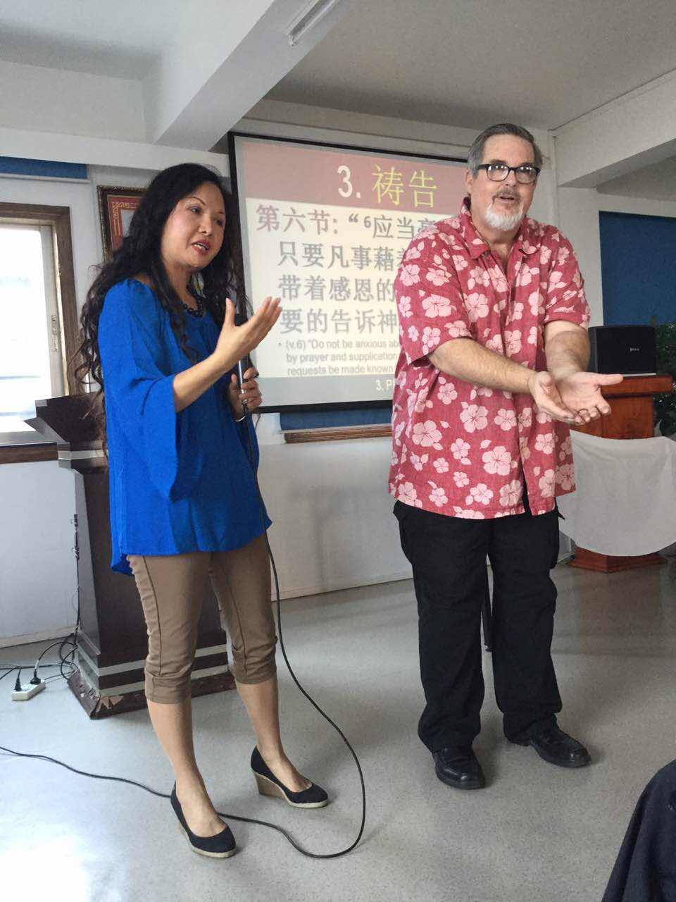
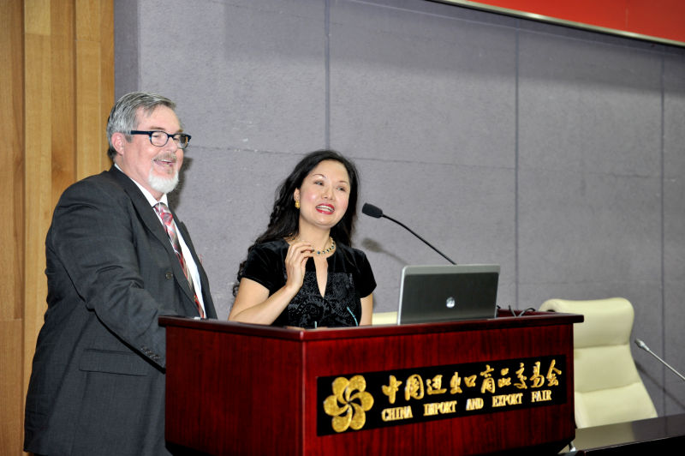
讲道 vs. 教导
(PREACHING vs. TEACHING)

Slide 7
目标
讲道 (PREACH) | 心/脑 (HEART/HEAD)
教导 (TEACH) | 脑/心 (HEAD/HEART)
(AIM)

Slide 8
渴望得到的反应
讲道 (PREACH) | 应用/理解 (APPLY)
教导 (TEACH) | 理解/应用 (UNDERSTAND)
(DESIRED RESPONSE)

Slide 9
教导层次
讲道 (PREACH) | 简单 (EASIER)
教导 (TEACH) | 较深 (DEEPER)
(LEVEL OF TEACHING)

Slide 10
场合
讲道 (PREACH) | 会众 (CONGREGATION)
教导 (TEACH) | 课堂 (CLASSES)
(LOCATION)

Slide 11
文本
讲道 (PREACH) | 圣经 (BIBLE)
教导 (TEACH) | 多种 (MISC.)
(TEXT)

Slide 12
例证
讲道 (PREACH) | 许多 (MANY)
教导 (TEACH) | 较少 (FEWER)
(ILLUSTRATIONS)

Slide 13
教导者
讲道 (PREACH) | 牧师 (PASTORS)
教导 (TEACH) | 老师 (TEACHERS)
(TEACHERS)

Slide 14
观众
讲道 (PREACH) | 基督徒 和非基督徒 (CHRISTIANS & NON-CHRISTIANS)
教导 (TEACH) | 基督徒 (CHRISTIANS)
(AUDIENCE)

Slide 15
六个关键点
!!!!!!
(6 KEYS)

Slide 16
1. 信息从不改变；
方法必须改变。
The MESSAGE never changes; the METHODS must change.
哥林多前书 9:22 (CCB)
面对什么人，我就做什么人，
为了要尽可能地救一些人。

Slide 17
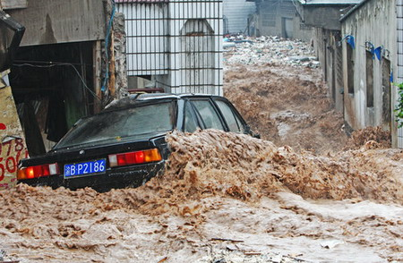
2. 太多好东西就会
变成坏东西。
Too much of a GOOD thing is a BAD thing.

Slide 18
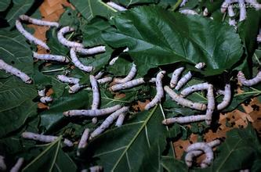
3. 一切有生命的东西
都会成长,除非有
东西在扼杀它们。
All LIVING things grow unless something is KILLING them.

Slide 19
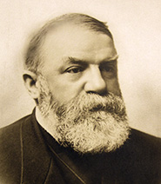
4. 光有信息而无
应用会起到反作用。
INFORMATION without APPLICATION is counter-productive.
“神将祂的话赐下来不是要给我们信息，而是要我们改变。”
——穆迪

Slide 20
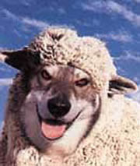
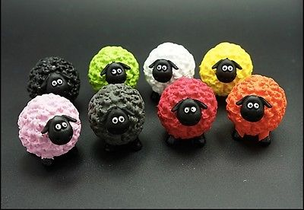
5. 我们必须学会识别 谁是豺狼,谁是
不同颜色的羊儿。
We must learn to distinguish WOLVES from DIFFERENT COLOR SHEEP

Slide 21
6. 若爱缺席，
耶稣也就缺席。
If LOVE is absent, so is JESUS.

Slide 22
WHY SHOULD WE PREACH?
为何要讲道？

Slide 23
1. 为何要讲道？
A. 圣经的命令 。
A. Biblical Mandate
提前4:2 (2 Tim. 4:2)
西 1:28 (Col. 1:28)
太 28:19-20 (Matt.28:19-20)
耶 3:15 (Jer. 3:15)
彼前5:1-5 (1 Pet. 5:1-5)
1. WHY SHOULD WE PREACH?

Slide 24
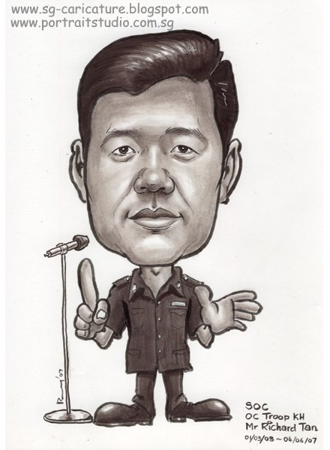
B. 信徒的需要。
Believer’s Needs
C. 避免异端邪说。
Avoid Heresy
D. 生产门徒。
Make Disciples
1. WHY SHOULD WE PREACH?

Slide 25
WHO SHOULD PREACH?
谁应讲道？

Slide 26
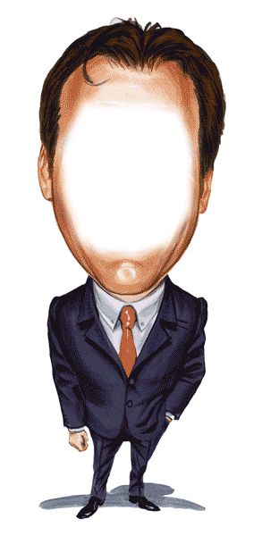
2. 谁应讲道？
A. 人人都能向某人讲道。
Everyone can preach to someone.
B. 小组带领人。
Small Group Leaders
C. 宣教士。
Missionaries
2. WHO SHOULD PREACH

Slide 27
D. 教会牧师和长老
Church Pastors & Elders
蒙召的
(Called)
5. 经时间考验的 (Time Tested)
2. 有恩赐的 (Gifted)
6. 勇敢的 (Courageous)
3. 合格的 (Qualified)
7. 圣灵充满的 (Spirit Filled)
4. 受装备的 (Equipped)
8. 激情充沛的 (Passionate)
2. WHO SHOULD PREACH

Slide 28
1. 蒙召的
如何知道自己要蒙召讲道？
How do I know if I am called of God to preach?
内在呼召
The INTERNAL CALL
外在呼召
The EXTERNAL CALL
1. CALLED

Slide 29
2. 有恩赐的
“所有神呼召讲道的, 祂也赐他们天赋讲道.”
“Everyone He calls to preach, He gifts to preach”
“蒙召讲道不是一种感觉， 而是一种恩赐.”
“Being called to preach is not a feeling, it is a gift”
罗12:6-7 林前 9:16
Roman 12:6-7 1 Cor. 9:16
2. GIFTED

Slide 30
3. 合格的
保罗在写给提摩太和提多的书信中
列出了谁有资格做长老和教导牧师
Paul wrote to Timothy and Titus outlining exactly WHO is qualified to be an elder; teaching pastor
我们将会简要地回顾这二十八项资格
We will look briefly at the 28 qualifications
自我评估表在你的笔记本后面
Self-Evaluation sheet is in the back of notebook
3. QUALIFIED

Slide 31
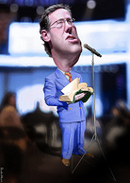
QUALIFICATIONS OF AN ELDER
长老资格长老资格
长老资格
长老资格
长老资格

Slide 32
ONLY MEN (1 Tim. ; Titus 6) “God makes the rules… we either obey or deny Him”
只能是男人
(提前；提多6)
“神定的规则…我们要么遵守，要么否认他”
一个妇人的男人
One woman man
家庭的管理者
Controller of the household
只有少数男人合格
Only a few men are qualified

Slide 33
三种主要观点 (3 Main Views)
沙文主义: 男人领导教会,因为男人就是比女人强。
CHAUVINISM (Men are better than women)
2) 平均主义: 在教会的领导层,男女具备相同的角色和恩赐。
EGALITARIANISM: (Women have all the same roles and gifts as men in church leadership.)
3) 互补主义（符合圣经的观点）: 在上帝的眼里男女平等，但是在家庭和教会里，各自扮演的角色具有互补性。
COMPLIMENTARIANISM: (Men and women are equal in God’s eyes but are given complimentary roles in the family and church)

Slide 34
平均主义的十个论据 TOP TEN EGALITARIAN ARGUMENTS
赞成: “有个女师士，叫狄波拉。”
PRO: “One of the Judges, Deborah, was a woman”
反对: “她是政治领袖，不是宗教领袖。”
CON: “She was a political leader, not a religious leader.”
赞成: “仅因为长了乳房就不能做领导吗?”
PRO: “Having breasts shouldn’t exclude you from leadership”
反对: “即使男人也只有很小比例的人能成为长老。”
CON: “Only a small percentage of men are qualified to be elders”

Slide 35
赞成: “man这个词在提前三章其实就某人的意思。”
PRO: “The word man just means person in 1 Timothy 3”
反对: “ 丈夫；一个女人的男人；家庭的管理者。” Husband; one woman man; controller of household”
赞成: “拥有权柄本意就是要篡夺权柄。”
“To HAVE authority literally means to USURP authority.”
反对: “不论怎样…其余的经文澄清了作者的意图。”
CON: “Regardless…the rest of the verse clarifies the intent.”

Slide 36
赞成:“提前2:11-14只是针对当时的文化.”
PRO: “1 Tim. 2:11-14 was just a cultural directive”
“A woman should learn in quietness and full submission. I do not permit a woman to teach or to have authority over a man; she must be silent (in the church).”
反对: 保罗给出提摩太两条原因…
CON: Then Paul gives Timothy TWO reasons…
因为亚当受造在先，然后才是夏娃。 For Adam was formed first, then Eve.
不是亚当被引诱。
这两条事实变了吗？
Adam was not the one deceived; Have these changed?

Slide 37
赞成: “罗16:1称菲比为diakonos, 常在圣经中被译成牧师. 她就是教导牧师.”
PRO: “Romans 16:1 calls Phoebe a diakonos which is often translated in Scripture as minister. She was a teaching pastor.”
反对:“执事（diakonos: 执行牧师吩咐的人，是仆人, 服务员; 君王的侍从; 餐馆端茶上菜的侍应生; 执事就是教会指派的一个职分, 看顾穷人, 分配教会所收用于此项的钱款.）”
CON: “Deacon (diakonos: one who executes the commands of a master, a servant, attendant, minister; the servant of a king; a waiter who serves food and drink; a deacon, one who, by virtue of the office assigned to him by the church, cares for the poor and distributes the money collected for their use)

Slide 38
赞成: “我们今日不再是父权社会。”
PRO: “We no longer live in a Patriarchal society”
反对: “圣经不只适用于一种社会形态。”
CON: “Bible principles do not apply to only one form of society.”
赞成:“百基拉和亚居拉教导了亚波罗。她的名字排在前面，因此她主导教导。”
PRO: “Priscilla and Aquila educated Apollos. She is listed first and therefore did most of the teaching”
反对: “百基拉是亚居拉在训练某个人时的助手. 她在教会并没有领导或教导的职分.”
CON: “Priscilla was Aquila’s helpmeet in training an individual. She has NO leadership or teaching position in the church.”
.

Slide 39
赞成:“罗马书16:7说‘又问我亲属与我一同坐监的安多尼古和犹尼亚安，他们在使徒中是有名望的，也是比我先在基督里。’犹尼亚，是女人，也是使徒。”
PRO: “Romans 16:7 says, ‘Salute Andronicus and Junia, my kinsmen, and my fellow prisoners, who are of note among the apostles, who also were in Christ before me.’ Junia, a woman, was an apostle.”
反对: “首先，没有证据表明犹尼亚是女人, 因为该名是中性. 其次,‘在…中’翻译成‘被’使徒们所熟知更好. 犹尼亚为使徒们所熟知. ”
CON: “First, there is no evidence Junia was a woman as the name is neutral. Second, among (en in Greek) is better translated “by’. Junia was well known BY the apostles.”

Slide 40
赞成: “提前5:14告诉女人要成为家庭主人.”
“所以我愿意年轻的寡妇嫁人, 生养儿女, 治理家务, 不给敌人辱骂的把柄；”管理(oikodespoteō)意思是 ‘成为主人; 治理.’ 在另一些段落里翻成 ‘独裁者’或 ‘统治者’。
PRO: “1 Tim. 5:14 tells women to be the master of their house. “So I counsel younger widows to marry, to have children, to manage their homes...” Manage (oikodespoteō) means “to be the master; to rule.” and is translated in some passages as ‘despot’ or ‘ruler’.
反对: “oikodespoteō” 同时也翻成 ‘管理’或 ‘引导’。
《赛耶希希腊文字典》将这段经文中的该词翻成‘管理’指的是管理在她之下的人，而非之上的人。
CON: “Oikodespoteō is also translated as ‘manage’ or ‘guide’. The Thayer’s Lexicon which narrows the focus of Greek words, translates this passage as ‘manages’ and refers to those under her charge, not those over her.

Slide 41
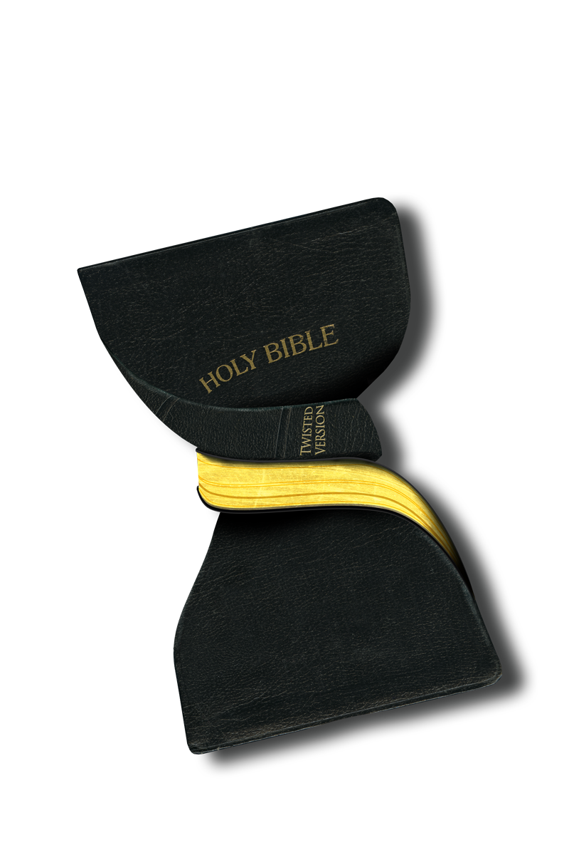
警告:
不要篡改经文以迎合你的观点.
乃要改变你的观点以匹配圣经.
WARNING: Do not try to manipulate scripture to match your opinion. Alter your opinion to match scripture.

Slide 42
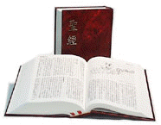
不管你感觉自己蒙召去做什么,神的话总有最后的发言权。
REGARDLESS OF WHAT YOU FEEL CALLED TO DO,
GOD’S WORD ALWAYS HAS THE LAST SAY.

Slide 43
DESIRE THE OFFICE (1 Tim. 3:1) “I earnestly want to do the work of an elder”
羡慕善工
(提前3:1)
“我诚然想做长老之工.”
动机: 为何想成为长老？
Motive: Why do you want to be an elder?
“他羡慕善工”
“He desires a good thing”
羡慕善工

Slide 44
ABOVE REPROACH (1 Tim. 3:2; Titus 1:6) “No one has a valid accusation against me”
无可指责
(提前3:2；提多1:6)
“没有针对我的有效指控”
不能控告,指责,责备， 清白
anepilēmptos: cannot charge, censure or reprehend; blameless
他的生活无可指责。诬告陷害是容易驳倒的。
His life is free of blame. False accusations are easily refuted.
无可指责

Slide 45
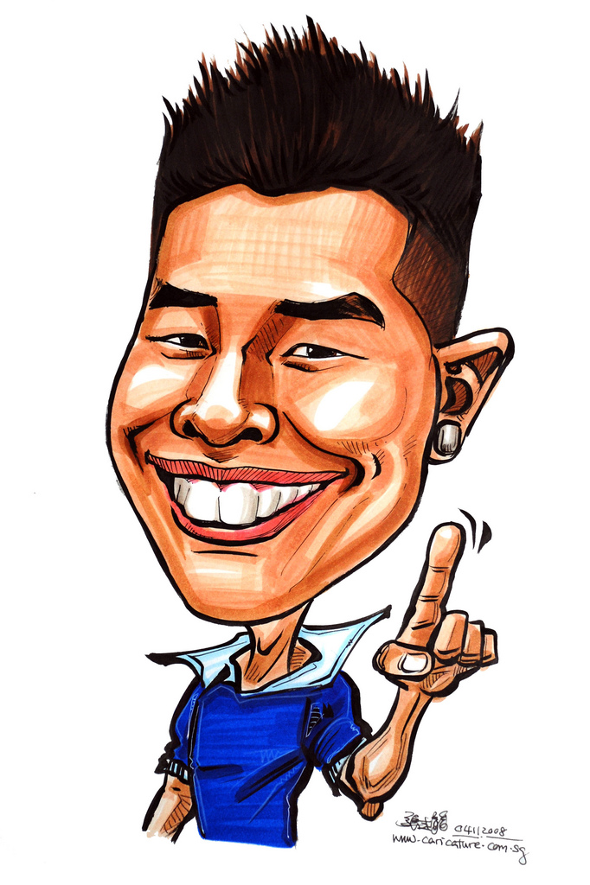
ONE WOMAN MAN (1 Tim. 3:2; Titus 1:6) “I am completely devoted to my wife; no others”
一个妇人的男人
(提前3:2；提多1:6)
“我完全忠于我的妻子；没有其他女人。”
一个妇人的男人。
aner mia gyne: one woman man
他只聚焦一个女人，那个神为他选择的女人。
His focus is on only one woman, the woman God has chosen for him.

Slide 46
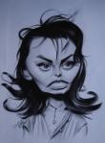
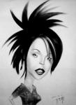
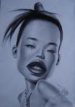
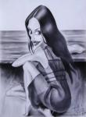
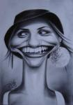
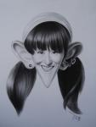
ONE WOMAN MAN (1 Tim. 3:2; Titus 1:6) “I am completely devoted to my wife; no others”
不排除单身男人
DOES NOT exclude Single men
不排除离婚的男人
DOES NOT exclude Divorced men
排除一夫多妻。
DOES exclude polygamists
排除作风轻浮的男人
DOES exclude flirtatious men
排除纳妾
DOES exclude concubinage
排除不忠诚的男人
DOES exclude unfaithful men

Slide 47
TEMPERATE (1 Tim. 3:2) “I avoid addictions and excessive habits”
节制
(提前3:2)
“我远离各种瘾癖和极度习惯。”
不酗酒（或其他癖好）
nephalios: abstaining from the abuse of wine (or other addictions)
哪些个人习惯你该戒除？
What habits should you personally break?
节制

Slide 48
PRUDENT (1 Tim. 3:2) “I set and keep wise priorities”
自守
(提前3:2)
“我设定保持智慧的优先顺序”
健全的头脑；神志正常; 克制自己的欲望和冲动;自我控制
sophron: sound mind; sane; able to curb one’s desires and impulses; self-controlled
你能控制欲望和脾气吗？
Can you control your desires and temptations?
自守

Slide 49
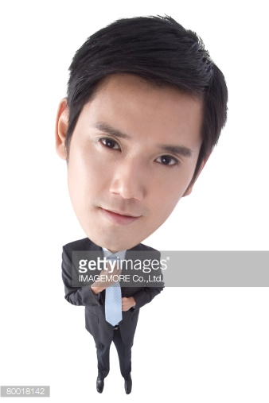
RESPECTABLE (1 Tim. 3:2) “I am well respected by others”
端正
(提前3:2)
“我广受他人尊重”
因着他的谦逊，广受他人尊
重；次序良好的生活。
kosmios: well respected by others for his modest; well-ordered life
你是否因严谨且目标明确的生活方式而赢得他人的尊重？
Do other people express respect for your disciplined and purposeful lifestyle?
端正

Slide 50
HOSPITABLE (1 Tim. 3:2; Titus 1:8) “I demonstrate love for strangers”
殷勤好客
(提前3:2，多1:8)
“我向陌生人展示爱”
对陌生人和来客慷慨; 殷勤友好
philoxenos: generous to strangers and guests; hospitable
你对陌生人是否慷慨殷勤，还是只对你认识的人才如此？
Do you show hospitality to strangers or only to those you know?
殷勤好客

Slide 51
ABLE TO TEACH (1 Tim. 3:2) “I am skillful at teaching. I am also teachable”
善于教导
(提前3:2)
“我擅长教导. 我也受教”
擅于教导;能有效地与之交流真理。
didaktikos: skillful in teaching; able to communicate truth effectively
他人是否喜欢你的教导风格？
Do others enjoy your teaching style?
人们能否将你所教的应用于生活？
Do people apply your lessons to life?
善于教导

Slide 52
NOT ADDICTED TO WINE (1 Tim. 3:3; Titus 1:7) “I am not addicted to alcohol”
不痴迷酒精
(提前3:3；多1:7)
“我没有酒瘾”
不是酒鬼;不贪恋和滥用
酒精
paronios: not a drunkard; does not crave or abuse alcohol
不觉得需要酒精
Do you feel a need for alcohol?
如果你发现会使人跌倒,
能否完全放弃喝酒？
Could you give it up entirely if you found out it made others stumble?
不痴迷酒精

Slide 53
NOT PUGNACIOUS (1 Tim. 3:3; Titus 1:7) “I am not physically violent or abusive”
不好斗
(提前3:3; 多1:7)
“我没有暴力和虐待倾向”
拳击,不是攻击者，
打人者，不暴力;
plektes: pugilistic; not a striker or hitter; not violent;
你上次打人是何时？
When did you last strike someone?
不好斗

Slide 54
GENTLE (1 Tim. 3:3) “I will give up my rights to help others”
温和
(提前3:3)
“为了他人, 我愿放弃自己的权利.”
公正合理,温和,公平,和蔼
epieikes: equitable, mild, fair, gentle
你是凡事都要坚持自己的方式还是能放弃自己的权利？
Do you insist on everything being your own way or can you give up your rights?
温和

Slide 55
NOT QUARRELSOME (1 Tim. 3:3) “I can discuss my opinions without arguing”
不争竞
(提前3:3)
“我能讨论我的观点而不争吵”
没有语言暴力; 不好争论;
不爱辩论;不好争吵
amachos: not verbally abusive; contentious , argumentative ; quarrelsome
别人是否看你好争吵？
Do others see you as argumentative?
你能否聆听而不拒绝相反的
意见？
Can you listen without objecting to opposing views?
不争竞

Slide 56
NOT A LOVER OF MONEY (1 Tim. 3:2; Titus 1:7) “I do not covet or love money”
不贪财
(提前3:2,多1:7)
“我不贪恋和喜好金钱”
不贪爱钱财; 为人行事不是出于金钱和贪婪的动机 。
aphilargyros: does not love money; is not motivated by greed or income
若没有收入你是否愿作牧师？
Would you be a pastor if there were no pay?
在你做决定时,金钱因素有多
重要？
How important is $ in your decisions?
不贪财

Slide 57
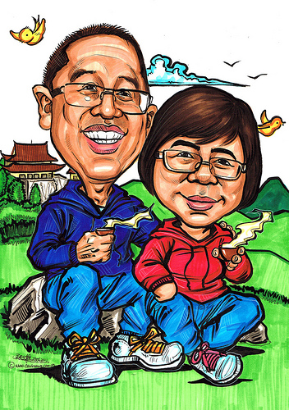
MANAGES HIS FAMILY WELL (1 Tim. 3:4; Titus 1:6) “I mange my family affairs well”
管理好家庭
(提前3:4; 多1:6)
“我将家庭事务管理得好”
以一种高尚,卓越和纯洁的方式看顾,保护,照料和关注在你家里的成员。
proïstēmi idios oikos kalōs: to watch over, guard, care for and give attention to those members of his family living in his home in an honorable, excellent and pure manner.

Slide 58
MANAGES HIS FAMILY WELL (1 Tim. 3:4; Titus 1:6) “I mange my family affairs well”
你是否供应了孩子的所需？
Do you provide for all of the needs of your children?
你妻子会否说她感到被爱和照料？
Would your wife say she feels loved and cared for?
你花多少时间与你的妻儿在一起？
How much time do you spend with your wife and kids?
你的家人与你在一起是安全还是害怕？
Does your family feel secure or afraid around you?
你妻子会否认为你爱她如同基督爱教会？
Would your wife say you love her as Christ loves the church?
你是否以神或教会的名义而忽略家人？
Do you neglect your family in the name of God and the church?

Slide 59
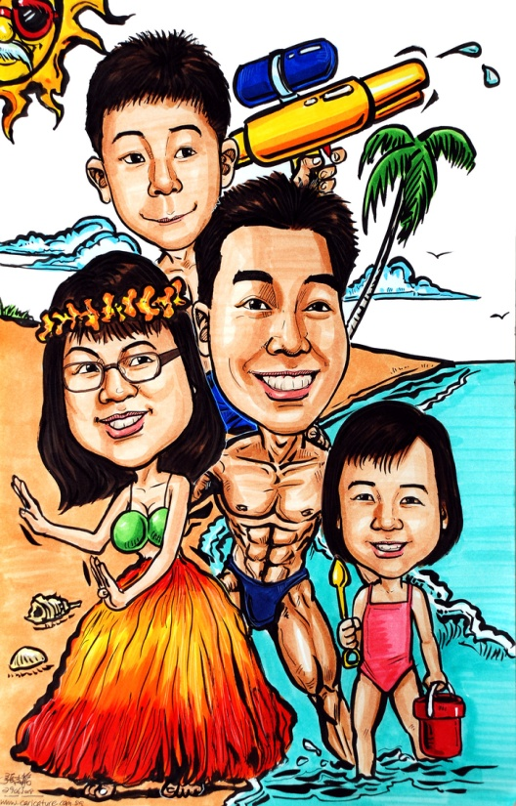
CHILDREN UNDER CONTROL (1 Tim. 3:4-5; Titus 1:6) “My children obey me out of respect, not fear”
孩子端庄顺服
(提前3:4-5;多1:6)
“我的孩子顺服我是出于尊敬而非恐惧”
他的孩子出于尊敬而顺服他,从而表现尊贵，
纯洁和高尚。他掌控家庭。
teknon en hypotagē meta pas semnotēs: his children obey his words out of respect and are thus seen as dignified, pure and honorable. He maintains control.
当你吩咐孩子做某事时，他们是否忽视你或
对你说“不”。
Do your children ignore you or tell you ‘NO’ when you tell them to do something?
你是让他们规规矩矩还是让他们随心所欲？
Do you keep them in control or let them do as they please?

Slide 60
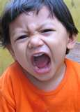
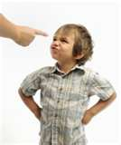
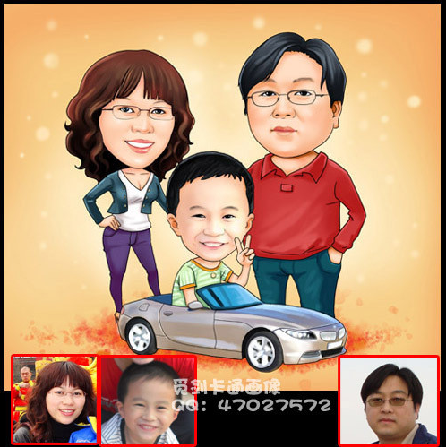
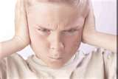
The reason is given in verse 5…
理由在第五节里说到了…
如果有人不知如何管理好他的家，他又如何能管理神的教会呢？
If anyone does not know how to manage his own family, how can he take care of God's church?

Slide 61
NOT A RECENT CONVERT (1 Tim. 3:6) “I have been a Christian for a lengthy time”
不是初信的
(提前3:6)
“我成为基督徒好很长时间了”
不是一个初信基督徒。
me neophytos: not a new Christian
你成为基督徒多长时间？
How long have you been a Christian?
你的牧师会否说你牧养良好？
Would your pastor say you are well discipled?
不是初信的

Slide 62
The reason is given in verse 6,,,
理由在第六节中提到
他可能自高自大 （骄傲，洋洋得意） 落在魔鬼所受的刑罚里（定罪）(诬告者).
he may become conceited (proud; puffed up) and fall under the same judgment (condemnation) as the devil (lit. false accuser).
理由在第六节中提到

Slide 63
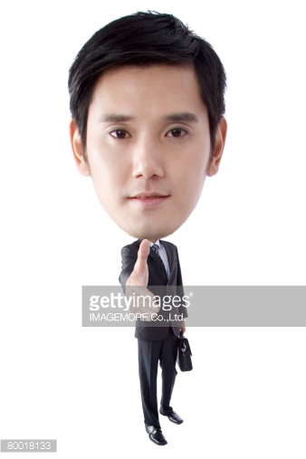
GOOD REPUTATION WITH OUTSIDERS (1 Tim. 3:7) “I have a good reputation among Non-Christians”
在教外有好名声
(提前3:7)
“我在非基督徒中也有好名声”
在非基督徒中有好见证
kalos martyria apo exothen: good testimony with non-Christians
“必须有”; 毫无商量余地
”MUST HAVE”; non-negotiable
你是否有非基督徒朋友？
Do you have non-Christian friends?
在教外有好名声

Slide 64
The reason is given in verse 7…
理由在第七节中说到
这样他便不会落入（被压倒）耻辱
（责备；言语攻击）
和魔鬼的圈套
（诬告者所设的网罗）里。
so that he will not fall into (be overtaken by) disgrace (reproach; verbal attacks) and into the devil's trap (snares set by the false accuser).

Slide 65
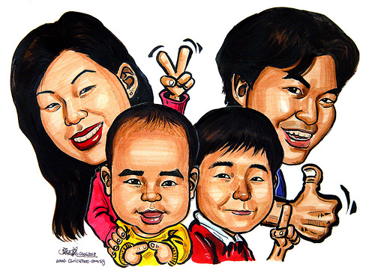
CHILDREN BELIEVE (Titus 1:6) “My children at home are all Christians”
孩子信主
(多1:6)
“我在家里的孩子都是基督徒”
孩子们忠心,信靠(神)
teknon pistos: children are faithful; trusting (in God)
你的孩子都是基督徒吗？
Are your children Christians?
你的孩子对神忠心吗？
Are your children faithful to God?

Slide 66
NOT QUICK TEMPERED (Titus 1:7) “I am patient and do not get angered easily”
不暴躁
(多1:7)
“我有耐心,不容易生气”
不容易愤怒
me orgilos: not prone to or easily angry
你多经常生气？
为什么？
How often do you get angry? Why?
不暴躁

Slide 67
HOLD FIRMLY TO HIS FAITH (Titus 1:9) “I stand firm in God’s Word”
坚守他的信仰
(多1:9)
“我坚守神的话语”
坚守他所教导的神的道。
antecho pistos logos kata didache : cleave to the faithful Word of God as he has been taught
你对圣经有多熟悉？
How well do you know the Bible?
坚守他的信仰

Slide 68
The reason is given in verse 9-11…
理由在9-11节中提到…
这样他就能…
so that he can…
以纯正的教义鼓励人
Encourage with sound doctrine
驳倒那反对的人
Refute those who oppose it
坚守他的信仰

Slide 69
CAN ENCOURAGE WITH SOUND DOCTRINE (Titus 1:9) “I can recognize needs and Biblically encourage others”
以整全的教义劝勉
(多1:9)
“我能识别需要并以圣经劝勉他人”
以毫无错误的神之道劝说，鼓励，教导，坚固他人。
parakaleō en hygiainō didaskalia: to come alongside and exhort, encourage, teach and strengthen others with errorless teachings from the Word…
以整全的教义劝勉

Slide 70
REFUTE FALSE TEACHERS (Titus 1:9-10) “I can identify and Biblically refute false teachings”
驳倒假教师
(多1:9-10)
“我能以圣经识别和驳倒假教导”
以神真理的亮光来曝光, 证实和驳斥那些否认,违背或曲解真理的人。
elegchō antilegō: expose, convict and refute those who deny, disobey or misinterpret truth by bringing the truth of God’s Word to light.
驳倒假教师

Slide 71
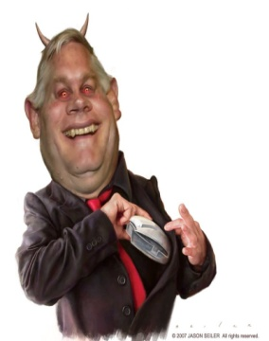
The reason is given in verses 10-11…
理由在10-11节中提到…
因为许多人不服管束,说虚空话欺哄人,那奉割礼的更是这样. 这些人的口总要堵住. 他们因贪不义之财,将不该教导的教导人,败坏人的全家.
For there are many rebellious people, mere talkers and deceivers, especially those of the circumcision group. They must be silenced, because they are ruining whole households by teaching things they ought not to teach—and that for the sake of dishonest gain.

Slide 72
LOVING WHAT IS GOOD (Titus 1:8) “I love the pure things, not the impure”
好善
(多1:8)
“我喜爱纯洁的事物，而非不纯之事”
喜爱美善的事物。
pjhilagathos: loving the good things
你生活中有哪些美善之事？
What good things are in your life?
你生活中有哪些不善之事？
What bad things are in your life?
好善

Slide 73
JUST (Titus 1:8) “I am consistently fair with others”
公正
(多1:8)
“我总是公正待人”
顺从神的命令;正直； 圣洁;公义的生活;清白; 无懈可击;无辜;基督般的
dikaios: obedient to God’s commands; upright; holy; righteous life; innocent; faultless; guiltless; Christlike
在哪些方面你像耶稣？
In what ways are you NOT like Jesus?
公正

Slide 74
DEVOUT (Titus 1:8) “I live a holy life before the Lord”
圣洁
(多1:8)
“我在神面前圣洁度日”
圣洁;远离诡诈;敬虔地遵守道德义务以保持纯洁.
Hosios: holy; free from wickedness; religiously observing moral obligations to remain pure
不完全, 但为之努力.
Not perfect, but striving for it
你的家人会否这么描述你？
Would your family say this describes you?
圣洁

Slide 75
NOT PURSUING DISHONEST GAIN (Titus 1:7) “I do not make any money dishonestly”
不贪不义之财
(多1:7)
“我不赚不义之财”
不在金钱上贪婪，不通过侍奉致富。
me aischrokerdēs: not greedy for money; not using the ministry to get wealth
牧师应得良好工价，但这不应成为做牧师的理由。
Pastors should be paid well but not become a pastor for that reason
你有否得过不义之财？
Do you ever get money disohonestly?
不贪不义之财

Slide 76
SELF CONTROLLED (Titus 1:8) “I do not indulge in lust or pornography”
自持
(多1:8)
“我不沉迷于情欲或色情”
过规矩的生活; 能胜过试探；能控制自我.
egkratēs: Disciplined life; having power over temptations; mastering himself
哪方面的试探你最不能胜过？
What temptations do you give into most regularly?
自持

Slide 77
4. 受装备的
拥有扎实的圣经工作知识.
A strong working knowledge of the Bible
拥有清楚解释圣经的能力.
The ability to clearly explain the Bible
拥有将圣经应用于生活的能力.
The ability to apply the Bible to life
4. EQUIPPED

Slide 78
5. 历经时间考验的
你是否花时间考察过他是否符合圣经要求.
Have you had time to see if he is qualified Biblically?
他是否忠于目前的教会和牧师？
Has he been faithful to his current church and pastor?
若有需要, 他是否愿意在其它领域服事？
Is he willing to serve in other areas if needed?
5. TIME TESTED

Slide 79
6. 刚强壮胆
若蒙召传道, 我是否愿意为此不惜代价？
Am I willing to pay the ultimate price if called upon by the Lord?
不管个人喜好, 我是否愿意讨论圣经上的任何话题。
Am I willing to discuss every subject the Bible discusses even if it makes me uncomfortable?
6. COURAGEOUS

Slide 80
7. 圣灵充满
受圣灵控制和灌能。
CONTROLLED and EMPOWERED by the HOLY SPIRIT
约14:26
John 14:26
约16:13-14
John 16:13-14
7. SPIRIT FILLED

Slide 81
8. 激情澎湃
“讲道没有激情就如同烹饪不调味. ”
“To preach without passion is to cook without flavor”
若你自己对所讲的内容都感到兴趣索然, 别人也会如此。
If you are not excited about what you are preaching, no one else will be either.
8. PASSIONATE

Slide 82
WHEN SHOULD WE PREACH?
何时应讲道？

Slide 83
(主日:讨论) (SUNDAYS: Discussion)
主日应该讲多少堂道？
How many services should we preach Sunday?
每篇道应该多长？
How long should a sermon be?
讲道与教导之间的差异。
Differences between Service & School
若需要你在主日以外讲道怎么办？
What if circumstances require preaching on a different day?

Slide 84
讨论 (DISCUSSION)
B. 周间成长小组
MID-WEEK GROWTH GROUPS
C. 与客座讲员合并
INCORPORATING GUEST SPEAKERS
D. 特殊研讨会/培训课程
SPECIAL SEMINARS / TRAINING COURSES

Slide 85
WHERE SHOULD WE PREACH?
应在何处讲道？

Slide 86
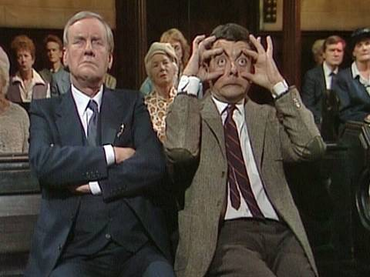
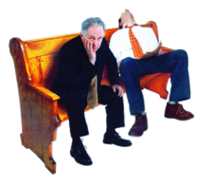
A. 选择场地
Choosing a Location
B. 预备讲堂
Preparing the Room
灯光/讲台/舒适
Lighting / Pulpit / Comfort
C. 有用的设备
Helpful Equipment

Slide 87
WHAT SHOULD WE PREACH?
我们应讲什么？

Slide 88
教导 vs. 讲道
Teaching vs. Preaching
教导着重以便于记忆的方式呈现信息.
Teaching is more focused on the presentation of information in a memorable way
讲道则包含传讲真理，阐明真理， 以及激励听众在生活中应用真理。
Preaching involves presenting truth, illustrating that truth, and motivating the listeners to apply the truth to their lives.

Slide 89
B. 圣经 vs. 信经 (Bible vs Creeds)
信条, 宗派教义,要理问答,等等 决不应该取代我们主日的讲道, 乃是要在我们的教导中使用。
Creeds, denominational doctrines, catechisms, etc. should never replace the Bible in our Sunday Sermon but should be used during our teaching times
庇哩亚原则：教导你的会众在个人的圣经学习中察验你的教导。
The BEREAN PRINCIPLE: Teach your people to check your teaching through personal Bible Study.

Slide 90
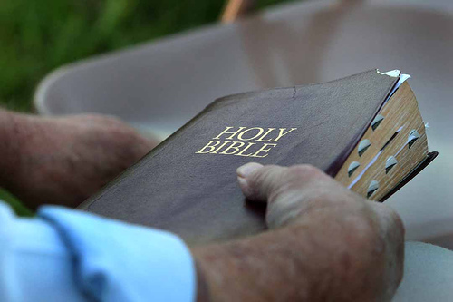
“求你用真理使他们成圣;你的道就是真理” —(约17:17)
“Sanctify them by the Truth;
Your Word is Truth.”
–John 17:17
当你发表观点时,告诉学生这只是你的个人观点.
要小心不要把教会传统当作圣经那般进行教导。
When you give an opinion, tell your students it is only your opinion. Be careful NOT to teach your churches traditions as if it were Scripture.

Slide 91
C.原意解经 vs. 私意解经
Exegesis vs Eisegesis
定义 (Definitions)
原意解经 (EXEGESIS) | 私意解经 (EISEGESIS)
原意解经是在谨慎的客观分析的基础上，对文本进行的阐述或说明。 前缀的“ ex ” 是由希腊文来的，意思是“导出来”；也就是把文本的意思吸出来，按着原意解释，求得经文的真正意义。 | 私意解经是在主观，非分析式的读经基础上对段落所做解释。 前缀的“eis ”是由希腊文来的，是“注入”的意思，就是把自己的意思注入圣经，想怎么解就怎么解。.

Slide 92
C.原意解经 vs. 私意解经
Exegesis vs Eisegesis
焦点 (Focus)
原意解经 (EXEGESIS) | 私意解经 (EISEGESIS)
通过观察，解释，关联和应用，逐节逐节研究圣经所有的书卷。 | 主题式地查考不同的话题，传道人先入为主地带着自己的观点去寻找经文的支持。

Slide 93
C.原意解经 vs. 私意解经
Exegesis vs Eisegesis
长处 (Advantages)
原意解经 (EXEGESIS) | 私意解经 (EISEGESIS)
覆盖每一个主题。 无法回避冲突。 神全备的话语。 神的观点。 信靠神, 而非传道人。 文法和背景。 结合上下文解经。 | 容易形成讲章。 切合人们的兴趣。 推动牧师的议程。

Slide 94
C.原意解经 vs. 私意解经
Exegesis vs Eisegesis
短处 (Disadvantages)
原意解经 (EXEGESIS) | 私意解经 (EISEGESIS)
要刻苦钻研, 花时更多。 需要付出更多的努力来形成讲章。 提后2:15. | 避开众多话题。 留下大量圣经不做探讨。 牧师的观点(而非神的)? 错误解经甚嚣尘上。 宗派主义至高无上。 容易断章取义。

Slide 95
“释经式讲道应该为基督徒社区提供主食....因为这种方法能最佳地展示和传达了你对整本圣经皆为真理的坚定信念。这种方法也证明你确信任何一部分圣经都是神的道，而不只是某些特定的主题或某部分你认可或喜欢的内容才是...释经式讲道对传道人而言有点冒险...你无法完全预定你的会众在未来几周或几个月里将会听到什么. 当文本打开时,问题和答案跃然纸上,无人预知它们的到来. 我们常认为圣经是一本回答我们众多问题的书,这种认识也没错. 不过,我们若真的让经文自己说话,可能会发现我们甚至连问题都没问对。”
——提摩太·凯乐

Slide 96
“Expository preaching should provide the main diet of preaching for a Christian community. . . . It is the best method for displaying and conveying your conviction that the whole Bible is true. This approach testifies that you believe every part of the Bible to be God’s Word, not just particular themes and not just the parts you feel comfortable agreeing with…Exposition is something of an adventure for the preacher…You can’t completely predetermine what your people will be hearing over the next few weeks and months. As the texts are opened, questions and answers emerge that no one might have seen coming. We tend to think of the Bible as a book of answers to our questions, and it is that. However, if we really let the text speak, we may find that God will show us that we are not even asking the right questions.””
–Tim Keller

Slide 97
D. 旧约 vs 新约 (O.T. vs N.T.)
提后3:16-17
2 Timothy 3:16-17
路24:27
Luke 24:27
平衡新旧约的教导
Balance Old & New Testament Teaching
马丁路德的律法—福音的教导。
Martin Luther’s LAW / GOSPEL teaching

Slide 98
E. 门训 vs 宣教
Discipleship vs Evangelism
不管你用意如何良好,不要更改福音的真理。
Do not change the truth of the Gospel regardless of your good intentions.
“我对从神而来的领受乃是这样： 我的讲道对象主要是教会不断成熟的信徒，同时也要注意到其中尚有未信之人.” (“使徒行传二十九章”的主席)
“My understanding from the Word of God is that I am supposed to preach for the maturation of the believer with a view that lost people are there.” -Matt Chandler (Acts 29 President)

Slide 99
HOW SHOULD WE PREACH?
应如何讲道？

Slide 100
PART 1: PREPARATION
“对于神而言,讲什么固然重要. 同时怎么讲同样重要. 无论谁都不能想讲什么就讲什么,想怎么讲就怎么讲。”
“It matters to God what is preached. And it matters to Him how it is preached. No man is free to preach whatever and however he so chooses.” -Steven Lawson
第一部分: 预备

Slide 101
A. 5 Things to AVOID in your Sermon
A. 讲章中要避免的五大问题
1
骄傲自大
PRIDE
2
高高在上
CONDESCENSION
3
律法主义
LEGALISM
4
沉闷乏味
BOREDOM
5
讨好迎合
PANDERING

Slide 102
B. 21 ESSENTIAL SERMON ELEMENTS
B. 21条讲章基本要素

Slide 103
符合圣经 (BIBLICAL)
使用圣经作为你的主要文本。
Use the Bible as your main text.
尊重敬虔学者们的替代性观点。
Respect alternate views of godly scholars
所有经文都要结合上下文解释。
Keep all verses in context
不要假设人人都了解圣经。
Don’t assume people know the Bible

Slide 104
2. 能荣耀神 (GOD HONORING)
人们离开时是带着对神之爱的敬畏,还是津津乐道于你的学识？
Do people leave with a greater awe of God’s love or of your knowledge?

Slide 105
3. 基督为中心 (CHRIST-CENTERED )
每一篇讲章都应吸引我们靠近基督。
Every sermon should draw us closer to Jesus
约 5:39 (Jn 5:39)
林后 4:5 (2 Cor. 4:5)
路 24:27 (Lk 24:27)
徒 28:31 (Acts 28:31)
约 20:30-31 (Jn 20:30-31)
林前 1:23 (1 Cor 1:23)

Slide 106
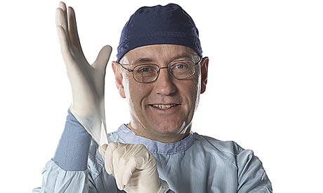
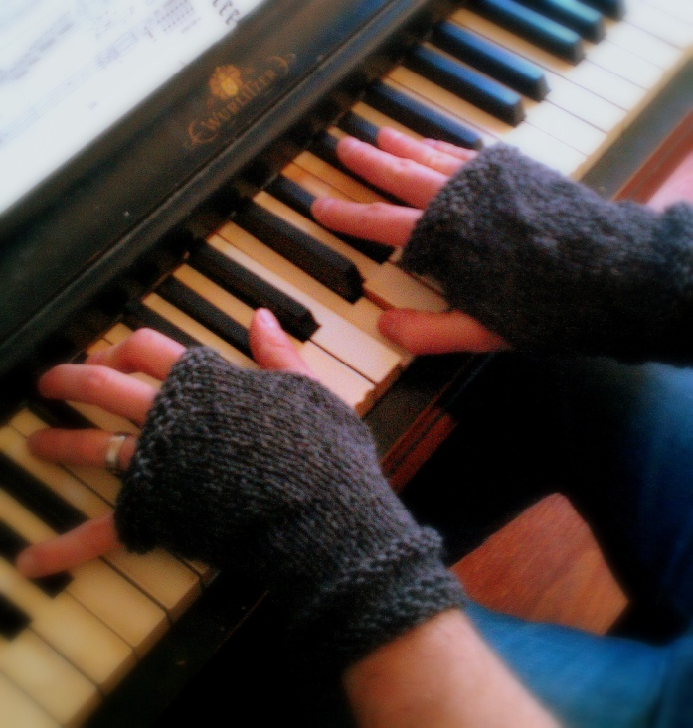
4. 圣灵充满的 (SPIRIT FILLED )
神的手在弹钢琴. （你只是手套）
God’s hands play the piano (you are just the glove)
这是他的信息, 不是你的.
让他透过你讲道.
This is HIS message, not yours. Let Him preach it through you.

Slide 107
不要使用“圣灵做工”作为不良预备和不良学习习惯的借口。 (Do NOT use the “filling of the Spirit” as an excuse for poor preparation and poor study habits!)
警告 (WARNING!)
!
!

Slide 108
“福音是对着所有人的耳朵传讲的，但是只对某些人有功效。福音的大能既不在于讲员的雄辩口才，否则凭着人的能力就能使人归信了，也不在于讲员的学问知识，否则就包含了人的智慧。我们尽可以讲得口干舌燥，唾沫横飞，甚至气喘吁吁，若其中没有来自上帝神秘的能力，也是无济于事，不会有一人得救——只有圣灵才能改变人的意志。弟兄啊！除非我们讲的道伴随着圣灵的大能，否则，我们对着人讲还不如对着一面石墙讲呢。因为只有圣灵才有能力转变灵魂。”——查尔斯·司布真

Slide 109
“The gospel is preached in the ears of all men; it only comes with power to some. The power that is in the gospel does not lie in the eloquence of the preacher otherwise men would be converters of souls. Nor does it lie in the preacher’s learning; otherwise it could consists of the wisdom of men. We might preach till our tongues rotted, till we should exhaust our lungs and die, but never a soul would be converted unless there were mysterious power going with it – the Holy Ghost changing the will of man. O Sirs! We might as well preach to stone walls as preach to humanity unless the Holy Ghost be with the word, to give it power to convert the soul.”
― Charles Haddon Spurgeon

Slide 110
5. 真实正确 (TRUE)
“讲真理时充满权柄,讲个人观点时带着谦卑.” —介巴梁
“Preach truth with authority and opinion with humility.” –Jay BarLeon
区分真理和观点. 明白两者的差异。
Distinguish between truth and opinion. KNOW the difference.
教父们的教导受时代背景的局限。
Church fathers taught in limited contexts

Slide 111
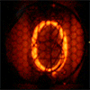
十大 得到错误答案 的原因
Top 10 Reasons We Get Wrong Answers

Slide 112
为什么我问的每个圣经问题都会得到多种不同的答案？ 既然圣经是容易明白的，为什么他们观点不一致呢？
Why do I get such a variety of different answers to each Bible question I ask? Why don’t they all agree if the Bible is so easy to understand?

Slide 113
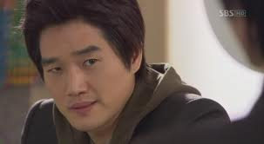
PRIDE
1. 骄傲
有时候我们甚至不愿意承认我们可能错了。
(Sometimes we are unwilling to even consider that WE MIGHT BE WRONG.)

Slide 114
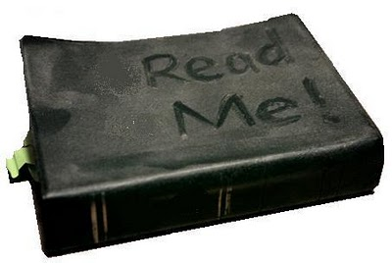
LAZINESS
1.骄傲
有时我们不愿深入学习，常采取一种“且信且行”的态度。
(Sometimes we are unwilling to devote ourselves to deep study. We adopt a
“just believe and move on” attitude.)
2. 懒惰

Slide 115
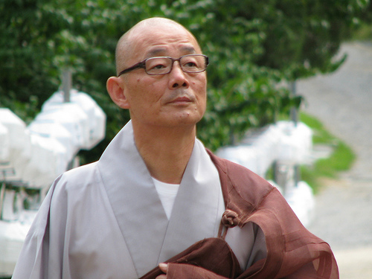
FALSE LOYALTY
1.骄傲
有时我们忠于自己的宗派或导师多过忠于神。
(Sometimes we put our devotion to our denomination or mentors before our devotion to God.)
2. 懒惰
3. 愚忠

Slide 116
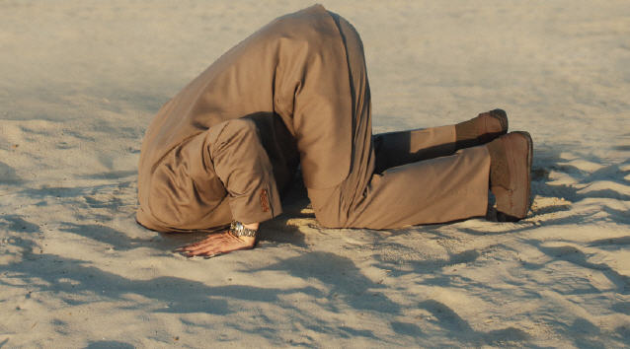
EMOTIONALISM
1.骄傲
有时只接受那些我们感觉良好的答案。不愿接受那些触犯我们世界观的教义。
(Sometimes we will only accept answers we FEEL good about. We won’t accept doctrines that offend our worldview.)
2. 懒惰
3. 愚忠
4. 情感倾向
4. X
4. X
4. X
4. X
4. X
4. X

Slide 117
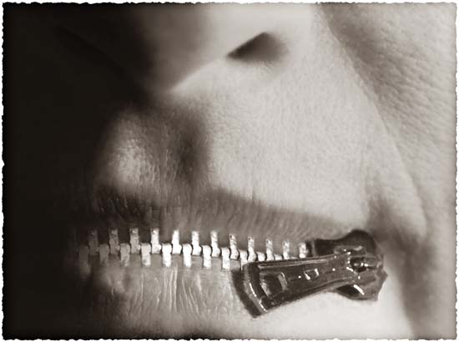
OPINIONATED
1.骄傲
对于神自己都沉默的问题，有时我们谈论起来却满带权威。
(Sometimes we speak authoritatively when even God is silent on the subject.)
2. 懒惰
3. 愚忠
4. 情感倾向
5. 固执己见
4. X
4. X
4. X
4. X
4. X

Slide 118
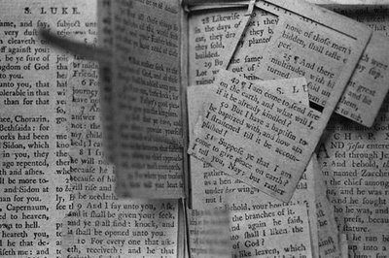
DECONTEXTUALIZING
1.骄傲
有时我们从上下文中抽出经文证明自己的观点。我们假设每节经文都适用于我们当下的情况。
(Sometimes we take verses out of context to prove our points. We assume that every verse applies to our given situation.)
2. 懒惰
3. 愚忠
4. 情感倾向
5. 固执己见
6. 断章取意
4. X
4. X
4. X
4. X

Slide 119
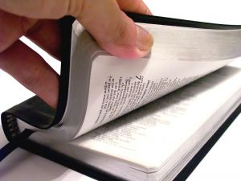
BAD HERMENEUTICS
1.骄傲
有时我们忽略了基本的圣经学习原则。往往在尚无正确释经的前提下就开始应用这节信息。
(Sometimes we ignore the most basic principles of Bible Study. We try to apply a passage before we interpret it’s meaning.)
2. 懒惰
3. 愚忠
4. 情感倾向
5. 固执己见
6. 断章取意
7. 不良释经
4. X
4. X
4. X

Slide 120
CULTURAL BLINDERS
1.骄傲
有时我们以自己的文化，语言和情景来解释经文，而不是将之还原到最初的语言和意思。
(Sometimes we interpret Scripture in light of our culture, language and situation instead of the original meaning and language.)
2. 懒惰
3. 愚忠
4. 情感倾向
5. 固执己见
6. 断章取意
7. 不良释经
8. 文化盲区
4. X
4. X

Slide 121
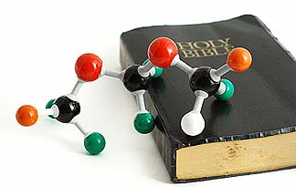
FEAR and DOUBT
1.骄傲
有时我们认为表面上的矛盾就是真矛盾。害怕科学上的新发现，不愿接受它们。
(Sometimes we assume that apparent contradictions are real contradictions.
We fear scientific breakthroughs rather
than embrace them.)
2. 懒惰
3. 愚忠
4. 情感倾向
5. 固执己见
6. 断章取意
7. 不良释经
8. 文化盲区
9. 畏惧和怀疑
4. X

Slide 122
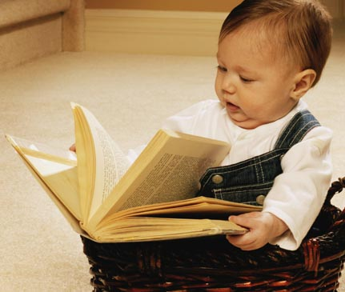
LIMITED GROWTH
1.骄傲
有时我们想明白的教义超过了我们目前的成熟度。
(Sometimes we want to understand doctrines beyond our maturity level.)
2. 懒惰
3. 愚忠
4. 情感倾向
5. 固执己见
6. 断章取意
7. 不良释经
8. 文化盲区
9. 畏惧和怀疑
10. 成长局限

Slide 123
10 Reasons We Get Wrong Answers
那我如何获得正确的答案呢？
(So how do I get the RIGHT ANSWER?)
1.骄傲
2. 懒惰
3. 愚忠
4. 情感倾向
5. 固执己见
6. 断章取意
7. 不良释经
8. 文化盲区
9. 畏惧和怀疑
10. 成长局限

Slide 124
十大 获得正确答案 的原因
Top 10 Reasons We Get RIGHT Answers

Slide 125
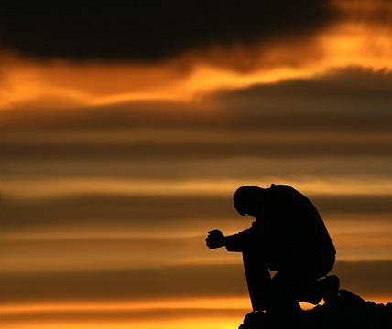
HUMILITY
1. 谦卑
要认识到你的认知可能不完整。祈求神挪去骄傲和罪。
(Realize that your knowledge may be incomplete. Ask God to remove pride
& sin as you study)

Slide 126
STUDY THE WORD
1. 谦卑
“竭力钻研，
得蒙神的认可，做无愧的工人，按着正义分解神的道。”
“Study to show yourself approved to God;
a workman who doesn’t need to be ashamed; rightly dividing the Word of Truth.”
2. 钻研神的道

Slide 127
DEVOTION TO TRUTH
1. 谦卑
将你的忠诚聚焦在圣经已启示的真理上, 而不是你的宗派或导师如何相信。
(Focus your devotion on TRUTH as revealed in the Bible; NOT on what your denomination or mentors believe. )
2. 钻研神的道
3. 忠于真理

Slide 128
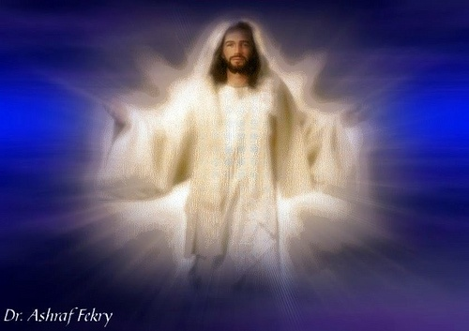
LET GOD BE GOD
1. 谦卑
接受圣经里神启示的祂自己，而不是你感觉祂该怎样或你认为他该如何。
(Accept God for who He is as revealed
in Scripture; NOT as you feel He should be or how you think He should act. )
2. 钻研神的道
3. 忠于真理
4. 让神做神
4. X
4. X
4. X
4. X
4. X
4. X

Slide 129
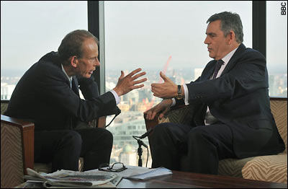
“MY OPINION IS…”
1. 谦卑
确保将观点与事实分开。有自己的观点是可以的，但要意识并承认你可能错了。
(Make sure you separate opinions from fact. It is okay to have an opinion but realize and admit that you may be wrong.)
2. 钻研神的道
3. 忠于真理
4. 让神做神
5. “我的观点是…”
4. X
4. X
4. X
4. X
4. X

Slide 130
KEEP IT IN CONTEXT
1. 谦卑
所有的经文都有上下文。问谁写的？写给谁？何时？为什么？哪里？正确答案总能在上下文里找到。
(All verses have a context. Ask who wrote it? To whom? When? Why? Where? The truth is always found in context.)
2. 钻研神的道
3. 忠于真理
4. 让神做神
5. “我的观点是…”
6. 保持上下文
4. X
4. X
4. X
4. X

Slide 131
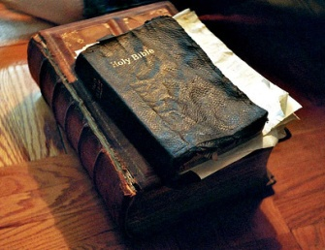
INTERPRET FIRST
1. 谦卑
只有正确的释经才能带来正确的应用。决不在没有释经的情况下就应用某节经文。
(Only a true interpretation can lead to a true application. Never apply a verse without first interpreting it.)
2. 钻研神的道
3. 忠于真理
4. 让神做神
5. “我的观点是…”
6. 保持上下文
7. 首先释经
4. X
4. X
4. X

Slide 132
LOOK FOR THE ORIGINAL SETTING
1. 谦卑
总是根据原始的文化，语言和情形，而非你的国情和文化背景去释经。
(Always interpret Scripture in light of the original culture, language and situation instead of your national background.)
2. 钻研神的道
3. 忠于真理
4. 让神做神
5. “我的观点是…”
6. 保持上下文
7. 首先释经
8. 原始背景
4. X
4. X

Slide 133
TRUTH IS TRUTH
1. 谦卑
真正的科学总是最后支持圣经里的真理。不存在矛盾，勇敢地寻求答案吧。
True science will always eventually support the truths found in Scripture. There are NO contradictions; just look for the answer.
2. 钻研神的道
3. 忠于真理
4. 让神做神
5. “我的观点是…”
6. 保持上下文
7. 首先释经
8. 原始背景
9. 真理就是真理
4. X

Slide 134
ENJOY GROWING
1. 谦卑
不要指望一下就明白所有的答案。按照神给你的速度，享受学习之旅每一步的乐趣。
(Don’t expect to know all answers at once. Enjoy the learning journey at God’s pace.)
2. 钻研神的道
3. 忠于真理
4. 让神做神
5. “我的观点是…”
6. 保持上下文
7. 首先释经
8. 原始背景
9. 真理就是真理
10. 享受成长

Slide 135
通常，难题不是缺少答案，而是很多答案听上去都有道理。然而每节经文只有一个正确的解释。——杰·巴里昂
“Often, the problem is not a lack of answers, but a lot of answers that all sound correct.
But there is only one correct interpretation for each passage.”
–Dr. Jay BarLeon

Slide 136
6. 传福音式 (EVANGELICAL)
意识到会众中可能有未信者.
Be aware of possible unbelievers
不要更改或截留福音.
Don’t alter or shorten the Gospel
留出时间清晰地陈述福音.
Offer a time for a clear Gospel presentation

Slide 137
7. 践行应用 (APPLICABLE)
讲道的目的.（弗4:11-13）
The purpose for preaching (Eph 4:11-13)
讲道的目的是帮助人们变得像耶稣.
The purpose of preaching is to help people become like Jesus.
有哪些原因让我们避开应用？
What are some reasons we avoid application?

Slide 138
应用要回答两个问题: 那又怎样？接下来怎么办？
Application answers two questions: So what? What now?
“讲道和教导中缺乏应用，我认为是美国讲道人中存在的最大问题。太多的讲章无非是长篇大论地讲述圣经背景或晦涩难懂的希腊或希伯来文词汇。结果，尽管人们在教会进进出出，生命却毫无改变。”——华理克
“The lack of application in preaching and teaching is, I believe, the number one problem with preaching in America. Too many sermons are nothing more than lectures on biblical backgrounds or obscure Greek and Hebrew words. As a result, people walk into a church and walk out, but their lives remain unchanged.” –Rick Warren

Slide 139
每次你教导,问你自己, “我知道什么—— 我想让这些学生知道什么？我感觉到什么—— 我想让学生感觉到什么？我要做什么—— 我想让他们做什么？”
Every time you teach, ask yourself, “What do I know—and what do I want these students to know? What do I feel—and what do I want them to feel? What do I do—and what do I want them to do?”

Slide 140
“神将祂的道赐下来不是要给我们信息，而是要我们转变。”
——穆迪
“The Scriptures were not given for our information, but for our transformation.” –D. L. Moody

Slide 141
8. 重视教义 (DOCTRINAL)
以浅显易懂的方式解释教义.
Explain doctrines in understandable terms
过多 vs. 过少教义.
Too much vs. Too little Doctrine
圣经甚于宗派.
Bible over Denomination
对异端学说的警告.
Warn of heresies

Slide 142
9. 生动有趣 (INTERESTING )
“有些人喜欢以长篇大论，没完没了的讲道折磨人; 要知道人的听力脆弱有限,没多久就会疲倦厌烦.” —马丁路德
“Some plague the people with too long sermons; for the faculty of listening is a tender thing, and soon becomes weary and satisfied.”-Martin Luther
总是在他们的意犹未尽，而非兴致索然时结束。
Always leave them wanting more, not less.

Slide 143
“作为传道人，决不要忘记。我们不只是在灌输信息。若是这样的话，让会众自己去读一些书籍从中获得需要的信息就行了。讲道要做的是让知识进入生活...可悲的是许多传道人所做的仅仅是在上口述信息，会众在下记录信息。牧师的工作不该是这样的。若只是要获得信息，人们大可以自己去读书。讲道要做的是点燃火焰，激发热心，鼓励行动，激活生命。这才是讲道的主要任务。让我们铭记于心：今日我们超越一切的需要是感人肺腑，富有激情，强大有力的讲道。我们的讲道必须'温暖'，也必须'热切'.“
——摘自钟马田《清教徒和威斯敏斯特大会》(1976)的发言。

Slide 144
“As preachers we must not forget this. We are not merely imparters of information. We should tell our people to read certain books themselves and get the information there. The business of preaching is to make such knowledge come to life… The tragedy is that many preachers simply dictate information and the congregation takes them down. That is not the job of the pastor. People can read books for themselves; the business of the preacher is to start a fire, to enthuse, to stimulate, to enliven. And that is the primary business of preaching. Let us take this to heart. … What we need above everything else today is moving, passionate, powerful preaching. It must be ‘warm’ and it must be ‘earnest’. - D. Martyn Lloyd-Jones, Lecture delivered at the Puritan and Westminster Conference (1976).

Slide 145
10. 便于记忆 (MEMORABLE )
耶稣曾创作过一些便于记忆的声明. 说几个来听听.
Jesus crafted memorable statements. Name some
你若想像耶稣那样讲道, 就制作一些便于记忆的声明和大纲.
If you want to preach like Jesus, craft memorable statements and outlines.
将你的重点设计得容易记住,然后与会众反复咀嚼。
Make the main point easy to remember. Repeat it over and over with the congregation

Slide 146
11. 精心组织 (WELL ORGANIZED)
简易的大纲
Easy Outline
清晰的引子
Clear Introduction
清晰的结论
Clear Conclusion
（样板在你的笔记后面）
(Samples in the back of your notebook)

Slide 147
12. 举例阐明 (ILLUSTRATED )
来自拉丁词 “lustrare”: 将光打在某个想法上; 照亮
From the Latin “lustrare”: to cast light on an idea; to illuminate
“我们努力地准备讲章，就是希望会众头脑中带着最大的讲章留存率离开。然而，我们使用的却是那个留存率最低的方法——讲述.”
“We work hard on our sermons. We should want the highest retention rate possible with our congregation, and yet we use the one method with the lowest retention rate…lecture.”

Slide 148
提后 3:16-17 (2 Timothy)
“圣经都是神所默示的 (或作凡神所默示的圣经), 于教训,督责,使人归正, 教导人学义,都是有益的. 叫属神的人得以完全, 预备行各样的善事.”
“All Scripture is God-breathed and is useful for teaching, rebuking, correcting and training in righteousness, so that the man of God may be thoroughly equipped for every good work.”

Slide 149
我们需要运用和开发好的教导方法。当耶稣看到教导机会时, 他会针对不同情况而使用不同而恰当的教导方法。
Good teaching methods need to be used and developed. Jesus utilized different but appropriate methods for different teaching situations which He saw as learning opportunities.

Slide 150
请记住…
(We Remember…)
10%
20%
75%
90%
50%

Slide 151
为何我们花时间这般教导？
10%
20%
75%
90%
50%
90%
8%
1%
.05%
.05%
(SO WHY DO WE SPEND OUR TEACHING TIME THIS WAY?)

Slide 152
请谨记——教导方法并不是神圣不可改动的，它们只是一种方式和目的——为了确保学生真正学会！
Methods of teaching are not sacred, but are only a means and end—to insure that learning actually occurs!

Slide 153
故事
(Stories)
视频短片
(Video Clips)
语言图像
(Word Pictures)
见证
(Testimonies)
统计数字
(Statistics)
幽默
(Humor)

Slide 154
13. 可测度的 (MEASURABLE )
会众是否知道应该做什么?
Do people know what they are supposed to do?
会众能否区别他们是否顺服神？
Can people even tell if they are obedient or not?

Slide 155
14. 精心准备 (WELL PREPARED)
一篇经过深入钻研的讲章在一半的时间内就可讲完。
A well studied text can be preached in half the time
你不必告诉他们你所掌握的某个话题或文本的所有知识。
You do not need to tell them everything you know about a subject or text
使用手头可获得的资源。
Use available Resources

Slide 156
讲章
预备

Slide 157
15. 启迪感召 (INSPIRATIONAL )
在你告知答案前，先提问。 若无人提问则不必回答问题。
Before you preach your answers, raise the questions. There is no need to answer questions that no one is asking.
一个精彩的引子会激发人们听你信息的兴趣。
A good introduction will inspire people to want to hear your message.

Slide 158
16. 激励鞭策 (MOTIVATIONAL
不能激励我们的事物。
THINGS THAT DO NOT MOTIVATE
能激励我们的事物。
THINGS THAT DO MOTIVATE

Slide 159
17. 明白易解 (UNDERSTANDABLE)
你的任务是让每位听众都能理解 圣经，而非证明你有多聪明。
Your task is to make the Bible understandable to each listener, not to try to prove how smart you are.
如果你要使用 “基督徒行话”， 一定要解释它的意思。
If you want to use “Chrstian-eese”, always explain the meaning.

Slide 160
18. 切合年龄 (AGE APPROPRIATE )
强迫儿童与成年人在一起敬拜是对他们的一种折磨。会让他们将圣经与 百无聊赖，痛苦和逃离联系起来。
Children who are tortured by being forced to sit through the adult services will learn to associate the Bible with boredom, pain, and escape.
主日应该成为孩子们一周里最有趣的一天,这样他们会每周都期待去教会。
Sunday should be the funnest day of the week for kids so they will desire to be at church every time the doors open.

Slide 161
19. 信赖可靠 (RELIABLE )
审察你的资料来源。
Check your Sources
不要夸大其词。
Do not Exaggerate

Slide 162
20. 历史背景 (HISTORICAL )
在讲圣经中的故事时， 交代一些基本的背景知识。
Give some basic background info on the stories you use from the Bible.
不要因为你以前曾经提过， 会众就会知道并记住这些背景。
Don’t assume your congregation knows or remembers the background just because you may have mentioned it before.
重复=记忆
Repetition = memory.

Slide 163
21. 富于想象 (IMAGINATIVE )
让大家参与想象。
Engage the Imagination
你要将故事讲得栩栩如生， 跃然纸上.
Your words should tell a visible story

Slide 164
PART 2: PRESENTATION
A. 讲道前需要问的问题.
Questions to ask before preaching
我与神的关系是否正确？
Am I right with God?
我是否被圣灵充满？
Am I filled with the Holy Spirit?
第二部分: 呈现

Slide 165
3. 我是在这里侍奉还是提出要求？
Am I here to serve or make demands?
4. 今天神将得荣耀还是我得荣耀？
Will God receive honor today or will I?
5. 我能否辨别哪是神的道,哪是我的观点？
Can I distinguish God’s Words from my opinions?
6. 我是否已将 “毒药”从我的讲章中清除？
Have I removed “poison” from my sermon?
7. 我是否深爱我讲道的对象？
Do I love the people I am preaching to?

Slide 166
B. 身体语言
BODY LANGUAGE
C. 声调变化
VOCAL INFLECTION
D. 眼神交换
EYE CONTACT
E. 面部表情
FACIAL EXPRESSIONS

Slide 167
F. 着装得体 (DRESS APPROPRIATELY)

Slide 169
ADDITIONAL RESOURCES
附加资源

