Slide 1

Gaius
Diotrephes
Demetrius

Slide 2

Turn to

Slide 3
¹ The elder, To my dear friend Gaius, whom I love in the truth. ² Dear friend, I pray that you may enjoy good health and that all may go well with you, even as your soul is getting along well. ³ It gave me great joy when some believers came and testified about your faithfulness to the truth, telling how you continue to walk in it. ⁴ I have no greater joy than to hear that my children are walking in the truth. ⁵ Dear friend, you are faithful in what you are doing for the brothers and sisters, even though they are strangers to you. ⁶ They have told the church about your love. Please send them on their way in a manner that honors God. ⁷ It was for the sake of the Name that they went out, receiving no help from the pagans. ⁸ We ought therefore to show hospitality to such people so that we may work together for the truth. ⁹ I wrote to the church, but Diotrephes, who loves to be first, will not welcome us. ¹⁰ So when I come, I will call attention to what he is doing, spreading malicious nonsense about us. Not satisfied with that, he even refuses to welcome other believers. He also stops those who want to do so and puts them out of the church. ¹¹ Dear friend, do not imitate what is evil but what is good. Anyone who does what is good is from God. Anyone who does what is evil has not seen God. ¹² Demetrius is well spoken of by everyone—and even by the truth itself. We also speak well of him, and you know that our testimony is true. ¹³ I have much to write you, but I do not want to do so with pen and ink. ¹⁴ I hope to see you soon, and we will talk face to face. Peace to you. The friends here send their greetings. Greet the friends there by name.

Slide 4
GAIUS
DIOTREPHES
DEMETRIUS

Slide 5

Which one are YOU going to
be like?

Slide 6
Introduction
Example 1: GAIUS
Example 2: DIOTREPHES
Example 3: DEMETRIUS
Conclusion

Slide 7
INTRODUCTION
“THE ELDER…”(v.1a)
  Advanced Age & Apostolic Authority
WHAT CAN YOU TELL ME ABOUT JOHN?
  Last living Apostle;
  Beloved by Jesus; Saw miracles; heard Jesus’ teachings
  Caretaker of Mary, mother of Jesus;
  Most renowned & influential Christian alive in his day;
  Author of 5 Bible books (Gospel, 1,2,3 John, Revelation)
  Church leader; pastor at Ephesus; (3 John written from here)
  Exiled to Patmos after a failed attempt to boil him to death;

Slide 8
INTRODUCTION
“The Elder, TO Gaius…”(v.1a)
This is one of the N.T.’s few personal letters (Philemon, Timothy, Titus)
The great Apostle John took time for personal correspondence.
Personal encouragement notes can have eternal effect.
Studies in psychology and sociology show that it takes 14+ positive comments to counteract 1 negative comment.
I encourage you to write encouraging notes to your pastor following his sermons.
  Be specific as to what you learned or what encouraged you
  Leave out the negative comments

Slide 9

THANK YOU
FOR YOUR ENCOURAGEMENT

Slide 10
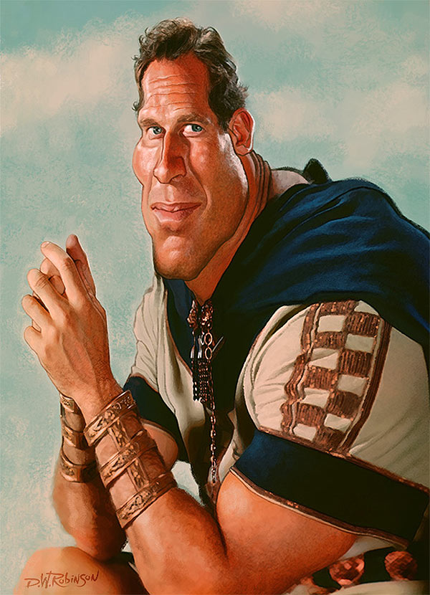
EXAMPLE 1: GAIUS
3 EXAMPLES

Slide 11
EXAMPLE 1: GAIUS
“To my dear friend Gaius, whom I love in the truth. Dear friend, I pray that you may enjoy good health and that all may go well with you, even as your soul is getting along well. It gave me great joy when some believers came and testified about your faithfulness to the truth, telling how you continue to walk in it. I have no greater joy than to hear that my children are walking in the truth. Dear friend, you are faithful in what you are doing for the brothers and sisters, even though they are strangers to you. They have told the church about your love. Please send them on their way in a manner that honors God. It was for the sake of the name that they went out, receiving no help from the pagans. We ought therefore to show hospitality to such people so that we may work together for the truth.” (V. 1b-8)

Slide 12
EXAMPLE 1: GAIUS
“my dear friend “… “Dear friend”… “Dear friend” (3x)
  No special titles. Probably not an elder, just a normal guy.
  How would you feel if you got a letter from Billy Graham or another prominent pastor calling you “dear friend”?
“whom I love in the truth”
  There is a love among Christian brothers that gets stronger and stronger as each draws closer to the Lord.
  Q: What does it mean to ‘love in the truth’?
  Q: Do you ever remind others that you “love them in the truth”?
  This week: Let a few ‘dear friends’ know what they mean to you.

Slide 13
EXAMPLE 1: GAIUS
“I pray that you may enjoy good health and that all may go well with you, even as your soul is getting along well.”
  Gaius may have been in poor health, but his spirit was healthy
  There were difficulties in his church (as we will see).
  Q: How can church schisms affect a person’s health?
“It gave me great joy when some believers came and testified about your faithfulness to the truth, telling how you continue to walk in it.”
  Some traveling Christians (missionaries) came to Ephesus
  They recounted to John how they were treated by others
  Gaius got a great report of faithfully walking in truth
  This brought great joy to John’s heart
  We ALL love to hear when friends are standing strong for Jesus

Slide 14
EXAMPLE 1: GAIUS
“I have no greater joy than to hear that my children are walking in the truth.”
  Both our natural children and those we’ve nurtured spiritually.
  And there are few pains as great as seeing your children (and those you have discipled) walk away from the truth.
“you are faithful in what you are doing for the brothers and sisters, even though they are strangers to you. They have told the church about your love.”
  Gaius showed hospitality towards visiting missionaries
  He did this in direct violation of the leadership in his church.
  Follow Jesus above everyone else in life.
  Q: How can we support those on the mission field?

Slide 15
EXAMPLE 1: GAIUS
HOSPITALITY (philoxenos: generosity to guests, especially those you do not know; love to strangers)
1 Peter 4:9, “Show hospitality to one another without grumbling”
Romans 12:13, “Contribute to the needs of the saints and seek to show hospitality.”
Titus 1:8, “But hospitable, a lover of good…”
Hospitality is a vital qualification for an elder
1 Timothy 3:2, “Therefore an overseer must be above reproach, the husband of one wife, sober-minded, self-controlled, respectable, hospitable, able to teach…”

Slide 16
EXAMPLE 1: GAIUS
“Please send them on their way in a manner that honors God. It was for the sake of the name that they went out, receiving no help from the pagans.”
  God is honored (or dishonored) by how we treat missionaries.
  This includes financial support, prayer support, encouragement, hospitality, and any other ‘manner that honors God’.
  Missionaries do not depend on the financial support of secular organizations, but of brothers and sisters in Christ.

Slide 17
EXAMPLE 1: GAIUS
“We ought therefore to show hospitality to such people so that we may work together for the truth.”
  We are PARTNERS with whomever we show hospitality
    GOOD Partnerships: “that we may work together for the truth.”
    BAD Partnerships: (“If anyone comes to you and does not bring this doctrine (the true Gospel message), do not receive him into your house nor greet him; for he who greets him shares in his evil deeds.” 2 John 10-11)
    Every battle needs front line fighters and supply line workers

Slide 18
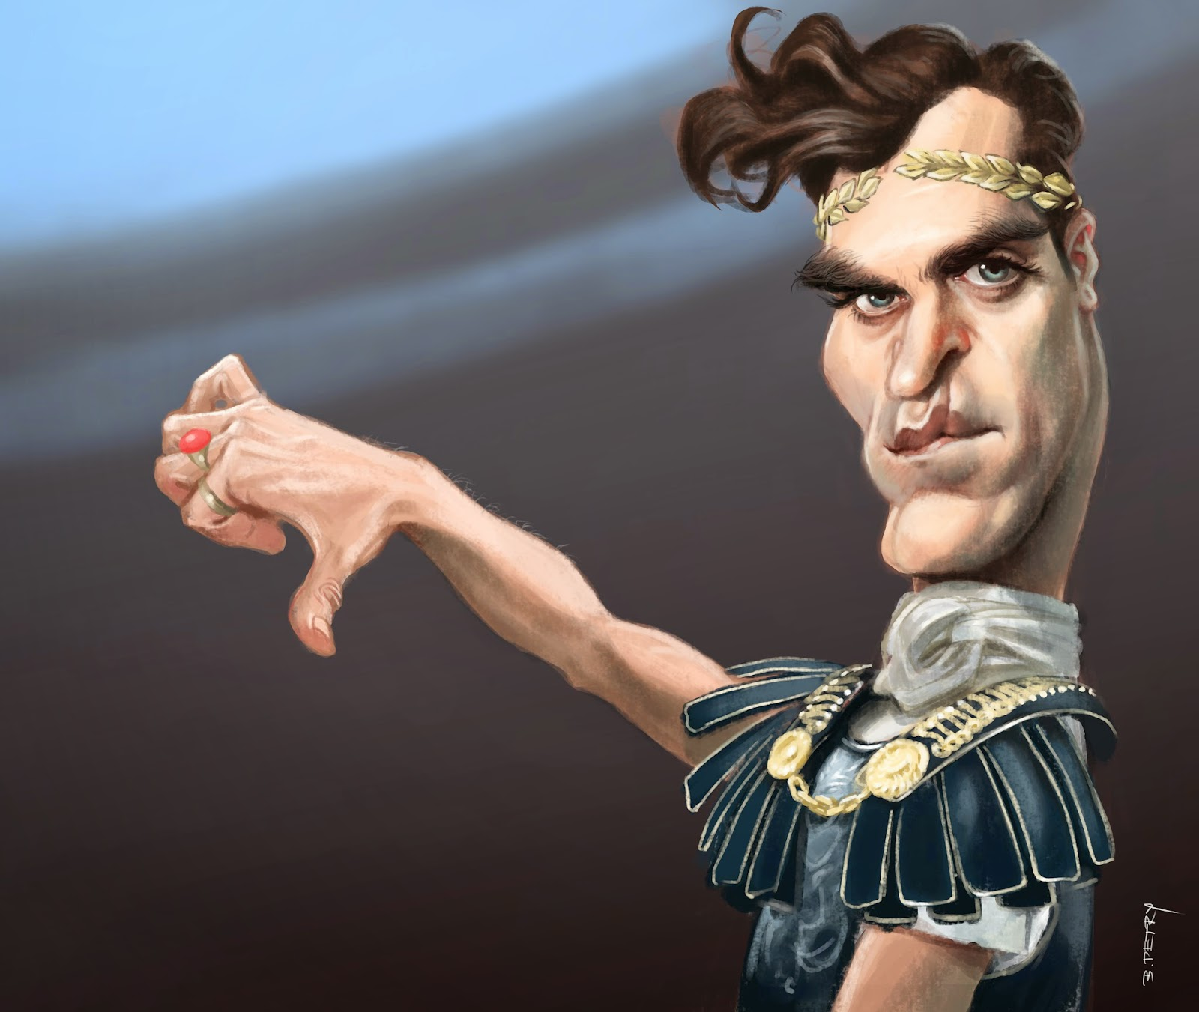
EXAMPLE 2: DIOTREPHES
3 EXAMPLES

Slide 19

EXAMPLE 2: DIOTREPHES
“I wrote to the church, but Diotrephes, who loves to be first, will not welcome us. So when I come, I will call attention to what he is doing, spreading malicious nonsense about us. Not satisfied with that, he even refuses to welcome other believers. He also stops those who want to do so and puts them out of the church. Dear friend, do not imitate what is evil but what is good. Anyone who does what is good is from God. Anyone who does what is evil has not seen God.” (v. 9-11)

Slide 20
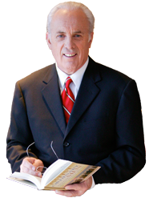
Quote by John MacArthur
  “The word ‘preeminence’ has the idea of ‘desiring to be first.” It conveys the idea of someone who is selfish, self-centered and self-seeking. The language suggests a self-promoting demagogue, who served no one, but wanted all to serve him. Diotrepehes actions directly contradict Jesus’ and the New Testament’s teaching on servant-leadership in the church.”

Slide 21
“I wrote to the church, but…”
  John wrote to the congregation to tell them he was coming
“Diotrephes, who loves to be first…” (“have preeminence” NKJV)
  Some people are self’-appointed representatives of the church
  Some church leaders demand absolute control and preeminence; They abuse the authority of the office.
  Diotrephes was a megalomaniac authoritarian who rejected any and all who preached without his permission & blessing
  Q: How does a megalomaniac authoritarian hurt the church even if he is not in a leadership position?
  An elders must have a servant’s heart, not a power hunger.
  Q: What does a “servant Leader” look like?
  “A true leader rejoices when others can do their delegated jobs better than the leaders himself could. He is happy, not threatened, when the Gospel is preached by others.” –Jay Barleon

Slide 22
“will not welcome us.”
  ‘Will not” (he did not say “could not”): It was not a lack of available funds or room, but a lack of love.
  John includes himself among those Diotrephes rejects!
  John had written to the church letting them know he would visit.
  Diotrephes rejected even the apostle.
  Diotrephes refused to give money, time, food, shelter, or any other necessity to those who were spreading the Gospel
Q: Which elder qualification did Diotrephes lack?
1 Timothy 3:2, “Therefore an overseer must be above reproach, the husband of one wife, sober-minded, self-controlled, respectable, hospitable, able to teach…”
How should we approach a person like this?

Slide 23
“So if I come, I will call attention to what he is doing”
  John says that may come anyway to confront Diotrephes.
  There IS a time to confront abusive leadership
“spreading malicious nonsense about us.”
  Diotrephes was spreading lies (nonsense) about John to make himself look more important. Another sign of a false teacher.
  It was done with malicious intent
“Not satisfied with that, he even refuses to welcome other believers. He also stops those who want to do so and puts them out of the church.”
  Had no intention to welcome people into his church
  Excommunicated anyone who followed Christ’s commands to be hospitable instead of his commands to turn them away.

Slide 24
“Dear friend, do not imitate what is evil but what is good. Anyone who does what is good is from God. Anyone who does what is evil has not seen God.”
CONTEXT IS KEY!
  Imitate Gaius (humble, supportive, hospitable, faithful)
  Do NOT Imitate Diotrephes (Arrogant, controlling, inhospitable)
  Diotrephes is called EVIL and his actions should not be imitated.
  He has NOT SEEN GOD (as evidenced by his deeds)
  Even a church leader can be UNSAVED
  Q: Is it possible that Diotrephes was not even a Christian?
  LOOK FOR FRUIT, NOT TITLE!

Slide 25
  John wrote previously (1 John 3:6-10) re: UNCHANGED LIVES
  “No one who lives in him keeps on sinning. No one who continues to sin has either seen him or known him. Dear children, do not let anyone lead you astray. The one who does what is right is righteous, just as he is righteous. The one who does what is sinful is of the devil, because the devil has been sinning from the beginning. The reason the Son of God appeared was to destroy the devil’s work. No one who is born of God will continue to sin, because God’s seed remains in them; they cannot go on sinning, because they have been born of God. This is how we know who the children of God are and who the children of the devil are: Anyone who does not do what is right is not God’s child, nor is anyone who does not love their brother and sister.”

Slide 26
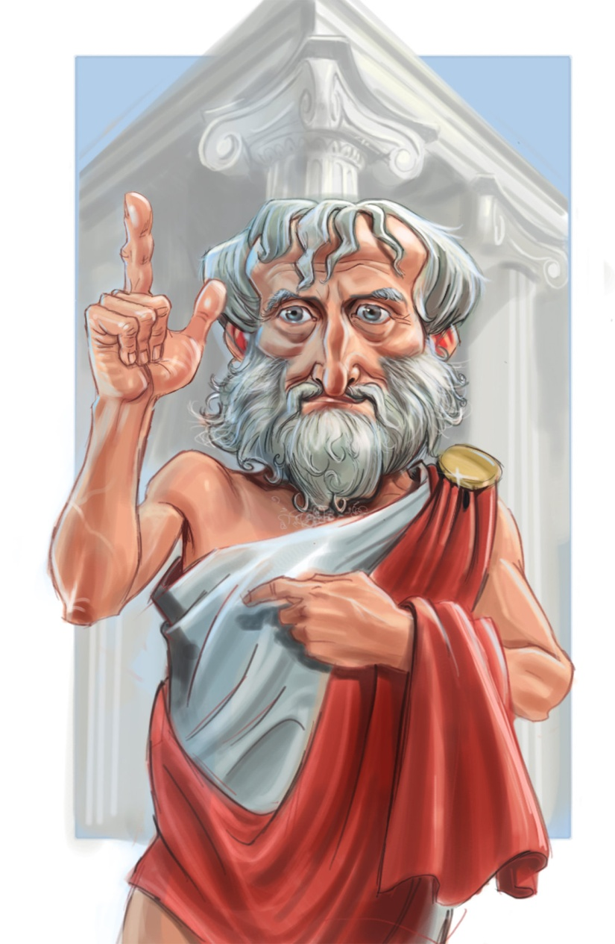
EXAMPLE 3: DEMETRIUS
3 EXAMPLES

Slide 27
EXAMPLE 3: DEMETRIUS
“Demetrius is well spoken of by everyone—and even by the truth itself. We also speak well of him, and you know that our testimony is true.” (v. 12)
“well spoken of by everyone —and even by the truth itself.””
  Q: How do you balance this verse with Luke 6:26?
  Q: What does “and even by the truth itself” mean?
“We also speak well of him, and you know that our testimony is true.”
  John gives Demetrius his seal of approval
  John had spent about 70 years building his reputation
  Q: Whose endorsement would you love to have?
  Q: How can we build our reputation so that we can say “you know our testimony is true”?

Slide 28
CONCLUSION
“I have much to write you, but I do not want to do so with pen and ink. I hope to see you soon, and we will talk face to face. Peace to you. The friends here send their greetings. Greet the friends there by name.” (v.13-14)
  “pen and ink” refers to papyrus sheets and mixture of water, charcoal and gum resin used to write.
  Letters are good; personal visits are even better! (ie Doug in China)
  John is optimistic that God can change his circumstances and restore him to his friend if it is God’s will.
  John had other friends in that church that he knew by name.
  Who would YOU love to receive a letter from?
  Who would you love to visit?

Slide 29

Support your missionaries

