Slide 1
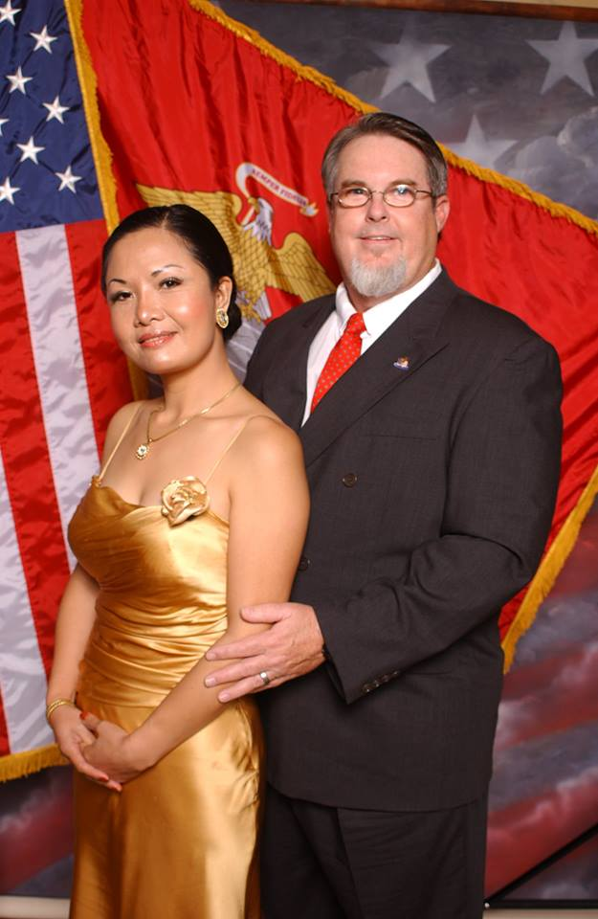
最大化你的婚姻幸福度
Maximize Your
Marriage

Slide 2

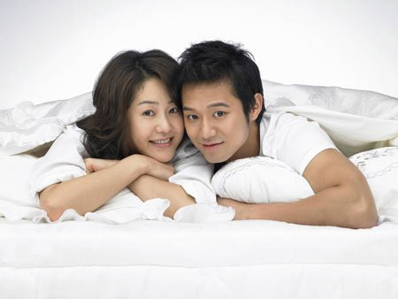
FUN TIPS for MARRIED COUPLES
给夫妻的有趣建议

Slide 3
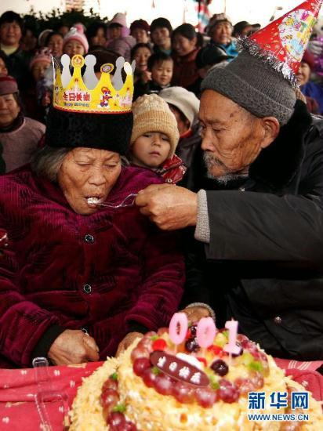
找机会一起庆祝(生日, 结婚纪念日,特殊日子, 节假日等.)
Find events to celebrate. (birthdays, anniversaries, special days, holidays, etc.)

Slide 4
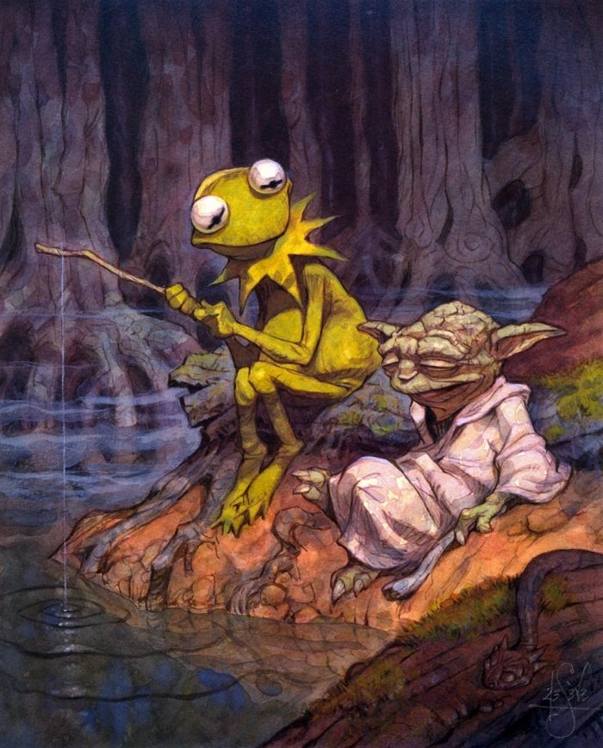
去钓鱼
或 只一起
说说话 go fishing
& just talk

Slide 5

给某个朋友看孩子 babysit together for a friend

Slide 6
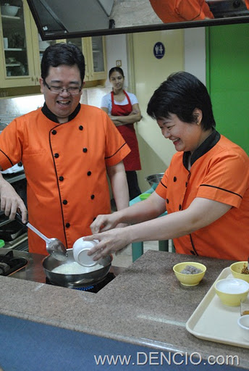
一起学
点什么
新东西
Take a fun class together

Slide 7
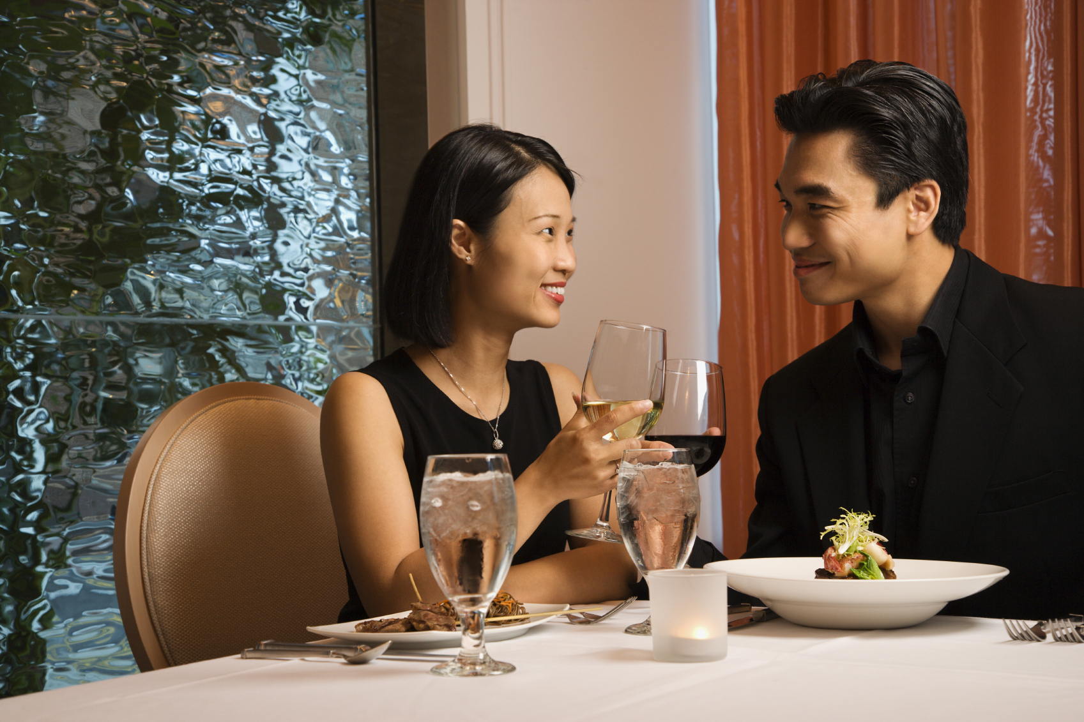
每周 单独
约会
一次
Have a
DATE NIGHT once a week

Slide 8
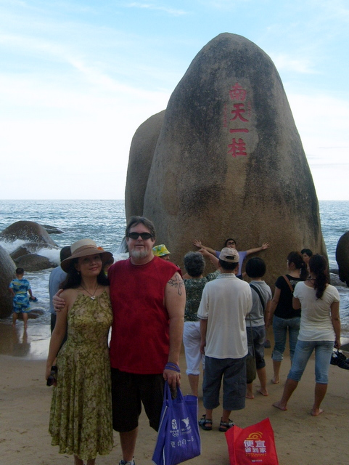
不带孩子和家人外出 度几天假
Get away for a few days without kids or family.

Slide 9

存一笔旅游基金,有一天一起去一个你们俩都梦想的地方
Start a savings account for a trip you both want to take someday

Slide 10
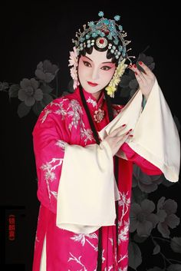
文化之夜
去参观博物馆，看音乐会，歌剧或芭蕾。
CULTURE NIGHT
Go to an art museum, concert, opera or ballet.

Slide 11
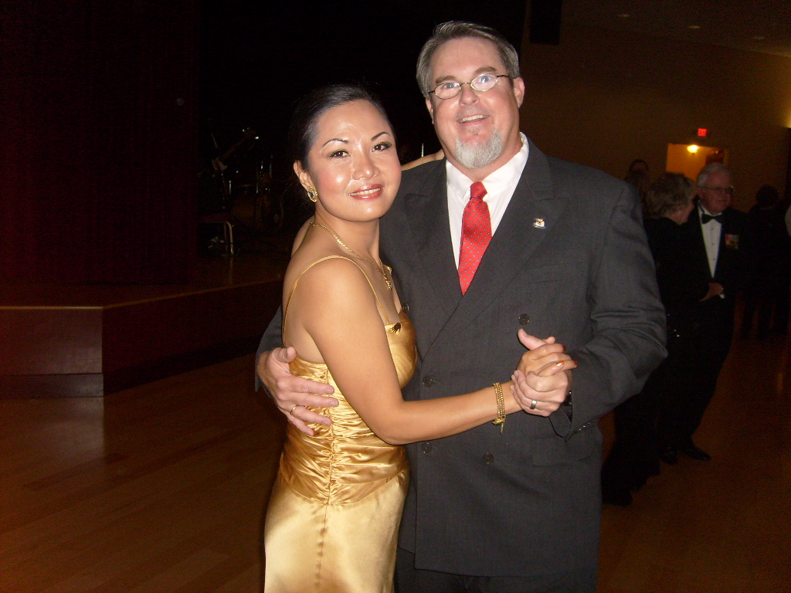
跳舞
月夜河边翩翩起舞
DANCE
(by the river in the moonlight?)

Slide 12
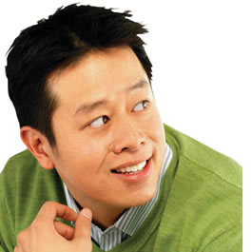
那是美国男人的做法… 我们中国男人不习惯这一套!
That’s for American men… Chinese men don’t do that!

Slide 13
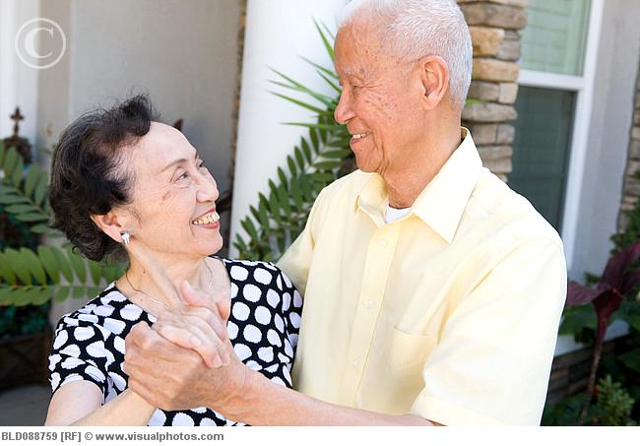

Slide 14
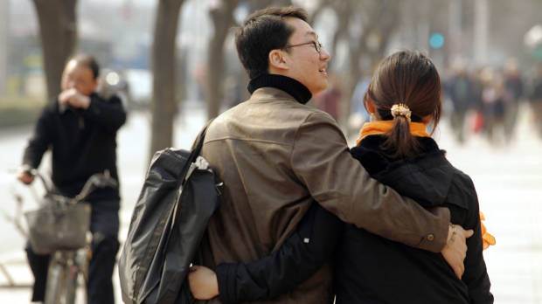
到一新的地方散步
TAKE A WALK SOMEWHERE NEW

Slide 15
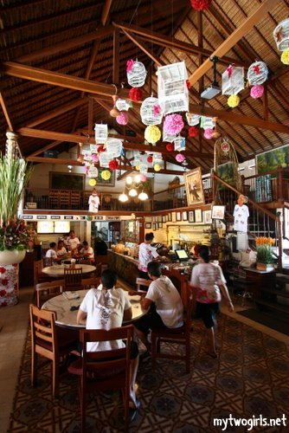
外出去 一个从未去过餐厅 用餐
DINE OUT at a place you have never tried

Slide 16

给彼此做做按摩
GIVE EACH OTHER A MASSAGE

Slide 17
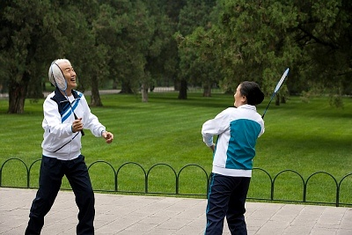
一起玩网球、乒乓球、 羽毛球和高尔夫球比赛
Play a game of tennis, ping-pong, badminton or golf.

Slide 18
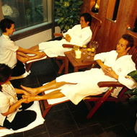
在水疗馆里度过一天
ENJOY a day at the SPA

Slide 19
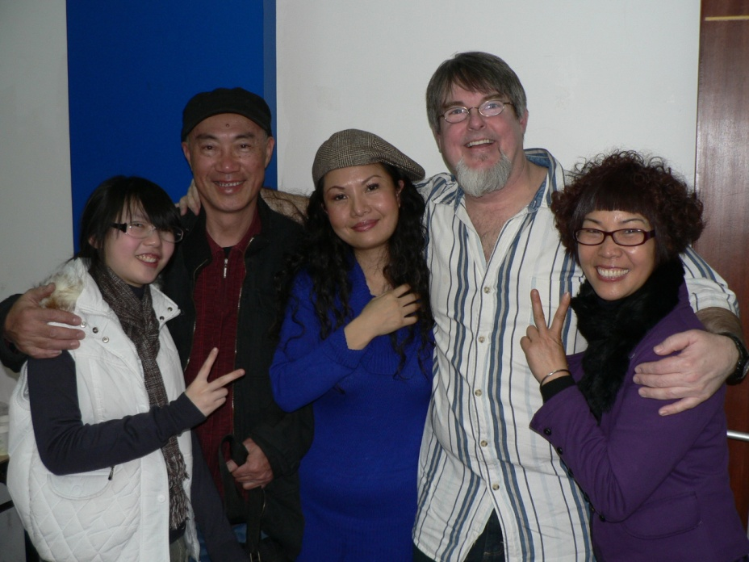
一起去看一个很久不见的老朋友
Visit old friends together you haven’t seen in a while

Slide 20

一起玩一个你们孩子玩过的游戏
Try playing one of your kid’s video games together

Slide 21

订一个 “遗愿清单”
(在离世前你们想一起做
的事情)
Make a “bucket list”
(Things you want to do together before you die)

Slide 22

在一起看一遍儿童时最喜欢的电影
Watch your favorite childhood movies again together

Slide 23

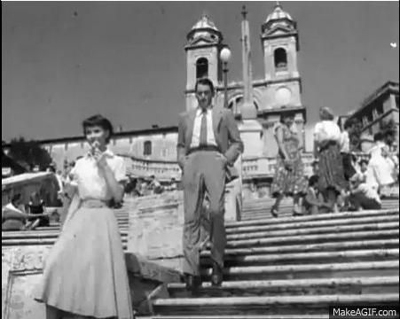
一起观看一部经典电影
Watch an old classic movie together

Slide 24

给床换边
Change sides in the bed

Slide 25

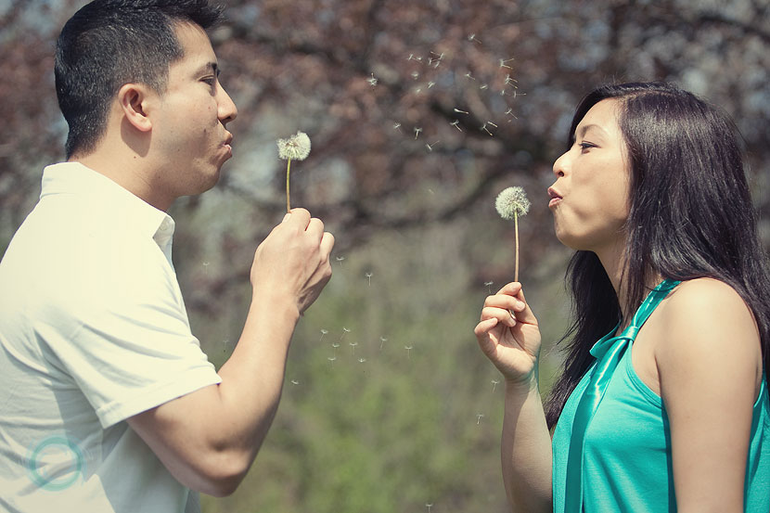
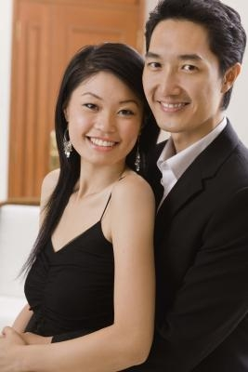
拍一些新的照片
HAVE SOME NEW PICTURES TAKEN

Slide 26
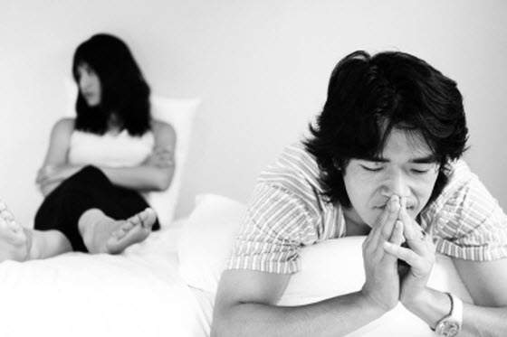
询问对方哪些方面你可
以改变让对方更幸福
Ask them what you can change to make them happier.

Slide 27

一起翻阅你们的老相册
Look through all of your old photo albums

Slide 28

谈谈你们的童年(朋友,宠物,学校,苦难,假期等)
Discuss your childhoods
(Friends, pets, schools, hardships, vacations, etc.)

Slide 29

依偎着一起看电影
Cuddle while watching a movie

Slide 30
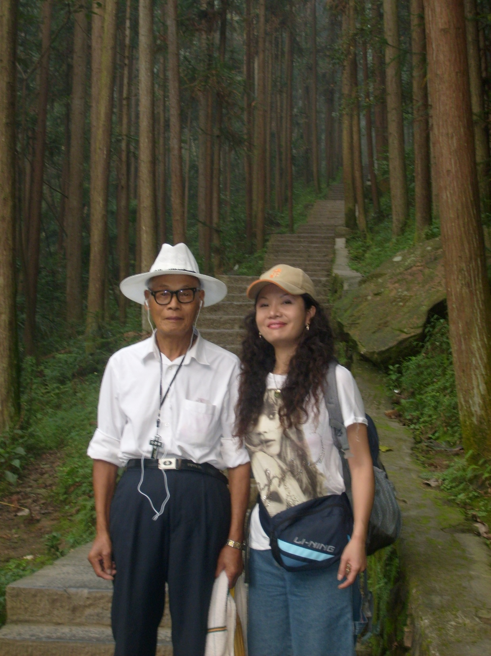
带你们的父母去一个他们想去的地方
Bring your parents somewhere they always wanted to go

Slide 31
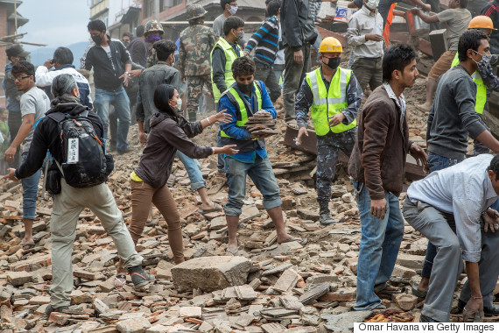
一起参加一个赈灾项目
Do a Service Relief Project Together

Slide 32
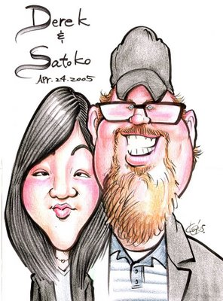
去让人画一幅肖像漫画
Have
Caricatures made

Slide 33
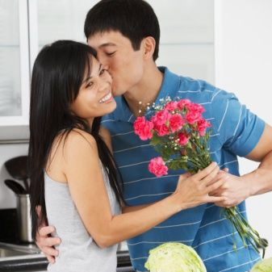
每天都用不同的方式说: “我爱你.”
Say “I LOVE YOU” in a different way
EVERY DAY

Slide 34

推荐电影: 消防员
Recommended Movie: FIREPROOF

