Slide 1
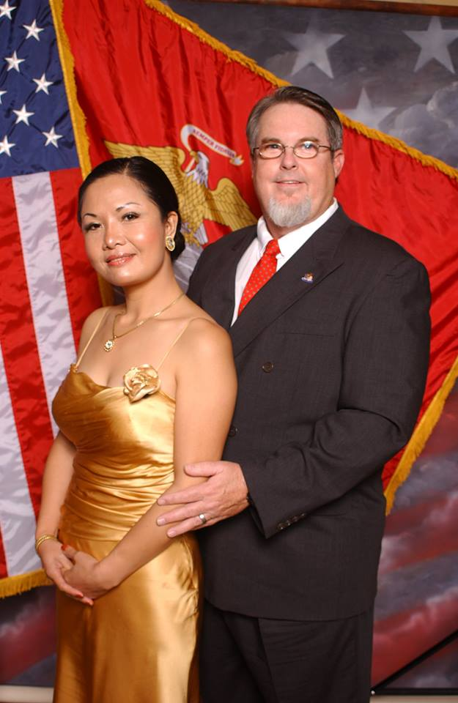
Maximize Your
Marriage

Slide 2

Key elements to a fun marriage…
  Commitment
  Time together
  Friendship
  Romance
  And yes… dating.

Slide 3

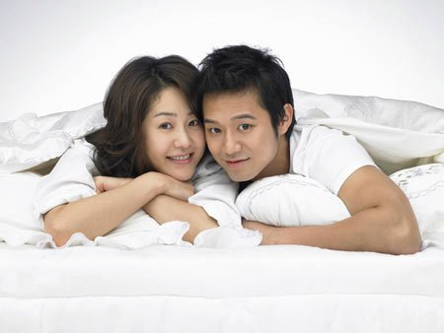
FUN DATING TIPS for
MARRIED COUPLES

Slide 4

Find events to celebrate.
(birthdays, anniversaries, special days, holidays, etc.)

Slide 5
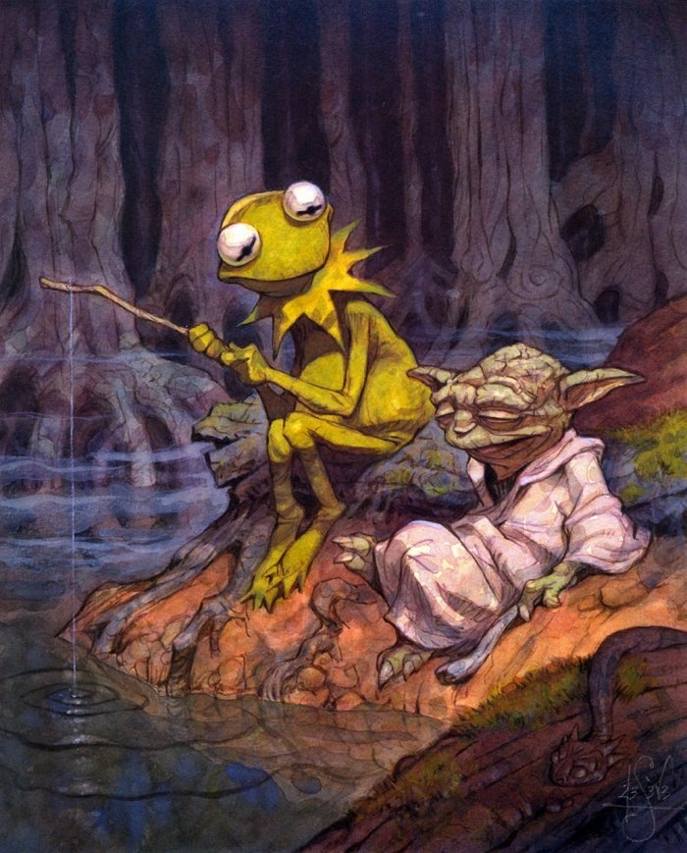
go fishing
& just talk

Slide 6

babysit together for a friend

Slide 7

Take a fun class together

Slide 8
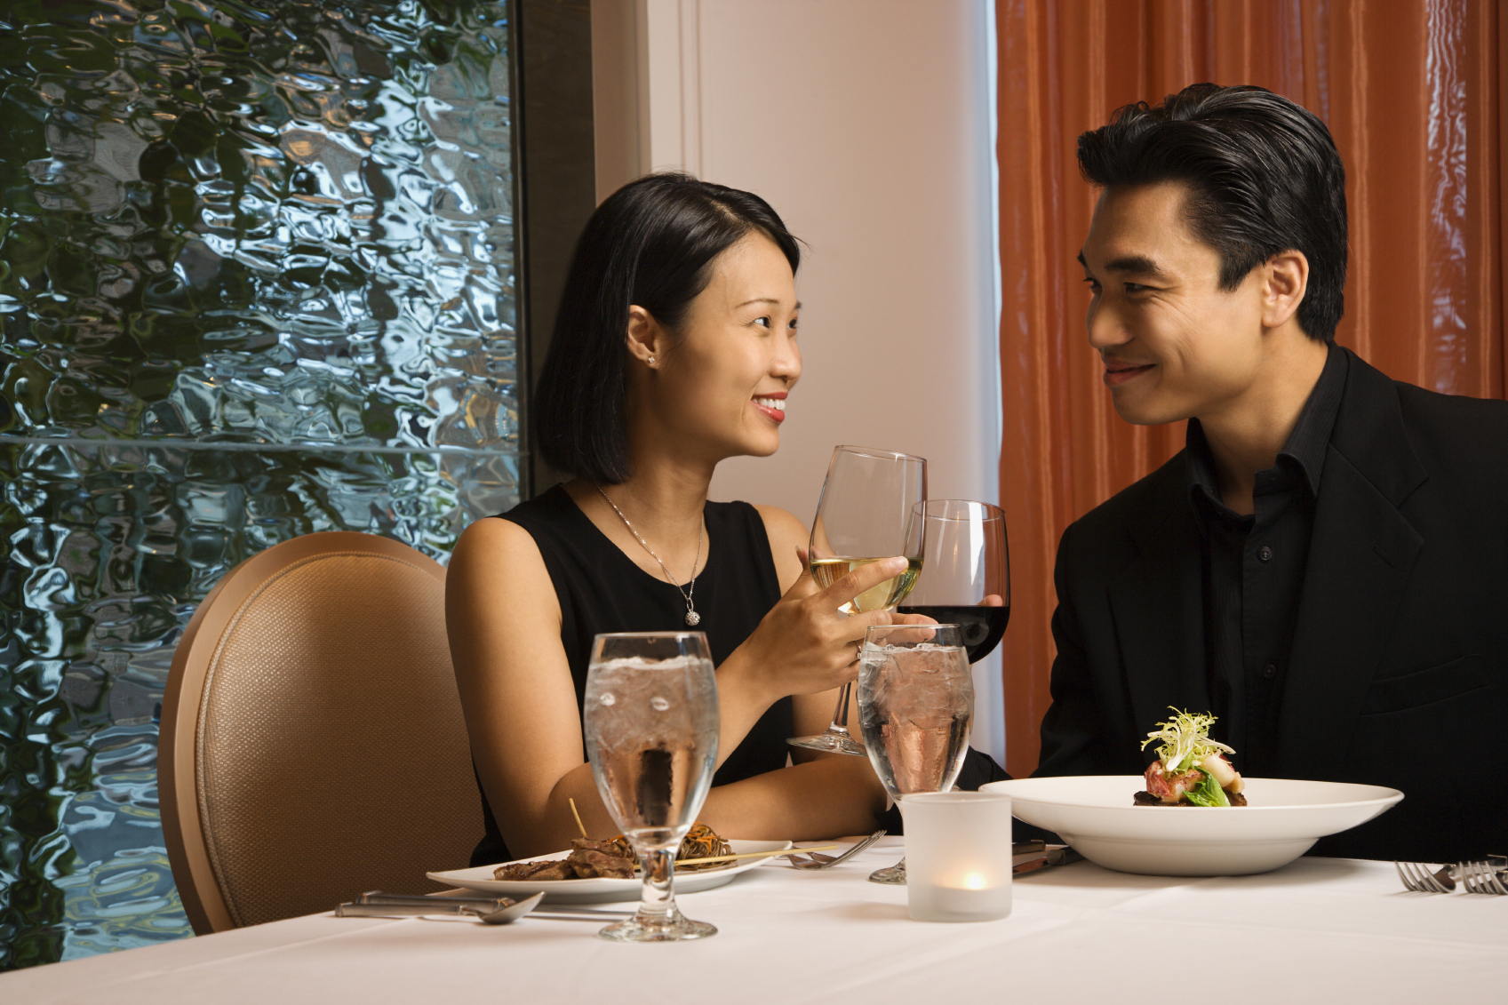
Have a
DATE NIGHT once a week

Slide 9
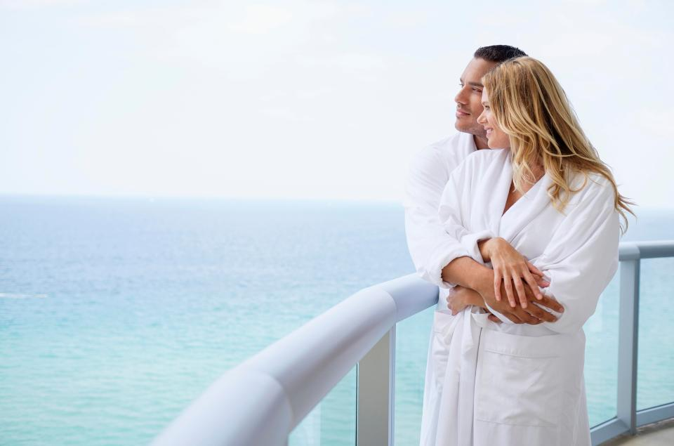
Get away for a few days without kids or family.

Slide 10

Start a savings account for a trip you both want to take someday

Slide 11
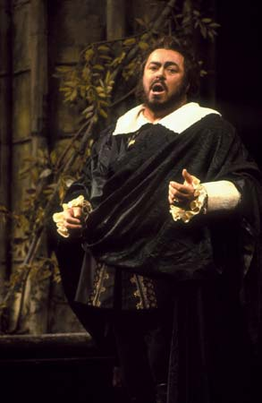
CULTURE NIGHT
Go to an art museum, concert, opera or ballet.

Slide 12
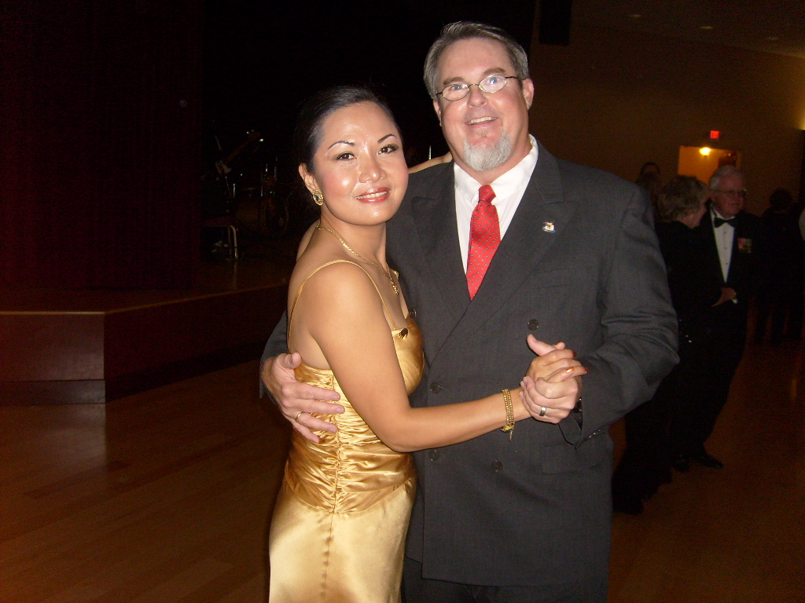
DANCE

Slide 13
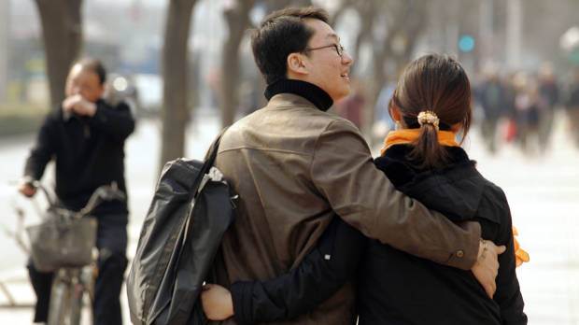
TAKE A WALK SOMEWHERE NEW

Slide 14
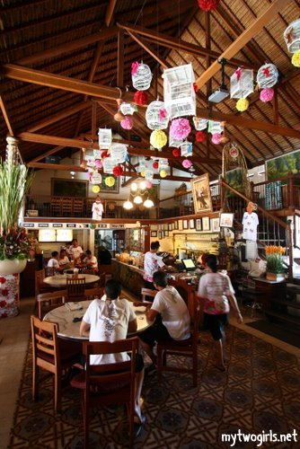
DINE OUT at a place you have never tried

Slide 15

GIVE EACH OTHER A MASSAGE

Slide 16
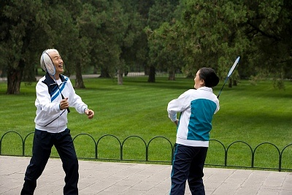
Play a game of tennis, ping-pong, badminton or golf.

Slide 17

ENJOY a day at the SPA

Slide 18
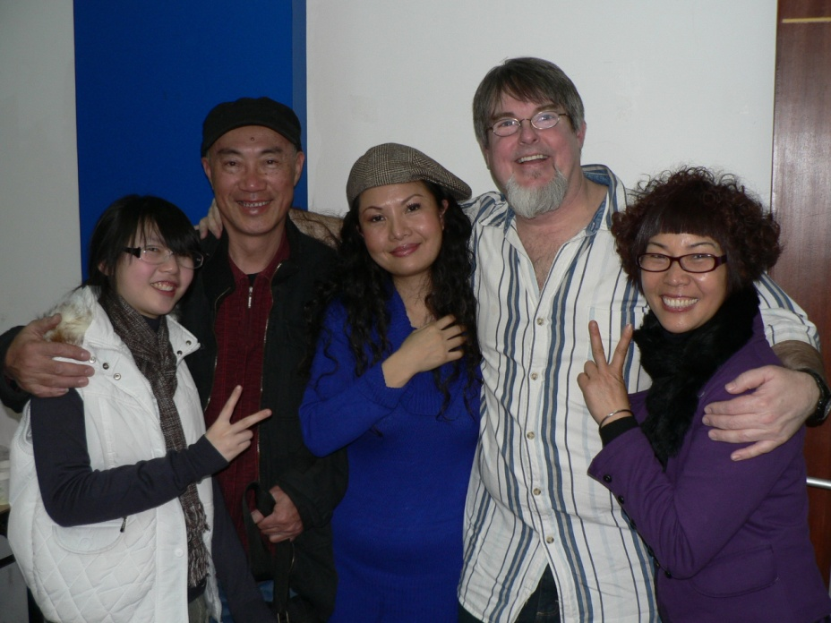
Visit old friends together you haven’t seen in a while

Slide 19

Try playing one of your kid’s video games together

Slide 20

Make a “bucket list”
(Things you want to do together before you die)

Slide 21
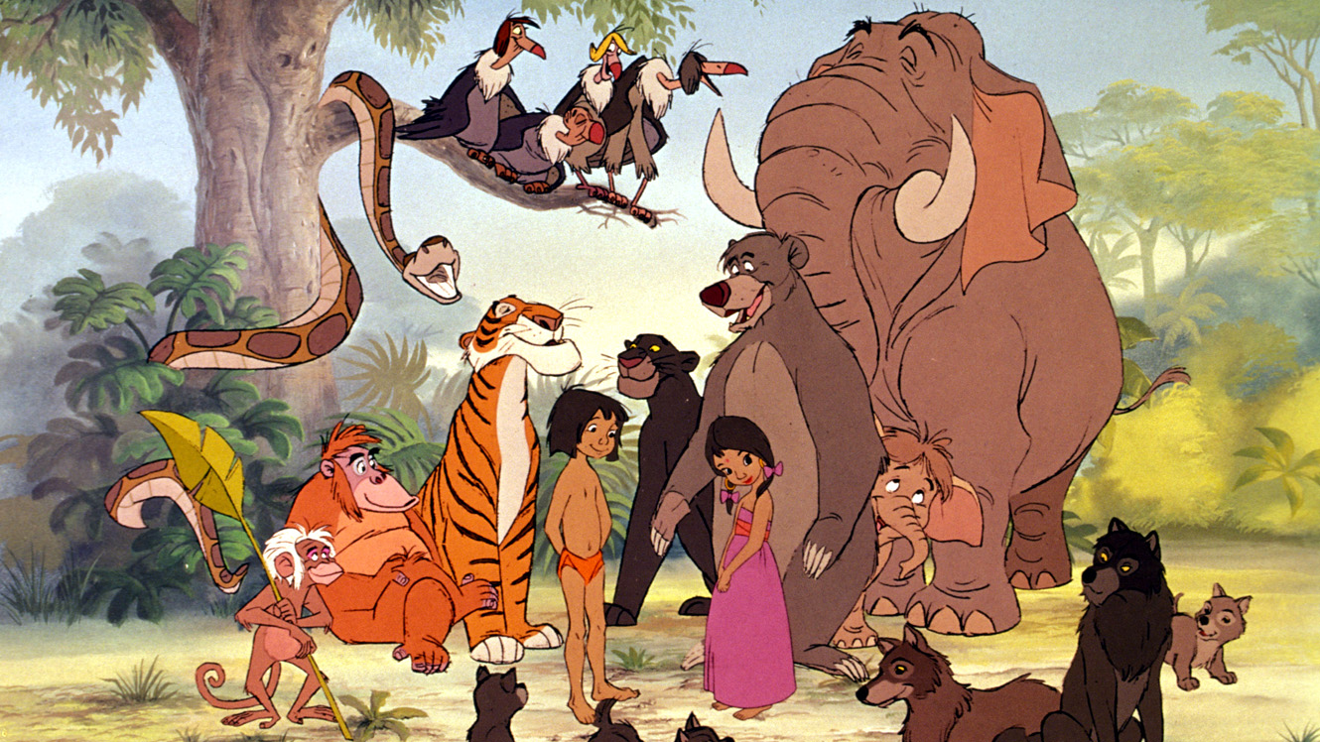
Watch your favorite childhood movies again together

Slide 22

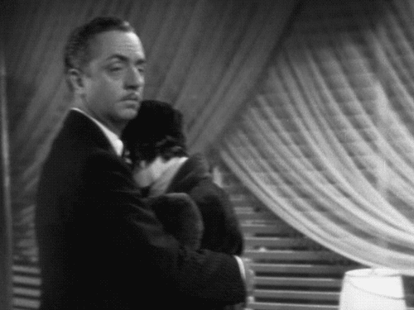
Watch an old classic movie together

Slide 23

Change sides in the bed

Slide 24


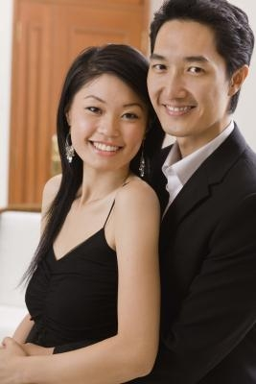
HAVE SOME NEW PICTURES TAKEN

Slide 25

Ask them what you can change to make them happier.

Slide 26

Look through all of your old photo albums

Slide 27

Discuss your childhoods
(Friends, pets, schools, hardships, vacations, etc.)

Slide 28

Cuddle while watching a movie

Slide 29

Bring your parents somewhere they always wanted to go.

Slide 30

Do a Service Relief Project Together

Slide 31

Have
Caricatures made

Slide 32
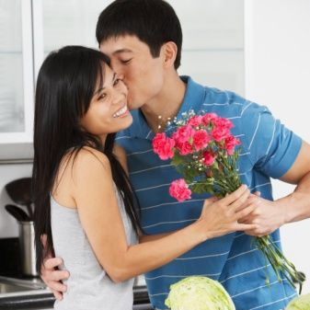
Say
“I LOVE YOU” in a different way
EVERY DAY

Slide 33

Recommended Movie:

Slide 34
HAVE FUN

