Slide 1
JESUS NATIVITY

Slide 2
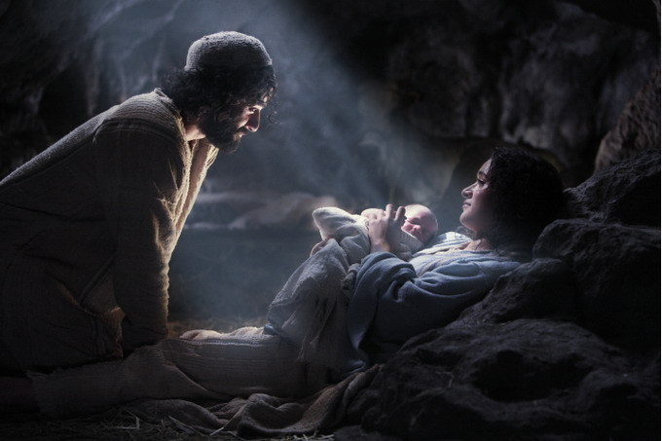
“NATIVITY”
The TRUE Story of the BIRTH OF JESUS

Slide 3
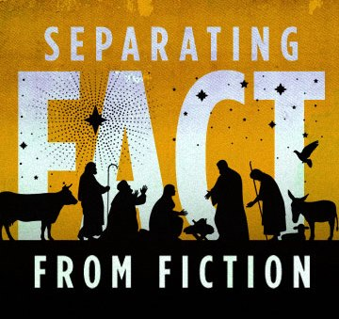
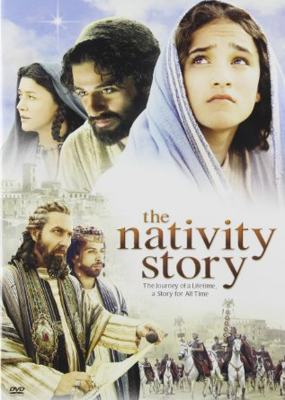
Billions of people in the world today celebrate Christmas. Some as the birth of Christ, some as a seasonal holiday. It can be a bit confusing.
The story of the birth of Jesus has been changed a bit over the years in order to make the story easier to tell and fit into a 2 hour movie.
Today we want to clarify a few of the details surrounding the nativity… one of the greatest events in the history of mankind.

Slide 4
WHAT DOES THE WORD “NATIVITY” MEAN?
Birth
Birth with reference to place (i.e.: of Irish nativity)
The birth of Christ
The church festival commemorating the birth of Christ (Christmas)

Slide 5
LUKE: The Gospel Writer
Luke was a Gentile doctor and historian
He was commissioned by a person known as Theophilus to carefully examine the details of the life of Christ and the early church, interviewing eye witnesses, and to write an accurate account in a two volume set of history books
These 2 Books are known as Luke & Acts in the Bible
Luke accompanied Paul on some of his journeys and questioned Jesus’ family

Slide 6
The purpose of Luke’s Gospel was to once and for all separate fact from fiction regarding the events in the life of Jesus.
“Many have undertaken to draw up an account of the things that have been fulfilled among us, just as they were handed down to us by those who from the first were eyewitnesses and servants of the Word. With this in mind, since I myself have carefully investigated everything from the beginning, I too decided to write an orderly account for you, most excellent Theophilus, so that you may know the certainty of the things you have been taught.” - Luke 1:1-4

Slide 7
Luke 1: 26-38 “The 1st Announcement”

Slide 8
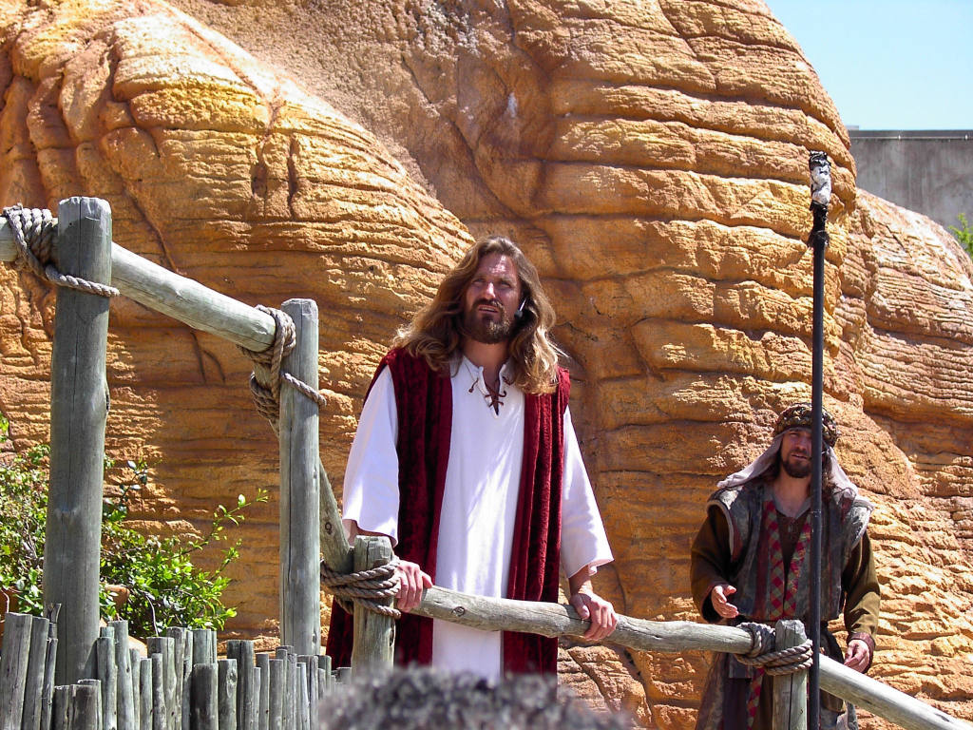
“In the sixth month, God sent the angel Gabriel to Nazareth, a town in Galilee“

Slide 9
The SIXTH MONTH
Possibility 1: 6th month of the Jewish Calendar Elul.
Possibility 2: 6th month of Elizabeth’s pregnancy.
Possibility 3: 6th lunar month according to the Syro- Macedonian calendar
Instituted by Alexander the Great 300 years prior.
This calendar was the standard for dating throughout the Middle East for many centuries.
In 5 BCE the sixth lunar month of Xanthikos was from March 10 to April 7.
The middle of that month was about March 25, 5 BCE, the traditional date for the Annunciation.

Slide 10
GABRIEL the ANGEL
FANTASY:
In Islam, Gabriel is the angel who revealed the Qur'an to the Prophet Mohammed
The Ethiopian Church celebrates his feast on Dec. 28 with believers making a pilgrimage to a church dedicated to "Saint Gabriel" in Kulubi on that day.
In Mormonism, Gabriel is believed to have lived a mortal life as the prophet Noah.
In Christianity, he is often picture as effeminate with wings and a halo.
FACT: Gabriel was an angelic messenger of the Lord.
No wings or halo. He would resemble a warrior.
He usually began his message with “Fear not”

Slide 11
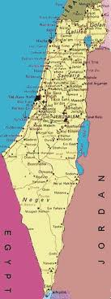
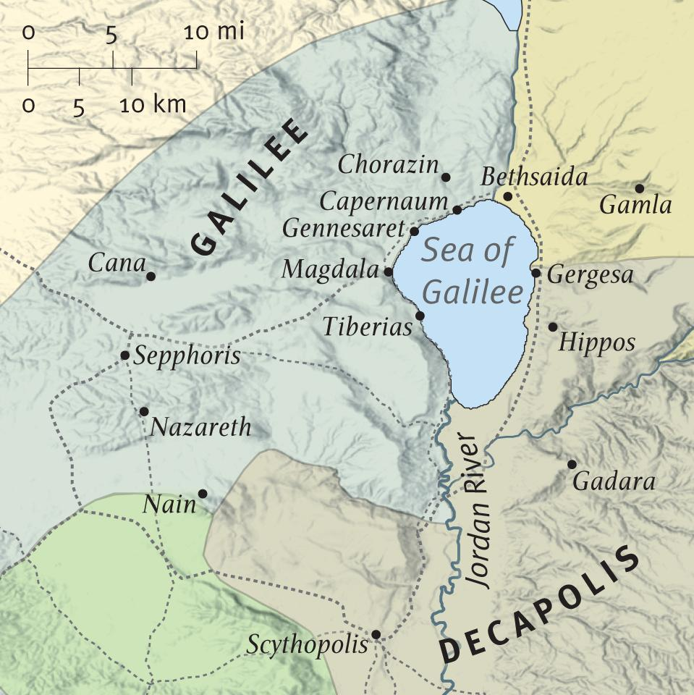
NAZARETH in GALILEE

Slide 12
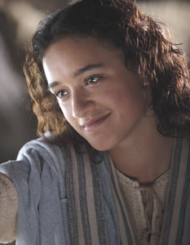
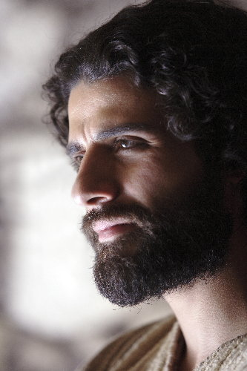
“…to a virgin pledged to be married to a man named Joseph, a descendant of David.”

Slide 13
VIRGIN
“to a virgin pledged to be married to a man named Joseph, a descendant of David.”
O.T. Heb. almah: “young woman of child bearing age”
N.T. Greek. parthenos: “virgin”
Mary claimed “I have known no man” (Lk 1:34)
Gabriel told Joseph that Mary was a virgin (Mt 1:18-25)
Luke identifies Mary as a virgin (1:26-38)
Why did Mary have to be a virgin?
“Seed of a woman”; “Son of the Most High”;
Tradition and Jewish studies tell us Mary was approx. 13 years old hen she gave birth to Jesus.

Slide 14
The MARRIAGE PLEDGE
“to a virgin pledged to be married to a man named Joseph”
Rabbinical writings show 2 stages in Hebrew marriage
The Kiddushin was legally binding and could only be dissolved through divorce or death.
The parties were even called husband and wife
Parents often arranged the marriages
Christians are called ‘the Bride of Christ’
We are in the Kiddushin period and will experience the Huppa at the Wedding feast of the Lamb.
STAGE ONE
The KIDDUSHIN
aka: Betrothal Period
Normally 12 Months
STAGE TWO
The HUPPA
aka: The Marriage Feast
Normally 7 Days

Slide 15
JOSEPH
“to a virgin pledged to be married
to a man named Joseph”
Father’s name was Jacob.
Joseph was the husband of Mary but not the biological father of Jesus.
Joseph was a “tekton” (stoneworker; craftsman; general contractor; ship builder; poet; carpenter)
Joseph is not mentioned as being around when Jesus began His public ministry. He is conspicuous by His absence. Most agree that he had died before the time Jesus revealed Himself to the world. We know nothing of the circumstances surrounding his death.

Slide 16
DAVID’S DESCENDENTS
“to a virgin pledged to be married to a man named Joseph, a descendant of David.”
17 verses in the N.T. say Jesus is the "son of David.”
Jesus was the promised Messiah, which meant He was of the seed of David.
Matthew 1 gives the genealogical proof that Jesus was a direct descendant of David through Joseph, giving Jesus legal right to the throne through His father by adoption.
Luke 3 gives the genealogical proof that Jesus was a direct descendant of Mary with a birthright to the throne through blood lineage.

Slide 17
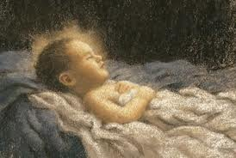
DAVID’S DESCENDENTS
ADAM
ABRAHAM
DAVID
SOLOMON
NATHAN
JOSEPH
MARY
Gospel of Matthew
LEGAL RECORD of Jesus Royal lineage
Gospel of Luke
NATURAL RECORD of Jesus Royal lineage

Slide 18
“The virgin’s name was Mary”

Slide 19
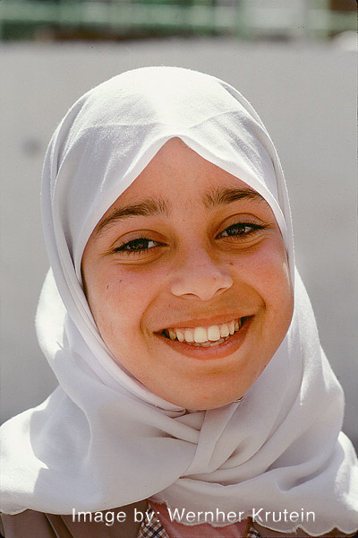
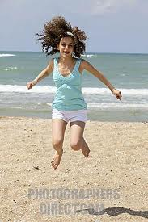
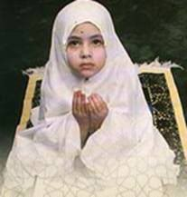
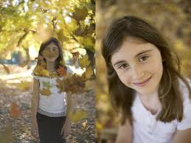
MARY
Daughter of Heli and Anna
Cousin to Elizabeth (mother of John the Baptist)
Engaged to Joseph; not married yet.
Young teenage girl (12-15); virgin
Godly, faith filled young lady from a godly family.
Villager; peasant girl; illiterate; hard working;
Girls from Israel age 12 - 14

Slide 20
“The angel went to her and said, “Greetings, you who are highly favored! The Lord is with you.”

Slide 21
The GREETING
Gabriel met her where she was
Strange men didn’t talk to young women
“Greetings” (chairo: “Rejoice! Be glad!”)
“You who are highly favored” (charitoo: to be given honor, grace, blessings, favor)
“The Lord is with you” (kyrios meta sou: “the King, Master, Messiah, God, is beside and behind you”)
“Rejoice, Mary! You have been chosen by the Master to receive a gracious blessing! He is here right beside you!”

Slide 22
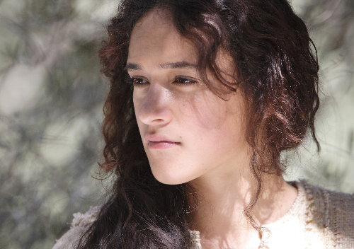
“Mary was greatly troubled at his words and wondered what kind of greeting this might be.

Slide 23
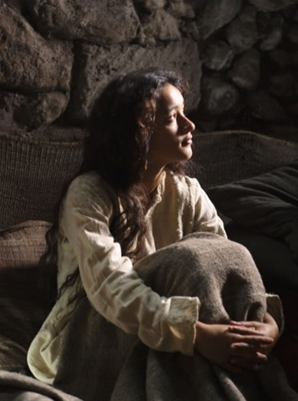
“But the angel said to her, “Do not be afraid, Mary, you have found favor with God. You will be with child and give birth to a son, and you are to give Him the name Jesus. He will be great and will be called the Son of the Most High. The Lord God will give Him the throne of His father David,”

Slide 24
“and He will reign over the house of Jacob forever; His kingdom will never end.”

Slide 25
The ANNUNCIATION
“Don’t be afraid” (phobeo: fear that makes you want to run away; struck with fear; seized with alarm)
“you have found favor with God” (charis: grace; undeserved favor or mercy; given by God) Repeats the phrase,
“You will be with child and give birth to a son” (imagine the thoughts of Mary at this proclamation)
“and you are to give Him the name Jesus” (“Jehovah is Salvation”)
“He will be great” (megas: big; important; highly esteemed)
“and will be called the Son of the Most High. The Lord God will give Him the throne of His father David” (Your son will be the Messiah)

Slide 26
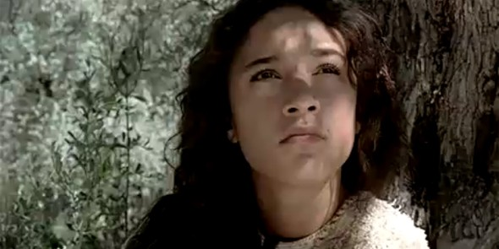
“How will this be,” Mary asked the angel,
“since I am a virgin?”

Slide 27
IS THE VIRGIN BIRTH IMPORTANT?
FALSE SCHOLARS
Harry Fosdick (pastor of the influential N.Y. Riverside Church) “I do not believe in the virgin birth and I hope none of you do”
Bishop Sprague (United Methodist Church) “a myth”
John Spong (Episcopalian Bishop) “In time, the virgin birth account will join Adam and Eve and the story of the cosmic ascension as clearly recognized mythical elements in our faith tradition whose purpose was not to describe a literal event.”
Theologian Raymond Brown calls it “folkloric”
Theologian Wolfhart Pannenberg “archeological legend”
TRUE = “The greatest and most monumental fact which the history of the world records is the fact of Jesus’ birth.” - Charles Haddon Spurgeon

Slide 28
“Those who reject the virgin birth, must reject the role of the Holy Spirit in the birth of Christ, must reject the spiritual nature of Christ’s birth, must reject Luke’s claim that he was writing truth from carefully examined eyewitnesses… in short, they must reject Christ Himself”
-Jay BarLeon

Slide 29
“The angel answered, ‘The Holy Spirit will come upon you, and the power of the Most High will overshadow you, so the Holy One to be born will be called the Son of God.’”

Slide 30
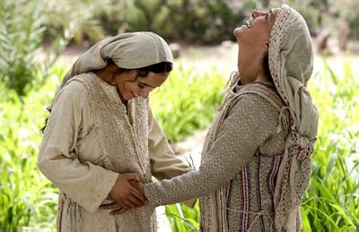
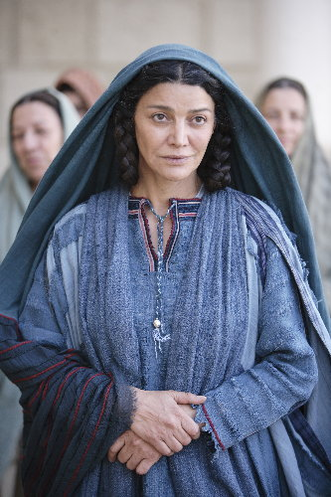
“Even Elizabeth your relative is going to have a child in her old age, and she who was said to be barren is in her sixth month. For nothing is impossible with God.”

Slide 31
“I am the Lord’s servant,” Mary answered. “May it be to me as you have said.”
“Then the angel left her.”

Slide 32
Matthew 1:18-25 “The 2nd Announcement”

Slide 33
“This is how the birth of Jesus Christ came about”

Slide 34
“His mother Mary was pledged to be married to Joseph; “but before they came together, she was found to be with child through the Holy Spirit.”

Slide 35
UNMARRIED PREGNANCY in the Times of Jesus
“before they came together” (before they had intercourse)
The cost of unmarried pregnancy was more than just a stigma for girls that were already ‘betrothed’
It was considered adultery and accountable to the laws
Joseph had 4 OPTIONS when he learned Mary was pregnant
Marry her quickly and try to hide the pregnancy
Marry her while suffering public shame and ridicule
Divorce her and send her away from the village
Have her publically stoned to death for adultery

Slide 36
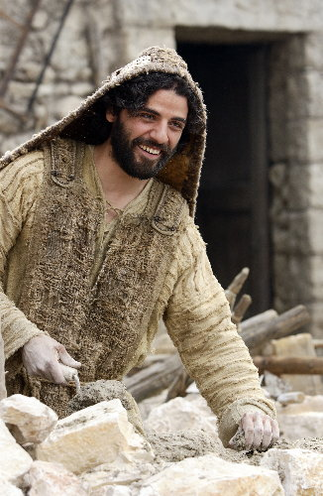
“Because Joseph her husband was a righteous man and did not want to expose her to public disgrace, he had in mind to divorce her quietly.”

Slide 37
JOSEPH’S CHOICE
JOSEPH CHOSE THE THIRD OPTION
Marry her quickly and try to hide the pregnancy
Marry her while suffering public shame and ridicule
Divorce her and send her away from the village
Have her publically stoned to death for adultery
He made this choice for 2 reasons…
He was a righteous man (wanted to do what was right)
He did not want her to experience public disgrace
Notice… Joseph is called ‘her husband’
Do you think Joseph struggled between his desire to keep Old Testament laws and his love for his wife?
AFTER the angel spoke to Joseph, he chose option #2: Marry her while suffering public shame and ridicule

Slide 38
“But after he had considered this, an angel of the Lord appeared to him in a dream and said, "Joseph son of David, do not be afraid to take Mary home as your wife, because what is conceived in her is from the Holy Spirit.”

Slide 39
“She will give birth to a son…”

Slide 40
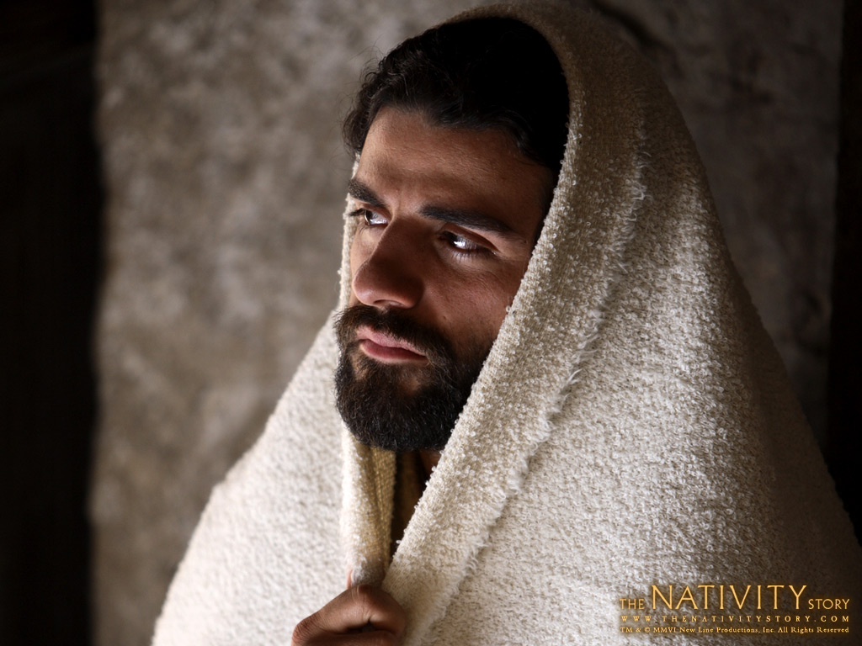
“...and you are to give Him the name Jesus, (YHWH SAVES) because He will save His people from their sins”

Slide 41
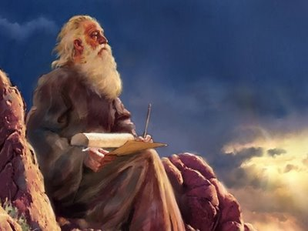
“All this took place to fulfill what the Lord had said through the prophet (Isaiah)
"The virgin will be with child and will give birth to a son, and they will call Him Immanuel"--which means, "God with us.“

Slide 42
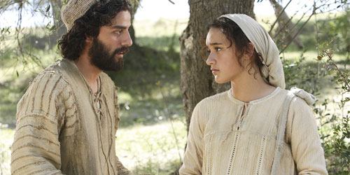
“When Joseph woke up, he did what the angel of the Lord had commanded him and took Mary home as his wife. But he had no union with her until she gave birth to a son. And he gave him the name Jesus.”

Slide 43
JOSEPH’S OBEDIENCE
Joseph also had his life planed out (Marry Mary, have babies, work hard, provide for kids, die old & happy)
When Joseph had the dream, he immediately surrendered to God’s plans and gave up his own.
He understood the extent of the rejection and abuse he would have to endure.
His knowledge of the coming Messiah was limited;
No N.T. or even O.T. for guidance. Just limited teaching.
WOULD YOU BE AS WILLING TO RELEASE ALL OF YOUR LIFE’S PLANS AND INVITERIDICULE, SCORN, FINANCIAL LOSS, ETC. IF GOD ASKED IT OF YOU TODAY?

Slide 44
THE 4 PART JEWISH WEDDING
THE BETROTHAL:
The young man prepared a Ketubah (marriage covenant) which he presented to the intended bride and her father.
This included the " Bride Price“ to compensate the young woman's parents for the cost of raising her, as well as being an expression of his love for her.
THE ACCEPTANCE:
The young man would pour a cup of wine for his beloved and wait to see if she drank. This cup represents a blood covenant.
If she drank the cup she has accepted the proposal and they would be betrothed.
The young man would then give gifts to his beloved, and leave.
The young woman would have to wait for him to return & collect her.

Slide 45
THE 4 PART JEWISH WEDDING
3. THE WEDDING CHAMBER AND THE CHUPPAH:
Before leaving the young man would announce, " I am going to prepare a place for you ", and "I will return for you when it is ready".
The usual practice was for the young man to return to his father's house and build a honeymoon room there. This is what is symbolized by the chuppah or canopy which is characteristic of Jewish weddings.
He had to get his father's approval before he could consider it ready for his bride. If asked the date of his wedding he would have to reply, "Only my father knows."
Meanwhile the bride would be making herself ready so that she would be pure and beautiful for her bridegroom.
During this time she would wear a veil when she went out to show she was spoken for (she has been bought with a price)

Slide 46
THE 4 PART JEWISH WEDDING
4. THE WEDDING:
When the wedding chamber was ready the bridegroom could collect his bride. He could do this at any time so the bride would keep a lamp, her veil and her other things beside her bed.
Her bridesmaids were also waiting and had to have oil ready for their lamps.
When the groom and his friends got close to the bride's house they would give a shout and blow a shofar to let her know to be ready.
When the wedding party arrived at father's house the newly weds went into the wedding chamber. (This could occur before or after the 7 day party).
The best man stood outside waiting for the groom to tell him that the marriage had been consummated.
Then all the friends really started celebrating for the seven days that the couple were honeymooning.
When the couple emerged there would be much congratulation and the Marriage Supper could begin.

Slide 47
OUR WEDDING TO CHRIST
THE BETROTHAL:
We have entered into a Ketubah (marriage covenant) with Jesus.
Jesus has already paid the Bride price; His blood..
THE ACCEPTANCE:
Jesus poured out the cup of His blood; we accepted it.
Jesus gave us the gift of His Holy Spirit and He left.
We are anxiously awaiting the return of our Groom.
3. THE WEDDING CHAMBER AND THE CHUPPAH:
Jesus said He is preparing a place and will return for us.
Jesus said "Only my father knows the day of My return."
We are to be making ourselves ready for His return.
We wear a veil of purity to show we are the Bride of Christ.
4. THE WEDDING:
Jesus could come at any time to collect His bride so we must be ready..
Jesus will blow the shofar upon His return to collect His Bride.
We will celebrate the Marriage of the Lamb and the Wedding Feast.

Slide 48
Luke 1:39-56 “The VISIT”

Slide 49
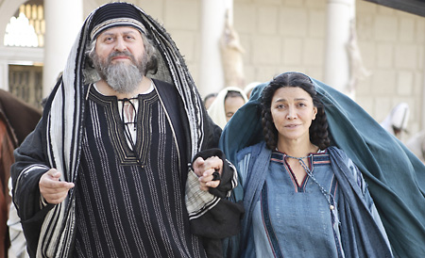
“At that time Mary got ready and hurried to a town in the hill country of Judea where she entered Zechariah’s home and greeted Elizabeth”

Slide 50
HILL COUNTRY OF JUDEA
Mary’s visit to see Elizabeth & Zechariah
Travelers do not go through Samaria
The 80 – 100 mile trip would take about a week on foot or several days if traveling with a caravan.
V. 39 says “She hurried to…”

Slide 51
ZECHARIAH
Zechariah means "God has remembered"
Husband to Elizabeth (Cousin of Mary)
Eventually became the father of John the Baptist when a senior.
He was “upright in the sight of God, observing all the Lord's commandments and regulations blamelessly." (1:6)
A priest of the division of Abijah (1Chr 24:10) a descendant of Aaron (via Eleazar); chief of one of the 24 orders of the priesthood divided by David (1 Chr. 24:10).
Elizabeth is also descended from Aaron
This was Zechariah’s year to serve in the temple by performing the incense offering. (Lk 1:8-11)
Zechariah was visited by an angel, experienced miraculous taking and restoration of his voice, and given instruction by God.

Slide 52
ELIZABETH (Reminder)
Her name means "God is my oath" or "dedicated to God".
She lived in a city in the hill country of Judea.
She was "from the daughters of Aaron" (Luke 1:5).
She was married to Zechariah ("God has remembered"), an upright man and an Aaronic priest of the division of Abijah (1Chr 24:10).
Although Elizabeth was barren (& too old to have children) she was 6 months pregnant with John the Baptist when Gabriel appeared to Mary. (1:7)
This is known as a ‘secondary’ or ‘reconfirmation’ sign
Kept her pregnancy hidden for 5 months (Luke 1)
Elizabeth was “upright in the sight of God, observing all the Lord's commandments and regulations blamelessly." (1:6)
She was filled with the Holy Spirit (1:41)

Slide 53
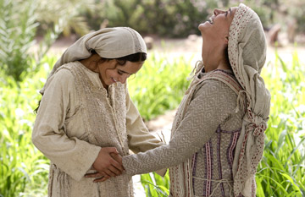
“When Elizabeth heard Mary’s greeting, the baby leaped in her womb, and Elizabeth was filled with the Holy Spirit.”

Slide 54
BABIES IN THE WOMB…(v.41)
Those in the womb are BABIES, not fetal tissue (“The baby within me”)
Can have emotion (“leaped for joy”)
Are designed by God regardless of disabilities
“You formed my inward parts; you knitted me together in my mother’s womb.” –Psalm 139:13)
“The Lord said to him, "Who gave man his mouth? Who makes him deaf or mute? Who gives him sight or makes him blind? Is it not I, the Lord? –Ex. 4:11)
God’s choice in regards to sex
(“male and female He created them.” - Gen.1:27)
Have a relationship with God
("Before I formed you in the womb I knew you, before you were born I set you apart...“ - Jer. 1:5)
Is a valuable life
(“If men who are fighting hit a pregnant woman and…there is serious injury you are to take life for life.” –Ex. 21:22,23)
Are a reward from the Lord (“The fruit of the womb is a reward.” –Ps. 127:3)

Slide 55
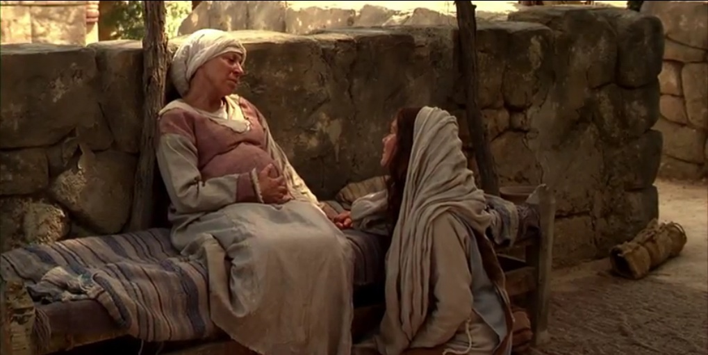
“In a loud voice she exclaimed: “Blessed are you among women, and blessed is the child you will bear! But why am I so favored, that the mother of my Lord should come to me? As soon as the sound of your greeting reached my ears, the baby in my womb leaped for joy. Blessed is she who has believed that the Lord would fulfill his promises to her!”

Slide 56
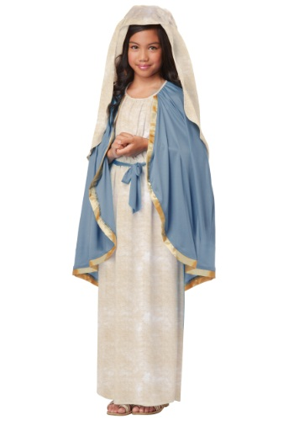
The ELIZABETHAN BLESSING
Mary and Jesus are ‘blessed’
(Happiness resulting from a God’s gift)
Elizabeth questions her worthiness to even have Mary visit
Godly people are more humble and apt to know they’re unworthy
Elizabeth refers to the unborn Jesus as “my Lord”
Blessing comes from believing that God will fulfill His promises

Slide 57
“And Mary said: ‘My soul glorifies the Lord and my spirit rejoices in God my Savior, for He has been mindful of the humble state of His servant. From now on all generations will call me blessed, for the Mighty One has done great things for me— holy is His name. His mercy extends to those who fear Him, from generation to generation. He has performed mighty deeds with His arm; He has scattered those who are proud in their inmost thoughts. He has brought down rulers from their thrones but has lifted up the humble. He has filled the hungry with good things but has sent the rich away empty. He has helped His servant Israel, remembering to be merciful to Abraham and his descendants forever, just as he promised our ancestors.’”

Slide 58
MARY’S MAGNIFICAT
‘My soul glorifies the Lord and my spirit rejoices in God my Savior, for He has been mindful of the humble state of His servant.”
God = glorified; rejoicing in; Savior;
Mary = humble; servant of God
“From now on all generations will call me blessed, for the Mighty One has done great things for me; holy is His name.”
She gives God the glory and receives none.
She recognizes that everyone will see her as having been blessed by God (made happy).

Slide 59
MARY’S MAGNIFICAT
“His mercy extends to those who fear Him, from generation to generation. He has performed mighty deeds with His arm; He has scattered those who are proud in their inmost thoughts. He has brought down rulers from their thrones but has lifted up the humble. He has filled the hungry with good things but has sent the rich away empty. He has helped His servant Israel, remembering to be merciful to Abraham and his descendants forever, just as he promised our ancestors.’”
Notice the rest of the song never mentions Mary
The focus is (as it should be) on God’s mercy, might, power, deeds, omniscience, Kingship, provision, sovereignty, helping, and promises to His children.

Slide 60
“Mary stayed with Elizabeth for about three months and then returned home.”

Slide 61
Luke 2:1-5 “The Decree”

Slide 62
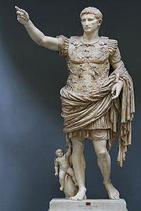
“In those days Caesar Augustus issued a decree that a census should be taken of the entire Roman world.”

Slide 63
THE DATE OF JESUS’ BIRTH
“In those days ….”
It is possible to correlate the N.T. with extra-Biblical sources (Jewish and Greco-Roman documents like Josephus and Tacticus) to estimate a specific date
Two approaches can be used to estimate the year of birth of Jesus, one based on the nativity accounts in the gospels, the other by working backwards from the date of the start of his ministry.
Most scholars assume a date of birth between 6 and 4 BC
Dating must keep in mind the years in offfice of Caesar Augustus, Quirinius, and Herod, & the presence of a temple in Jerusalem, etc.

Slide 64
ISRAEL in the DAYS of JESUS
POPULATION: 1/10 Jews lived in Israel; Gentiles outnumbered Jews
LANGUAGES: Latin = legal; Greek = Lingua Franca; Israel = Hebrew/Aramaic
TRANSPORTATION: poor roads; 4 main highways; donkeys/caravans
COMMERSE: Roads, rivers & sea transport; Alexandrian ships
COMMUNICATION: Town criers; wrote on papyrus & pottery
PUBLIC CONVENIENCES: Village life; synagogues; town squares
HOMES: mud brick; stone; walled cities; bedroom on roof;
FOOD: 2 meals; noon & evening; Fruit, vegies, fish (little meat); reclined to eat
(More detail when we study Church History)

Slide 65
ISRAEL in the DAYS of JESUS
CLOTHES: Tunics; belt, sandals, scarf, (men: medium hair; beard)
SOCIAL CLASSES: Upper class (Priests, Rabbis);
SLAVES: slaves outnumber free men; many skilled and educated
FAMILY: Large; no surnames; “son of” or “of the town…” etc.
MORALS: Pagan temples & perversions; sexual society; Jews contrasted life
ENTERTAINMENT: similar toys and games for kids; parties for adults
BUSINESS: Trade Unions regulated hours; small family shops;
SCIENCE & MEDICINE: Doctors, surgeons, dentists
(More detail when we study Church History)

Slide 66
CAESAR AUGUSTUS
“In those days Caesar Augustus issued a decree…”
Augustus (63 BC –14 AD) was the founder and 1st Emperor of the Roman Empire ruling from 27 BC until his death in 14 AD.
Born into a wealthy branch of the Octavii family, Augustus was adopted posthumously by uncle Julius Caesar following Caesar's assassination.
Augustus restored an apparent free Republic, with power vested in the Roman Senate, the executive magistrates, and the legislative assemblies.
In reality, he retained autocratic power over the Republic as a military dictator.
By law, Augustus held a collection of powers granted to him for life by the Senate, including supreme military command, tribune and censor.
He called himself Princeps Civitatis ("First Citizen").
His reign initiated an era of peace known as the Pax Romana (Roman Peace).

Slide 67
CAESAR AUGUSTUS
Despite wars on the Empire's frontiers and one year-long civil war over the imperial succession, the Mediterranean world remained at peace for more than two centuries.
Augustus dramatically enlarged the Empire, annexing Egypt, Dalmatia, Pannonia, Noricum, and Raetia, expanded possessions in Africa, expanded into Germania, and completed the conquest of Hispania.
He reformed the Roman system of taxation, developed networks of roads with an official courier system, established a standing army, established the Praetorian Guard, created official banks, police and fire-fighting services for Rome, and rebuilt much of the City during his reign.
Augustus died in 14 AD at the age of 75. (Perhaps from natural causes, though there were unconfirmed rumors that his wife Livia poisoned him.)
He was succeeded as Emperor by his adopted son (also stepson and former son-in-law) Tiberius.

Slide 68
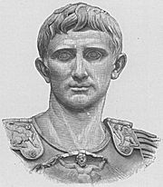
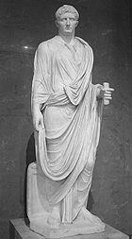
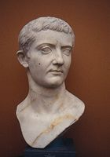
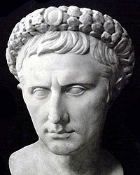
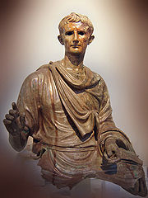
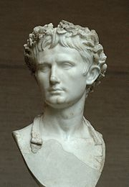
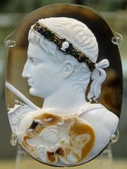
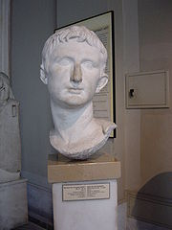
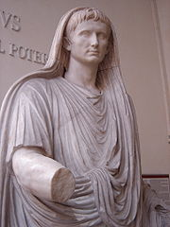
Augustus

Slide 69
TIMELINE
AUGUSTUS (27 BC – 14 AD)
TIBERIUS (14 – 37 AD)
CALIGULA (37-41 AD)
CLAUDIUS (41-54 AD)
NERO (54-68 AD)
VESPACIAN (69-79 AD)
DOMITIAN (81-96 AD)
JESUS
PAUL
JOHN

Slide 70
The ROMAN EMPIRE in the Time of Jesus
ROME
ISRAEL

Slide 71
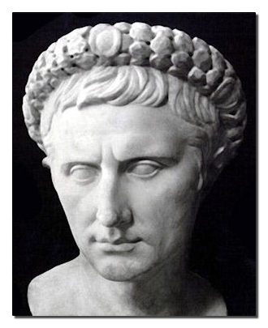
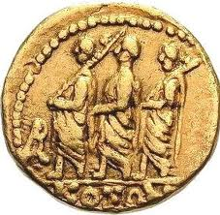
“This was the first census that took place while Quirinius was governor of Syria.”

Slide 72
DATING THE CENSUS
“In those days Caesar Augustus issued a decree that a census should be taken of the entire Roman world.”
A census is an “enrollment prior to taxation”
An accurate registry is needed to get ultimate taxation.
One major census took place in 6 A.D. under Quirinius
(too late a date to be the one referred to in Luke)
Censuses were forbidden under Jewish law.
The census was greatly resented by the Jews, and open revolt was prevented only by the efforts of the high priest Joazar.
Luke notes in his other book (Acts 5:37) that at the time of this taxation census, a false Messiah (a Galilean named Judas) rose up and led zealots and followers in a revolt against the Romans. When he failed, his followers dispersed. (Josephus the Historian also records this event)

Slide 73
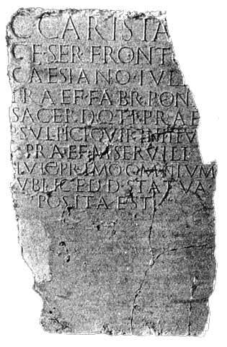
DATING THE CENSUS
“This was the first census that took place while Quirinius was governor of Syria.”
FIRST (prote: can also mean ‘before’ or ‘prior to’).
Thus the verse could be read… “This was the prior census that took place while Quirinius was governor of Syria.”
Herod died in 4 B.C.
So a PRIOR census would have taken place in 5-4 B.C. while Herod was still ruling in Judea.
The first census and the birth of Jesus would have taken place between 6 - 4 B.C.

Slide 74
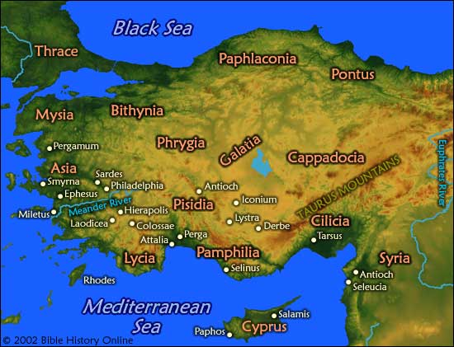
QUIRINIUS
Publius Sulpicius Quirinius (51 BC – AD 21)
Roman aristocrat.
After the banishment of Herod Archelaus from Judea in AD 6, Quirinius was appointed governor of Syria (the province of Judea had been added for the purpose of a census).
In 12 BC he was named consul (highest elected office in the Roman Republic), a sign that he enjoyed the favor of Augustus.
ISRAEL

Slide 75
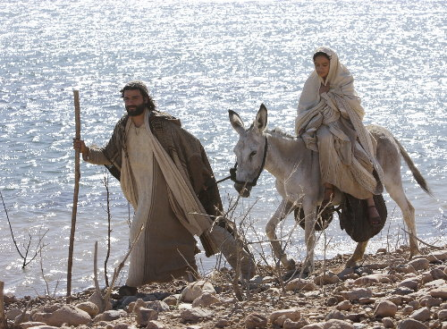
“And everyone went to his own town to register. So Joseph also went up from the town of Nazareth in Galilee to Judea, to Bethlehem the town of David, because he belonged to the house and line of David. He went there to register with Mary, who was pledged to be married to him and was expecting a child. “

Slide 76
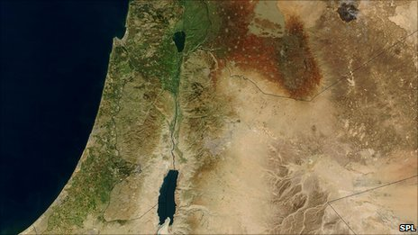
The JOURNEY
x
NAZARETH
JERUSALEM
BETHLEHEM

Slide 77
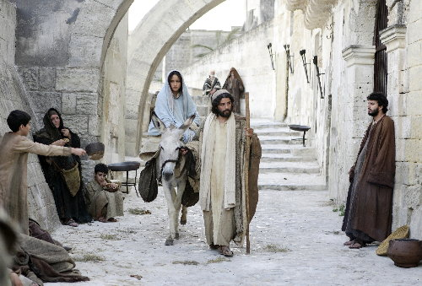
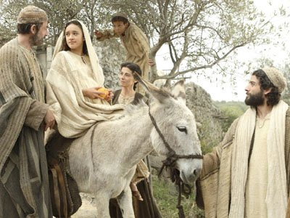
The JOURNEY
We do not know if they traveled by caravan, donkey, horse, cart or on foot.
Both of their entire families, also descended from David, would have also traveled to Bethlehem so we can assume they may have traveled in a caravan.

Slide 78
Luke 2:6-7 “The Birth”

Slide 79
“While they were there, the time came for the baby to be born, and she gave birth to her firstborn, a son.”

Slide 80
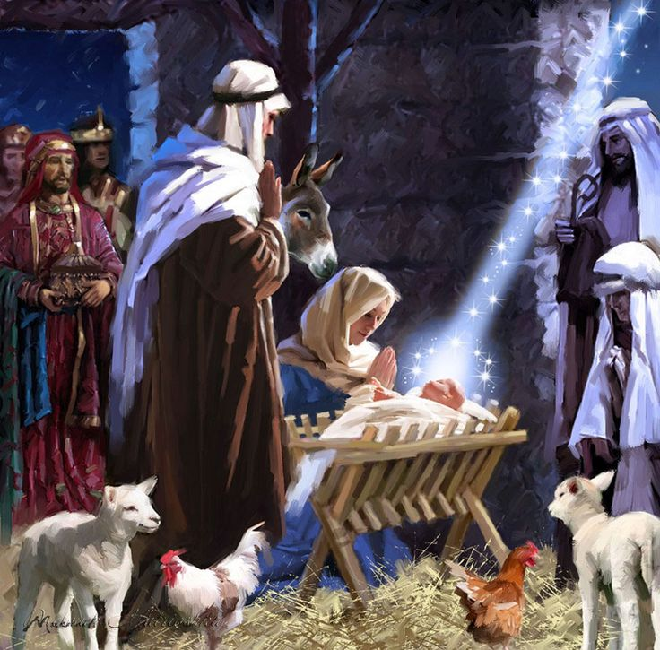
THE BIRTH
The stories of Mary and Joseph arriving in Bethlehem the night she gave birth and rushing to find a place is not in the Bible.
They may have arrived weeks in advance to the birth (more logical).
The verse simply says “While they were there, the time came for the baby to be born…”
SHE gave birth; SHE wrapped Jesus; SHE laid Him in a manger (Was Joseph even at the birth?)

Slide 81
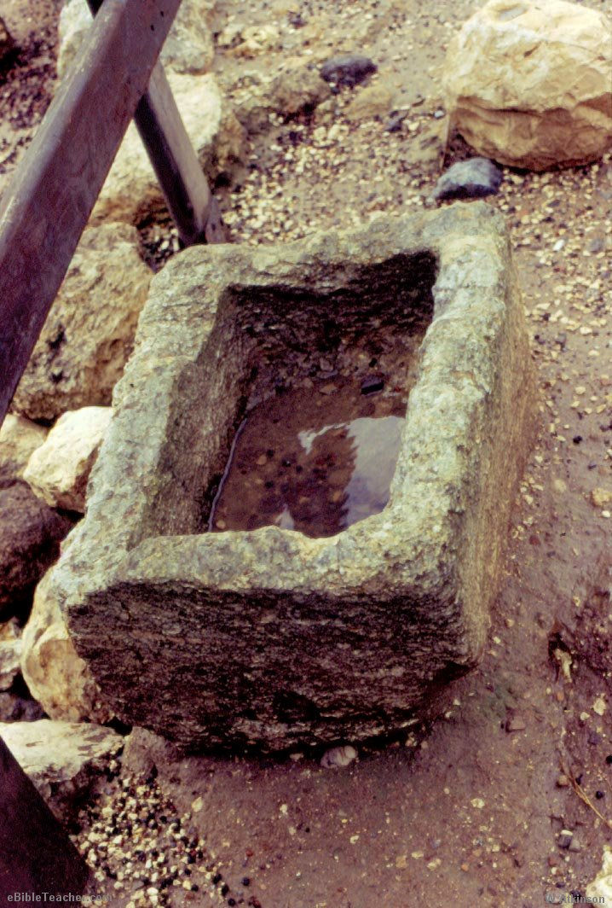
“She wrapped him in cloths and placed him in a manger, because there was no room for them in the inn”

Slide 82
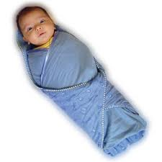
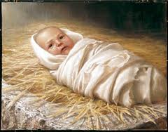
SWADDLING CLOTHS
Swaddling is the practice of wrapping infants in blankets or similar cloth so that movement of the limbs is tightly restricted.
Swaddling cloths were wrapped around each limb prior to wrapping the infant in a swaddling blanket
Swaddling is practiced in nearly every culture on earth and is currently gaining favor in the United States.
The shepherds were told to look for a baby in swaddling cloths.

Slide 83
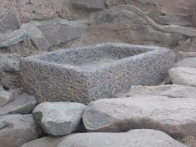
THE MANGER
Manger: feeding trough
Usually carved in stone in the middle east allowing it to survive thousands of years
Many have been uncovered in King Solomon’s stables.

Slide 84
THE “INN”
The Greek word for “Inn” is pandocheion
E.G.: The Good Samaritan brought the injured man to an Inn.
The Greek word used in Luke’s account is katalyma
Usually used for a guest room in someone’s home (e.g.: the room used for the last supper; a billet for soldiers, etc.)
A common cultural practice in Israel was to go to the town square each night and invite travelers home to your guest room; thus bringing more honor and respect from neighbors.

Slide 85
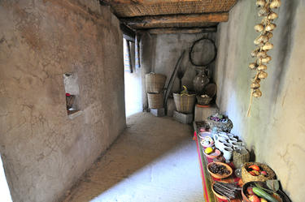
THE “GUEST ROOM”

Slide 86
The FAMILY REACTION
Neither family seems to have offered Mary and Joseph room in their various homes during her time of greatest need. This may indicate how they reacted to her illegitimate pregnancy.
Mary and Joseph’s stay in the cave may have lasted weeks or even months before moving into an available home.

Slide 87
Luke 2:8-20 “The Shepherds”

Slide 88
“And there were shepherds living out in the fields nearby, keeping watch over their flocks at night.”

Slide 89
The SHEPHERDS
Shepherds were considered the lowest class of society next to slaves. They could not keep up all of the ceremonial cleansings and were treated as ‘dirty peasants’.
King David, after whom the city is named, was a shepherd.
The shepherds in the fields of Bethlehem watched over the sheep and lambs to be used in the sacrifices in the temple in Jerusalem (5 miles away). They were the first to see the SACRIFICE LAMB that would soon replace the sheep they watched.
The shepherds “were living in the fields nearby”
They were “watching their sheep by night”
Contrary to the movies that show them sleeping or ignoring the sheep, they are on high alert at night as that is when wolves usually strike to steal the lambs. .

Slide 90
“An angel of the Lord appeared to them, and the glory of the Lord shone around them, and they were terrified.”

Slide 91
THE ANGELIC ANNOUNCEMENT
“AN Angel of the Lord” (Not Jesus: He is in the manger)
Only ONE angel appeared.
(doxa) glory: splendor; brightness
God’s glory “shown around them”; (shepherds)
“They were terrified” (phobio phobos: extreme terror; fear of harm; feel the need to run in panic; dread)

Slide 92
“But the angel said to them, "Do not be afraid. I bring you good news of great joy that will be for all the people. Today in the town of David a Savior has been born to you; He is Christ the Lord.“

Slide 93
GOOD NEWS
GOOD NEWS (evaggelizō: GOSPEL): in the NT used especially of the glad tidings of the coming kingdom of God, and of the salvation to be obtained in it through Christ that relates to salvation
GREAT JOY: (they are about to be given news that will make them happier than anyone living on earth)
ALL PEOPLE (Not just the Jews): Jesus came as the Messiah to the Jews but also as the Savior to the world.

Slide 94
OFFICES of JESUS
“But the angel said to them, "Do not be afraid. I bring you good news of great joy that will be for all the people. Today in the town of David a Savior has been born to you; He is Christ the Lord.“
SAVIOR: Rescuer of all mankind from sin
CHRIST: Messiah of the Jews
LORD: Master and Ruler of our lives
Jesus holds ALL 3 offices. YOU cannot divide them.
You cannot accept Jesus as Savior now and Lord later

Slide 95
PART 4

Slide 96
“This will be a sign to you: You will find a baby wrapped in cloths and lying in a manger.“

Slide 97
THE SIGNS
The shepherds knew the town was packed for the census.
We don’t know how long it took for the shepherds to reach the place where the baby lay.
2 Signs: Swaddling cloths and the manger

Slide 98
“Suddenly a great company of the heavenly host appeared with the angel, praising God and saying, ‘Glory to God in the highest, and on earth peace to men on whom His favor rests.’“

Slide 99
GREAT COMPANY of ANGELS
The angel is joined by innumerable heavenly warriors.
“Suddenly (exaiphnēs: unexpectedly; surprisingly)
This was also probably frightening to the shepherds.

Slide 100
“When the angels had left them and gone into heaven, the shepherds said to one another, "Let's go to Bethlehem and see this thing that has happened, which the Lord has told us about.“

Slide 101
“So they hurried off and found Mary and Joseph, and the baby, who was lying in the manger.”

Slide 102
SHEPHERD’S RESPONSE
“Let’s go see” & “They hurried”
ANGELS LEAVE
They return to heaven
They do not accompany the shepherds to the manger as seen in the Nativity scenes
WHO WAS AT THE MANGER?
Mary
Baby
Shepherds
Joseph (?)

Slide 103
“When they had seen Him, they spread the word concerning what had been told them about this child, and all who heard it were amazed at what the shepherds said to them.”

Slide 104
SPREADING THE WORD
The shepherds spread the word all over Bethlehem about what what the angels had told them… (“they spread the word concerning what had been told them about this child”)
Messianic Announcement, peace, God choosing to give favor to men from all nations, etc.
Did anyone else come to see the baby Jesus?
Did anyone believe a lowly shepherd? (“and all who heard it were amazed at what the shepherds said to them”)
Amazed: (thaumazō: to wonder, marvel)

Slide 105
“But Mary treasured up all these things and pondered them in her heart.”

Slide 106
MARY’S THOUGHTS
“But Mary treasured up all these things”
(syntēreō: to store to memory)
“and pondered them in her heart.”
(symballō: to bring together; to gather your thoughts and contemplate on how events all fit together)
When was the last time YOU or I “syntereo & symballo” the events of Christmas day (really thought about how these event fit into our own lives)

Slide 107
“The shepherds returned, glorifying and praising God for all the things they had heard and seen, which were just as they had been told.”

Slide 108
APPLICATIONS
Returned to their flocks
Returned to their daily routine
(Not everyone is called to the mission field)
Glorifying and praising God
Natural result of meeting Jesus
They got to see and hear
Shared their testimony
Exactly has they had been told
God’s message is dependable

Slide 109
Luke 2:21-40 “The Temple Visit”

Slide 110
“On the eighth day, when it was time to circumcise him, He was named Jesus, the name the angel had given Him before He had been conceived.”

Slide 111
BIBLICAL CIRCUMCISION
In Genesis 17, God made a covenant with Abraham
God’s part was to make a great nation from Abraham
Abraham’s part was to circumcise every male
Self, Relatives & slaves
Uncircumcised Jews were to be cut off from Israel
“Let me get this straight! The Arabs get all the oil, and we have to cut off our WHAT?!?”

Slide 112
“When the time of their purification according to the Law of Moses had been completed, Joseph and Mary took him to Jerusalem to present him to the Lord “

Slide 113
The TRIP to JERUSALEM
Distance between Jerusalem and Bethlehem is 5.52 mi.

Slide 114
The TIME of PURIFICATION
Lev. 12:1-8 “The LORD said to Moses, “Say to the Israelites: ‘A woman who becomes pregnant and gives birth to a son will be ceremonially unclean for seven days, just as she is unclean during her monthly period. On the eighth day the boy is to be circumcised. Then the woman must wait thirty-three days to be purified from her bleeding. (The time of purification) She must not touch anything sacred or go to the sanctuary until the days of her purification are over. If she gives birth to a daughter, for two weeks the woman will be unclean, as during her period. Then she must wait sixty-six days to be purified from her bleeding. “‘When the days of her purification for a son or daughter are over, she is to bring to the priest at the entrance to the tent of meeting a year-old lamb for a burnt offering and a young pigeon or a dove for a sin offering. He shall offer them before the LORD to make atonement for her, and then she will be ceremonially clean from her flow of blood. “‘These are the regulations for the woman who gives birth to a boy or a girl. But if she cannot afford a lamb, she is to bring two doves or two young pigeons, one for a burnt offering and the other for a sin offering. In this way the priest will make atonement for her, and she will be clean.’”

Slide 115
“…as it is written in the Law of the Lord, "Every firstborn male is to be consecrated to the Lord“

Slide 116
“Now there was a man in Jerusalem called Simeon, who was righteous and devout. He was waiting for the consolation of Israel, and the Holy Spirit was upon him. It had been revealed to him by the Holy Spirit that he would not die before he had seen the Lord's Christ. “

Slide 117
“Moved by the Spirit, he went into the temple courts. When the parents brought in the child Jesus to do for Him what the custom of the Law required, Simeon took Him in his arms and praised God, saying
"Sovereign Lord, as you have promised, you now dismiss your servant in peace. For my eyes have seen your salvation, which you have prepared in the sight of all people, a light for revelation to the Gentiles and for glory to your people Israel."

Slide 118
SIMEON
Filled with the Spirit
Spoken to by the Spirit
Moved to action by the Spirit
Promised to live until he saw the birth of the Messiah
Says Jesus came to the Gentile and to the Jews
NEW CONCEPT for Jews
Application: Anyone who has seen Jesus can die in peace

Slide 119
TITLES OF JESUS by SIMEON
“Consolation Of Israel”
“The Lord’s Christ”
“Your Salvation”
“A Light For Revelation To The Gentiles”
“The Glory Of Your People Israel”

Slide 120
“The child's father and mother marveled at what was said about Him.”

Slide 121
Then Simeon blessed them and said to Mary, his mother: "This child is destined to cause the falling and rising of many in Israel, and to be a sign that will be spoken against, so that the thoughts of many hearts will be revealed. And a sword will pierce your own soul too”

Slide 122
4 RESULTS of JESUS’ BIRTH
“cause the falling and rising of many in Israel”
Is. 8: Jesus would be a stumbling block to many in Israel
Lowly are lifted up (salvation) and the lofty are brought down
“to be a sign that will be spoken against”
“He came to His own and they did not receive Him” -John
“that the thoughts of many hearts will be revealed”
Hearts intent and true repentance, not outward piety and religious observations, will determine salvation
THIS IS NEW TO JEWS
“And a sword will pierce your own soul too”
Prophecy of Jesus’ death; Mary would watch
No mention of Joseph’s pain; prediction of death?

Slide 123
“There was also a prophetess, Anna, the daughter of Phanuel, of the tribe of Asher. She was very old; she had lived with her husband seven years after her marriage, and then was a widow until she was eighty-four. She never left the temple but worshiped night and day, fasting and praying.”

Slide 124
“Coming up to them at that very moment, she gave thanks to God and spoke about the child to all who were looking forward to the redemption of Jerusalem.”

Slide 125
ANNA
She was a prophetess (Spoke of the coming Messiah)
She was a daughter of Phanuel. (Know nothing of him)
She was a member of the tribe of Asher (1 of the 12 tribes)
She was widowed after seven years of marriage
She was a devout Jew; regularly practiced prayer & fasting
Luke describes Anna as "very old"
Lit. “widow of 84 years”
Might mean “84 years old”
Or “widowed for 84 years”
(On this option, she could not have married younger than about age 14, and so she would have been at least 14 + 7 + 84 = 105 years old)

Slide 126
Matthew 2:1-12 “The Magi”

Slide 127
“After Jesus was born in Bethlehem in Judea, during the time of King Herod…”

Slide 128
Herod the Great

Slide 129
HEROD the BUILDER

Slide 133
HEROD the MURDERER
Herod the Great was titled “King of the Jews”
He was an Edomite, not Jewish. He was hated by the Jews.
He was born in 73 B.C. to Antipater and Cyprus (daughter of an Arab sheik).
He was a brutal man who killed his father-in-law, brother-in-law, several of his ten wives, and two of his sons.
He had many rabbis slaughtered.
He killed all of the babies in the Bethlehem region 2 and under.
Augustus said, “Better to be Herod’s pig than his son”
He died in 4 BC in Jericho
Shortly before death, he had all of the key townspeople put in a cell with orders to kill them all upon is death “so that at least some tears will be shed for his death.” When he died, his men let them go..

Slide 134
“Magi from the east came to Jerusalem”

Slide 135
MAGI
WISE MEN; Star gazers
Saw the star the night Jesus was born
Studied it; prepared for the journey; traveled
Usually in a large caravan (not just 3)
Didn’t arrive at the manger - Arrived 2 years later
Went to Herod’s in Jerusalem to ask directions

Slide 136
“…and asked, "Where is the one who has been born king of the Jews? We saw his star in the east and have come to worship Him."

Slide 137
“When King Herod heard this he was disturbed, and all Jerusalem with him.”

Slide 138
“When he had called together all the people's chief priests and teachers of the law (scribes), he asked them where the Christ was to be born.”

Slide 139
CHIEF PRIESTS & SCRIBES
CHIEF PRIESTS: Religious leaders
SCRIBES: Religious lawyers
They KNEW where the Messiah was to be born
They were only 5 miles away.
Did they go see? NO

Slide 140
“’In Bethlehem in Judea,’ they replied, ‘for this is what the prophet has written: 'But you, Bethlehem, in the land of Judah, are by no means least among the rulers of Judah; for out of you will come a ruler who will be the shepherd of my people Israel.‘”

Slide 141
WHICH BETHLEHEM?
Bethlehem means house of bread.
It was known as Ephrath (Gen.35:16), Bethlehem Ephratah (Micah 5:2), Bethlehem-Judah (1 Sam. 17:12), "the city of David" (Lk. 2:4).
It is mentioned as the place that is close to where Rachael died, the place where Ruth followed Naomi, and where David was both born and anointed.
The birthplace of Jesus, Bethlehem (near Jerusalem, in the territory of Judah), is so famous that it has eclipsed another town that existed in Israel by the same name in the north, Bethlehem near Nazareth, in the territory of Zebulun 6 miles N.W. of Nazareth. (now a ruin). It's mentioned only once in the Bible, among a listing of cities within the tribal allotment of Zebulun during the time of Joshua:

Slide 142
“Then Herod called the Magi secretly and found out from them the exact time the star had appeared”

Slide 143
“He sent them to Bethlehem and said, "Go and make a careful search for the child. As soon as you find Him, report to me, so that I too may go and worship Him."
LIE

Slide 144
“After they had heard the king, they went on their way”

Slide 145
“…and the star they had seen in the east went ahead of them until it stopped over the place where the child was. When they saw the star, they were overjoyed.”

Slide 146
“On coming to the house, they saw the child with His mother Mary, and they bowed down and worshiped Him.”

Slide 147
NO MANGER for the MAGI
The Magi never made it to the manger.
It took 2 years for them to reach Bethlehem once they saw the star in the East (Matt. 2:1-12)
“On coming to the house” (Greek: oikia means the dwelling place for a family)
“They saw the young child” (Greek: paidion can refer to any child from an infant to a mature young child)

Slide 149
“Then they opened their treasures and presented him with gifts of gold and of incense and of myrrh.”

Slide 150
“And having been warned in a dream not to go back to Herod, they returned to their country by another route.”

Slide 151
Matthew 2:13-15 “The Warning”

Slide 152
“When they had gone, an angel of the Lord appeared to Joseph in a dream. ‘Get up,’ he said, ‘take the child and His mother and escape to Egypt. Stay there until I tell you, for Herod is going to search for the child to kill Him.’”

Slide 153
“So he got up, took the child and his mother during the night and left for Egypt, where he stayed until the death of Herod.”

Slide 154
THE NIGHT TRIP TO EGYPT
Long, hot journey
Finances: Gold from magi

Slide 155
“And so was fulfilled what the Lord had said through the prophet: "Out of Egypt I called my son.“

Slide 156
Matthew 2:16-18 “The Slaughter”

Slide 157
“When Herod realized that he had been outwitted by the Magi, he was furious, and he gave orders to kill all the boys in Bethlehem and its vicinity who were two years old and under, in accordance with the time he had learned from the Magi.”

Slide 158
“Then what was said through the prophet Jeremiah was fulfilled: "A voice is heard in Ramah, weeping and great mourning, Rachel weeping for her children and refusing to be comforted, because they are no more."

Slide 159
ORDERS TO KILL
Many modern scholars say only 10 – 12 babies died because Bethlehem was such a small village. BUT REMEMBER…
Hundreds of thousands came to the region for a census!
Babies were to be killed in “Bethlehem and the vicinity”
included Jerusalem and surrounding towns
Included “hill country of Judea” where John the Baptist lived (now around 2 1/2 years old: within death penalty)
Some families lost 2 – 3 sons
“2 years old and under” (Up to 3 years)
"A voice is heard in Ramah, weeping and great mourning (not just a few sad mothers), Rachel (all the women of Israel) weeping for her children and refusing to be comforted, because they are no more."

Slide 160
A VOICE HEARD IN RAMAH
Ramah is about 5 miles north of Jerusalem
Home to Samuel's mother Hannah and his father Elkhana,
Ramah is mentioned in 1 Sam. 8:4 in reference to a meeting place during Samuel's rule.

Slide 161
Matthew 2:19-23 “The Return”

Slide 162
“After Herod died, an angel of the Lord appeared in a dream to Joseph in Egypt and said, "Get up, take the child and His mother and go to the land of Israel, for those who were trying to take the child's life are dead."

Slide 163
“So he got up, took the child and his mother and went to the land of Israel. “

Slide 164
“But when he heard that ARCHELAUS was reigning in Judea in place of his father Herod, he was afraid to go there.”

Slide 165
ARCHELAUS
When King Herod died, he ‘quartered’ his kingdom.
Herod Archelaus (23 BC – c. 18 AD) was the ruler over Samaria, Judea, and Edom from 4 BC to 6 AD.
This means Jesus would have been born prior to 4 B.C.
His brother, Herod Antipas (instrumental in the deaths of John the Baptist and Jesus) ruled Galilee and Perea.
His half-brother of Herod Philip had his wife stolen by Herod Antipas.

Slide 166
“Having been warned in a dream, he withdrew to the district of Galilee, and he went and lived in a town called Nazareth.”

Slide 167
NAZARETH
The people of Nazareth were proverbially despised and looked on with contempt (John1:46; John7:52)
To come from Nazareth, therefore, or to be a Nazarene, was the same as to be despised, or to be esteemed of low birth
Jesus came to be known as “Jesus of Nazareth” as there were many men named Jesus in that day.

Slide 168
“So was fulfilled what was said through the prophets: "He will be called a Nazarene."

Slide 169
WHICH PROPHET SAID THAT!?
WHICH PROPHET SAID THAT!?
(None we know of)
He does not say “by the prophet,” as in Mat1:22; Mat2:5, Mat2:15, but “by the prophets,” meaning no one particularly, but the general character of the prophecies.
The leading and most prominent prophecies respecting Him were that He was to be of humble life; to be despised and rejected.
See Is. 53:2-3,7-9,12; Ps. 22.

Slide 170
LUKE 2:39-40 “The Youth”

Slide 171
“When Joseph and Mary had done everything required by the Law of the Lord, they returned to Galilee to their own town of Nazareth.

Slide 172
“And the child grew and became strong; He was filled with wisdom, and the grace of God was upon Him.”

