Slide 1
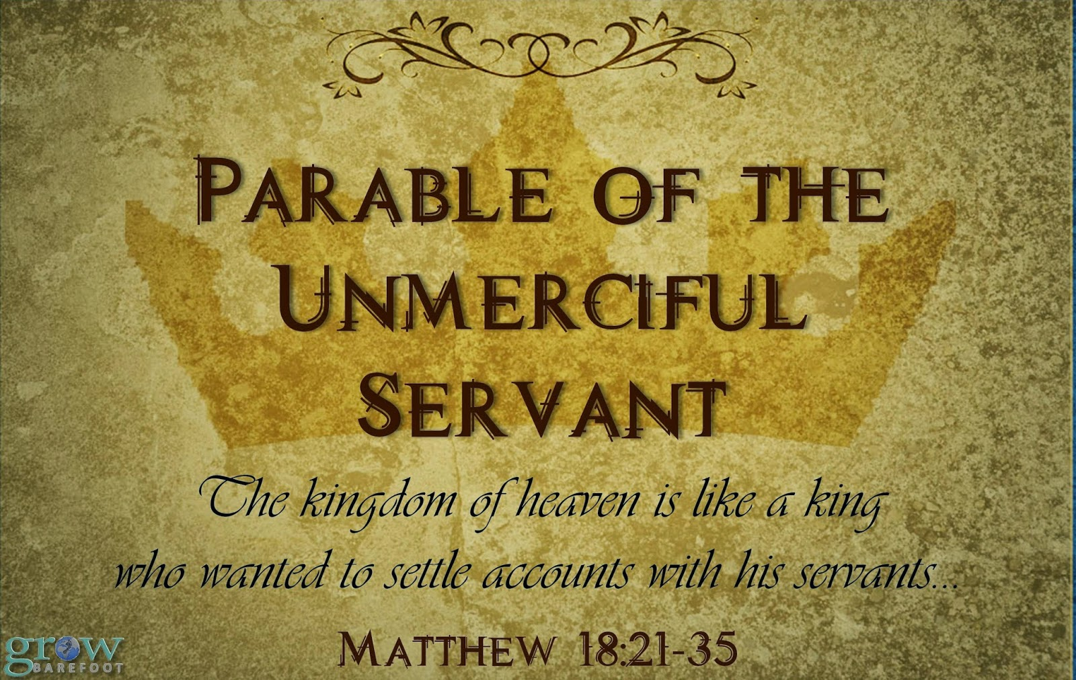

Slide 2
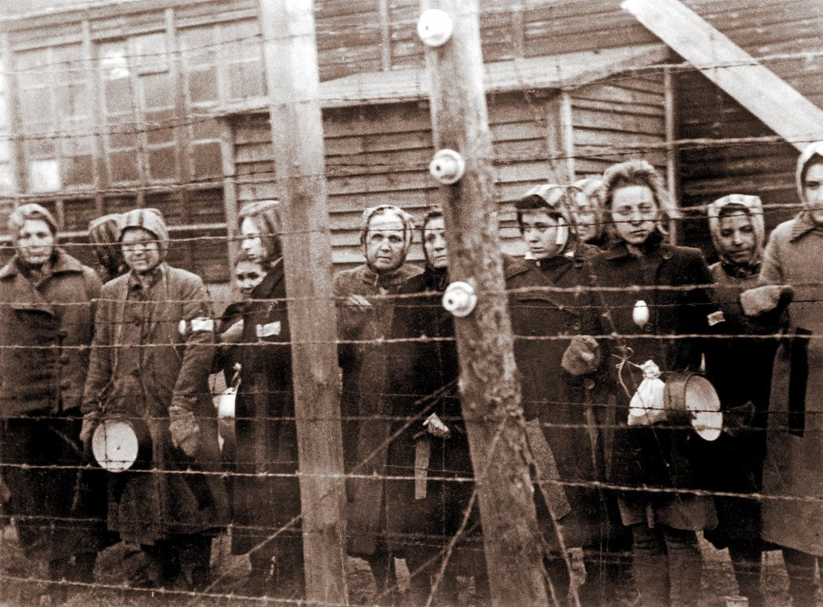
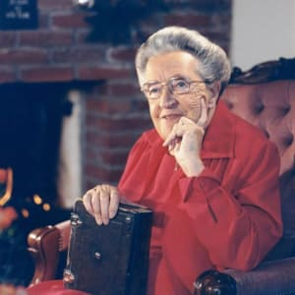
CORRIE TEN BOOM

Slide 3
INTRODUCTION
A parable is “a short allegorical story designed to illustrate or teach some truth, religious principle or moral lesson.”
The Key to a Parable: Look for the main lesson, not the minutia. We can draw many teaching moments from each parable, but don’t try and attribute a new theology to minutia that is only in the parable to illustrate the main lesson.

Slide 4
INTRODUCTION
Q: Who uses parables?
A: Prophets, Preachers, Jesus, Rabbis, etc.
Q: Were parables important to Jesus?
A: “In fact, in His public ministry Jesus never taught without using parables; but afterward, when He was alone with His disciples, He explained everything to them” (Mark 4:34)

Slide 5
CONTEXT
Matthew Chapter 18
  (v.1-5) Who is the greatest in the Kingdom?
  (v.6-9) Danger in causing others to stumble
  (v.10-14) Parable of the One Lost Sheep
  (v.15-20) Dealing with Church Discipline
    “Then Peter came to Jesus and asked…”
  (v.21-35) Parable of the Unmerciful Servant

Slide 6
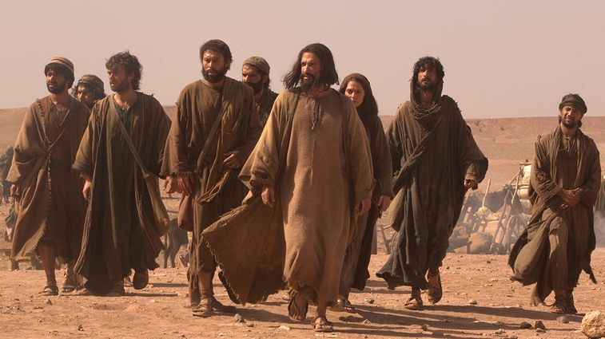
READ MATTHEW 18:21-35

Slide 7
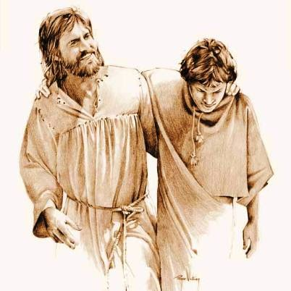
1
FORGIVENESS
is not a one-time event (v.21-22)
The QUESTION: How often should we forgive someone who has sinned against us? (7?)
The ANSWER: (70x7) Innumerable

Slide 8

2
FORGIVENESS
is not the debtor’s choice (v.23-24)
  Kingdom of Heaven: Not a place. A King and His followers
  King: The King in this parable is Jesus.
  Servants: Jesus’ followers (not unbelievers)
  Settle accounts: Every King has a right to confront any of his subjects at any time for any reason.

Slide 9
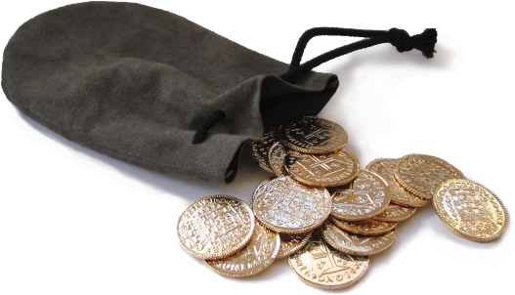
3
FORGIVENESS
covers immeasurable debts (v.25)
    The Key: Unpayable debt; beyond measure. In this parable, Jesus is comparing us to this debtor. We cannot ever pay for the debt we owe due to our sin.
    NOTE: Forgiveness does not eliminate consequences.
    NOTE: God can still enact consequences even though He has forgiven

Slide 10
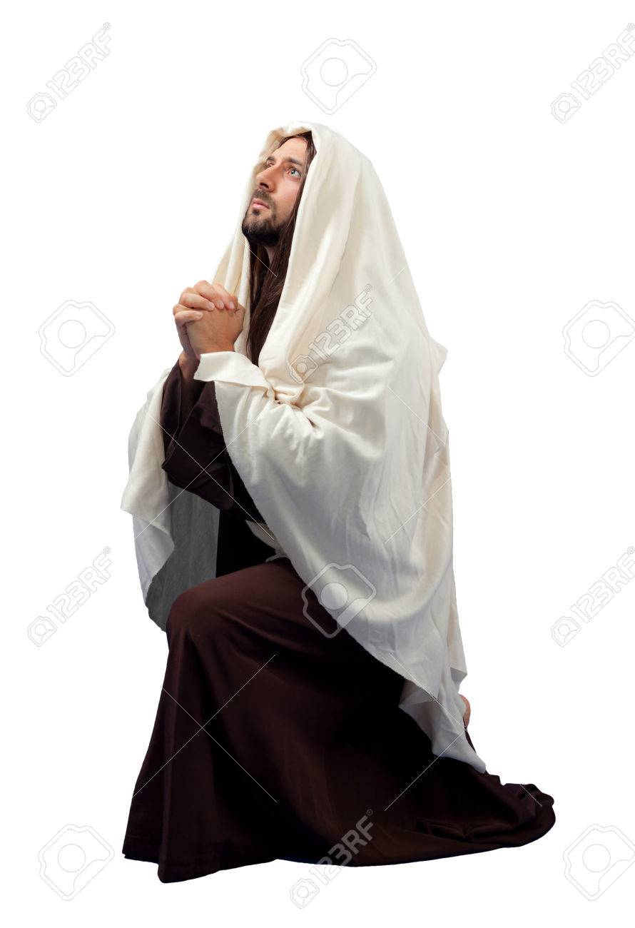
4
FORGIVENESS
must be sought with repentance (v.26)
    NOTICE: He did not ask for mercy. He asked for patience.
The servant “fell on his knees” Humble position; Begged; Willing to take responsibility for his wrongdoing.

Slide 11
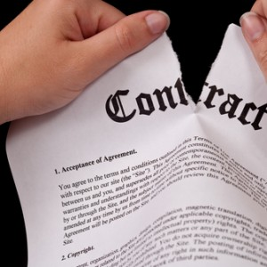
5
FORGIVENESS
is mercy based, not deserved (v.27)
The debt was cancelled, not lowered.
Active pity based on emotional pity.

Slide 12
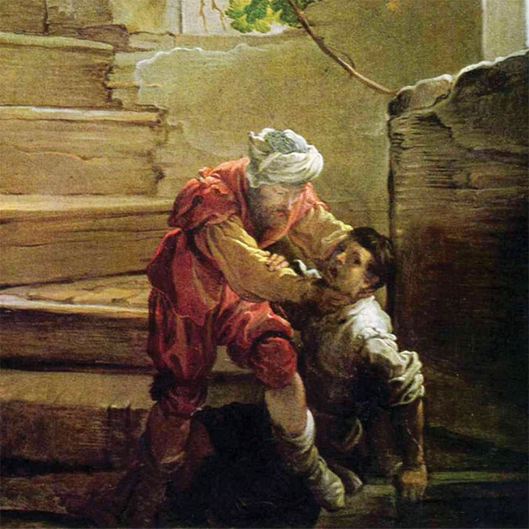
6
FORGIVENESS
is not our default setting (v.28-30)
Same position, same plea, same promise
His refusal to forgive demonstrated radical ingratitude.

Slide 13
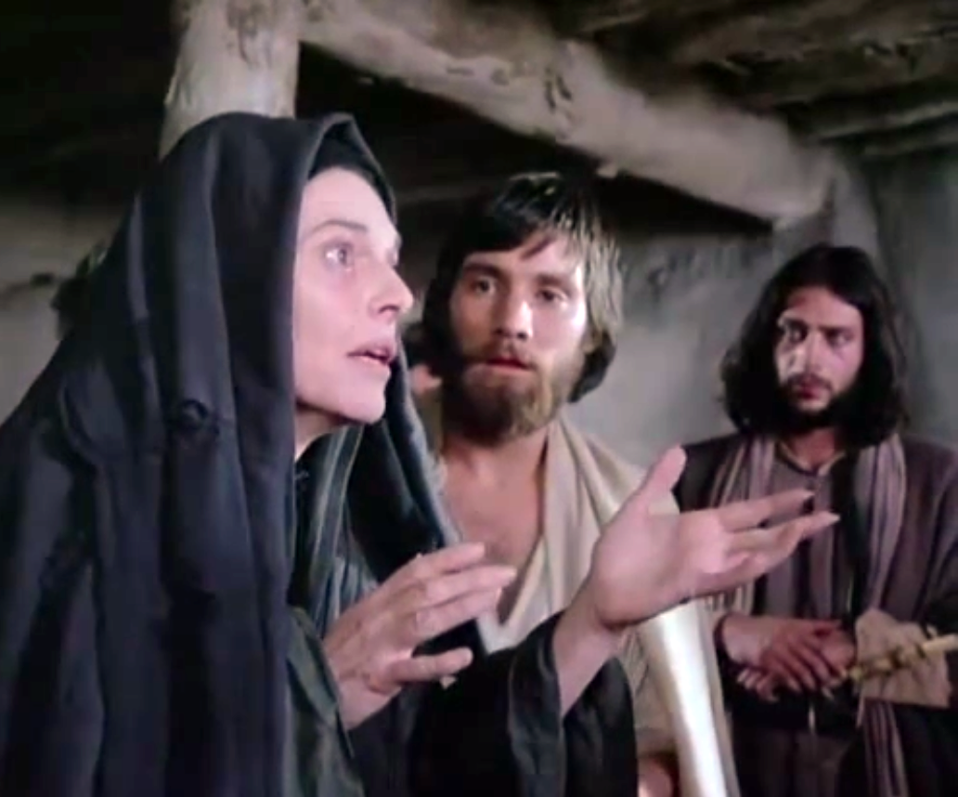
7
FORGIVENESS
is not a private act (v.31)
Every act of unforgiveness is known by the King
Private offenses = Private forgiveness
Public offenses = Public Forgiveness

Slide 14
8
FORGIVENESS
is expected of the forgiven (v.32-33)
The unforgiving are not called ungrateful. They are called “wicked”
      Eph. 4:32, “…forgiving one another, even as God for Christ's sake hath forgiven you."
      Col. 3:13, “…forgive one another…Forgive as the Lord forgave you.”
      Matt. 6, Pray “¹² And forgive us our debts, as we also have forgiven our debtors… “

Slide 15
9
FORGIVENESS
is not the same as forgetting (v.34)
God does not have spiritual amnesia
We are not given the ability to forget everything that has happened to us.
It is not always wise to forget.
Don’t assume everything should be as if nothing ever happened.

Slide 16
10
FORGIVENESS
is not an option for us (v.35)
    The point of this parable is to show us our responsibility to demonstrate grace to others without limit because God has demonstrated unlimited grace to us.
    The Generosity Principle: Luke 6:38
    The Grieving God Principle: Ephesians 4:30

Slide 17

APPLICATION
          Write the name of a few people you need to forgive and why
          write the name of someone you need to ask forgiveness from and why
          Make a list of as many things as possible that you can remember that God has forgiven you from

Slide 18
CONCLUSION
This message of this parable is clear… there is nothing any person on this earth could possibly “owe” us, there is no way anyone could have possibly wronged us that begins to compare with the forgiveness and mercy we have received from God our Heavenly Father.

