Slide 1
2019 CHURCH LEADERSHIP TRAINING
STORY TELLING
Dr. Jay BarLeon
Shifus International

Slide 2
2019 CHURCH LEADERSHIP TRAINING
教会领袖 训练营
Dr. Jay BarLeon
Shifus International

Slide 3
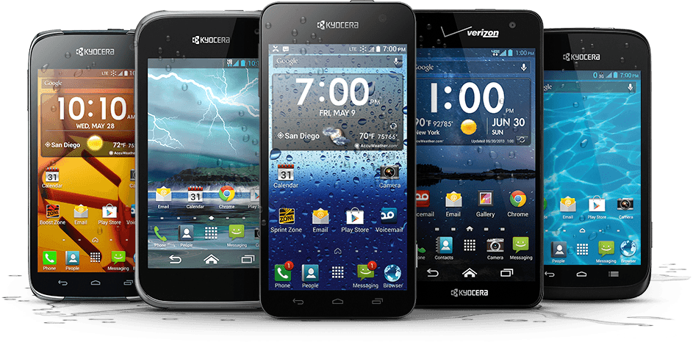
请将所有手机关掉!
PLEASE TURN ALL CELL PHONES OFF!

Slide 4
讲故事
STORY TELLING

Slide 5
VIDEO: BAO

Slide 6
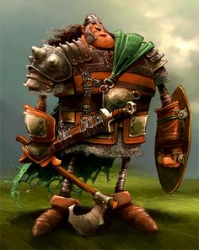
讲故事的重要性
The Importance of Storytelling
1. 故事符合圣经
Stories are BIBLICAL
2. 故事是 经过时间考验的
Stories are TIME TESTED
3. 故事具有治疗作用
Stories are THERAPEUTIC
4. 故事令人难忘
Stories are MEMORABLE
5. 故事具有教育作用
Stories are EDUCATIONAL
6. 故事具有励志作用
Stories are MOTIVATIONAL

Slide 7
讲好故事的关键元素
Key Elements of Storytelling
1. 有趣
Interesting
2. 目的性
Intentional
3. 肢体语言
Body Language
4. 适宜
Appropriate
5. 可应用性
Applicable
6. 结构
Structured
7. 情感
Emotional
8. 人物
Characters
9. 引人入胜
Compelling
10. 明白易懂
Understandable

Slide 8
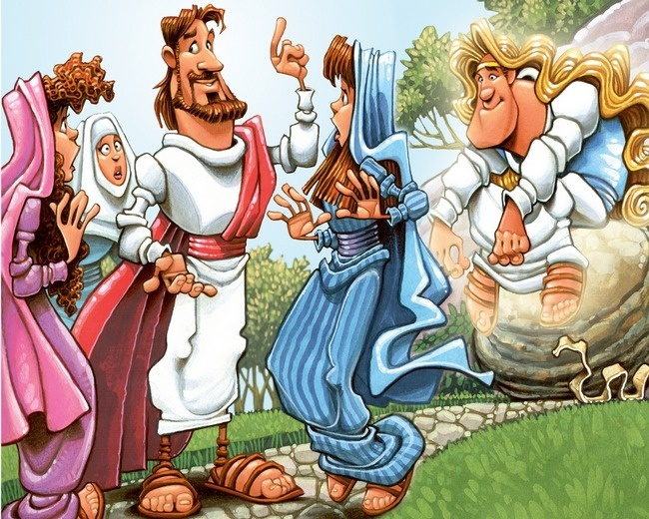
故事类型
Types of Stories
见证 (Testimony)
圣经故事 (Bible Stories)
口头传统 (Oral Traditions)
叙事 (Narrative)
人物 (Character)
虚构作品 (Fiction)
视觉的 (Visual)

Slide 9
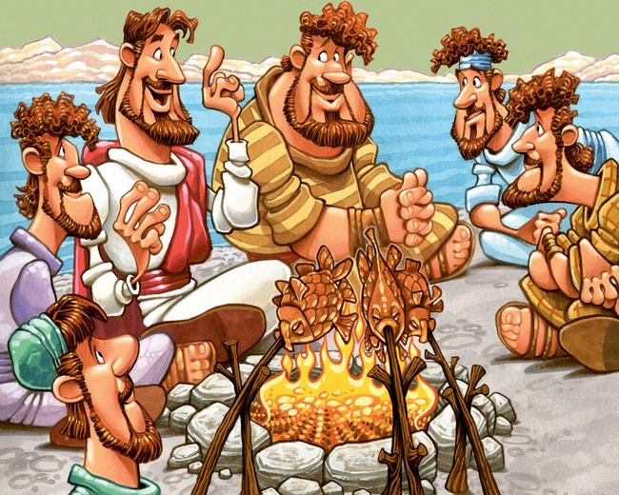
如果耶稣认为故事绝对必要和有效，我们也应该认为
(If Jesus saw stories as absolutely necessary and effective, so should we)

