Slide 1
Excuses vs. Accountability
The Key to Unlocking your Potential

Slide 2
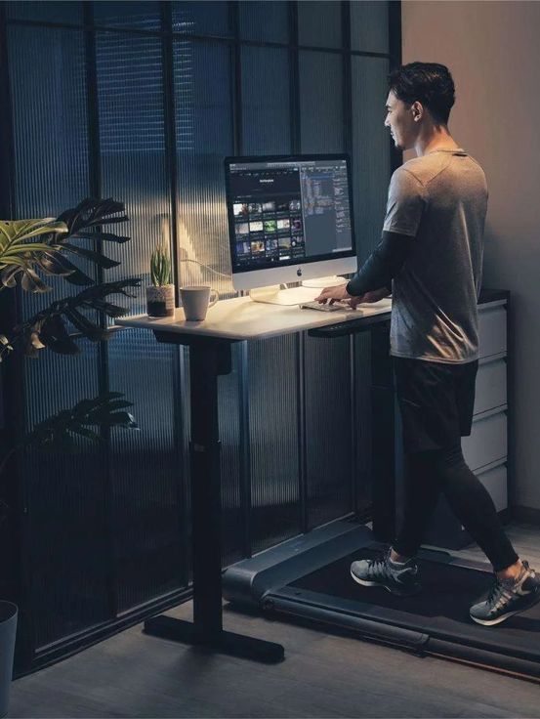
Excuses Vs. Accountability -
Excuses are easy - They’re the stories we tell ourselves to justify why something didn’t happen or why we aren’t where we want to be.
Accountability, on the other hand, is about owning your actions, decisions, and outcomes—both good and bad. It’s not always comfortable, but it’s essential for growth.
Excuses are the mental barriers we create to avoid responsibility.
They shift the focus away from what we can control and place blame on external factors.

Slide 3
Excuses are Rooted in Fear
They may protect our ego in the short term, but they prevent us from learning, growing, and achieving our potential.
Accountability is the willingness to take ownership of your actions and results. It means acknowledging your role in both successes and failures and focusing on what you can do to improve.
Accountability is empowering because it shifts the focus back to what you can control. When you take ownership, you regain the power to create change and move forward.

Slide 4
The Impact of Excuses vs. Accountability
Excuses
Keep you stuck in the same patterns.
Limit your growth and potential.
Damage trust and credibility with others.
Accountability
Drives growth and improvement.
Builds trust and respect with others.
Empowers you to take control of your success.

Slide 5
Why Is Accountability the Key to Success?
Builds Resilience
You develop resilience by focusing on solutions rather than problems.
Encourages Growth
self-awareness leads to continuous improvement and a growth mindset.
Strengthens Relationships
Accountability fosters trust and credibility in both personal and professional relationships.
Fuels Progress
Excuses keep you in a cycle of inaction, accountability drives you to take the steps necessary to move forward.

Slide 6
How can you make the shift from excuses to accountability?
Recognize your excuses
Reframe your mindset
Set clear goals and action plans
Track your progress
Embrace discomfort
Find an accountability partner

Slide 7
Excuses Vs. Accountability -
Excuses may feel easier in the moment, but they keep you stuck in the same place. Accountability, on the other hand, is the foundation of growth and success.
When you take ownership of your actions and results, you gain the power to overcome challenges, improve, and achieve your goals.
At Zero Limits Mindset, we believe that accountability is a cornerstone of success. Our coaching programs are designed to help you recognize excuses, embrace accountability, and unlock your full potential.

