Slide 1
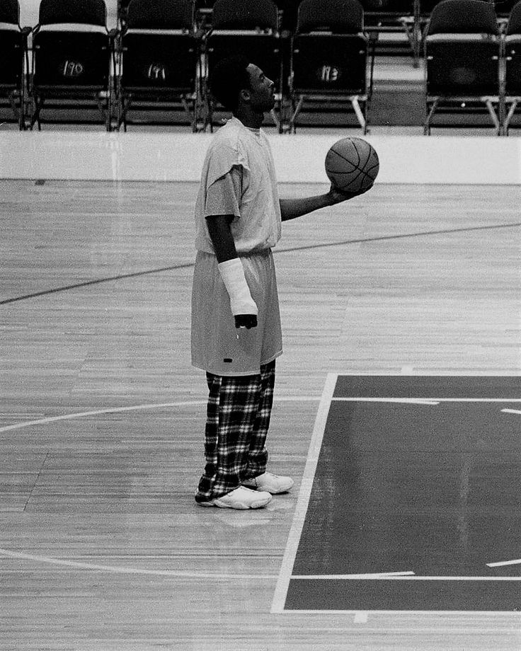
Motivation and the Power of Your “Why”

Slide 2
When you know your “Why” -
Your “why” is your purpose, your driving force, and the foundation of your resilience when things get tough.
When you know your ”Why” You gain –
Clarity – You understand the bigger picture and why your efforts matter.
Resilience – Your “why” helps you push through setbacks and obstacles.
Focus – It keeps you aligned with your goals, even when distractions arise.
Energy – Purpose-driven people are naturally more energized and driven.

Slide 3
Finding your “Why”
Finding your “why” is one of the most important steps you can take to create lasting motivation and success.
Your “why” is the core reason behind your actions—a deeply personal, purpose-driven force that fuels you even when external rewards or excitement fade.
Discovering it isn’t always easy, but it’s worth the effort.

Slide 4
Reflect on Your Values
Your values are the foundation of your “why.”
What principles do I live by?
What’s non-negotiable in my life?
What makes me feel fulfilled and proud?
An athlete values teamwork and personal growth →
“why” = to inspire others to push past their limits while creating a supportive environment for their teammates.
A business leader values innovation and integrity. “why” →.
To build products that solve meaningful problems without compromising ethical standards.

Slide 5
Who Are You Doing it For?
Your “why” is often tied to the people who matter most to you. Whether it’s family, friends, a community, or even a future version of yourself, the relationships you cherish can provide insight into your purpose.
Who inspires me to be my best self?
Who do I want to impact or help?
What legacy do I want to leave for others?
A young gymnast dedicates their training to their family, who sacrificed to support their dream. Their “why” is to honor their family’s commitment.
An entrepreneur is driven by the desire to create a business that provides opportunities for their community, helping others thrive and grow.

Slide 6
Connect To Your Passion
Passion is the emotional fuel behind your actions.
What excites and energizes you?
What would you pursue even if no one was watching?
Your passion often points directly to your “why.”
What makes me lose track of time?
What activities or causes light me up?
What am I naturally drawn to?
A swimmer feels alive when competing and loves the feeling of pushing their body to its limits. Their “why” might be to discover their full potential and inspire others to do the same. A tech innovator has always been passionate about solving complex problems, their “why” could be to simplify life for others through groundbreaking solutions.

Slide 7
Identify the Impact You Want to Make
Your “why” is often tied to the difference you want to make in the world. What kind of mark do you want to leave? How do you want to be remembered?
What legacy do I want to leave behind?
How do I want to contribute to the lives of others?
What problem do I want to solve?
A retired athlete mentors young players, sharing lessons they’ve learned. Their “why” is to shape the next generation of athletes and give back to the sport.
A CEO creates a sustainable brand to combat climate change, their “why” is to leave the world in a better place for future generations.

Slide 8
Revisit Your Defining Moments
Sometimes, your “why” is rooted in your past experiences—both triumphs and challenges. Think about the events that have shaped who you are today. Ask Yourself - • What experiences have had the greatest impact on me? • What lessons have I learned from my biggest struggles? • How can I use my story to drive my purpose?
A basketball player who overcame a major injury might find their “why” in showing others that setbacks can lead to comebacks. An entrepreneur who grew up in poverty might use their story to fuel a mission of creating economic opportunities for underserved communities.

Slide 9
Combine the Pieces
Once you’ve reflected on your values, passion, relationships, and impact, start putting the pieces together to create a clear and powerful “why.”
“My why is to inspire young athletes to believe in themselves, no matter what challenges they face, and to show that hard work pays off.”
"My why is to create innovative solutions that empower others to live more fulfilling lives while leaving a positive impact on the world.”

