Slide 1
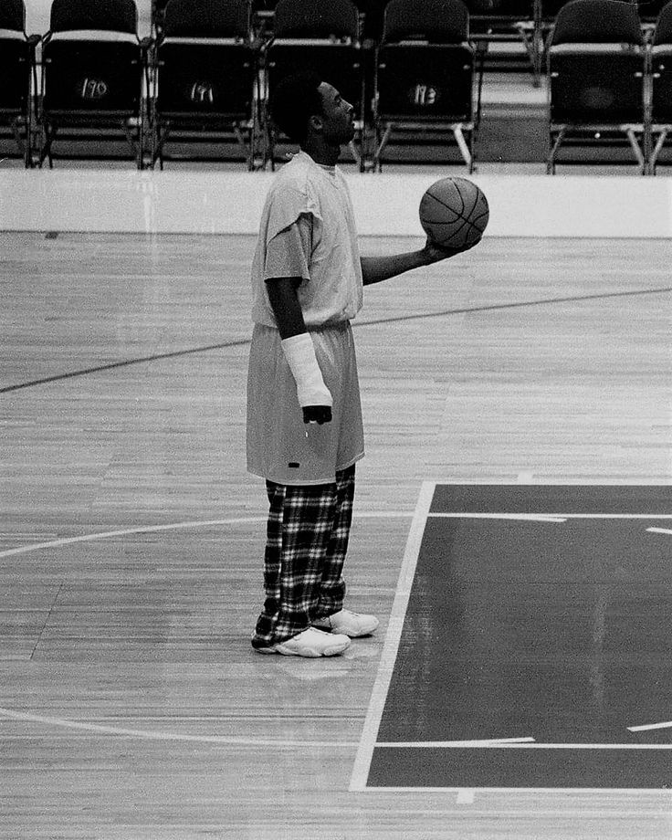
What Are You Doing When Nobody Is Watching?

Slide 2
Thriving in Remote Work with Self-Discipline -
How do you stay disciplined and productive without the structure of an office environment? Remote work is an opportunity to grow your self-discipline and develop a winning mindset—one rooted in personal accountability and effort.
Communicate Effectively: Stay connected with your team, even from a distance. Clear and consistent communication is key.
Deliver Results: Meet deadlines and focus on producing high-quality work.
Stay Proactive: Take initiative to solve problems, improve processes, and add value without waiting for instruction.

Slide 3
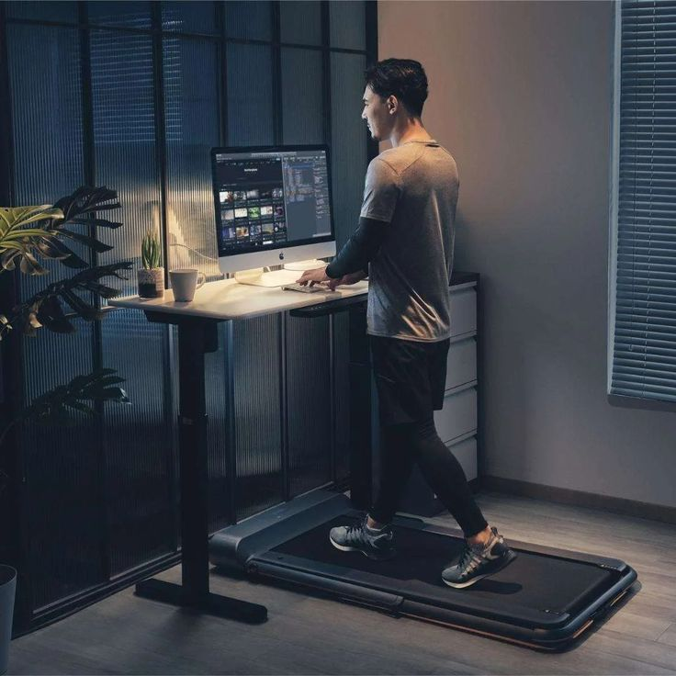
The Foundation of Remote Work is self-discipline-
Self-discipline is the ability to do what’s necessary, even when you don’t feel like it
Jocko Willink, a retired Navy SEAL and leadership coach, often says, “Discipline equals freedom” When you’re disciplined in managing your time and tasks, you gain the freedom to enjoy the flexibility that remote work provides.
Start and End Your Day at the Same Time: Establishing boundaries keeps work from spilling into personal time.
Plan Your Day: Write down your priorities and tackle the most important tasks first.
Minimize Distractions: Create a dedicated workspace that’s free of clutter and interruptions.
Take Regular Breaks: Rest is essential for maintaining focus and avoiding burnout.

Slide 4
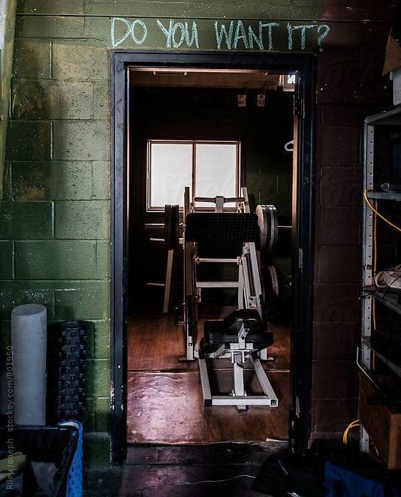
Training When No One Is Watching- Game Day vs. Practice - what you do in practice prepares you for game day.
Create a Dedicated workspace
Set clear goals and track progress
Develop a pre-work routine
Remind yourself:
I have the discipline to stay on track.
My small efforts today lead to big results over time
I’m capable of delivering my best work, even when no one is watching.
At the end of each day, reflect on these questions:
Did I accomplish what I planned today?
What went well, and where can I improve?
What steps can I take tomorrow to be even more effective?

Slide 5
Excellence in Private Leads to Success in Public
The work you put in when no one is watching defines your success
Discipline is doing what you’re supposed to do, even when you don’t feel like it.
Whether you’re working remotely or training for a championship, the principles are the same: stay disciplined, stay focused, and take ownership of your success. The habits you build now will shape your future achievements.
As a leader, It is their job to look for someone better than you. As an athlete or employee, it’s YOUR job to make sure they never find them. The work you put in when nobody is watching will make you unstoppable.

