Slide 1
The Brain and Body Connection: Using EMDR to Treat Trauma
Lillian Ramey, LCSW
EMDRIA-Approved Trainer and Consultant
Rivers Edge Institute

Slide 2
Chaos Theory From Dan Siegel, MD
Signals occurring in the physiology of the body become a strangely attractive feedback loop that reinforces itself.
Complex systems will reorganize when given the right conditions. In working with people, we are trying to create the “right conditions”.
Trauma is when a system moves away from maximizing complexity and becomes stuck in chaos or rigidity or both
Notes:
Socialization teaches us to inhibit impulses. Trauma often inhibits impulse that is designed to help us survive!

Slide 3
“There is an innate drive for complex systems to move towards integration….Integration is the linkage of differentiated parts. When a system becomes integrated it is more flexible, adaptive, coherent, energized, and stable.”
Dan Siegel, MD
Notes:
This is the opposite of a traumatized state.

Slide 4
Polyvagal Theory From Steven Porges
Trauma is about the physiology of how it gets “stuck” in the Autonomic Nervous System and not about coping.
These physiological states limit our behavioral ability.
Notes:
Not about the event or about how we coped

Slide 5
Autonomic Nervous System
OLD
Sympathetic
Fight / Flight
Parasympathetic
Rest/Digest
NEW
Sympathetic – FF
Parasympathetic
Dorsal Ventral
Vagal Vagal

Slide 8
Ventral Vagal System
Dorsal Vagal System
Face and neck
Above the heart
Striated muscles in neck
Middle ear, nose, mouth
Larynx/pharyx
If you stimulate any part you stimulate the whole system
Below the heart and into the gut
Sub diaphragmatic organs
Stomach
Bladder
A conservation state
Notes:
Look at someone in room or touch on shoulder. When we move into social engagement we calm the heart. Eye gaze, vocal intonation (monotone voice registers as danger)
VV is a mylenated system – moves quicker and turns on fast.

Slide 9
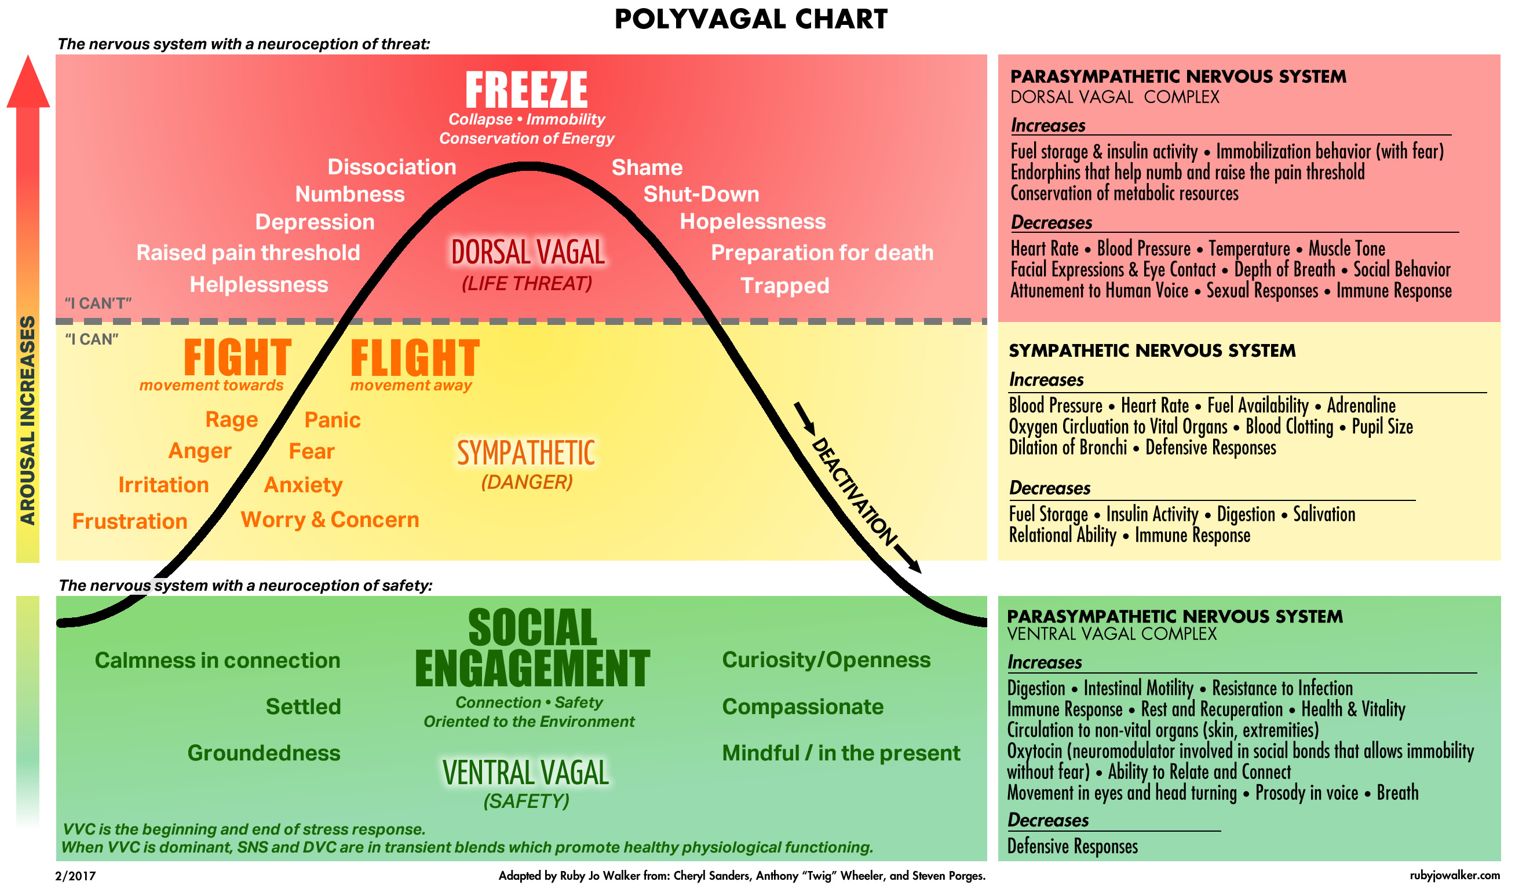
Notes:
Talk about primitive tiger
Person whose social engagement system is suppressed has trouble reading positive emotions from other people’s faces and postures…..greatly diminishes the person’s capacity to receive and incorporate empathy and support.
We move through trauma in this order – 1. social (head) 2. mobilize (limbs) 3. immobile (viscera)

Slide 10
Polyvagal System Overview
2 vagal motor systems
Neuroregulation of the heart is linked to the muscles of social engagement
The vagus nerve is bi-directional.
If you calm the body, you send signals from the body into the brain.
Social engagement can positively change biology.
The vagal nerve is a sensory system that transmits from organs to brain
Notes:
If you have upset in the gut because of trauma you are sending the message to the brain that says “danger”
Disease like IBS, Chronic fatigue, etc = signaling process that is off

Slide 11
Phase 1 CHAOS OR RIGIDITY | Phase 2 DOING | Phase 3 BEING | Phase 4 RECONNECTING
Finding Safety | Inhibition increases function | Self-organizing | Establishing meaning
Stabilization | How to think about things | Physiologically regulating | Recreating relationships
 | Controlling the chaos | Letting go of trauma | Building purpose
 | Self-regulation | Enjoying pleasure naturally | Renewing skills
 | Top-down | Bottom up | Organic
 | CBT, DBT, Grounding
 | PREPARATION | DESENSITIZATION

Slide 12
WINDOW OF TOLERANCE Peter Levine
Hyper-arsousal: panic, anxiety, freezing
________________________________________
Optimal Functioning
________________________________________
Hypo-arousal: Flat, numb, dissociated

Slide 13
Eye Movement Desensitization Reprocessing (EMDR)
Declared an effective evidence-based treatment for PTSD by the U.S. Department of Defense, the American Psychological Association, and the American Psychiatric Association.
SAMHSA cites EMDR as evidence-based practice for treatment of PTSD, anxiety and depression symptoms and indicates that EMDR leads to an improvement in mental health functioning.
Notes:
Give Shapiro history of EMDR
EMDR has helped more than 2 million people in their recovery from trauma and psychological stress. EMDR incorporates elements from many different treatment approaches. It is used to help reduce emotional distress related to traumatic experiences from the past that continue to impact one’s present day life.
EMDR facilitates the processing of traumatic experience to the point of adaptive resolution. In other words, EMDR can help desensitize the trauma, so that its association with physical and emotional distress is reduced.
EMDR can help people recognize and work on feelings and thoughts that come up with the trauma. It can help people think differently about themselves and the world in relation to the trauma.
EMDR appears to stimulate a natural healing mechanism allowing for spontaneous movement toward health.

Slide 14
Brain Structure
AMYGDALA
HIPPOCAMPUS
PRE-FRONTAL CORTEX

Slide 15
Basic Principles of EMDR
Pathological patterns occur because information that happened at the time of the disturbing event was insufficiently processed. This sets in motion a pattern of affects, behaviors, cognitions, and identity structures that maintain dysfunction.
Processing allows the breaking of old dysfunctional connections and the linking of new adaptive associations and responses.

Slide 16
Changes in the Brain Dr. Daniel Amen

Slide 17
How it Works
Adaptive Information Processing
Hemispheric synchronization
Orienting Process
Neurobiological process similar to REM sleep
Dual Awareness
Desensitization
Cognitive Restructuring

Slide 18
Adaptive Information Processing
System is geared to integrate internal and external experiences
Memories stored in neuronetworks form the basis of perception, attitudes, behaviors which contribute to health or pathology
Trauma disrupts normal adaptive processing which results in dysfunctionally held memory networks
New experiences link into memory networks which further strengthen the dysfunctional patterns of belief and behavior
High disturbance stored in implicit memory which does not allow for connecting with more adaptive information

Slide 19
AIP continued…the up side
Adaptive information is also stored in memory networks
Processing of dysfunctionally held memories facilitates linkage to adaptive networks
Nonadaptive perceptions, attitudes, etc are discarded and replaced with more effective beliefs, emotions, sensations which allow for the system to reorganize and resume building complexity

Slide 20
What’s the purpose of bilateral stimulation?
Similar to REM sleep
The brain’s natural time for processing
1
Hemispheric synchronization
Communication between right and left brain to access adaptive information
2
Orienting Process
Provides a neutral place for focus while engaging traumatic material which therefore allows the parasympathetic system to engage
3

Slide 21
As dysfunctional information is reprocessed, the organism will move towards health
Dysfunctionally stored Functionally stored
Implicit memory Explicit memory
Episodic recall Semantic based recall
Ineffective perceptions More effective perceptions
Ineffective behaviors More effective behaviors
Trauma time orientation Present day time

Slide 22
8 Phases of EMDR
Phase 1: Client History
Phase 2: Preparation
Phase 3: Assessment
Phase 4: Desensitization
Phase 5: Installation
Phase 6: Body Scan
Phase 7: Closure
Phase 8: Reevaluation

Slide 23
Benefits of EMDR
Directly accesses the memory
Processes on all levels at once
Shorter duration
No need to share the story
Can be adapted to most populations, used globally
The client has everything they need to do the work!

Slide 24
Strengths development
Resources are the natural and human elements that support the individual’s return to equilibrium, peace, and fulfillment.
In working with trauma we use resourcing techniques to manage hyper-arousal and to support the client’s return to optimal functioning.

Slide 25
Key References
Bergmann, U. Neurobiological Foundations for EMDR Practice. New York, NY. Springer Publishing. 2012.
Van der Kolk, B. The Body keeps the Score: Memory and the Evolving Psychobiology of Post-Traumatic Stress. Harvard Review of Psychiatry, 1994, 1(5), 253-265.
Shapiro, F. Eye Movement Desensitization and Reprocessing: Basic Principles, Protocols and Procedures, 3rd edition. New York, Guilford Press. 2018.
Walker, RJ. Polyvagal Chart. www.rubyjowalker.com

Slide 26
Dr. Bessel Van der KolK
“Trauma is now our most urgent public health issue, and we have the knowledge necessary to respond effectively.
The choice is ours to act on what we know.”

Slide 27
Resources for more….
www.emdria.org – research and information on EMDR and trainings
www.riversedgeinstitute.com – EMDR and other trainings
www.rubyjowalker.com – Somatic Experience and Nervous System workshops
Lillian Ramey, LCSW Lillian@riversagecounseling.com

