Slide 1
Trauma, Attachment
And
Sensory Integration

Slide 2
COMPLEX TRAUMA
Multiple traumatic events such as: witnessing violence, hunger/prolonged malnutrition, childhood accidents with no medical care, moving from home to home, loss of possessions, sexual and physical abuse, parents drinking/using drugs, missing school, parent raging, parent absent….
It is disentegrative of development.

Slide 3
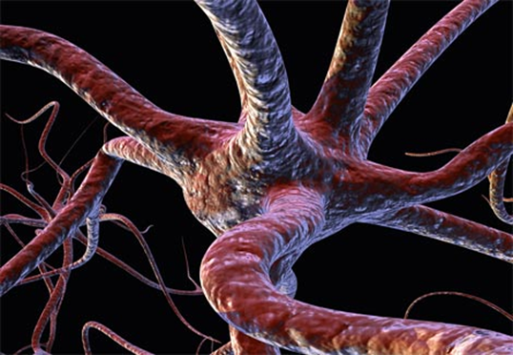
Trauma is: A Neurological Event
Complex trauma is by definition a series of events that shatters a person’s threshold of tolerance.
It is sensory shattering. Our eyes, ears, skin, nose are conveying information that we cannot stand to process.

Slide 4
“Leaving the baby in chronic high-arousal states (increased heart rate, respiratory rate) negatively impacts the infant’s socio-emotional learning during critical periods of right brain development.”
Allan Schore

Slide 5
In acute stress increased cortisol levels allow nerve cells to respond more intensely, but a prolonged stress response with chronically increased cortisol levels may cause cell death and fewer connections between the cells that remain.
CORTISOL CAN BE NEUROTOXIC.

Slide 6
A Trauma Based Sensory Integrative Focus
“Our children experience complex trauma. As a result they exhibit hyper-arousal and numbing on a deeply somatic level. It manifests as a vast system of internal disorganization.”
-Bessel van der Kolk, MD.
Hyper-arousal – Can’t relax, irritable, controlling
Numb-Frozen – Avoidant, oppositional

Slide 7
ATTACHMENT
A deep enduring reciprocal bond.
“Attachment is where the child uses the primary caregiver as a secure base from which to explore and when necessary as a haven of safety and source of comfort”(Benoit, 2004)

Slide 8
Relationships matter!
Relational safety….
Is formed through interaction
Is laid down as neural pathways
Affects implicit view of self and others
Stable but can be changed by new experiences

Slide 9
What is *Sensory – Attachment Therapy?
A sensory rich activity paired with warm playful human interaction.
The parent provides a relational and sensorial mirror to the activity
The parent and child engage in a sensory activity within a nurturing environment to reactivate attachment.
*Jane Koomar, OT, PhD

Slide 10
Why Combine Sensory Integration and Attachment Therapy?
Each model can support the other to work more effectively.
Gives more options and interventions for clinicians and parents to draw from.
Sensory integration issues can create challenges to attachment.
Behaviors can be triggered by
sensory issues as well as trauma/attachment issues.

Slide 11
Why Combine Sensory Integration and Attachment Therapy?
Sensory based interaction is rhythmic. The rhythm creates a movement toward connection, then a movement away from connection, then a return and a move away, and so on.
This pace enables the child to sustain interaction better than direct continued interaction.

Slide 12
“Felt Safety”
With sensory based attachment therapy there is an increase in “felt safety” vs. being told you are safe.
Children can be in safe loving homes for years and can continue to be in an alarm state.
“Felt safety” can only register in the child’s physiology and neurochemistry through an attachment-rich, sensory-rich environment.

Slide 13
“Felt Safety” When a child receives safe nurturing touch, pressure receptors are stimulated under the skin. This in turn sends a message to the vagus nerve in the brain. The vagus nerve slows down heart rate and blood pressure. The child is in a relaxed state. Relational safety.

Slide 14
“Felt-Safety”
Through sensory attachment interactions calming brain chemicals are produced. The master regulator of the brain is serotonin.
This balance in the body and the brain of a child who receives attachment rich and sensory rich care is the foundation for emotion regulation and behavior regulation.

Slide 15
What else do we need?
Quality Repetition
This weaves together the neurobiology of
Relationship, Reward, and Regulation

Slide 16
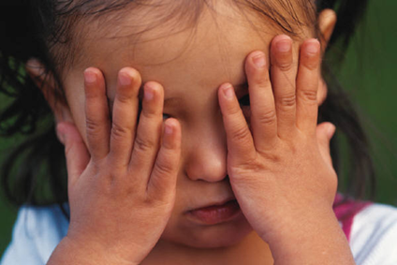
The Bottom Line:
Traditional parenting alone,
and traditional therapy alone,
is not effective for children with
complex
developmental trauma.

Slide 17
OUR COMMITMENT
To create a sensory rich environment,
(the Alert program tools)
To create an attachment rich environment,
(Theraplay tools)
So our children can experience
relational safety.

