Slide 1
Hispanics and Hospice
Leroy aragon, msw
Alliance home health and hospice

Slide 2
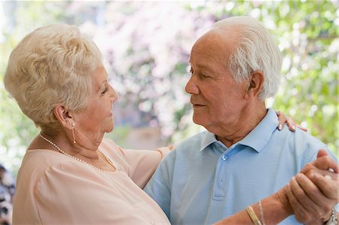
Hispanics and Hospice
WHO ARE HISPANICS/LATINOS?
DEPENDS
WHERE YOU ARE FROM
NEW MEXICO – HISPANIC
LATIN AMERICA – LATINO
GOVERNMENT/CENSUS
DIVERSE POPULATION (Not Monolithic)

Slide 3
Hispanics and Hospice
Number of hispanics in US – 50 million
  (2013 US Census)
  15% - 20% of US Population
  15% Increase by 2050 (30% of US Population)
  Fastest growing ethnic group in US
  43% Increase 2000-2010
  LOGICAL QUESTION
  Why the Under-utilization of Hospice/EOL services among Hispanics? (only about 7% of Hispanics use Hospice)

Slide 4
Hispanics and Hospice
Culture
Familismo – Decisions, interdependence, affiliation,cooperation; shielding of patient
Filial Piety – Moral Obligation to Care for and Respect Elders
Respeto – On basis of Authority, Age , Gender and Socioeconomic Status
Personalismo – Warm personal relationship with Provider

Slide 5
Hispanics and Hospice
FATALISMO
Belief in Fate – We have no Control
RELIGIOSITY
Prayer
Faith In God
SPIRITUALITY
Connection with Spiritual World
Sometimes Santeria
Curandera
Sobador

Slide 6
Hispanics and Hospice
EXTREME RESPECT FOR DOCTOR
Tendency to Believe ALL Doctor says
Often do not seek Second Opinion
MACHISMO
Can be Positive – Protector, Provider, Support
Can be Negative – Misogyny
MARIANISMO
Caregiver
Health Decisions, care for Family
Moral Strength

Slide 7
Hispanics and Hospice
LANGUAGE
Providers
Interpreters – Professional Not Family Members!!
EDUCATION
Poor Communication with Doctor
Medical Literacy
Often Hispanics lack education
Fear – Maybe not treated with dignity before
Discrimination

Slide 8
Hispanics and Hospice
IMMIGRATION ISSUES
Fear of Deportation
Fear of being reported to Authorities
Assimiliation
Discrimination
COST
Medicare?
Medicaid?
Private Insurance?
Private Pay?

Slide 9
Hispanics and Hospice
ELIGIBILITY
Length of US Residency
Legal Residency Status
May Not Realize Severity of Condition

Slide 10
Hispanics and Hospice
GREATER Utilization
OUTREACH
Build Trust
Community Liaison – (bilingual/bicultural)
Get Feedback (Input from Community)
Set Clear Goals – Guide for Outreach
Create Advisory Committee - Stakeholders

Slide 11
Hispanics and Hospice
STAY CONNECTED
Ask Advice about the use of Spanish Terms
FOCUS ON RELATIONSHIPS, NOT PROJECTS

Slide 12
Hispanics and Hospice
Strategies - Outreach
FOTONOVELAS – For people who have limited literacy
ESL CLASSES – Many students will get jobs in Healthcare
Migrant Workers – Social Service Programs
Spanish-Language Publications
Spanish – Language Radio/TV
Pharmacies
Health Clinics
Funeral Directors

Slide 13
Hispanics and Hospice
Strategies – Outreach - continued
Community Education – Seminars, Workshops
Individual Assistance – Hospice Staff, Social Worker, Volunteers
Immigration Groups – Enlace Comunitario
Churches
Bulletin Boards
Catholic Charities
NCLR
LULAC

Slide 14
Hispanics and Hospice
REMEMBER
ALL THIS REQUIRES
Cultural Sensitivity
Diplomacy
Bi-lingual Staff
Bi-Cultural Staff
Resources !!!!

Slide 15
Hispanics and Hospice
QUESTIONS ??

