Slide 1
To advance health equity and improve health in U.S. communities through application of best practices from around the world.
Reimagining Equity

Slide 2
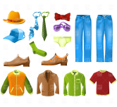
Global to Local: The Connection Desk
1938 unduplicated clients served in 2019
Over 2/3 of residents speak a language other than English
Approximately 2/3 are people of color
Approximately half are foreign-born
Sign up for health insurance | Sign Up for ORCA LIFT | Applying/Finding a food assistance program
Find legal assistance for tenant rights, immigration | Find an ESL class | Find job training/computer class
Information on housing or rent assistance | Information about utilities assistance | Help with a resume or job application
Sign me up for a fitness or nutrition class | Find programs for my children | Clothing Assistance for Adults and Children

Slide 3
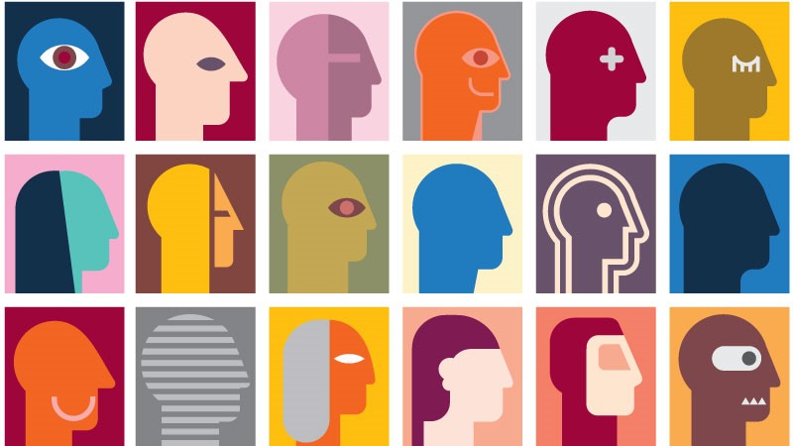
CIE and Equity: Services to Systems Change
Eliminate barriers
Culturally appropriate engagement
Assess Whole Person Needs
Connect to service partners

Slide 4
The covid-19 racial disparities could be even worse than we think – Washington Post
Institutional racism contributes to Covid-19's "double whammy" impact on the Black community, Fauci says - CNN
Racial health disparities already existed in America— the coronavirus just exacerbated them - CNBC
2020
Seattle Latinos Disproportionately Affected by COVID-19 – Governing.com
US reports show racial disparities in kids with COVID-19 – Seattle Times
New analysis shows pronounced racial inequities among COVID-19 cases, hospitalizations and deaths
– Public Health-Seattle & King County Blog

Slide 5
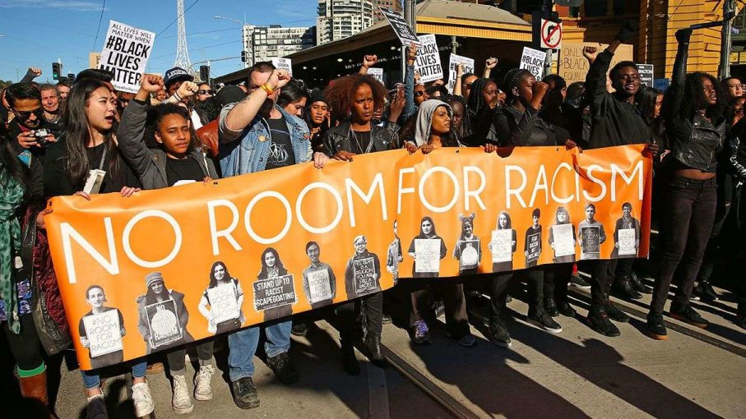
Health equity cannot exist without racial equity.

Slide 6
More than just services…
Health equity requires policy and system change.
The CIE can be an incubator for system change

