Slide 1
Tanikka Watford Williams
Executive Director
Tanikka@tmwg.org

Slide 2
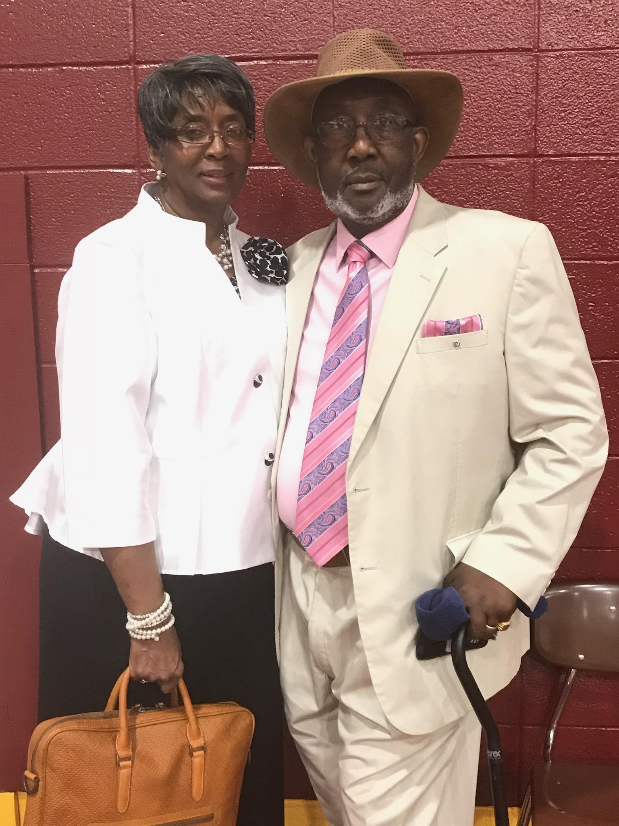
The Moore Wright Group (TMWG) is a 501(c)3 nonprofit organization. Our mission is to break the cycle of poverty, abuse, and abandonment in their community by providing hope. Our vision is to create communities where everyone can thrive.

Slide 3
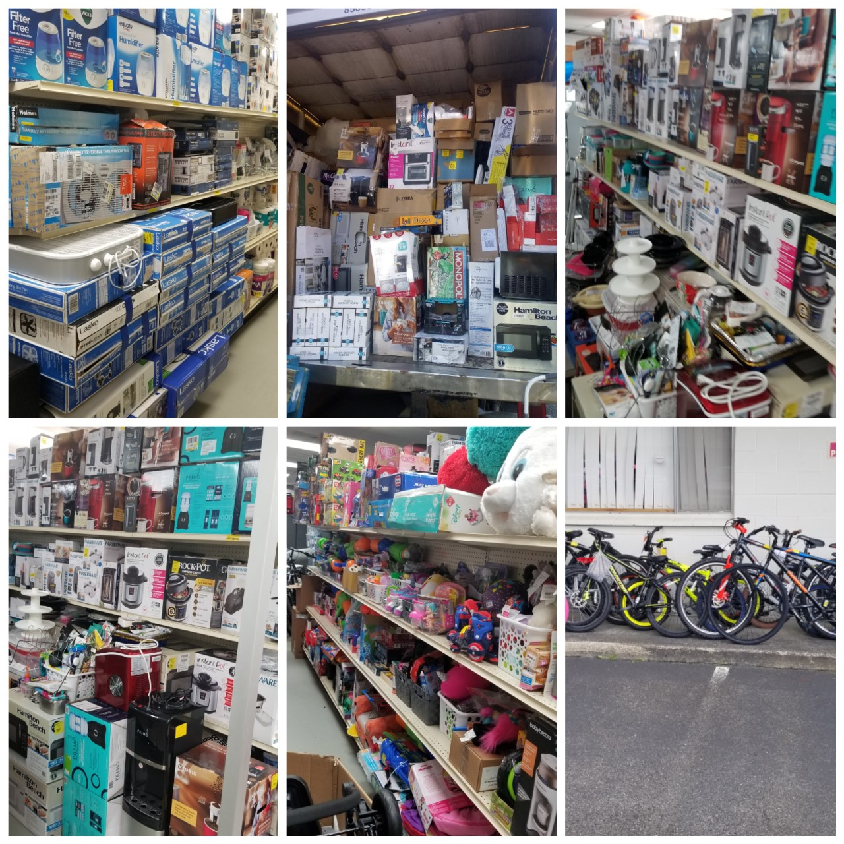
Resource
Connection
Center

Slide 4
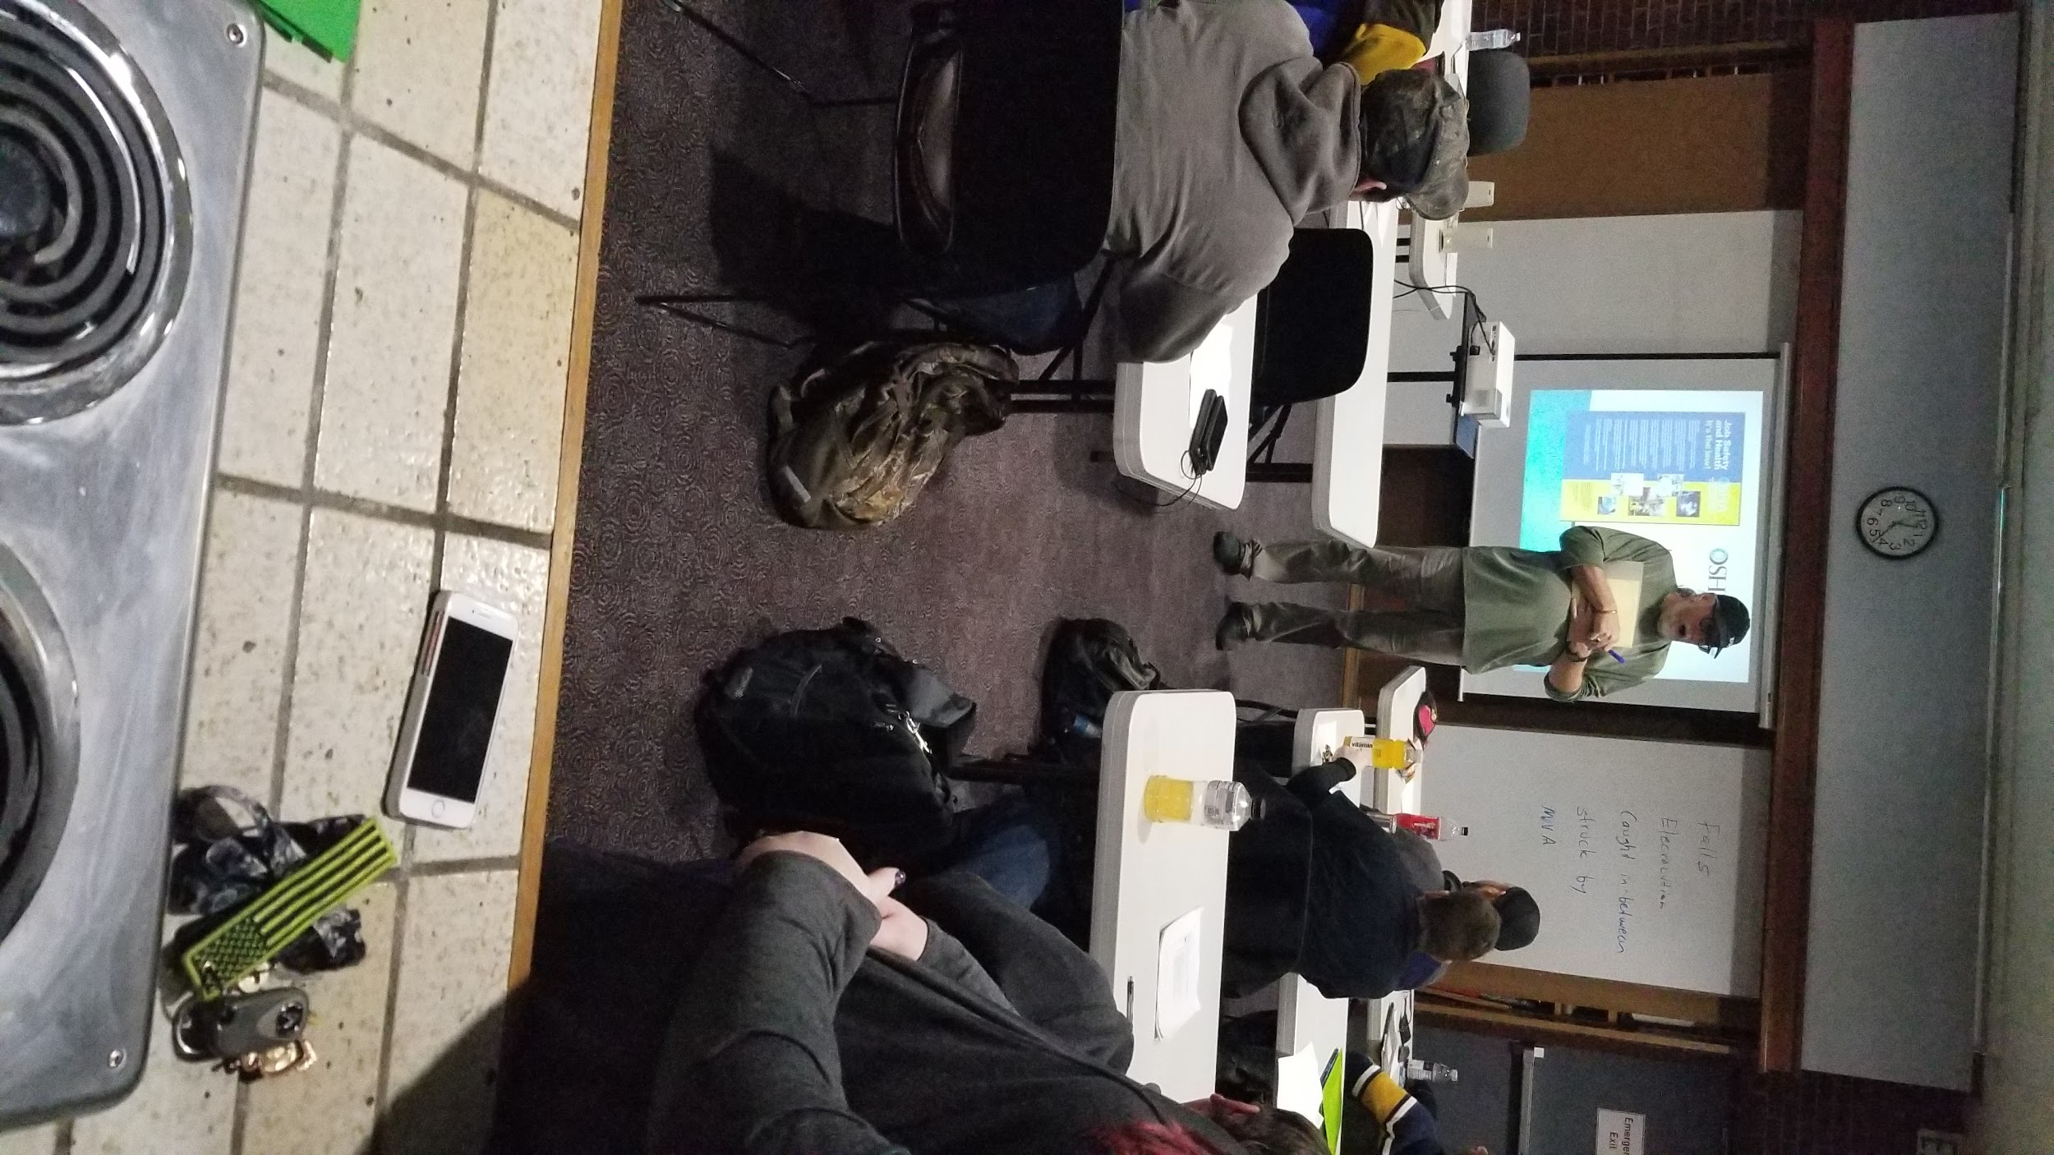
Warehousing and Logistics Academy
Certified Logistics Associate
Certified Logistics Technician
Certified Production Technician
OSHA10
Forklift
Virtual Classes offered

Slide 5
$9,376,245.00
Disaster Distribution Center
28 counties served
573,855 families
207 organizations

Slide 6
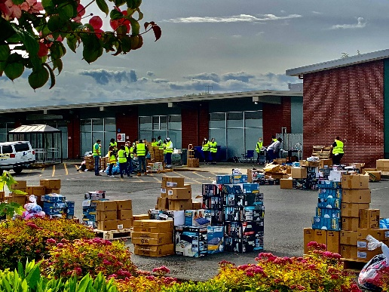
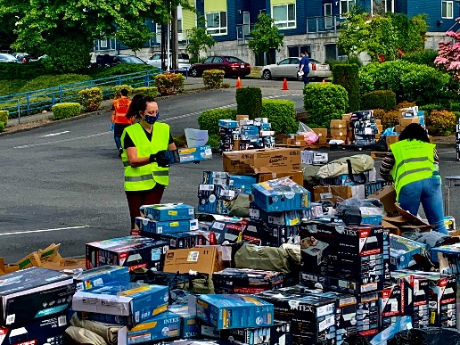
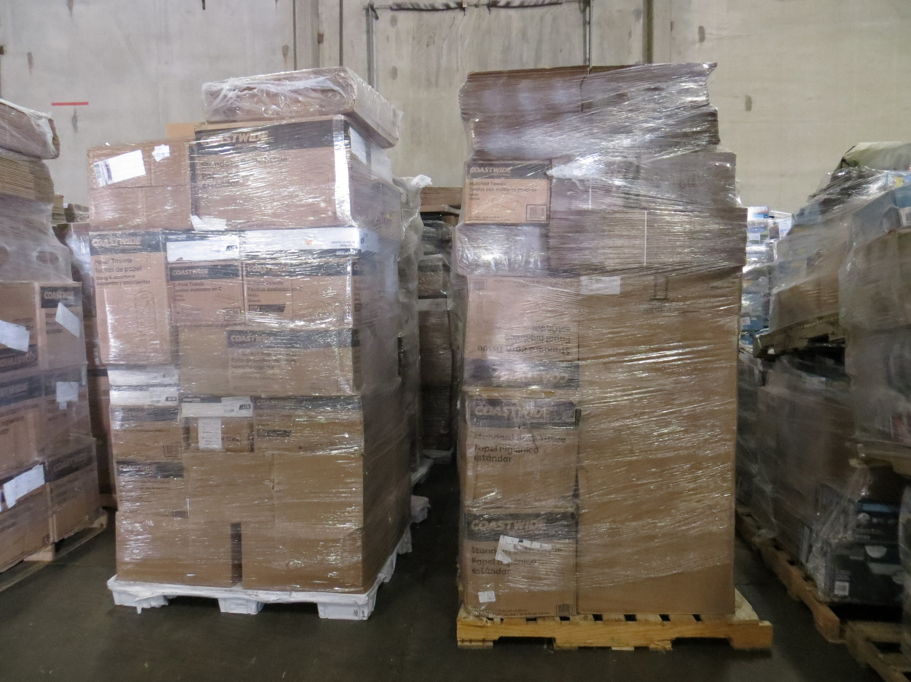
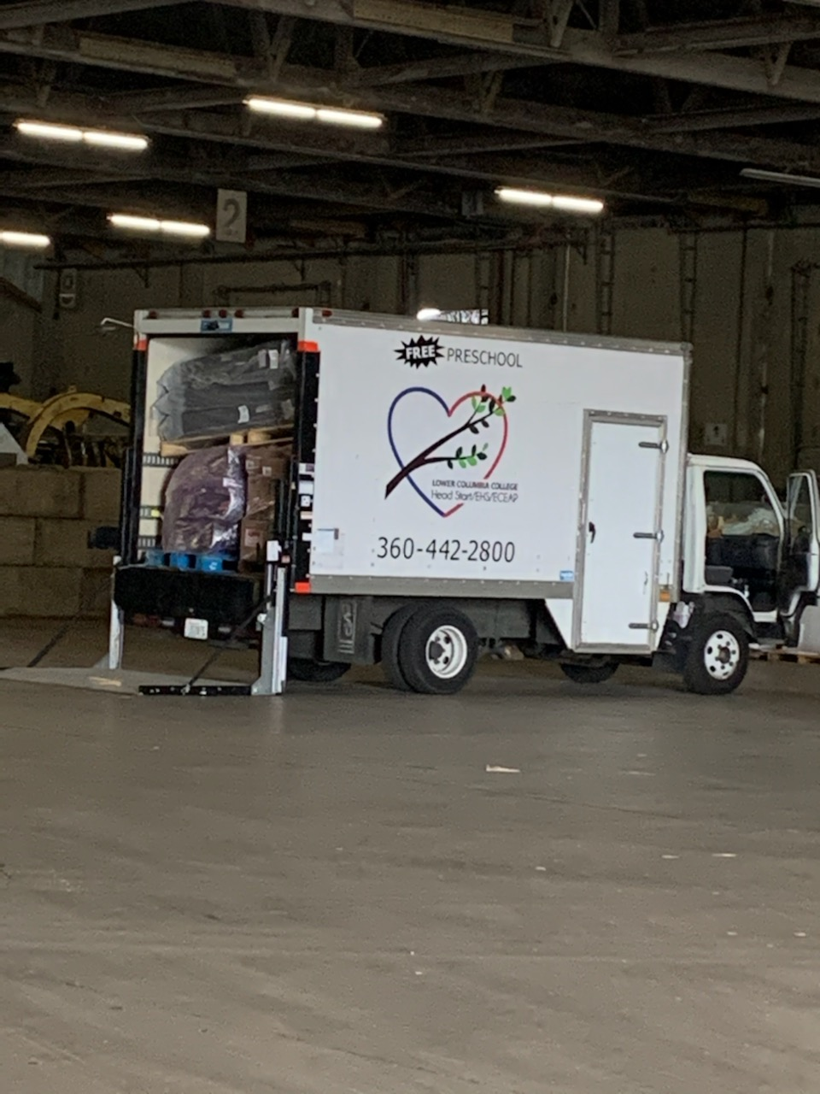
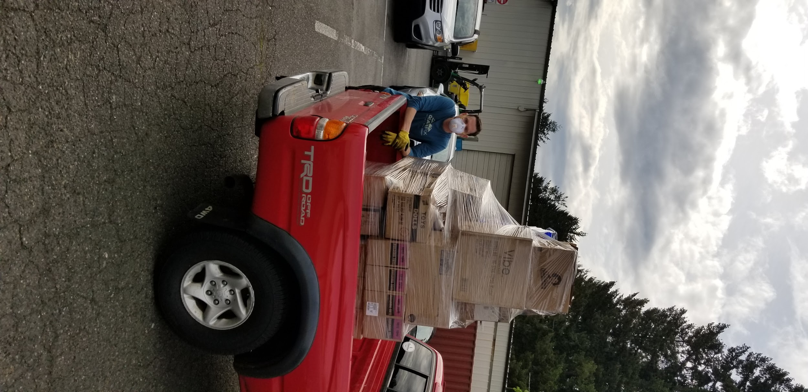
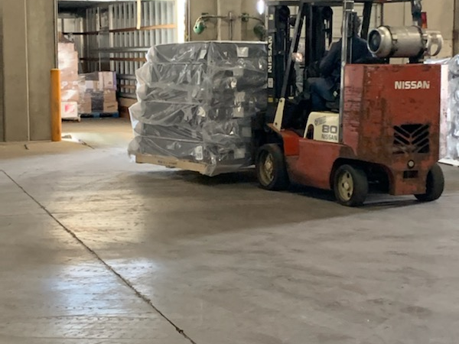

Slide 7
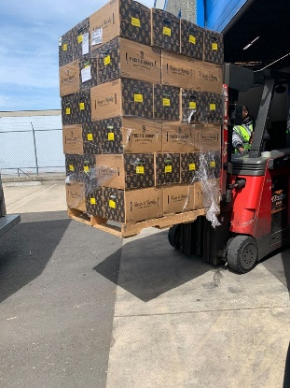
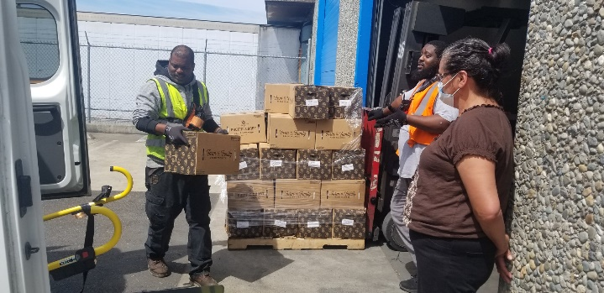
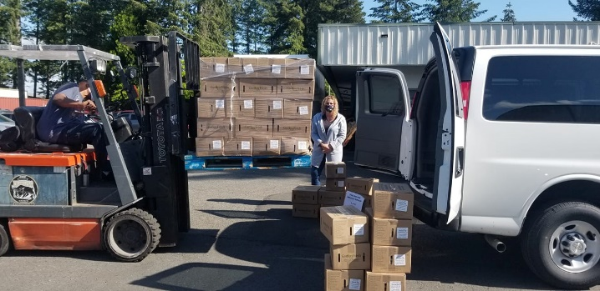
FOOD DISTRIBUTION
BOXES OF FOOD

Slide 8
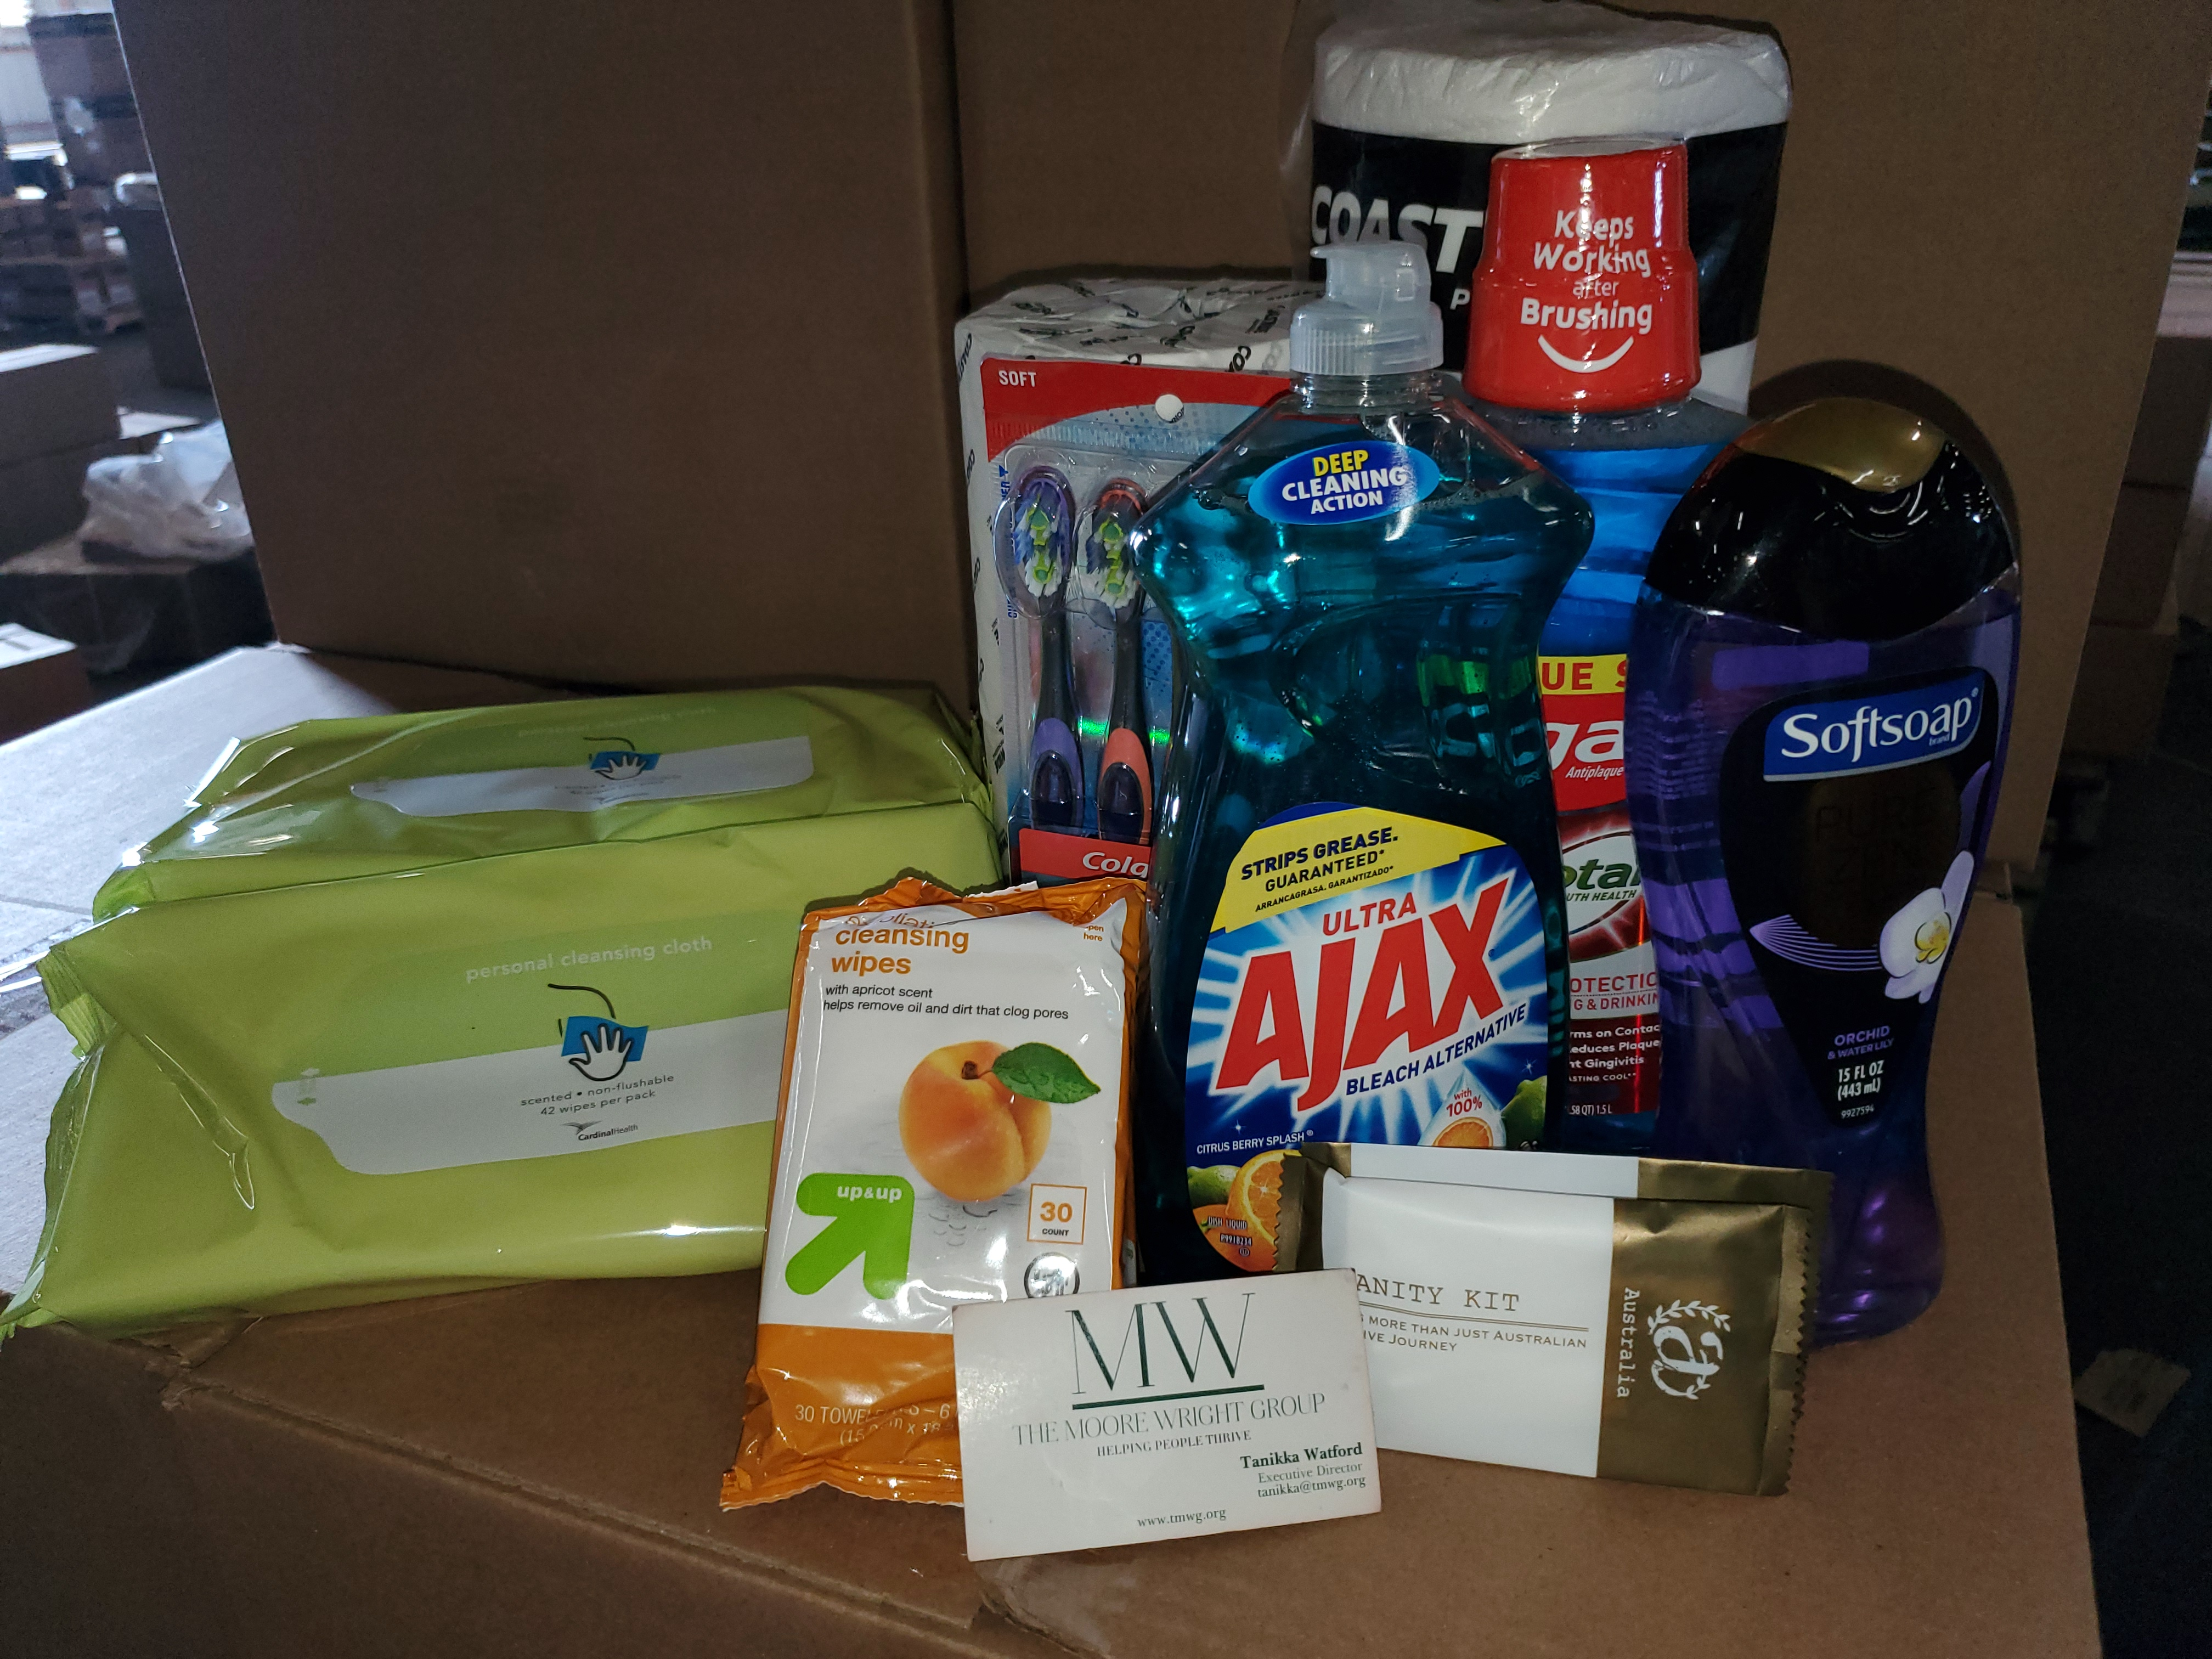
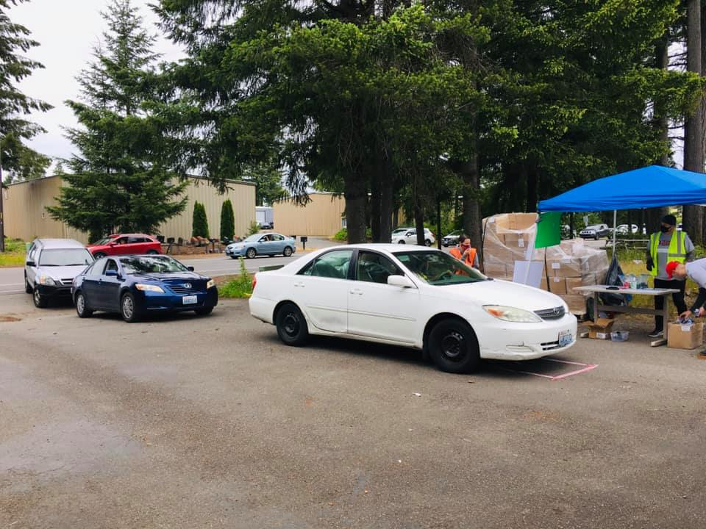
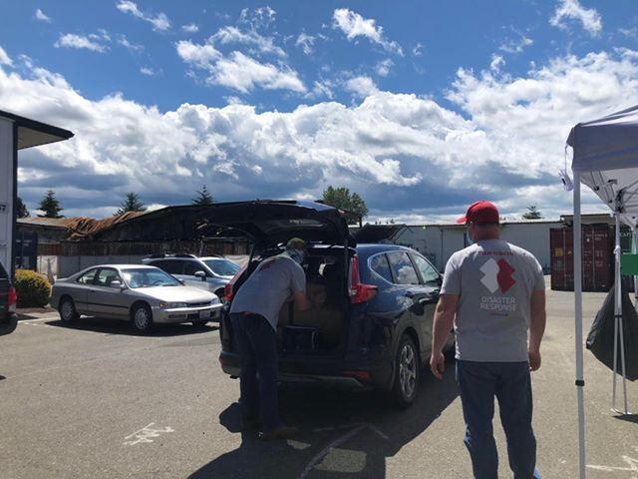
Community
Distribution Days

Slide 9
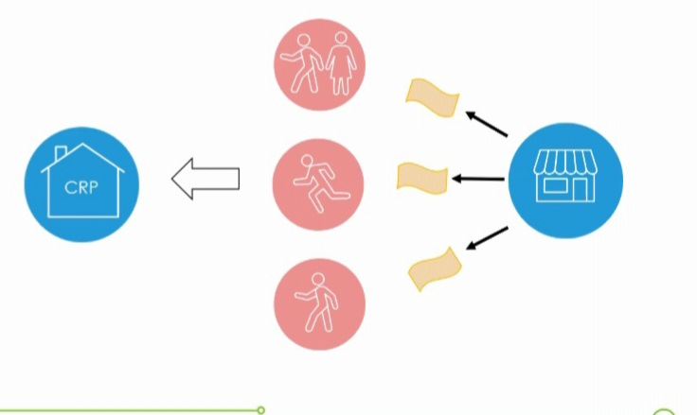
Partnership Voucher Program

Slide 10
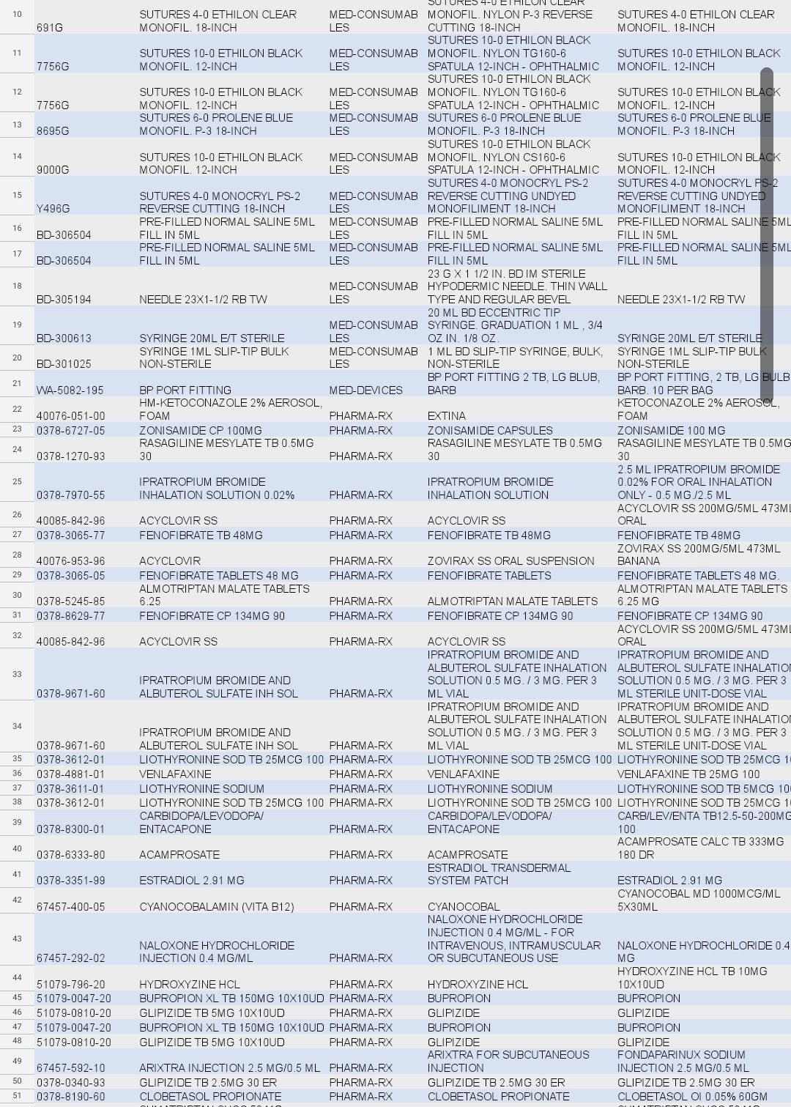
Distributing Health

Slide 11
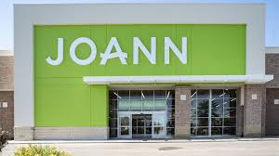
Retail Partnership Distribution

Slide 12
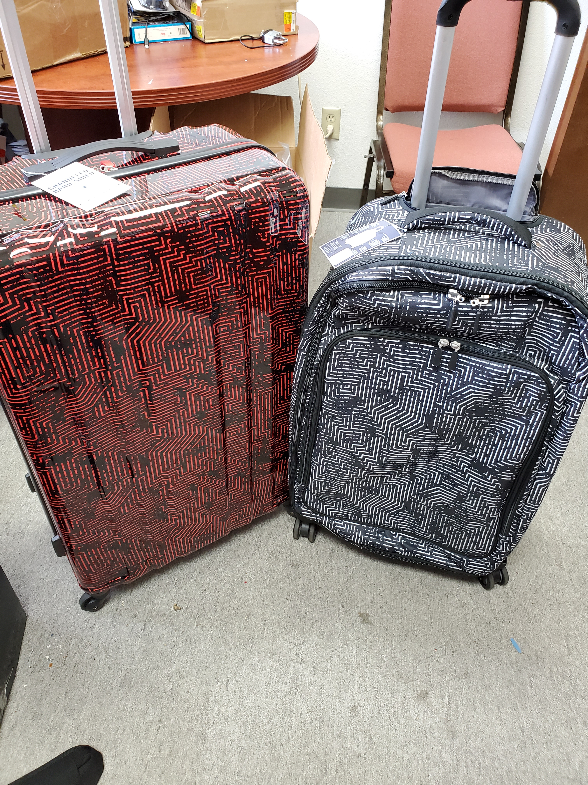

Slide 13
Catholic Community Services Farmworker Center

Slide 15
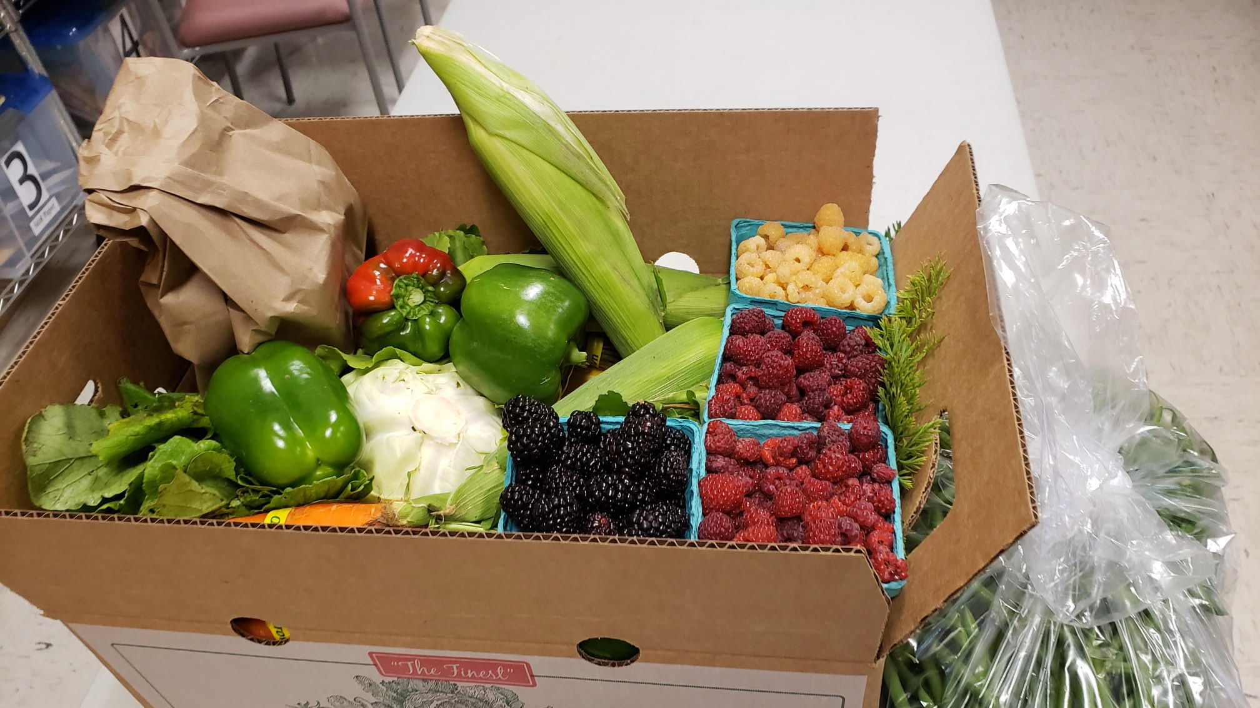

Slide 17
Chelan-Douglas Health District

Slide 18
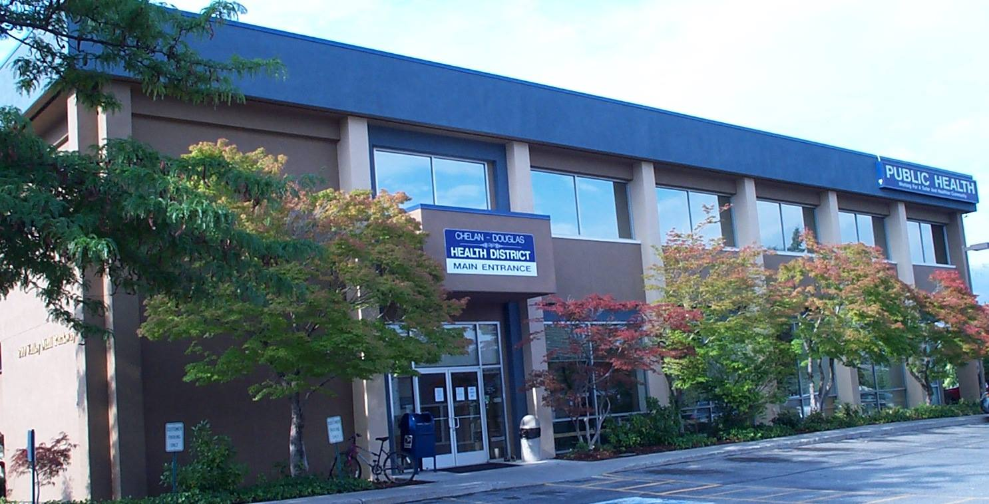

Slide 19
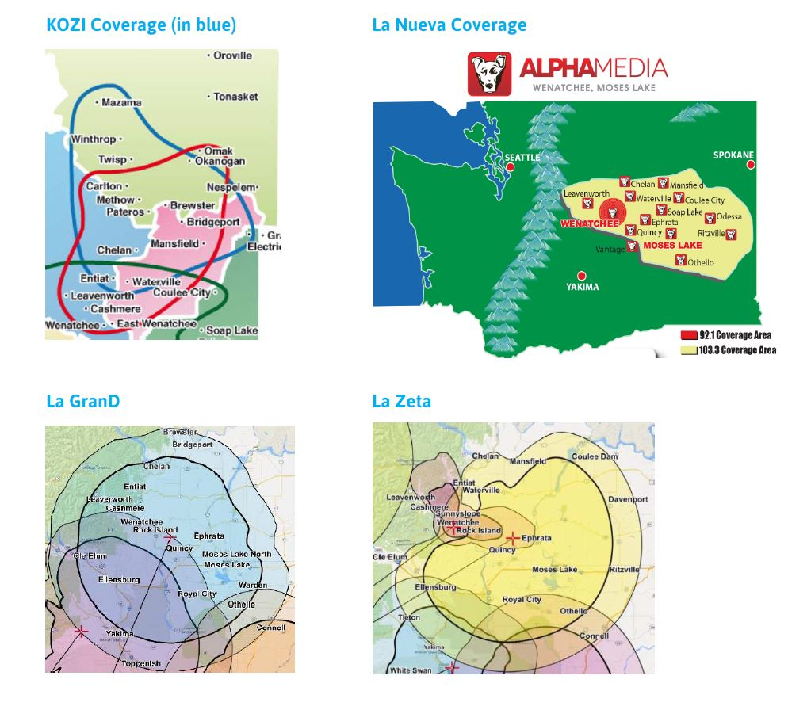

Slide 21
