Slide 1
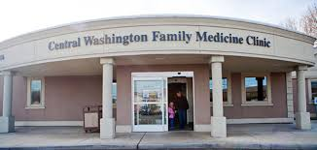
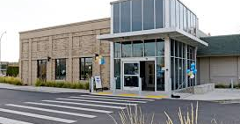
Community Health of Central Washington (CHCW)
Bridget Beachy, Director of Behavioral Health
Roles: BHC, administrator, primary supervisor for interns and fellows, faculty for FM residency
CHCW fast facts
5 primary care clinics
350+ employees
30,000 patients
76% of pts have very low incomes
5.3% are still uninsured
46.3% represent a race or ethnicity other than white
11.2% require care in another language
Operate via the Primary Care Behavioral Health model
Mission – fortify primary care
Increase ACCESS & REDUCE stigma
Growth – can only grow if it’s working for providers and patients!
Work flow

Slide 2
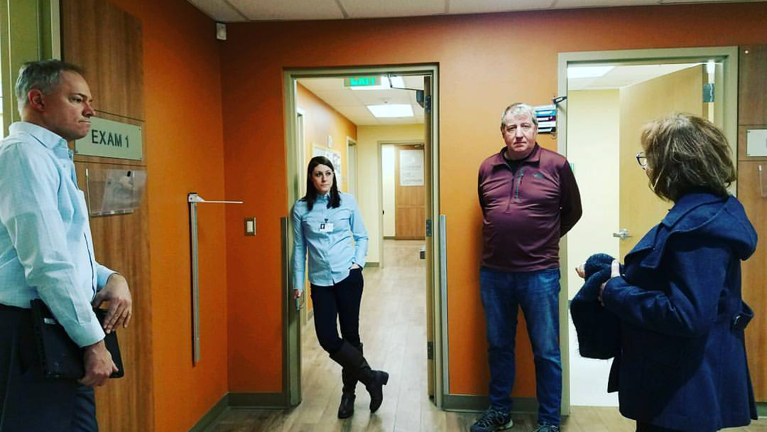
From GATHER to the Four C’s: PCBH philosophy
Great special edition on PCBH from the Journal of Clinical Psychology in Medical Settings¹
If you haven’t read, please do!
G – Generalist
A – Accessible
T – Team oriented
H – Highly productive
E – Educator
R – Routine
*Remember… GATHER → Four C’s²
First Contact
Continuity of care
Comprehensive care
Coordinate care when needed
Notes:
12:15 – 12:20 pm bridget
Really emphasize the importance of understanding the philosophy

Slide 3
Primary Care Providers’ Satisfaction
1-5 Likert Scale | 2016 | 2017 | 2018 | 2019 | 2020
Number of providers | 40 | 40 | 45 | 41 | 39
Overall, how satisfied | 4.63 | 4.45 | 4.77 | 4.78 | 4.78
Overall, how helpful to patients | 4.6 | 4.575 | 4.72 | 4.73 | 4.84
Overall, how helpful to you | 4.68 | 4.68 | 4.81 | 4.88 | 4.95
Patients are more likely to be compliant | 3.72 | 3.73 | 3.88 | 3.9 | 4.0
BHCs make my job easier | 4.63 | 4.5 | 4.67 | 4.75 | 4.63

Slide 4
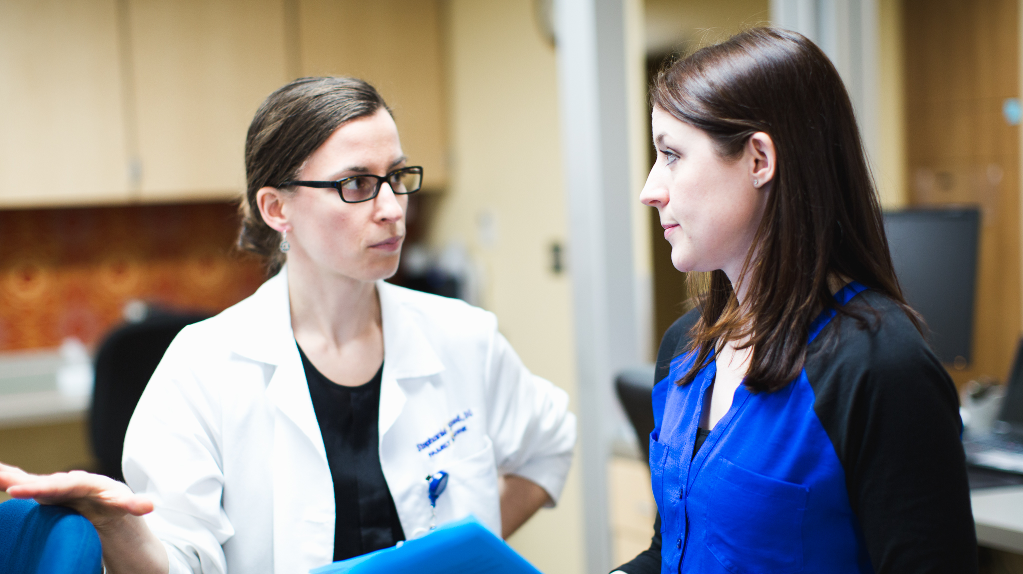
PCPs’ Qualitative responses
I have come to believe this brings more value to the care I can offer patients than any other service in our clinic.
One of the main reasons I came and that I will stay
BHCs well integrated into clinic and very much appreciate warm hand-offs and co-visits
In the future, I will never practice without a BHC partner on the team.
I am glad we have BHCs in our practice, it’s a resource that every single patient needs access to.
Love them!! Makes our job so much easier!
Our BHCs greatly increase patient care and satisfaction, at the same time supporting me in practice
I can't say enough good things about the support our BHC staff provides for our patients.
…BHC is better at making an impact on our childhood obesity epidemic as well as the overwhelming number of children that come in for anxiety, depression, even school related troubles
BHC services are an indispensable service provided at CHCW and sets our FQHC apart from others!
We are extremely fortunate to have such an energetic, knowledgeable BHC team. You have made our pts and providers lives better. Thank you!
This is the best innovation in primary care in my entire career. It is vital to good patient care.

Slide 5
Patient Satisfaction with BHCs
How it compares to state and national averages…
 | 2016 | 2017 | 2018 | 2019 | Rolling
Provider Listening | 91.76 | 91.76 | 91.3 | 94.9 | 94.1
Provider time spent | 89.18 | 89.18 | 89.3 | 92.2 | 91.5
Provider explanation of care | 89.83 | 89.83 | 90.7 | 94.6 | 93.7
Provider knowledge of BH/medical history | 87.4 | 87.4 | 87.3 | 89.5 | 91.6
Overall Satisfaction | 90.59 | 90.59 | 87.1 | 90.2 | 89.8

Slide 6
What are patients saying?
I like the interest of Dr. BHC in us.
I enjoyed that I was able to talk to Dr. BHC and that he was able to understand me.
They are usually friendly. Dr. BHC was awesome.
I like meeting with Dr. BHC; she listens to me and gives me advice.
I have had the same provider for years now, Dr. BHC.
It was very heart felt.
BHC was very helpful and knowledgeable, and it seemed like she took her time. I didn't feel rushed during my visit. They are friendly at the front desk.
I like BHC; she is easy to talk to and makes things comfortable.
BHC was really informed and organized, and she gave me very personalized care.
I like the good rapport that I had with BHC.
I like BHC; she is a good listener.
Dr. BHC listened to me, and she was able to make sense of what I was saying. She gave me some tools that help me out.
Notes:
“Please tell me what you liked the most (best part) about your last visit to the clinic?”

Slide 7
BHC Team Members

Slide 8
Total BHC Encounters

Slide 9
Workflow
All staff and providers: BHCs are members of interdisciplinary team (all conditions, all ages)
Before every half day (AM / PM) – BHCs are assigned to be “in clinic”
If WHO or same day visit is needed – Microsoft Teams all BHCs who are “on”
3 minute rule to respond w/ETA
BHCs’ schedules are staggered on scheduled visit “on” and then “off”
Aim to be available in
< 15 minutes
BHC communicates in about 1-2 minutes w/medical provider
Sees patient in exam rooms
Uses the scheduling processes established by clinic

Slide 10
Initial visit: Contextual Interview Love, Work, Play & Health BXs SDOH? → CC team Cultural aspects
Love
Living Situation
Relationship
Family
Friends
Spiritual, community life?
Work/School
Work/school situation
Income?
Play
Fun/Hobbies
Relaxation
Health Behaviors
Exercise
Sleep
Diet
Substance use (caffeine, cigs, alcohol, drugs, etc.)
3 T’s
Time, Trigger, Trajectory
Notes:
Bridge

