Slide 1
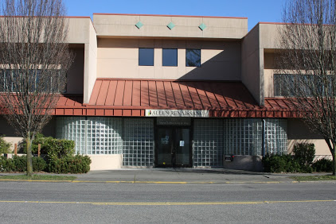
ALLEN RUSSELL CONFERENCE CENTER

Slide 2
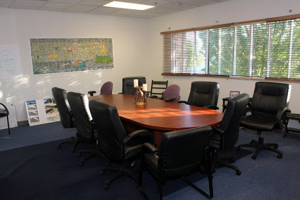
OFFICE SPACE

Slide 3
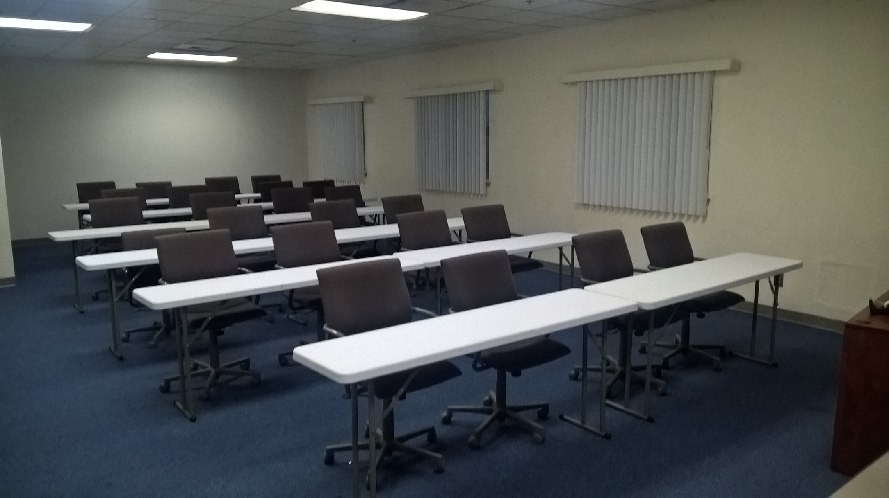
CLASSROOM SPACE

Slide 4
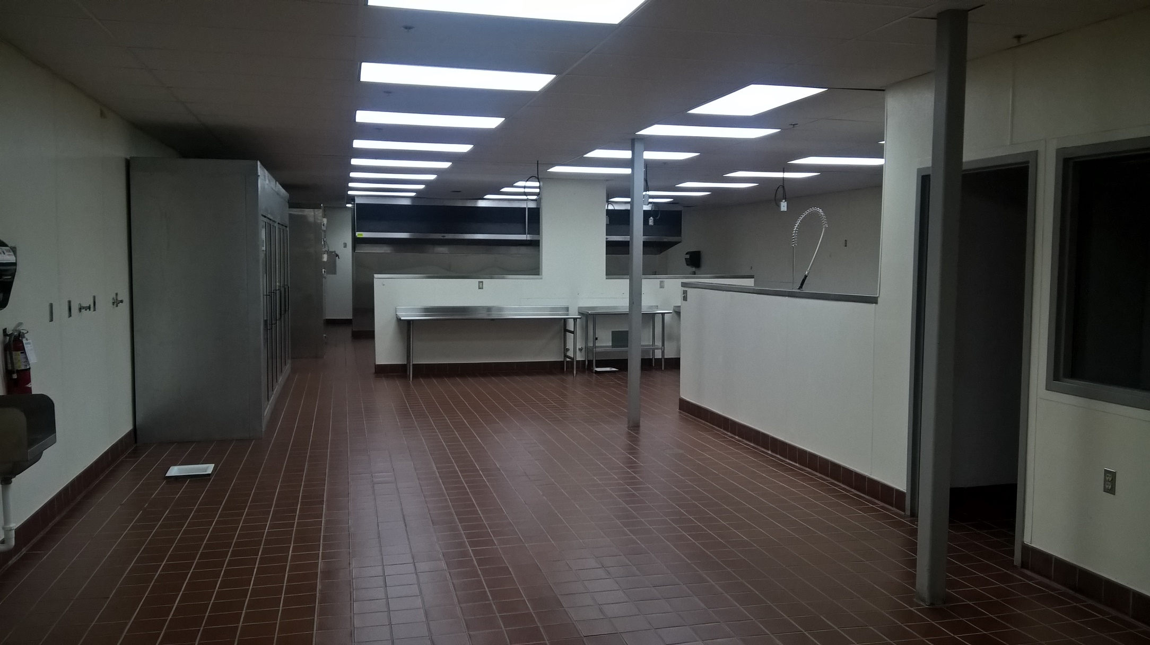
COMMERCIAL KITCHEN

Slide 5
ALLEN RUSSELL CONFERENCE CENTER

Slide 6
SYSTEMIC “ISM”
Barriers of the Black Community

Slide 7
SYSTEMIC “ISM”
CRONYISM
NEPOTISM
RACISM

Slide 8
CRONYISM

Slide 9
NEPOTISM

Slide 10
RACISM

Slide 11
SYSTEMIC “ISM”
Barriers of the Black Community

