Slide 1
Building Belonging in Health Care
October 23, 2020
john a. powell, Director
Othering & Belonging Institute
Othering & Belonging Institute

Slide 2
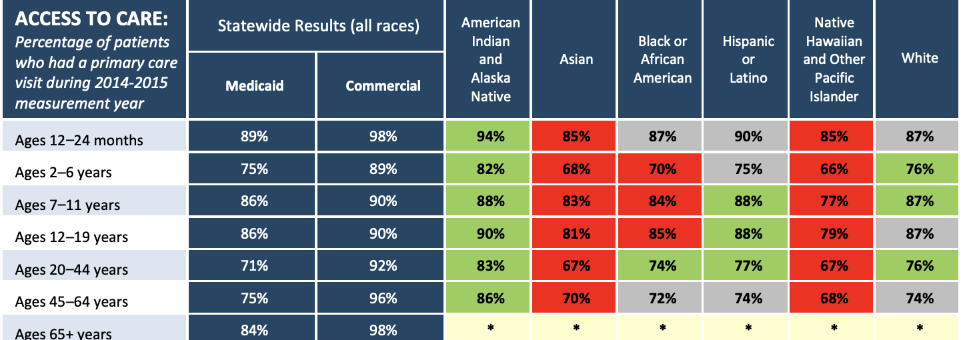
Disparities in Medicaid Access
Source: Washington Health Alliance

Slide 3
Rapid change produces collective anxiety:
Change in demographic
Climate, Tech
Globalism
Fear, anger, Othering
Breaking
Leadership, Meta-Narrative, Structures, Organizing
Bonding
Empathy, belonging, inclusion
Increase in anxiety
Connecting on similarities, common threads of identity

Slide 4
The problem of “Othering” is the problem of the 21st century
And the possible demise of the nation state as we know it
Notes:
The Problem of the 21st Century”] john says: “Over a century ago, WEB Dubois predicted that ‘the problem of the 20th century is the problem of the color line.’ Today, the problem is othering.
Looking around the world, we see inter-group conflict as central to almost every human problem: territorial disputes, war and conflict, climate change, migration, economic inequality. Group identities and differences informs almost all of them.

Slide 5
sexuality
class
ability
skin tone
gender
race
ethnicity
religion
age
Othering is a generalized set of common processes that engender marginality and group-based inequality across any of the full range of human differences
Notes:
john says: “We define othering as follows. It’s important to emphasize that othering is marginality on the basis of group status – not individual identities or idiosyncratic identities. It’s also not the same thing as alienation.”

Slide 6
Indices of Othering
Lack of effective voice
Lack of representation
Lack of recognition
Lack of power
People can experience strong othering in one or some of these areas and low or no othering in others. When someone experiences othering on all of these indices, then the othering is more likely durable. High durability also exists when othering happens between the interpersonal, structural, and cultural.

Slide 8
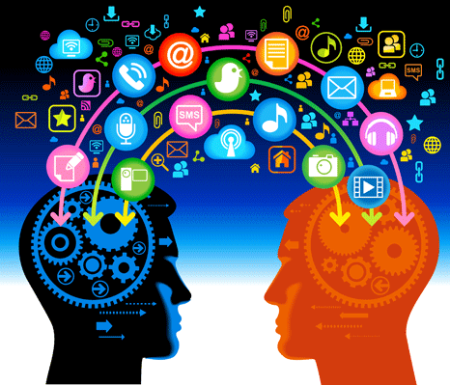
Mind Science and the Importance of Human Connection
Source of Strength Support
Relational Catalyst Support

Slide 9
Heart of Belonging: co-creating & being seen

Slide 13
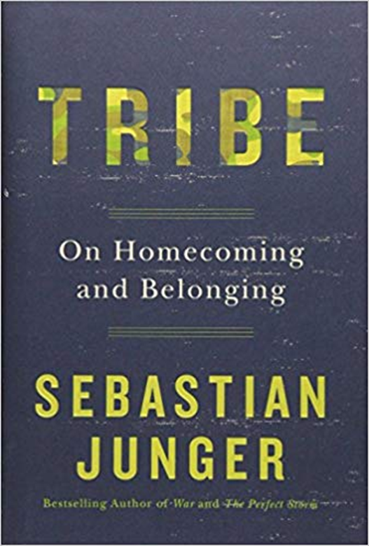
The Trauma of Othering
In addition to demographic change, technological change, inequality and migration, another stressor is hyper-individualism.
Both post-traumatic stress disorder – the trauma experienced by veterans – and even post-partum depression – are exacerbated by our hyper-individualistic society, that does not make people feel cared for.
In his book “Tribe,” Sebastian Junger writes “Modern society has gravely disrupted the social bonds that have always characterized the human experience.”

Slide 14
Othering and Pandemics: Lessons from the San Francisco
1876 Smallpox Epidemic: SF Health Officer blames the spread and severity of the epidemic on “unscrupulous, lying, and treacherous Chinamen” and their “willful and diabolical disregard of our sanitary laws”
1938 Tuberculosis Epidemic: SF Health Officer blames substandard tenement housing conditions of Chinese residents
What changed? Chinese-American activism and struggle for political voice and belonging
However, their claim to cultural belonging was contingent on performing “normative hygiene and heterosexual family forms”
Source: Nayan Shah; Public Health, Race, and Citizenship
Notes:
The modern process of public health reform emerged within a web of so- cial, political, and cultural linkages that produced a new conception of the human subject in the nineteenth and early twentieth centuries.
“In the 1930S and I940s, Chinese American activists were able to demonstrate that they were experts on themselves and their living conditions, and they made this self-knowledge a potent political claim. By engaging prevailing norms of conduct, Chinese American activists could argue for the wor- thiness of Chinese Americans to participate in and draw upon the re- sources of American society. “
Women and men, white and Chinese, reinterpreted their identity and their relationship to the nation through racially coded languages of hygiene and health. This racial coding was shaped and transformed by the norms of class through discourses of respectabil- ity and middle-class tastes and by the norms of marital heterosexuality through discourses of the nuclear family formation, adult male respon- sibility, and female domestic caretaking.

Slide 15
Notes:
We believe the answer to othering is belonging. We must strive to build a society in which everyone belongs. But belonging is not the same as “saming.” Belonging does not mean making everyone the same through assimilation.

Slide 16
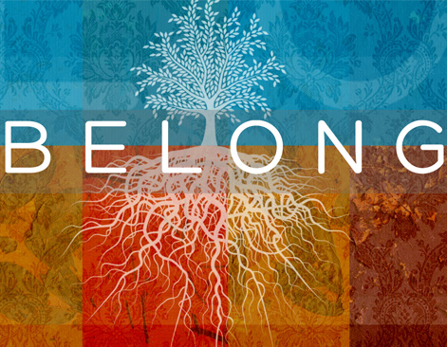
Belonging
Belonging or being fully human means more than having access. Belonging entails being respected at a basic level that includes the right to both co-create and make demands upon society.
Belonging
Notes:
Belonging means being fully viewed as a human, but also as a full member of society and of the community. It means having dignity and voice.

Slide 17
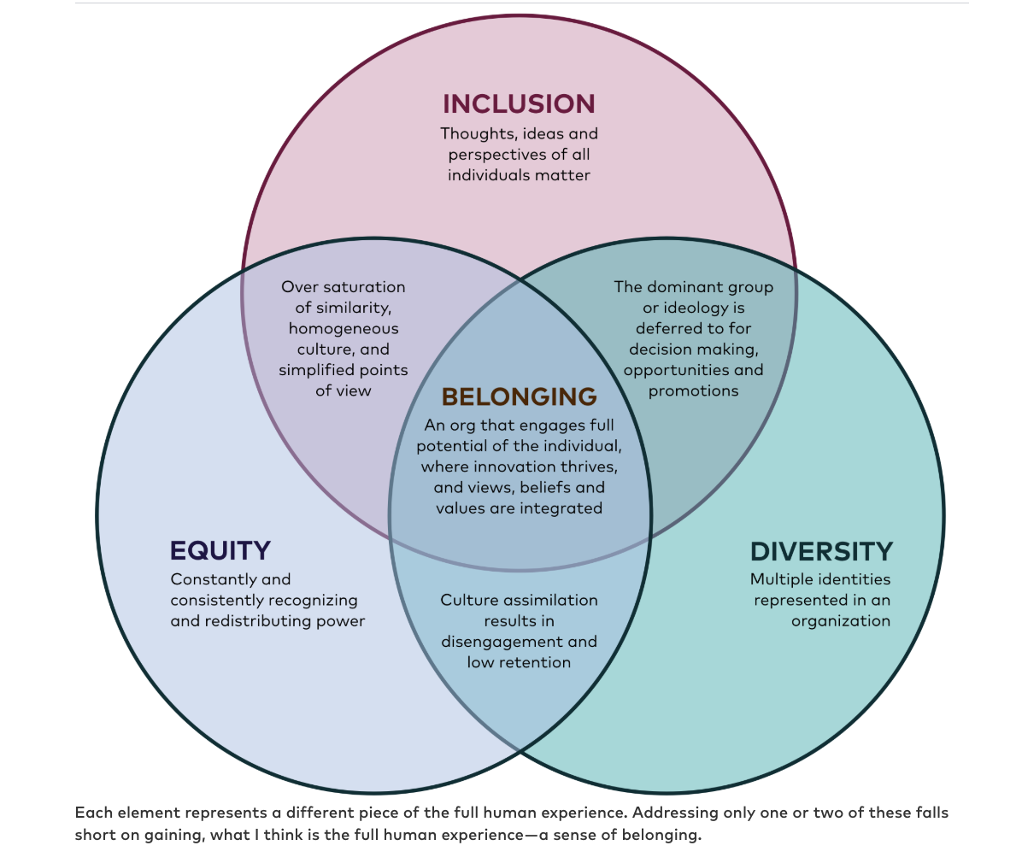
Belongingness interventions communicate not only that someone belongs, but it shapes how they feel about and regard the thing to which they belong to.

Slide 18
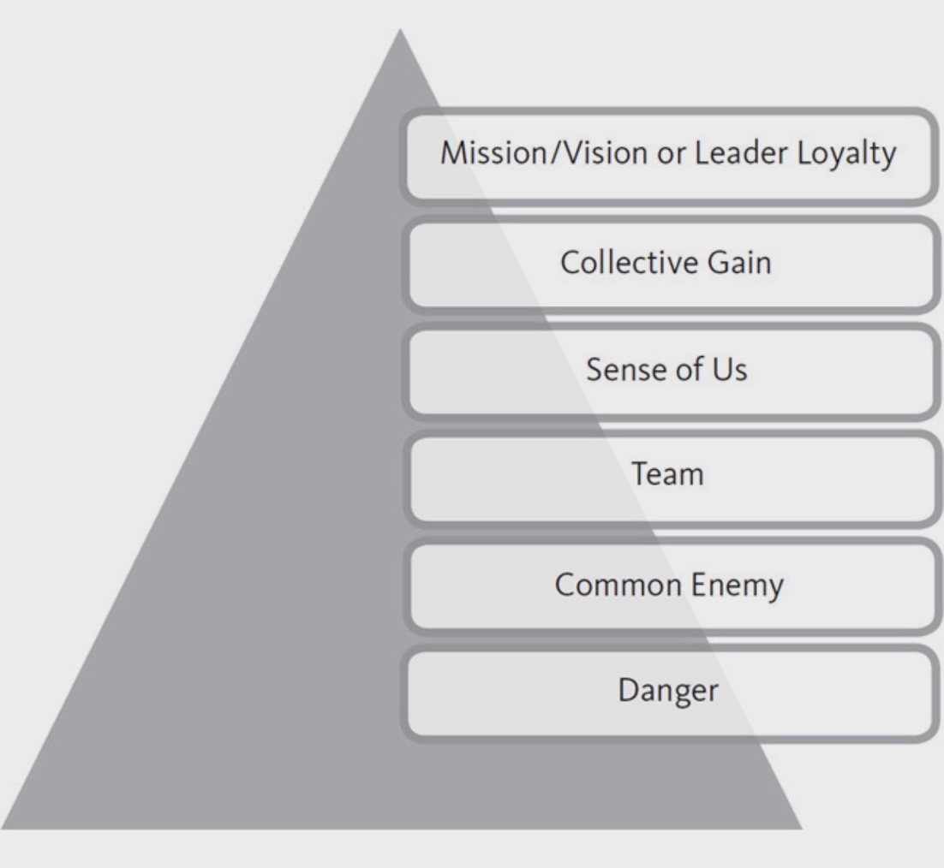
Tiers of Belonging
Notes:
Head of Kaiser

Slide 19
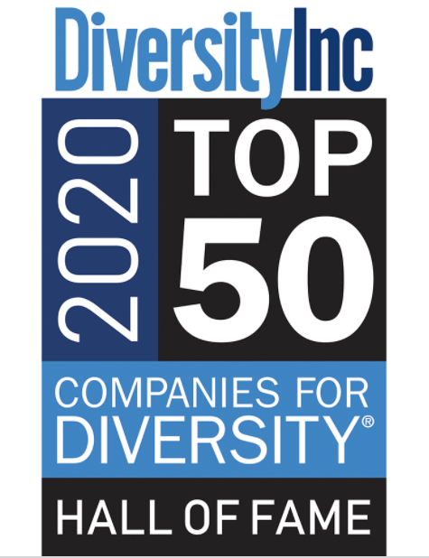
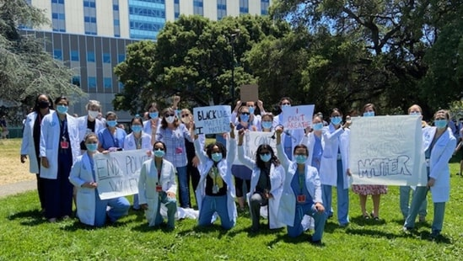
Belonging in Health Care: Kaiser Permanente
Greg Halvorson, CEO and chairman of Kaiser from 2002 and 2013, had the goal of creating a culture of belonging in the workplace
Kaiser also works to build belonging through mentorship, community outreach opportunities, and Dialogue Circles
Source: Kaiser Permanente
Notes:
Kaiser works to build belonging through:
Mentorship for POC residents
Outreach opportunities for residents to mentor local high school, college, and medical students to improve pipeline of health care providers
All residents participate in a 3-year longitudinal community-based experience called the Kaiser Pediatric Resident Education in Advocacy and Community Health (REACH) program
Hold Dialogue Circles to share personal experiences of racism
Presentations to staff by experts on racism and impact of place on health
Equity, Inclusion, and Diversity Committee with residents and faculty does curriculum development cultural humility training and “commits to transforming our residency program by centering on comprehensive, equitable care through URM recruitment and retention, comprehensive antiracist training and direct community engagement, thereby fostering an authentically inclusive community of action”
Source: https://residency-ncal.kaiserpermanente.org/programs/peds/oakland-pediatrics-diversity-equity-inclusion/

Slide 20
Belonging in Health Care: Devoted Health
Guiding question: how to cultivate love within the company and in their interactions with patients and their community?
Devoted Social Club: creating belonging circles with staff, investors, patients, and seniors.
Source: Devoted Health
Notes:
Devoted Health is a Silicon Valley-backed integrated health service company (similar to the Kaiser model), that uses advanced technology in their provision of care. The company’s motto is to come from a place of love. One of their guiding questions s how to cultivate love within the company and in their interactions with patients and their community.
They decided to create the Devoted Social Club which is a monthly circle. Their research showed that loneliness was a big factor at the company so they brought people together in these circles for 10 weeks of relationship building.
The next phase was a monthly belonging circle where they convened employees and staff as well as investors and the executive leadership. In these convenings they had conversations about who the profits belong to.
They realize quickly that there were voices missing from the room who would have an opinion about this and a stake in what happens to the profits, like their patients and the seniors that they care for.
Devoted is now working on opening up their belonging circles to a wider community to include these voices.

Slide 21
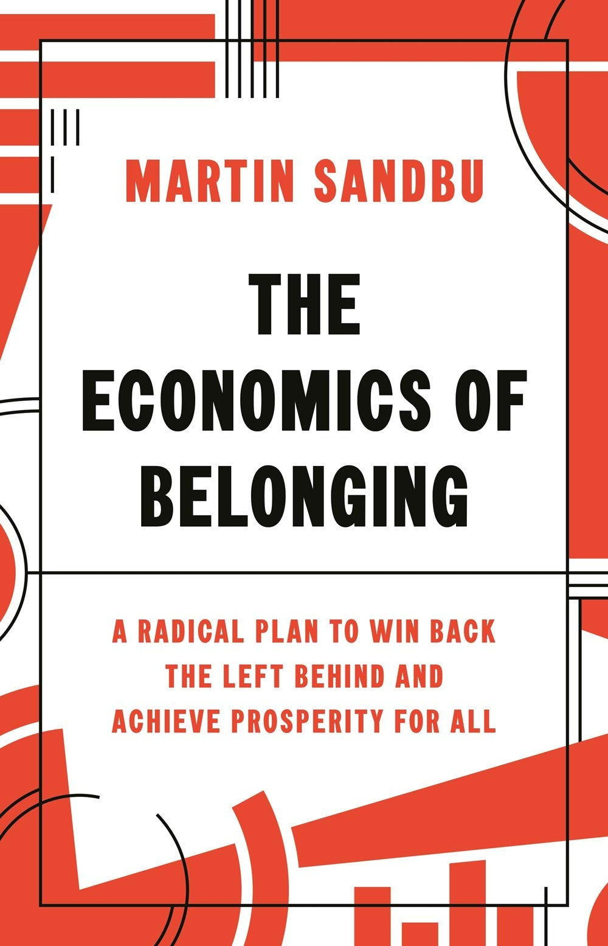
Belonging and Structures

Slide 22
Othering & Belonging within Structures
Structures are not neutral.
Power gives us greater positive access to structures and more ability to shape structures.
We are all situated within structures but not evenly.
Cultural Structures
Physical Structures
OUTCOMES
Social Structures
These structures interact in ways that produce a differential in outcomes. We live in structures. They live in us

Slide 23
Structures limit and enhance opportunity
We can define opportunity through access to:
EDUCATION
ECONOMIC
TRANSPORTATION
FOOD
HOUSING JUSTICE HEALTHCARE COMMUNICATIONS
This is an issue of membership and belonging.
Notes:
Don’t just work to remove barriers. Structural/Cultural inclusion

Slide 24
Race, place, and access to opportunity.
People of color are far more likely to live in opportunity deprived neighborhoods and communities
Five decades of research indicate that your environment has a profound impact on your access to opportunity and likelihood of success
High poverty areas with poor employment, underperforming schools, distressed housing, and public health/safety risks depress life outcomes and life itself
High poverty is associated with high stress and allostatic load that can restructure the brain and decrease ability to learn
Neighborhoods (reservations) & access to opportunity
Notes:
24

Slide 25
Transformative vs. Transactional Change
Equity efforts can be directed towards transactional or transformative change. Both are sometimes needed, but we should not confuse the two.
Transactional Change: A change within existing structures.
Transformative Change: A change to existing structures
What might this look like in a clinic setting? Perhaps given certain structures, to enact transformative change, we must change our strategies: pursue State court claims instead of higher courts that uphold discriminatory structures.

Slide 26
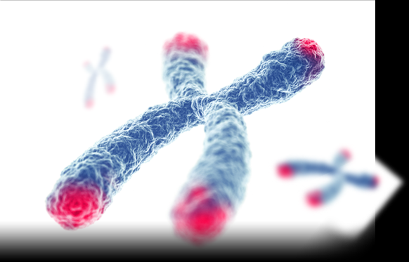
Structural Marginalization, Allostatic Load, and Telomere Length

Slide 27
Targeted Universalism
Structural inequity produces consistently different outcomes for different communities
Targeted universalism responds with universal goals and targeted solutions
VS.

Slide 28
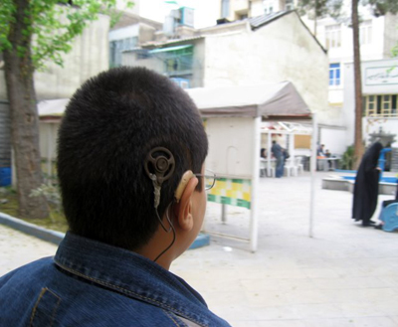
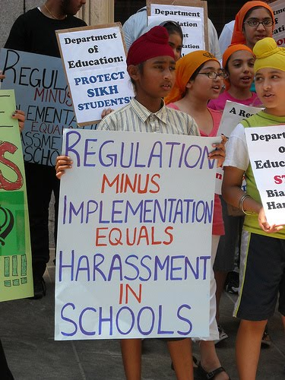
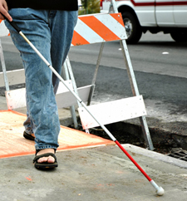
Why T/U?
People are differently situated
Not only are people situated differently with regard to institutions, people are situated differently with regard to infrastructure
People are impacted by the relationships between institutions and systems…
…but people also impact these relationships and can change the structure of the system.

Slide 29
Targeted Universalism
How are people differently situated?
Start with the data!
What is the universal?
What is the structure and culture?

Slide 30
Targeted Universal
What is the story?
Who is telling it?

Slide 31
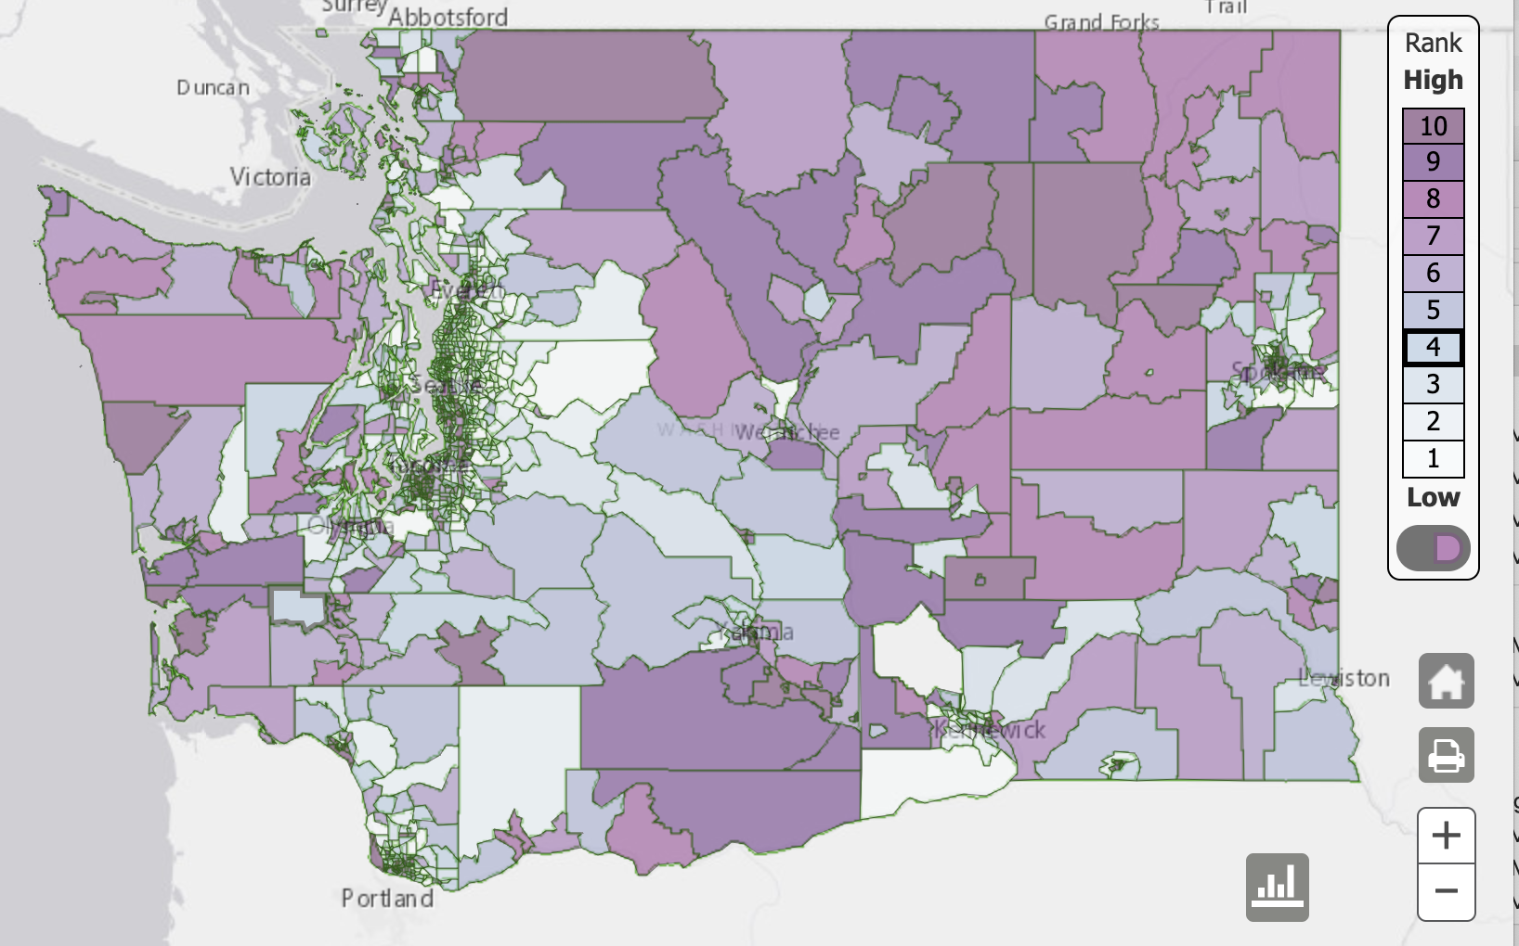
Economic Disparities in WA: Percent living in poverty
Source: WA Dept. of Health

Slide 32
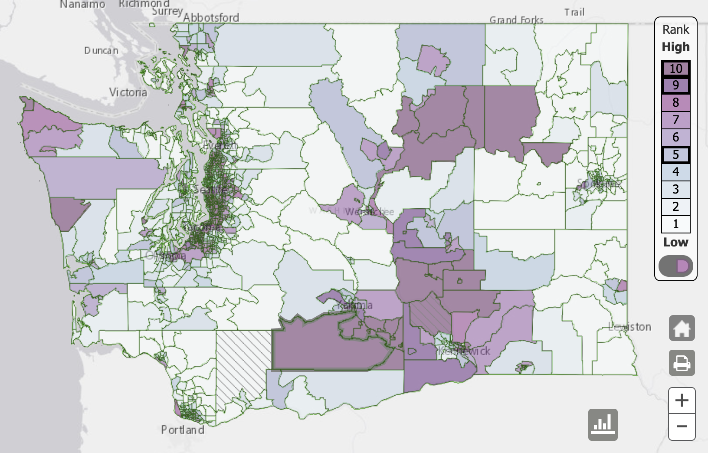
Racial Demographics in WA: Percent people of color
Source: WA Dept. of Health

Slide 33
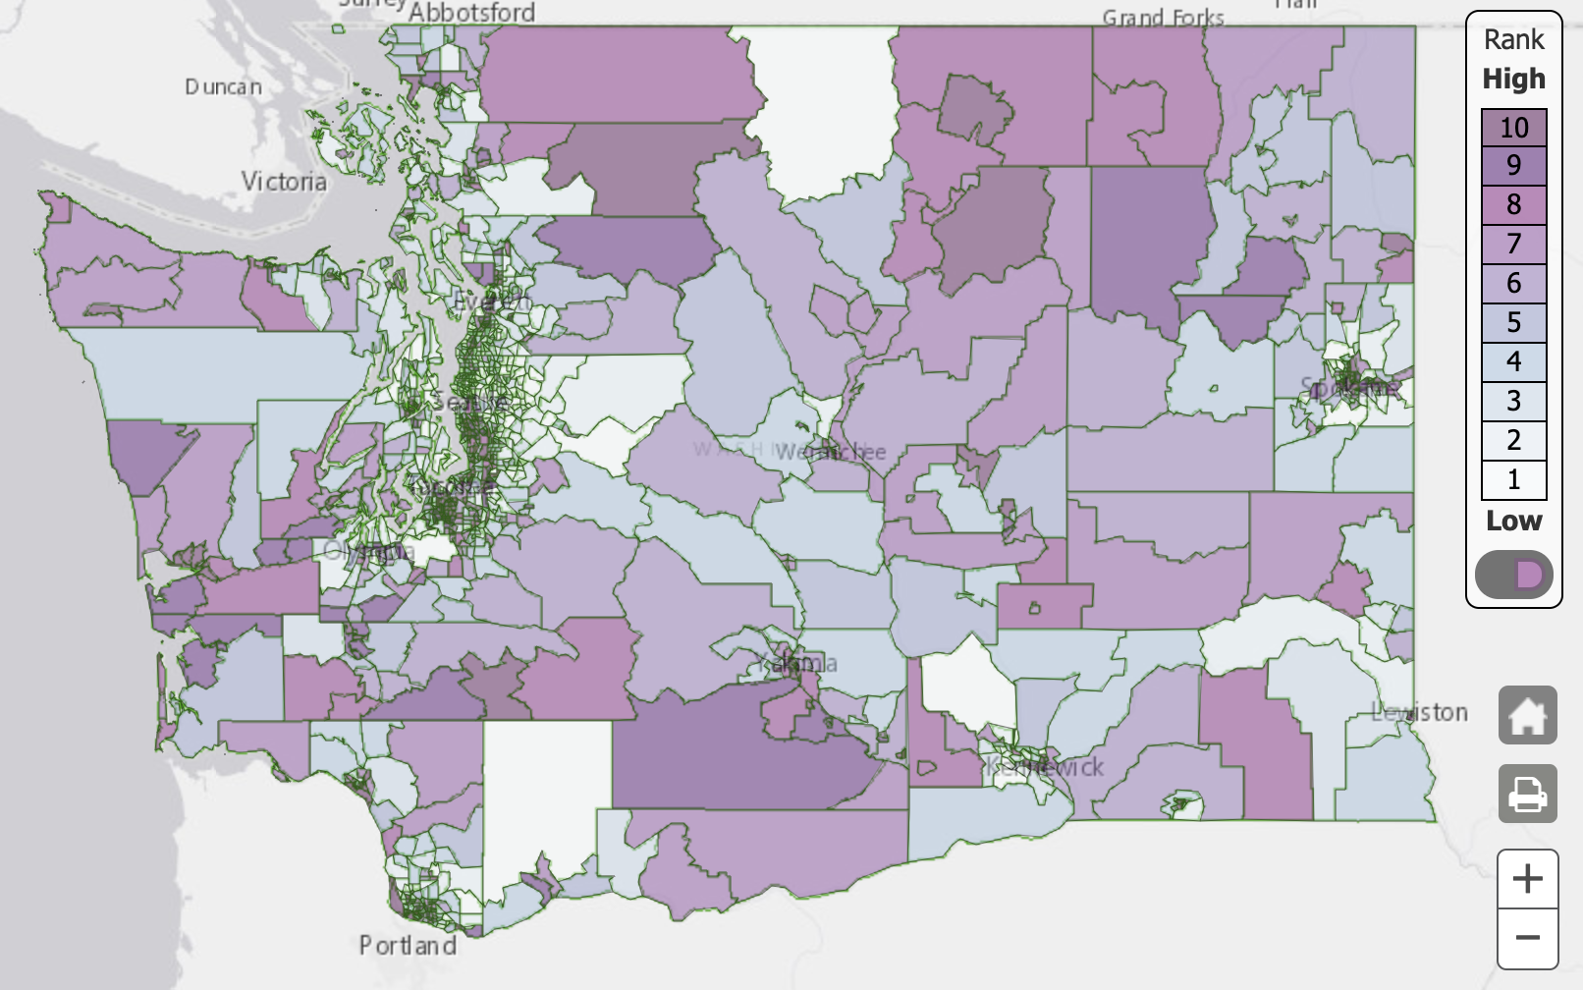
Health Disparities in WA
Source: WA Dept. of Health

Slide 34
Targeted Universalism
After the data and universal develop an action plan?
Note the goal is not just eliminating the disparity. Why?

Slide 35
TU and Health Equity in Oregon
Oregon tracked disparities in health care use and health outcomes for black, American Indian, and Alaska Native Medicaid enrollees compared to white enrollees.
Introduced health equity policies and Coordinated Care Organizations
Disparities in access to primary care and preventative services decreased
State and use the universal.
Source: Oregon Health & Science University
Notes:
Measuring disparities:
The average life expectancy for Oregonians who identified as black, American Indian, or Alaska Native was two years lower than for those who identified as white in 2011, and more than 35 percent of minority women in Oregon had no regular care provider, compared with 18 percent of white women, in the same year. Policymakers have begun using Medicaid reform as a tool to combat such disparities. Medicaid covers nearly 20 percent of the United States population, including a relatively large proportion of racial or ethnic minorities.
The TU solution:
In 2012, Oregon established coordinated care organizations (CCOs) to serve as the single point of accountability for the health care and outcomes of Medicaid members. CCOs were locally governed, with representation from Medicaid members, health care providers, and other local stakeholders. They received a global budget that covered physical, behavioral, and oral health care services, and they were responsible for coordinating and integrating these services
• The state required each CCO to develop and implement a transformation plan that included efforts to reduce racial and ethnic disparities among enrollees.
• CCOs were encouraged and given support to stratify health care access and quality measures by race and ethnicity.
• Oregon established Regional Health Equity Coalitions—community-led, regionally organized groups that provided CCOs with guidance on reducing disparities in their communities.
• Oregon trained and certified over 400 community health workers. Community health workers typically share race, ethnicity, or language with those they serve, and help to form a bridge between local health care services and the communities in which they operate.
Measuring the outcome:
The study team selected eight measures of health care service use and quality where significant disparities existed before CCOs were established. They calculated each measure using data from Oregon’s Medicaid program. They then compared the size of the disparity between black and white enrollees, and between AI/AN and white enrollees, in the years 2010 and 2011 (the pre-CCO period) to the years 2013 and 2014 (the post-CCO period).
The outcome:
Disparities in use of primary care and other outpatient services between black and white enrollees, and between AI/AN and white enrollees, decreased substantially from the pre-CCO period to the post-CCO period. Most notably, the disparity in primary care visit rates between black and white enrollees narrowed by one-third, from a difference of 40 visits per 1,000 member months to 25 visits per 1,000 member months (Figure 1). However, use of primary care and other outpatient services among black and AI/AN enrollees remained lower than among their white counterparts. The disparity in access to preventive services between black and white enrollees also narrowed substantially from the pre-CCO period to the post-CCO period.
Source: https://www.ohsu.edu/sites/default/files/2019-10/Brief_Disparities_FINAL.pdf

Slide 36
TU and COVID-19 in California
Source: CA Dept. of Public Health
Notes:
The Blueprint for a Safer Economy relies on two measures – case rate[i] and test positivity[ii] – to determine when a county can move to a less restrictive tier with more sector openings and resultant increased interaction among residents. In order to avoid a surge of infections, the level of baseline infection in a community should be progressively lower as there is more movement and mixing.
For a county with a population of greater than 106,000, the county must:
Equity Metric. Ensure that the test positivity rates in its most disadvantaged neighborhoods, referred to as the Health Equity Quartile of the Healthy Places Index census tracts, do not significantly lag behind its overall county test positivity rate, as described in detail below.
Targeted Investments. Submit a plan that (1) defines its disproportionately impacted populations, (2) specifies the percent of its COVID-19 cases in these populations, and (3) shows that it plans to invest Epidemiology and Laboratory Capacity for Prevention and Control of Emerging Infectious Diseases (Strategy 5: Use Laboratory Data to Enhance Investigation, Response, and Prevention) grant funds at least at that percentage to interrupt disease transmission in these populations. The targeted investments can include spending on augmenting testing, disease investigation, contact tracing, isolation/quarantine support, and education and outreach efforts for workers. Effective for the October 20 tier assignment, this plan must be submitted to CDPH by October 15 before a county may progress to a less restrictive tier. The required components due by October 15 include: Planned Activity, Priority Population, Funding Amount, and Source. Due to data limitations in small populations, the equity metric described above cannot be reliably applied to smaller counties, as described below.
https://www.cdph.ca.gov/Programs/CID/DCDC/Pages/COVID-19/CaliforniaHealthEquityMetric.aspx

Slide 37
Exclusion
Inclusion
Belonging
Bridge — Listen, engage, organize, love.

Slide 38
United Kingdom Minister of Loneliness

Slide 39
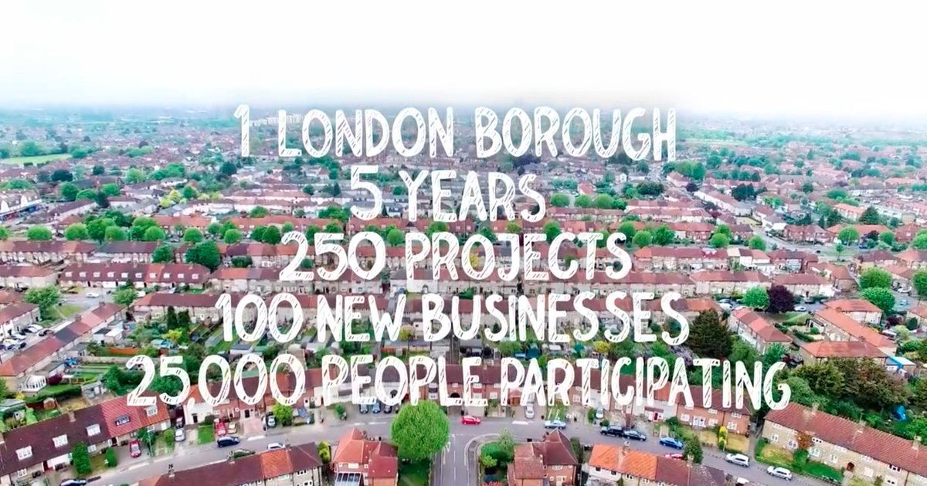
Belonging in Barking and Dagenham
Source – Participatory City Foundation
Notes:
Participatory City
Even though Participatory City has worked with Barking and Dagenham on a community level, many of their belonging practices can be replicated at the school level. Schools can host these types of belonging programs during non-pandemic times:
The London borough of Barking and Dagenham has high levels of unemployment, homelessness, and violence. The Participatory City Foundation approached the borough’s council with a system they had been developing for nine years. The council funded a five year experiment for the borough called Every One, Every Day. The premise of the project is to foster bridging and belonging. To have community participation as opposed to just the provision of isolated service delivery.
Participatory City had researched community projects around the world and distilled their findings into a set of core principles. Participatory City has set up a number of warehouses in Barking and Dagenham for residents to come together and collaborate on projects or launch ideas and ventures together.
The residents of this borough have set up welcoming committees to bring new people into the fold, they have community meals and cook together, they’ve built community gardens and play areas for the children, skill building workshops, and have set up urban farming plots.
The program has helped people build a greater sense of community. It has given people a sense of common purpose and destiny. Working on a project with others has helped people to feel more confident and comfortable about themselves and to feel a closer bond to the people they live around. Working with others on a common goal has helped some people get pass feeling shameful about being unemployed.
The program has helped people from different backgrounds break out of their isolated groups and put stereotypes, prejudices, and fears about the other to rest. One woman said she no longer feels fear about the young men in the borough she once stereotyped. She said she no longer feels intimidated because now she knows them.
The program has helped to bring people from different backgrounds and generations together, and the response from borough residents has been one of overwhelming happiness. Many said that when they had wanted to move in the past, now they love where they live and want to stay and continue to feel invested in it.

Slide 40
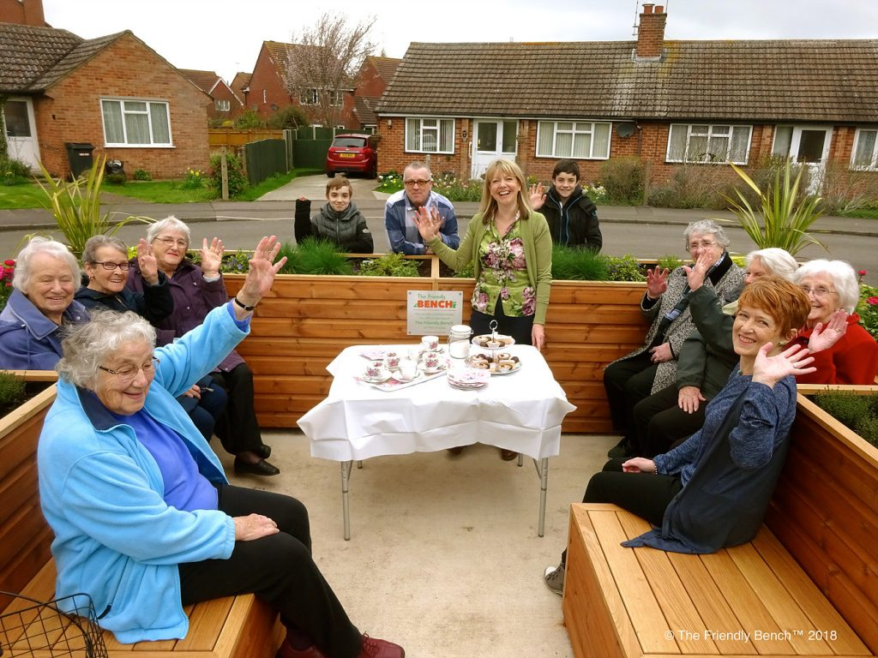
The Friendly Bench
By sitting at a friendly bench, people agree to engage in conversation or a social activity.
Can this be replicated in other settings?
In restaurants
In online forums

Slide 41
Targeted Universalism Operationalizes Belonging
Each group’s differences must be taken into account
T/U is designed through careful consideration of positionality and situatedness
It is inclusive of all regardless of differences, it expands the ‘we’
T/U is a communications strategy
It avoids breaking and scarcity
Participation/data/power/stories
Move us toward belonging
Notes:
Health is not just a biological issue but a social and power issue.

Slide 42
Targeted universalism in practice.
This strategic framework…
Starts with identifying the universal goals for all, yet the current position of whites should not be normalized in the system whereby becoming the universal goal for all. So, set a universal bench mark/goal that is not dependent on the dominant group.
Identify specific obstacles in particular geographies that limit certain populations from reaching those goals.
Create targeted strategies for each group that are designed to affirmatively promote inclusion/belonging AND remove barriers to inclusion/belonging.
Involve the group in the goal setting/ the research and the story
This could be through a Community Health Needs Assessment
Notes:
Targeted universalism is an approach that supports the needs of the particular while reminding us that we are all part of the same social fabric
Universal, yet captures how people are differently situated
Targets those who are most marginalized
Targeted universalism is a common framework through which to pursue justice
A model which recognizes our linked fate
A model where we all grow together
A model where we embrace collective solutions

Slide 43
San Francisco Health Improvement Partnership
Notes:
“SFHIP is currently focused on creating systems-levels changes that impact our communities of color and marginalized populations. Our current focus areas include: Community Healing, Economic Inclusion, and Food Security. We’ve created teams for each topic and we meet every other month. Team members include SFHIP Steering Committee members, but also subject matter experts who come from other organizations or collaborations in the field and bring programmatic, policy, advocacy, and governmental experience”
Community Healing: Communities of color and marginalized communities are harmed by trauma at a community-level as a result of adverse conditions, which are a result of systemic racism, structural violence, and economic exclusion. In order to create population level changes, it’s critical to move beyond individual-level interventions and create community-level interventions to address to underlying factors that are affecting all members in a community. Community healing seeks to address to the current wounds and inequities faced by our communities by creating community-led strategies that improve the social-cultural environmental, physical/built environment, and improve economic opportunities.
Economic Inclusion: The city of San Francisco has experienced tremendous economic growth in recent years; however, significant economic disparities and inequalities continue to exist in under-resourced populations, which are largely composed of people of color. These communities often face high levels of poverty, low educational attainment, and discrimination – all factors which prevent people for obtaining and maintaining fair paying jobs and which prevent upward mobility for their families and communities. Economic inclusion seeks to use public and private efforts to reduce long-standing economic barriers and create pathways for marginalized populations to economically flourish.
Food Security: Entire communities in San Francisco experience food insecurity at a population level, also known as food apartheid, contributing to poor health and health disparities. This is often the result of political, economic, and system-level inequalities, which have led to lack of healthy grocery options and an abundance of processed and fast food options in low-income communities. Food security seeks to address the current system-level barriers that contribute to vulnerable populations’ food insecurity.
http://www.sfhip.org/initiatives/current-efforts/

Slide 44
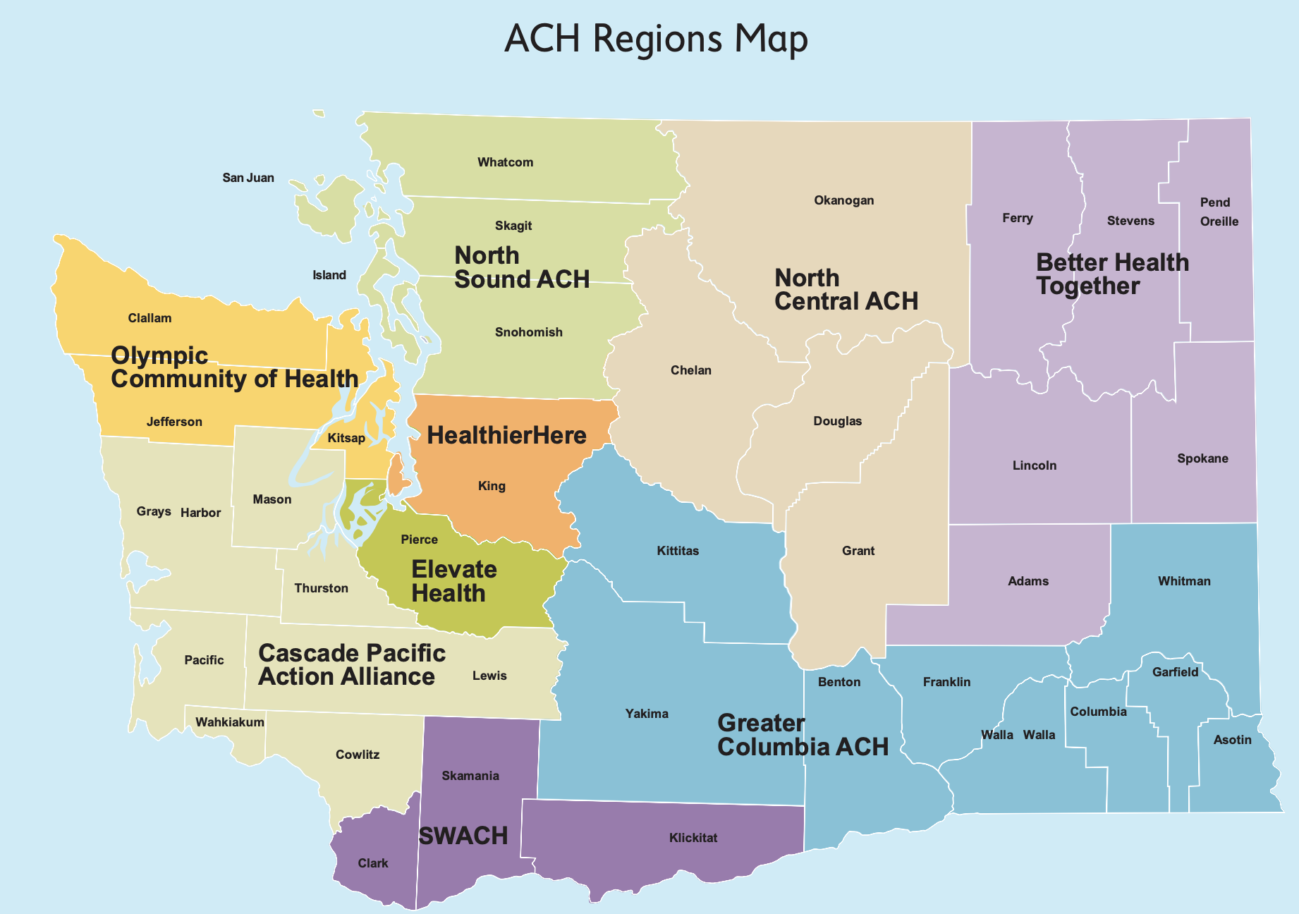
How can we create a culture of belonging in ACH?
Notes:
Analyze the social network of the organization and make interventions.
Who is relied upon for information, who goes to who? Reveal powerful connections and potential blocks.
Value diversity/belonging within the workgroup.
Create space so that everyone can contribute, offer recognition to those who make valuable contributions
Create structured and unstructured opportunities for bridging and linking
Achieve team objectives and build the social capital of team members.
What are some short and long bridges.
What’s our story

Slide 45
What Does a Transformative Agenda Look Like?
Transformative change requires substantive efforts in three areas:
Talking about race: Understanding how language and messages shape reality and the perception of reality.
Thinking about race: Understanding how framing and priming impact information processing in both the explicit and the implicit mind.
Acting on race: Understanding how we arrange our institutions and policies, and intervening in equitable arrangements.

Slide 47
For more information, visit: http://www.iupress.indiana.edu/catalog/806639
Like the Othering & Belonging Institute on Facebook
https://www.facebook.com/otheringandbelonging/

