Slide 1
HEALTHY PEOPLE,
THRIVING COMMUNITIES
PURPOSE
Tackling health issues that no single sector or Tribe can tackle alone
MISSION
To solve health problems through collaborative action
Foster a region of healthy people,
thriving communities
Notes:
Hello, my name is Amy Brandt and I am the Communications Coordinator at Olympic Community of Health. Today I’m going to share with you a tool that Olympic Community of Health has created to take stock of local projects addressing determinants of health.
Olympic Community of Health is the Accountable Community of Health working in the Olympic region, with the purpose of tackling health issues that no single sector or Tribe can tackle alone. Collaboration is at the core of our work, and this determinants of health inventory is just one way that we foster collaborative and innovative problem-solving, ultimately co-creating a region of healthy people, thriving communities.

Slide 2
Partnership
Being innovative with partnerships is important […] you’d be surprised by who is interested in partnering with you and why. It’s another way to understand what your community needs.
Collaboration
There has to be a collective approach within the community. Coming together and working on the same goals.
Notes:
OCH has been expanding our awareness, understanding, and resources related to local determinants of health over the past few years. A reoccurring theme that we keep hearing from our partners is the need and importance of collaboration/partnership. A partner shared “being innovative with partnerships is important, you’d be surprised by who is interested in partnering with you and why.” The work that our region sets out to do is challenging work with a long road ahead, and by working together, sharing best practices, lessons learned, and maximizing regional strengths, we can ultimately create more meaningful health impacts.

Slide 3
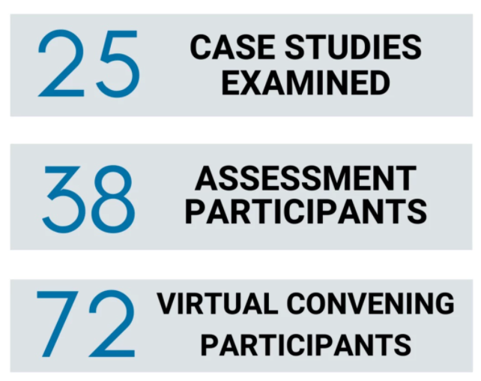
Inventory of local projects addressing determinants of health in the Olympic region
build situational awareness
inspire future projects and collaboration
visually display current outreach
Notes:
Through our work over the past two years, we’ve conducted 25 case studies, conducted a regional assessment with our partners, and hosted several convenings on the topic of determinants of health. Through all these activities, it became apparent that there are a lot of innovative projects happening all across the region. Partnerships between clinical and community-based organizations, health teams meeting community members where they are at, projects that think outside the box to address access to food, housing, transportation, etc.
But there is no where to see who’s working on what. If I was interested in implementing a project addressing food access but wanted to see what others have done and succeeded at, I wouldn’t know where to start. Thus--- the determinants of health inventory.
This identified need for a platform to take stock of local projects led to OCH creating the determinants of health inventory for the Olympic region. The purpose of this tool is to build situational awareness, what are our neighbors working on? Instead of everyone starting their own transportation systems, let’s take a look at who is already working on transportation (is their room for expansion or partnership?)
The inventory also aims to serve as creative examples and inspire future projects and collaboration. If a project is succeeding in Kitsap, is there a way to adapt it and share resources to launch a similar project in Forks?
Lastly, as this tool grows, we will able to visually see at a birds eye view, where are projects happening and where are there gaps. Are there lots of financial support projects in PT, but not much in PA?

Slide 4
www.olympicch.org/localdeterminantsofhealth
Notes:
So now I’m going to access the inventory on our website via this link on the screen. I will walk you through.

Slide 5
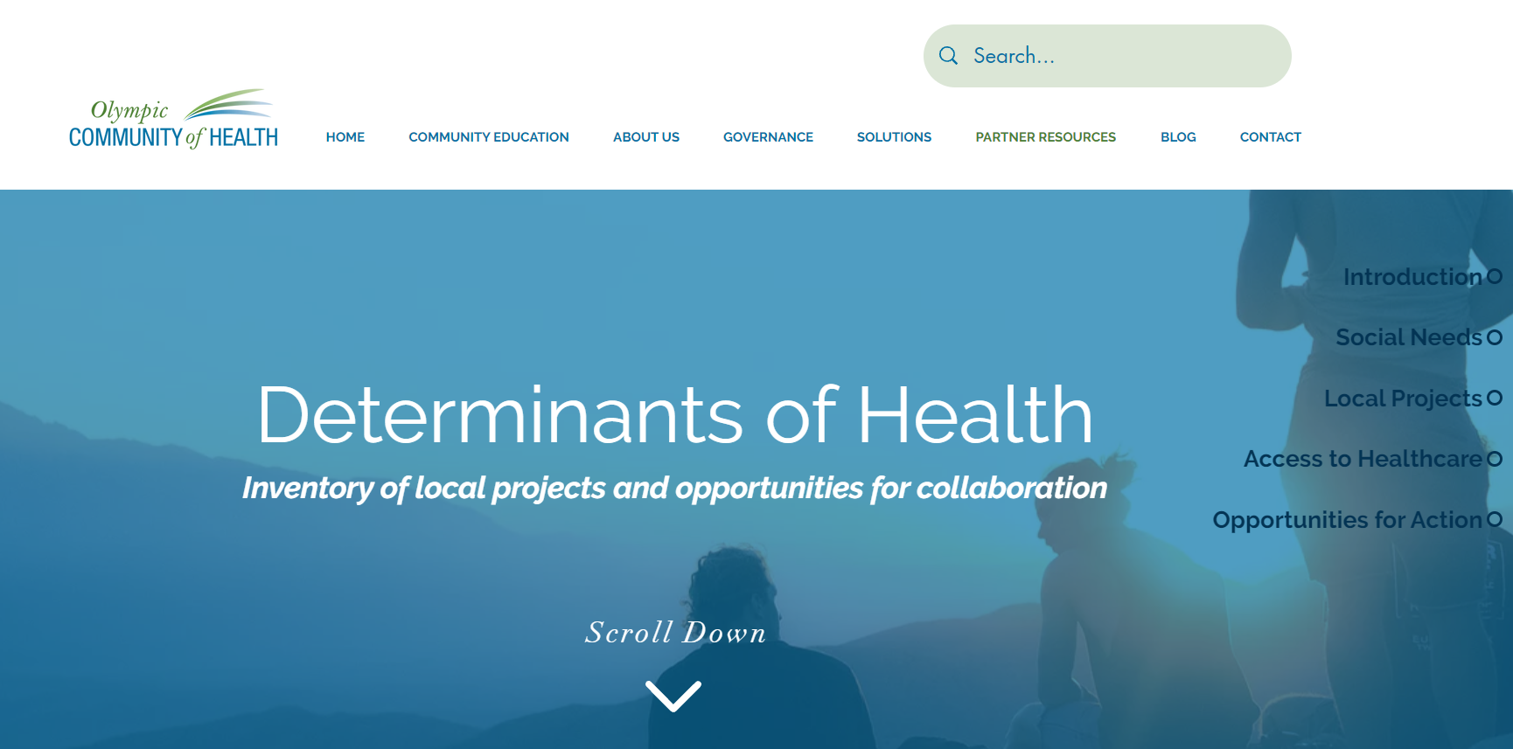

Slide 6
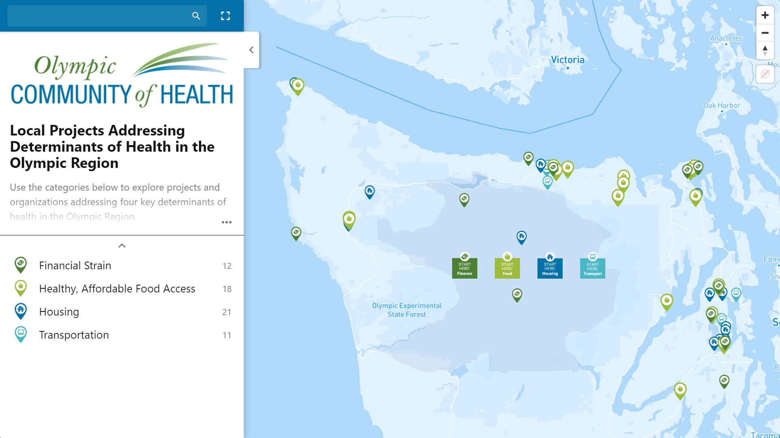
Notes:
Featuring over 60 projects related to financial strain, healthy affordable food access, housing, and transportation

Slide 7
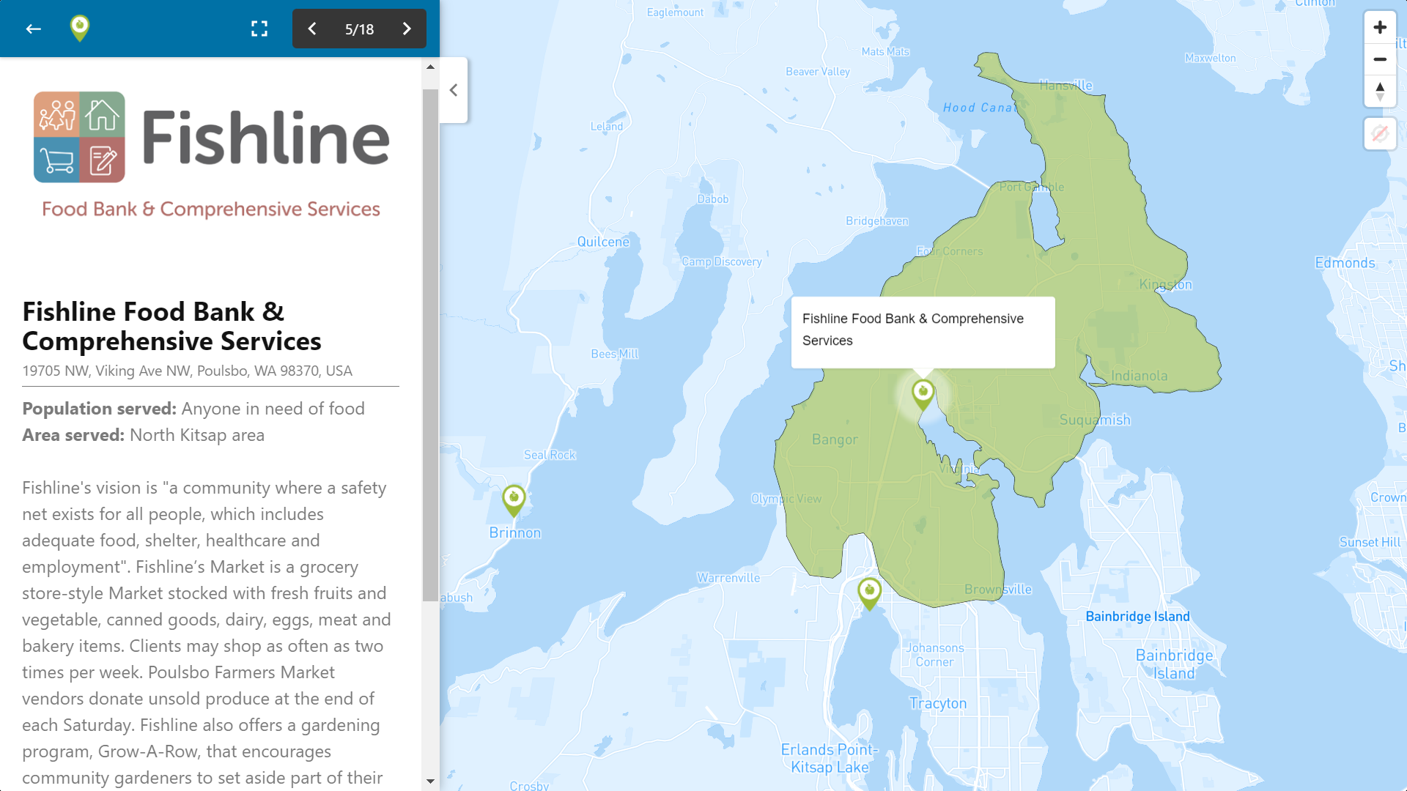
Notes:
As you explore the tool, by clicking on an organization or Tribe, a panel appears with a description about the project, the population being served, and the geographic reach. The area served can also be easily seen by the appearance of a regional layer on the map. These regions are not restricted by zipcode or city limits, as they represent a broader region that reflects access patterns (just because a foodbank is in Poulsbo doesn’t necessarily mean it’s clients are limited to those who live in Poulsbo– the greater north kitsap area is being served).

Slide 8
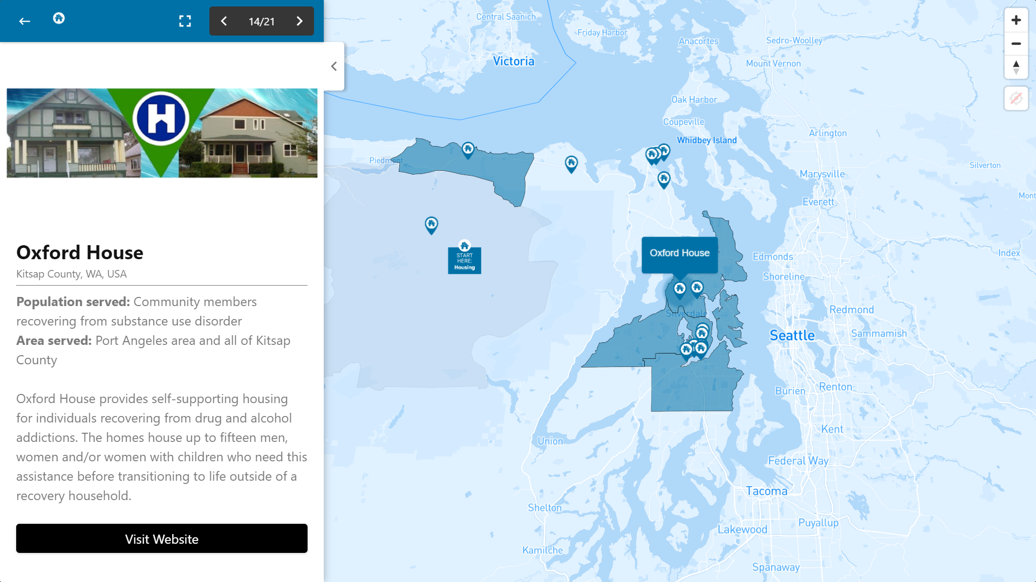
Notes:
Some organizations serve several subregions– the Oxford House serves Kitsap County and community members in Port Angeles.

Slide 9
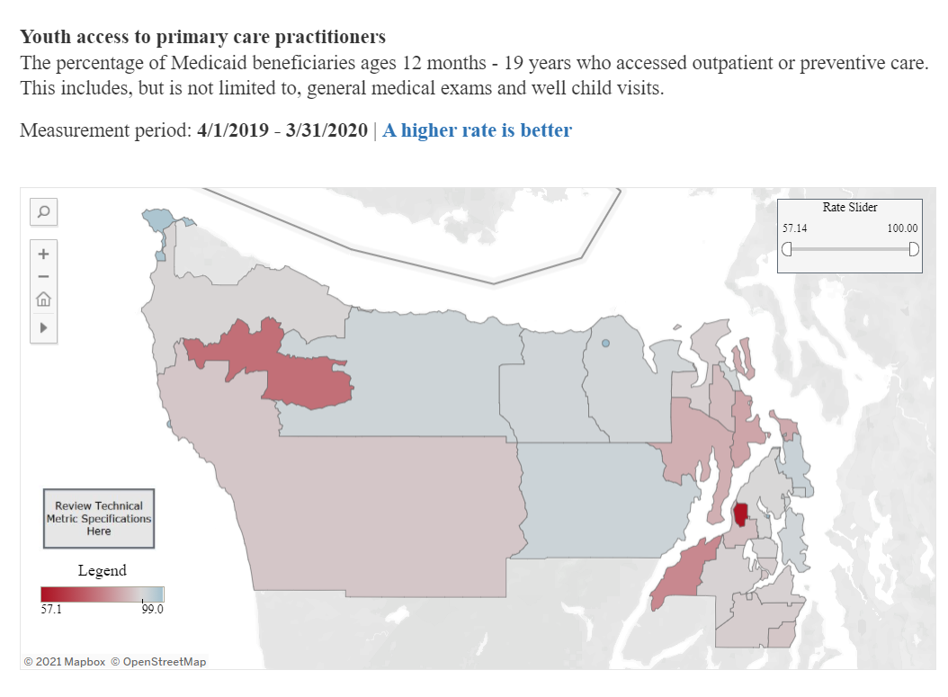

Slide 10
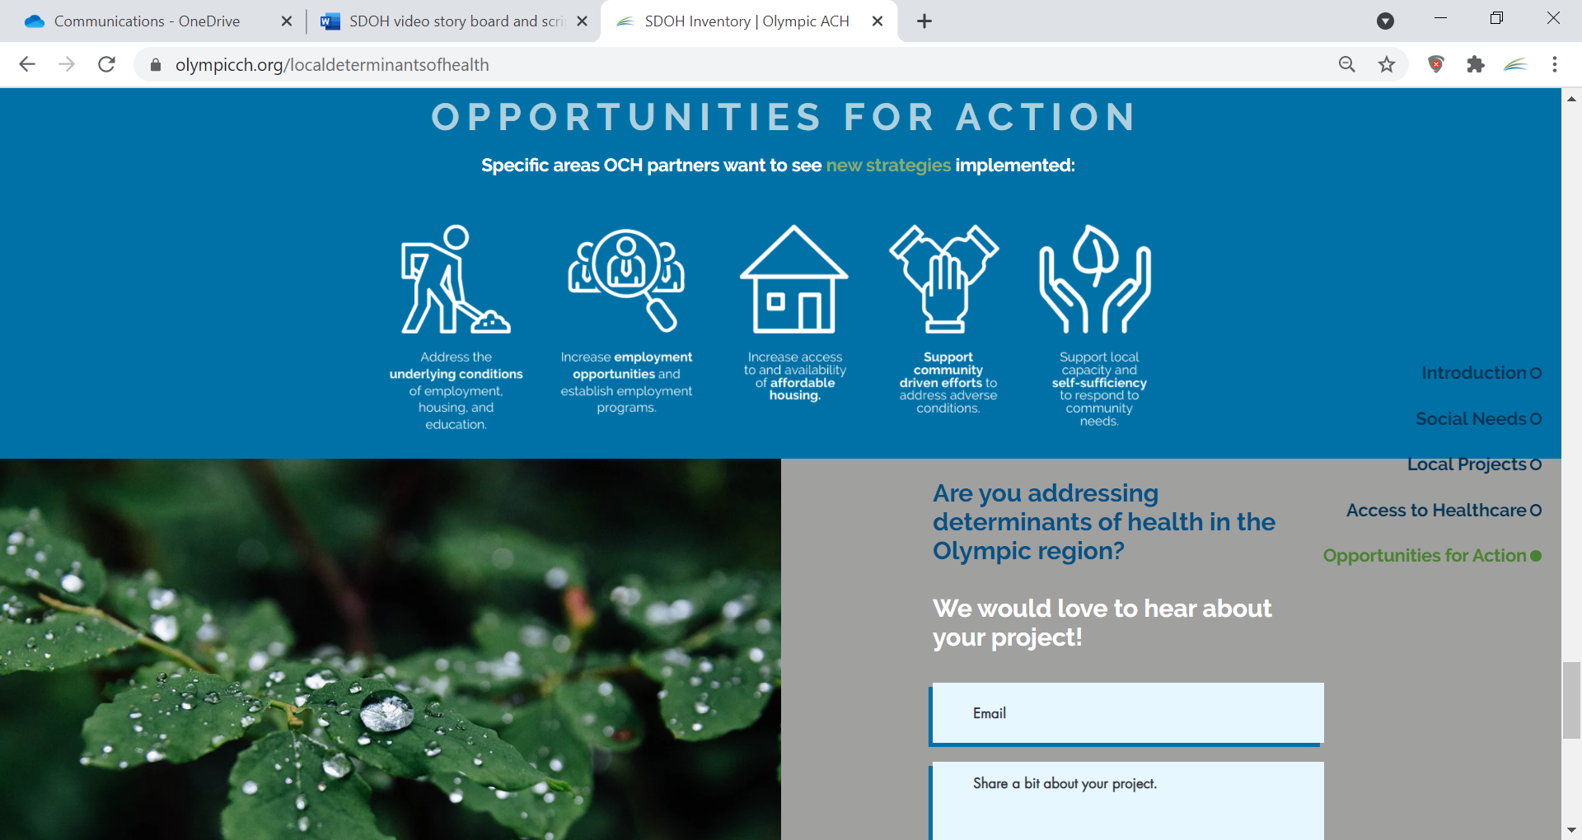
Notes:
Next steps-- continue to build and maximize projects

