Slide 1
Care Coordination and Social Determinates
Daryn Nelsen-Soza, MSW, LICSW
Care Manager – SeaMar Community Health Center

Slide 2
Health Homes & HealthConnect Pathways
Whole Person Care:
Consider their full spectrum of needs – medical, behavioral, socioeconomic, and beyond.
Coordination of health, behavioral health, and social services in a patient-centered manner.
Goals of improved health outcomes and more efficient and effective use of resources.

Slide 3
HealthConnect and Whole Person Care
The Accountable Community of Health in SW Washington (SWACH) spearheaded the HealthConnect Regional Hub
Centralized community-based care coordination infrastructure.
Data infrastructure, and workforce development.
Diverse community voice to address the social determinants of health and improve health outcomes

Slide 4
Community Care Coordination

Slide 5
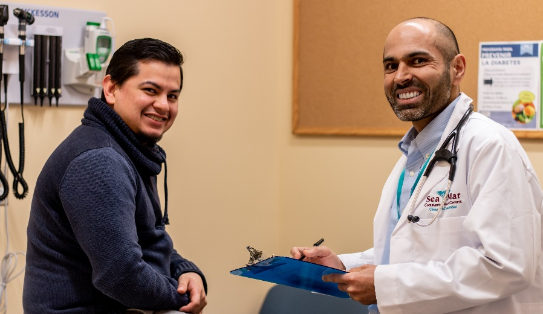
Major Social Determinate
Language: The lack of cultural specific and positive care often created a culture of distrust towards individual health care.
SeaMar/Health Homes/Pathways/HealthConnect have all made the hiring of bilingual individuals to address this this.

