Slide 1
Leaning into this moment to build a shared Movement for Thriving Together
Somava saha, md ms
Executive lead, well-being and equity (we) in the world and well being in the nation network

Slide 2
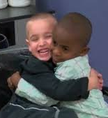
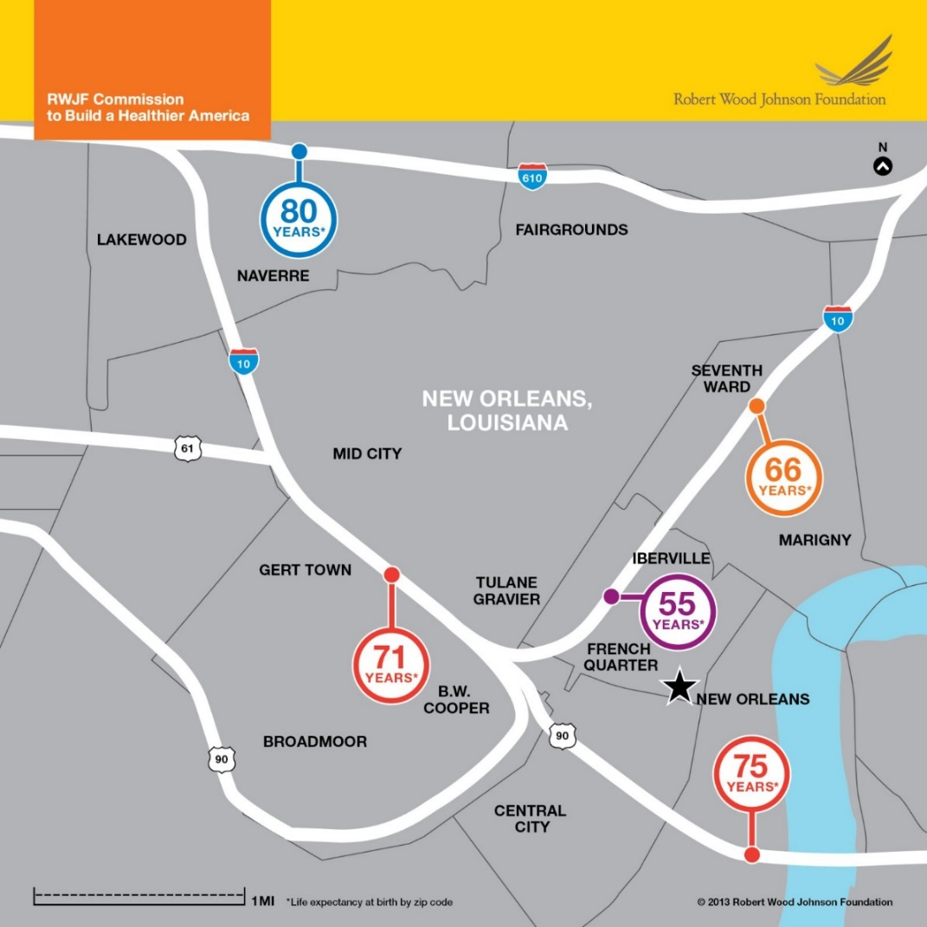
A tale of two boys
https://wsvn.com/news/us-world/color-blind-boys-scheme-to-get-same-haircut-to-trick-teacher/

Slide 3
Relationship between the health and well-being of people, places and equity

Slide 4
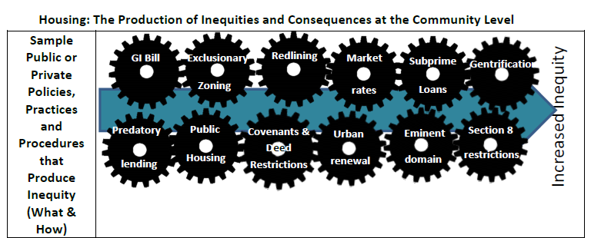
Chronic place-based inequities are not accidental – there is a system in place that propagates them
“Countering the Production of Health Inequities” Report from the Prevention Institute

Slide 5
Interrelationship between the health, wellbeing and equity of people, places and the systems of society
Well-being of People
Systems driving (in)equity
Vital Conditions in Places
Health, wellbeing and equity

Slide 6
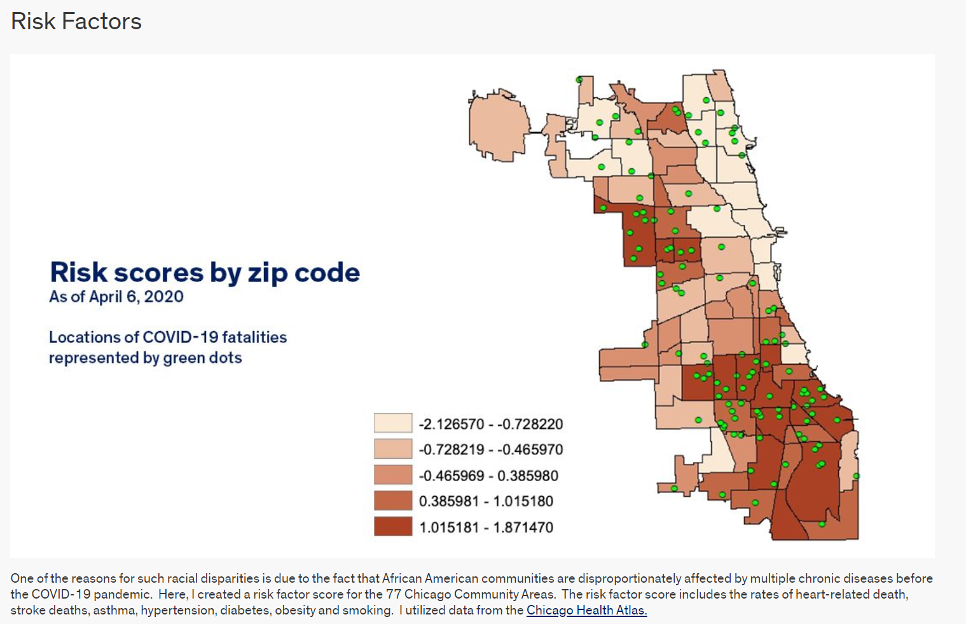
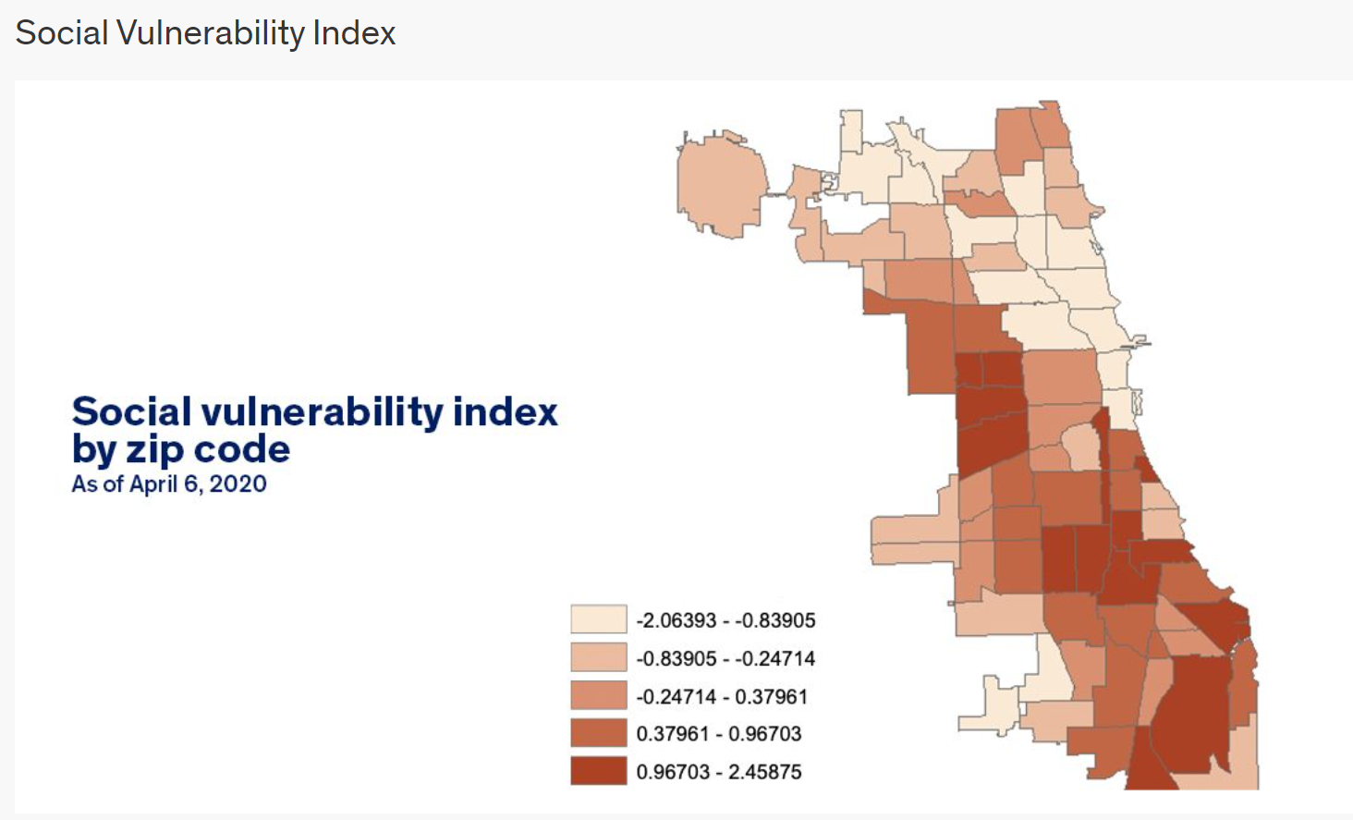
Figure 1 SOCIAL VULnERABILITY AND RACE IN CHICAGO
SOCIAL VULNERABILITY INDEX

Slide 7
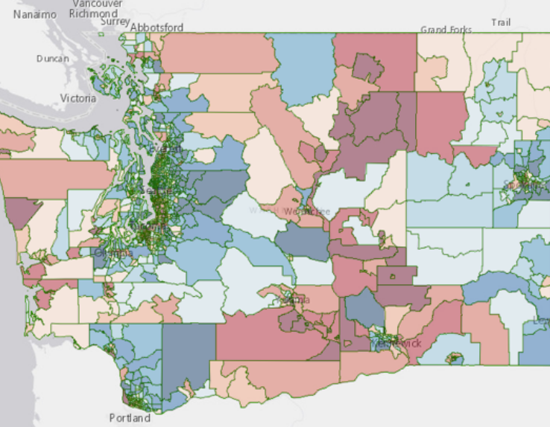
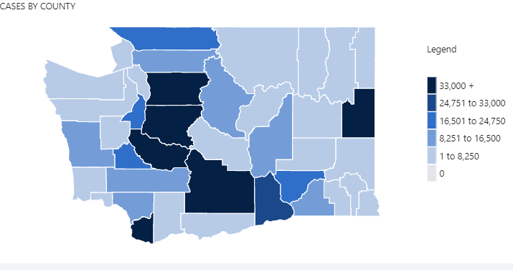
In the same storm in different boats

Slide 8
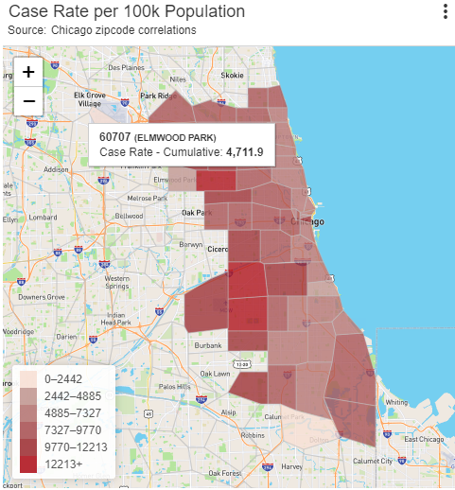
The new redlining – covid cases, paycheck protection program loans, and vaccinations

Slide 9
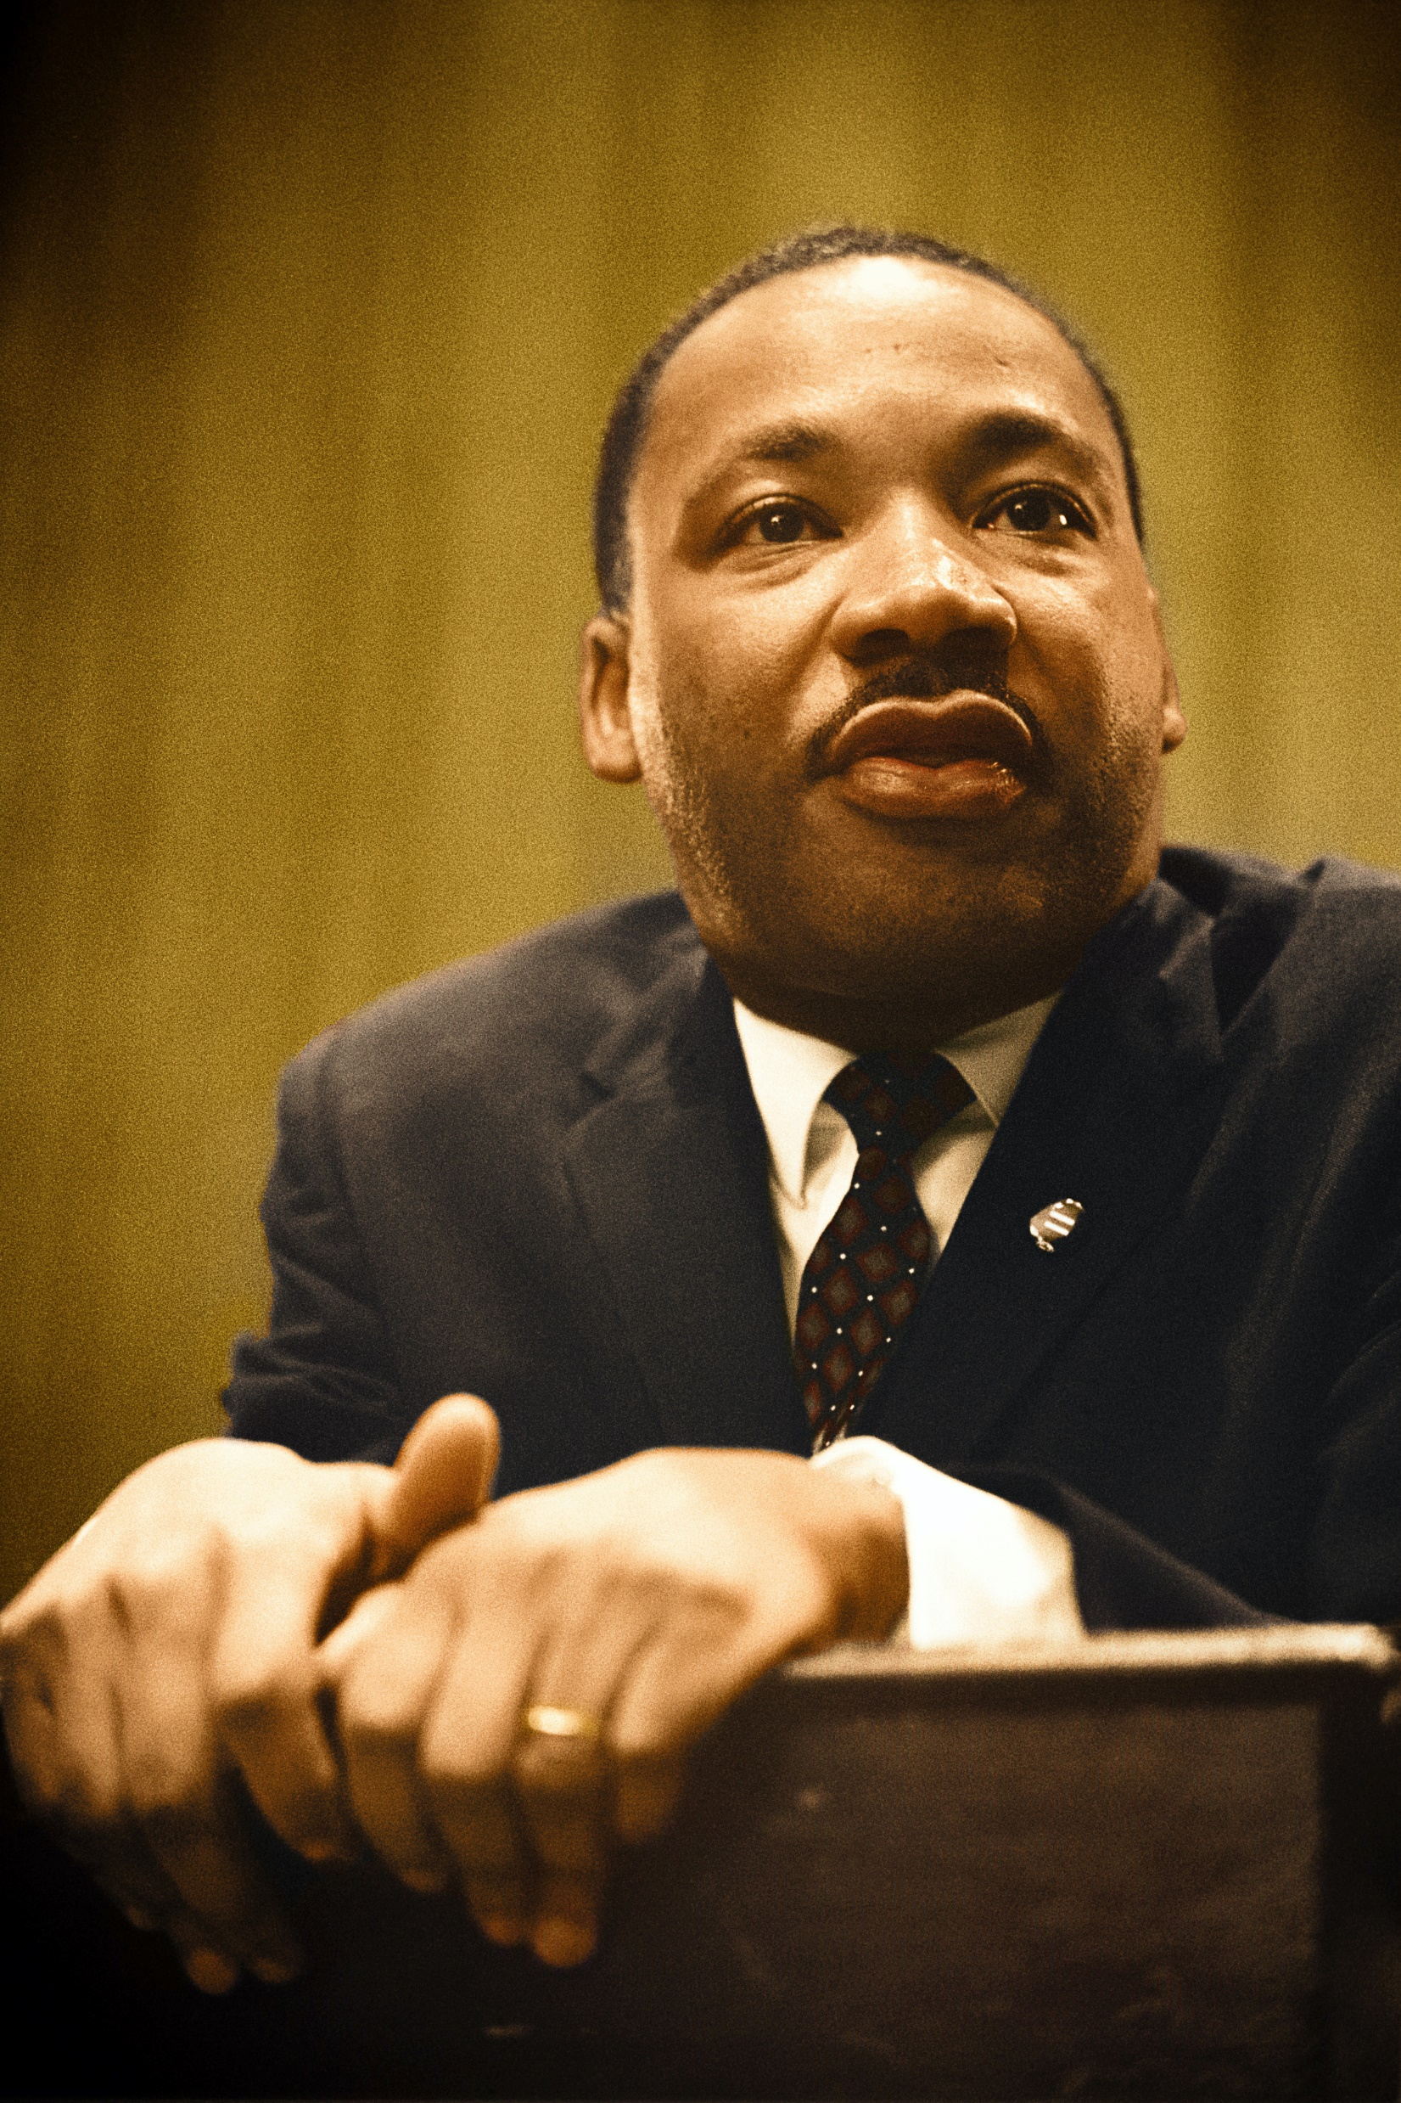
“Power without love is reckless and abusive, and love without power is sentimental and anemic. Power at its best is love implementing the demands of justice, and justice at its best is power correcting everything that stands against love.”
Rev. Martin Luther King Jr

Slide 10
Well Being In the Nation (WIN) Network

Slide 11
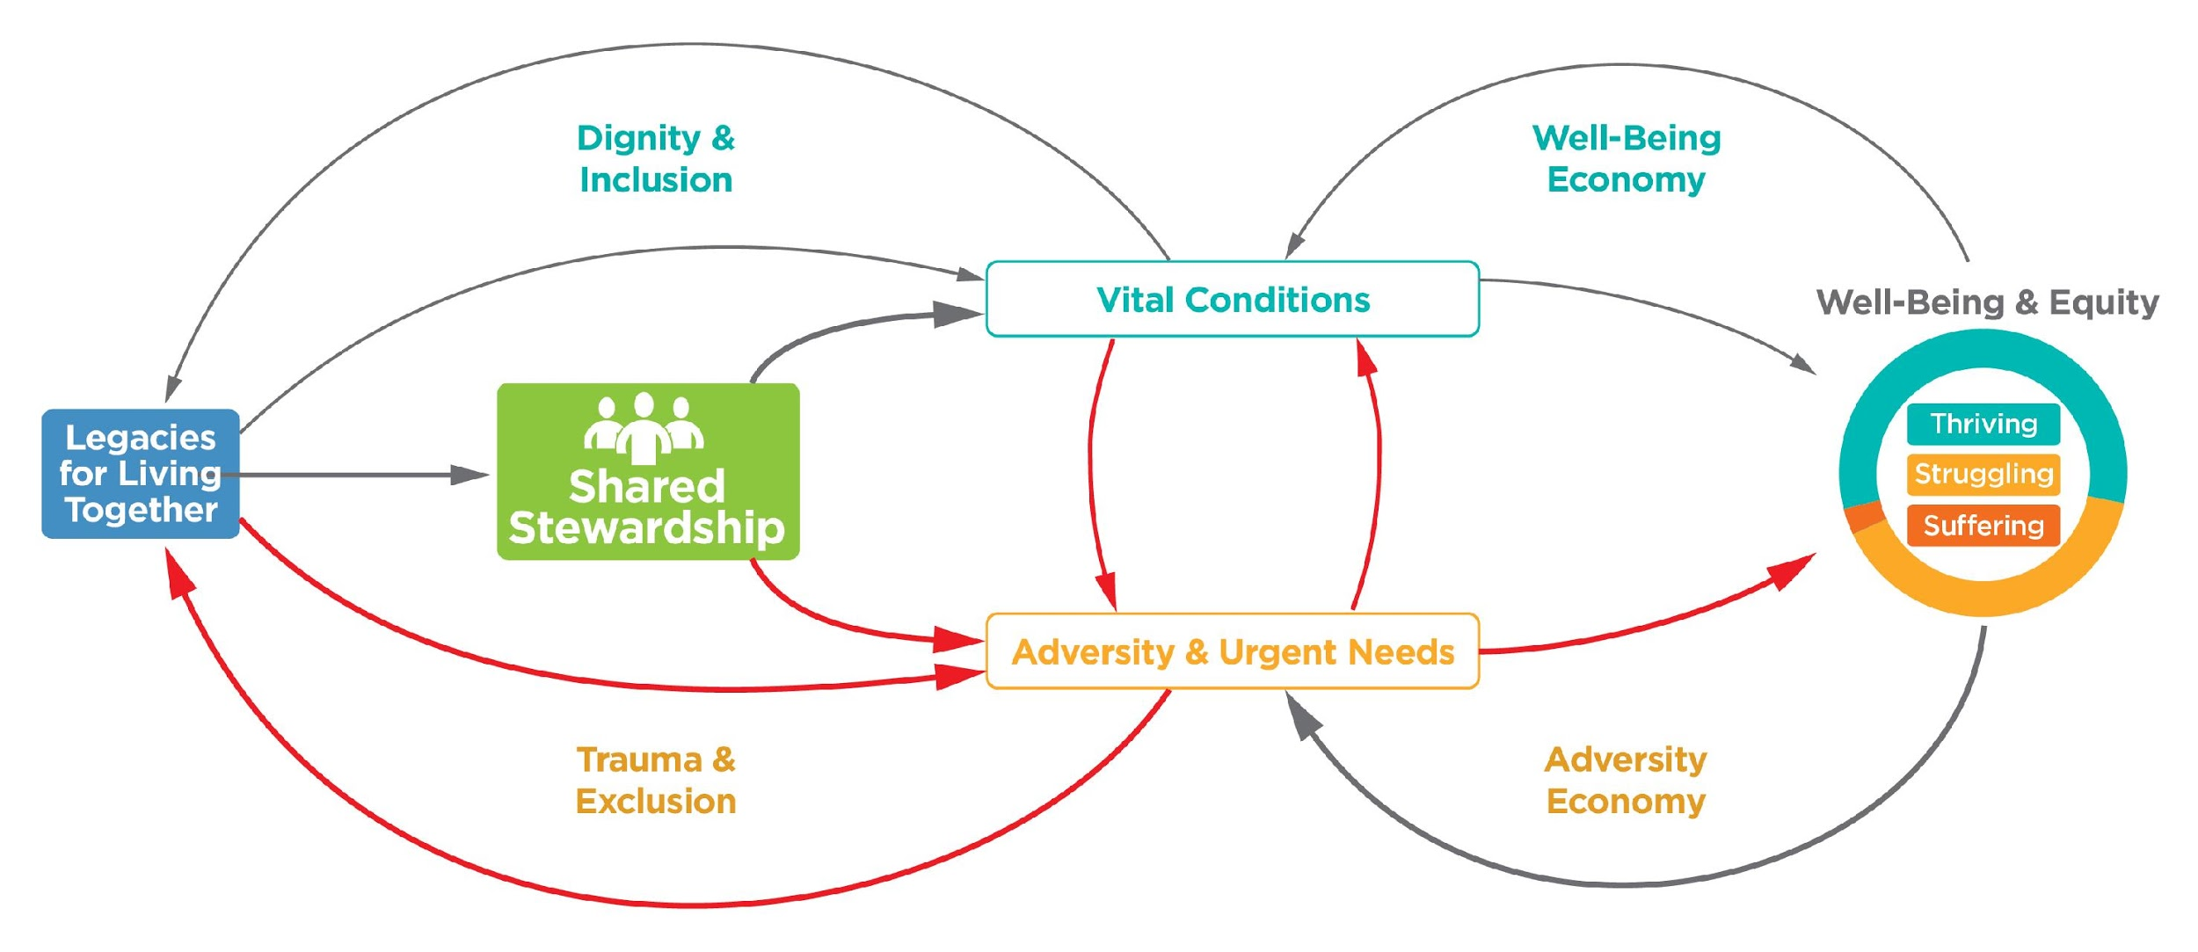
WIN Theory of Change in the context of covid-19
Resilience
Relationship
Renewal
Response
Theory of Change: http://tiny.cc/WINTheory; Narrative: http://tiny.cc/SharedStewardshipVideo;

Slide 12
www.winnetwork.org

Slide 13
Shifting from charity to equity to liberation in the south of texas
Health, well-being and equity
Addressing root causes
Improving the mental, physical, social and spiritual well-being of people
P1: Physical and/or mental health
P4: Communities of Solutions
Resilient Families
Equity
Thriving Communities
P2: Social and/or spiritual wellbeing
P3: Community health and wellbeing
Improving community vital conditions
Improving the systems of society to “reverse the down escalator”

Slide 14
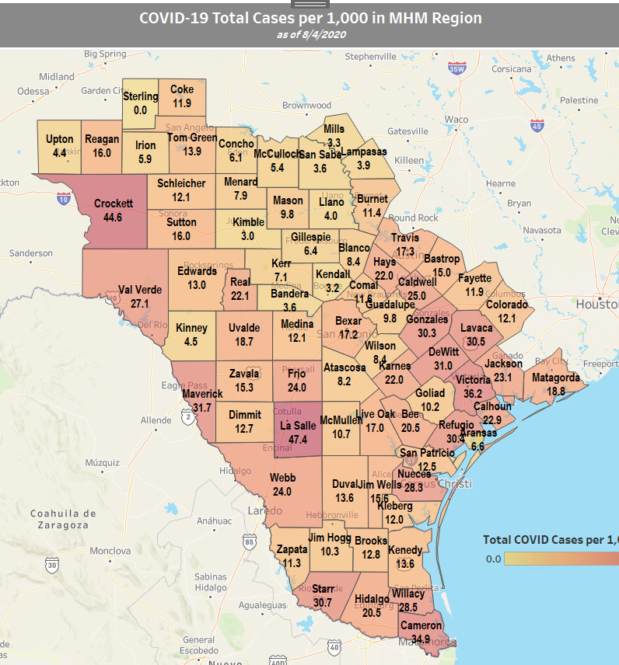
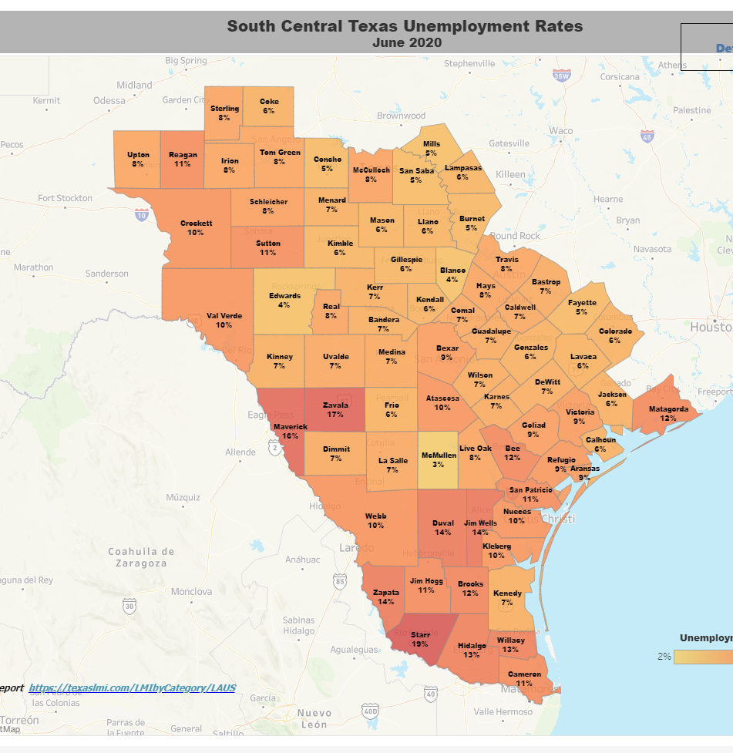
Addressing Race, place, health and wealth n texas
COVID Cases
Child poverty
COVID Unemployment
Health status

Slide 15
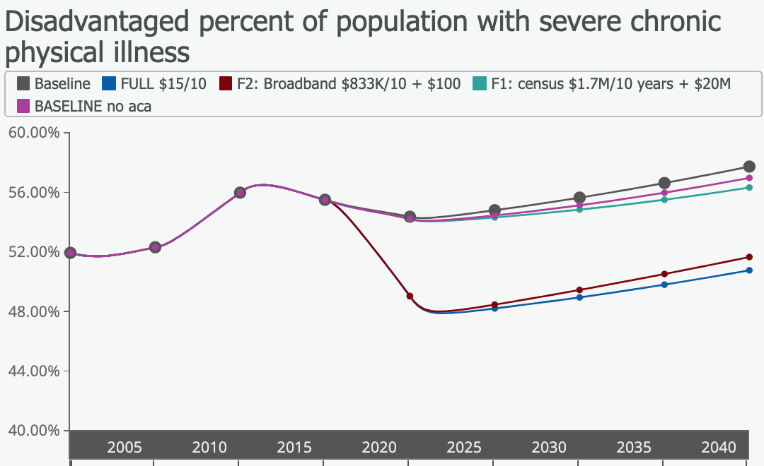
Severe Chronic Physical Illness (Disadvantaged)

Slide 16
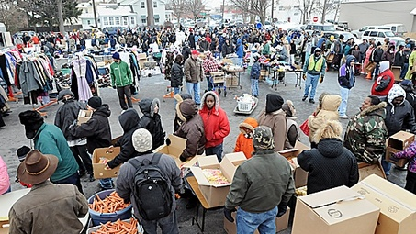
2. Invest in emergency and recovery supports in a way that advances long-term equitable recovery and resilience
Giving people food →
Building the capacity of community assets (food banks, faith communities etc) to distribute healthy food →
Making fresh healthy food affordable where people shop in local markets

Slide 17
4. Invest in cross-cutting systemic efforts to address root causes of health inequity, including structural racism and economic inequality

Slide 18
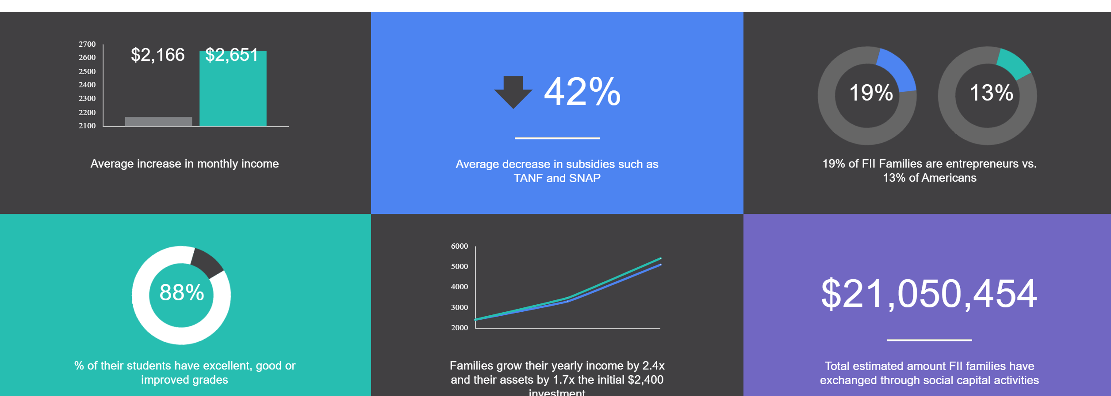
Family independence initiative

Slide 19
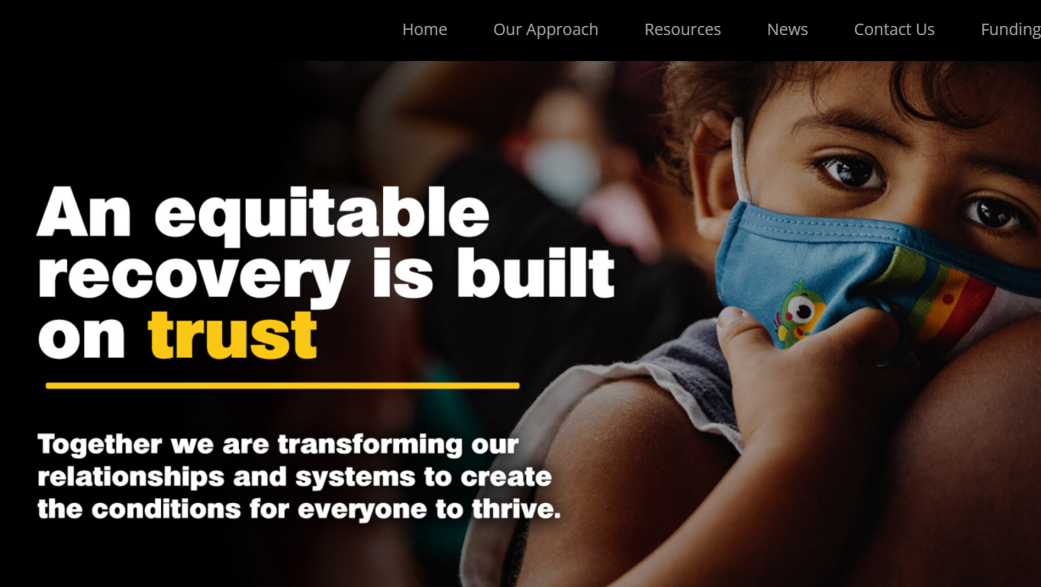
RISE (REACH, IMMUNIZATIONS, SYSTEM CHANGE FOR EQUITY

Slide 20
Rise pillars of action

Slide 21
COMMUNITIES RISE PARTNERS - INTRODUCTION BY PARTNER TEAM AND ROLE

Slide 22
RISE (reach, immunizations, system change for equity)
26,662 people vaccinated
46,786 people connected to their social and well-being needs
18.5M reached

Slide 23
Multi-solving for health, well-being and equity
Photo by Sai De Silva on Unsplash
#KeepBlackLoveAlive

Slide 24
Oceti wakan, pine ridge

Slide 25
springboard

Slide 26
Federal plan

Slide 27
what legacy will you risk your significance to create?
I will not die an unlived life I will not live in fear of falling or catching fire.
I choose to inhabit my days, to allow my living to open me, to make me less afraid, more accessible, to loosen my heart until it becomes a wing, a torch, a promise.
I choose to risk my significance; to live so that which came to me as seed goes to the next as blossom and that which came to me as blossom, goes on as fruit.
--Dawna Markova

Slide 28
For more information
WE WIN Together Racial Justice Community: https://winnetwork.org/communities-1
Springboard for Equitable Recovery and Resilience: https://thriving.us/
Health Equity and COVID-19: https://conta.cc/34WoYav
WIN Network: www.winnetwork.org
Well-being and Equity (WE) in the World - www.weintheworld.org
Somava Saha – somava.saha@weintheworld.org

