Slide 1

GANGS 101
Presented By:
ROBERT FOUNTAIN

Slide 2
Disclaimer of Confidentiality
The information contained in this presentation is intended to assist law enforcement officials, teachers, parents and concerned citizens in the identification of gang activity, symbols, graffiti, and practices. It is not intended to encourage persecution of any single person, group, organization, or religion. This information should be used as a general guide and not an ultimate source of identification of all gang and threat group practices. The information provided and views shared is that of the presenter.
Notes:
2

Slide 3
What is a Gang?
A group of three or more people
Who share a common identifying sign, symbol, or name
They individually or collectively engage in an ongoing pattern of criminal or delinquent activity

Slide 4
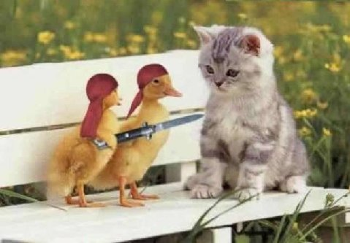
Gang in the Making
Two or more individuals?
Acting in concert?
For the purpose of committing criminal activity?

Slide 5
§ 14-50.16. Definition
Criminal street gang or street gang means: any ongoing organization, association, or group of three or more persons, whether formal or informal, having as one of its primary activities the commission of one or more felony offenses, or delinquent acts that would be felonies if committed by an adult, which has a common name, common identifying sign or symbol, and has three or more members individually or collectively engaged in, or who have engaged in, criminal street gang activity.
Notes:
5
5

Slide 6
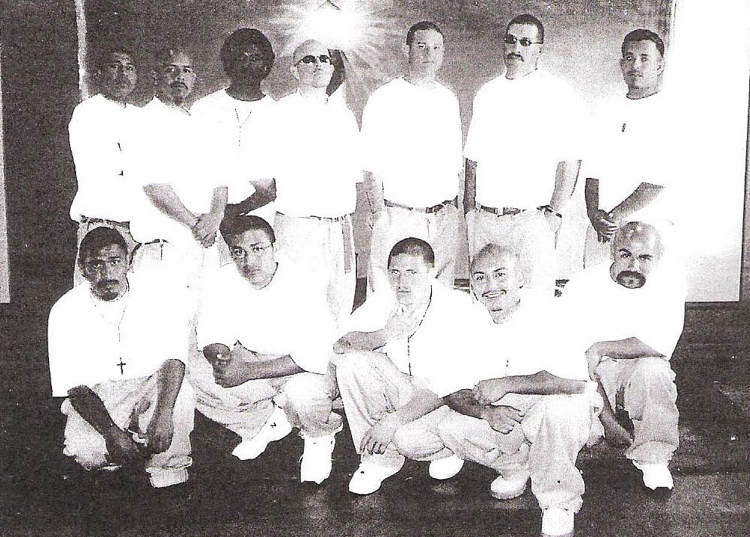
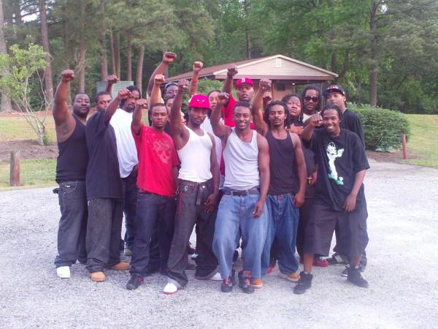
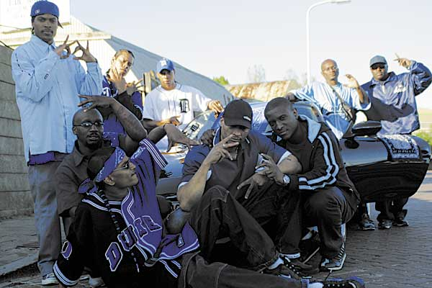
So a GANG is defined as?
Any group, gang or organization of meeting the general statue outlined above.
Goal is to engage in illegal or illicit activities or activities that threaten to undermine the safety of the communities in which we live.

Slide 7
Identified Gangs in
North Carolina
Five Percenters
Crips
Folk Nation or Gangster Disciples
United Blood Nation or Bloods
M.S.-13
18th Street
Community Threat Individual(CTI’s)
Aryan Brotherhood
Aryan Nation
Asian Boyz
Black Guerilla Family (BGF)
Brown Pride Aztecs
Dead Man Incorporated (DMI)
Juggalos/Juggalettes
Kings/Dons
KKK
Latin Kings
Malditos-13
Mexican Mafia
Nazi Low Riders (NLR)
Netas
Norte-14
Outlaw Motorcycle Gangs (OMG’s)
People Nation
Surenos-13 (SUR-13)
Tiny Raskals Gang (TRG)
Vatos Locos
Notes:
7

Slide 8
So What Is It All About
Perceived fun & excitement
Since of Family
Money
Drugs
Sex
Identity
Protection

Slide 9
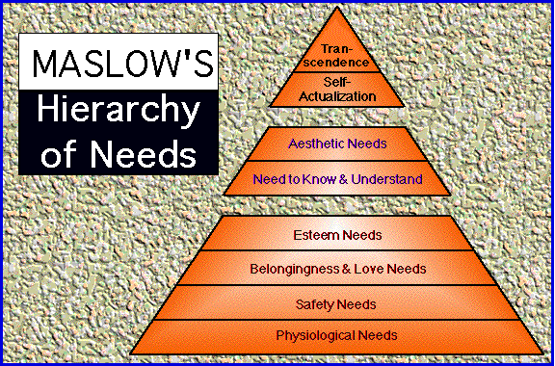
Maslow’s Hierarchy
Physiological hunger, thirst, bodily comforts
Safety/security from danger
Belongingness and love, affiliate with others, be accepted
Esteem to achieve, be competent, gain approval and recognition

Slide 10
Maslow’s Hierarchy
Cognitive to know, to understand and explore
Aesthetic, symmetry, order and beauty
Self-actualization to find self-fulfillment and realize one’s potential

Slide 11
Maslow’s Hierarchy
Self-transcendence to connect to something beyond the ego or to help others find self-fulfillment and realize their potential

Slide 12
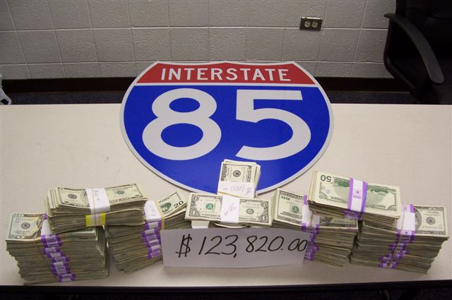
$123,820.00 IN CASH

Slide 13
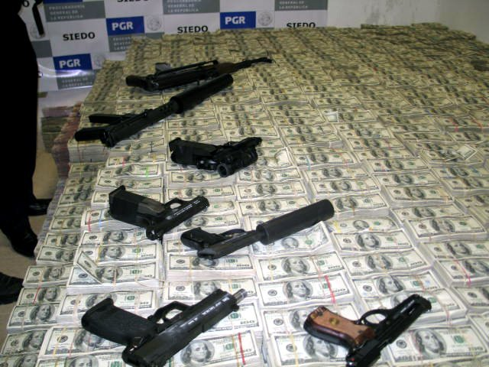

Slide 14
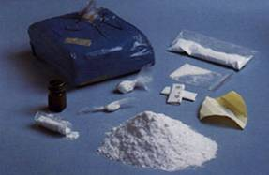
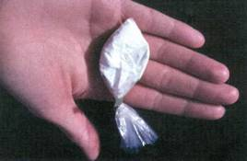
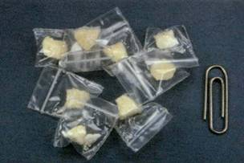
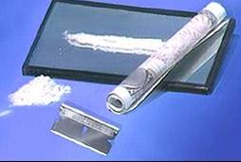
COCAINE
8-BALL
CRACK COCAINE
POWDER COCAINE

Slide 15
The Truth of the Matter
Jails
Prisons
Hospitals
Death

Slide 16
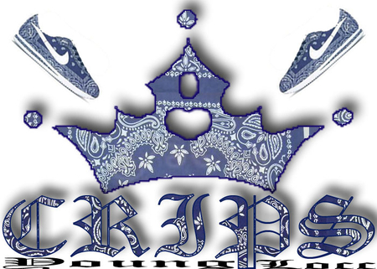

Slide 17
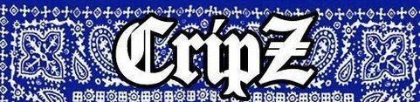
The Crips, originating in Los Angeles, California, are the oldest, largest, violent and most notorious African American gang in the United States. The Crips are mostly identified by the color blue worn by its members. What was once a single gang is now a loose network of “franchises” around the U. S. & Canada.
Notes:
17

Slide 18

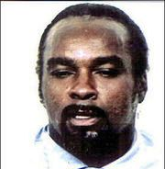
CRIPS FOUNDERS
The Crips were originally founded by two individuals; Raymond Lee Washington and Stanley ‘Tookie” Williams. Washington formed the Eastside Crips and Williams formed the Westside Crips.
Notes:
18

Slide 19
North Carolina CRIPS
  Avalon Gangster Crips
  83 Gangster Crips
  Rollin’ 20’s
  Rollin’ 30’s
  Rollin’ 60’s
  Hoover Crips
  Grape Street Watts Crips
  Neighborhood Crips
Notes:
19

Slide 20
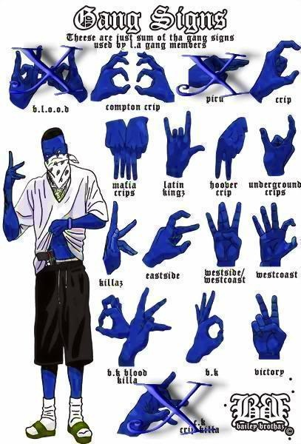
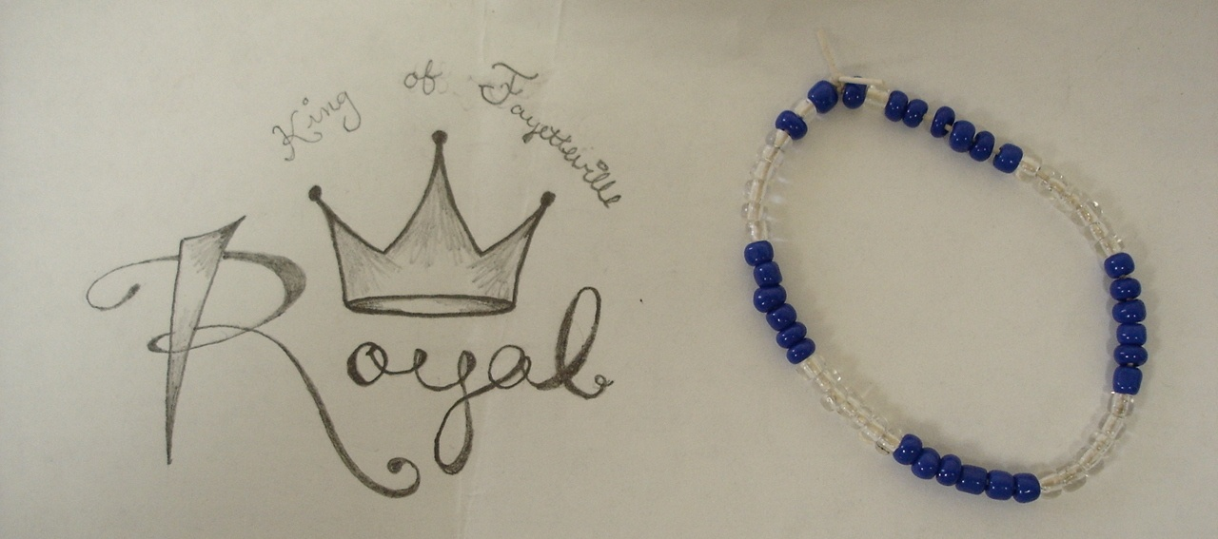
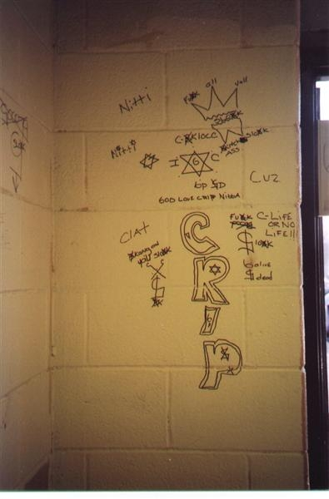
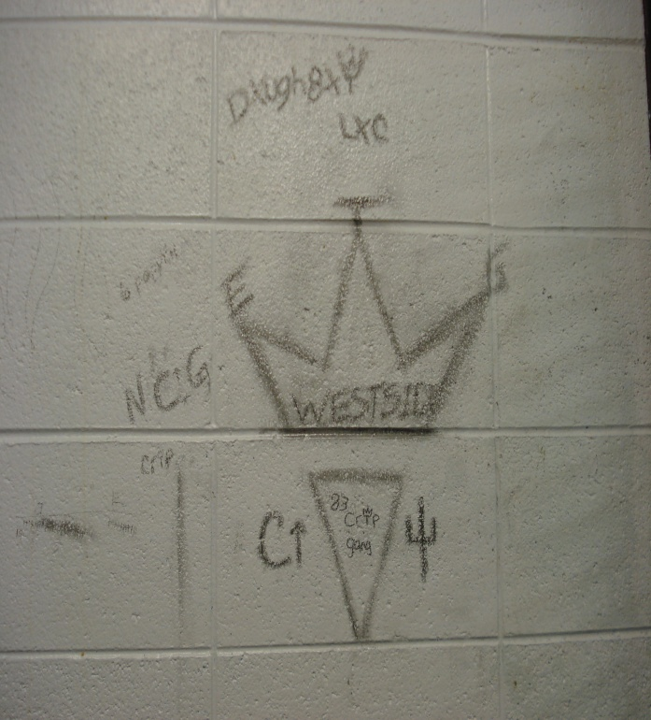
CRIPS IDENTIFIERS
Notes:
20

Slide 21
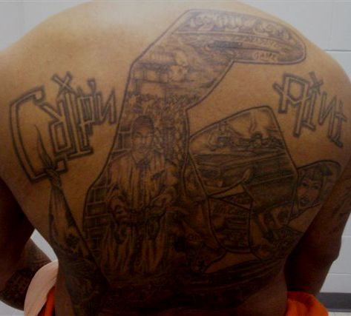
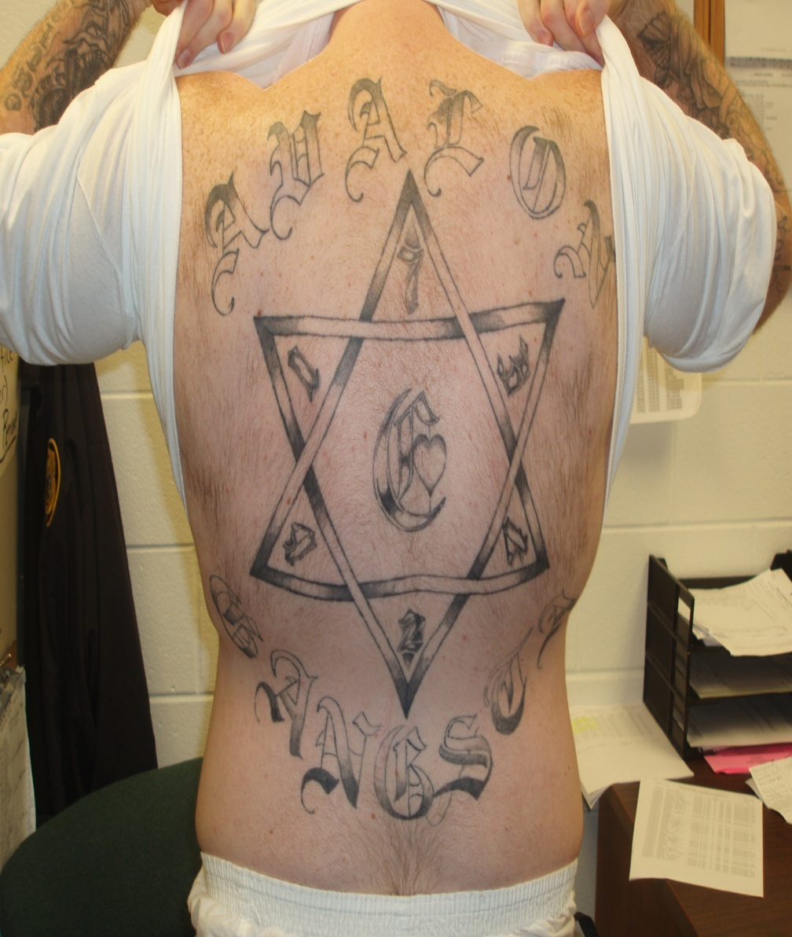
Tattoo Identifiers for the Crips
Notes:
21

Slide 22
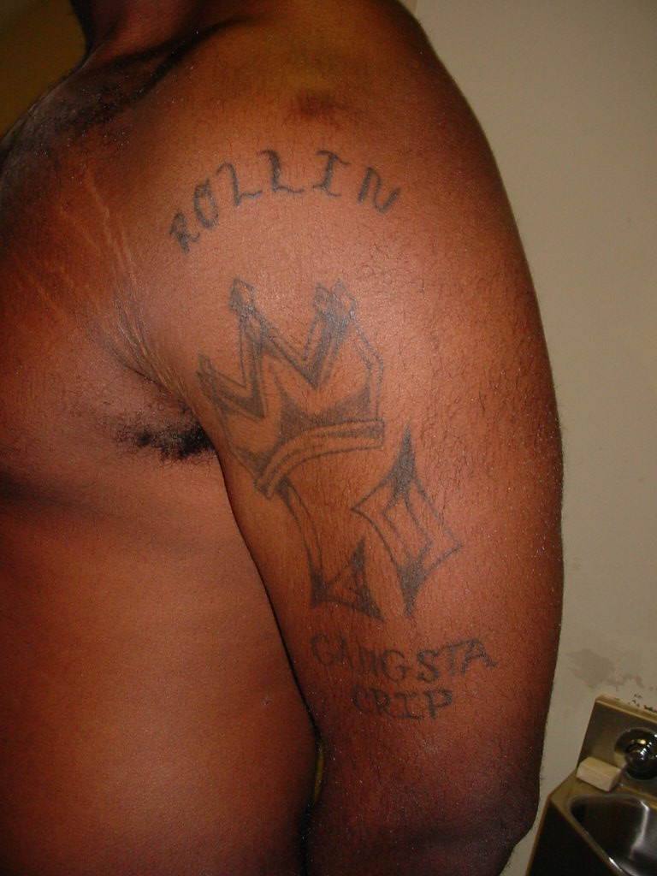
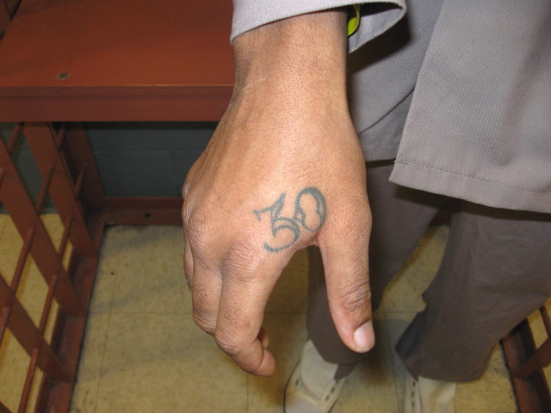
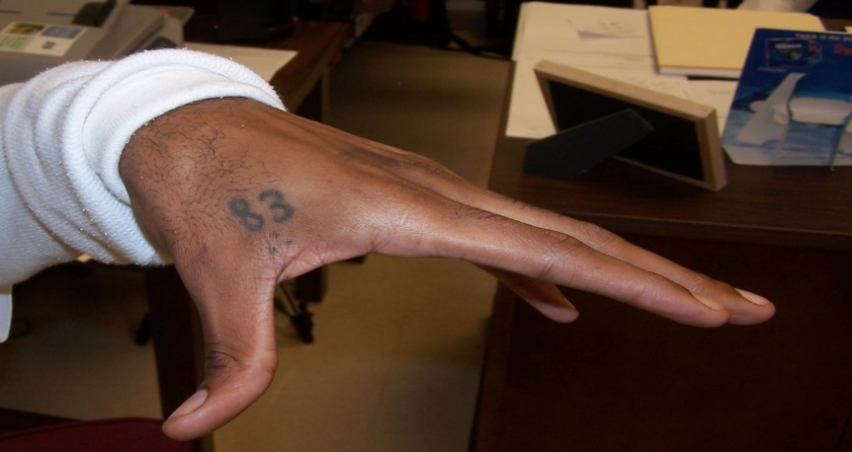
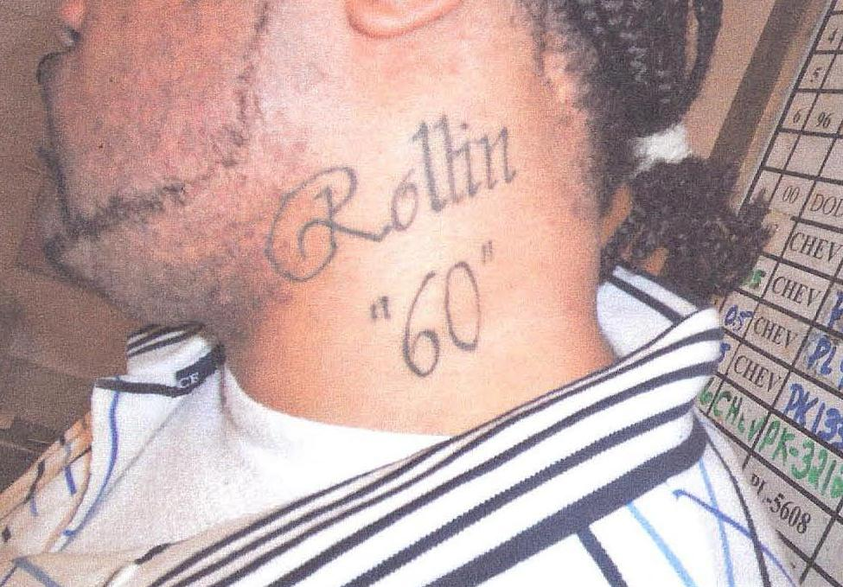
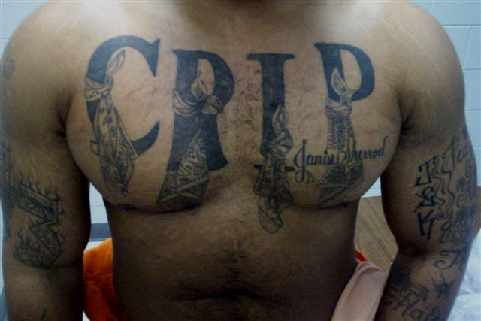
Tattoo Identifiers Continued
Notes:
22

Slide 23
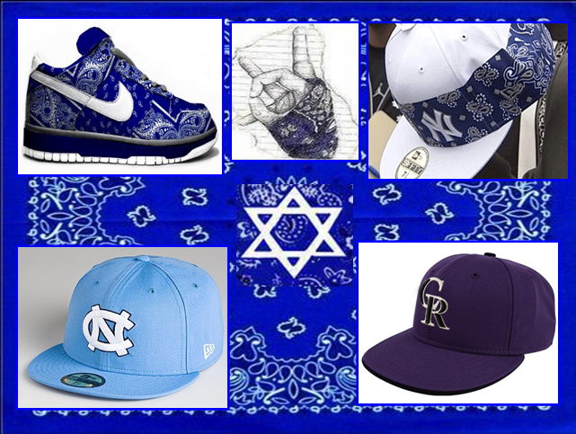
Notes:
23

Slide 24
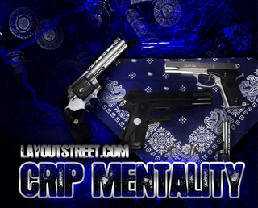
West Coast
Will wear the color Blue
Will also wear the colors of the High School they attended.
Left side identifiers.
They don’t rock (6) six point stars or pitchforks which are Folk Nation identifiers.
Will wear collegiate and professional sports apparel for identifiers.
Refer to themselves as Cuzz or Locs terms used to identify members of the Crips.
East Coast
Will wear the color Blue
Will rock (3) three point crowns, (6) six point stars and pitchforks which are Folk Nation identifiers.
Will also use left and right side identifiers.
Will wear collegiate and professional sports apparel for identifiers.
Refer to themselves as Cuzz or Locs terms used to identify members of the Crips.
Notes:
24

Slide 25
Definitions of Crips terms/phrases:
  Cuzz or Locs – terms used to identify members of the Crips
  Crippin’ – means robbing and stealing, now considered a way of life for Crips
  BK/211 – Blood Killer (2nd and 11th letters of alphabet - B K)
  312 – Crip Love (3rd and 12th letters of alphabet - C L)
  Blue Rip Ryders – a term used to identify members of the Crips
  Loc-Loc – Crips meeting
Notes:
25

Slide 26
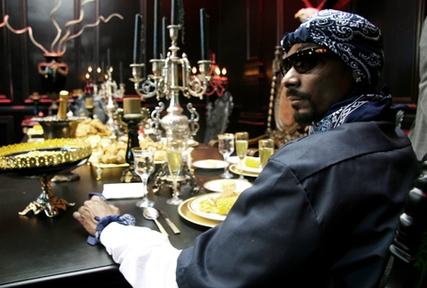
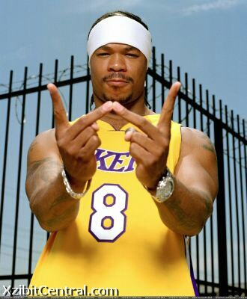
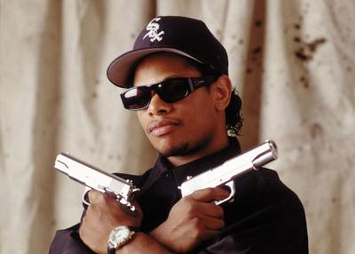
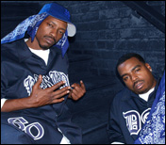
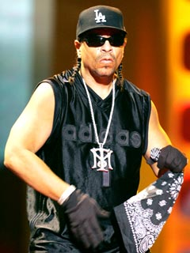
Famous Crips
Notes:
26

Slide 27
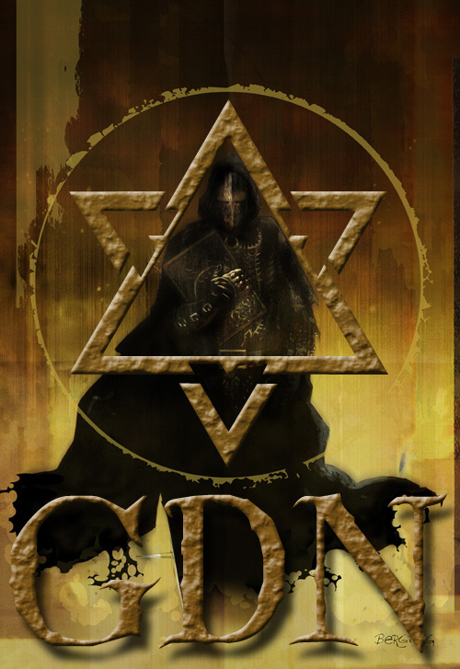
The FOLK NATION
The Folks Nation was formed on November 11, 1978 in the Illinois Department of Corrections.
The Folk Nation or Gangster Disciples was the 3rd Security Threat Group identified by the NCDOP in 1998.
Notes:
27

Slide 28
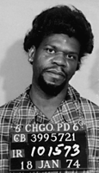

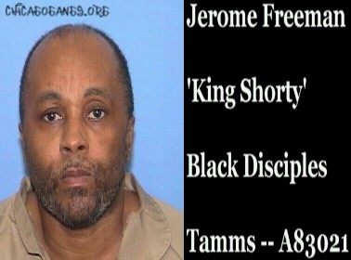
History and Origins
The Black Gangster Disciple Nation was started by a man named David Barksdale. The Black Gangster Disciple Nation {BGDN} fought bloody wars on the Chicago south side over turf and drug sales.
King
David Barksdale
King
Larry Hoover
King
Jerome Freeman
Notes:
28

Slide 29
“The King”
During this time Hoover began working on what he referred to as the Blueprint of the New Concept where he changed the name of Gangster Disciples to the “Growth and Development” organization. Thus establishing the 21st Century V.O.T.E. (Voice of Total Empowerment) which led to the gang gaining influence over political leaders in Chicago.
Currently Hoover is locked down 23 hours every day at the ADX Supermax Prison in Colorado. Larry Hoover is serving a 150-200 year prison sentence.
Notes:
29

Slide 30
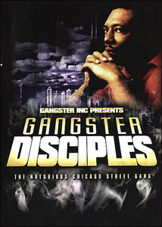
The Gangster Disciples
According to the DEA, the Gangsta Disciples allegedly operated a drug network throughout the country worth $100 - $300 million a year.
The GD’s are described as one of the largest and most organized gangs in the history of the U. S. There are allegedly 30,000 members of the Gangsta Disciples in the Chicago area.
Notes:
30

Slide 31
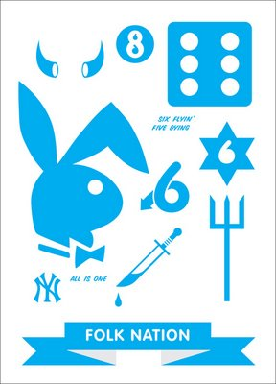
Group Identifiers
STAFF: Money, Mack and Murder
SWORD: Death Before Dishonor
FIRE: Eternal Life
CROWN: For our Kings; David, Hoover and Shorty
HORNS: Bravery on the path to better Growth and Development
TAIL: For all repressed 3rd world Black and Latino Nations
WINGS: Fly high, be proud and never descend upon the Earth
HEART: Eternal love for all Brothers and Sisters of the Struggle or B.O.S.S.
STAR: Life, Love, Loyalty, Knowledge, Wisdom and Understanding (old concept Gangster Disciples) or Education, Economics, Political, Organization, Social Development and Unity (new concept Growth and Development)
Notes:
31

Slide 32





Colors and Symbols
The colors Blue and Black
The number (6) six
Pitchforks
A (6) six point star
A (3) three point crown
The numbers 36 and 63; the number 36 represents King David, The White Pearl and the number 63
Notes:
32

Slide 33
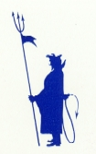
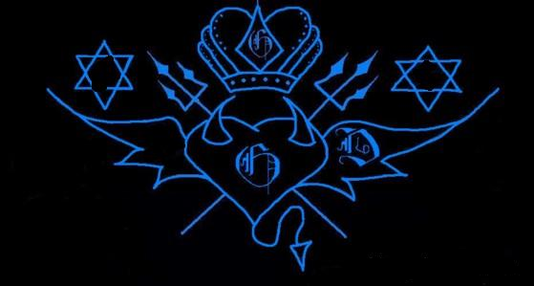
7 SYMBOLS BROKE DOWN
When somebody steps on my TAIL by disrespecting my life, my TORCH lights up illuminating my HORNS, which lets my beast out. The beast thinking bout the death of the fallen soldiers, grabs the SWORD & goes on a warpath of destruction, my HEART is my mind in battle, my HEART with HORNS is my body that protects me in battle my HEART with WINGS, carries my soul away after I have fallen in battle.
Notes:
33

Slide 34

LOVE
LIFE
LOYALTY
KNOWLEDGE
UNDERSTANDING
WIDSOM
Notes:
34

Slide 35
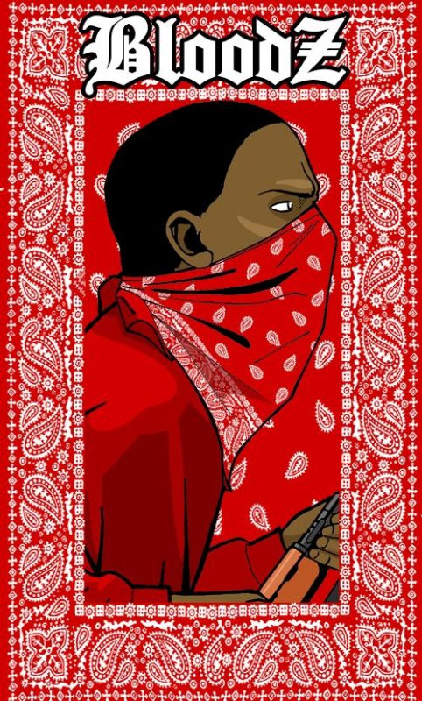
BROTHERLY LOVE OVER-RIDES OPPRESSION AND DISTRUCTION
Notes:
35

Slide 36
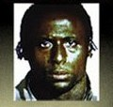
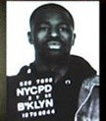
East Coast History
Omar Portee, also known as O.G. Mack, was born in LA and was involved in the Miller Gangster Bloods in South Central before moving to New York City. Mack and O.G. Deadeye are considered the "Godfathers" or O.G. (Original Gangster) of the East Coast Bloods.
O.G. Mack
O.G. Dead Eye
Notes:
36

Slide 37
The First East Coast United Blood Nation Sets:
Nine Tray Gangster, NTG, 93 or Billy Bad Ass
One Eight Trey or 183
Gangster Killer Bloods, G-Shine or GKB
Valentine Bloods or VB
Sex Money Murder, SMM or 252
Mad Stone Villains or MSV
Blood Stone Villains or BSV
Hit Squad Brims or HSB
59 Brims
Notes:
37

Slide 38
NC Blood Sets
Billy Bad Ass, Nine Teks & Grenades
P.T. or Pretty Tony - Redrum Militia
R.M.G Red Mob Gangstas - Executioner Bloods
Red Star Gangstas – Krimson Brigade
Bumpy Knuckles – Brimstone Villians
Gambinos – B.M.B - Blood Money Bangers
B – Low Gangstas – Killa Kartel Bloods
Notes:
38

Slide 39
United Blood Nation Philosophy:
is Brotherly Love Overrides Oppression and Destruction (BLOOD) & Dog And Man United (DAMU).
Love – is what we have and show to our people and thy nation.
Peace – is what we fight for and what we have within ourselves and to this Nation.
Truth – is what we are about and to stay true to the Nation.
Freedom – is what we have
Justice – is what we serve to others as well as ourselves if this nation is disrespected.
Notes:
39

Slide 40
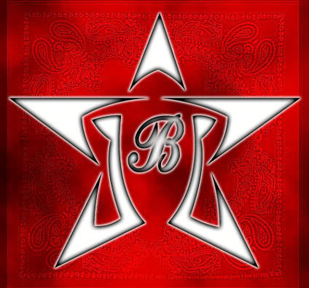
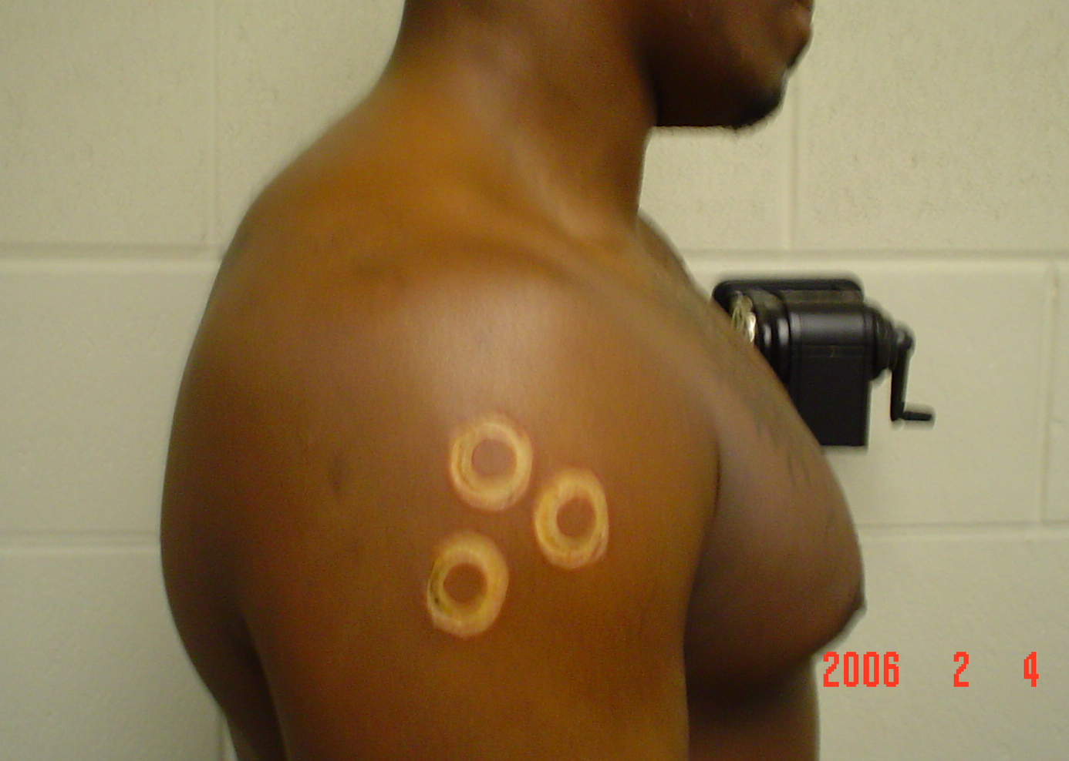
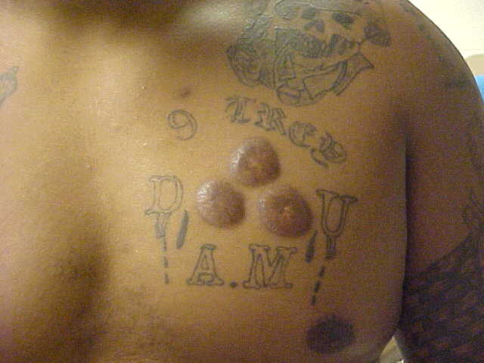
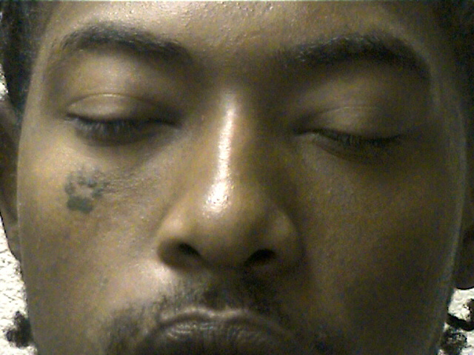
UBN IDENTIFIERS

Slide 41
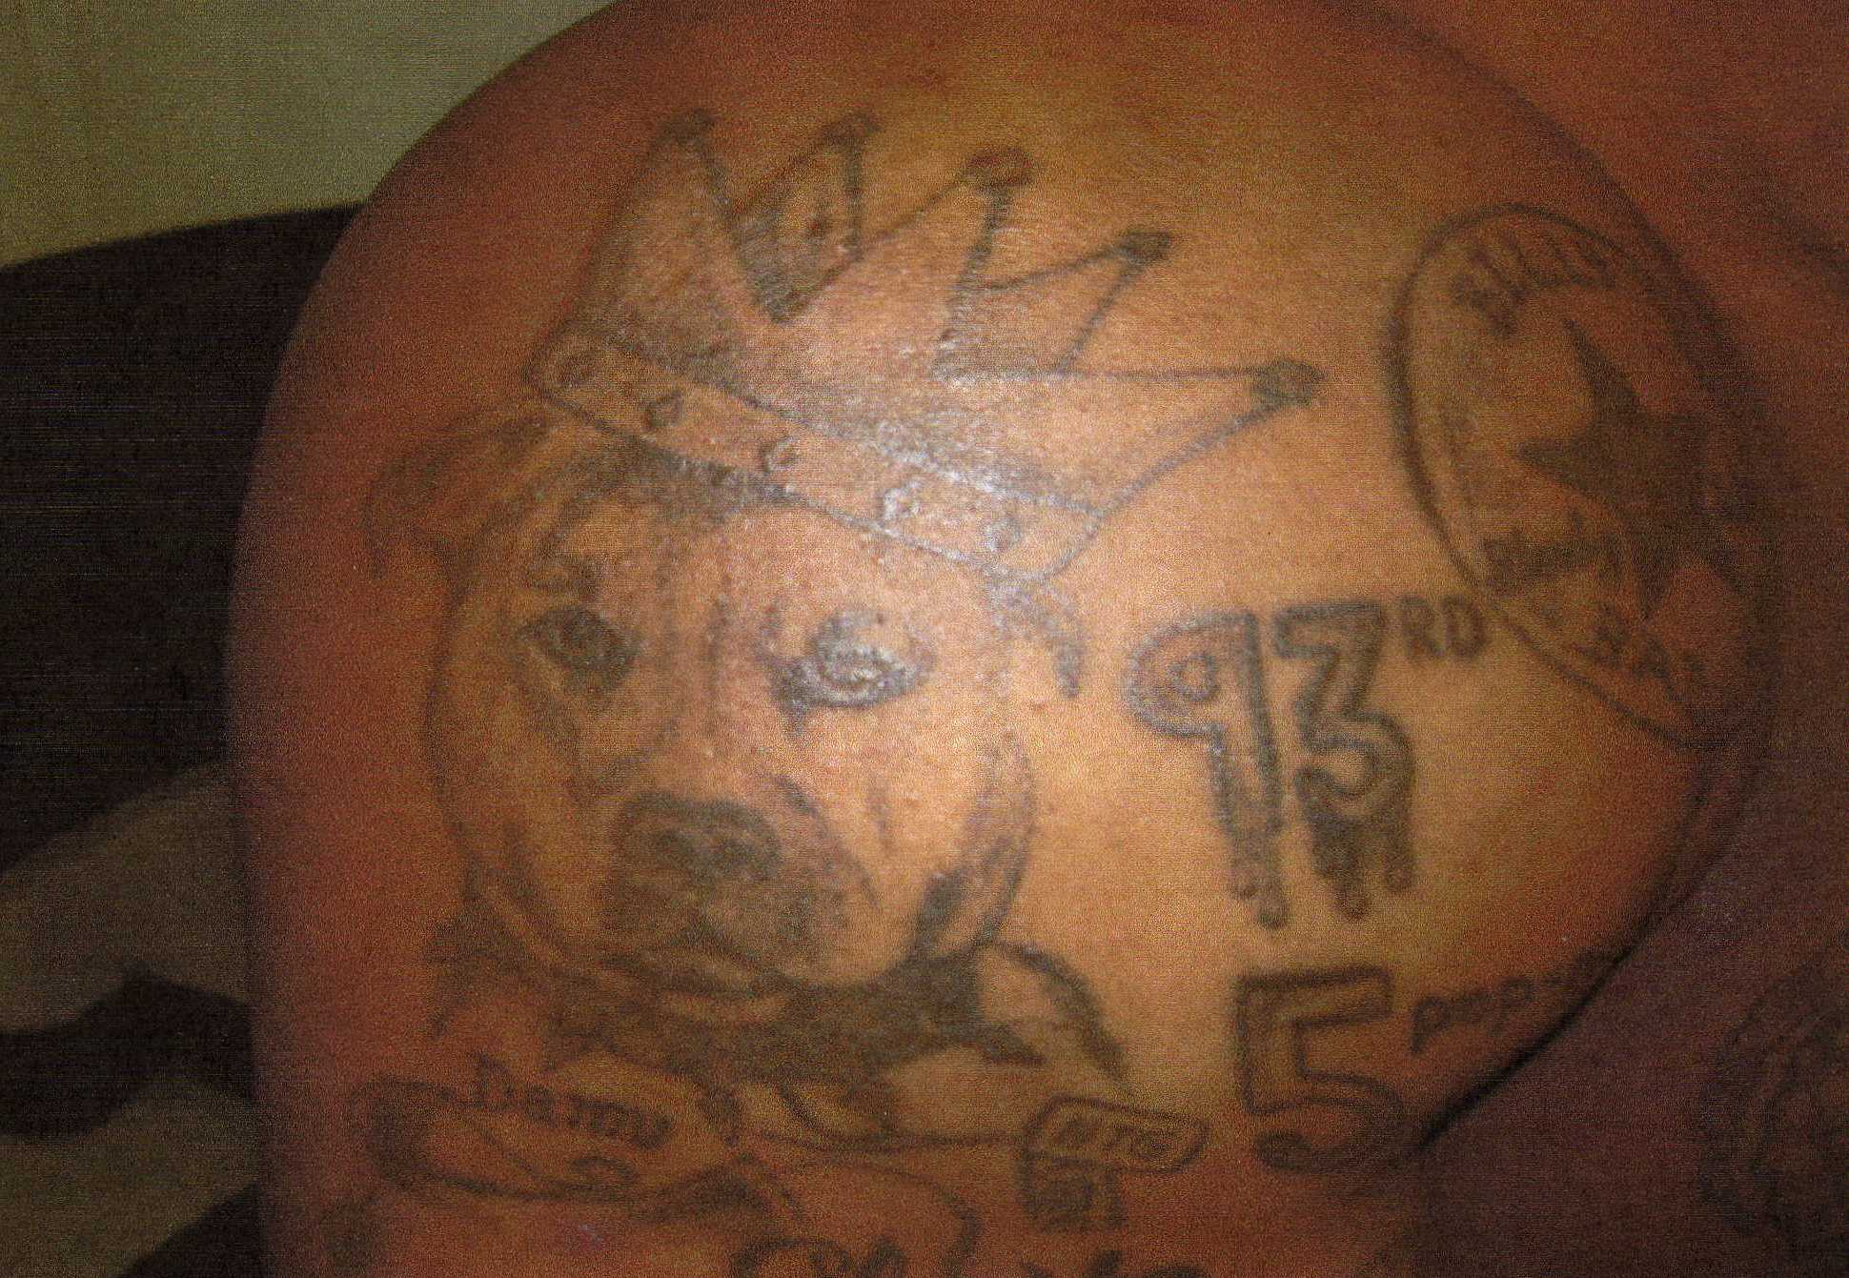
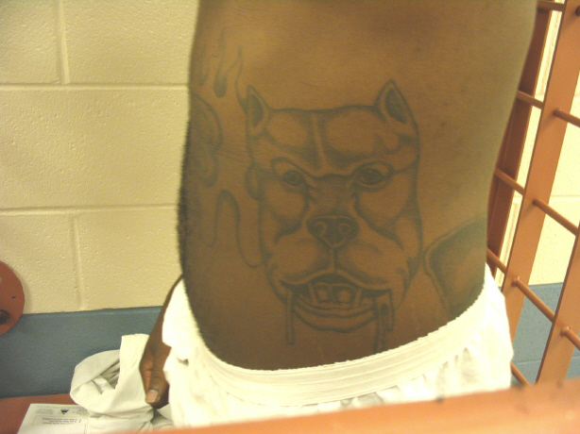
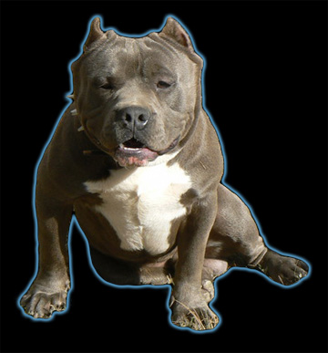
PITBULL DOGS

Slide 42
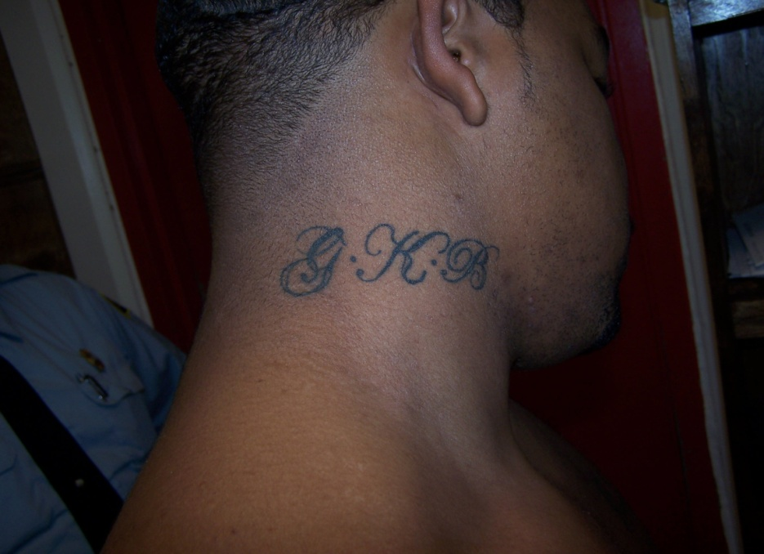




Slide 43







Slide 44

Mara Salvatrucha or MS13
La Mara Salvatrucha or MS-13 originated in El Salvador and Honduras in the early 80’s by paramilitary trained guerilla fighters.
Notes:
44

Slide 45

Notes:
45

Slide 46

MS-13 PHILOSOPHY
In our country, we were taught to KILL, our own people, No matter if they were from your own Blood. If your Father was the enemy, you had to KILL him. So the Military Training we got during the WAR in our country served to make us one of the most Violent Gangs in the United States.
Ernesto “Smokey” Miranda
Co-Founder of MS-13
Notes:
46

Slide 47




Colors and Identifiers
Blue, White and Black
Members will tattoo themselves with the initials of M and S and the number 13 in many forms such as 13, XIII and X3.
Demonic symbols such as the devil’s head and fingers used as hand signs.
Notes:
47

Slide 48

Latin Kings
The Latin kings have three main factions. These are the Latin Kings that were believed to have started in the mid 1940’s in Chicago “The Mother land”.
The second was formed during the 1980s Felix Millet and Nelson Millan, two inmates in the Connecticut prison system, created the Almighty Latin King Nation of Connecticut.
The third being Almighty Latin kings that were started in Collins Correctional Institution in the New York prison system In 1986 This was organized by Cuban born Luis Felipe known as King Blood.
Notes:
48

Slide 49


Latin King Leaders
In 1981, a Cuban immigrant by the name of Luis Felipe came to Chicago and joined the Latin Kings and became known as King Blood. In 1985, King Blood was drawing police attention and fled to New York, where 1 year later he was convicted of killing an ex-girlfriend and sent to New York state prison for 9 years.
Antonio Fernandez (King Tone) took control of the Latin Kings. In a sudden change of direction, King Tone vowed to lead the gang away from crime. He urged kids to put down their weapons, stay in school, and celebrate their Latino heritage in a positive way. In many poor neighborhoods, King Tone was hailed as a working class hero. The Kings grew to over 6,000 members. "King Tone" took over in 1996 after his predecessor, Luis "King Blood" Felipe, was sentenced to life in solitary confinement on a racketeering conviction.
Notes:
49

Slide 50
Organization
  The leader is the Primera Corona (First Crown)
  The second in command is the Segunda Corona (second crown)
  The third crown is the Tercera Corona "Warlord" or "Enforcer"
  The fourth crown is the Quarta Corona Counselor (and conducted the Latin King training lessons)
  The fifth crown is the Treasurer Quinta Corona (responsible for collecting the dues and fines and keeping unity in the ALKQN.)
Notes:
50

Slide 51


Identifiers Symbols Tattoos
They use the colors Black and Gold. Black represents death and the past, Gold represents life, the future, and the sign of the sun. A lion’s head
  The sun
  A diamond
  A Cross
  The figure of a King's head
  known as the “Master"
  Five-Pointed Castle
  Five-Point Crown
  The Number 5
Notes:
51

Slide 52






Hand Signs and Identifiers
Notes:
52

Slide 53

Aryan Brotherhood
History and Origins
• The Aryan Brotherhood is believed to have been formed by a group of bikers in 1964 at San Quentin State Prison; formed in reaction to the Black Panthers.
The four leaders of the Aryan Brotherhood :
Barry "The Barron" Mills: The alleged leader of the Aryan Brotherhood's operations in the federal prison system.
Tyler Davis "The Hulk" Bingham: With Mills, allegedly makes all major decisions involving the federal prison branch of the Brotherhood. Has allegedly ordered the murder and assault of AB enemies and former gang members.
Edgar "The Snail" Hevle: Allegedly, a former member of the three-man commission that oversaw the federal branch of the prison gang.
Christopher Overton Gibson: Allegedly, a member of the group that oversees the gang's day-to-day activities.

Slide 54





Identifiers & Symbols
Like most gangs, Aryan Brotherhood members mark themselves with distinctive tattoos. Designs commonly include the
words "Aryan Brotherhood", the acronym "AB", 666, SS sig runes, spider webs near the elbow, shamrocks, and other Nazi and/or Celtic iconography.
Notes:
54

Slide 55

Aryan Nations (AN) is a white nationalist neo-Nazi organization founded in the 1970s by Richard Girnt Butler as an arm of the Christian Identity group Church of Jesus Christ-Christian. As of December 2007 there were two main factions that claimed descent from Butler's group. Aryan Nations has been called a "terrorist threat" by the FBI, and the RAND Corporation has called it the "first truly nationwide terrorist network".
From the 1970s until 2001, the headquarters of AN was in a 20-acre compound at Hayden Lake, Idaho. There were a number of state chapters, only loosely tied to the main organization. The group ran an annual World Congress of Aryan Nations at Hayden Lake for both AN adherents and similar groups
Notes:
55

Slide 56


Identifiers and Symbols
Many members of the Aryan Nation bear the identifying tattoo of a swastika and the Nazi SS lightning bolt.
Notes:
56

Slide 57

Outlaw Motorcycle Gangs

Slide 58
Criminal Activity: OMG’s are involved in criminal activities including the production, smuggling, transportation, and distribution of drugs, murder, prostitution, money laundering, weapons trafficking, motorcycle and motorcycle parts theft, intimidation, extortion, and arson.
There are small numbers of bikers who refer to themselves as “1%ers”.

