Slide 1
LA County Library Programs and Resources
Lyda Truick
Regional Youth Services Coordinator

Slide 2
About LA County Library
88 library branches
Provides library service to 3.4 million residents
Provides programs, books, magazines, homework help, online classes, databases, and much more

Slide 3
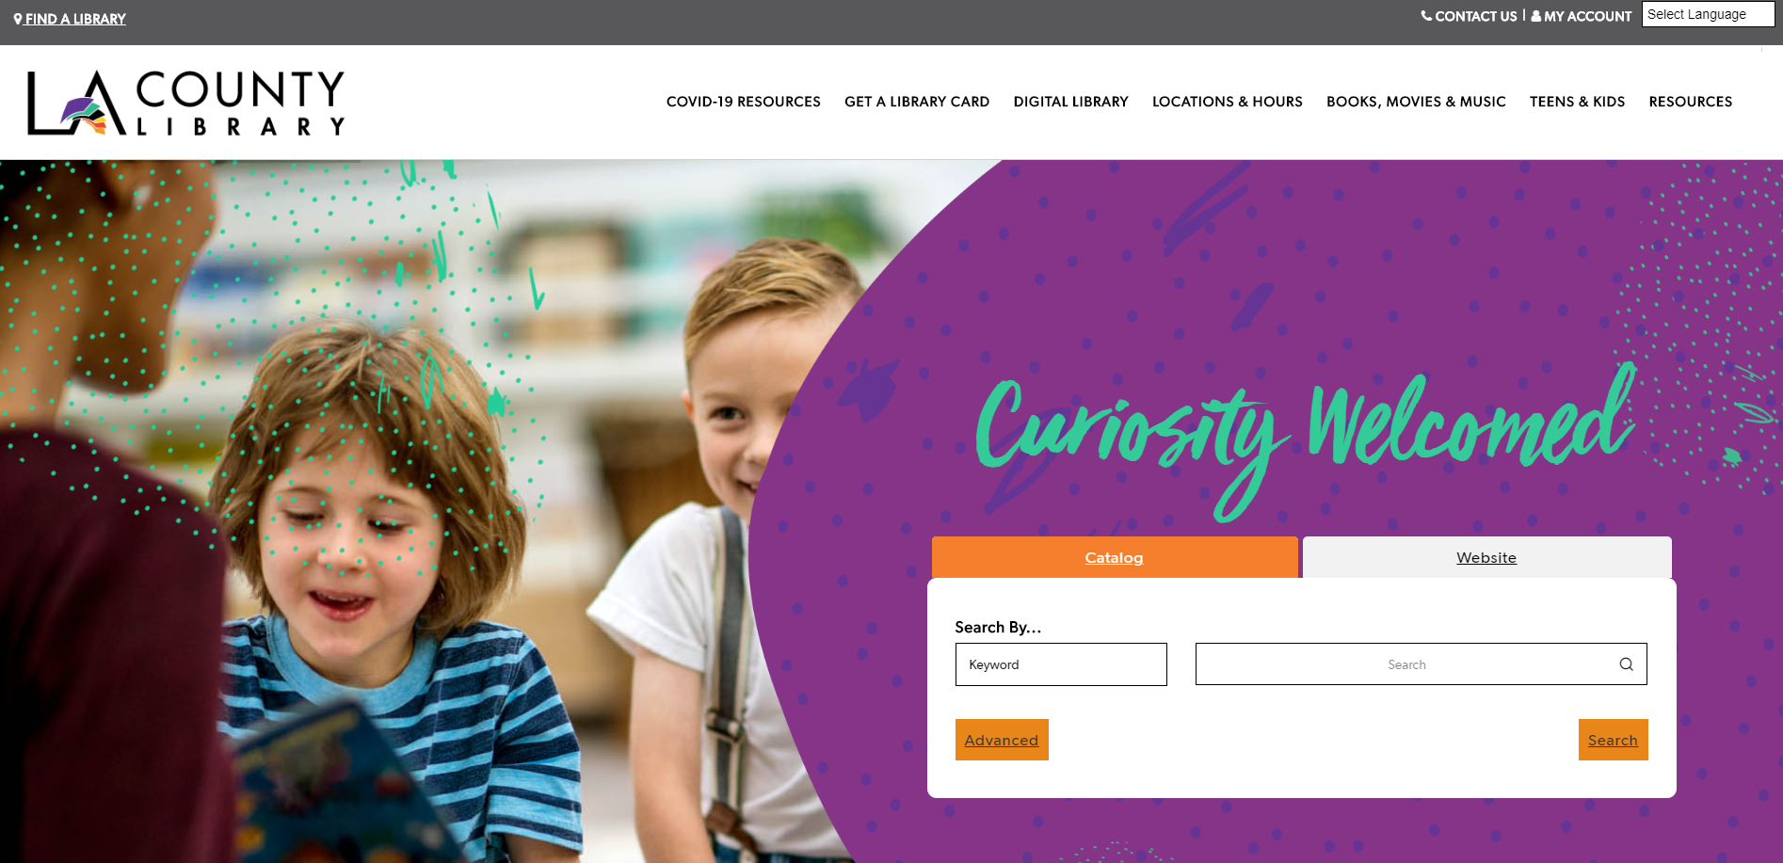
LACOUNTYLIBRARY.ORG

Slide 4
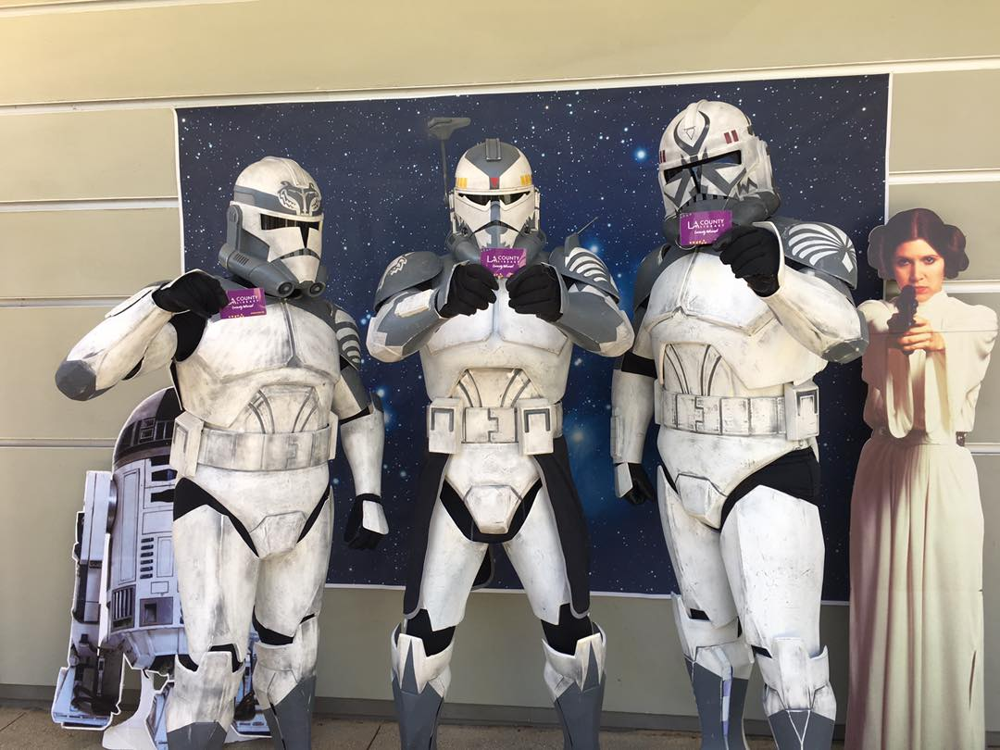
Temporary Digital Library Card
Access LA County digital resources
eBooks
Audiobooks
Magazines
TV and Movies
Homework Help
Online Classes
Valid for 90 Days

Slide 5
eBooks & Audiobooks
Overdrive and Libby
Free eBooks and audiobooks
Hoopla and RB Digital
Free audiobook downloads
BiblioBoard
Local content from self-published authors

Slide 6
Music and Magazines
Freegal Music
Unlimited music streaming and limited song downloads
Hoopla
Stream albums and digital video
RB Digital
Free digital downloads of popular magazines

Slide 7
Movies and TV Shows
Kanopy
Stream independent, international, classic and documentary films
Hoopla
Stream films and TV shows

Slide 8
Online Learning
Lynda.com
Access online instructional videos
Brainfuse
eLearning for all ages including live tutoring, job coaching, and skill building
RB Digital
Online language learning classes including ESL courses

Slide 9
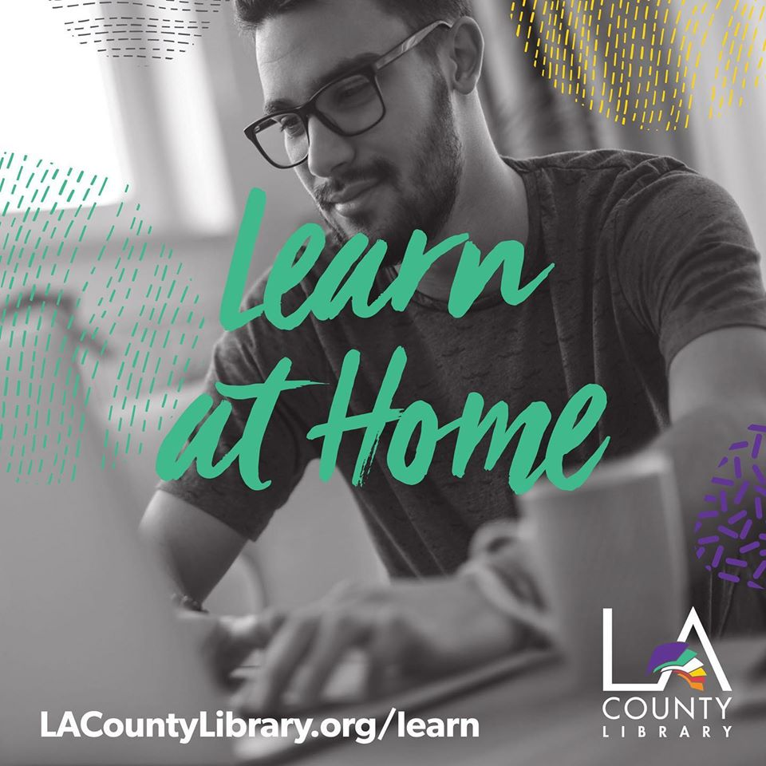
Instructor-Led Online Learning & Test Prep
Gale Courses
Wide range of free online classes such as grammar, resume writing, digital photography, and much more
Universal Class
Diverse online instructor-led classes in subjects including computers, business, health, and technology
Learning Express
Practice test, tutorials, and eBooks for school and career
Khan Academy
Study at your own pace with practice exercise and instructional videos

Slide 10
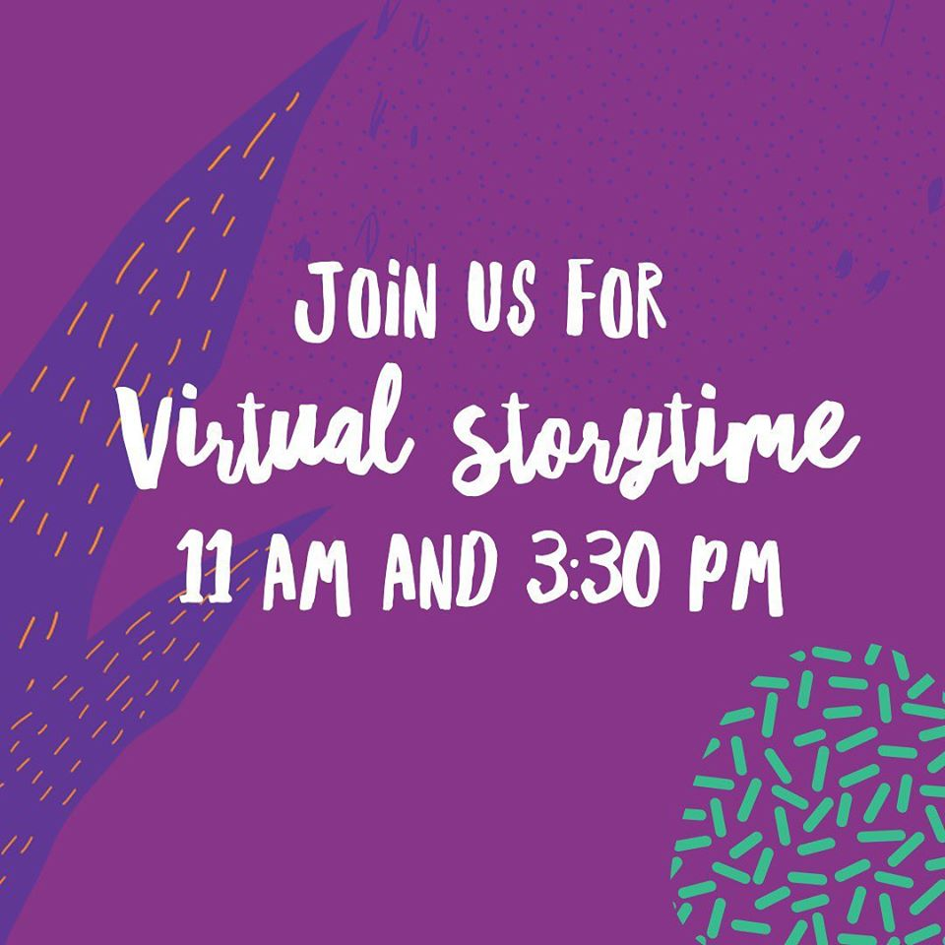
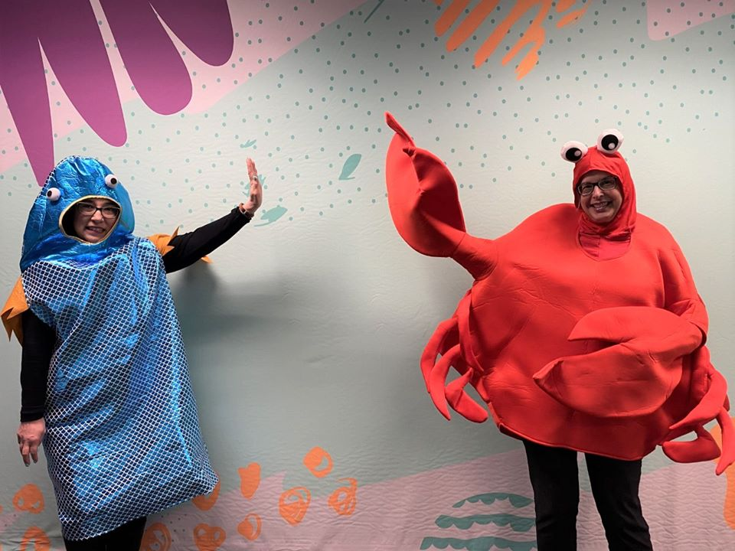
Virtual Programs
Virtual Storytime on Facebook and Instagram
Monday – Thursday 11 AM & 3:30 PM

Slide 11
Activities at Home
Activity Ideas
Kids & Parents, Tween & Teen and Adult activity idea worksheets
DIY Library Programs
Host your own library program at home with these step-by-step guides for kids and teens
Books & Learning
Dive into a variety of topics with books, online, courses, databases, and more

Slide 12
Spring & Summer Discovery Program
Discovery Program levels for all ages – Adults, Teens, Kids, and Babies & Toddlers
Log books you read
Write and read reviews
Complete online activities
Earn points and prizes

Slide 13
Kids’ Corner
Tumble Book Library
Online collection of animated and talking picture books. Read a book or have it read to you!
Online Homework Help
Get homework help from home. Live, online tutoring is available on Brainfuse for K-12 students, college students, and adult learners.
Databases & Resources
Up to date and reliable information on a variety of topics.

Slide 14
Great Read Away
Read at Home and Reduce Your Fines
$5 in fines will be removed for every hour spent reading
For customers ages 21 and under

Slide 15
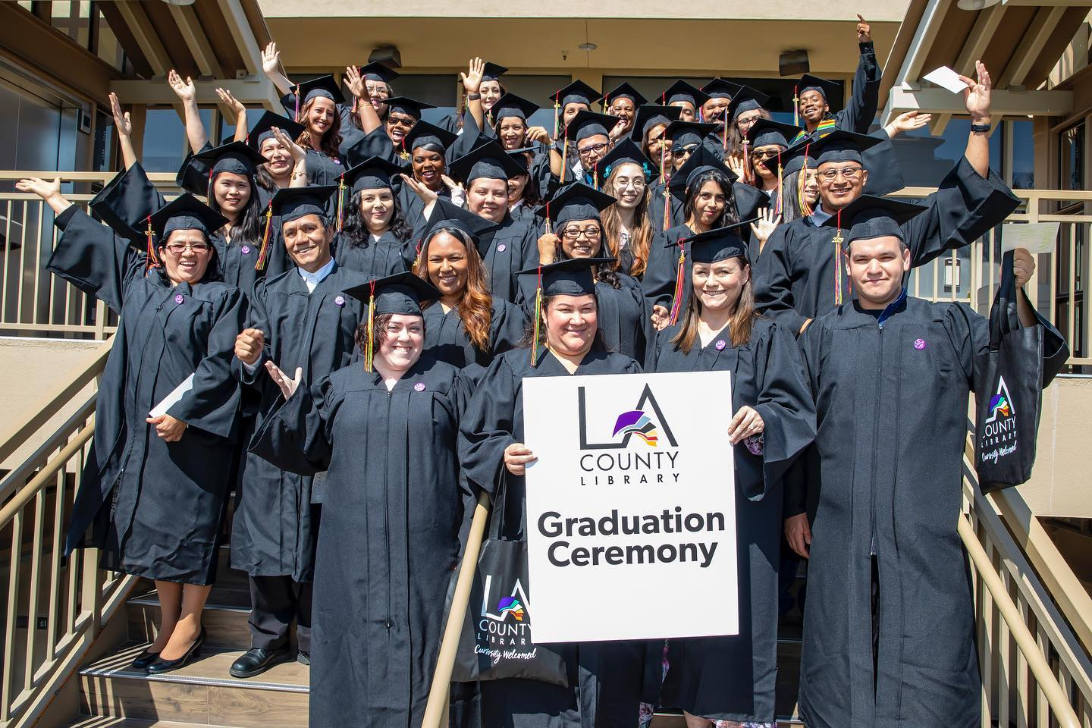
Career Online High School
Earn an accredited high school diploma online in 18 months or less
Includes Career Certificate in 1 of 10 high-demand field & personalized online career coaching

Slide 16
Stress Management
Mindfulness Tip Sheets, DIY Program, Books & Learning
Collection of tips and resources to help kids, teens, and adults maintain their well-being during these high stress times
Community Resiliency Model
Series of videos based on Community Resiliency Model, science-based system, which focuses on the biology of the human nervous system

Slide 17
Additional Resources
Coronavirus FAQ
Health Updates
Housing Updates
Job & Small Business Resources
Food Resources

Slide 18
Connect With Us
Website
Facebook
Instagram
Twitter

Slide 19
LYDA TRUICK | REGIONAL YOUTH SERVICES COORDINATOR
151 E Carson St, Carson, CA 90745
P: 310.830.0231 | M: 562.302.3891
LACountyLibrary.org | @LACountyLibrary 2019 Gale/LJ Library of the Year

