Slide 1


LA County
Department of Children & Family Services
Van Nuys Regional Office
Strength
Needs
Practice
Child
Safety & Equity
Presented by
Adrienne Olson, LCSW, Regional Administrator
olsona@dcfs.lacounty.gov or (818)904-8755
Notes:
Good Afternoon
Introduce Self
Very happy to be here to be part of this important conversation on building equity & to part of this panel amongst very esteemed colleagues.
I will be speaking about the DCFS Van Nuys Regional Office & providing a very high level overview of our work around equity for the last several years.
Upfront, I should thank the Van Nuys office staff & managers & especially the Van Nuys ERDD Team, SPA 2 ERDD Team & the DCFS Countywide ERDD Team as they have been an ongoing source of immeasurable support & without whom, I would not be here today.

Slide 2
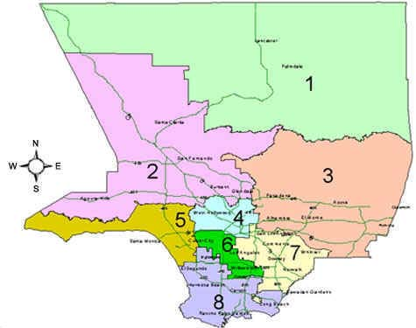
The DCFS Van Nuys Regional Office
One of Three Offices Serving the San Fernando & Santa Clarita Valleys
Van Nuys Office
7555 Van Nuys Blvd., Van Nuys 91405
West San Fernando Valley Office
20151 Nordhoff St., Chatsworth 91311
Santa Clarita Office
24890 Ave. Stanford, Santa Clarita 91321
Adrienne Olson, Regional Administrator
Van Nuys
(818)904-8755
olsona@dcfs.lacounty.gov
Michael J. Rauso, Regional Administrator
Santa Clarita
(661)702-6202
rausom@dcfs.lacounty.gov
Muzeyyen Balaban, Regional Administrator
West San Fernando Valley
(818)717-4808
balabm@dcfs.lacounty.gov
Notes:
To provide some context, we can see from this slide, that the Van Nuys office is located in the Northwest part of the County in SPA 2.
Van Nuys is one of three DCFS offices in SPA 2, along with the great WSFV & Santa Clarita Offices

Slide 3
Van Nuys Regional Office Staff
Approximately 400 direct service, support, & co-located staff
Strength
Needs
Practice
Child
Safety & Equity
Direct Service Staff
CSW - Children’s Social Worker
SCSW - Supervising Children’s Social Worker
ARA - Assistant Regional Administrator
RA - Regional Administrator
Support Staff
Human Service Aides
Clerical Support & Eligibility Workers
Adoption Assistants
Co-located Staff
Parents-in-Partnership (PIPs)
Departments of Mental Health, Public Social Services, Health & Public Health Nurses
Kinship Liaison, Youth Development Services, Permanency Partners Program, Educational Liaison, D-rate Evaluators, Resource Family Approval & Support/Adoptions & Child Care
One of seven child-serving County Depts co-located at the Zev Yaroslavsky Family Support Center
Notes:
The Van Nuys Office is comprised of approximately 400 DCFS direct service, support & co-located staff
Along with staff co-located with DCFS, the DCFS Van Nuys office is one of seven child-serving County Departments co-located in the Zev Yaroslavsky Family Support Center
The Zev Yaroslavsky Family Support Center along with Mid-Valley Health Center are located on the same property or campus and house approximately 1200 County employees

Slide 4



What is Disproportionality and Disparity?
Disproportionality: When a group makes up a proportion of those experiencing some event that is higher or lower than that group’s proportion of the population
Disparity: A comparison of one group (e.g., regarding disproportionality, services, outcomes) to another group
VS.
VS.
VS.
VS.
VS.
Child
Population
Allegations
Substantiations
Entries
In Care
Black
White
Latino
Asian
Native Am.
Notes:
Understanding how we know our child welfare system lacks equity is important.
Two terms are crucial to this understanding
Disproportionality – when a group makes up a proportion of those experiencing some event that is higher or lower than that group’s proportion to the population
Disparity: A comparison of one group (e.g., regarding disproportionality, services, outcomes) to another group
And in LA County, we consistently see Black as well as American Indian children disproportionally represented and achieving disparate outcomes in the child welfare system

Slide 5
Van Nuys Key Decision Points
Fiscal Year 16/17
Data Source: CWS/CMS Datamart. Family to Family Report for Fiscal Year 16/17. Extracted on 12/8/18..
Note: Missing, other and multi-race values were excluded from the analysis.
Notes:
This slide helps to illustrate how black children are disproportionally represented and achieving disparate outcomes.
I apologize for it being so out of date, but unfortunately I don’t believe our number have drastically changed.
We can see that our black children make up approximately 3% of the population in the East San Fernando Valley, but they represented 7% of our referrals, 7.3% of our substantiated referrals, 10% of the removals, and they make up 10.5% of our foster care caseload.

Slide 6
Institutional Analysis Findings
Lacks effective engagement
Inadequately matches services to needs
Pays insufficient attention to trauma, particularly grief and loss
Not organized to work with families in a coherent way
Undermines family connections
Provides limited advocacy
Privileges system functioning and needs over families needs
Reflects the effects of disinvestment in their communities
Source: Center for the Study of Social Policy, Child Welfare Practice: Creating a Successful Climate for Change, Findings and considerations from an Institutional Analysis, September 2012. https://www.cssp.org/publications/child-welfare/institutional-analysis/Child-Welfare-Practice-Creating-a-Successful-Climate-for-Change.pdf
Notes:
In 2012 the Center for the Study of Social Policy completed an Institutional Analysis of LA County’s child welfare system.
The analysis found that some of the main reasons for our disproportionate and disparate outcomes for black children are that our system:
Lacks effective engagement
Inadequately matches services to needs
Pays insufficient attention to trauma, particularly grief and loss
Not organized to work with families in a coherent way
Undermines family connections
Provides limited advocacy
Privileges system functioning and needs over families needs
Reflects the effects of disinvestment in their communities

Slide 7

Van Nuys ERDD Consciousness Raising,
Cultural Shift & Capacity Building
Office, SPA, & Countywide ERDD Champions/Leadership Team
Office Celebrations/Training
Annual ERDD Summit for SPA 2 Office Staff & Community Partners
Effective Black Parenting Classes
Faith-Based Partnership
Cultural Brokers
Fatherhood Project
Notes:
So what have we been doing to address these institutional or systemic issues?
First & foremost, we have recognized that we have a lot to learn & have been focused on raising our awareness, our consciousness, & our understanding of the problem. In order to do this work, we have to create a safe & supportive environment that is conducive to learning & growing.
To begin, we have developed a very strong team of champions in the Van Nuys office that meets regularly to discuss these issues, provide input to leadership & plan events, training & strategies for ERDD. Our team has also developed a very close partnership with the other SPA 2 offices, WSFV & Santa Clarita as well as the DCFS Countywide ERDD Team. This has helped us to know how others are moving forward & that we are learning & developing together & this in & of itself has been very helpful.
Our ERDD Team has come together and developed office celebrations and in-service trainings. This year, during Black History Month, we had a different virtual training or other fun activity in the office on each Thursday afternoon to learn about & celebrate black history.
We are also very proud of the ERDD Summits that our SPA 2 ERDD Teams in partnership with Friends of the Family have organized for over 300 staff and community partners each year for the last three years . Despite the pandemic, last year’s Summit was comprised of 8 virtual all-days trainings provided by Dr. Alan Michael Graves on how to have Courageous Conversations about race & other issues of equity.
We also utilized our Prevention and Aftercare dollars to certify 12 staff from DCFS and Friends of the Family to conduct Effective Black Parenting Classes.
We are developing our partnership & collaboration with the Faith Community & are very excited that SPA 2 was the first SPA in DCFS to implement the Care Portal.
We have partnered with Alan Michael Graves to certify 8 of our staff/managers as facilitators of the Fatherhood Project support groups.
Additionally, prior to the Pandemic, we began our development of Cultural Brokers, again allocating our PnA dollars to FOF to hire a Cultural Broker Coordinator.
So all in all, we may have not yet have moved the numbers, but I believe we are on the right track & are on way. I believe that all of these efforts are a necessary part of raising the consciousness, creating a cultural shift & building our capacity to do the work of equity.
Our goal is to create an environment where our workforce and their cultural humility, sensitivity and best practices will thrive.

Slide 8

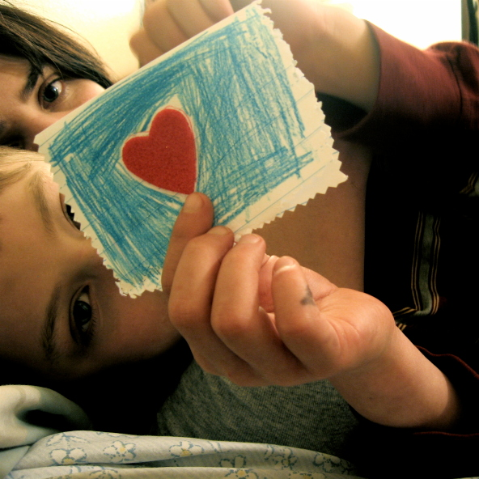
Any Questions?
Thank you for all you do for our children, families & community!
Notes:
Just

