Slide 1
CPT and ICD-10 Coding Update new codes for 2018
Steve Adams, MCS, COC, CPC, CPMA, CPC-I, PCS, FCS, COA
email: steve.adams@inhealthps.com
web: thecodingeducator.com

Slide 2
THECODINGEDUCATOR.COM

Slide 3
Discussion Points
ICD-10 Update
CMS Update
CPT Update
EM
Anesthesia
Surgery
Radiology
Pathology
Medicine

Slide 4
ICD-10 Updates

Slide 5
Ell.10 Ell.11
Type 2 DM with ketoacidosis, without coma
Type 2 DM with ketoacidosis, with coma

Slide 6
F10-F19
Abuse and Dependence Codes are Updated

Slide 7
I21.0-I21.3 I21.4 I21.A1 I21.A9
STEMI – Type 1
NSTEMI – Type 1
MI, Type 2
MI, Type 3, 4a, 4b, 4c and 5

Slide 8
I50.81__
Right Heart Failure as acute, chronic or acute on chronic

Slide 9
M48.06__
Spinal Stenosis of the lumbar region – absence or presence of neurogenic claudication

Slide 10
N63.__ __
New Codes for Breast Lumps better identify which breast and the area of the breast where the lump is found

Slide 11
R06.03
Acute Respiratory Distress

Slide 12
Z71.82
Preventive Medicine Counseling for Exercise

Slide 13
CMS Update

Slide 15
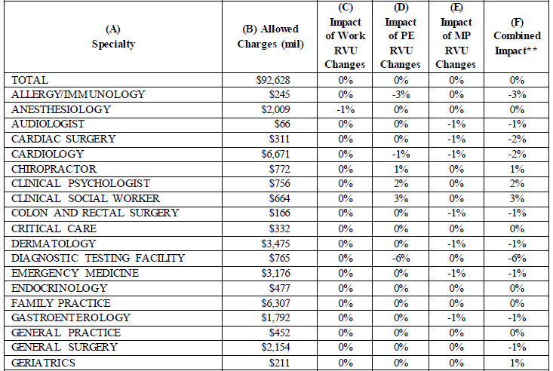
Proposed Impact 2018

Slide 16
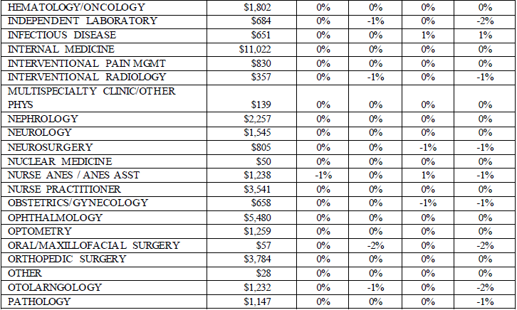
Proposed Impact 2018

Slide 17
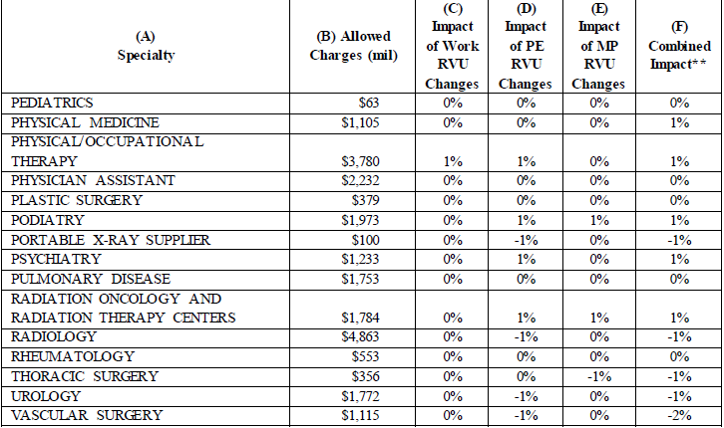
Proposed Impact 2018

Slide 18
Add-on Codes for Preventive Services

Slide 20
Changes to EM Coding

Slide 21
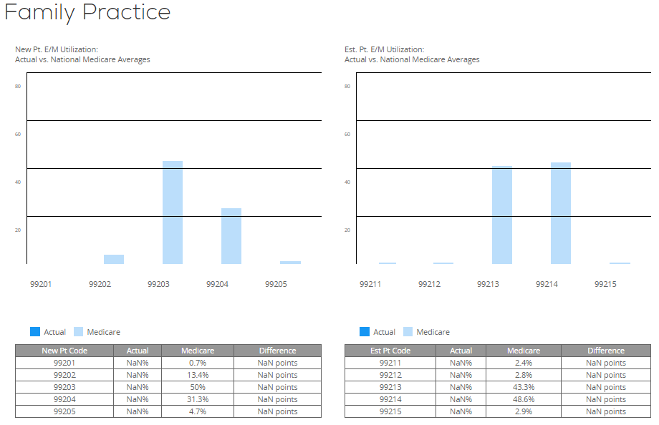

Slide 24
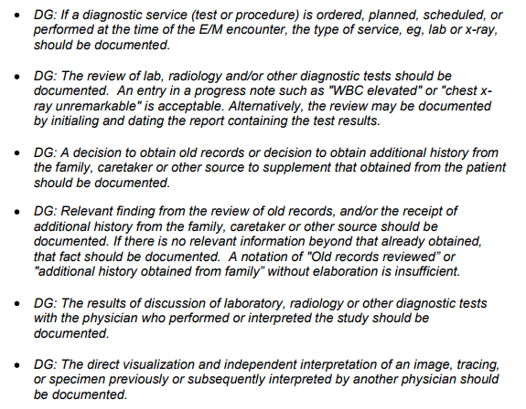
Data Points

Slide 25
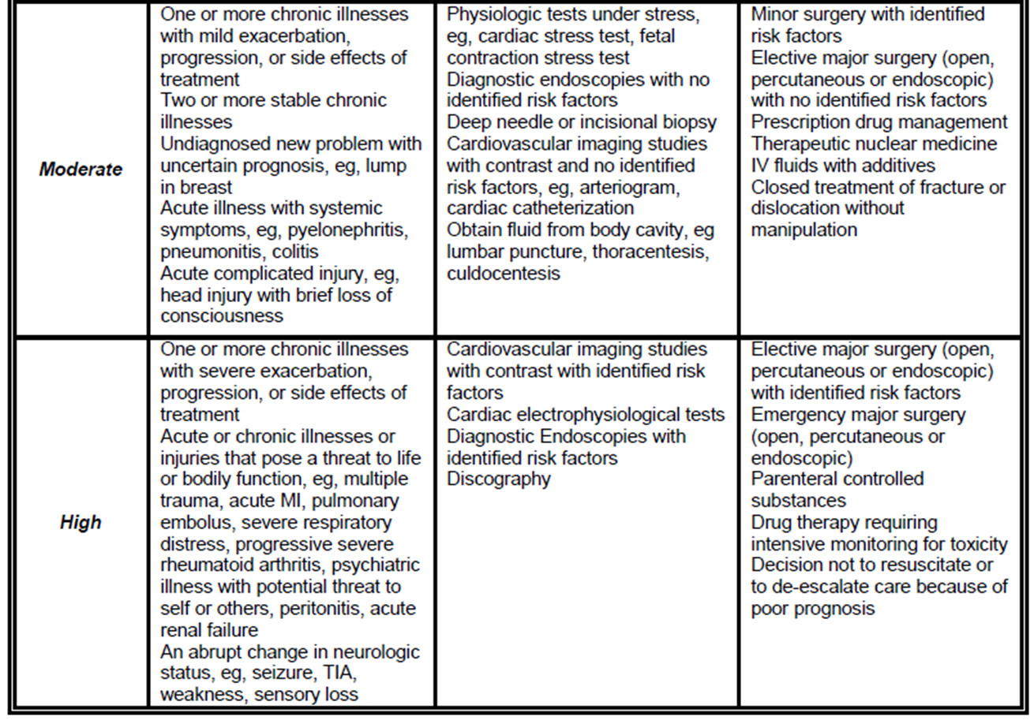
Medical Decision Making

Slide 26
High MDM without High Risk
Diagnosis Points (four dx points)
Data Points (four data points)
Diabetes – stable / A1C 6.5
HTN – new onset chest pain / EKG and NST
OSA – stable – continue with BiPap
CKD – stable / has f/u with nephrology
Ordered 83036
Ordered 93000
Ordered 76852
Review of nephrologist notes from last month show no change in CKD 1 dx earlier this year –Nephrologist believes this is most likely related to DM - patient encouraged to lose weight and obtain urine culture due to recent bout of UTI and encouraged to see Urologist

Slide 27
High MDM without High Risk
Diagnosis Points (four dx points)
Data Points (four data points)
Diabetes – stable - 1 point
HTN – new onset chest pain - 2 points
OSA – stable – 1 point
CKD – stable – 1 point
5 points
Ordered 83036 – 1 point
Ordered 93000 – 1 point
Ordered 76852 – 1 point
Review and summarize old records – 2 points
5 points

Slide 28
Established Patient Visits (2 out of 3)
99211 | N/A | N/A | N/A | N/A
 |  | Problem Focused CC 1HPI | Problem Focused 1995 –(1) 1997 – (1 check) | Straightforward Diagnosis – Minimal 1 Data – Minimal or None 1 Risk – Minimal 1 1 stable problem
99212 | 10
 |  | Exp. Problem Focused CC 1 HPI 1 ROS | Exp. Problem Focused 1995 – (2 – 7) 1997 – (6 checks) | Low Diagnosis – Limited 2 Data – Limited 2 Risk – Low 2 2 stable problems 1 unstable problem
99213 | 15
 |  | Detailed CC 4 HPI or status of 3 chronic conditions 2 ROS Medical or Family or Social History | Detailed 1995 – (4-7 – need 4x4) 1997 – (12 checks) | Moderate Diagnosis – Multiple 3 Data – Moderate 3 Risk – Moderate 3 3 stable problems on meds 1 stable and 1 unstable on meds 2 unstable problems on meds New problem requiring major surg
99214 | 25
 |  | Comprehensive CC 4 HPI or status of 3 chronic conditions 10 ROS Medical, Family, Social History | Comprehensive 1995 – (8) 1997 – (2 checks from 9 areas); or 1997(all checks in border & 1 check in others) | High Diagnosis – Extensive 4 Data – Extensive 4 Risk – High 4
99215 | 40

Slide 29
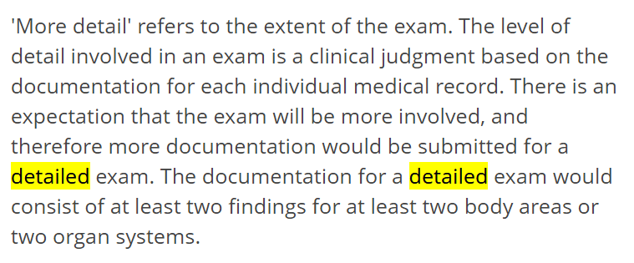
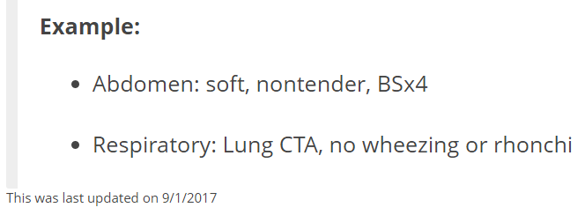
Palmetto and Detailed Examination

Slide 30
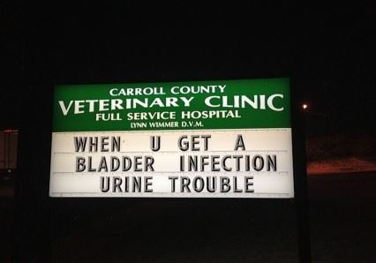
MIPS Changes

Slide 31
2018 QPP Program
One of the biggest take away points from the proposed rule is the note from CMS that only 36% of clinicians will be eligible for MIPS after all exclusions, although they make up 58% of Medicare Part B charges.
Flexibility is another major component in the proposed rule. CMS increased the low-volume threshold to $90,000 or less in Medicare Part B charges or 200 or fewer Medicare patients annually. The original threshold was $30,000 in Medicare Part B charges or 100 Medicare patients.

Slide 32
Virtual Groups
To form a virtual group, physicians can take one of two paths:
• Stage 1: Solo practitioners and groups with 10 or fewer eligible clinicians may contact their designated Technical Assistance representative(qpp.cms.gov) or the Quality Payment Program Service Center to determine if they are eligible to join or form a virtual group.
• Stage 2: CMS will determine if the group members are eligible to join or form a virtual group. During Stage 2, the virtual group must name an official representative who will submit their election to CMS via email to MIPS_VirtualGroups@cms.hhs.gov by Dec. 1.

Slide 33
The first year will be small
In a report CMS released on virtual groups, the agency said it expects low participation next year. It estimates that only 16 virtual groups will participate made up of 765 MIPS-eligible physicians nationwide.

Slide 34
Check Out Your Scores

Slide 35
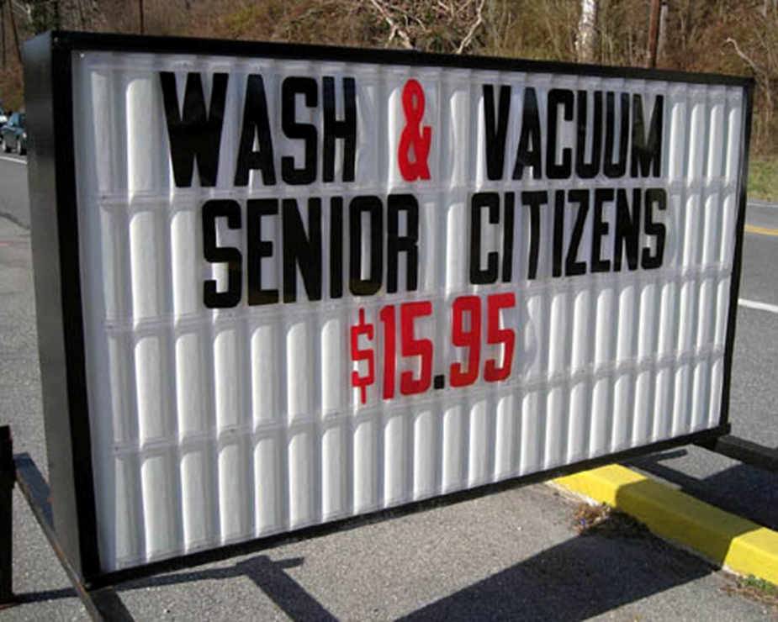
CPT Update

Slide 36
2018 CPT Changes
The CPT 2018 manual contains a total of
172 new codes
60 revised codes
82 were deleted

Slide 37
EM Changes for 2018
The word “Outpatient Hospital” has been added to 99218-99220 and discharge code 99217
Deleted those Anticoagulant management codes for warfarin (99363 & 99364) – CMS didn’t pay them anyway
Added some new codes for providers performing a cognitive assessment and care plan service (99483) – not billable with EM – more of a benefit we talked about last year – Neurologist normally bill this
Added some codes for Psychiatric collaborate care management (99492-99494)
New code 99484 is for care management services – at least 20 minutes per calendar month – more of a behavior health code

Slide 38
99483

Slide 39
99484

Slide 40
99484

Slide 41
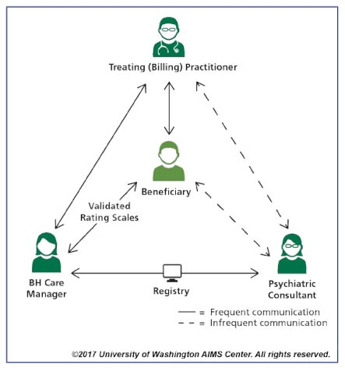
99492
99493
99494

Slide 42
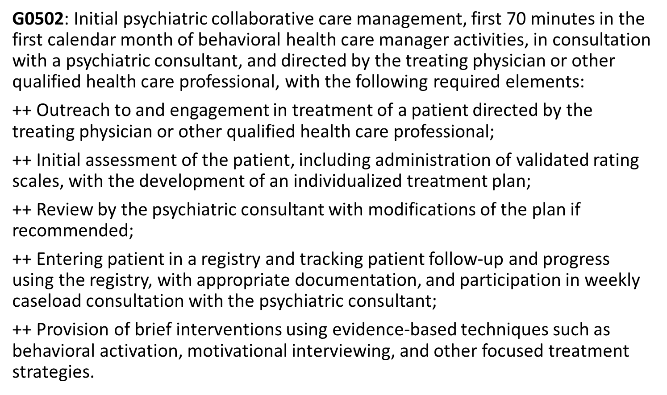
99492

Slide 43
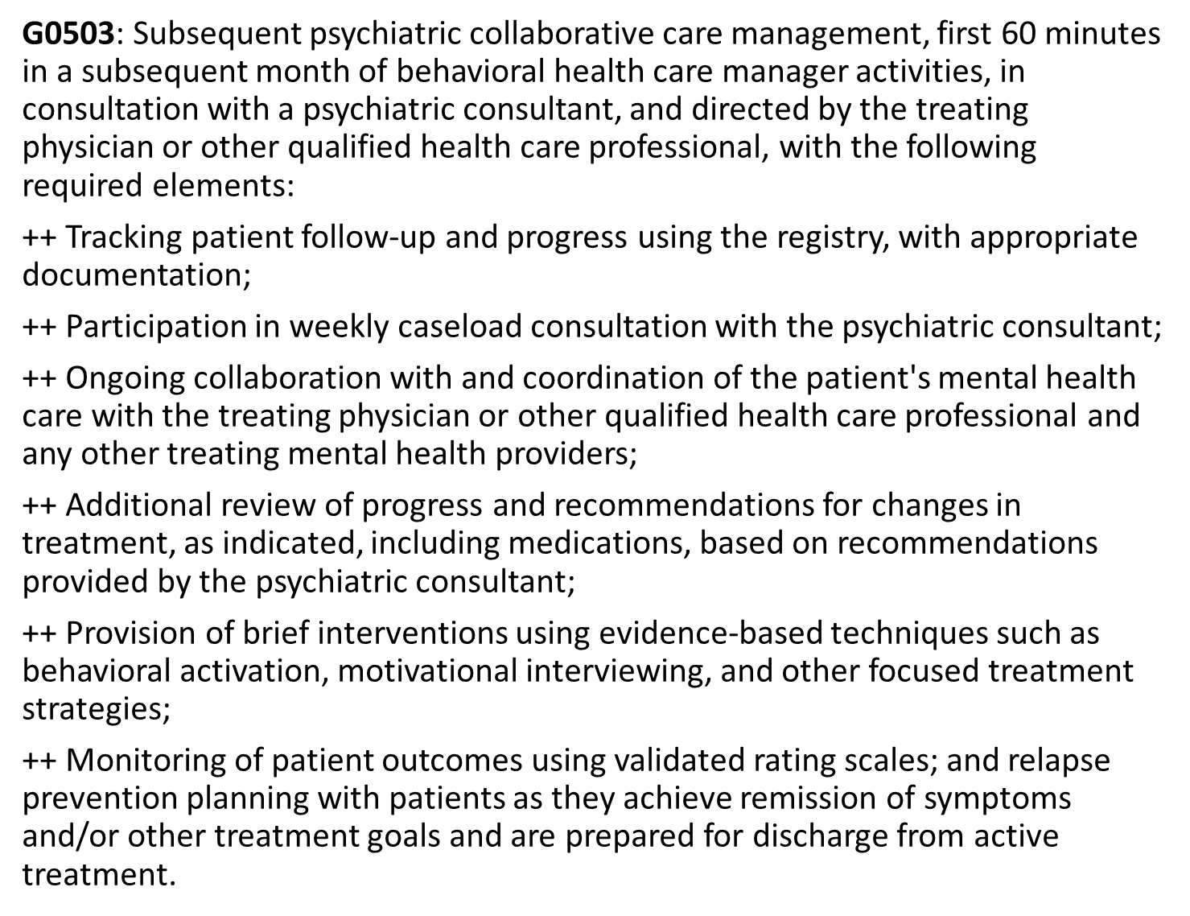
99493

Slide 44
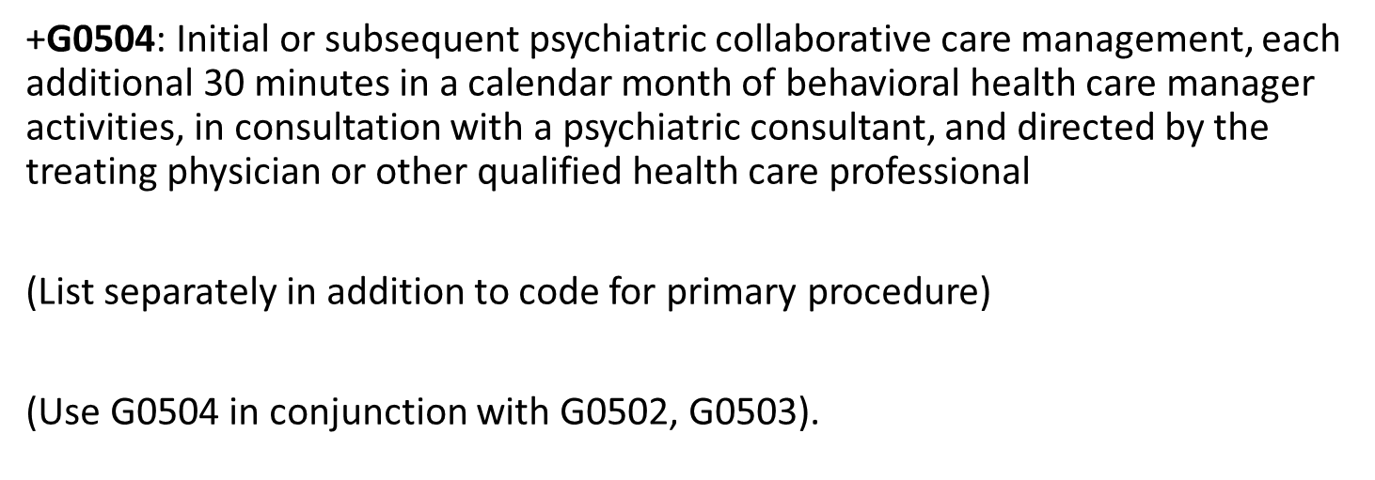
99494

Slide 45
INR Code
Oh, you now have a way to report managing a patient’s warfarin therapy via code 93793 (Anticoagulant management for a patient taking warfarin, must include review and interpretation of a new home, office, or lab international normalized ratio (INR) test result, patient instructions, dosage adjustment (as needed), and scheduling of additional test(s), when performed).

Slide 46
Anesthesia
00731 – upper GI proximal to duodenum
00732 – upper GI proximal to duodenum, ERCP
00811 – lower endoscope distal to duodenum
00812 – lower intestinal, screening colonoscopy
00813 – combined upper and lower both proximal and distal to the duodenum

Slide 47
Integumentary Changes for 2018
Because they are less bulky, fasciocutaneous flaps are indicated when thinner flaps are required. Unlike with muscle flaps, no functional loss occurs. Although these flaps provide a donor site in areas that are not available for random axial flaps, significant donor site morbidity can be associated with these flaps. Fasciocutaneous flaps are not as resistant to infection as muscle flaps. Monitoring flap failure occasionally can be difficult.
15730 – midface flap
15733 – Myocutaneous, or fasciocutaneous flap; head and neck
(For non-axial pattern advancement flaps continue with 14040-14302)

Slide 48
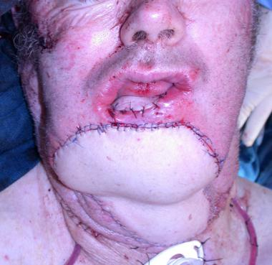
Use fasciocutaneous flaps to provide coverage when a skin graft or random skin flap is insufficient for coverage (eg, in coverage over tendon or bones). Orient the flap along the direction of the supplying vessel; knowledge of the direction or orientation of the fascial plexus, the fasciocutaneous perforators, and the fascial septum is required. They are simple to elevate, quick, and fairly reliable in healthy patients.

Slide 49
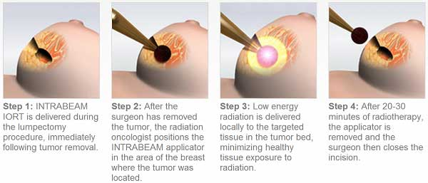
Integumentary Changes for 2018
+19294 – Preparation of tumor cavity, with placement of a radiation therapy applicator for intraoperative radiation therapy (IORT) concurrent with partial mastectomy
Intraoperative radiation therapy (IORT) delivers a concentrated dose of radiation therapy to a tumor bed during surgery. This advanced technology may help kill microscopic disease, reduce radiation treatment times or provide an added radiation "boost."

Slide 50
Chemical Cauterization
Revised to remove reference to sinus or fistula and to direct that use of chemical cauterization to achieve wound hemostasis is not reported with code 17250. Cauterization to achieve hemostasis is included in the code for wound care, excision or repair.
▲17250 Chemical cauterization of granulation tissue (ie, proud flesh, sinus or fistula)
(Do not report 17250 with removal or excision codes for the same lesion)
(Do not report 17250 when chemical cauterization is used to achieve wound hemostasis)
(Do not report 17250 in conjunction with active wound care management 97597, 97598, 97602 for the same lesion)

Slide 51
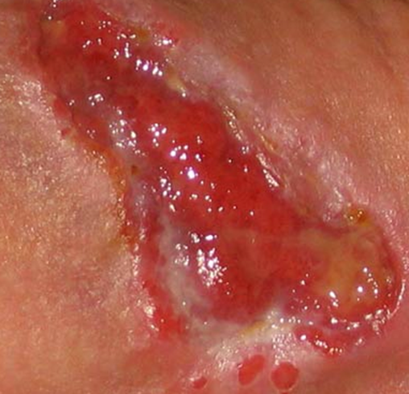
Proud Flesh
Granulation tissue is the pink layer you find under a scab if you pick it off. Proud flesh is also known as persistent granulation tissue, and occurs when the scabs normal granulation tissue does not go away. Proud flesh can persist for years until it is removed, destroyed, or until the cause is alleviated.

Slide 52
Nasal Sinus Surgery
Nasal sinus endoscopy codes revised and expanded. Five new codes allow you to report ligation of sphenopalatine artery (31241) and total anterior/posterior nasal/sinus endoscopy (31253, 31257 and 31259) and dilation of the frontal and sphenoid sinus ostia (31298). Codes 31254, 31255 and 31276 were revised.

Slide 54
Sinus Changes
31241 - Nasal/Sinus endoscopy, surgical; with ligation of sphenopalatine artery
31254 - Nasal/Sinus endoscopy, surgical with ethmoidectomy; partial (anterior)
31255 total (anterior and posterior)
31253 total, including frontal sinus exploration, with removal of tissue from frontal sinus, when performed
31257 total, including sphenoidotomy
32159 total, including sphenoidotomy, with removal of tissue from the sphenoid process
- Nasal/sinus endoscopy, surgical, with frontal sinus exploration, including removal of tissue from frontal sinus, when performed
31298 – Nasal/sinus endoscopy, surgical; with dilation of frontal and sphenoid sinus ostia (eg, balloon dilation)

Slide 55
Laryngotomy
Diagnostic laryngotomy code 31320 is deleted, while therapeutic aspiration bronchoscopy codes 31645 and 31646 are revised to specify initial or subsequent.

Slide 56
Cryoablation of Pulmonary Tumors
A Category I (32994) code will be established for cryoablation of pulmonary tumors, which is currently reported with Category III code 0340T.
Also, the code for radiofrequency ablation of pulmonary tumors (32998) will be revised to include imaging guidance.

Slide 57
Heart Replacement
Total heart replacement system codes move to CPT Category I from Category III. You’ll be able to report implantation (33927) removal and replacement (33928) and removal in preparation for heart transplant (33929) in place of codes 0051T-0053T.

Slide 59
AAA
New comprehensive codes will be created for endovascular repair of abdominal aortic aneurysms, and component codes such as 34802 and 75952 will be deleted. Also, the guidelines will be expanded to identify the procedures that may be coded separately.

Slide 60
Replacement codes 34701-34712 take the all-in-one approach with “all associated radiological supervision and interpretation” included along with the procedure.
34701-34702: aorto-aortic tube
34703-34704: aorto-uni-iliac
34705-34706: aorto-bi-iliac
34707-34708: ilio-iliac
34709: extension prosthesis distal to common iliac artery
34710-34711: delayed placement of proximal extension
34712: transcatheter delivery of enhanced fixation device to the endograft

Slide 62
Watch your add-on code rules at the bottom of each code
+34713: percutaneous access and closure of femoral artery for a large sheath (12 French or larger)
+34812: open exposure, by groin incision
+34714: open femoral exposure with creation of a conduit, by groin incision
+34820: open iliac exposure, by abdominal or retroperitoneal incision
+34833: open iliac exposure with creation of a conduit by abdominal or retroperitoneal incision
+34834: open brachial
+34715: open axillary
+34716: open axillary with creation of a conduit

Slide 63
Arteriography
The codes for retrograde brachial arteriogram (36120 and 75658) will be deleted, and code 36140 will become a stand-alone code for nonselective upper or lower extremity arteriography.

Slide 64
Arteriography

Slide 65
Incompetent Veins
Several new codes will be created for treatment of incompetent veins using chemical adhesive and non-compounded foam sclerosant. Also, the codes for injection of sclerosing solution (36468-36471) will be revised to clarify the conditions being treated.

Slide 66
36468: sclerosant for spider veins; limb or trunk
36470: sclerosant; single incompetent vein
36471: multiple incompetent veins
36465: non-compounded foam sclerosant with compression; single incompetent truncal vein
36466: multiple incompetent truncal veins
36482: endovenous ablation of incompetent vein of a chemical adhesive; first vein
36483 subsequent veins in a single extremity
Incompetent Vein

Slide 68
Bone Marrow Biopsy
A new combination code will be created for bone marrow biopsy and aspiration.
38222: Bone Marrow Biopsy and Aspiration

Slide 69
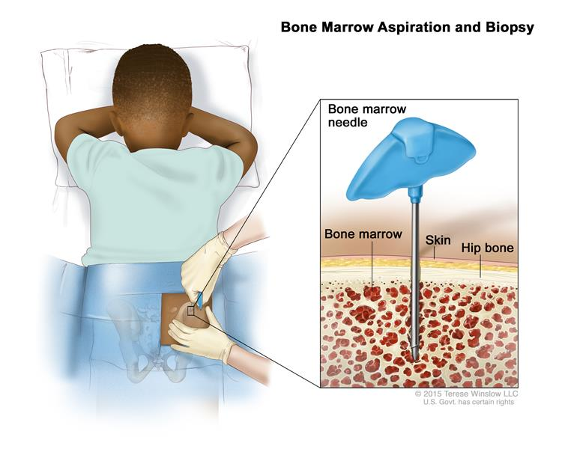
Bone marrow aspiration removes a small amount of bone marrow fluid and cells through a needle put into a bone.
A bone marrow biopsy removes bone with the marrow inside to look at under a microscope.
The aspiration (taking fluid) is usually done first, and then the biopsy.

Slide 70
Laparoscopy
38573 - Laparoscopy, surgical; with bilateral total pelvic lymphadenectomy and periaortic lymph node sampling, peritoneal washings, peritoneal biopsy(ies), omentectomy, and diaphragmatic washings, including diaphragmatic and other serosal biopsy(ies), when performed

Slide 72
Transperineal Injection
A new category I code ( 55874) has been created for transperineal injection of peri-prostatic spacer material, replacing Category III code 0438T.
The intent of SpaceOAR System to reduce the radiation dose delivered to the anterior rectum

Slide 74
57240 – 57265 Revised
Anterior colporrhaphy, repair of cystocele with or without repair of urethrocele, including cystourethroscopy, when performed – don’t bill with 52000

Slide 76
58575
Laparoscopy, surgical, total hysterectomy for resection of malignancy (tumor debulking), with omentectomy including salpingo-oophorectomy, unilateral or bilateral, when performed

Slide 77
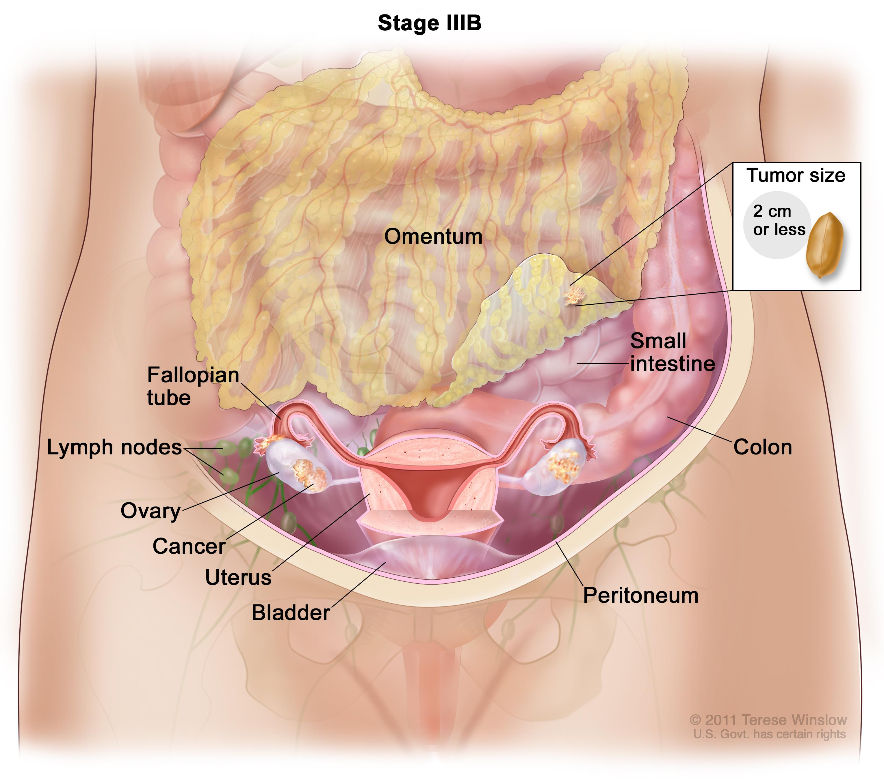
Debulking
In terms of ovarian cancer treatment, debulking or “cytoreduction” is a type of surgery with the goal to remove as much cancerous tissue in a patient’s abdomen as possible. Some tumors may be completely removed while others are just reduced in size.
In these cases, “optimal debulking” reduces tumor size to <1cm in order to make subsequent treatment strategies (chemotherapy or radiation) more effective.

Slide 78
TENS Unit
Providers who perform peripheral nerve neurostimulator services should note that 64550 will specify transcutaneous electrical nerve units next year. The new descriptor states “Application of surface (transcutaneous) neurostimulator (eg TENS unit).” In addition, neurostimulator code 64565 (Percutaneous implantation of neurostimulator electrode array; neuromuscular) will be deleted.

Slide 80
The nervous system chapter contains a handful of additions, revisions and deletions. Surgeons who perform nerve repairs with allografts will have a new primary and add-on code pair next year. Surgeons will report 64912 (Nerve repair; with nerve allograft, each nerve, first strand [cable]). They’ll report any additional strands with 64913 (…; with nerve allograft, each nerve, each additional strand [List separately in addition to code for primary procedure]).

Slide 81
Chest X-Ray
Diagnostic Radiology
Codes 71010–71035 have been deleted and replaced by the following:
● 71045 Radiologic examination, chest; single view
● 71046 2 views
● 71047 3 views
● 71048 4 or more views

Slide 82
Abdominal X-ray
Diagnostic Radiology
Codes 74000–74020 have been deleted and replaced by the following:
● 74018 Radiologic examination, abdomen; 1 view
● 74019 2 views
● 74021 3 or more views

Slide 83
Fluoroscopy - Revised
▲76000 Fluoroscopy (separate procedure), up to 1 hour physician or other qualified health care professional time, other than 71023 or 71034 710X4 (eg, cardiac fluoroscopy)

Slide 84
Ultrasound
Ultrasound exams revised. Revised descriptors instruct you to report a complete service when the provider examines the joint space and the surrounding soft tissues. Report a limited service when the exam involves a joint space or surrounding soft tissues such as tendons or nerves:
76881 Ultrasound, extremity, nonvascular, complete joint (ie, joint space and peri-articular soft tissue structures) real-time with image documentation; complete.
76882 Ultrasound, limited, anatomic specific joint or other nonvascular extremity structure(s) (eg, joint space, peri-articular tendon[s], muscle[s], nerve[s], other soft tissue structure[s], or soft tissue mass[es]), real-time with image documentation.

Slide 85
Drug Tests Revised Removed – (eg, immunoassay)
80305 - Drug test(s), presumptive, any number of drug classes, any number of devices or procedures; capable of being read by direct optical observation only (eg, utilizing immunoassay [eg, dipsticks, cups, cards, or cartridges]), includes sample validation when performed, per date of service
80306 - Drug test(s), presumptive, any number of drug classes, any number of devices or procedures; read by instrument assisted direct optical observation (eg, utilizing immunoassay [eg, dipsticks, cups, cards, or cartridges]), includes sample validation when performed, per date of service
80307 - Drug test(s), presumptive, any number of drug classes, any number of devices or procedures; by instrument chemistry analyzers (eg, utilizing immunoassay [eg, EIA, ELISA, EMIT, FPIA, IA, KIMS, RIA]), chromatography (eg, GC, HPLC), and mass spectrometry either with or without chromatography, (eg, DART, DESI, GC-MS, GC-MS/MS, LC-MS, LC-MS/MS, LDTD, MALDI, TOF) includes sample validation when performed, per date of service

Slide 87
Albumin - Revised
82042 - Albumin; other source, quantitative, each specimen
82043 - Albumin; urine (eg, microalbumin), quantitative
82044 - Albumin; urine (eg, microalbumin), semiquantitative (eg, reagent strip assay)

Slide 88
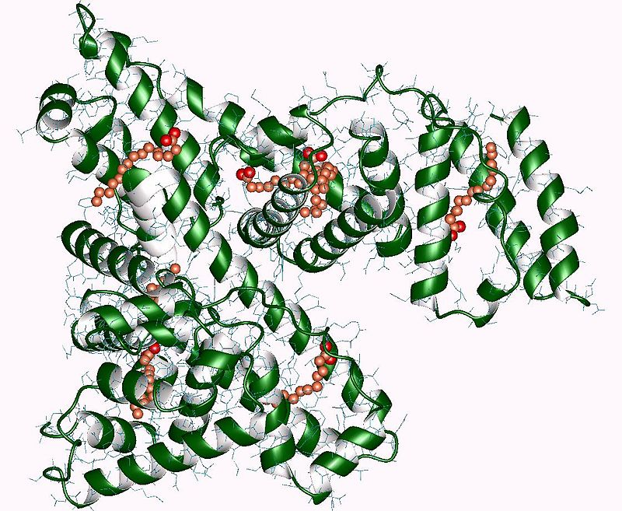
Albumin
It is the most abundant protein in human blood plasma; it constitutes about half of serum protein. It is produced in the liver. It is soluble and monomeric. Albumin transports hormones, fatty acids, and other compounds, buffers pH, and maintains oncotic pressure, among other functions.

Slide 89
Vaccines
Although effective July 1, the following changes will appear in the 2018 CPT manual to indicate the vaccine schedule changes.
#▲90621 Meningococcal recombinant lipoprotein vaccine, serogroup B (MenB-FHbp), 2 or 3 dose schedule, for intramuscular use
#▲90651 Human Papillomavirus vaccine types 6, 11, 16, 18, 31, 33, 45, 52, 58, nonavalent (9vHPV), 2 or 3 dose schedule, for intramuscular use
●90750 – Zoster vaccine (HZV), recombinant, subunit, adjuvanted, for intramuscular use
● 90682 Influenza virus vaccine, quadrivalent (RIV4), derived from recombinant DNA, hemagglutinin (HA) protein only, preservative and antibiotic free, for intramuscular use
# ● 90756 Influenza virus vaccine, quadrivalent (ccIIV4), derived from cell cultures, subunit, antibiotic free, 0.5mL dosage, for intramuscular use

Slide 90
Pulmonary
● 94617 Exercise test for bronchospasm, including pre- and post-spirometry and pulse oximetry
● 94618 Pulmonary stress testing (6-minute walk test
▲94621 Cardiopulmonary exercise testing, complex (including measurements of minute ventilation, CO2 production, O2 uptake, and electrocardiographic recordings)
Code 94620 was deleted -
Pulmonary stress testing; simple (eg, 6-minute walk test, prolonged exercise test for bronchospasm with pre- and post-spirometry and oximetry)

Slide 91
What is EIB?
Exercise-induced bronchospasm (also called EIB) happens when the airways in your lungs shrink (get smaller) while you are exercising. This makes it difficult to breathe. If you have EIB, it can be hard for you to exercise for more than 30 minutes at a time.

Slide 92
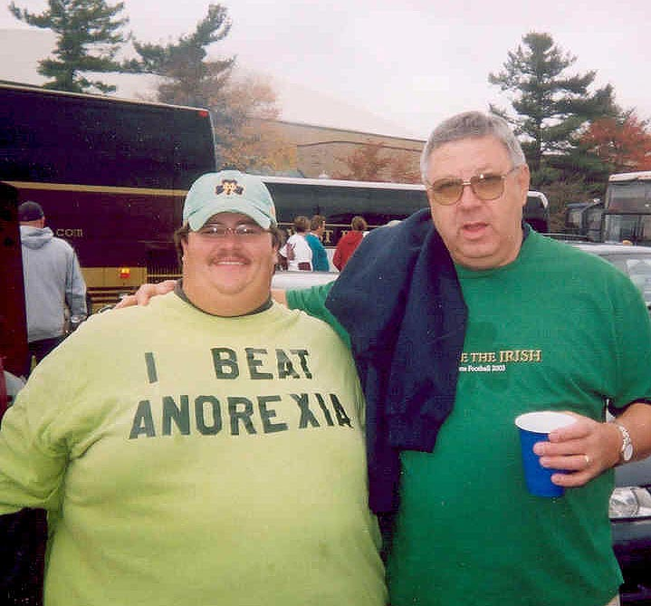
Questions?

Slide 93
Any Questions
Direct: 706-483-4728
E-Fax: 770-709-3698
E-mail: steve.adams@inhealthps.com
Web: www.thecodingeducator.com
Facebook: facebook.com/kingofcoders

