Slide 1
Understanding the Risk Adjustment Factor and HCCs payment for performance
Steve Adams, MCS, COC, CPC, CPMA, CPC-I, PCS, FCS, COA
email: steve.adams@inhealthps.com
web: thecodingeducator.com

Slide 2
THECODINGEDUCATOR.COM

Slide 3
Topics
QRUR
Financial Impact
Risk Adjustment Factor
ICD-10 and Risk Factor
Common HCCs
Finding Them on Your Own

Slide 4
QRUR

Slide 6
Payment for Performance

Slide 8
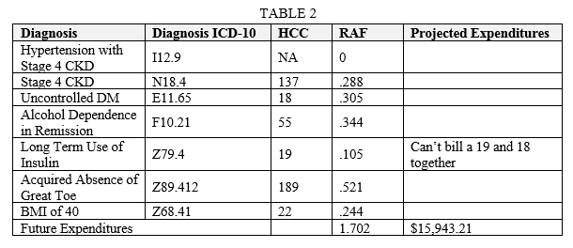

Slide 9
RAF

Slide 10
Risk Adjustment Factor
The purpose for the Centers for Medicare and Medicaid Services (CMS) to conduct Risk Adjustment Factors is to pay plans for the risk of the beneficiaries they enroll, instead of calculating an average amount of Medicare/Medicare Advantage beneficiaries

Slide 11
Risk Adjustment Overview:
HCC (Hierarchical Condition Category)
▪ Per CMS, the diagnosis codes are recorded per year, meaning each condition must be documented and coded each year.
▪ Diagnoses that demonstrate similar resource usage are categorized together.
▪ CMS designed the equation so that the average Medicare FFS patient has the score of 1.00.
E11.9 ICD-10
19 HCC
RAF Score = .105

Slide 12
Average Medicare Patient
0.4

Slide 13
Goal
1.0 - 2.0

Slide 16
ICD-10CM, HCC and Risk

Slide 17
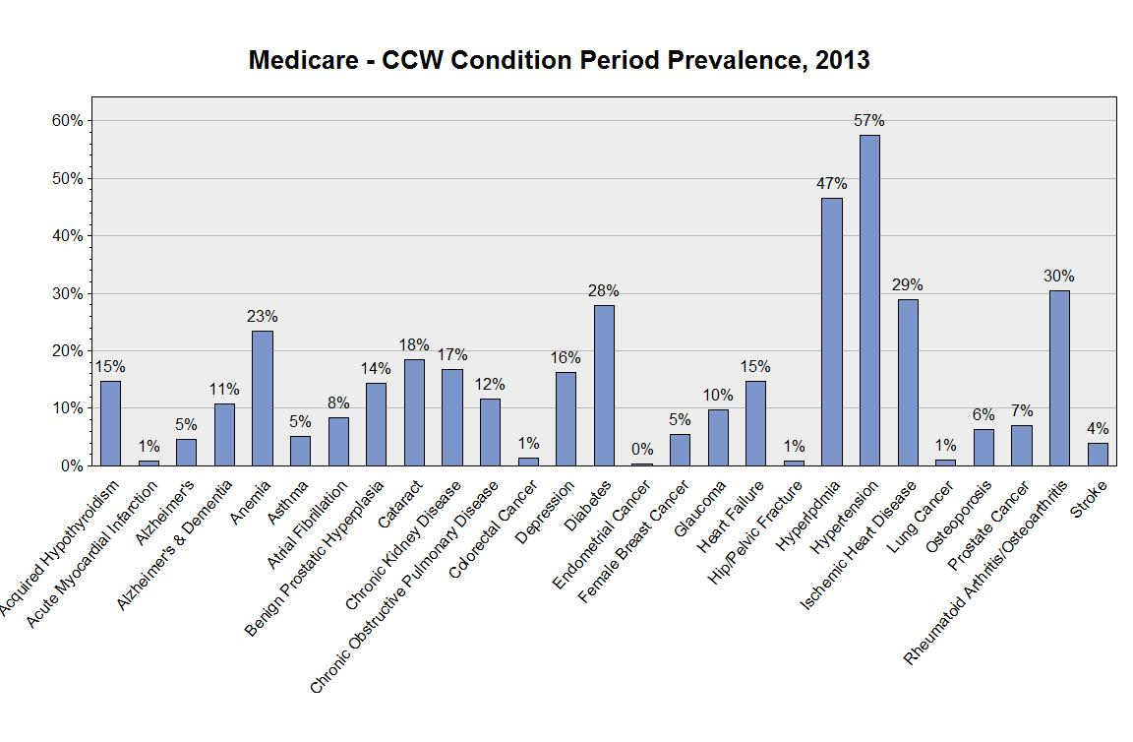
SOURCE: Chronic Condition Data Warehouse (CCW). Medicare Beneficiary Summary Files.
Notes:
Description: The conditions with the highest period prevalence rates are hypertension (57%) and hyperlipidemia (47%). Nearly one-third of the population has been treated for rheumatoid/osteo-arthritis (30%), ischemic heart disease (29%), and diabetes (28%).
Technical notes: Period prevalence is calculated for these rates. Beneficiaries with full or nearly full fee-for-service (FFS) coverage during the year who received treatment for the condition within the condition-specified look back period. Chronic conditions have a 1 to 3 year look-back time period. Please refer to the CCW Chronic Condition Categories for algorithm criteria. Denominator is all who were enrolled in Medicare on or after January 1, 2013 and had full or nearly full FFS coverage (i.e., 11 or 12 months of Medicare Part A and B [or coverage until time of death] and one month or less of HMO coverage). Only females are included in the denominator for endometrial and female breast cancer; only males are included for prostate cancer and benign prostatic hyperplasia. Beneficiaries may be counted in more than one chronic condition category.

Slide 18
HCC

Slide 19
Risk Adjustment Overview:
HCC (Hierarchical Condition Category)
▪ Per CMS, the diagnosis codes are recorded per year, meaning each condition must be documented and coded each year.
▪ Diagnoses that demonstrate similar resource usage are categorized together.
▪ CMS designed the equation so that the average Medicare FFS patient has the score of 1.00.
E11.9 ICD-10
19 HCC
RAF Score = .105

Slide 20
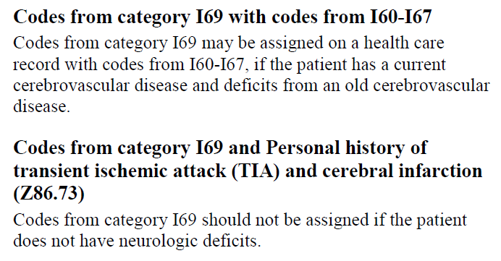
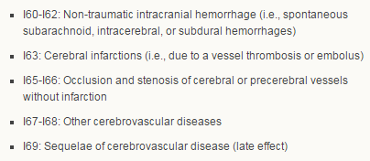
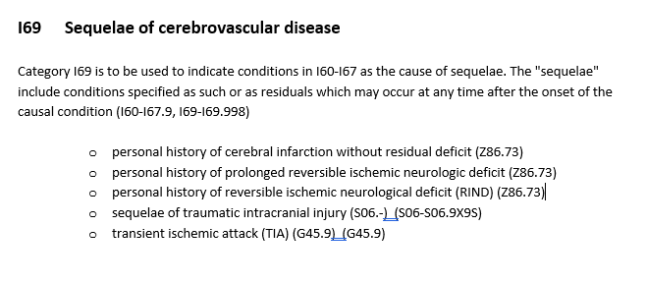
Stroke Sequelae and Personal Hx
I63.9
Cerebral infarction, unspecified
I69.951 Late effects of cerebrovascular disease, right dominant side
code dominant or non-dominant right or left side

Slide 21
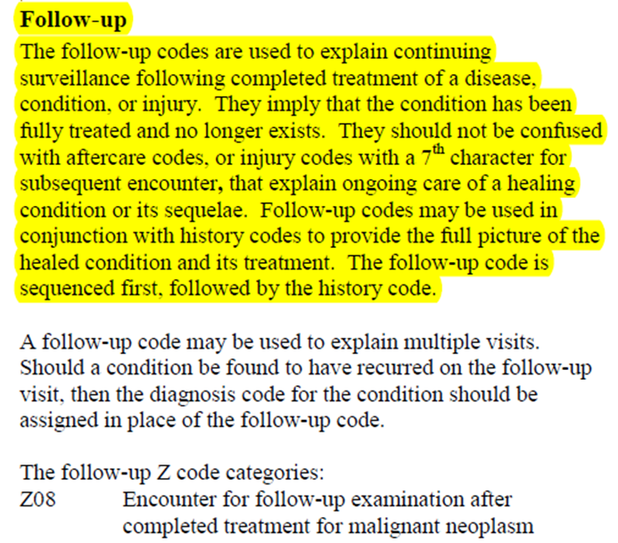
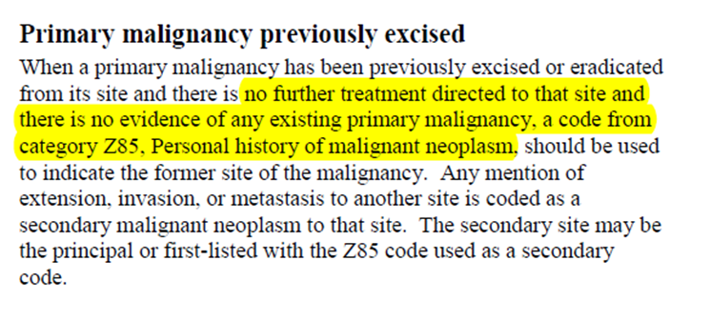
Cancer & Hx of Cancer
Can continue to code for Breast and/or Prostate Cancer when a patient continues adjuvant Rx with Tamoxifen, or Lupron respectively – (or other agent)

Slide 22
Myocardial Infarctions
I21
Up to 4 weeks
I22
Another MI during 4 weeks
I25.2
Old or healed

Slide 23
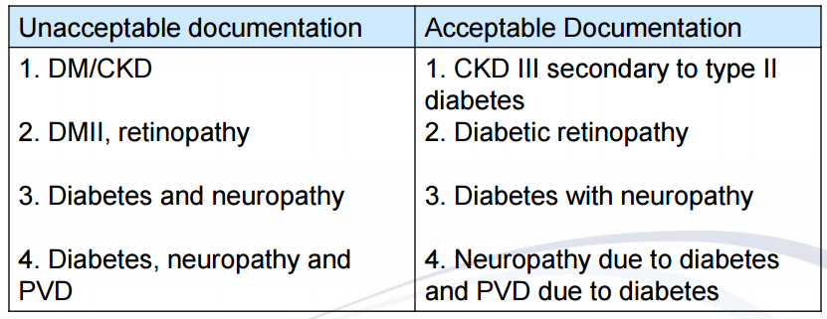
The Key to a Causal Relationship:
Due To
Secondary to

Slide 24
Here’s Why This is a Scam

Slide 34
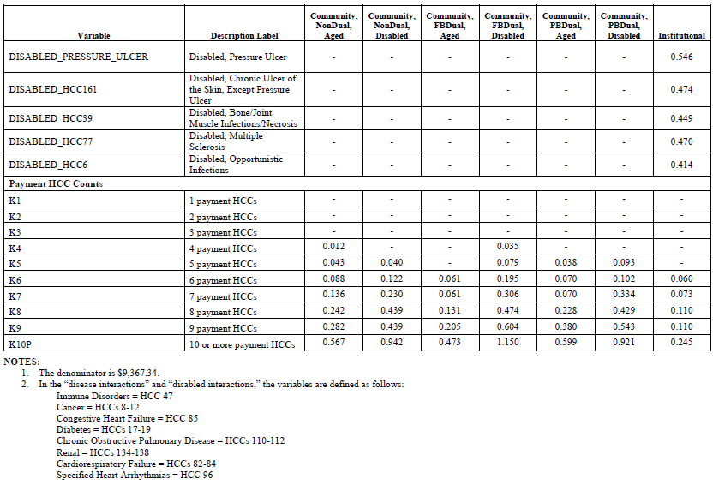
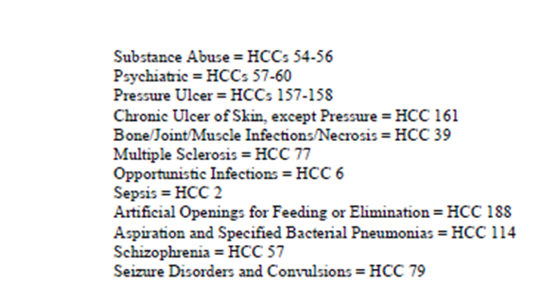

Slide 35
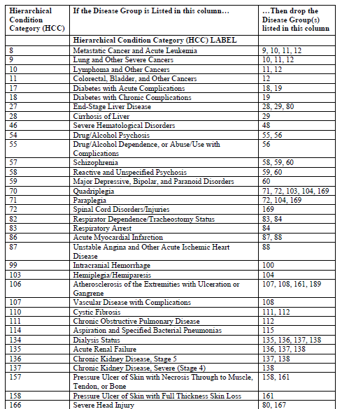

Slide 36
Code all Coexisting Conditions

Slide 37
Codes Can Be

Slide 38
Common HCCs

Slide 48
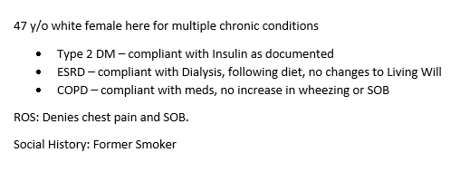

Slide 51
Finding Them On Your Own

Slide 52
THECODINGEDUCATOR.COM

Slide 53
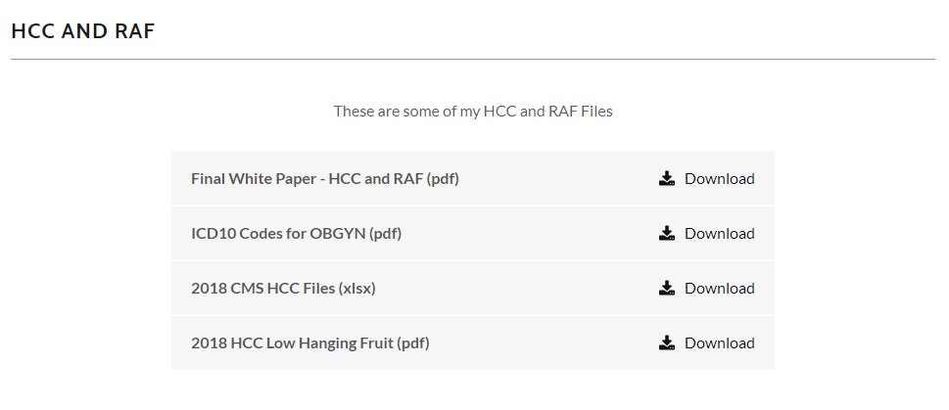

Slide 55
Topics
QRUR
Financial Impact
Risk Adjustment Factor
ICD-10 and Risk Factor
Common HCCs
Finding Them on Your Own

Slide 56
Questions?

Slide 57
Any Questions
Direct: 706-483-4728
E-Fax: 770-709-3698
E-mail: steve.adams@inhealthps.com
Web: www.thecodingeducator.com
Facebook: facebook.com/kingofcoders

