Slide 1

Using Technology to Resolve Coding Dilemmas where to go and what to look for
Steve Adams, MCS, COC, CPC, CPMA, CPC-I, PCS, FCS, COA
email: steve.adams@inhealthps.com
web: thecodingeducator.com

Slide 2
THECODINGEDUCATOR.COM

Slide 3
Discussion Points
Using the CMS Web Site
RAC audits
OIG Work Plan
Using our Carrier Website
Google Works
Using Encoder Pro

Slide 4

CMS
Website

Slide 5


Slide 6
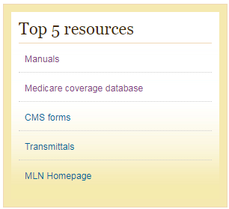

Slide 7
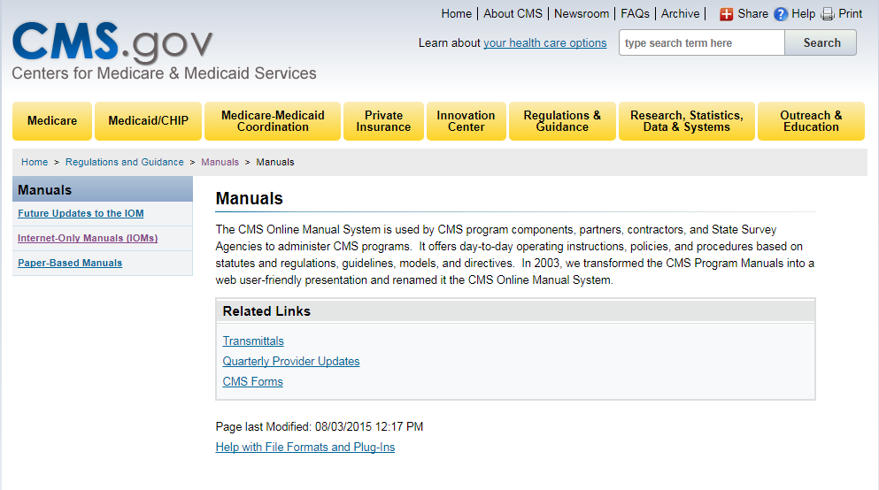

Slide 8
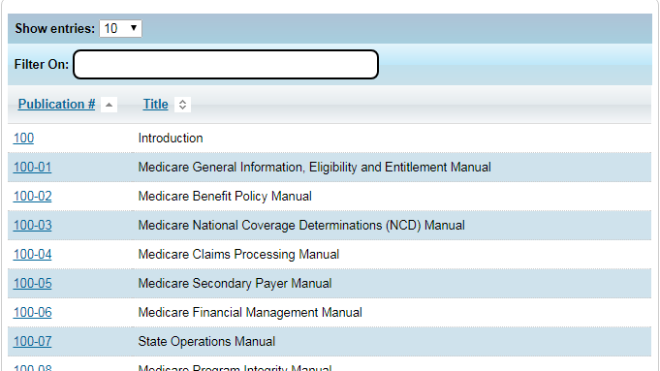

Slide 9
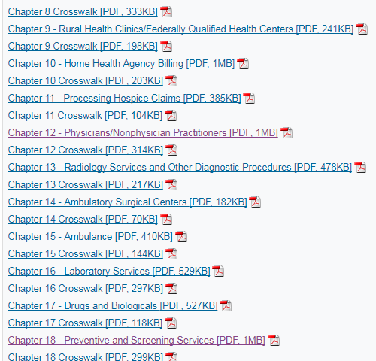

Slide 10
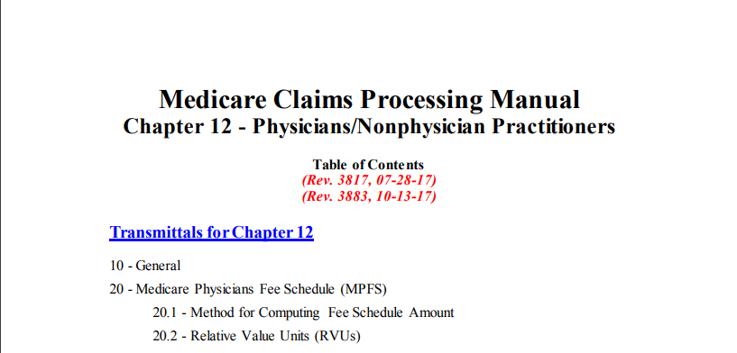

Slide 11
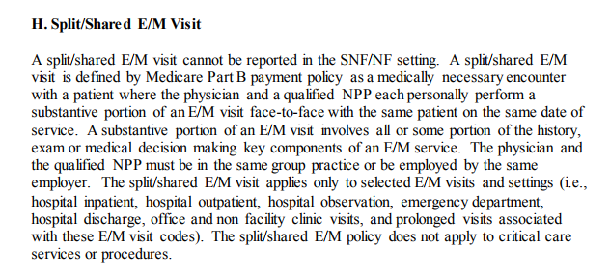

Slide 12
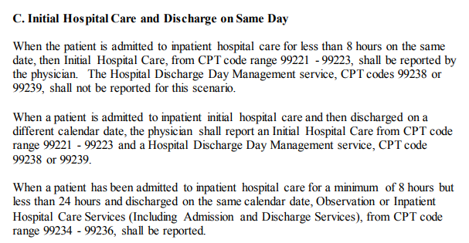

Slide 13
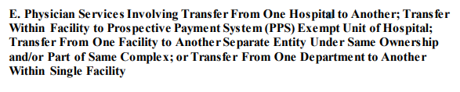
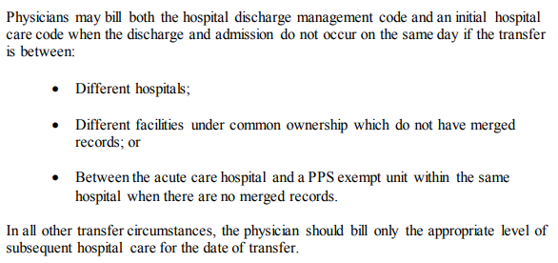

Slide 14
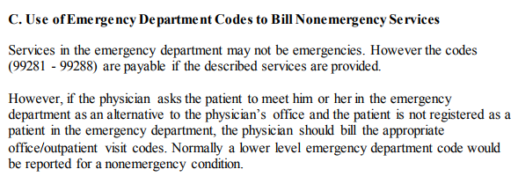

Slide 15
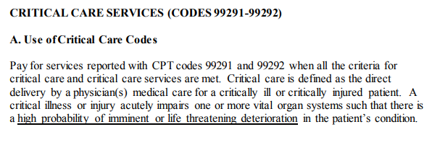

Slide 17
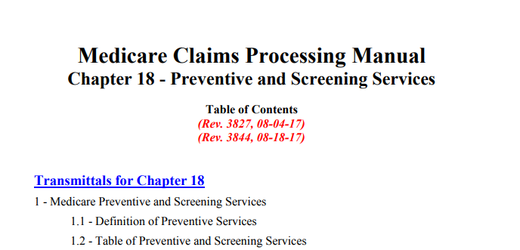

Slide 18
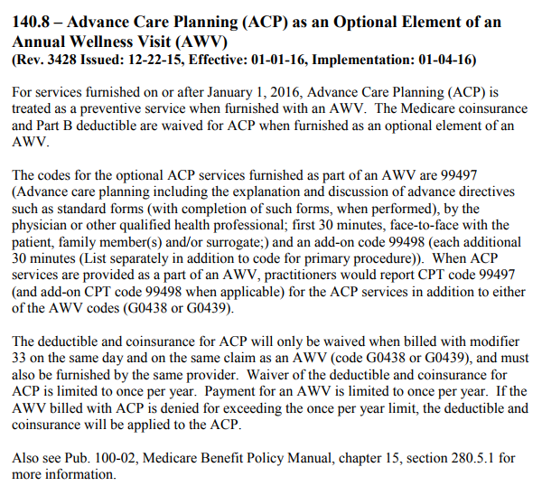

Slide 19
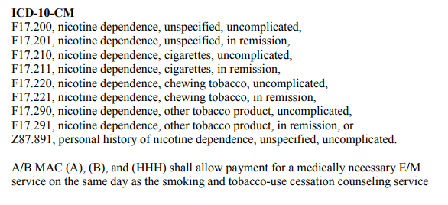

Slide 21
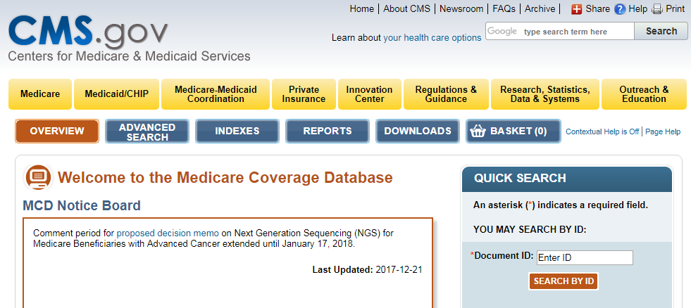

Slide 22
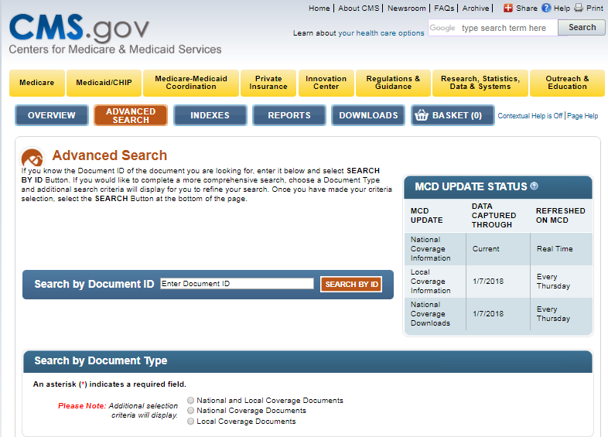

Slide 23
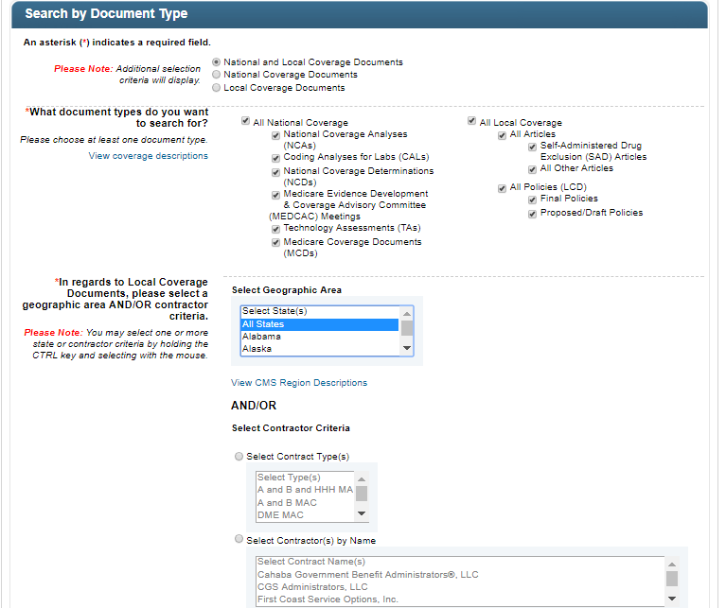

Slide 24
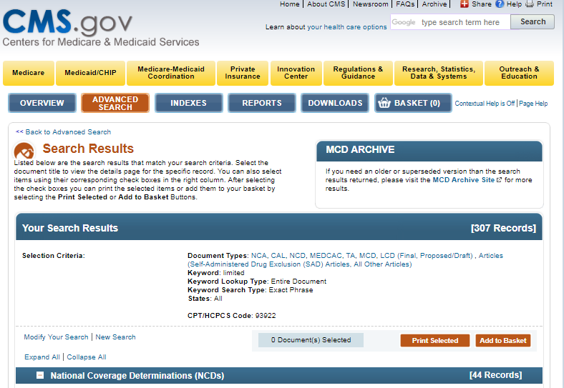

Slide 25
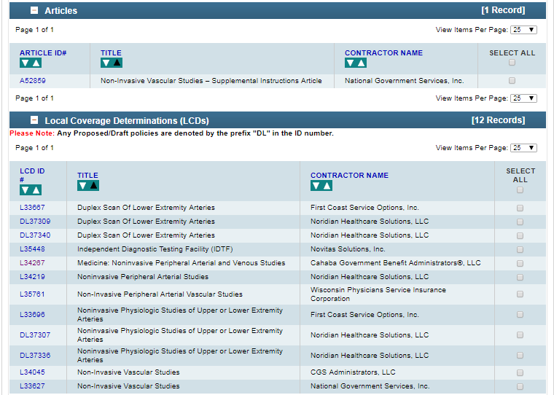

Slide 26
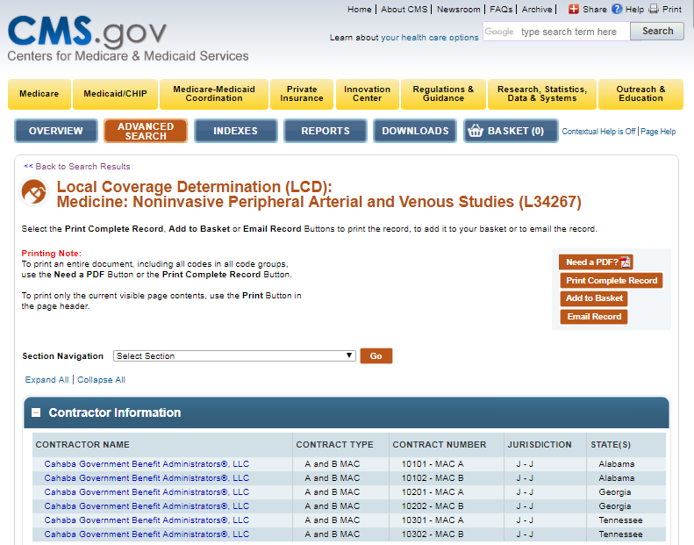

Slide 27
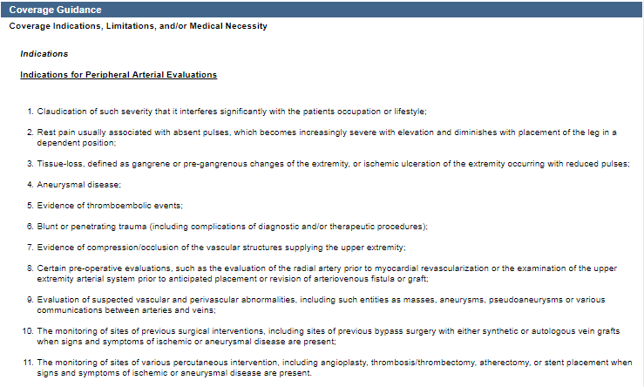

Slide 28
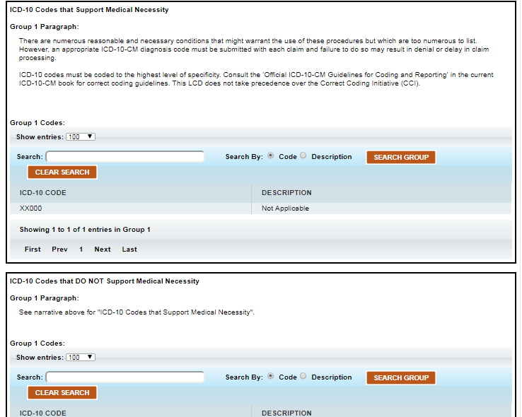

Slide 30
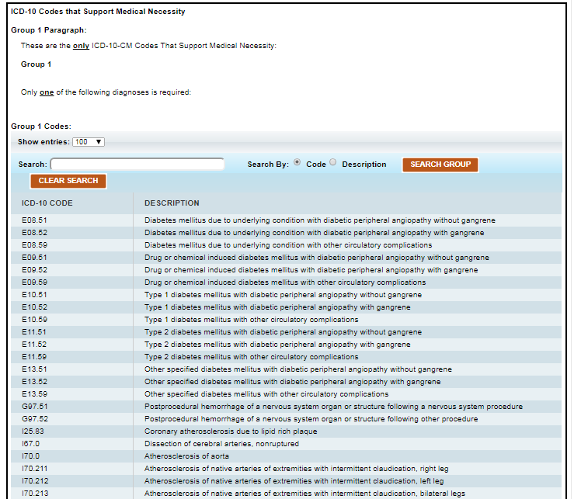

Slide 31
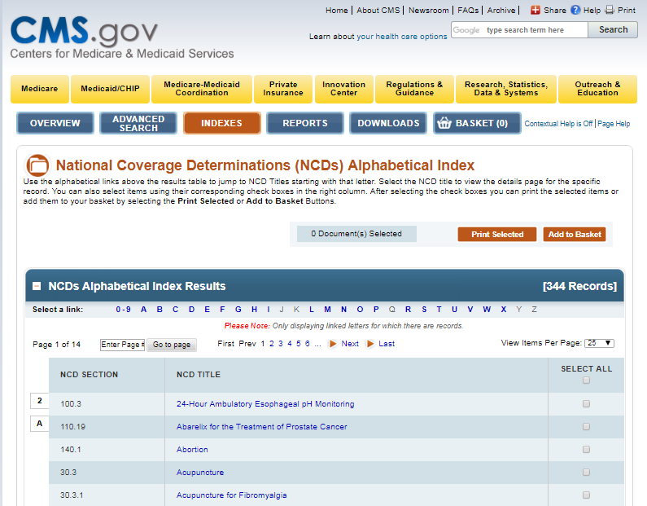

Slide 32
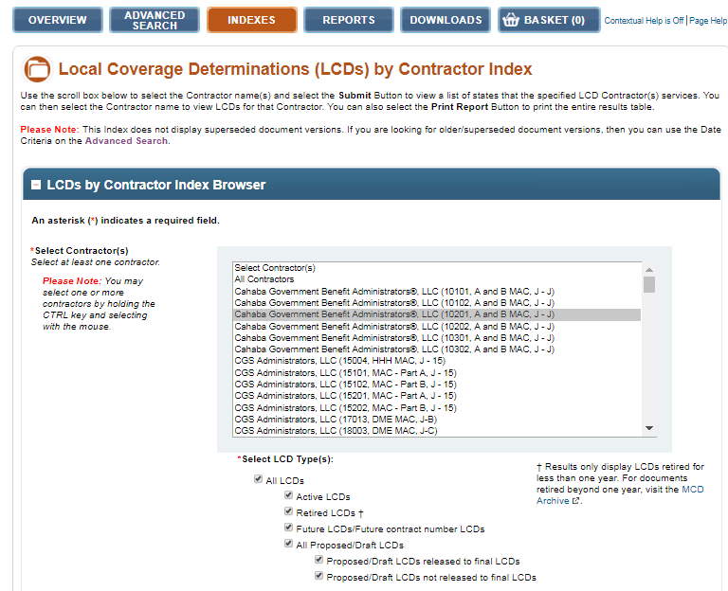

Slide 33
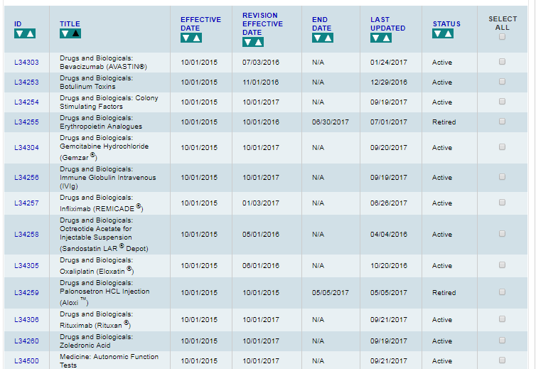

Slide 34
Carrier
Website

Slide 35
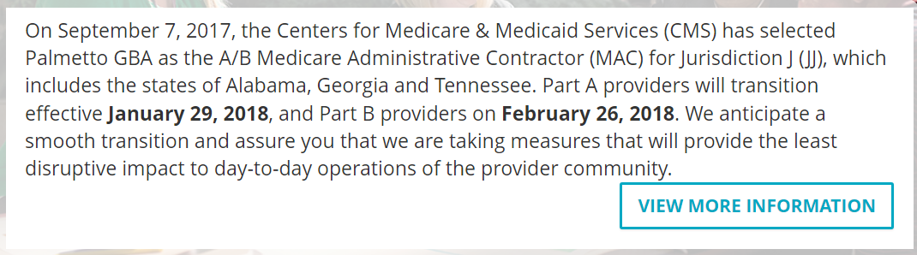

Slide 36


Slide 37


Slide 38


Slide 39
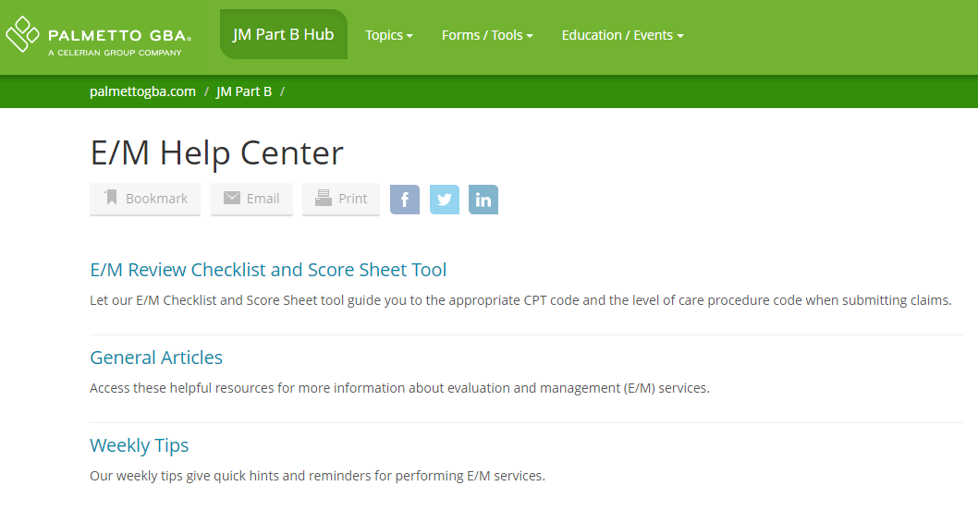

Slide 40
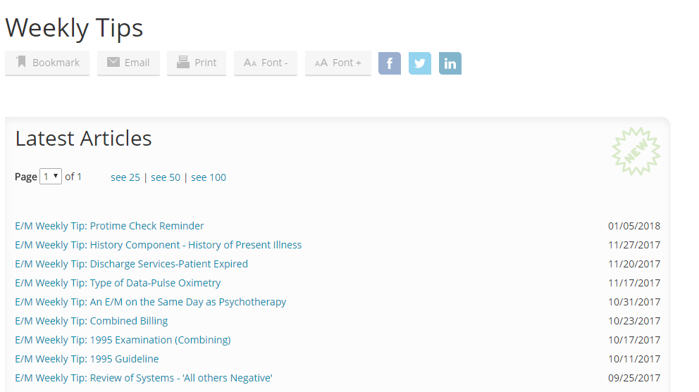

Slide 41
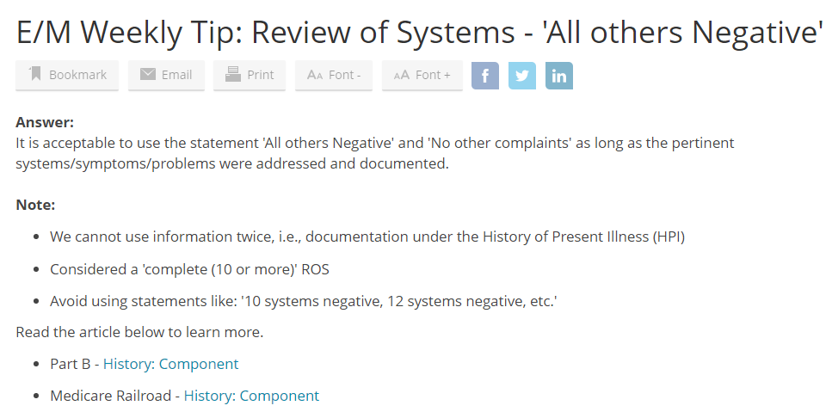

Slide 42
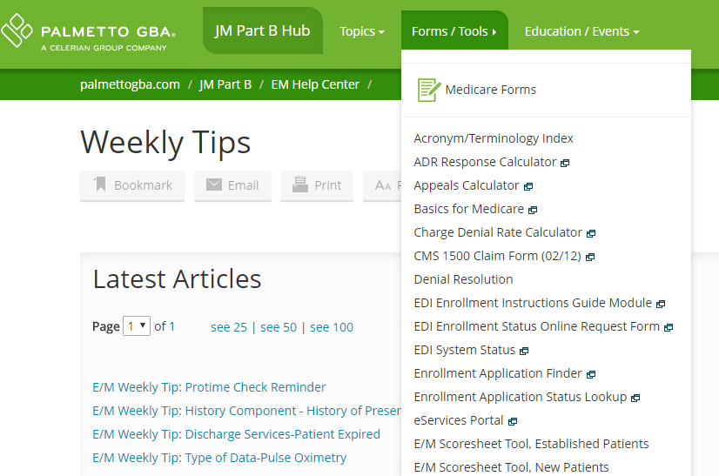

Slide 43
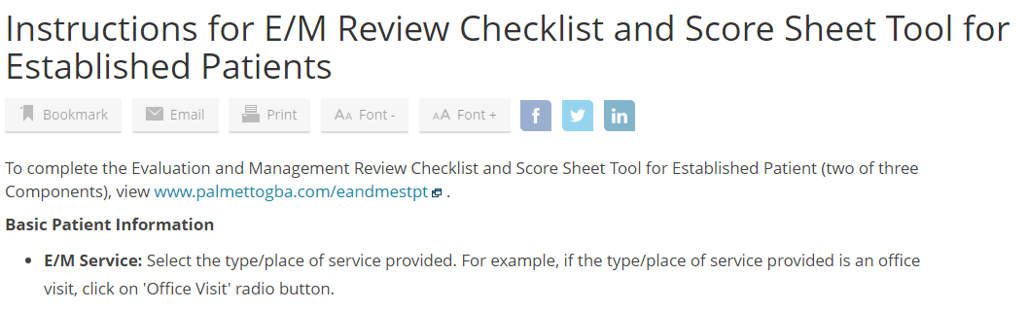

Slide 44
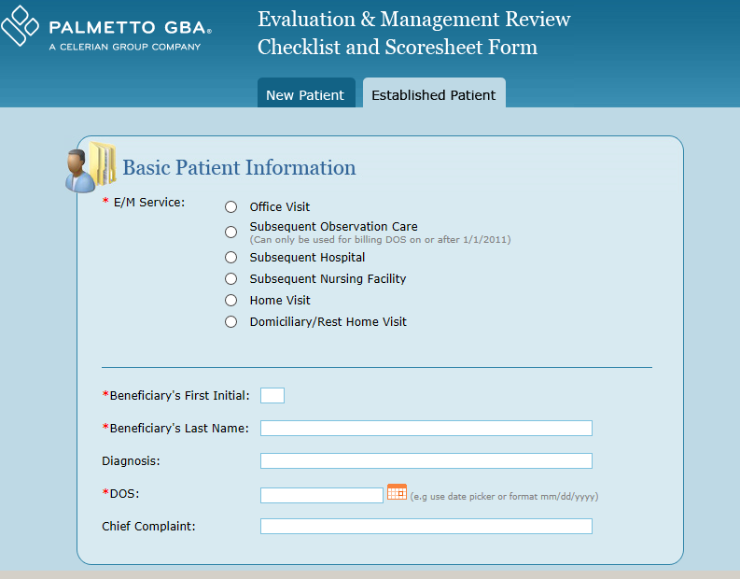

Slide 45

Fee Schedule and Modifiers

Slide 46


Slide 47
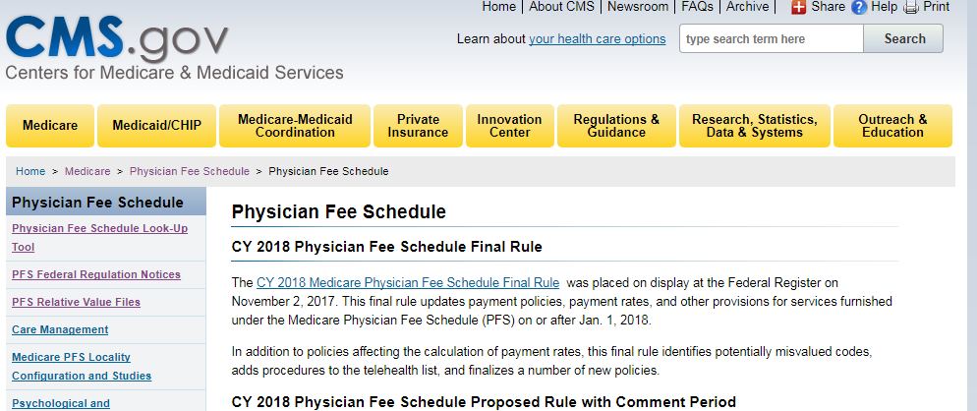

Slide 48
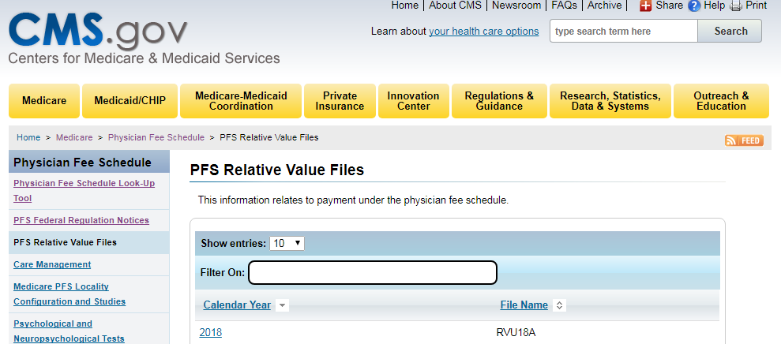

Slide 49
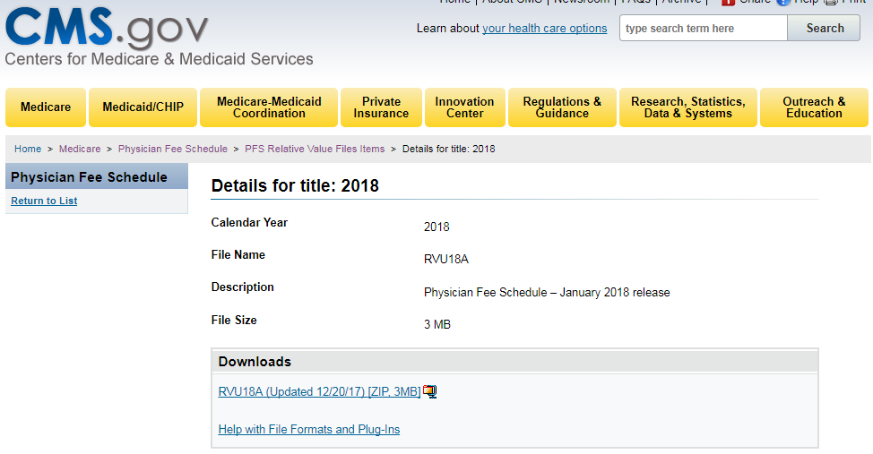

Slide 50
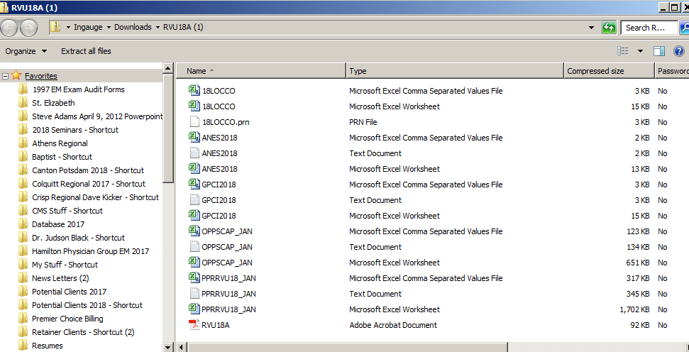

Slide 51
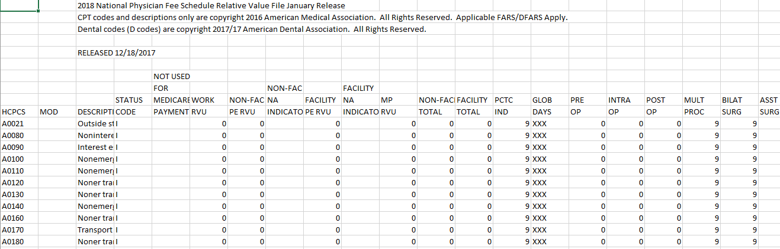

Slide 52
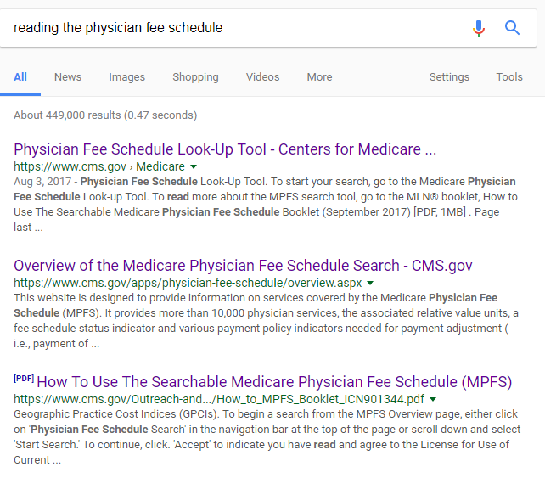

Slide 53


Slide 54
NCCI

Slide 55


Slide 56
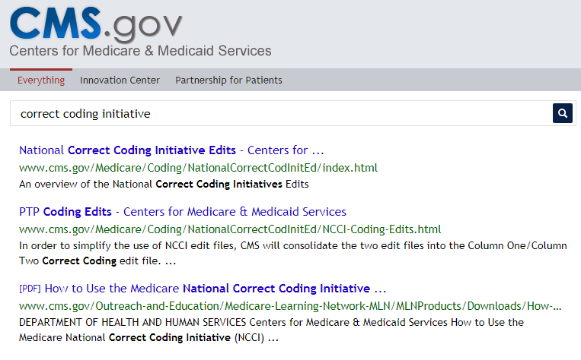

Slide 57
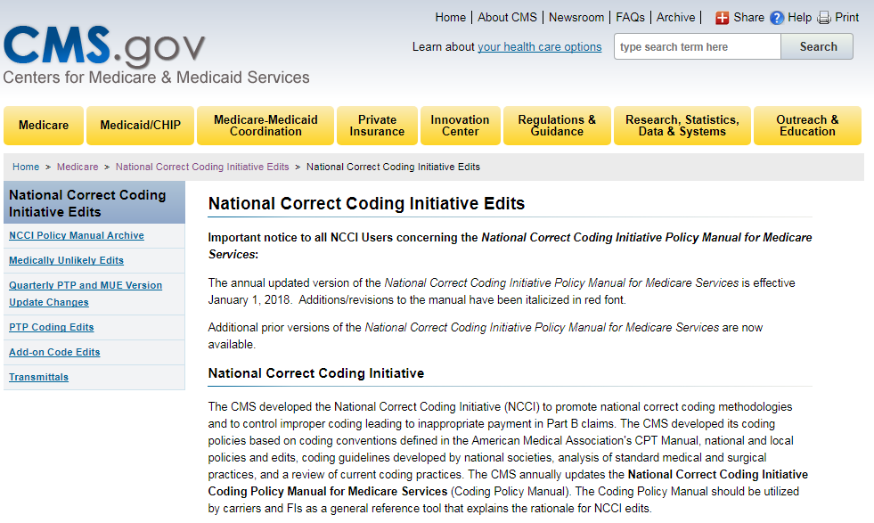

Slide 58
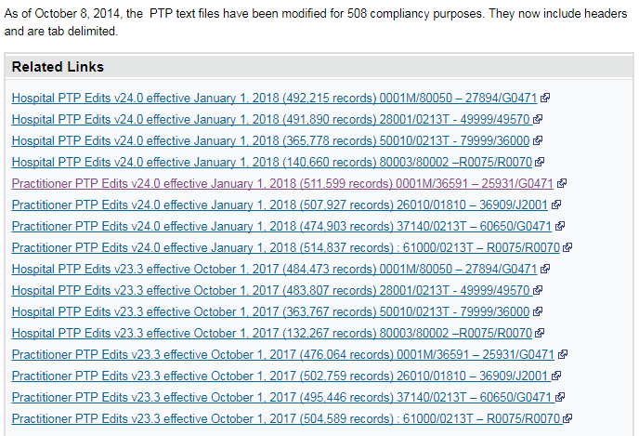

Slide 59
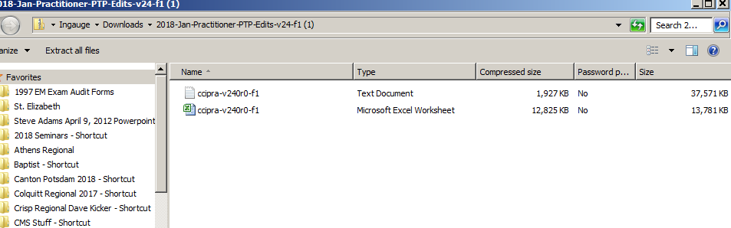

Slide 60
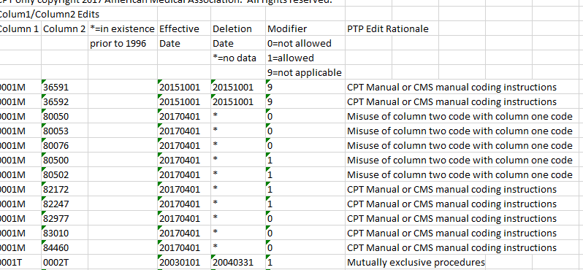

Slide 61
HCCs and RAF

Slide 62


Slide 63
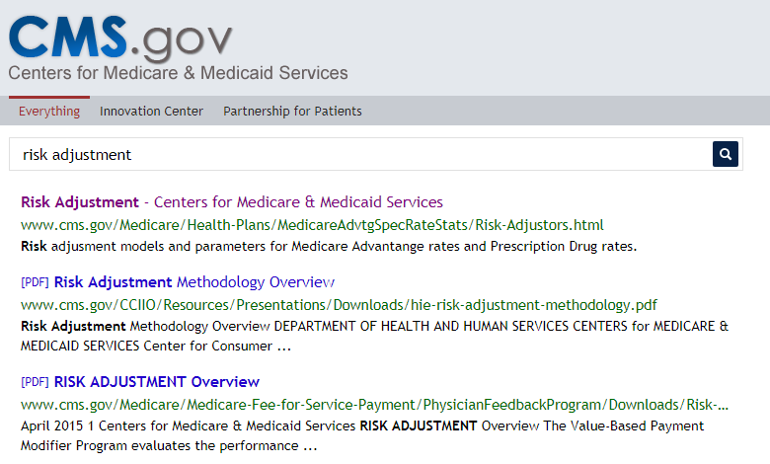

Slide 64
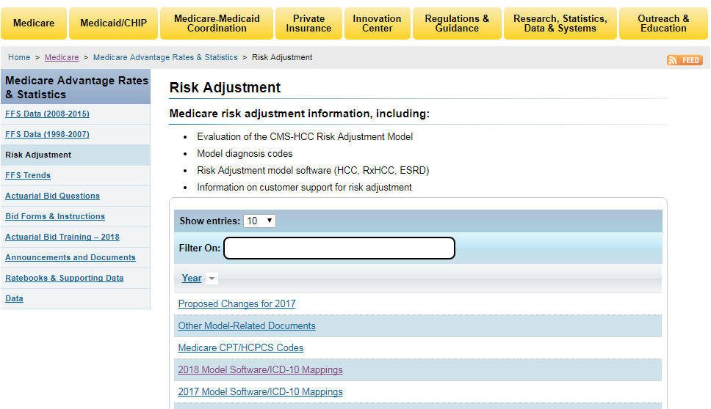

Slide 65
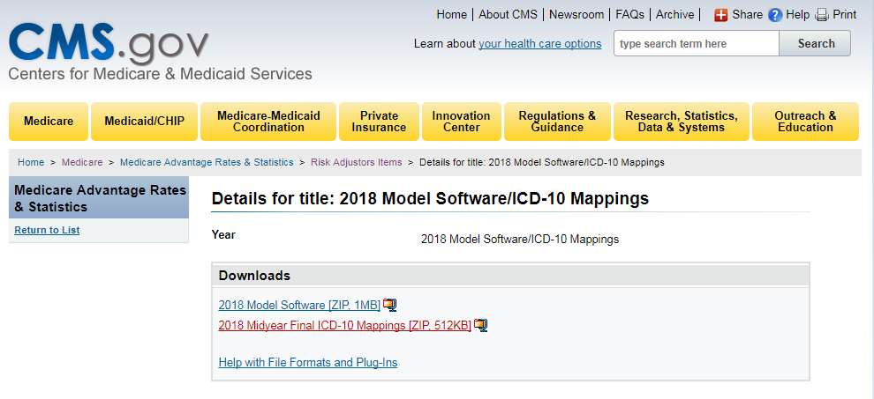

Slide 66
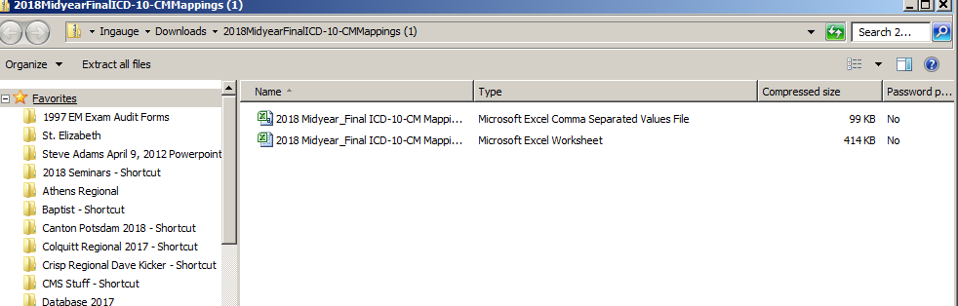

Slide 67
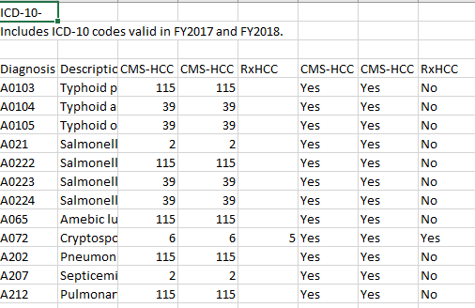

Slide 68
RAC Auditors

Slide 69
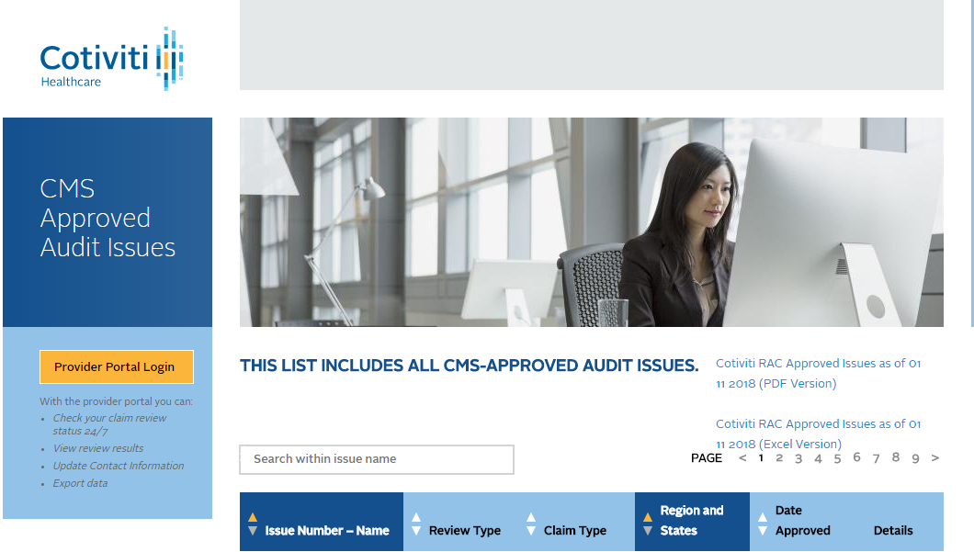

Slide 70


Slide 71


Slide 72


Slide 73
OIG Work Plan

Slide 74


Slide 75


Slide 76


Slide 77


Slide 78


Slide 79


Slide 80
Google

Slide 81


Slide 82


Slide 83


Slide 84


Slide 85


Slide 86


Slide 87


Slide 88
Encoder Pro

Slide 89


Slide 90


Slide 91


Slide 92


Slide 93


Slide 94


Slide 95
Discussion Points
Using the CMS Web Site
RAC audits
OIG Work Plan
Using our Carrier Website
Google Works
Using Encoder Pro

Slide 96

Questions?

Slide 97
Any Questions
Direct: 706-483-4728
E-Fax: 770-709-3698
E-mail: steve.adams@inhealthps.com
Web: www.thecodingeducator.com
Facebook: facebook.com/kingofcoders

