Slide 1

2019 CPT and ICD-10 Update
Doing It Right the First Time

Slide 3
Topics
QPP and MACRA Update
EM Changes now and in the Future
Surgery Section
Radiology Changes
Pathology Changes
Medicine Section Changes
ICD-10 Updates

Slide 4
QPP and MACRA

Slide 5
Some Miscellaneous Issues First
The 2019 MPFS conversion factor is increasing slightly from $35.9996 this year to $36.0391
CMS will not apply the multiple procedure payment reduction policy to office visits and other services done at the same encounter.
CMS is continuing to help small practices in Year 3 of Quality Payment Program (QPP) by increasing the small practice bonus to six points, but including it in the Quality performance category score of clinicians in small practices instead of as a standalone bonus

Slide 6
QPP and MIPS
CMS also added an additional low-volume threshold exemption to MIPS for next year. To be excluded, providers or groups need to meet at least one of the following conditions:
Have $90,000 or less in Medicare Part B allowed charges for covered professional services.
Provide care to 200 or fewer Part B-enrolled patients.
Provide 200 or fewer covered professional services under the PFS.

Slide 7
QPP and MIPS
The minimum period for each performance category remains unchanged, so quality and cost stay at 12 months while improvement activities and promoting interoperability remain at a continuous 90-day period.
However, the weighting to the final score of the cost and quality categories have both changed. Cost increases from 10 percent to 15 percent of the total score, and quality drops from 50 percent to 45 percent.

Slide 8
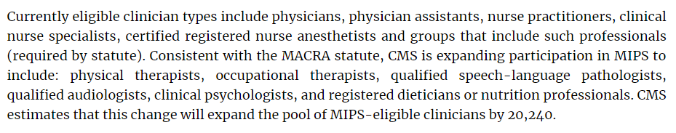

Slide 9

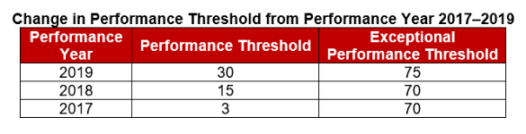

Slide 12
2019 E/M Update from CMS

Slide 13
We proposed to expand this policy to further simplify the documentation of history and exam for established patients such that, for both of these key components, when relevant information is already contained in the medical record, practitioners would only be required to focus their documentation on what has changed since the last visit or on pertinent items that have not changed, rather than re-documenting a defined list of required elements such as review of a specified number of systems and family/social history. Practitioners would still review prior data, update as necessary, and indicate in the medical record that they had done so. Practitioners would conduct clinically relevant and medically necessary elements of history and physical exam, and conform to the general principles of medical record documentation in the 1995 and 1997 guidelines. However, practitioners would not need to re-record these elements (or parts thereof) if there is evidence that the practitioner reviewed and updated the previous information.

Slide 14

Chief Complaint and HPI
Additionally, we are clarifying that for E/M office/outpatient visits, for new and established patients for visits, practitioners need not re-enter in the medical record information on the patient’s chief complaint and history that has already been entered by ancillary staff or the beneficiary. The practitioner may simply indicate in the medical record that he or she reviewed and verified this information; and

Slide 15


Review and Validated
For established patient office/outpatient visits, when relevant information is already contained in the medical record, practitioners may choose to focus their documentation on what has changed since the last visit, or on pertinent items that have not changed, and need not re-record the defined list of required elements if there is evidence that the practitioner reviewed the previous information and updated it as needed. Practitioners should still review prior data, update as necessary, and indicate in the medical record that they have done so.

Slide 16

Teaching Physicians and Residents
Removal of potentially duplicative requirements for notations in medical records that may have previously been included in the medical records by residents or other members of the medical team for E/M visits furnished by teaching physicians.

Slide 17
New HCPCS Codes for 2019
Brief communication technology-based service, e.g. virtual check-in (HCPCS code G2012) and
Remote evaluation of recorded video and/or images submitted by an established patient (HCPCS code G2010)

Slide 18
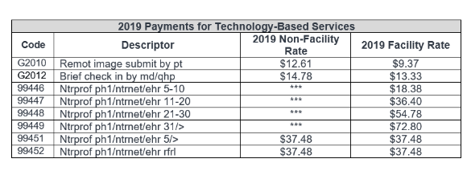

Slide 19
G2012
(Brief communication technology-based service, e.g. virtual check-in, by a physician or other qualified health care professional who can report evaluation and management services, provided to an established patient, not originating from a related E/M service provided within the previous 7 days nor leading to an E/M service or procedure within the next 24 hours or soonest available appointment; 5-10 minutes of medical discussion)

Slide 20
G2010
(Remote evaluation of recorded video and/or images submitted by an established patient (e.g., store and forward), including interpretation with follow-up with the patient within 24 business hours, not originating from a related E/M service provided within the previous 7 days nor leading to an E/M service or procedure within the next 24 hours or soonest available appointment)

Slide 21
Definitions
Practitioners could be separately paid for the brief communication technology-based service when the patient checks in with the practitioner via telephone or other telecommunications device to decide whether an office visit or other service is needed. This would increase efficiency for practitioners and convenience for beneficiaries.
Similarly, the service of remote evaluation of recorded video and/or images submitted by an established patient would allow practitioners to be separately paid for reviewing patient-transmitted photo or video information conducted via pre-recorded “store and forward” video or image technology to assess whether a visit is needed.

Slide 22
2021 Changes
Reduction in the payment variation for E/M office/outpatient visit levels by paying a single rate for E/M office/outpatient visit levels 2 through 4 for established and new patients while maintaining the payment rate for E/M office/outpatient visit level 5 in order to better account for the care and needs of complex patients;

Slide 23
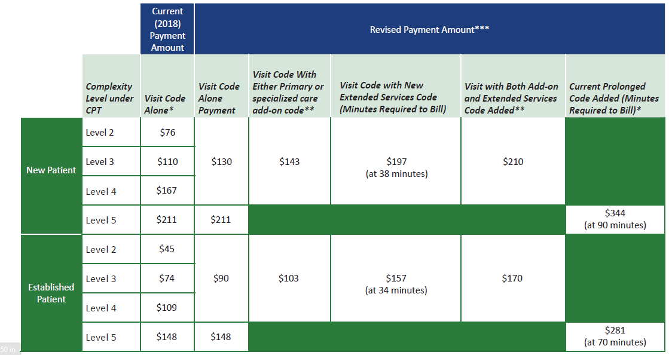

Slide 24
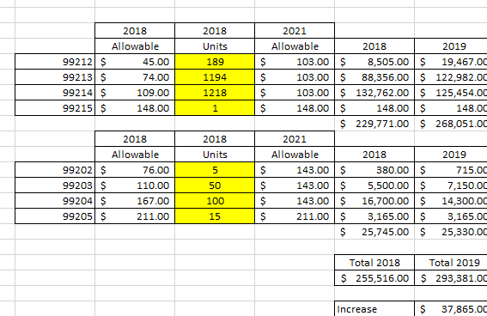

Slide 25

2021 Changes
Permitting practitioners to choose to document E/M office/outpatient level 2 through 5 visits using medical decision-making or time instead of applying the current 1995 or 1997 E/M documentation guidelines, or alternatively practitioners could continue using the current framework;

Slide 26
2021 Changes
Beginning in CY 2021, for E/M office/outpatient levels 2 through 5 visits, we will allow for flexibility in how visit levels are documented - specifically, a choice to use the current framework, MDM, or time. For E/M office/outpatient level 2 through 4 visits, when using MDM or current framework to document the visit, we will also apply a minimum supporting documentation standard associated with level 2 visits. For these cases, Medicare would require information to support a level 2 E/M office/outpatient visit code for history, exam and/or medical decision-making;

Slide 27
2021 Changes
When time is used to document, practitioners will document the medical necessity of the visit and that the billing practitioner personally spent the required amount of time face-to-face with the beneficiary;

Slide 28
2021 Changes
Implementation of add-on codes that describe the additional resources inherent in visits for primary care and particular kinds of non-procedural specialized medical care, though they would not be restricted by physician specialty. These codes would only be reportable with E/M office/outpatient level 2 through 4 visits, and their use generally would not impose new per-visit documentation requirements.

Slide 29
2021 Changes
Adoption of a new “extended visit” add-on code for use only with E/M office/outpatient services. To report extended time for E/M office and other outpatient E/M services when face-to-face time exceeds 34 minutes for an established patient or 38 minutes for a new patient whose E/M service is reported as level 2 through 4 and to report a level 5 code with prolonged service add-on code when face-to-face time exceeds 69 minutes for established patients or 89 minutes for new patients.

Slide 30
2019 CPT and ICD-10 Updates

Slide 31

CPT Changes 2019
The new current procedural terminology (CPT®) codes have been released with 335 code changes in 2019. There were many code revisions with guideline, description and instructional note changes. Let’s look at the highlights of many new CPT codes for 2019.

Slide 32
Modifier 63 Changes

Slide 33
Modifier 63 – Appendix F
When a surgeon performs certain procedures on an infant weighing less than 4 kilograms (approx. 8.8 lbs.), append modifier 63 to the CPT® code to inform the payer of the increased complexity of the procedure due to the patient’s small size, which may—depending on your payer and your negotiating skills—result in higher reimbursement.

Slide 34
EM Coding Changes

Slide 35
CCRPM
“Chronic Care Remote Patient Monitoring" -- an interaction whereby a patient purchases a home monitoring device to collect their health information and transmit that information to their doctor.

Slide 36
CCRPM
Chronic Care Remote Physiologic Monitoring (“CCRPM”) for (1) initial set-up and patient education, (2) initial device supply, and (3) monitoring data and interacting with patients or caregivers.

Slide 37

Remote Monitoring
99453: Remote monitoring of physiologic parameter(s) (eg, weight, blood pressure, pulse oximetry, respiratory flow rate), initial; set-up and patient education on use of equipment
99454: Remote monitoring of physiologic parameter(s) (eg, weight, blood pressure, pulse oximetry, respiratory flow rate), initial; device(s) supply with daily recording(s) or programmed alert(s) transmission, each 30 days

Slide 38
Remote Monitoring
99457 (Remote physiologic monitoring treatment management services, 20 minutes or more of clinical staff/physician/other qualified health care professional time in a calendar month requiring interactive communication with the patient/caregiver during the month)
  Use 99457 for time spent managing care when patients or the practice do not meet the requirements to report more specific services - CPT explains.

Slide 39
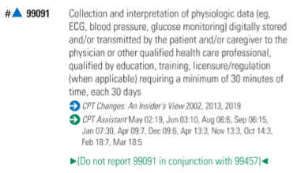
99091

Slide 40
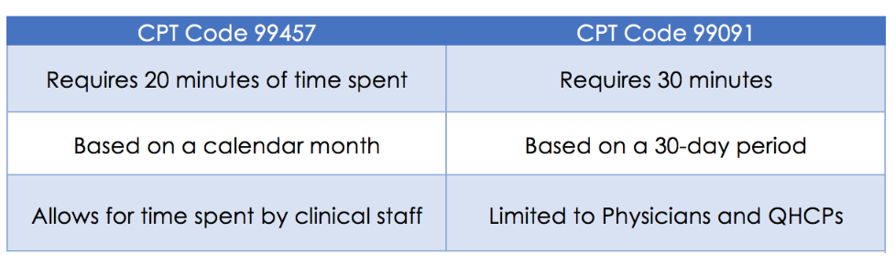
Differences
The Rule states that CPT Code 99457 describes only professional time and “therefore cannot be furnished by auxiliary personnel incident to a practitioner’s professional services.”

Slide 41
More to Come…
CMS stated in the Rule that it plans to issue further guidance to help practitioners and stakeholders determine the scope of service and better interpret the code descriptors listed above. Specifically, we can expect guidance on (i) the types of technology that can be used to provide these new RPM services, (ii) whether the descriptor for CPT Code 99454 includes transmissions that occur other than daily, and (iii) whether CPT Code 99453 can be furnished via telecommunication technology.

Slide 42
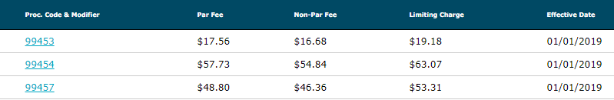

Fee Data

Slide 43
Physician-Led Chronic Care Management (CCM)
99491 - CCM services, provided personally by a physician or other qualified health care professional, at least 30 minutes of physician or other qualified health care professional time, per calendar month, with the following required elements: multiple (two or more) chronic conditions expected to last at least 12 months, or until the death of the patient, chronic conditions place the patient at significant risk of death, acute exacerbation/decompensation, or functional decline; comprehensive care plan established, implemented, revised, or monitored
99491 $81.33

Slide 44
Interprofessional Consults
99446: Interprofessional telephone/Internet assessment and management service provided by a consultative physician including a verbal and written report to the patient's treating/requesting physician or other qualified health care professional; 5-10 minutes of medical consultative discussion and review
99447: Same as 99446, but 11-20 minutes of medical consultative discussion and review
99448: Same as 99446, but 21-30 minutes of medical consultative discussion and review
99449: Same as 99446, but 31 minutes or more of medical consultative discussion and review

Slide 45
Interprofessional Consults
99451 (Interprofessional telephone/Internet/electronic health record assessment and management service provided by a consultative physician, including a written report to the patient’s treating/requesting physician or other qualified health care professional, 5 minutes or more of medical consultative time)
*99452 (Interprofessional telephone/Internet/electronic health record referral service[s] provided by a treating/requesting physician or other qualified health care professional, 30 minutes)

Slide 46
Interprofessional Consults
99446 $17.92
99447 $35.52
99448 $53.44
99449 $71.04
99451 $36.56
99452 $36.56

Slide 47
Surgery Changes

Slide 48
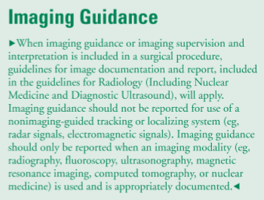
New for 2019

Slide 49
FNAB and a Core Needle Biopsy (CNB)
The FNAB involves aspiration of material with a fine needle and cytological examination of the cells.
A core needle biopsy involves obtaining a core sample with a larger bore needle and histopathologic examination of the tissue

Slide 50
2019
FNAB Codes
10021 (Fine needle aspiration biopsy; without imaging guidance) will be revised to state “Fine needle aspiration biopsy; without imaging guidance; first lesion.” When appropriate, a provider would report a new add-on code:
10004 (Each additional lesion [List separately in addition to code for primary procedure]).
Four more primary and add-on pairings will be available to report FNAB with
(10005-10006) – Ultrasound;
(10007-10008) – Fluoroscopy;
(10009-10010) – CT; or
(10011-10012) – MRI

Slide 51
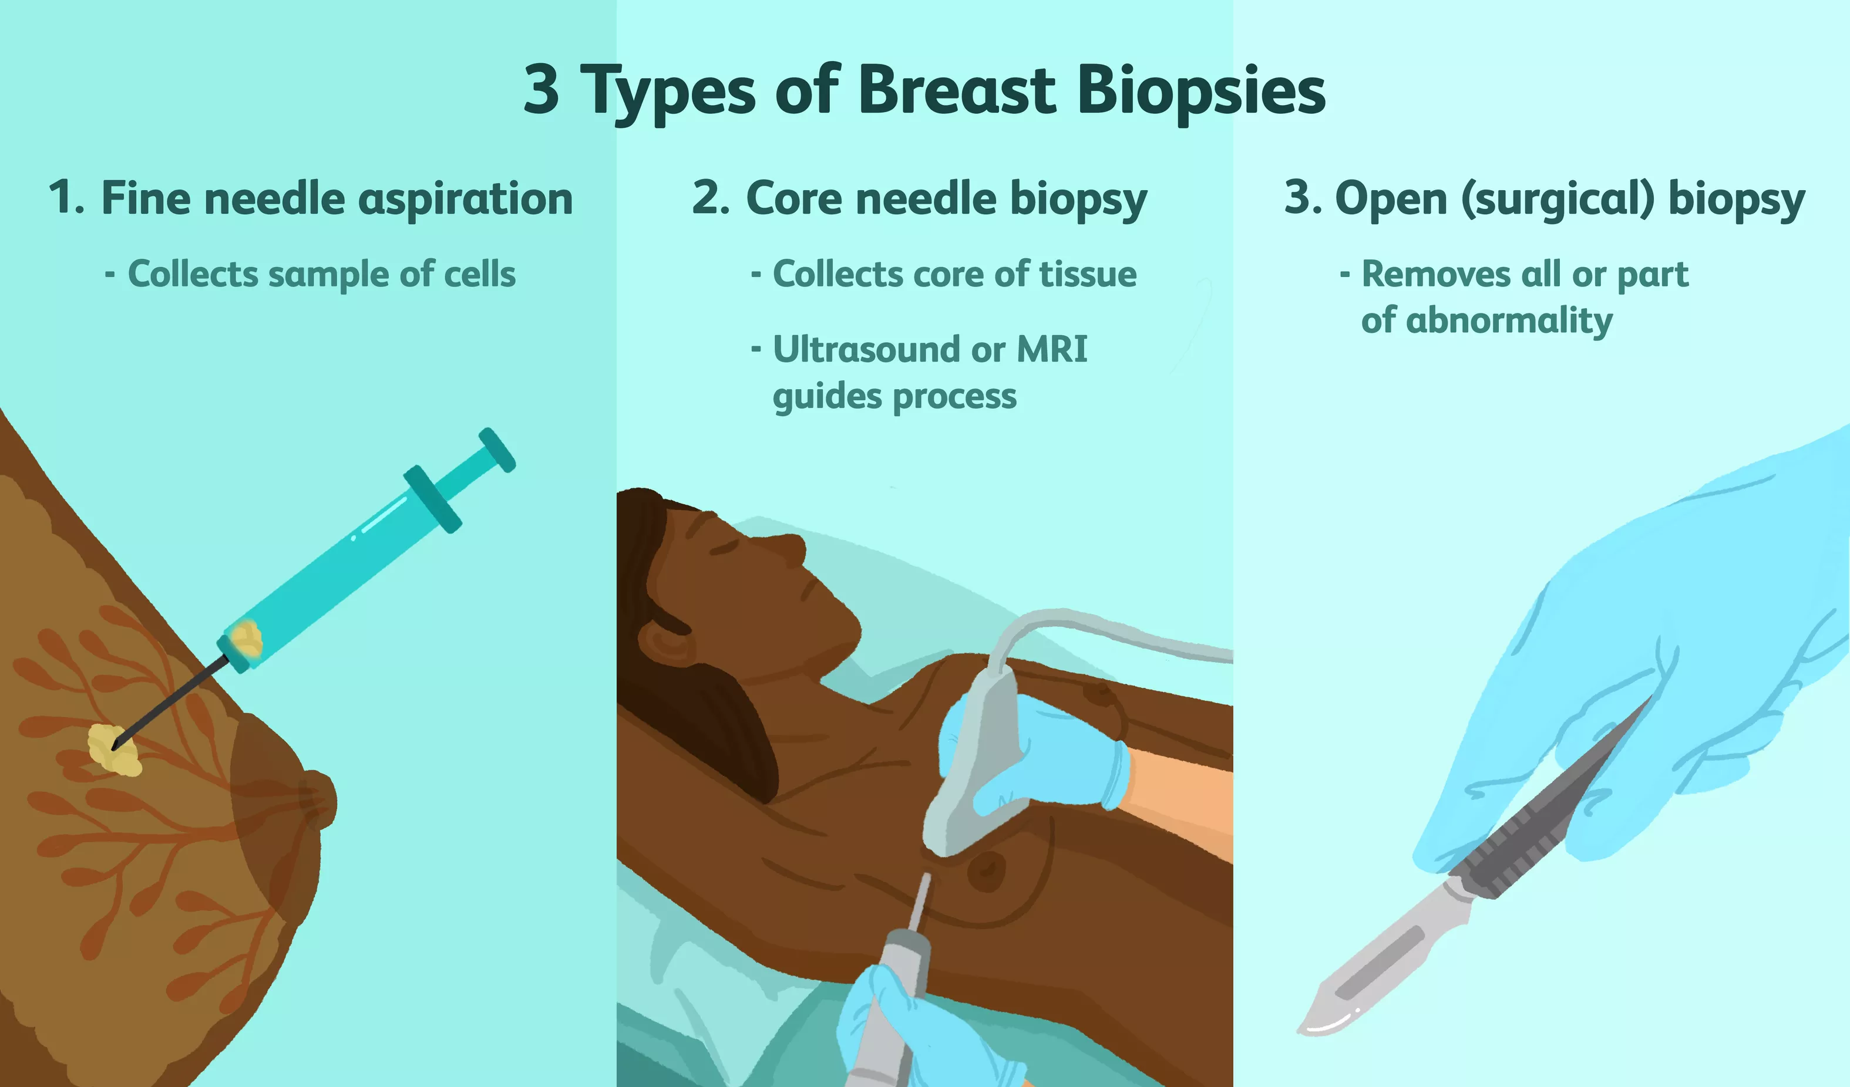
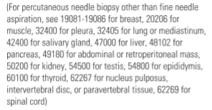

Slide 52
Allowables
10004 $51.88
10005 $122.57
10006 $59.67
10007 $269.89
10008 $152.79
10009 $438.57
10010 $265.55
10021 $94.70

Slide 53
Biopsy Codes Deleted
11100 (Biopsy of skin, subcutaneous tissue and/or mucous membrane [including simple closure], unless otherwise listed; single lesion); and
+11101 (…; each separate/additional lesion [List separately in addition to code for primary procedure])

Slide 54
11102 (Tangential biopsy of skin [e.g., shave, scoop, saucerize, curette]; single lesion) and
+11103 (…, each separate/additional lesion [List separately in addition to code for primary procedure]
The definition states that the biopsy is performed - with a sharp blade, such as a flexible biopsy blade, obliquely oriented scalpel or curette to remove a sample of epidermal tissue with or without portions of the underlying dermis
11104 Punch biopsy of skin, single lesion
+11105 (…; each separate/additional lesion [List separately in addition to code for primary procedure]) also includes a simple closure
11106 Incisional biopsy of skin, single lesion
+11107 (…; each separate/additional lesion [List separately in addition to code for primary procedure]) also includes a simple closure

Slide 55
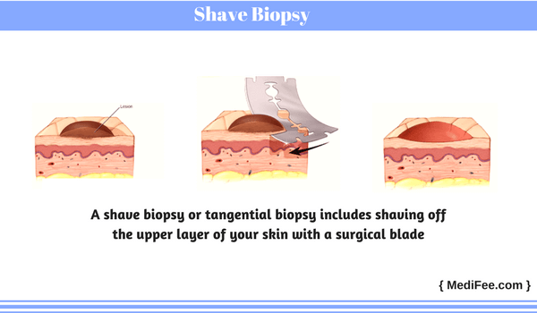

Slide 56
Allowables
11102 $93.68
11103 $50.62
11104 $117.76
11105 $58.06
11106 $142.57
11107 $68.50

Slide 57
Arthrography
When the provider performs a radiographic arthrography, report 73580 (Radiologic examination, knee, arthrography, radiological supervision and interpretation).

Slide 58
Arthrography Change for Common Code
Arthrography code 27370 (Injection of contrast for knee arthrography) will be deleted and replaced with 27369 (Injection procedure for contrast knee arthrography or contrast enhanced CT/MRI knee arthrography).
If you need help selecting the correct image guidance codes, look no further than the detailed parenthetical guidance.
27369 $134.91
# 27369 $41.27

Slide 59
Fluoroscopic Needle Guidance
When the provider uses fluoroscopic needle guidance (77002) for an enhanced computed tomography arthrography, report 77002 and 73701 (Computed tomography, lower extremity; with contrast material[s]) or 73702 (…; without contrast material, followed by contrast material[s] and further sections). If fluoroscopic needle guidance is used for an enhanced magnetic resonance arthrography use the needle guidance code and 73722 (Magnetic resonance [eg, proton] imaging, any joint of lower extremity; with contrast material[s]) or 73723 (…; without contrast material, followed by contrast material[s] and further sequences).

Slide 60
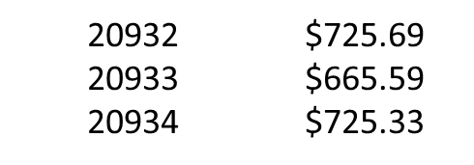
Allografts
CPT codes 20932-20934 were added for allografts. CPT 20932 includes templating, cutting, placement and internal fixation; osteoarticular, whereas CPT 20933 is hemicortical, intercalary, partial and CPT 20934 is hemicortical, complete.

Slide 61
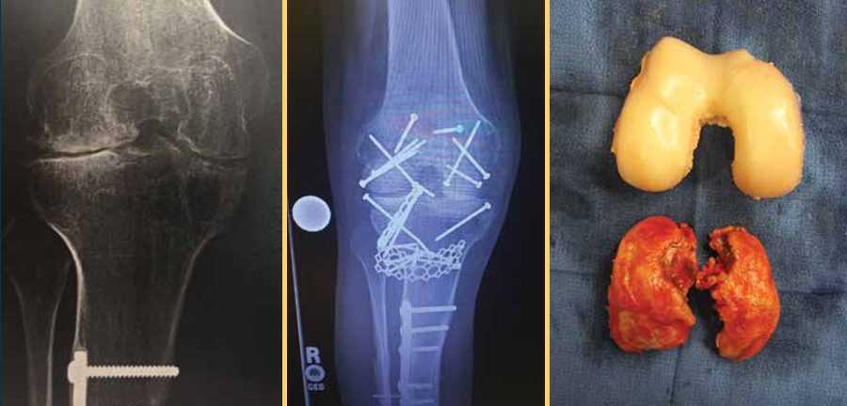

Slide 62
Pacemaker Changes
Category III codes 0387T-0391T were deleted and replaced with permanent codes
33274 (Transcatheter insertion or replacement of permanent leadless pacemaker, right ventricular, including imaging guidance [eg, fluoroscopy, venous ultrasound, ventriculography, femoral venography] and device evaluation [eg, interrogation or programming], when performed) and
33275 (Transcatheter removal of permanent leadless pacemaker, right ventricular).

Slide 63
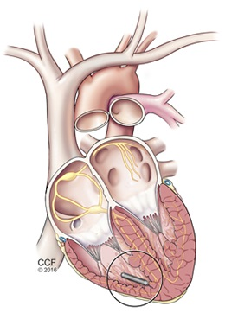

Slide 64
New guidelines state that insertion of a catheter into the right ventricle is included in the insertion, replacement or removal of a leadless pacemaker system. In addition, right heart catheterization codes 93451, 93453, 93456, 93457, 93460, 93461 and 93530-93533 should not be reported with the insertion or removal codes unless the right heart catheterization treats a condition that is “distinct from the leadless pacemaker procedure.” And when a system is removed and replaced during the same session, report 33274.

Slide 65
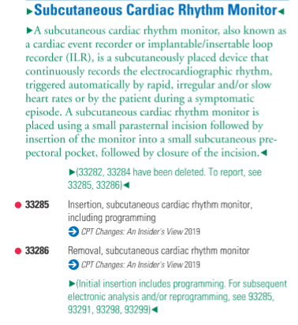
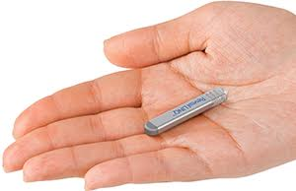

Slide 66
Aortic Procedure
33440 Replacement, aortic valve by translocation of autologous pulmonary valve and transventricular aortic annulus enlargement of the left ventricular outflow tract with valved conduit replacement of pulmonary valve (Ross-Konno Procedure)

Slide 67
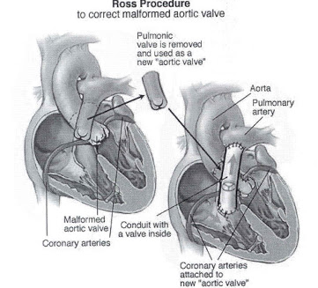

In layman's terms it means that they will take out his diseased aortic valve and replace with his own pulmonary valve

Slide 68
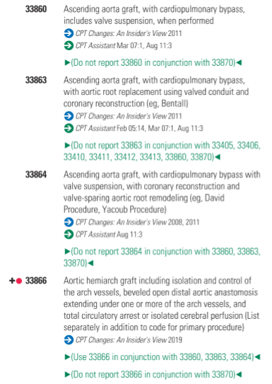
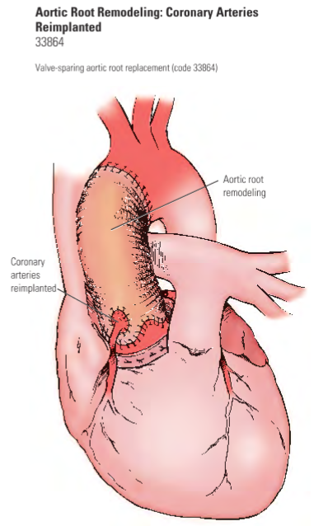

Slide 69
Definition of Central Venous Access Device
To qualify as a central venous access catheter or device, the tip of the catheter/device must terminate in the subclavian, brachiocephalic (innominate) or iliac veins, the superior or inferior vena cava, or the right atrium to be considered a “central venous” catheter.
The venous access device may be either:
  Centrally inserted (jugular, subclavian, femoral vein or inferior vena cava catheter entry site); or
  Peripherally inserted (eg, basilic, cephalic, or saphenous vein entry site).
The device may be accessed for use either via exposed catheter (external to the skin), via a subcutaneous port or via a subcutaneous

Slide 70
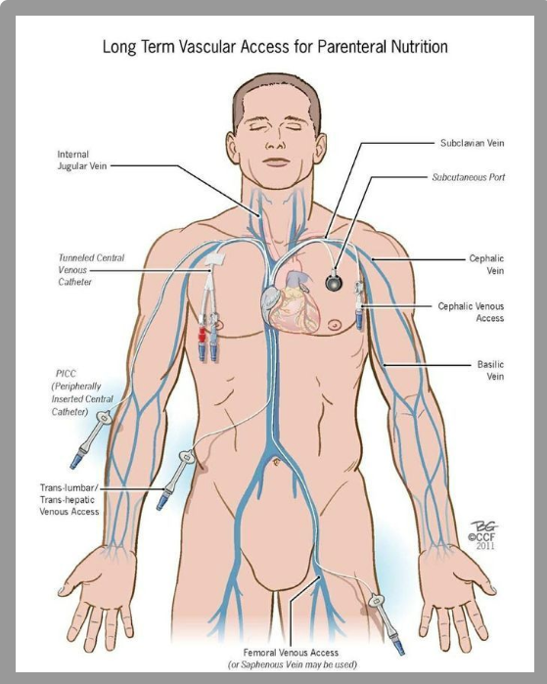
Vascular Access
Central and Peripheral Lines

Slide 71
Imaging Assistance with Central Lines
When imaging guidance is used for centrally inserted central venous catheters, for gaining access to the venous entry site and/or for manipulating the catheter into final central position, imaging guidance codes (eg, 76937, 77001) may be reported separately. Do not use 76937, 77001 in conjunction with 36568, 36569, 36572, 36573, 36584.

Slide 72
New PICC Line Including Imaging
New CPT codes 36572 and 36573 are used for an insertion of a peripherally inserted central venous catheter (PICC) without a subcutaneous port or pump including all imaging guidance

Slide 73
Revised PICC Line Including Imaging
36584 Replacement, complete, of a peripherally inserted central venous catheter (PICC), without subcutaneous port or pump, through same venous access, including all imaging guidance, image documentation, and all associated radiological supervision and interpretation required to perform the replacement

Slide 74
Imaging Assistance with PICC Lines
Chest X-ray codes (71045-71048) or other imaging services to document the final catheter tip position are bundled into 36584 and 36572-36573. However, when the provider uses imaging but does not confirm the tip’s location, the practice should append modifier 52 (Reduced services) with the code.

Slide 75
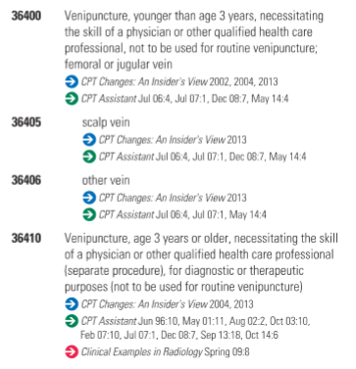
Midline Catheter
Finally, if you’ve been wondering how to report a midline catheter, the manual has the answer: Use a venipuncture code (36400-36410).

Slide 76
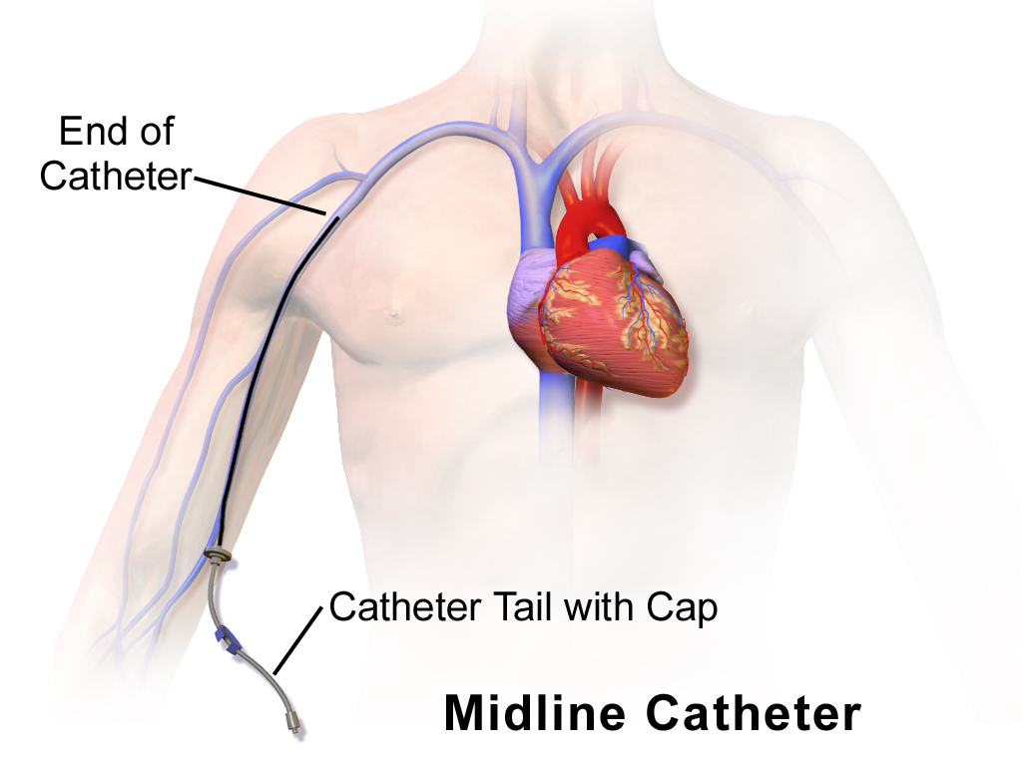

Slide 77
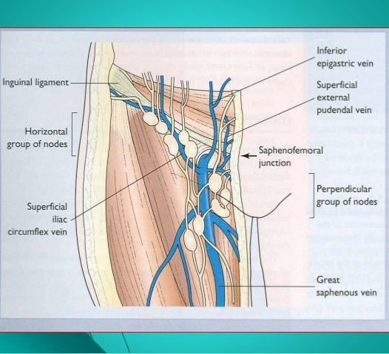
New Code for Excision of Lymph Node(s)
38531 is used to report a biopsy or excision of an open inguinofemoral lymph node.

Slide 78
Gastrostomy Tube Placement
43762 is reported for the percutaneous gastrostomy tube replacement including removal without imaging or endoscopic guidance not requiring revision of the gastrostomy tract and
43763 requires revision of gastrostomy tract. These codes were added to define simple versus complex replacement of a percutaneous gastrostomy tube.

Slide 79
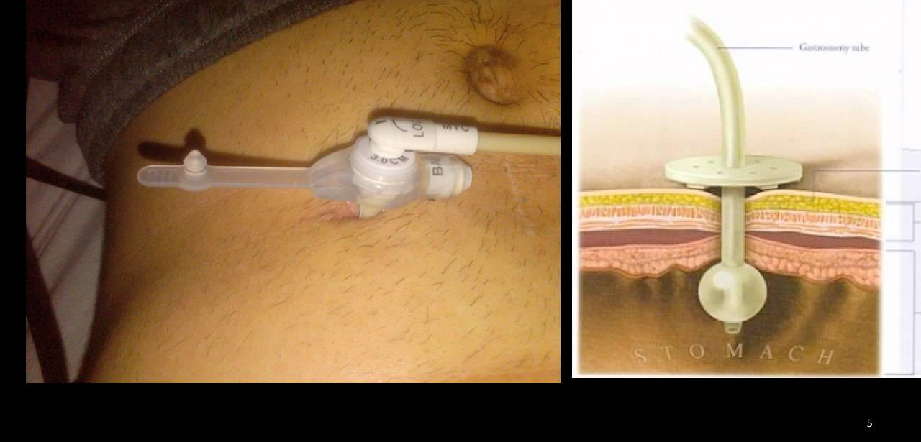

Slide 80
Dilation of Percutaneous Genitourinary Tract
CPT codes 50436 and 50437 are used to report dilation of existing tract, percutaneous for an endourologic procedure including imaging guidance with post procedural tube placement. CPT 50437 is reported when new access into the renal collecting system is performed.

Slide 81
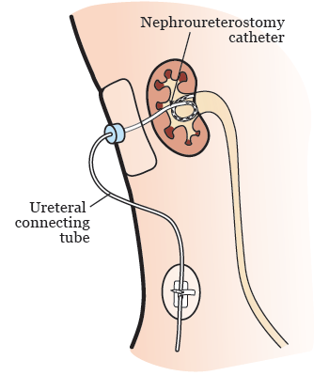

Slide 82
Transurethral Destruction of Prostate
New CPT code 53854 was added to report a transurethral destruction of prostate tissue by radiofrequency generated water vapor thermotherapy.

Slide 83
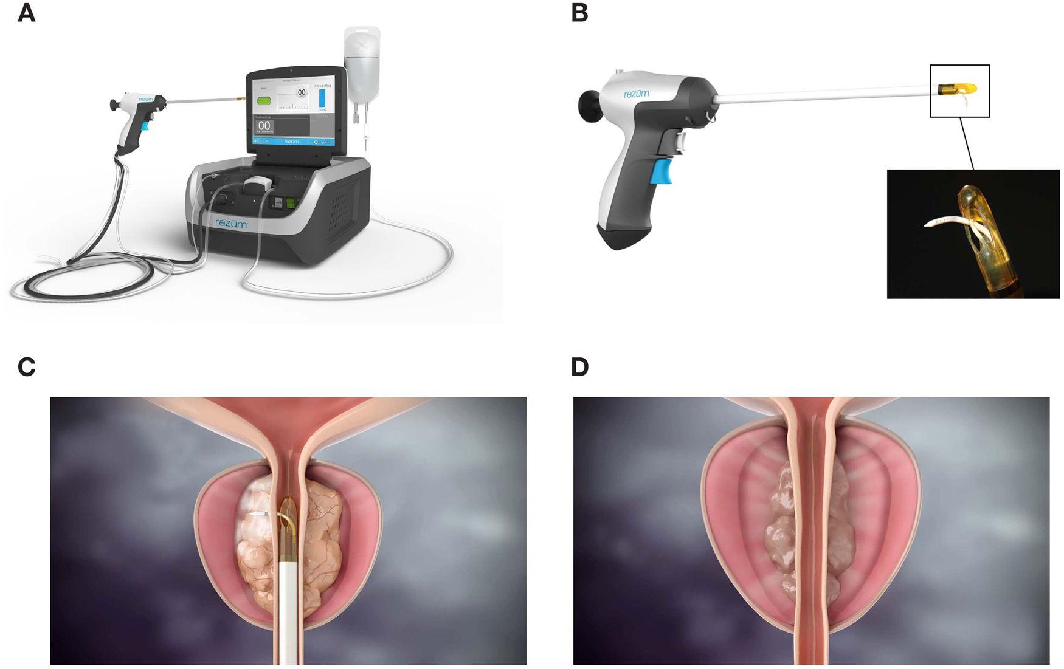

Slide 84
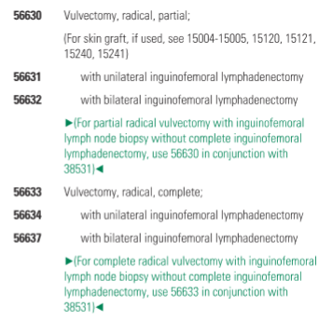
Vulvectomy Notes

Slide 85
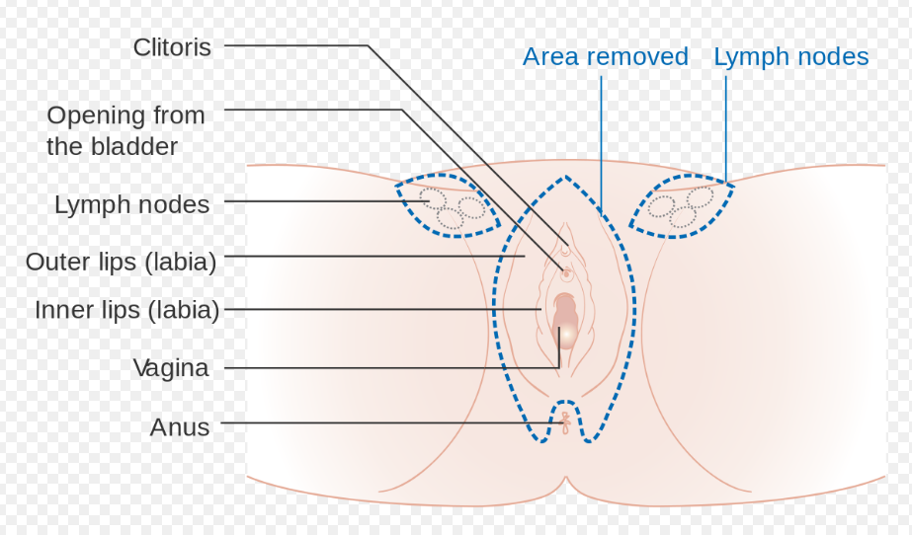

Slide 86
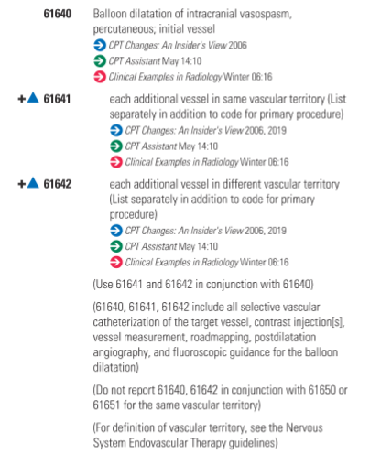


Slide 87
Radiology Changes

Slide 88
Non-Image Guided Services
In addition, the new guidance warns practices that nonimage-guided tracking or localization – such as radar should not be reported with radiology codes.
  According to CPT: - Imaging guidance should only be reported when an imaging modality (e.g., radiography, fluoroscopy, ultrasonography, magnetic resonance imaging, computed tomography, or nuclear medicine) is used and is appropriately documented the new guidance states.

Slide 89
Here It Is In Writing
According to the supervision and interpretation, imaging guidance section, all imaging guidance codes require image documentation in the patient chart and a description of the image guidance in the procedure note.
Radiological supervision and interpretation (S & I) documentation must include documentation in the patient’s “permanent record” and a procedure or separate image report “that includes written documentation of interpretive findings of information contained in the images and radiologic supervision of the service.”
In addition, new text in the written reports section states that for the purposes of descriptors for imaging services, the images “must contain anatomic information unique to the patient for which the imaging service is provided.”

Slide 90

MRE
New CPT code 76391 is used to report Magnetic Resonance (vibration) Elastography.

Slide 91
USE - Ultrasound
New codes were established for ultrasound elastography, CPT 76981-76983. These new codes distinguish reporting, per organ, first target lesion and each additional target lesion. Magnetic resonance elastography is new diagnostic imaging technology.

Slide 92
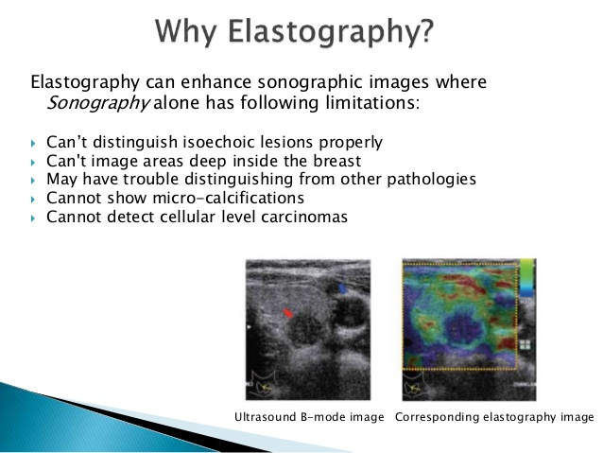

Slide 93
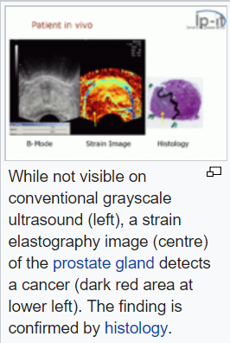
Cancer is harder than surrounding tissue

Slide 94

Microbubble
Two new CPT codes 76978-76979 are used to report ultrasound procedures that use dynamic microbubble-sonographic contrast with targeted ultrasound to evaluation lesions.

Slide 95
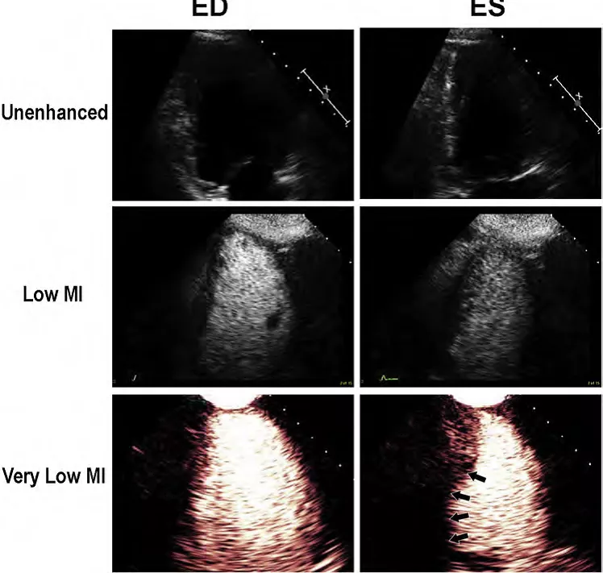

Slide 96
Breast MRI Procedures
CPT codes 77058 and 77059 were deleted.
Four new breast MRI procedures were added (77046-77049). Codes are selected based on laterality (unilateral vs. bilateral) and with or without contrast material.

Slide 97
Breast MRI Images
77046 Magnetic resonance imaging, breast, without contrast material unilateral
77047 bilateral
77048 Magnetic resonance imaging, breast, without and with contrast material(s), including computer-aided detection (CAD real-time lesion detection, characterization and pharmacokinetic analysis), when performed unilateral 3 CPT Changes:
77049 bilateral
(77051 has been deleted. To report, see 77065, 77066) (77052 has been deleted. To report, use 77067

Slide 98
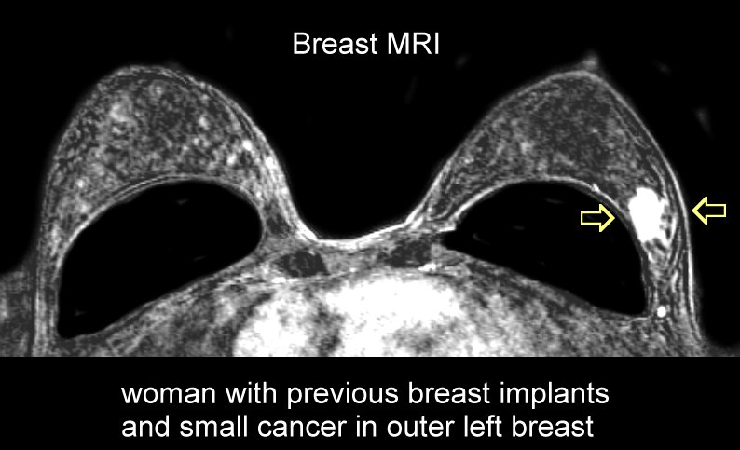

Slide 99
Pathology Changes

Slide 100
Pathology Changes
Due to frequent use, many services previously classified with the Tier 2 molecular pathology codes are now described using standalone Tier 1 codes like 81171-81183
The BRCA1 & BRCA2 codes have also been revised due to changes in clinical practice and are listed under Tier 1 codes

Slide 101
Medicine Section Changes

Slide 102

New Flu Vaccine
CPT code 90689 was added to report an inactivated adjuvanted preservative free flu vaccination.

Slide 103
Electroretinography (ERG)
In the Ophthalmology section, new codes 92273 and 92274 were added. These are electroretinography procedures to evaluate function of the retina and optic nerve of the eye.
CPT 92273 was added to report global response of photoreceptors of the retina and
CPT 92274 to report photoreceptors in multiple separate locations in the retina and macula.

Slide 104
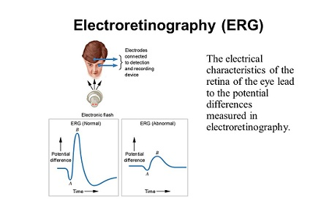
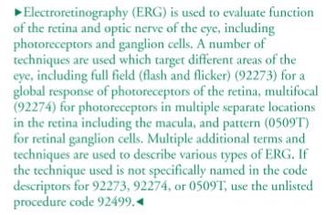

Slide 105
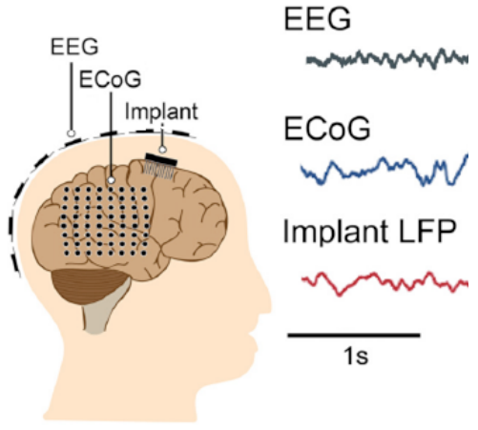
Electrocardiogram
In the Electrocorticography section, CPT 95836 (electrocardiogram) was added to report recording of ECoG from electrodes chronically implanted on or in the brain to allow for intracranial recordings to continue after the patient has been discharged from the hospital.

Slide 106
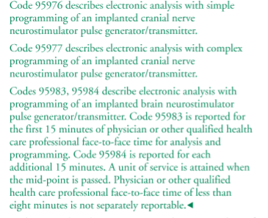
Implanted Neurostimulator Pulse Generator/Transmitter with Programming
A group of new codes (95976-95984) describe services related to implanted neurostimulator pulse generator/transmitter.
Codes are selected based on the nerve selected and simple versus complex.

Slide 107
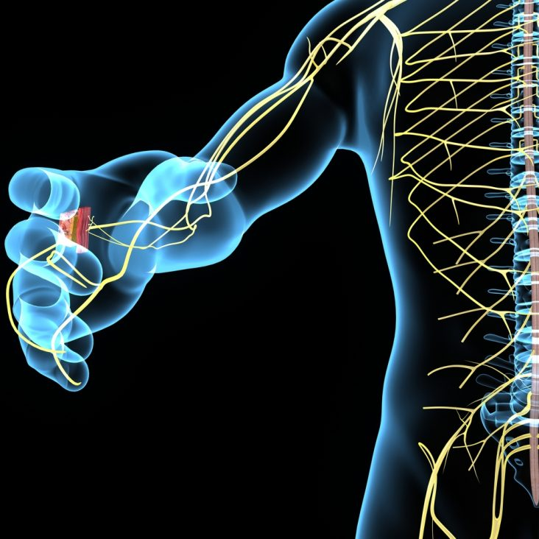
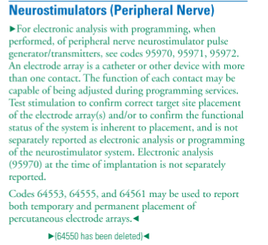

Slide 108
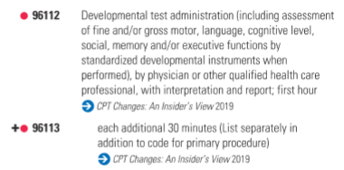
Developmental Testing
96111 (deleted) - Developmental testing, (includes assessment of motor, language, social, adaptive, and/or cognitive functioning by standardized developmental instruments) with interpretation and report

Slide 109
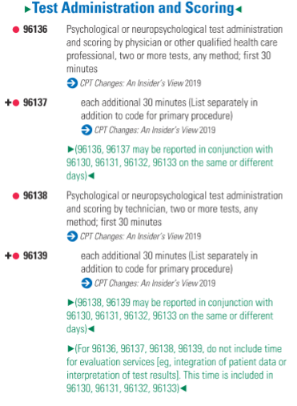
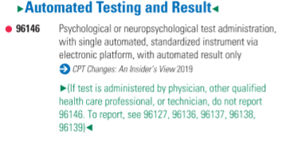
CPT codes 96136-96139 were added to report psychological or neuropsychological report testing and scoring. Codes are based on time and whether the service was performed by a technician or clinician. CPT code 96146 is used to report psychological or neuropsychological automated testing using an electronic platform.

Slide 110
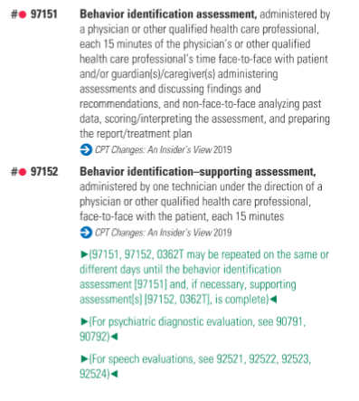
Adaptive Behavior Assessment

Slide 111
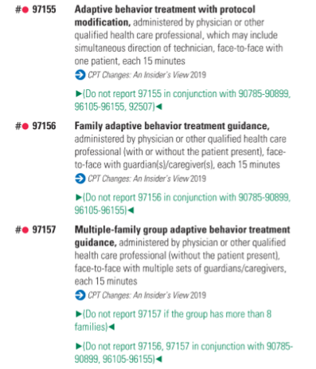
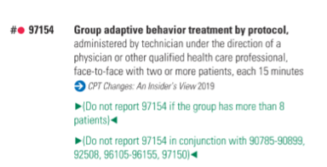
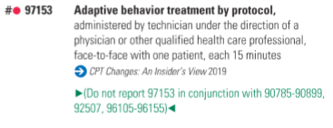
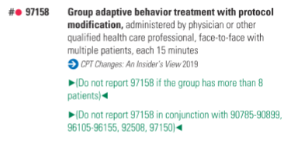
Adaptive Behavior Treatment

Slide 112
ICD-10 Updates

Slide 113
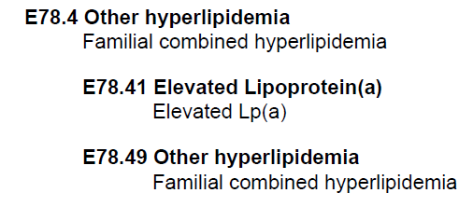
Chapter 4

Slide 114
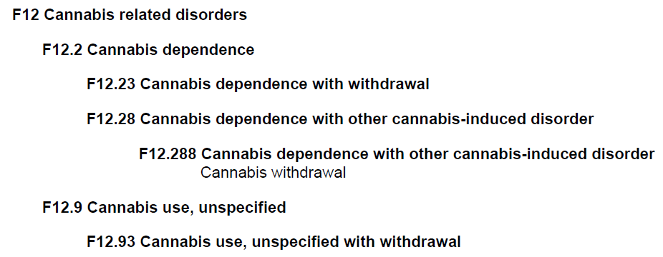
Chapter 5

Slide 115

Chapter 9

Slide 116


Chapter 11

Slide 117

Chapter 13

Slide 118

Chapter 15

Slide 119

Chapter 21

Slide 120
Topics
QPP and MACRA Update
EM Changes now and in the Future
Surgery Section
Radiology Changes
Pathology Changes
Medicine Section Changes
ICD-10 Updates

Slide 121
Questions

Slide 122
Contact Me
Direct: 706-483-4728
E-Fax: 770-709-3698
E-mail: steve.adams@inhealthps.com
Web: www.thecodingeducator.com
FB: facebook.com/kingofcoders
Twitter: @thekingofcoders

