Slide 1

Compliant E/M Coding
Doing It Right the First Time

Slide 2
Topics
E/M Coding
  Incident To
  Shared Visits
  New Office Visits
  Established Office Visits
  Consultations
  Modifiers

Slide 3
2019 E&M
Coding Changes

Slide 4

Chief Complaint and HPI
Additionally, we are clarifying that for E/M office/outpatient visits, for new and established patients for visits, practitioners need not re-enter in the medical record information on the patient’s chief complaint and history that has already been entered by ancillary staff or the beneficiary. The practitioner may simply indicate in the medical record that he or she reviewed and verified this information; and

Slide 5
We proposed to expand this policy to further simplify the documentation of history and exam for established patients such that, for both of these key components, when relevant information is already contained in the medical record, practitioners would only be required to focus their documentation on what has changed since the last visit or on pertinent items that have not changed, rather than re-documenting a defined list of required elements such as review of a specified number of systems and family/social history. Practitioners would still review prior data, update as necessary, and indicate in the medical record that they had done so. Practitioners would conduct clinically relevant and medically necessary elements of history and physical exam, and conform to the general principles of medical record documentation in the 1995 and 1997 guidelines. However, practitioners would not need to re-record these elements (or parts thereof) if there is evidence that the practitioner reviewed and updated the previous information.

Slide 6


Review and Update
For established patient office/outpatient visits, when relevant information is already contained in the medical record, practitioners may choose to focus their documentation on what has changed since the last visit, or on pertinent items that have not changed, and need not re-record the defined list of required elements if there is evidence that the practitioner reviewed the previous information and updated it as needed. Practitioners should still review prior data, update as necessary, and indicate in the medical record that they have done so.

Slide 7

Teaching Physicians and Residents
Removal of potentially duplicative requirements for notations in medical records that may have previously been included in the medical records by residents or other members of the medical team for E/M visits furnished by teaching physicians.

Slide 8
New HCPCS Codes for 2019
Brief communication technology-based service, e.g. virtual check-in (HCPCS code G2012) and
Remote evaluation of recorded video and/or images submitted by an established patient (HCPCS code G2010)

Slide 9
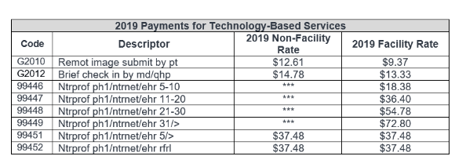

Slide 10
G2012
(Brief communication technology-based service, e.g. virtual check-in, by a physician or other qualified health care professional who can report evaluation and management services, provided to an established patient, not originating from a related E/M service provided within the previous 7 days nor leading to an E/M service or procedure within the next 24 hours or soonest available appointment; 5-10 minutes of medical discussion)

Slide 11
G2010
(Remote evaluation of recorded video and/or images submitted by an established patient (e.g., store and forward), including interpretation with follow-up with the patient within 24 business hours, not originating from a related E/M service provided within the previous 7 days nor leading to an E/M service or procedure within the next 24 hours or soonest available appointment)

Slide 12
Definitions
Practitioners could be separately paid for the brief communication technology-based service when the patient checks in with the practitioner via telephone or other telecommunications device to decide whether an office visit or other service is needed. This would increase efficiency for practitioners and convenience for beneficiaries.
Similarly, the service of remote evaluation of recorded video and/or images submitted by an established patient would allow practitioners to be separately paid for reviewing patient-transmitted photo or video information conducted via pre-recorded “store and forward” video or image technology to assess whether a visit is needed.

Slide 13
2021 Changes
Reduction in the payment variation for E/M office/outpatient visit levels by paying a single rate for E/M office/outpatient visit levels 2 through 4 for established and new patients while maintaining the payment rate for E/M office/outpatient visit level 5 in order to better account for the care and needs of complex patients;

Slide 14
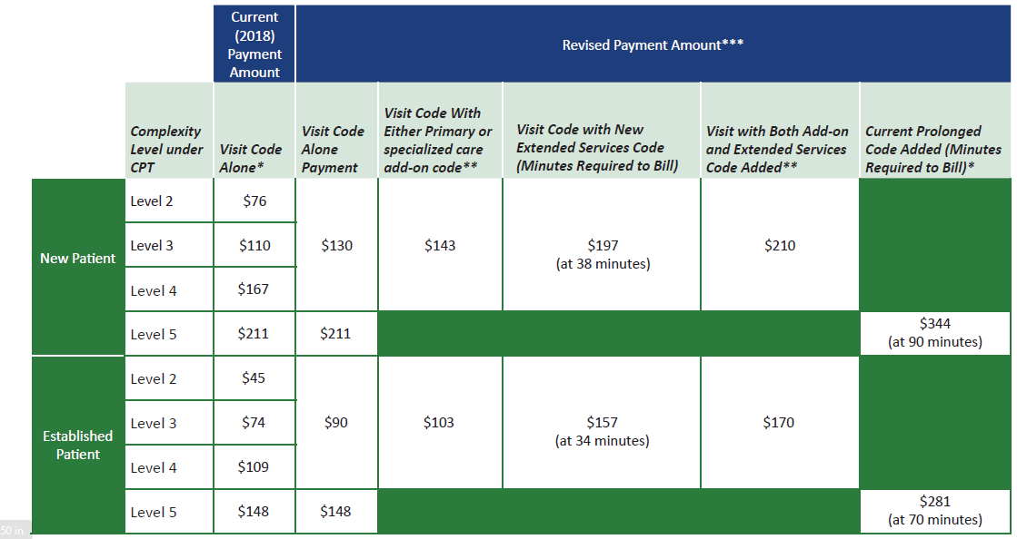

Slide 15
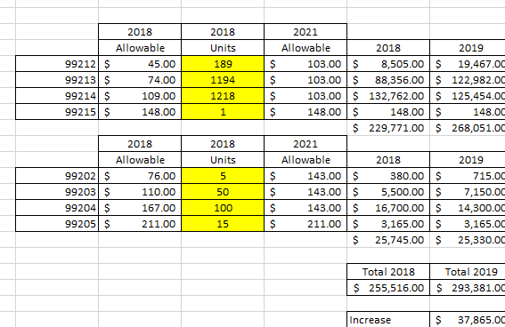

Slide 16

2021 Changes
Permitting practitioners to choose to document E/M office/outpatient level 2 through 5 visits using medical decision-making or time instead of applying the current 1995 or 1997 E/M documentation guidelines, or alternatively practitioners could continue using the current framework;

Slide 17
2021 Changes
Beginning in CY 2021, for E/M office/outpatient levels 2 through 5 visits, we will allow for flexibility in how visit levels are documented - specifically, a choice to use the current framework, MDM, or time. For E/M office/outpatient level 2 through 4 visits, when using MDM or current framework to document the visit, we will also apply a minimum supporting documentation standard associated with level 2 visits. For these cases, Medicare would require information to support a level 2 E/M office/outpatient visit code for history, exam and/or medical decision-making;

Slide 18
2021 Changes
When time is used to document, practitioners will document the medical necessity of the visit and that the billing practitioner personally spent the required amount of time face-to-face with the beneficiary;

Slide 19
2021 Changes
Implementation of add-on codes that describe the additional resources inherent in visits for primary care and particular kinds of non-procedural specialized medical care, though they would not be restricted by physician specialty. These codes would only be reportable with E/M office/outpatient level 2 through 4 visits, and their use generally would not impose new per-visit documentation requirements.

Slide 20
2021 Changes
Adoption of a new “extended visit” add-on code for use only with E/M office/outpatient services. To report extended time for E/M office and other outpatient E/M services when face-to-face time exceeds 34 minutes for an established patient or 38 minutes for a new patient whose E/M service is reported as level 2 through 4 and to report a level 5 code with prolonged service add-on code when face-to-face time exceeds 69 minutes for established patients or 89 minutes for new patients.

Slide 21
Incident To
&
Shared Visit

Slide 22

Incident To Billing (office)
Four standard criteria:
  Physician must be in office
  Must be an established patient
  Must not change anything from previous plan of care
  Doctor should see patient every 3rd or 4th visit (shows active participation)

Slide 23
Shared Visits (hospital)
Two standard criteria:
  NPP sees patient and documents note
  MD sees patient and documents “mini” hx, exam and MDM on same date
  “have to document something more than – seen and agreed –”

Slide 24
E&M Coding

Slide 26
Medical Necessity
Medical necessity of a service is the overarching criterion for payment in addition to the individual requirements of a CPT code. It would not be medically necessary or appropriate to bill a higher level of evaluation and management service when a lower level of service is warranted. The volume of documentation should not be the primary influence upon which a specific level of service is billed. Documentation should support the level of service reported. The service should be documented during, or as soon as practicable after it is provided in order to maintain an accurate medical record.

Slide 27
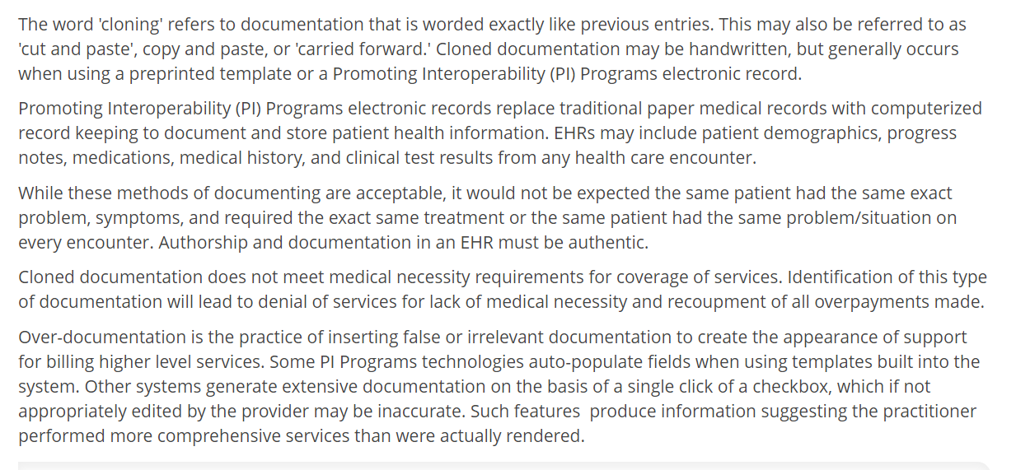

Slide 28
Office – Outpatient Services

Slide 29
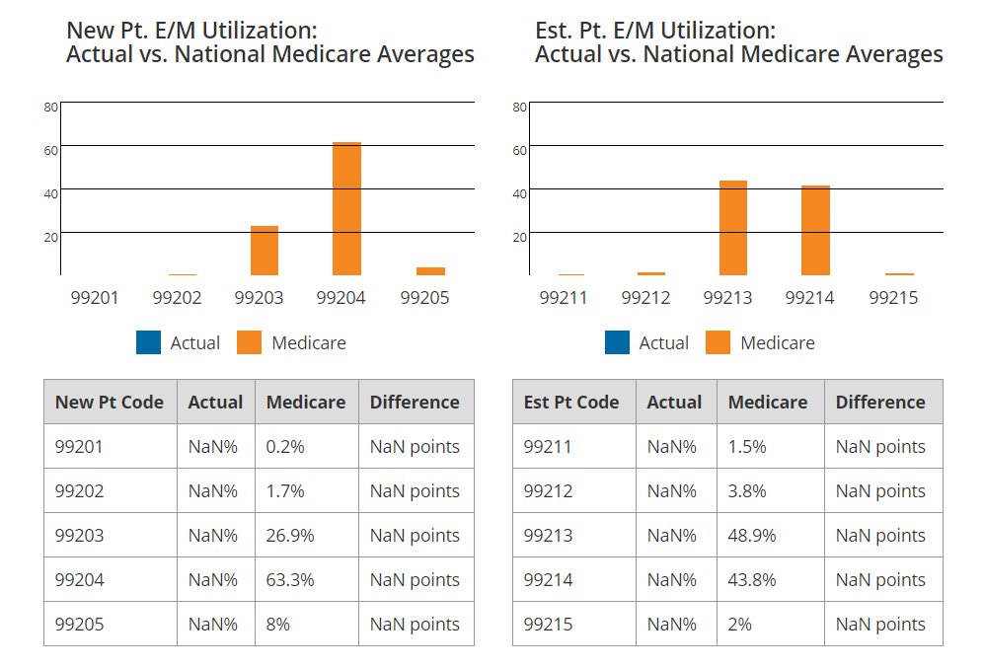
Pain Management

Slide 30
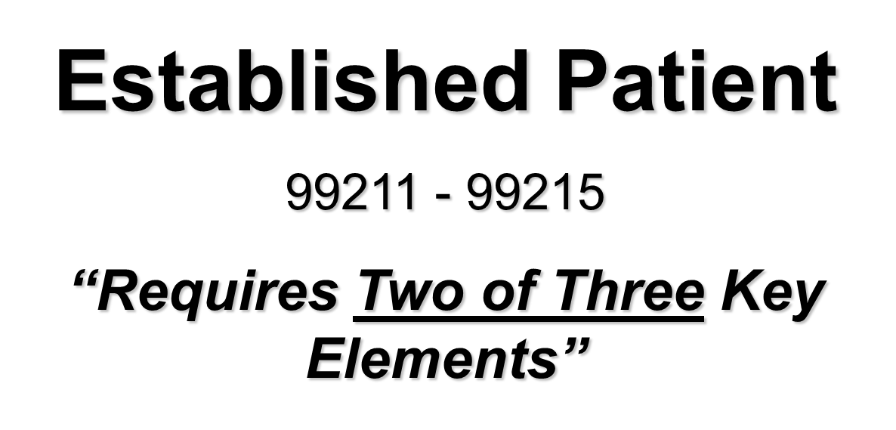

Slide 31

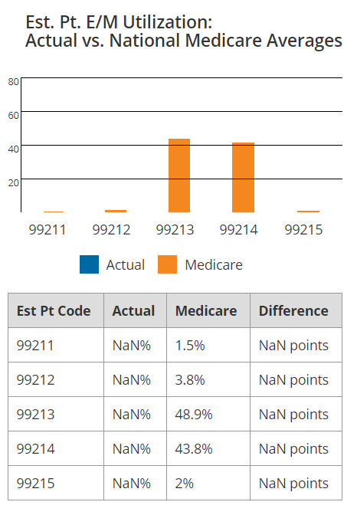

Slide 32

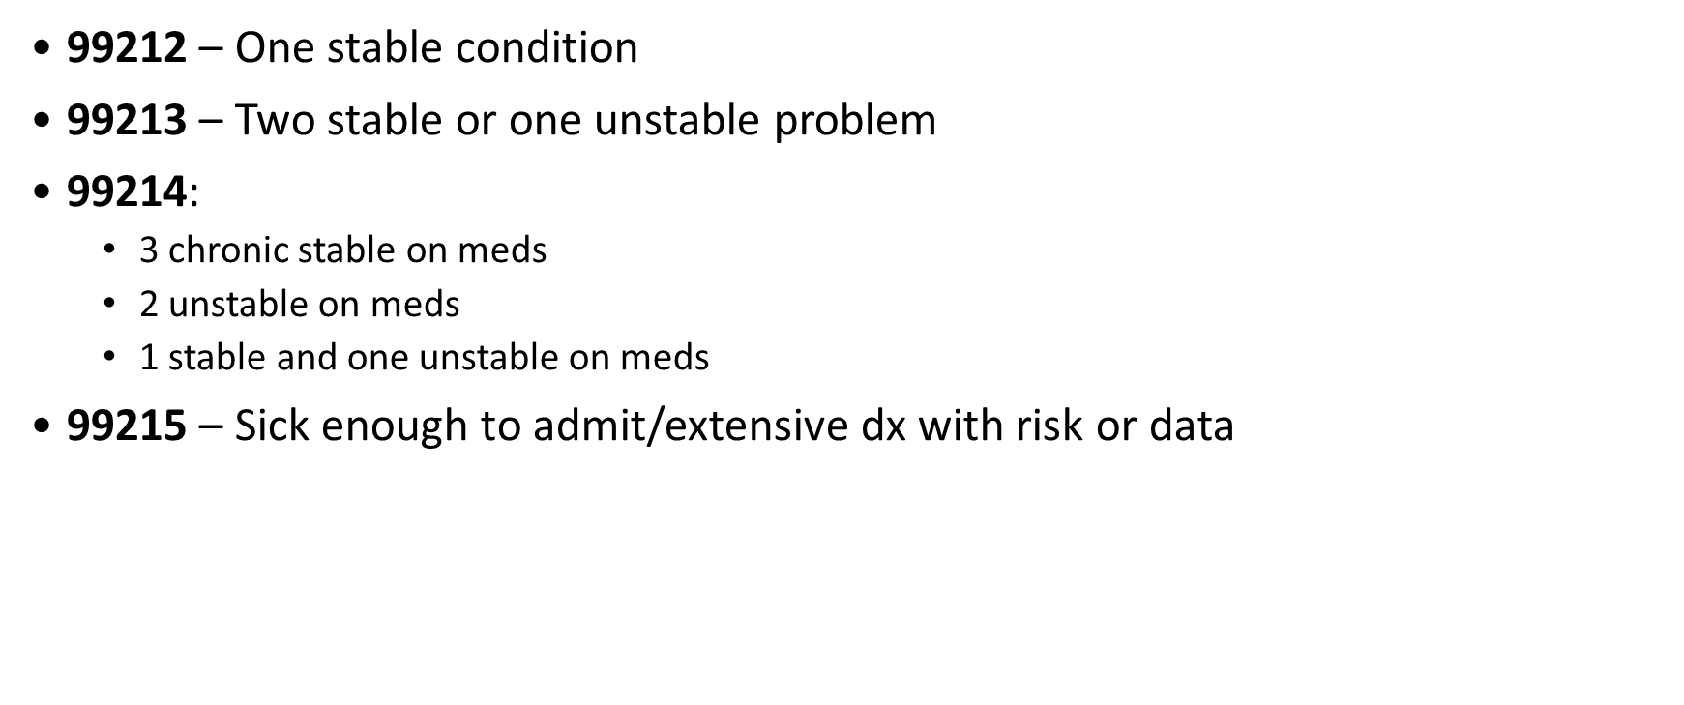


Slide 33
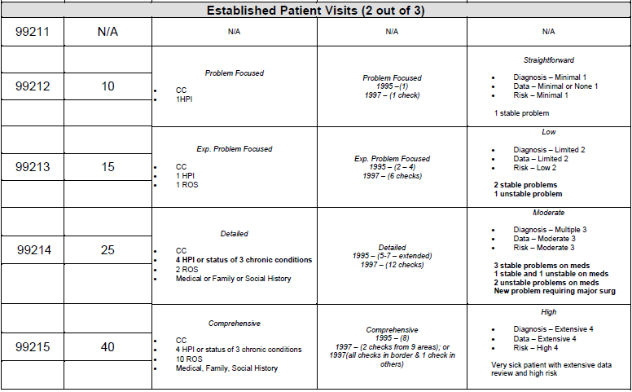
)
)

Slide 35
History

Slide 36
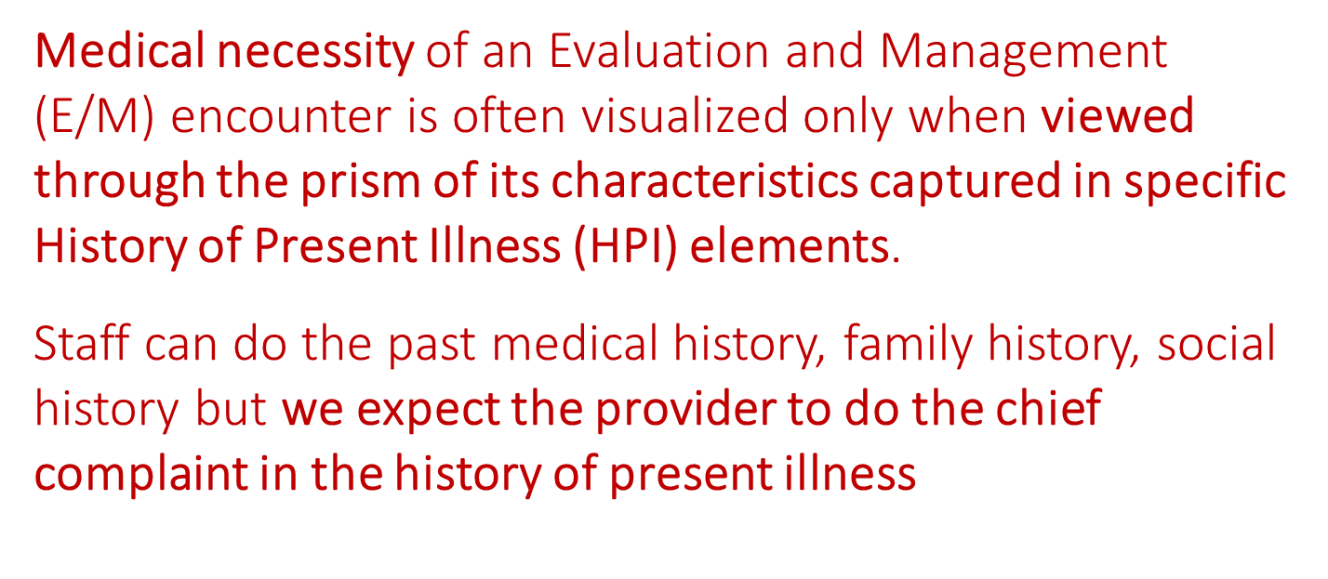

Slide 37
HPI / Assessment / Plan
The HPI outlines those elements that will be discussed today
Status of 3+ Chronic / Inactive Conditions:
      HPI – what patient thinks
      A/P – what provider thinks
Should match the Impression, Assessment and Plan

Slide 38
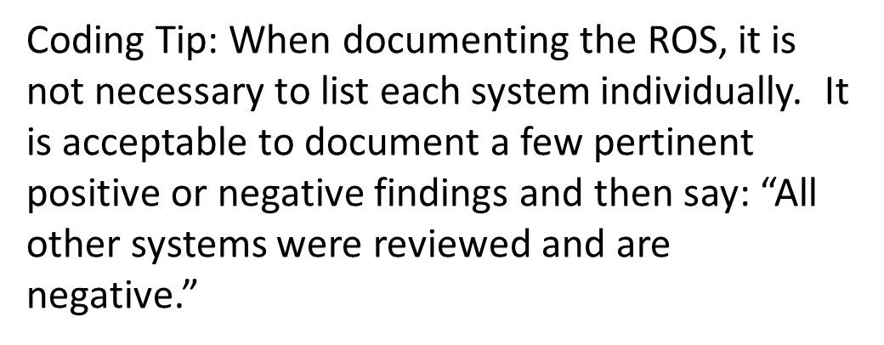

Slide 39

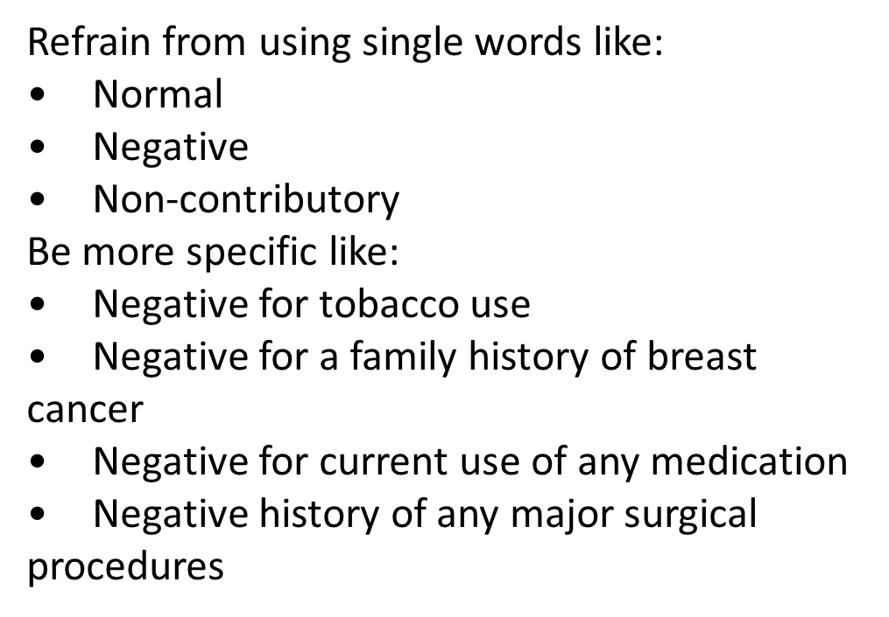

Slide 40
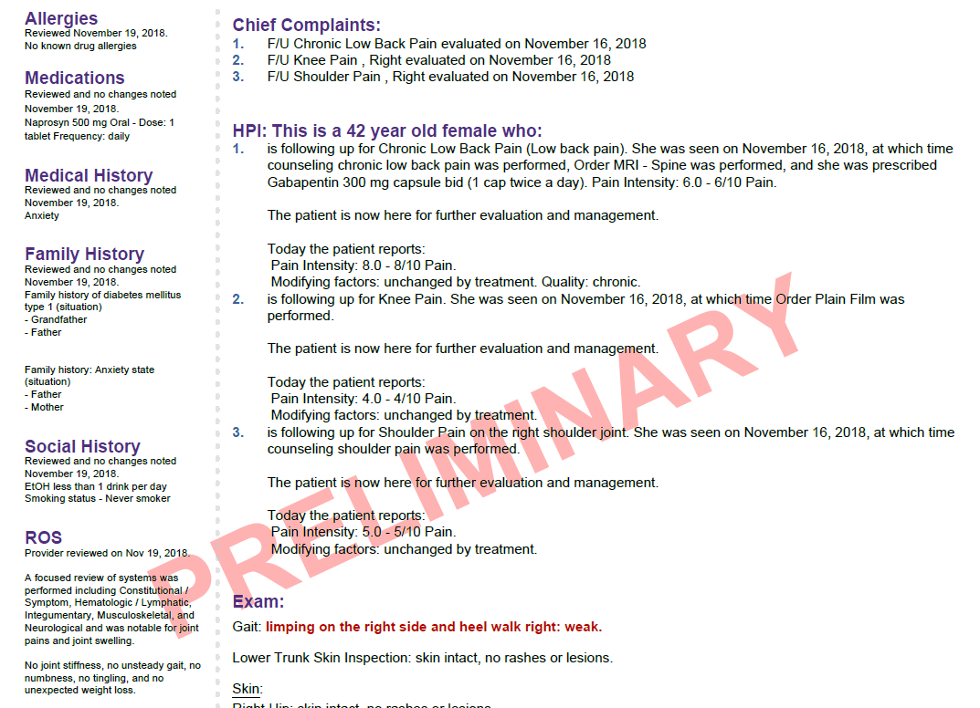

Slide 41
Exam

Slide 42
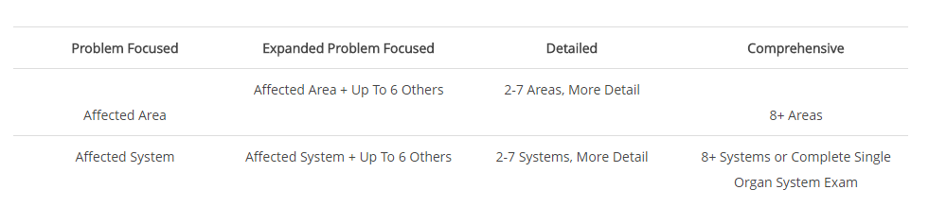
Expanded vs. Extended

Slide 43
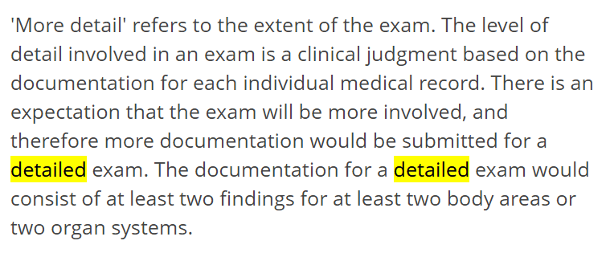
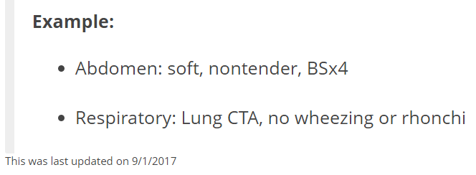
Palmetto and Detailed Examination

Slide 44
1995 – Comprehensive (8)
Const: Vital signs listed above. Well developed, well nourished and in no acute distress. Alert and oriented X’s 3. No mood disorders noted, calm affect.
Eyes: Sclera white, conjunctiva clear, lids are without lag. PERRLA. Pupils and irises are equal and round without defect.
ENT: TMs intact and clear, normal canals, grossly normal hearing. Oropharanx clear and moist without erythema. Gums pink, good dentition.
Lymph/Neck: No masses, thyromegaly, or abnormal cervical notes. No bruit. Tracheal midline.
Cardio: RRR, Normal S1, S2 w/o murmurs, rubs or gallops. Skin warm and dry. No peripheral edema.
Respiratory: Chest symmetrical, respirations non-labored. No dullness or flatness. Clear bilaterally to auscultation, non-tender to palpitation.
Musculo: No deformity or scoliosis noted. No frank gait disturbance noted. No cyanosis or edema. Pulses normal in all 4 extremities. No atrophy or abnormal movements. Appropriate muscle strength bilaterally.
Neurologic: No focal deficits, cranial nerves II-XII grossly intact with normal sensation, reflexes, coordination, muscle strength and tone.
GI/Abdomen: Soft, non tender, non distended, no hepatosplemomegaly, normal bowel sounds, no masses noted.

Slide 45
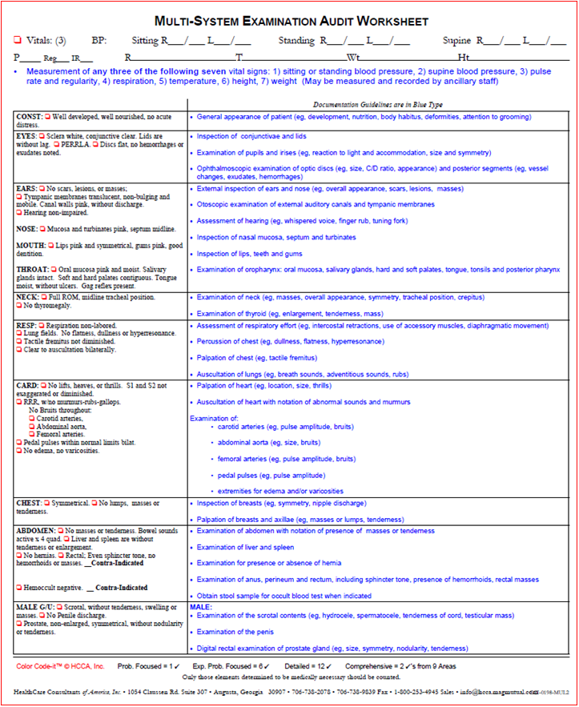
1997 –
Comprehensive
(2 from 9)

Slide 46
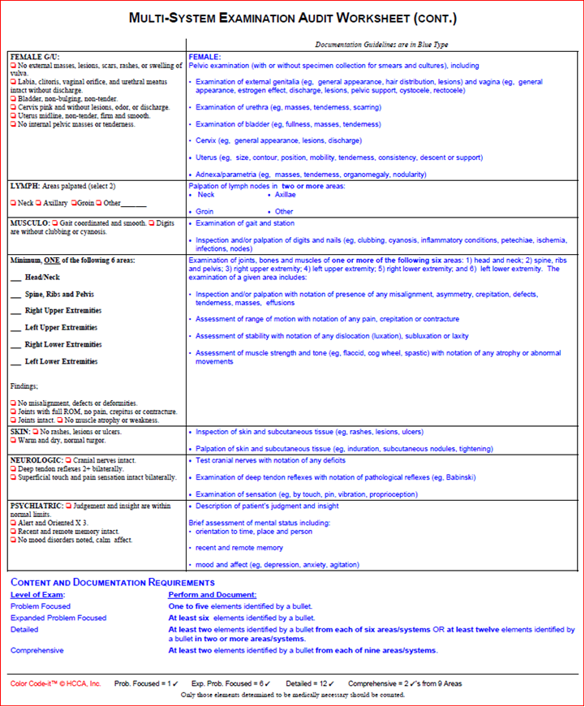
1997 –
Comprehensive
(2 from 9)

Slide 47
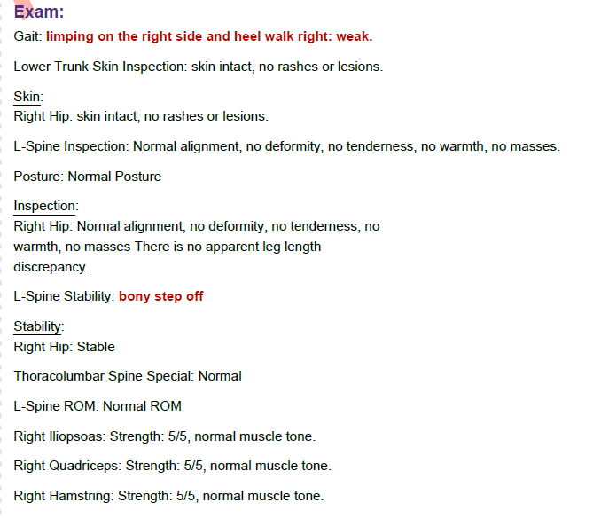

Slide 48
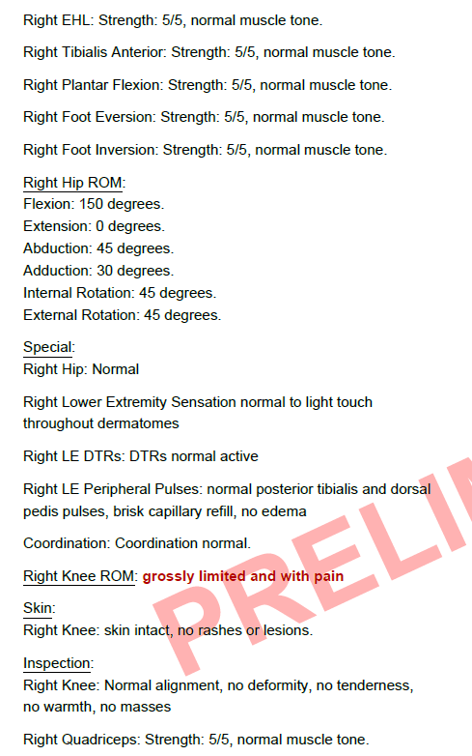

Slide 49
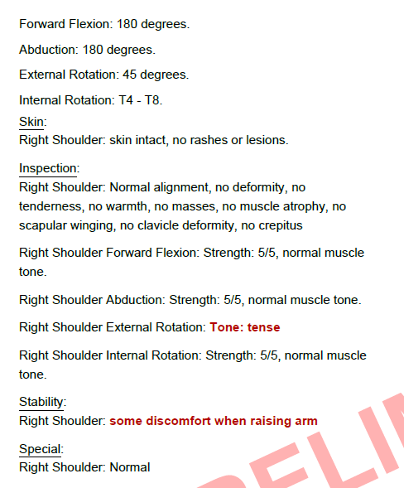

Slide 50
Medical Decision Making

Slide 51
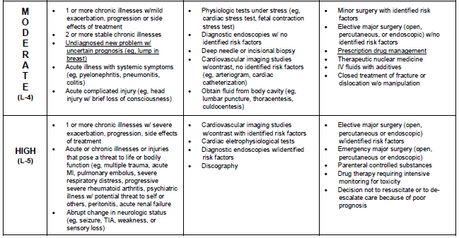
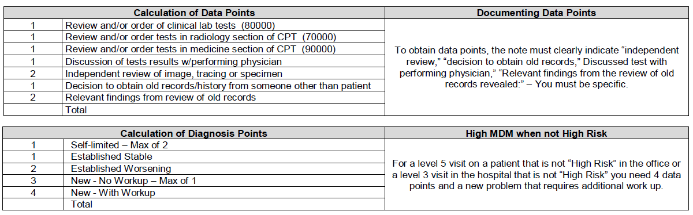
Medical Decision
Making

Slide 52
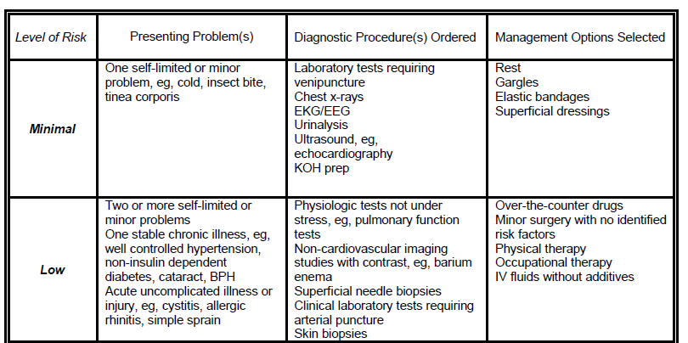

Slide 53
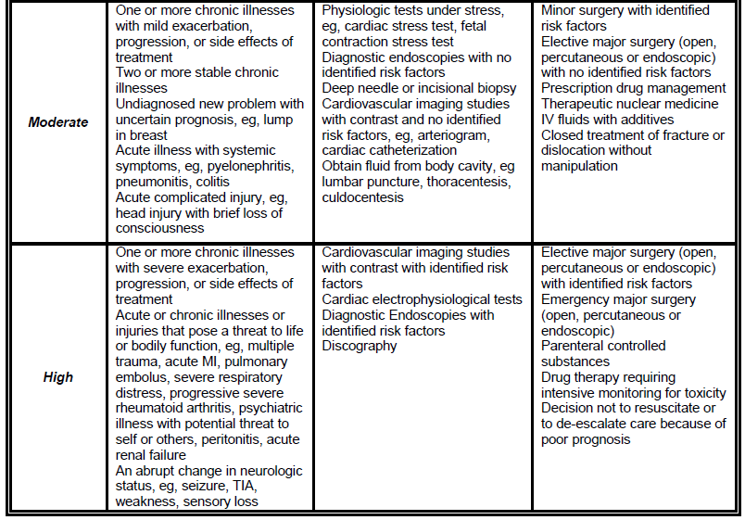

Slide 54
Medical Decision
Making

Slide 55
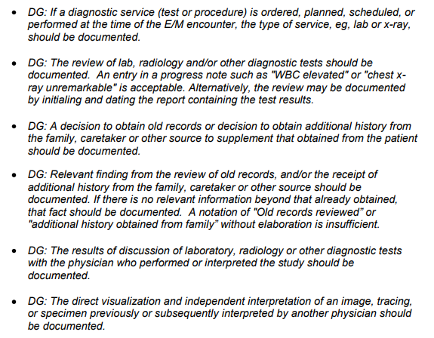
Data Points

Slide 56
Points for Independent Review
“If a provider is billing for the professional component of a test in the radiology and/or medicine section of the Current Procedural Terminology (CPT) Manual and an Evaluation & Management (E/M) procedure code on the same date of service, should that physician receive credit under the Independent Visualization of an image, specimen or tracing component in the Amount and /or Complexity of Data Reviewed Section of the Medical Decision-Making key component of an E/M?
If the provider is billing separately for the interpretation of a test in the radiology and/or medicine section of the CPT, then that same physician should not take credit for the independent visualization of that test in the Amount and /or Complexity of Data Reviewed Section of the Medical Decision-Making key component of an E/M.
The 1995 E/M Documentation Guidelines address this issue on page 13 and state that, "The direct visualization and independent interpretation of an image, tracing or specimen previously or subsequently interpreted by another physician should be documented."

Slide 57
Medical Decision
Making

Slide 58
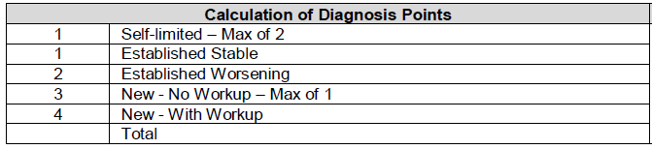
Make sure you make it clear that this is a new or established problem

Slide 59
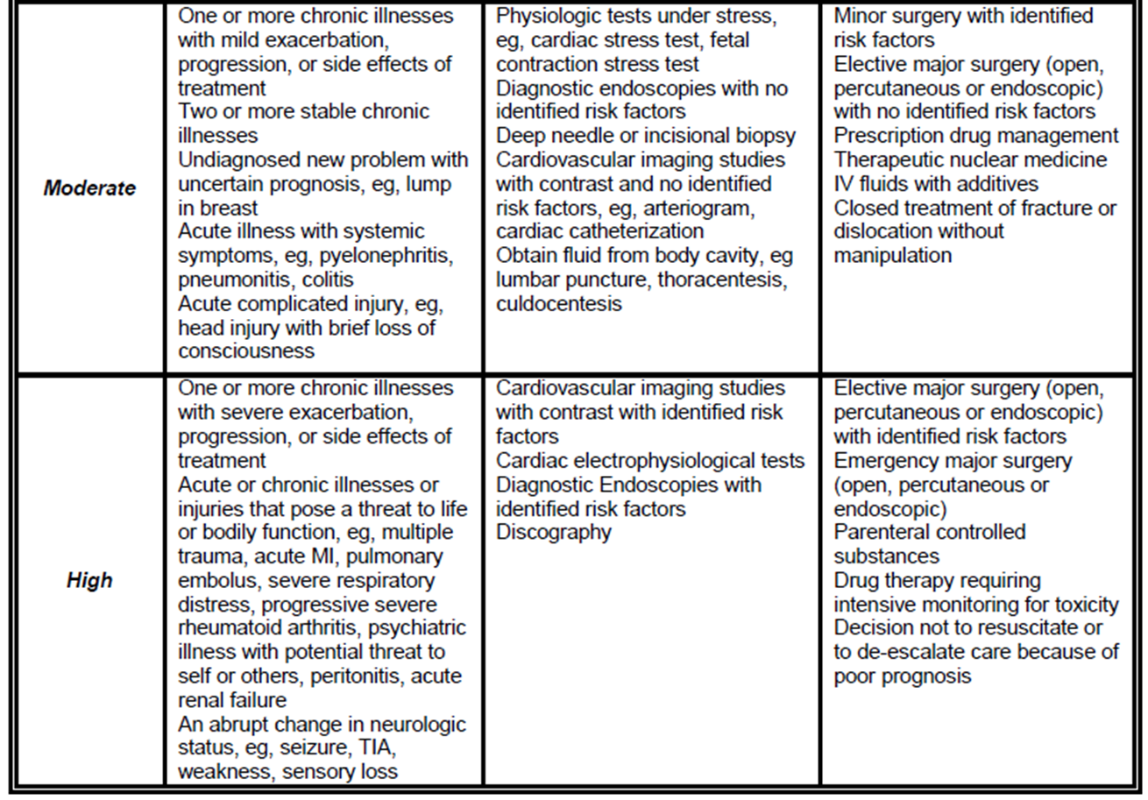

Medical Decision
Making

Slide 60
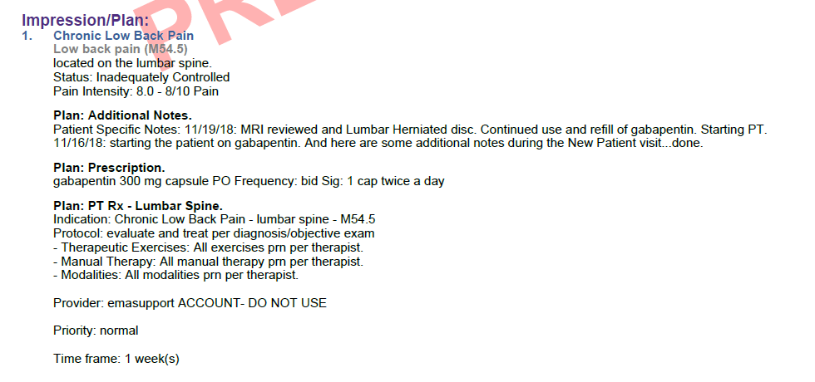

Slide 61
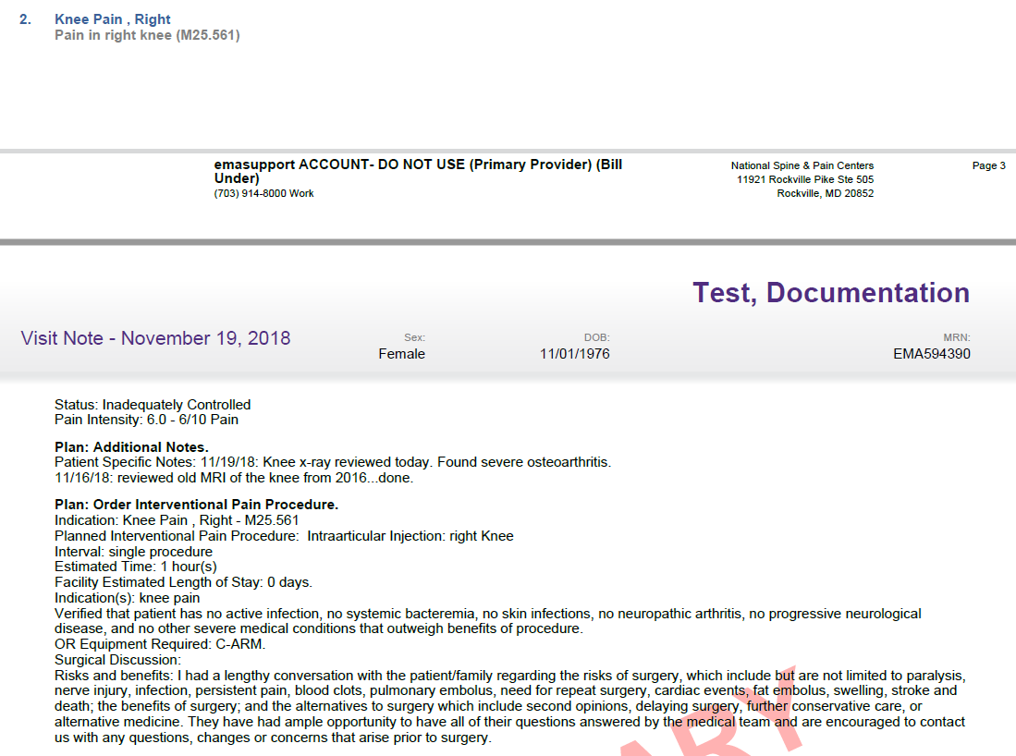

Slide 62
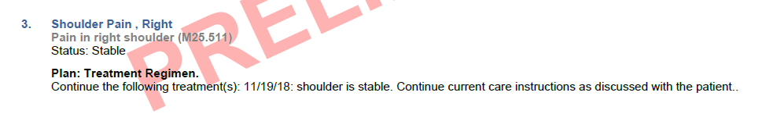

Slide 63
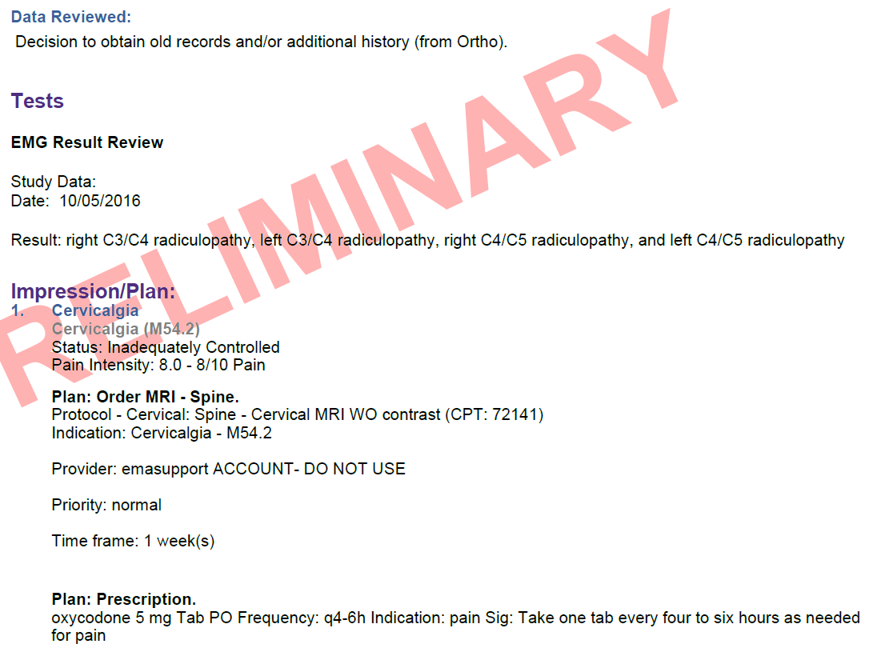
Is this a 99214

Slide 64
High MDM without High Risk
Diagnosis Points (four dx points)
Data Points (four data points)
Diabetes – stable / A1C 6.5
HTN – new onset chest pain / EKG and NST
OSA – stable – continue with BiPap
CKD – stable / has f/u with nephrology
Ordered 83036
Ordered 93000
Ordered 76852
Review of nephrologist notes from last month show no change in CKD 1 dx earlier this year –Nephrologist believes this is most likely related to DM - patient encouraged to lose weight and obtain urine culture due to recent bout of UTI and encouraged to see Urologist

Slide 65
High MDM without High Risk
Diagnosis Points (four dx points)
Data Points (four data points)
Diabetes – stable - 1 point
HTN – new onset chest pain - 2 points
OSA – stable – 1 point
CKD – stable – 1 point
5 points
Ordered 83036 – 1 point
Ordered 93000 – 1 point
Ordered 76852 – 1 point
Review and summarize old records – 2 points
5 points

Slide 66
Counseling Dominated
3 standard criteria for time:
  Total Face-to-Face time of provider
  That more than 50% was counseling
  Topics you discussed
“If the level of care is being based on time spent with the patient for counseling/coordination of care documentation should support the time for the visit and the documentation must support in sufficient detail the nature of the counseling”

Slide 68
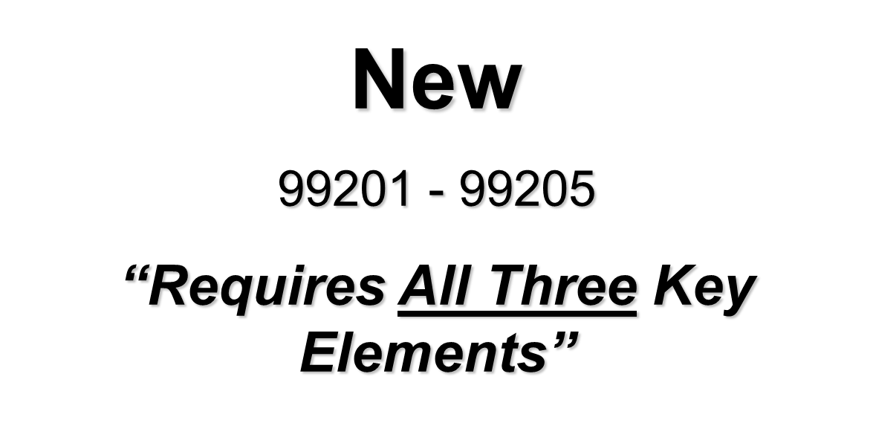

Slide 69
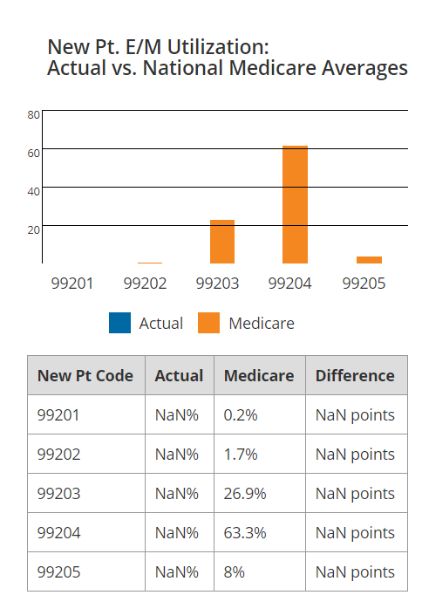

Slide 70

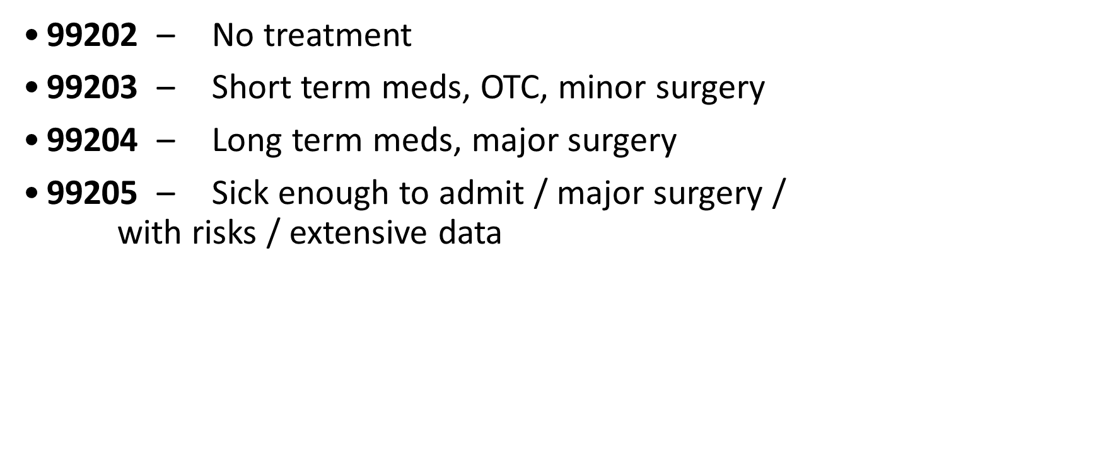

Slide 71
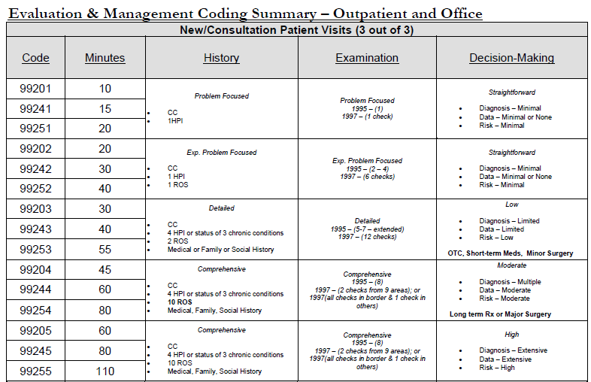
)
)

Slide 72
Exam

Slide 73
1995 – Comprehensive (8)
Const: Vital signs listed above. Well developed, well nourished and in no acute distress. Alert and oriented X’s 3. No mood disorders noted, calm affect.
Eyes: Sclera white, conjunctiva clear, lids are without lag. PERRLA. Pupils and irises are equal and round without defect.
ENT: TMs intact and clear, normal canals, grossly normal hearing. Oropharanx clear and moist without erythema. Gums pink, good dentition.
Lymph/Neck: No masses, thyromegaly, or abnormal cervical notes. No bruit. Tracheal midline.
Cardio: RRR, Normal S1, S2 w/o murmurs, rubs or gallops. Skin warm and dry. No peripheral edema.
Respiratory: Chest symmetrical, respirations non-labored. No dullness or flatness. Clear bilaterally to auscultation, non-tender to palpitation.
Musculo: No deformity or scoliosis noted. No frank gait disturbance noted. No cyanosis or edema. Pulses normal in all 4 extremities. No atrophy or abnormal movements. Appropriate muscle strength bilaterally.
Neurologic: No focal deficits, cranial nerves II-XII grossly intact with normal sensation, reflexes, coordination, muscle strength and tone.
GI/Abdomen: Soft, non tender, non distended, no hepatosplemomegaly, normal bowel sounds, no masses noted.

Slide 74
Medical Decision
Making

Slide 76
Consultations

Slide 77
Consults
Another provider is requesting your opinion and advice – Don’t bill consultation codes if the intent of the requesting provider is to transfer care
When billing a consult – you are seeing patient for a “consultation” and not a “referral”

Slide 78
Consults
99241 - 99255
“Requires All Three Key Elements”

Slide 79
New/Consultation Patient Visits (3 out of 3)
Code | Minutes | History | Examination | Decision-Making
99201 | 10 | Problem Focused CC 1HPI | Problem Focused 1995 –(1) 1997 – (1 check) | Straightforward Diagnosis – Minimal Data – Minimal or None Risk – Minimal
99241 | 15
99251 | 20
99202 | 20 | Exp. Problem Focused CC 1 HPI 1 ROS | Exp. Problem Focused 1995 – (2 – 7) 1997 – (6 checks) | Straightforward Diagnosis – Minimal Data – Minimal or None Risk – Minimal
99242 | 30
99252 | 40
99203 | 30 | Detailed CC 4 HPI or status of 3 chronic conditions 2 ROS Medical or Family or Social History | Detailed 1995 – (4-7 – need 4x4) 1997 – (12 checks) | Low Diagnosis – Limited Data – Limited Risk – Low OTC, Short-term Meds, Minor Surgery
99243 | 40
99253 | 55
99204 | 45 | Comprehensive CC 4 HPI or status of 3 chronic conditions 10 ROS Medical, Family, Social History | Comprehensive 1995 – (8) 1997 – (2 checks from 9 areas); or 1997(all checks in border & 1 check in others) | Moderate Diagnosis – Multiple Data – Moderate Risk – Moderate Long term Rx or Major Surgery
99244 | 60
99254 | 80
99205 | 60 | Comprehensive CC 4 HPI or status of 3 chronic conditions 10 ROS Medical, Family, Social History | Comprehensive 1995 – (8) 1997 – (2 checks from 9 areas); or 1997(all checks in border & 1 check in others) | High Diagnosis – Extensive Data – Extensive Risk – High
99245 | 80
99255 | 110

Slide 80
Modifiers

Slide 81
Global Period
0-10 days = minor (-25 on E&M)
90 days = major actually 92 days (-57 on E&M)
MMM = maternity codes
XXX = global concept doesn’t apply (x-ray/lab)
YYY = up to carrier (unlisted codes)
ZZZ = always included in global of another service (add on codes)

Slide 82
Modifier 25 –
EM and minor procedure same day

Slide 83
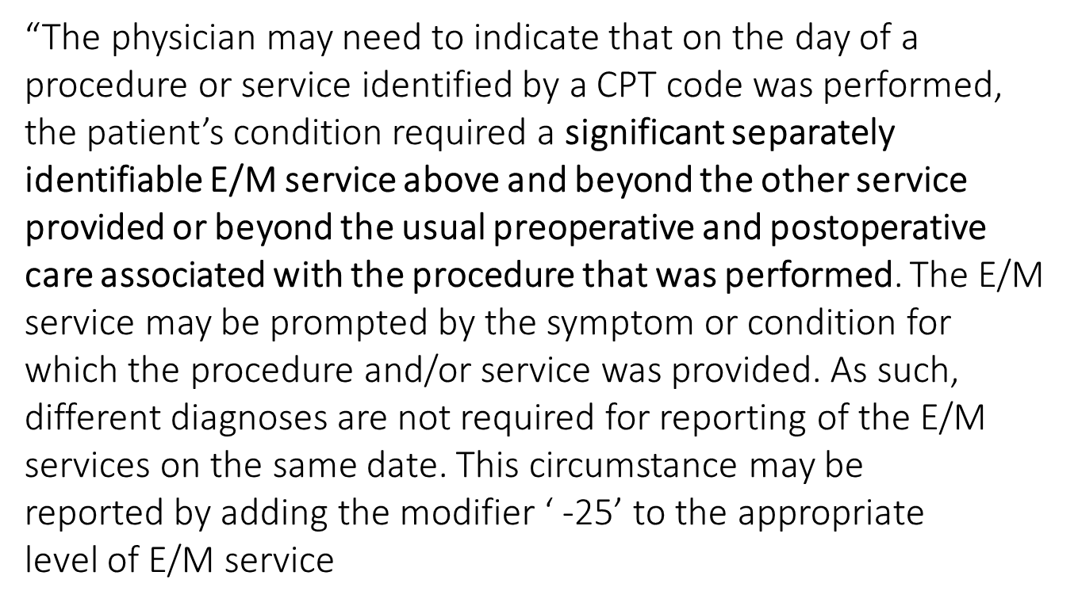
Definition of 25 Modifier

Slide 84
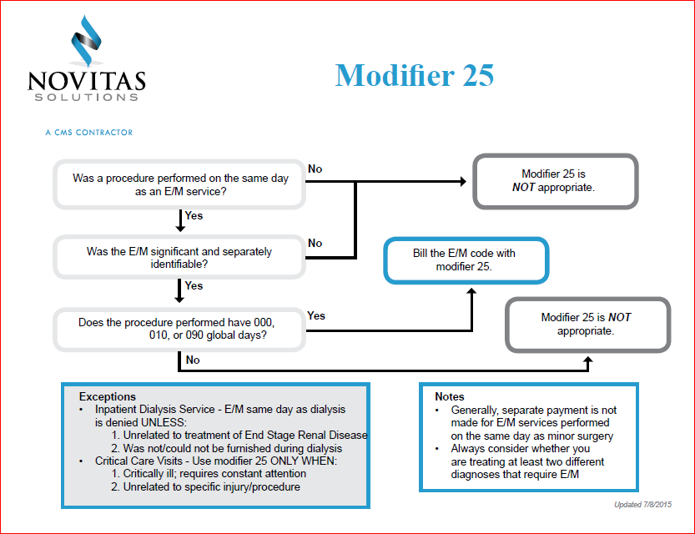
25 Modifier

Slide 85
Topics
E/M Coding
  Incident To
  Shared Visits
  New Office Visits
  Established Office Visits
  Consultations
  Modifiers

Slide 86
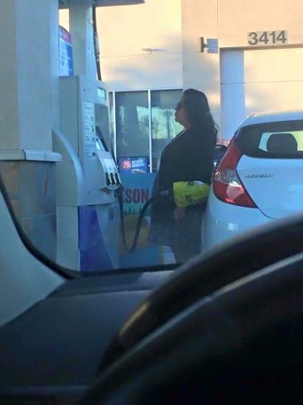
Questions

Slide 87
Contact Me
Direct: 706-483-4728
E-Fax: 770-709-3698
E-mail: steve.adams@inhealthps.com
Web: www.thecodingeducator.com
FB: facebook.com/kingofcoders
Twitter: @thekingofcoders

