Slide 1
Surviving Payment for Performance
Doing It Right the First Time

Slide 2
Payment for Performance

Slide 3
Payment for Performance
The goal of P4P is to improve quality and outcomes for patients. Reaching this goal is based on a set of changes in the way a patient receives care and the way providers quantify that care back to the plan via reporting, validating and coding of services.

Slide 4
(P4P) Quantification of Clinical Information

Slide 5
Most Common P4P Models
Quality Payment Program (QPP)
Accountable Care Organizations (ACO)
Clinically Integrated Network (CIN)
Bundled Payment Models (BPM)
Risk Adjustment Models (HCC and RAF)

Slide 6
2017 AAFP Requests Three Things from President Trump
Elimination/reduction of prior authorizations for certain drugs and supplies for established patients
Elimination of documentation guidelines for evaluation and management codes for primary care physicians
Repeal of the regulatory framework of the promoting interoperability (previously called Advancing Care Information) requirements under the Medicare Access and CHIP Reauthorization Act

Slide 7
Here’s His Response:
May – Direct Provider Payment Model (RFI)
June – Changes to qpp requirements
July – Proposed changes to EM Codes
August – Proposed changes to ACO participation

Slide 8
So even though the “model” might change – the quantification of clinical information will remain the same

Slide 9
QPP - Quality Cat 2 and HCPCS

Slide 10
CMS rewards high value, high quality Medicare clinicians with payment increases - while at the same time reducing payments to those clinicians who aren’t meeting performance standards. TMP

Slide 11
Merit-Based Incentive Payment System (MIPS)
MIPS combines parts of the Physician Quality Reporting System (PQRS), the Value Modifier (VM or Value-based Payment Modifier), and the Medicare Electronic Health Record (EHR) incentive program into one single program:
Quality
Cost
Promoting Interoperability
Advancing Care Information

Slide 12
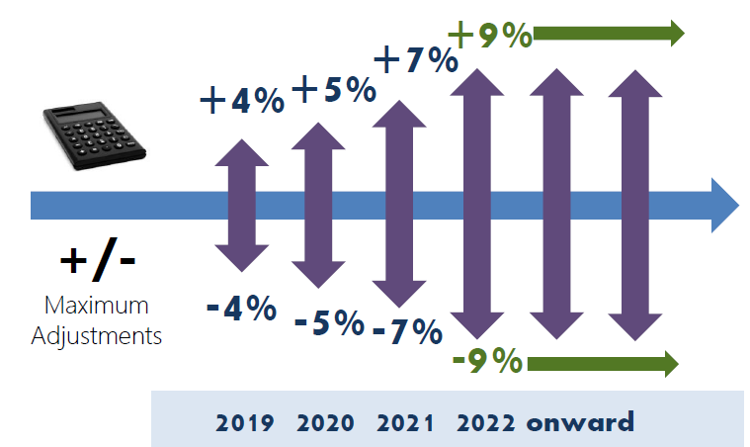

Slide 13
Clinicians have two tracks to choose from in the Quality Payment Program based on their practice size, specialty, location, or patient population:
Merit-based Incentive Payment System (MIPS) or
Advanced Alternative Payment Models (ACO)

Slide 14
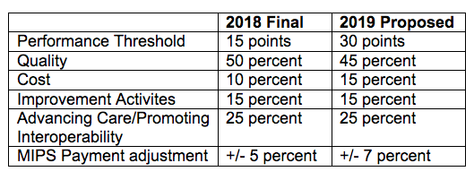

Slide 15
Quality

Slide 16
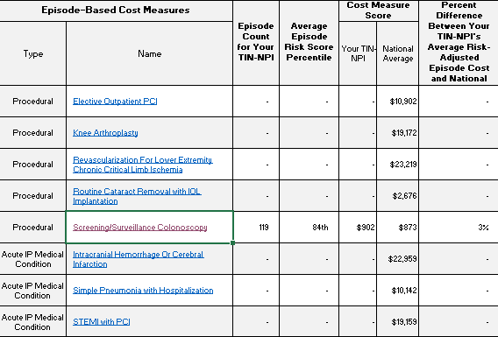
Cost - 2018

Slide 17
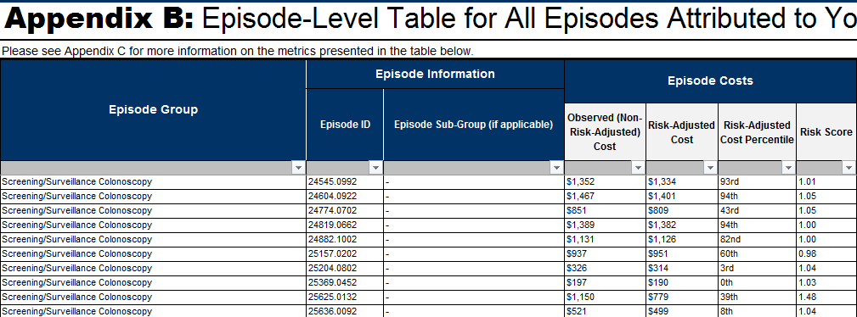
Quality – New for 2018

Slide 18
Accountable Care Organizations Core Measures and Prevention Codes

Slide 19
An ACO is a group of providers—potentially including physicians, hospitals, post-acute providers, and others—who are collectively responsible for the care outcomes of a TMP population.

Slide 20
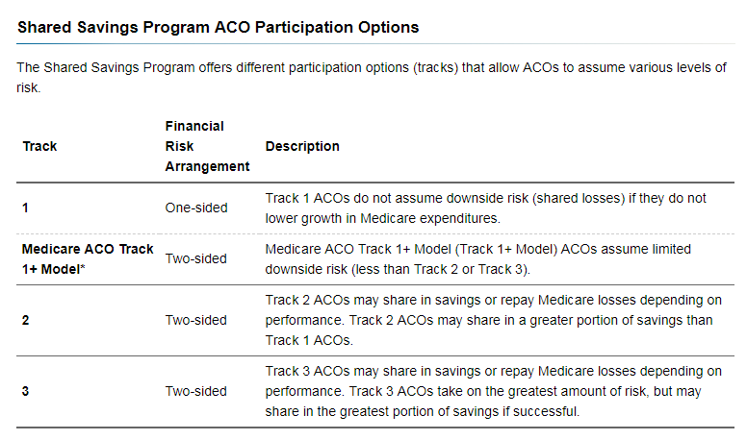

Slide 22
CMS to ACO – Limiting the length of time in Track One
“Indeed, as it stands today, MSSP Track 1 remains by far the most popular option for ACOs. Recently, the National Association of ACOs (NAACOS) surveyed Track 1 ACOs that were entering their third agreement period and found that 71 percent of ACO respondents indicated they are likely to leave the MSSP as a result of having to assume risk.”

Slide 23
Still Have Four Measures
Quality – more measures –
but it’s all providers doing this
Cost – only certain specialties
Promoting Interoperability – on your own
Advancing Care Information – done by ACO

Slide 25
Tobacco Cessation Codes
The CPT Codes:
99406: Smoking and tobacco cessation counseling; intermediate, greater than 3 minutes, up to 10 minutes,
99407: Smoking and tobacco cessation counseling; intensive, greater than 10 minutes,
The Diagnosis Codes
ICD-10 code F17.210 (dependent tobacco use disorder), or
ICD-10 code Z87.891 (history of tobacco use).
If used with E/M, don’t forget modifier 25

Slide 26
Annual Depression Screen
The HCPCS Code
G0444 - Annual Depression Screening – 15 minutes
ICD-10: Z13.89
Frequency: Annually
MCR Reimbursement: $17.13

Slide 27
Preventive Health Services are also a critical component under an ACO Model

Slide 28
Quality Measure

Slide 29
Do You Know These Codes
G0438
G0439
G0442
G0444
G0446
99497
93793

Slide 30
Clinically Integrated Networks Heidis and Prevention

Slide 31
A CIN is basically an ACO for Commercial Insurance (safe harbor) and Managed Care Medicare Plans

Slide 32
Like an ACO
You might have:
Chronic Care Coordinators
Prescription Drug Advocates
Case managers for coding
Transitional Care Coordinators
Annual Well & Preventive Healthcare Staff

Slide 33
More Data for Heidis

Slide 34
“The CIN will help with some CMS QPP issues, but is willing to set aside the APM for CMS and focus on other incentive based programs”

Slide 35
Bundled Payment Care Improvement (BPCI) Cost

Slide 36
Payers typically set the bundled payment amount at the historical price for providing care to a patient undergoing a certain procedure or managing a specific condition.

Slide 39
CMS Findings
We observed a statistically significant decline in Medicare allowed payments for five ACH initiated Model 2 clinical episodes: transient ischemia, MJRLE, medical non-infectious orthopedic, hip and femur procedures except major joint, and urinary tract infection.
In the Year 3 annual report, based on the first two years of the initiative, only MJRLE had a statistically significant decline in Medicare allowed payments. The average reduction in Medicare payments across these five clinical episodes was 6.7% greater than what we would have expected without BPCI.
The statistically significant declines in total payments for the inpatient stay and 90 day post-discharge period were driven by a reduction in PAC utilization, particularly IRF and SNF use…

Slide 40
HCC and Risk Adjustment Models ICD-10 and HCCs

Slide 41
This allows insurance companies an opportunity to forecast future expenditures on each patient within the risk model.

Slide 42
HCC

Slide 43
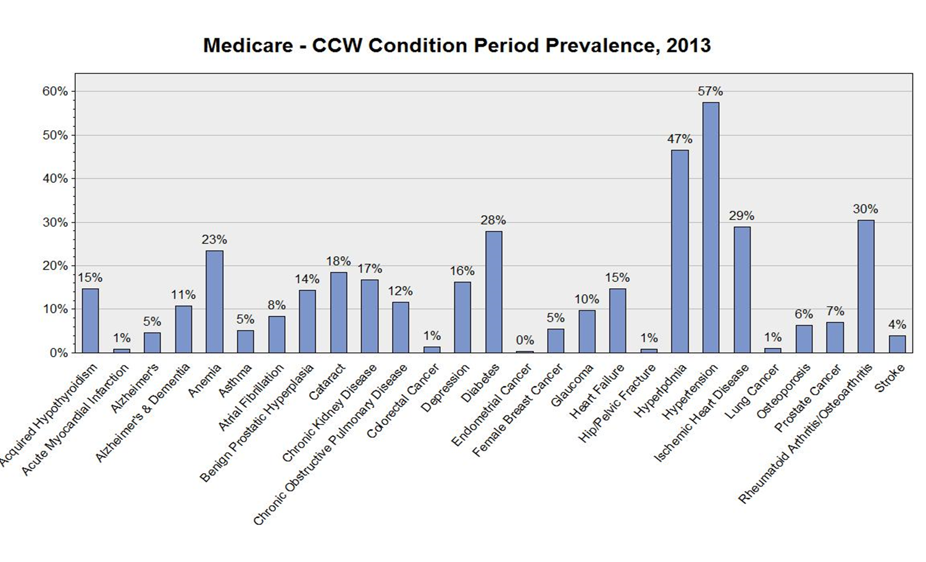

Slide 44
How It Works:
HCC (Hierarchical Condition Category)
▪ Per CMS, the diagnosis codes are recorded per year, meaning each condition must be documented and coded each year.
▪ Diagnoses that demonstrate similar resource usage are categorized together.
▪ CMS designed the equation so that the average Medicare FFS patient has the score of 1.00.
E11.9 ICD-10
19 HCC
RAF Score = .105

Slide 45
Equation
Add Up the total RAF score at the end of the year for a patient (don’t double dip)
Multiply by the conversion factor
.4 x 9,000 = 3,600

Slide 46
Typical Southern Medicare Patient
HTN- I10 Risk Score = 0
DM – E11.9 Risk Score = .105
HPL – E78.2 Risk Score = 0
65 Y/O male Risk Score = .307

Slide 47
Goal
1.0 - 2.0

Slide 48
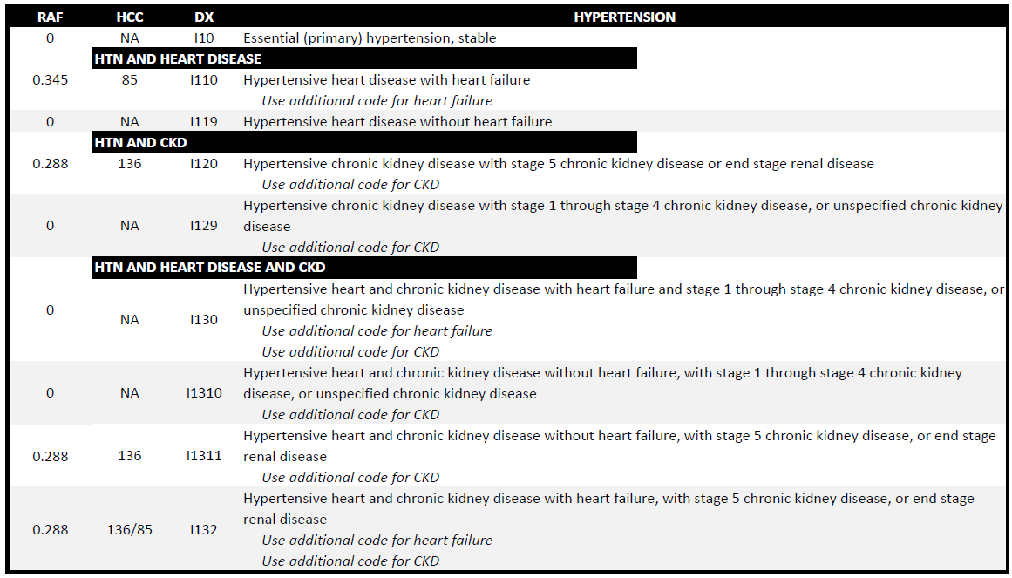

Slide 49
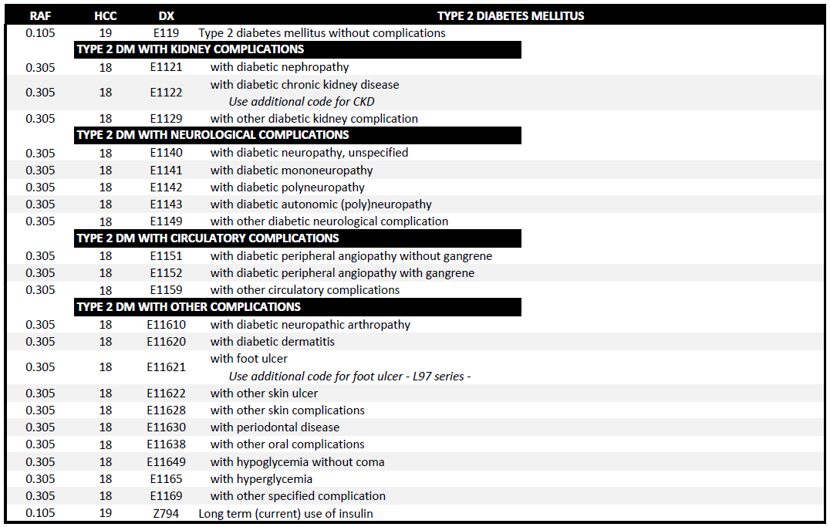

Slide 53
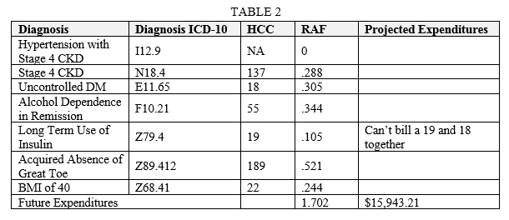

Slide 54
What Do These All Have in Common?

Slide 55
What Have We Learned Today
QPP - Quality – Cat 2 codes/HCPCs codes
QPP - Cost associated with the procedures you perform
ACO - Learn to incorporate HEIDIS into your patient visits
ACO - Bill for every Medicare Preventive service you can
CIN - Don’t forget the rest of your practice – Commercial and Part C Medicare
CIN - Commercial and Part C Medicare bonus programs HEIDIS and Prevention
BPCI - Reduce Costs
HCC - Understand ICD-10 coding to quantify patient’s medical condition
HCC - Validate every chronic condition the patient has

Slide 56
Final Thoughts I Share With My Clients

Slide 57
Three Questions
What is your CIN or ACO doing with “our” shared savings – ask for the formula
Who “owns” your patients – ask leadership – does the ACO or CIN own them?
Who will be signing “my” paycheck?

Slide 58
Discussion Points
Quality Payment Program (QPP)
Accountable Care Organizations (ACO)
Clinically Integrated Network (CIN)
Bundled Payment Models (BPM)
Risk Adjustment Models (HCC and RAF)

Slide 59
Questions?

Slide 60
Any Questions
Direct: 706-483-4728
E-Fax: 770-709-3698
E-mail: steve.adams@inhealthps.com
Web: www.thecodingeducator.com
Twitter: @thekingofcoders
Instagram: kingofcoders
Facebook: facebook.com/kingofcoders

Slide 61
Direct Provider Contracting Model
The Trump administration remains committed to testing alternative payment models. CMS is willing to listen to independent stakeholders as it designs models to test. The direct provider contracting model also presents an opportunity for interested practices to provide input into an innovative new alternative payment initiative.
The DPC Model is a PMPM payment model set up between CMS and primary care physicians.

