Slide 1

Your Local Community Network
Crewkerne and Ilminster LCN
Notes:
LCNs will be able to jointly align the priorities of your community and partners, with the new council priorities. It is through this partnership working and engagement, that we will look to improve outcomes for residents.

Slide 2
Agenda
Apologies
Declaration of interest
Approval of minutes of the last meeting
Public Question Time (anything not covered on the agenda)
Highlights of themes discussed at the last meeting
An introduction to data
Discussion: what are the more detailed issues, how do we know, what does good look like and what can we do with regard to :
a. The state of the roads and road signage
b. Volume and weight of the traffic
c. On street parking
d. Flooding
e. Speeding
f. Events and road closures
g. Diversion of traffic during road closures
Feedback and Q and A
Dates of the next meetings

Slide 3
Highlights and themes from last meeting
Transport
Services
Environmental Issues
Employment and Skills
Communication/
Connectivity
Rural/Social Isolation
Anti-social Behaviour
Highways
Somerset Council
Notes:
LCNs will be able to jointly align the priorities of your community and partners, with the new council priorities. It is through this partnership working and engagement, that we will look to improve outcomes for residents.

Slide 4
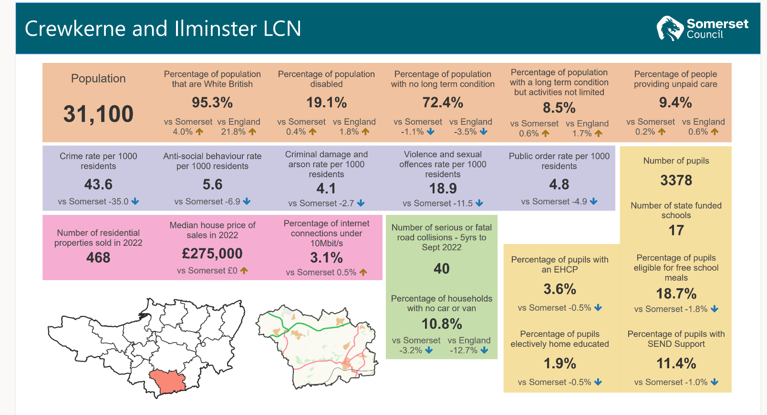

Slide 5
Discussion
What are the more detailed issues, how do we know, what does good look like and what can we do with regard to :
a. The state of the roads and road signage
b. Volume and weight of the traffic
c. On street parking
d. Flooding
e. Speeding
f. Events and road closures
g. Diversion of traffic during road closures

Slide 6
Feedback from tables – Q and A

Slide 7
Dates for future Meetings
Wednesday 15th November
Thursday 18th January

