Slide 1
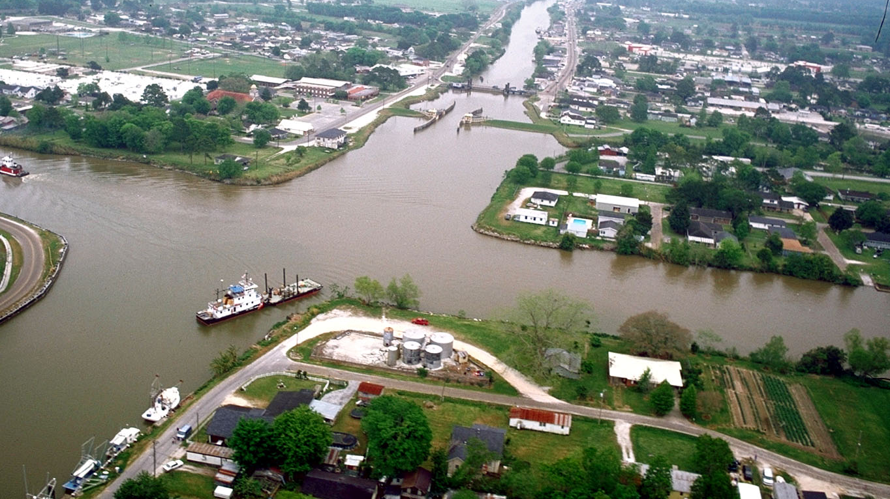
Industrial Chemical Corridor Community Cohort Study - The I 4C (Foresee) Study Edward Trapido etrapi@lsuhsc.edu 504.568.5700
This Photo by Unknown author is licensed under CC BY-SA.
Notes:
Presentation Created by Sarah Grunblatt

Slide 2
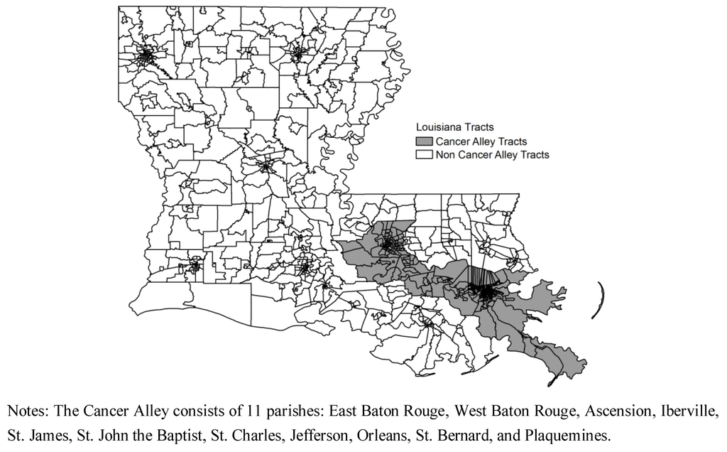
Background
74 million Americans are thought to be at higher cancer risks
Majority of Blacks
Louisiana Industrial corridor (IC)
Inequities in social determinants
Resulting in epigenetic changes, shortening of telomeres, and oxidative stress.
https://www.mdpi.com/1660-4601/9/12/4365/htm

Slide 3
Background
The EPA strives to safeguard the population against cancer risks that are more than 1 in a million, but 74 million Americans are thought to be at higher cancer risks than that, on top of other risk factors.
This projected cancer risk from toxic air pollution is more than twice as high in census tracts with a majority of Blacks as in areas with a majority of Whites.
In the Louisiana Industrial corridor (IC), several areas purportedly have the highest cancer risk in the country, allegedly due to emissions from manufacturing plants and refineries.
While these are potential causes of cancer, the etiology is more complicated than a simple direct causal relationship, likely due to long-standing inequities in social determinants- including racial and socioeconomic disparities, which further influence health behaviors/diets, resulting in epigenetic changes, shortening of telomeres, and oxidative stress.
https://www.mdpi.com/1660-4601/9/12/4365/htm

Slide 4
COHORT OVERVIEW
Notes:
Scientific vision of the cohort
Research gaps that the cohort could address
Study population
w/ Community engagement plan as appropriate

Slide 5
Methodologic Questions #1
What works best to improve recruitment in environmentally justice-challenged communities exhibiting distrust of government and academic entities?
APPROACH:
Enroll 12,500 persons
Multipronged approach:
(1) Clinic based
(2) Community-engaged recruitment
(3) RISE St. James
(4) Media campaign
Which works best at increasing awareness, enrollment, and biospecimen donation?
What messages are most effective?
Does the method have differential impacts on subsets of individuals in a community?

Slide 6
Methodologic Questions #2
How can exposure measures of complex mixtures of industrial VOC, PM, and metal emissions be improved for population studies?
APPROACH:
(1) Generic epidemiological exposure variables
Compared to estimates of exposure from:
Silicon bands for personal chemical exposure assessment.
(2) Technology-based exposure measures
(3) Biomonitoring
Advanced statistical methods and AI
Can low-cost technologies like geolocation apps and passive or active environmental monitors increase the validity of exposure estimates and improve study power to detect associations between exposures and health outcomes when they exist?

Slide 7
Methodologic Questions
1. What works best to improve recruitment in environmentally justice-challenged communities exhibiting distrust of government and academic entities? Which works best at increasing awareness, enrollment, and biospecimen donation? What messages are most effective? Does the method have differential impacts on subsets of individuals in a community?
2. How can exposure measures of complex mixtures of industrial VOC, PM, and metal emissions be improved for population studies? Can low-cost technologies like geolocation apps and passive or active environmental monitors increase the validity of exposure estimates and improve study power to detect associations between exposures and health outcomes when they exist?
Notes:
*********** Delete this slide or the next one ***********

Slide 8
Methodologic Questions
1. What works best to improve recruitment in environmentally justice-challenged communities exhibiting distrust of government and academic entities? Which works best at increasing awareness, enrollment, and biospecimen donation? What messages are most effective? Does the method have differential impacts on subsets of individuals in a community?
APPROACH:
2. How can exposure measures of complex mixtures of industrial VOC, PM, and metal emissions be improved for population studies? Can low-cost technologies like geolocation apps and passive or active environmental monitors increase the validity of exposure estimates and improve study power to detect associations between exposures and health outcomes when they exist?
APPROACH:
Expanding upon the experiences of the Women and Children’s Health (WaTCH) Study (Trapido), the Ochsner- GRAIL Galleri® Multi-Cancer Early Detection Test to Patients at Risk for Cancer (Duesbery), the All of Us Study (Miele), The Pennington Center Longitudinal Study (Katzmarzyk), the LA Superfund Studies (Cormier), and the Cancer Reporting in St John Parish (CRISP) Study (Williams), we shall enroll 12,500 persons.
We shall employ a multipronged approach (Clinic based, community-engaged recruitment, RISE St. James (Katner), and media campaign).
We shall supply enrollees with silicon bands for personal chemical exposure assessment.
These will be compared to estimates of exposure from
(1) Generic epidemiological exposure variables (e.g., residence-source proximity and models of contaminant-specific exposure concentrations at residence);
(2) Technology-based exposure measures (e.g., geolocation apps for concentration*duration; passive monitors [HHEAR], active monitors [purple air, etc.);
(3) Biomonitoring (gold standard) for total VOCs, PM, and metals (urine, saliva, hair, nail clippings).
We will utilize advanced statistical methods and AI to understand the relationships between one, two, and three.

Slide 9
Aim 1: Enrollment Aim 2. SDOH, Environmental, Modifiable Exposures Aim 3.Follow for Health Conditions
INPUTS
HEALTH DISPARITY DRIVERS
INPUTS
MODIFIABLE EXPOSURES
BIOMARKERS
INPUTS
HEALTH
SDoH: Access to Health Services, Food Insecurity, Health Literacy, Occ. Prestige, PA-Neighborhood Environment
Surveys from
Phen-x toolkit
Remote Food Photography Method© and SmartIntake
Diet
Demographic: Address, Age, Ethnicity, Race, Family Income, Birthplace, Employ Status, Education, Health Ins.
Exposome, Methylation Age, Rate of Telomere Shortening
Surveys from
Phen-x toolkit
Cancer
Physical and Sedentary Activity
LTR
Fitbit Charge or similar, Fitabase
Silicone Wristbands, Geolocation app, purple monitors
Environmental: Occ. History, Characteristics of Current residence, Work and daily exposures, Residential History, Climate Change
Blood, (Unpainted) Fingernails, Saliva, Hair, Urine
Obesity
Oxidative Stress, Conserved Transcriptional Response to Stress , Urinary Metabolites of Chemicals
Measure Height, Weight, Waist Circumference
Comorbidities
Self-Reports & EMR
Medical History, Personal and Family History of Cancer, Respiratory Diseases (P), BMI
History, Current Tobacco Use, 2nd Hand Exposure, Lifetime Alcohol Exposure
Surveys from
Phen-x toolkit
Surveys from Phen-x toolkit
ACE, Chronic Stress Scales, ISEL
Chronic Stress, Discrimination, Neighborhood and Traumatic Stress, Interpersonal Support
Notes:
************** Use this slide to edit and take screenshot to put final version on next slide ***************

Slide 10
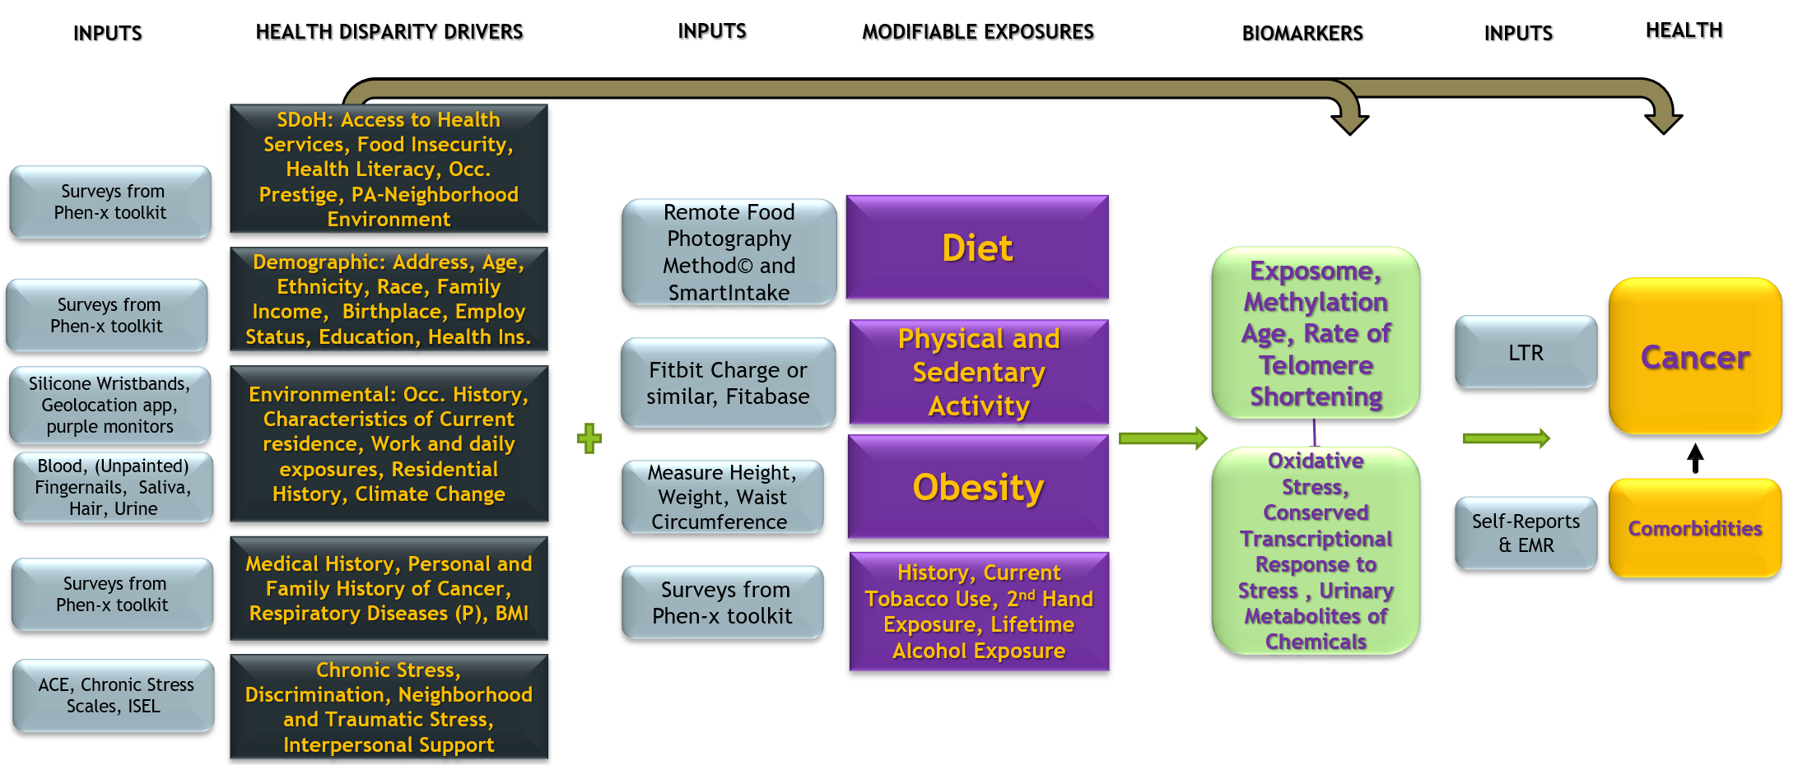
Short-Term Research Questions
What is the relationship between exposures and proximal outcomes?
#1

Slide 11
What is the relationship between exposures and proximal diseases identified risk factors for cancer?
How does the confluence of exposures and risk factors relate to recommended cancer screening guidelines?
Does the attention awareness overlaid on personal exposures and risk factors increase compliance with cancer screenings?
How has climate change impacted individuals with regard to environmental exposures, cancer risk behaviors, and recommended screenings for cancer?
#2
Short-Term Research Questions
#3
#4

Slide 12

What is the relationship between exposures and proximal diseases identified risk factors for cancer?
How does the confluence of exposures and risk factors relate to recommended cancer screening guidelines?
Does the attention awareness overlaid on personal exposures and risk factors increase compliance with cancer screenings?
How has climate change impacted individuals with regard to environmental exposures, cancer risk behaviors, and recommended screenings for cancer?
Short-Term Research Questions
#2
#3
#4
Notes:
*********** Delete this slide or the prior one ***********

Slide 13
Research Gaps to Be Addressed
4. Cancer screening behaviors
1. Expanding the diversity of populations in epidemiologic cohort studies
5. Impact of climate change
3. Relationship between endogenous exposures and multiple cancers and comorbid diseases.
2. Increasing the knowledge of the impact of exogenous exposures

Slide 14
Research Gaps to Be Addressed
2. Increasing the knowledge of the impact of exogenous exposures in the context of social determinants of health, environmental injustice, perceived racism, mutable risk factors, family history of cancer, and gene-environmental interactions on cancer risk.
3. Addressing the gap in our understanding of the relationship between endogenous exposures ad multiple cancers and comorbid diseases.
4. Cancer Screening Behaviors among Individuals Who are Inundated With News About Cancer
5. Impact of Climate Change on hazardous exposures, cancer risk behaviors, cancer screening, delays in medical appointments (and later, on cancer treatment).
1. Expanding the Diversity of Populations in Epidemiologic Cohort Studies: Cancer in Populations Experiencing Environmental Injustice and High Rates of Cancer in the South

Slide 15
Projected Enrollment
and Biospecimens
 | Year 1 | Year 2 | Year 3 | Year 4 | Year 5
Surveys | At least 12,500 enrolled | Remainder to reach 25,000 enrolled | Resurvey Year 1 Enrollees | Resurvey Year 2 Enrollees | Resurvey Year 1 Enrollees
Biospecimens | Half of Year Above | Those enrolled above | Repeat of those providing samples in Year 1 | Repeat of those providing samples in Year 2 | Repeat of those providing samples in Year 1
Goal | 6,250 | 6,250 | 6,250 | 6,250 | 6,250

Slide 16
WORKING CORRELATION STRUCTURE:
Compound symmetry with ρ=0.2 |  | Compound symmetry with ρ=0.5 |  | AR(1) with ρ=0.2 |  | AR(1) with ρ=0.5
Highly exposed group % | Power | Highly exposed group % | Power | Highly exposed group % | Power | Highly exposed group % | Power
5% | 0.6576 | 5% | 0.6846 | 5% | 0.6576 | 5% | 0.6846
6 % | 0.7277 | 6 % | 0.7537 | 6 % | 0.7277 | 6 % | 0.7537
7 % | 0.7834 | 7 % | 0.8076 | 7 % | 0.7834 | 7 % | 0.8076
8 % | 0.8273 | 8 % | 0.8493 | 8 % | 0.8273 | 8 % | 0.8493
9 % | 0.8618 | 9 % | 0.8815 | 9 % | 0.8618 | 9 % | 0.8815
10 % | 0.8890 | 10 % | 0.9063 | 10 % | 0.8890 | 10 % | 0.9063
20 % | 0.9821 | 20 % | 0.9867 | 20 % | 0.9821 | 20 % | 0.9867
30 % | 0.9939 | 30 % | 0.9957 | 30 % | 0.9939 | 30 % | 0.9957
40 % | 0.9958 | 40 % | 0.9971 | 40 % | 0.9958 | 40 % | 0.9971
50 % | 0.9950 | 50 % | 0.9964 | 50 % | 0.9950 | 50 % | 0.9964
60 % | 0.9903 | 60 % | 0.9928 | 60 % | 0.9903 | 60 % | 0.9928
Notes:
************** Use this slide to edit and take screenshot to put final version on next slide ***************

Slide 17
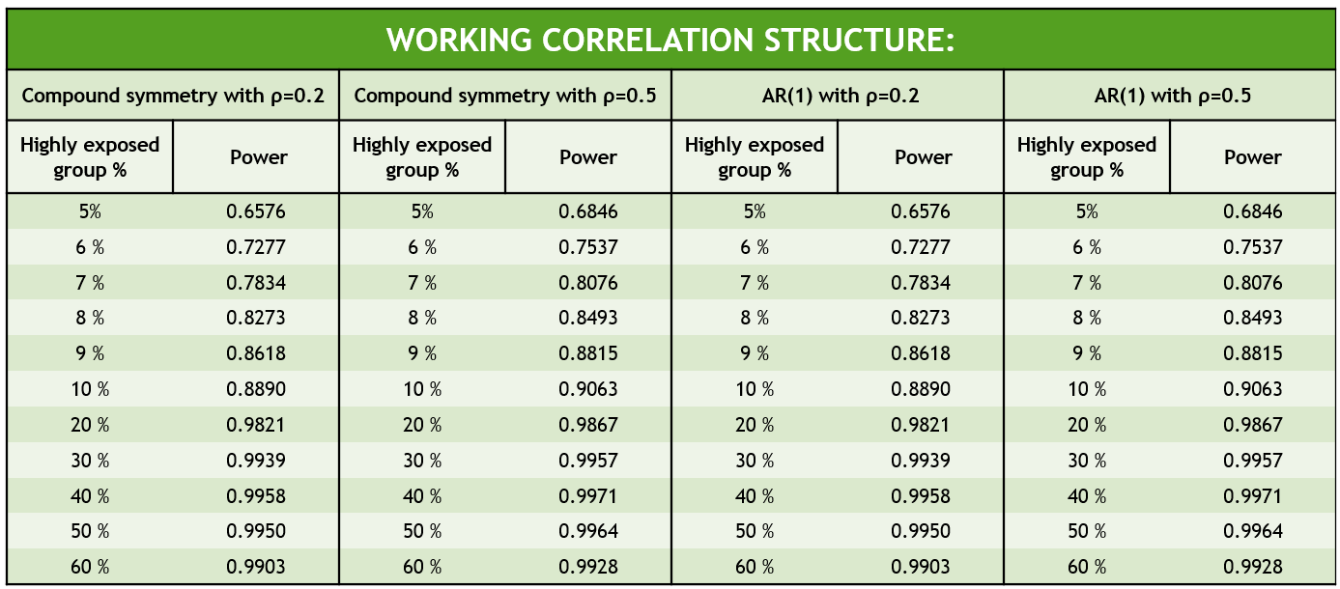
Justification for Sample Size

Slide 18
SPECIFIC AIMS

Slide 19
Specific Aims
Aim #1
Influences on cancer screening behaviors
Aim #5
Determine the relationship between “exposures” and survivorship and mortality
Aim #4
Identify and improve the environmental exposure measures
Enroll 12,500 cancer-free residents from Louisiana’s Industrial Chemical Corridor
Social Déterminants of Health
Environmental
Modifiable Exposures
Aim #3
Determine the association between exposures and health outcomes
Collect information on risk factors
Identify the modifiers or mediators
Biospecimens on 6,250 participants
Aim #2
Notes:
**** NEED TO ADD TITLES TO SOME OF THE AIMS ***
Aim #???: Follow for Health Conditions

Slide 20
Specific Aims
Aim #1: Enrollment
Recruit and follow 12,500 residents without a history of cancer between 18 and 70 from Louisiana’s Industrial Chemical Corridor, and obtain biospecimens on 6,250 participants. We will collect information on risk factors such as demographic, physical and mental health, and diet and health behaviors for the risk of multiple cancers and identify the modifiers (psychosocial stress and comorbidities) or mediators (obesity, tobacco use) using multiple modalities.
Aim #2:
Aim #3: SDoH, Environmental, Modifiable Exposures
Evaluate the association of environmental exposures, including climate change, in the context of health disparity drivers with proximal outcomes (faster telomere shortening, more oxidative stress, inflammation, methylation, and higher mutational load) and incident cancers during follow-up.
Establish whether living in communities inundated with news and information about high cancer risk influences screening behaviors.
Aim #5:
Determine the relationship between “exposures” and survivorship and mortality utilizing the SEER-Louisiana Tumor Registry’s data on treatment, follow-up, end-results, and Ochsner medical records.
Aim #4:
Identify and improve the environmental exposure measures and determine the association between exposures and health outcomes using low-cost technologies such as geolocational apps and passive or active environmental monitors.
Notes:
**** NEED TO ADD TITLES TO SOME OF THE AIMS ***
Aim #???: Follow for Health Conditions

Slide 21
BUDGET
Notes:
Slides
Costs per site
Total indirect costs
Total direct costs
Total TOTAL costs
Bottom of spreadsheet will have name of institution

Slide 22
Projected Budget
Cost Category |  | Year 1 | Year 2 | Year 3 | Year 4 | Year 5 | TOTAL
 | Subtotal Salaries, Fringe, & Student | 808,137 | 893,957 | 1,014,553 | 1,038,167 | 1,062,825 | 4,817,638
 | Subtotal Capital Equipment | 40,000 | - | - | - | - | 40,000
 | Subtotal Travel | 44,806 | 44,806 | 22,403 | 22,403 | 22,403 | 156,820
 | Subtotal Supplies | 38,000 | 11,000 | 11,000 | 11,000 | 11,000 | 82,000
 | Subtotal Other Expenses | 800,592 | 50,592 | 800,592 | 50,592 | 50,592 | 1,752,960
 | Subtotal Patient Incentives | 197,625 | 197,625 | 395,250 | 395,250 | 135,125 | 1,320,875
Subawards
 | Ochsner | 1,010,886 | 1,177,584 | 1,177,584 | 1,177,584 | 1,177,584 | 5,721,222
 | LSU | 94,526 | 94,526 | 94,526 | 94,526 | 94,526 | 472,632
 | Pennington | 591,476 | 496,623 | 549,693 | 549,693 | 534,521 | 2,722,007
 | Harvard | 44,336 | 47,726 | 44,336 | 47,726 | 47,726 | 231,850
 | Univ. Of Miami | 41,526 | 44,596 | 41,526 | 44,596 | 44,596 | 216,841
 | Subtotal Direct Subawards | 1,134,549 | 1,213,604 | 1,209,594 | 1,213,594 | 1,203,479 | 5,974,819
 | Subtotal Indirect Subawards | 648,202 | 647,452 | 698,072 | 700,532 | 695,475 | 3,389,733
 | Subtotal Subawards | 1,782,751 | 1,861,056 | 1,907,666 | 1,914,126 | 1,898,954 | 9,364,552
Total Direct Costs |  | 3,711,911 | 3,059,035 | 4,151,463 | 3,431,537 | 3,180,898 | 17,534,844
Total Direct Costs less Subk F&A |  | 3,063,709 | 2,411,583 | 3,453,391 | 2,731,005 | 2,485,423 | 14,145,111
Indirect Costs
 | Indirect Cost Base | 1,816,535 | 1,000,354 | 1,848,548 | 1,122,162 | 1,146,819 | 6,934,417
 | Subtotal F&A Costs | 908,267 | 500,177 | 924,274 | 561,081 | 573,410 | 3,467,209
TOTAL ALL COSTS |  | 4,620,178 | 3,559,212 | 5,075,737 | 3,992,618 | 3,754,308 | 21,002,053

Slide 23
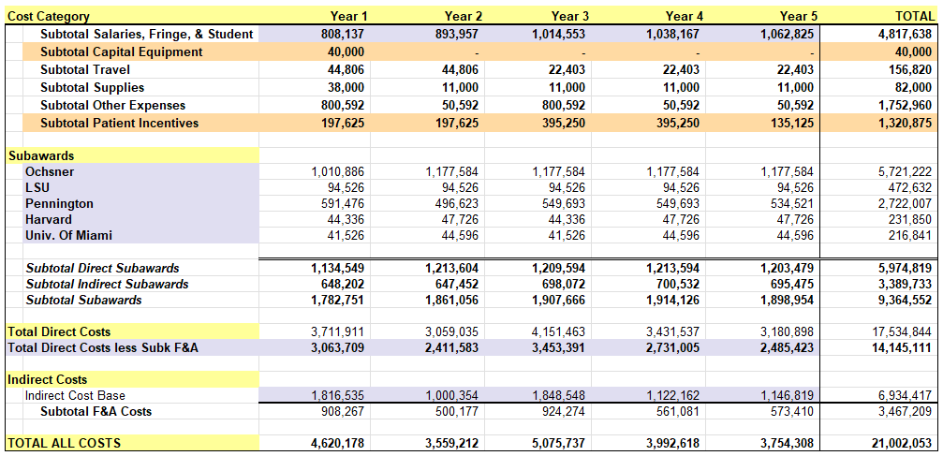
Projected Budget

Slide 24
DATA AND RESOURCES

Slide 25
Data/Resource Sharing
Data Structure
Metadata
Data

Slide 26
Data/Resource Sharing
Data Structure
Metadata
Data

Slide 27
Data/Resource Sharing
Data Structure
Metadata
Data

Slide 28
Data/Resource Sharing
Data Structure
Metadata
Data

Slide 29
Data/Resource Sharing
Data Structure
Metadata
Data

Slide 30
Data/Resource Sharing
Data Structure
Metadata
Data

Slide 31
Data/Resource Sharing
Data Structure
Metadata
Data

Slide 32
Data/Resource Sharing
Data Structure
Metadata
Data

Slide 33
Data/Resource Sharing
Data Structure
Metadata
Data

Slide 34
Data/Resource Sharing
Data Structure
Metadata
Data

Slide 35
Data/Resource Sharing
Data Structure
Metadata
Data

Slide 36
Data/Resource Sharing
Data Structure
Metadata
Data

Slide 37
ENGAGEMENT

Slide 38
Community Engagement Plan
Engagement Activities
Predominant Community Partners

Slide 39
Community Engagement Plan
Engagement Activities
Predominant Community Partners

Slide 40
Community Engagement Plan
Engagement Activities
Predominant Community Partners

Slide 41
Community Engagement Plan
Engagement Activities
Predominant Community Partners

Slide 42
Community Engagement Plan
Engagement Activities
Predominant Community Partners

Slide 43
Community Engagement Plan
Engagement Activities
Predominant Community Partners

Slide 44
Community Engagement Plan
Engagement Activities
Predominant Community Partners

Slide 45
Community Engagement Plan
Engagement Activities
Predominant Community Partners

Slide 46
Community Engagement Plan
Engagement Activities
Predominant Community Partners

Slide 47
Community Engagement Plan
Engagement Activities
Predominant Community Partners

Slide 48
Community Engagement Plan
Engagement Activities
Predominant Community Partners

Slide 49
SUSTAINABILITY

Slide 50
Sustainability Plan
Strategic Planning and Evaluation
Funding Sustainability
Leadership Sustainability
System Sustainability
Communication Sustainability
Policy and Procedures

Slide 51
Sustainability Plan
Strategic Planning and Evaluation
Funding Sustainability
Leadership Sustainability
System Sustainability
Communication Sustainability
Policy and Procedures

Slide 52
Sustainability Plan
Strategic Planning and Evaluation
Funding Sustainability
Leadership Sustainability
System Sustainability
Communication Sustainability
Policy and Procedures

Slide 53
Sustainability Plan
Strategic Planning and Evaluation
Funding Sustainability
Leadership Sustainability
System Sustainability
Communication Sustainability
Policy and Procedures

Slide 54
Sustainability Plan
Strategic Planning and Evaluation
Funding Sustainability
Leadership Sustainability
System Sustainability
Communication Sustainability
Policy and Procedures

Slide 55
Sustainability Plan
Strategic Planning and Evaluation
Funding Sustainability
Leadership Sustainability
System Sustainability
Communication Sustainability
Policy and Procedures

Slide 56
Sustainability Plan
Strategic Planning and Evaluation
Funding Sustainability
Leadership Sustainability
System Sustainability
Communication Sustainability
Policy and Procedures

Slide 57
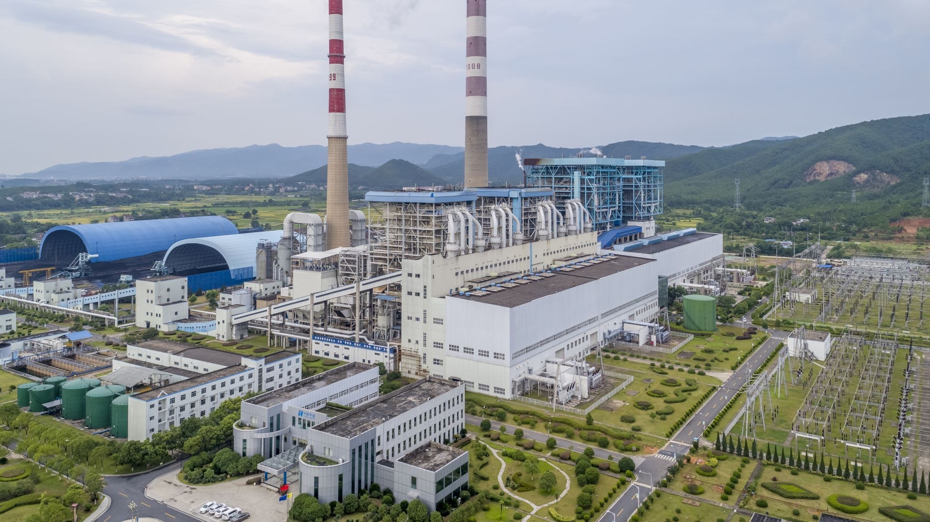
?
?
Any Questions?

Slide 58
Industrial Chemical Corridor Community Cohort Study - The I 4C (Foresee) Study Edward Trapido etrapi@lsuhsc.edu 504.568.5700
This Photo by Unknown author is licensed under CC BY-SA.

Slide 59
HIDDEN SLIDES FROM HERE TO THE END
Notes:
DOC: Scientific Flow Charts ET 7

Slide 60
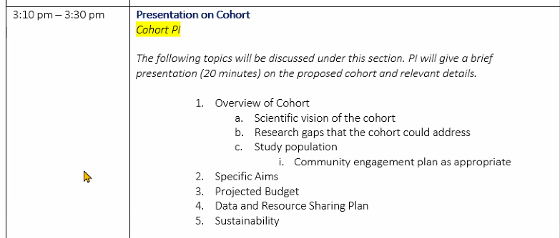
Questions:
Who is the audience? NIH?
Send by Nov. 22 AT LATEST
Add content from next 4 sides?
Study pop – includes sample size
Image – projected enrollment and biospecemins
What kind of tone for background? (Audience not familiar with our state?)
3 vs. 4 AIMs?
Notes:
4 columns
AA
Creole
Cancer Alley
French
20 slides
Idea of the Area
Picture from Katner – make them the background of transition slides

Slide 61
References
Notes:
All of us

Slide 62
Louisiana’s Cancer Alley
• 200+ mile stretch of the Mississippi River
• Only 11 of Louisiana’s 64 parishes
• 35% of the state’s population and 0.5% of the total U.S.
• 39% Black vs. national average of 14%
• 16% in poverty vs. national average of 11%
• 182 Federally Qualified Health Centers in Cancer Alley
• 47 Ochsner Health System hospitals and more than 370 health and urgent care centers across Louisiana, Mississippi, Alabama and the Gulf South.
https://www.mdpi.com/1660-4601/9/12/4365/htm
Notes:
Ochsner -- It operates 47 hospitals and more than 370 health and urgent care centers across Louisiana, Mississippi, Alabama and the Gulf South
History | Ochsner Health
https://www.mdpi.com/1660-4601/9/12/4365/htm
# of miles???? https://www.portgbr.com/fast-factsfaqs#:~:text=Is%20situated%20on%20the%20Mississippi,Waterway%20at%20its%20northernmost%20point.
Number of Federally Qualified Health Centers (FQHCs) and Look-Alikes, 2022
https://data.hrsa.gov/data/reports/datagrid?gridName=FQHCs
Ascension Parish -- 3
East Baton Rouge Parish -- 33
Iberville Parish -- 9
Jefferson Parish -- 38
Orleans Parish -- 77
Plaquemines Parish -- 3
St. Bernard Parish -- 2
St. Charles Parish -- 7
St. James Parish -- 3
St. John the Baptist Parish -- 5
West Baton Rouge Parish -- 2
Cancer Alley TOTALS -- 182
Cancer Alley AVERAGES -- 17

Slide 63
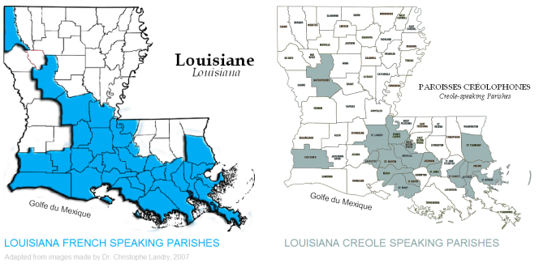
French & Creole Heritage
• Only 1 of the 11 parishes in Cancer Alley is not designated as Louisiana French and/or Creole-Speaking (East Baton Rouge – where the LA State Capital and Louisiana State University are).
• The Creole language, in particular, is endangered (with less than 10,000 speakers remaining).
https://seventhcoalition.org/2018/01/22/creoles-in-louisiana-history/
Notes:
Creoles in Louisiana History – Seventh Coalition: History
https://seventhcoalition.org/2018/01/22/creoles-in-louisiana-history/
Creole Parishes in Cancer Alley –
Ascension Parish
Iberville Parish
Jefferson Parish
Orleans Parish
St. Bernard Parish
St. Charles Parish
St. James Parish
West Baton Rouge Parish
Only 1 of the parishes in Cancer Alley are not designated as Louisiana French and/or Creole-Speaking – East Baton Rouge
The Creole language, in particular, is endangered (with less than 10,000 speakers remaining).

Slide 64
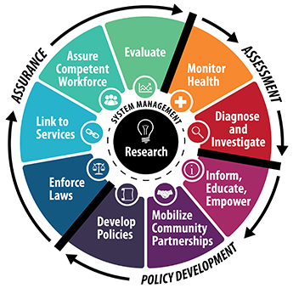
Public Health Challenges
Major Environmental Statutes
Numerous negative health impacts
Permissible Exposure Limits from 1970s
Cumulative exposure effect
Environmental justice disparities
Public health research needed
This Photo by Unknown Author is licensed under CC BY-SA-NC
Notes:
Cancer Alley includes seven Louisiana parishes: Ascension, East Baton Rouge, Iberville, St. Charles, St. James, St. John, and West Baton Rouge
150 petrochemical plants and oil refineries (James, 2012)
25% of the petrochemical production in the United States (James, 2012)
16% of Louisiana residents live in Cancer Alley (2020 Census)
46 per 1,000,000 at risk of developing cancer vs. 30 per 1,000,000 in U.S (James, 2012)
50% of the cancer-related health problems in the area
Environmental justice

Slide 65

Economic Challenges
Financial incentives to industries
Billions of tax dollars for Louisiana
45,000+ jobs
Current residents
Failed the Center for Public and Global Integrity integrity investigation
“A culture in which the state agency is expected to protect industry” (Katner, 2021)
Oil and Gas 3rd highest political campaign contributor in 2020
Monitoring and reports
Whistleblowers
Outdated Environmental policies
This Photo by Unknown author is licensed under CC BY-SA.

Slide 66
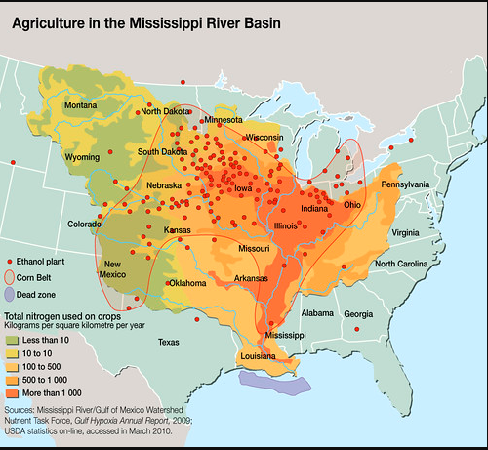

Slide 67
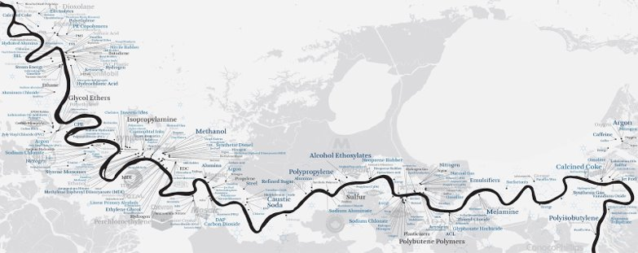
Petrochemical and Industrial Plants
• 150+ petrochemical plants and refineries (54 are Major Polluting Factories (MPFs))
• 25% of the petrochemical production in the U.S.
• 46 individuals per one million are at risk of developing cancer vs. national average of 30
• Known as “Cancer Alley”
• Considered a “sacrifice zone”
https://massachusettsonamap.blogspot.com/2020/07/cancer-alley-louisiana-map.html
https://massachusettsonamap.blogspot.com/2020/07/cancer-alley-louisiana-map.html
Notes:
https://massachusettsonamap.blogspot.com/2020/07/cancer-alley-louisiana-map.html
(Wikipedia)
which contains over 150 petrochemical plants and refineries.^{[2]} This area accounts for 25% of the petrochemical production in the United States.^{[3]} The region is considered a sacrifice zone.^{[4]} In Cancer Alley, forty-six individuals per one million are at risk of developing cancer, compared with the national average of roughly thirty individuals per one million.^{[3]} The abnormally high cancer risk and concentration of petrochemical operations inspired the "Cancer Alley" moniker.

Slide 68
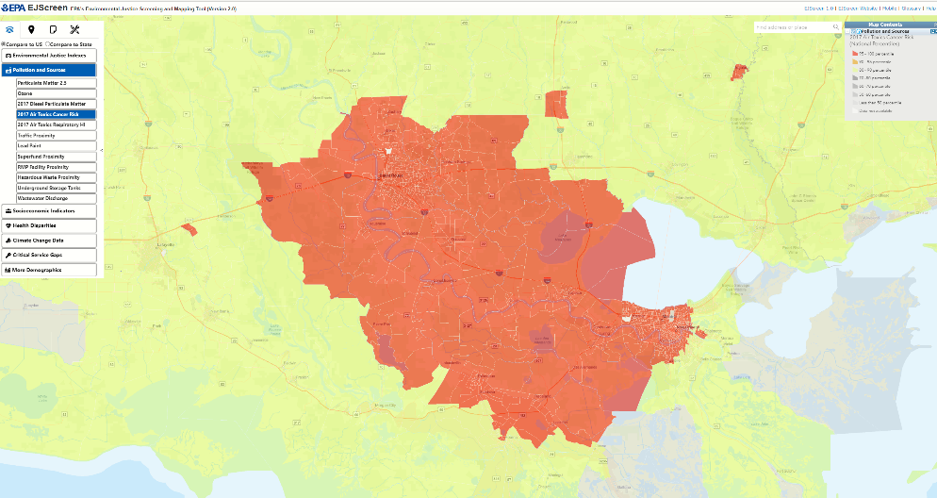

Slide 69
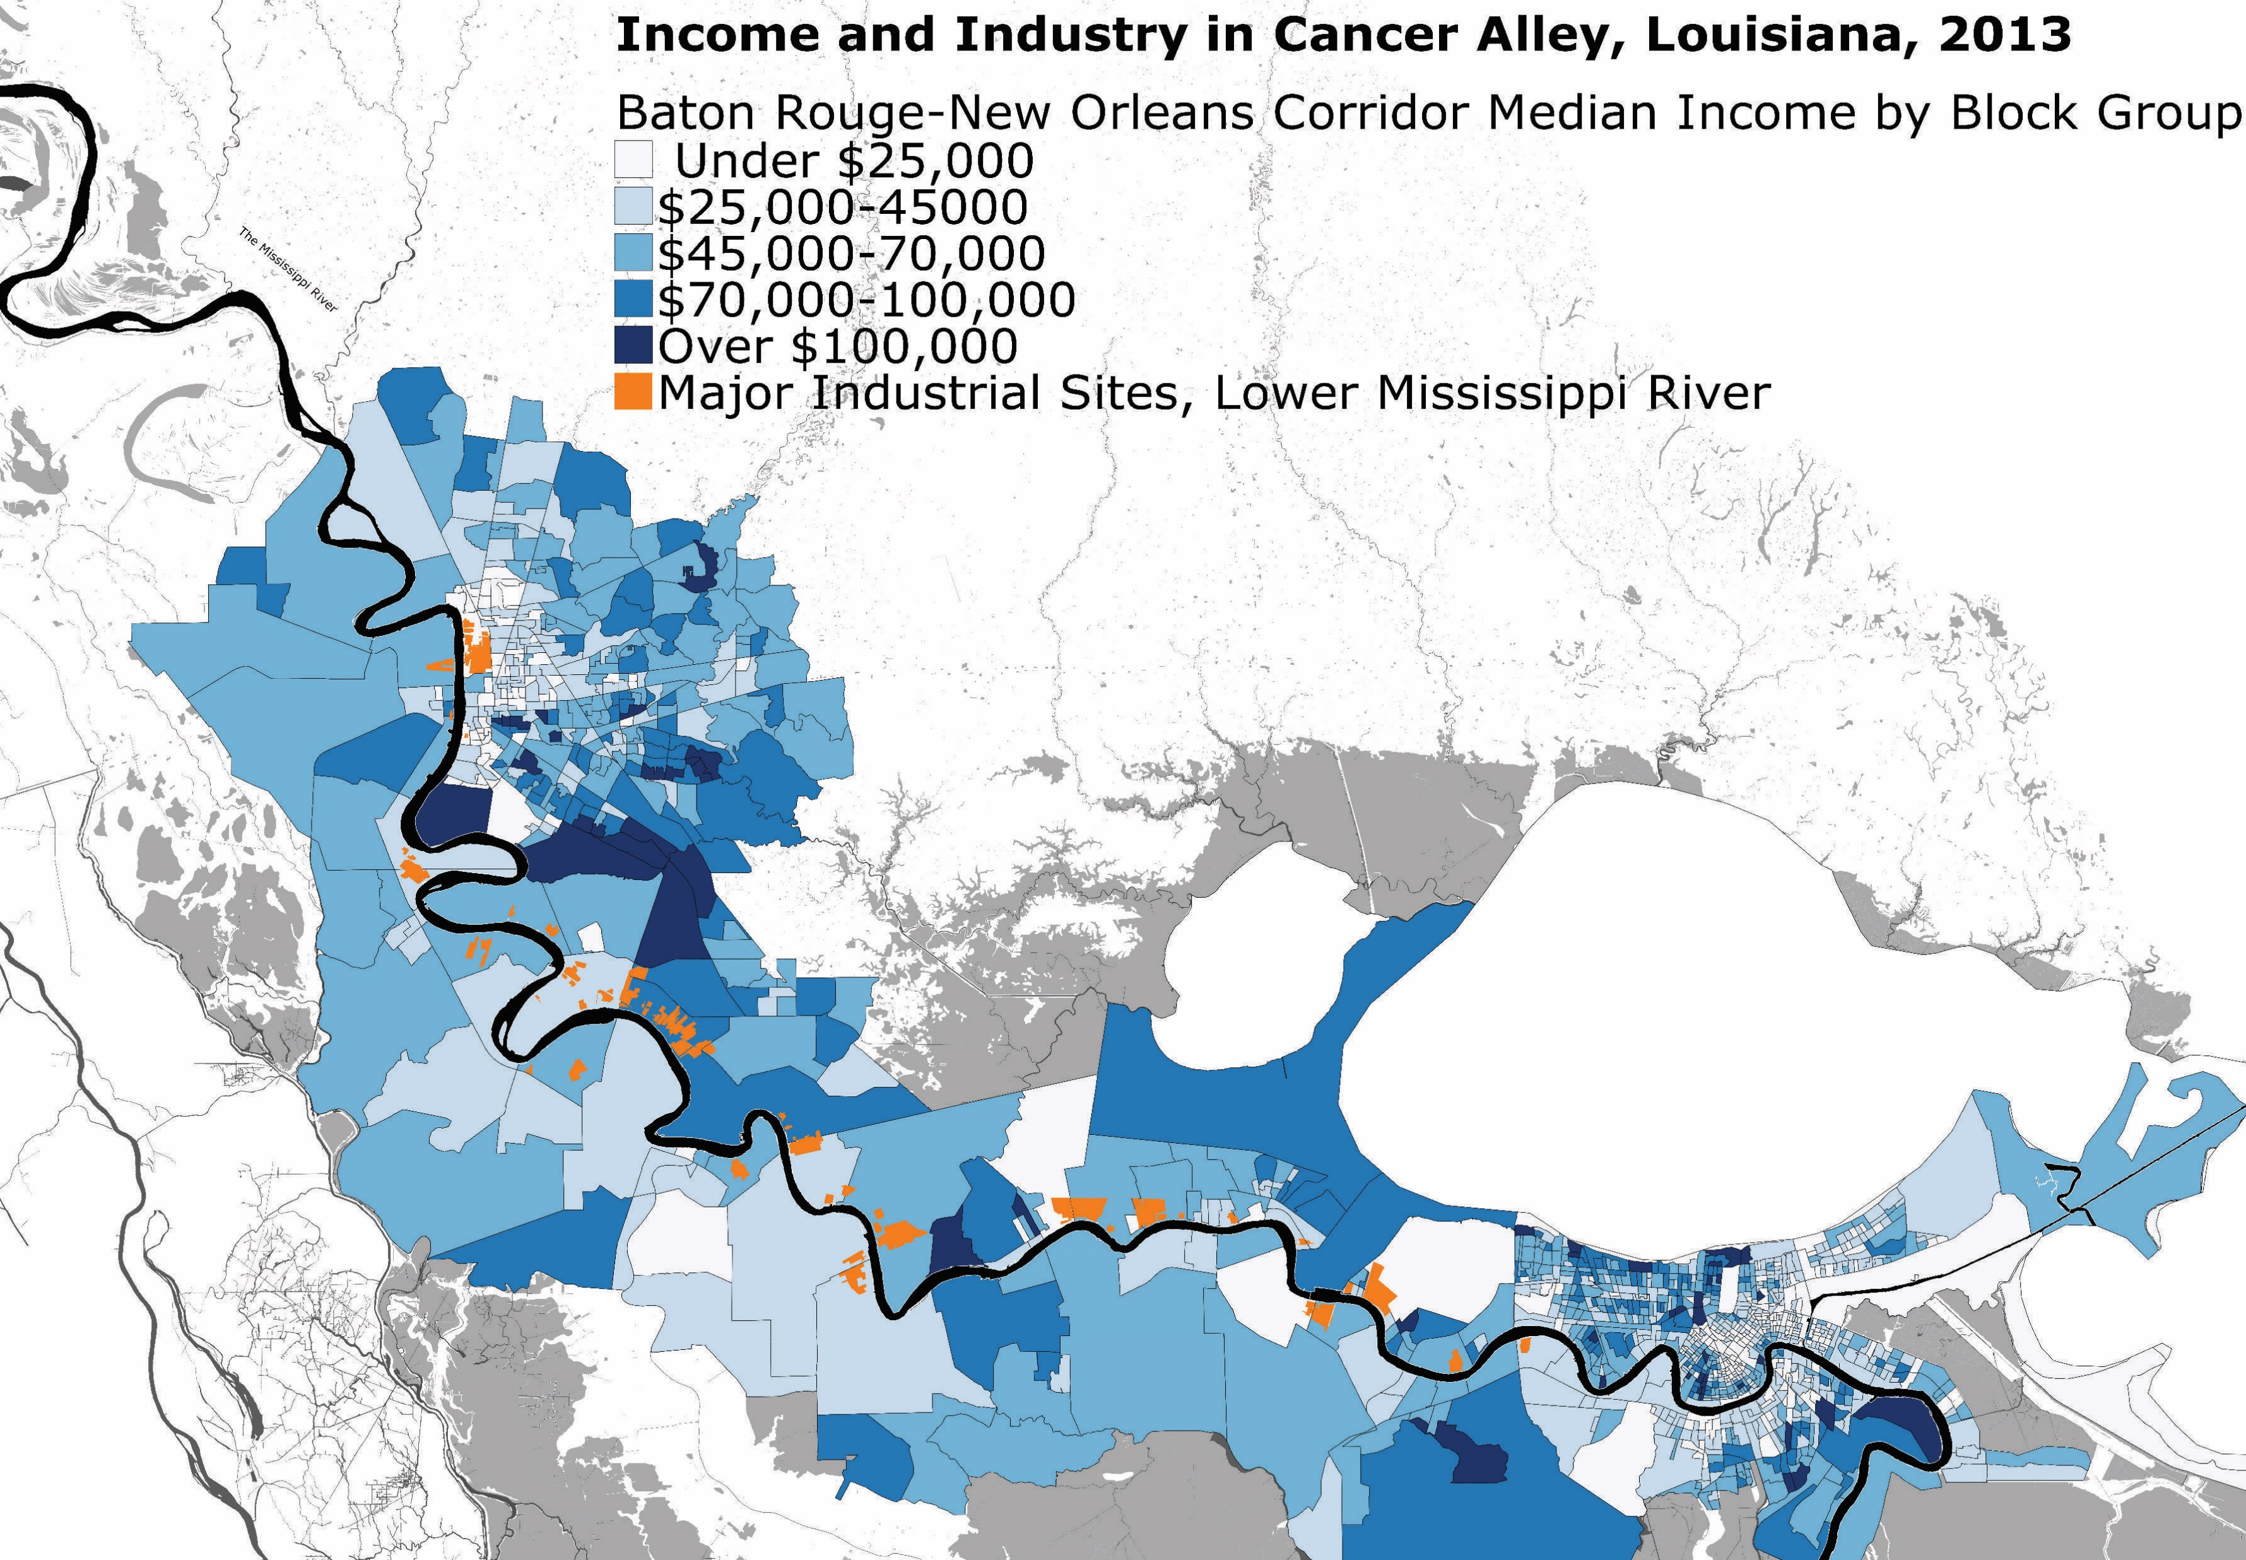
Income and Industry in Cancer Alley, Louisiana, 2013
http://due-parsons.github.io/methods3-fall2015/projects/industry-infrastructure-cancer-alley-la-and-detroit-mi/
Notes:
Industry & Infrastructure: Cancer Alley, LA and Detroit, MI (due-parsons.github.io)
http://due-parsons.github.io/methods3-fall2015/projects/industry-infrastructure-cancer-alley-la-and-detroit-mi/

Slide 70
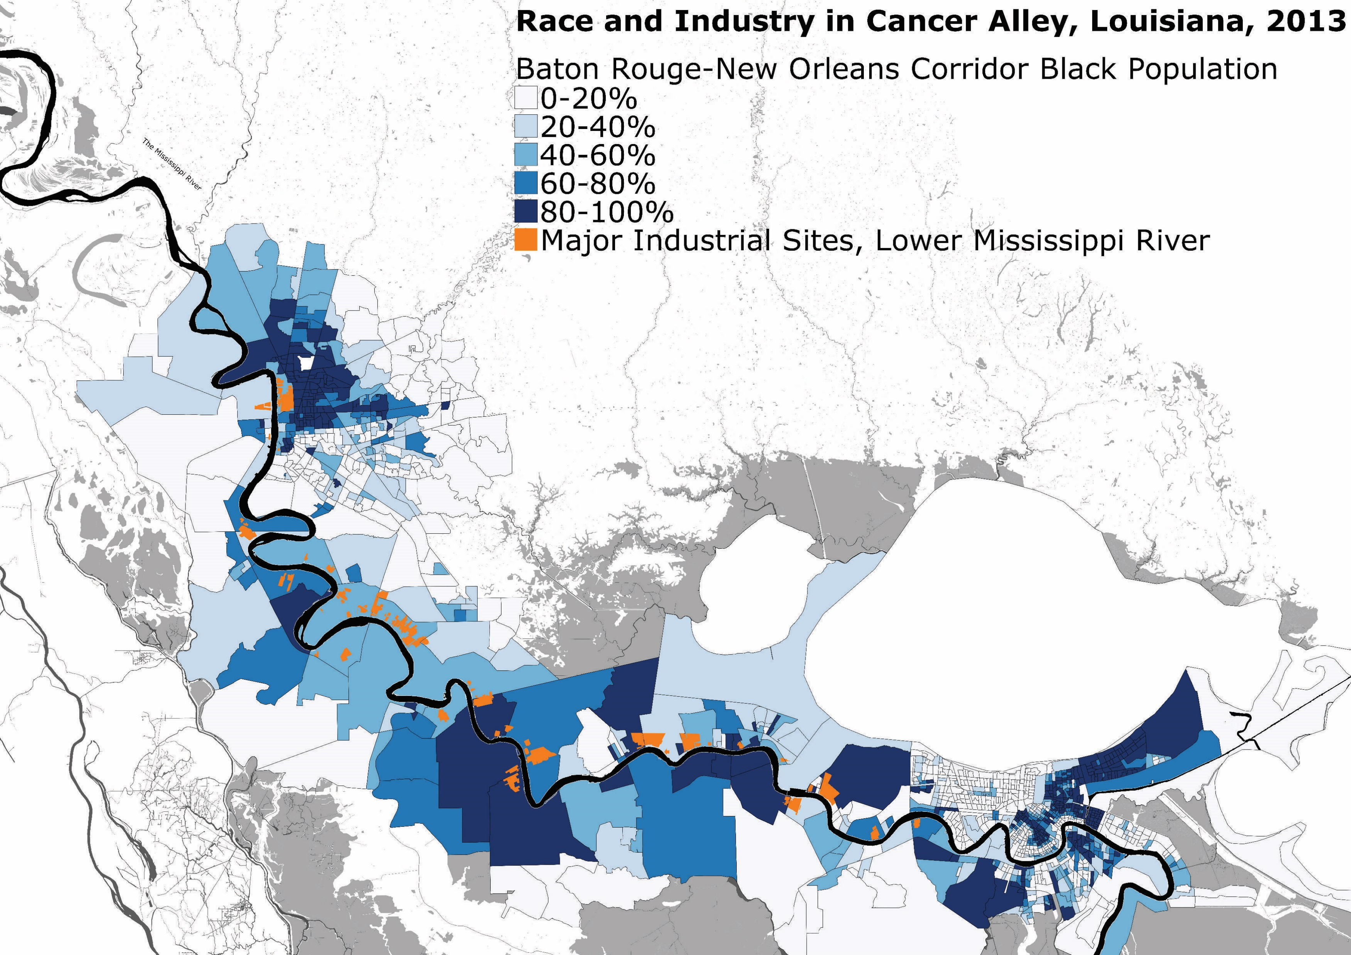
Race and Industry in Cancer Alley, Louisiana, 2013
http://due-parsons.github.io/methods3-fall2015/projects/industry-infrastructure-cancer-alley-la-and-detroit-mi/
Notes:
Industry & Infrastructure: Cancer Alley, LA and Detroit, MI (due-parsons.github.io)
http://due-parsons.github.io/methods3-fall2015/projects/industry-infrastructure-cancer-alley-la-and-detroit-mi/

Slide 71
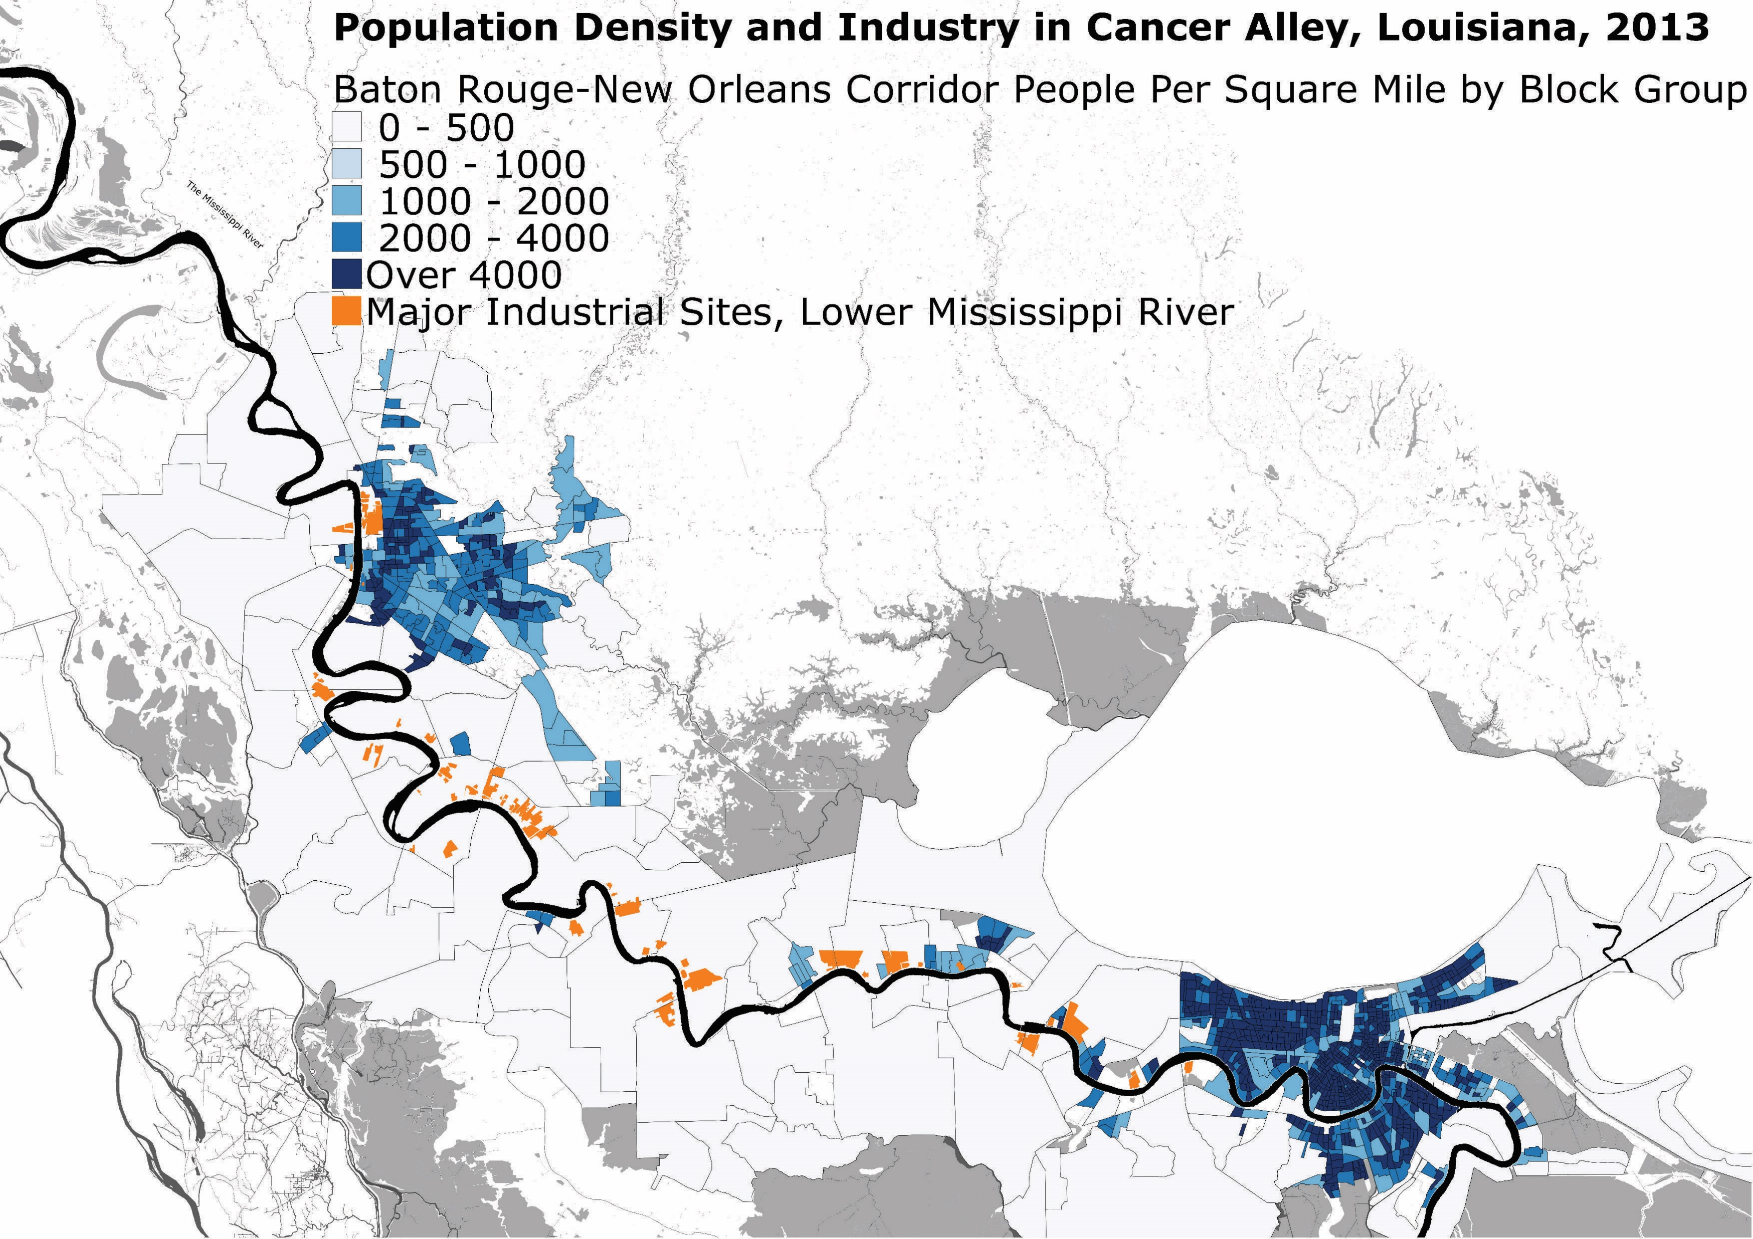
Population Density and Industry in Cancer Alley, Louisiana, 2013
http://due-parsons.github.io/methods3-fall2015/projects/industry-infrastructure-cancer-alley-la-and-detroit-mi/
Notes:
Industry & Infrastructure: Cancer Alley, LA and Detroit, MI (due-parsons.github.io)
http://due-parsons.github.io/methods3-fall2015/projects/industry-infrastructure-cancer-alley-la-and-detroit-mi/

Slide 72
Aim 1: Enrollment
Notes:
Specific Aims
1. Recruit 25,000 residents without a history of cancer between the ages of 18 and 70 from Louisiana’s Industrial Chemical Corridor. Characterize cohort members’ “exposures” using multiple modalities. Follow participants over time for incident cancers and related diseases.
2. Evaluate the association of environmental exposures in the context of health disparity drivers (SDOH, demographic, family and medical history, stress, discrimination) with cancer and other proximal outcomes (faster telomere shortening, more oxidative stress, inflammation, methylation, and higher mutational load).
3. After controlling for other risk behaviors, assess the role of obesity as a mediator in the association of environmental exposures and cancer/proximal outcomes, and determine whether psychosocial stress and comorbidities are moderators in the associations between environmental exposures and cancer.
4. Link the “exposure” information to assess predictors of survivorship and mortality utilizing the SEER-Louisiana Tumor Registry’s data on treatment, follow-up, and end-results.

Slide 73
Aim 2: SDoH, Environmental, Modifiable Exposures

Slide 74
Aim 3: Follow for Health Conditions

Slide 75
Aim 4:
Notes:
Specific Aims
1. Recruit 25,000 residents without a history of cancer between the ages of 18 and 70 from Louisiana’s Industrial Chemical Corridor. Characterize cohort members’ “exposures” using multiple modalities. Follow participants over time for incident cancers and related diseases.
2. Evaluate the association of environmental exposures in the context of health disparity drivers (SDOH, demographic, family and medical history, stress, discrimination) with cancer and other proximal outcomes (faster telomere shortening, more oxidative stress, inflammation, methylation, and higher mutational load).
3. After controlling for other risk behaviors, assess the role of obesity as a mediator in the association of environmental exposures and cancer/proximal outcomes, and determine whether psychosocial stress and comorbidities are moderators in the associations between environmental exposures and cancer.
4. Link the “exposure” information to assess predictors of survivorship and mortality utilizing the SEER-Louisiana Tumor Registry’s data on treatment, follow-up, and end-results.

Slide 76
FQHC INVOLVEMENT

Slide 77

Benefits to FQHC
1. Additional marketing and visibility of the FQHC
2. Increased patron traffic/awareness from community
3. Enrollment of new patrons at FQHC
4. Helps to meet FQHCs' mandates to serve as a community resource
5. Financial incentive – If FQHC provides staffing a "bounty" per head may be provided.
Notes:
Or even, $1,000 per 100 enrolled, etc.
= $250,000

Slide 78
TIME
Minimum Commitment by FQHC
1 day per week per month
Answer questions / calls received
Maximum Commitment by FQHC
1 week per month
Staff taking history and obtaining specimens

Slide 79
STAFF
Minimum Commitment by FQHC
None -- LSUHSC provides all staff
Maximum Commitment by FQHC
Nurse / phlebotomist

Slide 80
SPACE
Minimum Commitment by FQHC
LSUHSC provide van outside (no space needed inside)
2-3 spaces to park (van)
2 chairs to wait in lobby
Maximum Commitment by FQHC
Table in the lobby
6 chairs
Private consult room

Slide 81
PUBLICITY
Minimum Commitment by FQHC
Flyers on table in lobby
Flyers posted in lobby and/or treatment rooms
Maximum Commitment by FQHC
Send emails to clients regarding study enrollment
Put sandwich boards outside daily to publicize next visit dates

Slide 82
LOGISTICS
Minimum Commitment by FQHC
Electricity connection
Participants use inside restroom
Maximum Commitment by FQHC
Storage space for specimens

Slide 83
Issues to Discuss
Should participants be informed about health information that they cannot currently do anything about?
#1
#2
#3

Slide 84
COHORT STUDY DESIGN

Slide 85
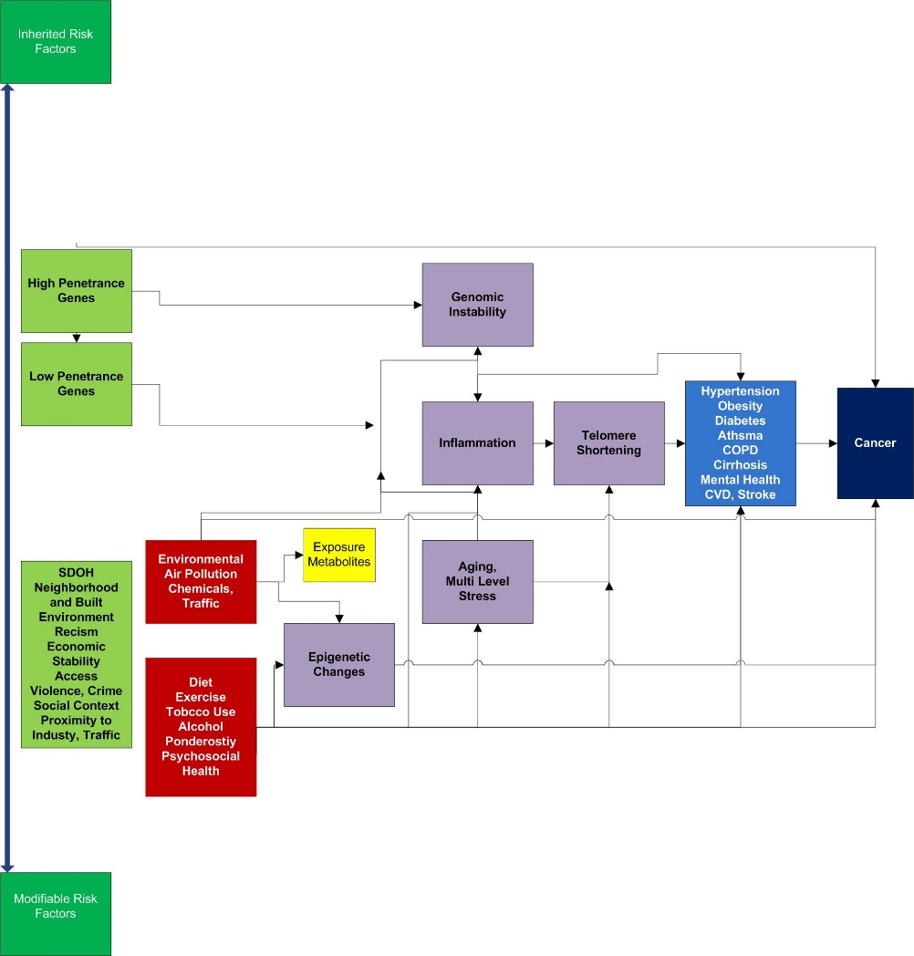
Scientific Flow

Slide 86
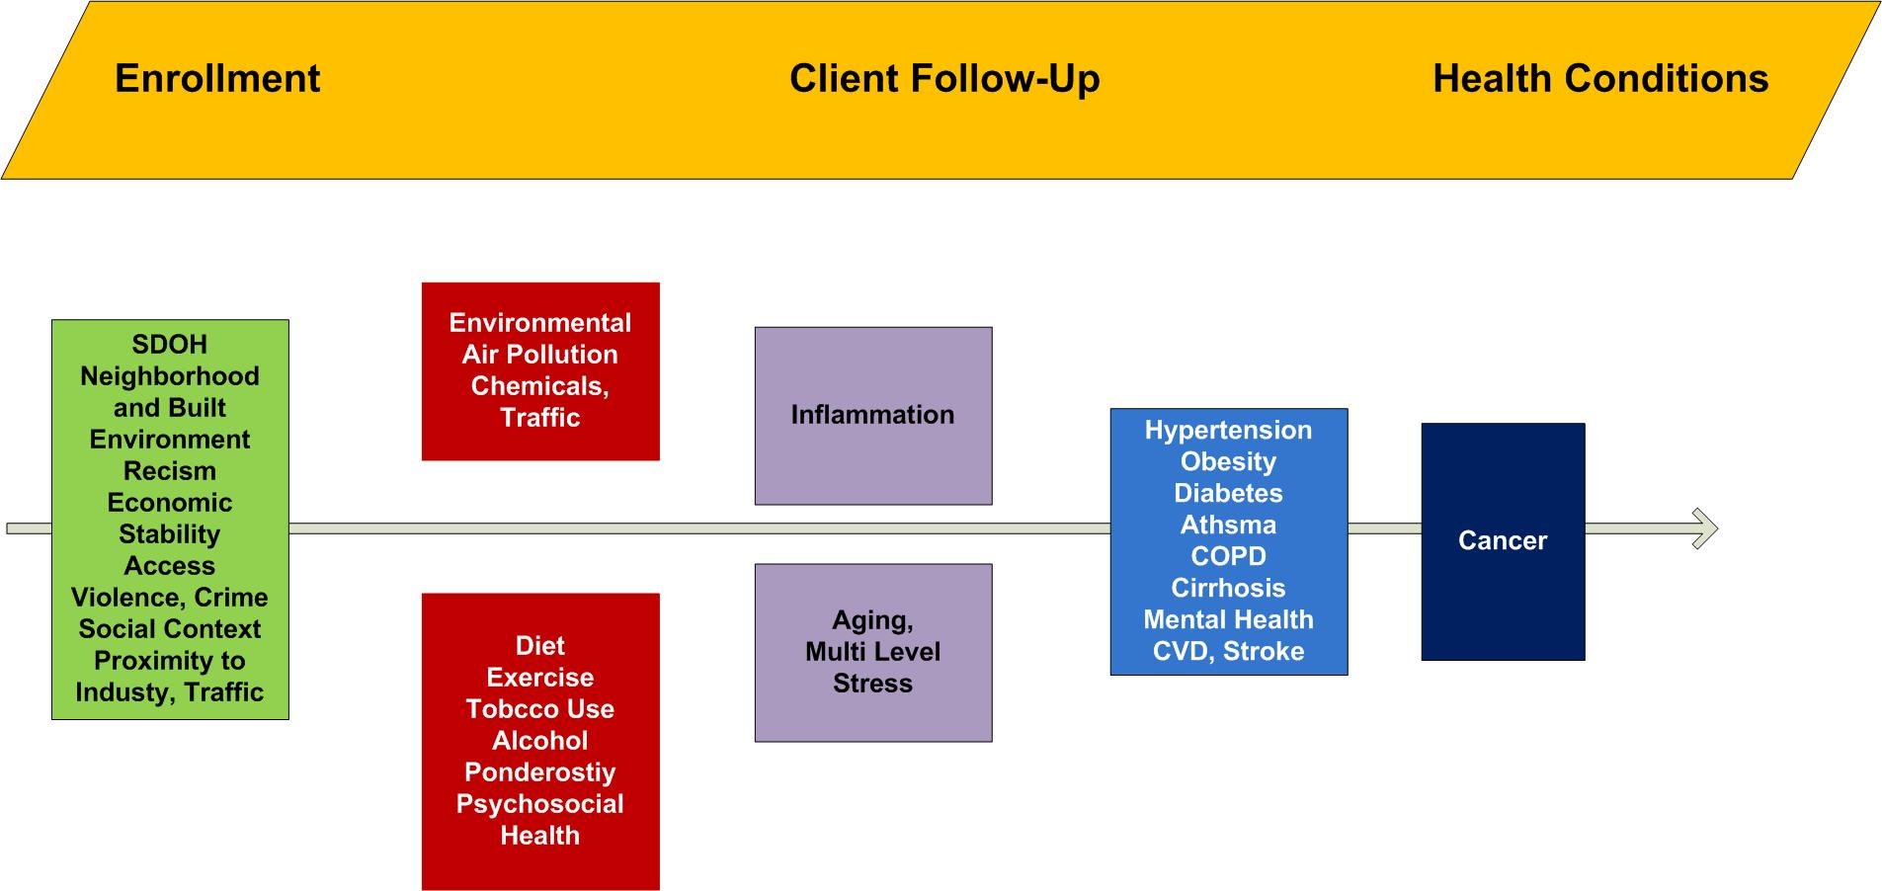
Basic Approach

Slide 87
Study Timeline
NOVEMBER 2022
FEBRUARY 2023
NOVEMBER 2023 (at earliest)
JANUARY 2024 (at earliest)
NIH MEETING
Submit grant to LSUHSC IRB for approval
Submit grant
Grant results (awarded/rejected)
Begin Cancer Alley Cohorts
DECEMBER 2022
OCTOBER 2022
Confirmation of Ochsner / FQHC participation

Slide 88
PARTICIPANT INVOLVEMENT

Slide 89

Benefits to Participants
1. DNA (including ancestry) and genetics information at no cost
2. Gift card
3. Fitbit (or similar) and environmental exposure monitor
4. Continuity of care at local FQHC, if needed
5. Help family, friends, and community for generations to come by assisting researchers in understanding why some people get sick and others stay healthy

Slide 90

What Do Participants Need to Know?
Participants will share information about their health, habits and what is like where they live.
All data will be kept safe and confidential.
How to enroll
Who to contact
Participants will be contributing to research that may improve the health for everyone.

Slide 91
?

