Slide 1
Should the Legal Drinking Age Stay at 21?
(Don’t want to know your answer. I just ask that you right down a yes or a no somewhere that you can refer back to it after my presentation.)
Notes:
Tell about my grandfather and dad.
Does scripture say don’t drink?
Should the Legal Drinking Age Stay at 21?
Don’t want to know your answer. I just ask that you right down a yes or a no somewhere that you can refer back to it after my presentation.
When did the legal drinking age go to 21 and why / how enforced?
Simple Answer:
Should the Legal Drinking Age Stay at 21?
Christians are encouraged to obey the laws of the land, as Romans 13:1 (ESV) states, "Let every person be subject to the governing authorities." Supporting a legal drinking age of 21 is consistent with this principle and helps maintain order and protect the well-being of young individuals.
Is this what the Bible says though?

Slide 2
Lowering the Legal Drinking Age: An Evangelical Christian Perspective on Reducing Underage Alcohol Use
Sarah Grunblatt, MPH, MS, MS, MEd, MEd, MA
CEEF 9403: Human Growth and Development
October 20, 2023

Slide 3
AGENDA
Biblical Principles and Personal Responsibility
Critique of the Existing Legal Drinking Age
The Role of Family and Faith
Public Health and Education
International Comparisons and Cultural Considerations
Responding to Concerns

Slide 4
INTRODUCTION
Legal drinking age in the U.S.
Impact on underage alcohol use
Supporters may argue that obeying the law and respecting authority is a Christian principle (Romans 13:1, ESV), and maintaining the legal drinking age at 21 is in line with this principle.
My position:
Lowering the legal drinking age from 21 resonates with evangelical Christian principles, emphasizing personal responsibility, individual choice, and the guidance of faith and family.

Slide 5
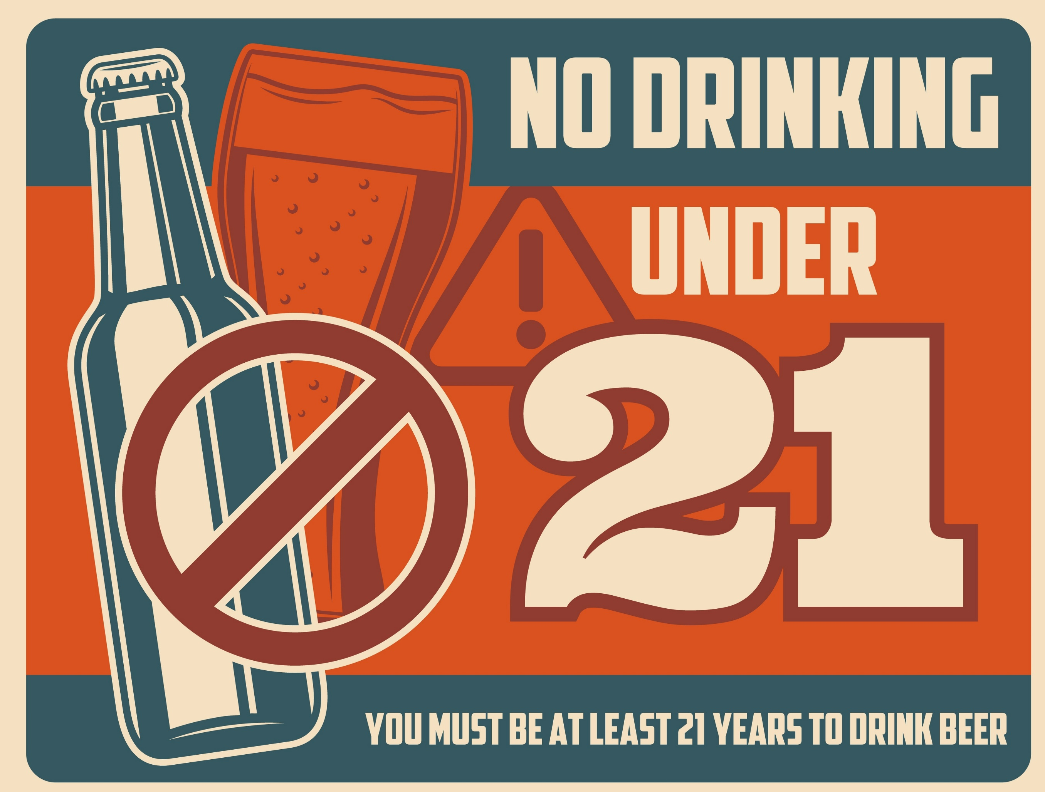
Illustration
What do you know about the National Minimum Drinking Age Act of 1984, which set the legal drinking age at 21 nationwide in the United States?
Notes:
https://www.vsu.edu/counseling/substance-abuse/drinking-age-laws.php

Slide 6
Discussion Questions
How has the legal drinking age affected the culture and behavior of young adults in the United States?
What societal factors led to the establishment of the legal drinking age at 21?
What potential impact does the legal drinking age have on the overall culture and behavior of young adults in the United States?

Slide 7
Biblical Principles and Personal Responsibility
Personal responsibility and free will from an evangelical Christian standpoint
Scripture emphasizes personal choice, individual accountability, and the importance of making responsible decisions
Deuteronomy 30:19
Galatians 6:7

Slide 8
Illustration
How does this relate to the biblical story of Adam and Eve and their choice in the Garden of Eden?
Notes:
https://www.psychologytoday.com/nz/blog/moments-matter/201701/i-hate-making-decisions

Slide 9
Discussion Questions
How do personal responsibility and free will align with evangelical Christian values, and how are they expressed in daily life?
Can you provide examples of biblical stories that emphasize personal choice and individual accountability?
Can you identify specific biblical passages that emphasize personal choice and individual accountability? How do these passages relate to the topic of the legal drinking age?

Slide 10
Critique of the Existing Legal Drinking Age
Shortcomings of the current legal drinking age of 21
A higher drinking age does not align with biblical principles of personal responsibility and choice
Deuteronomy 30:19
Galatians 6:7

Slide 11
Illustration
How the legal drinking age in the U.S. align or not align with evangelical Christian principles?
Notes:
https://www.behaviorist.biz/oh-behave-a-blog/decision-making-style

Slide 12
Discussion Questions
How might a higher legal drinking age be perceived as either supportive or contradictory to personal responsibility and individual choice from an evangelical Christian standpoint?
What criticisms have been raised about the legal drinking age and its impact on young people's behavior?
What are some specific criticisms of the existing legal drinking age from an evangelical Christian perspective, and how might these criticisms be addressed?

Slide 13
The Role of Family and Faith
The role of the family and faith communities in shaping individual behavior
Proverbs 22:6
Families and faith-based institutions are better suited to guide young people in making responsible choices regarding alcohol

Slide 14
Illustration
Throughout history, how families and faith communities have played a role in guiding young people's decisions?

Slide 15
Discussion Questions
In what ways do families and faith-based institutions impart moral and spiritual values that guide young people's choices, including those regarding alcohol?
Can you think of any well-known figures or stories where family or faith communities played a crucial role in shaping individuals' behavior?
Are there any potential challenges or drawbacks to relying on families and faith communities for guidance in shaping individual behavior, particularly regarding alcohol use?

Slide 16
Public Health and Education
The importance of public health and education in promoting responsible drinking
Proverbs 4:6-7
Comprehensive alcohol education programs and awareness campaigns as alternatives to legal restrictions.
1 Corinthians 6:19-20

Slide 17
Illustration
https://www.youtube.com/watch?v=GOnENVylxPI
https://www.youtube.com/watch?v=iXQgaviA8ng
What do you remember about the "Just Say No" public health campaigns like in 1980s and 1990s?
What was the impact?
Notes:
https://www.psychologytoday.com/nz/blog/moments-matter/201701/i-hate-making-decisions

Slide 18
Discussion Questions
How do public health and education programs align with the values of evangelical Christianity in promoting responsible behavior, including responsible drinking?
Can you provide examples of effective public health and education initiatives that have positively influenced young people's choices?
What are some effective strategies employed by public health and education initiatives to address alcohol-related issues among young people, and how can these strategies be integrated into the evangelical Christian perspective?

Slide 19
International Comparisons and Cultural Considerations
International comparisons of legal drinking ages and cultural differences
1 Corinthians 9:22
The U.S. can learn from other countries that have lower drinking ages without experiencing disproportionate harm

Slide 20
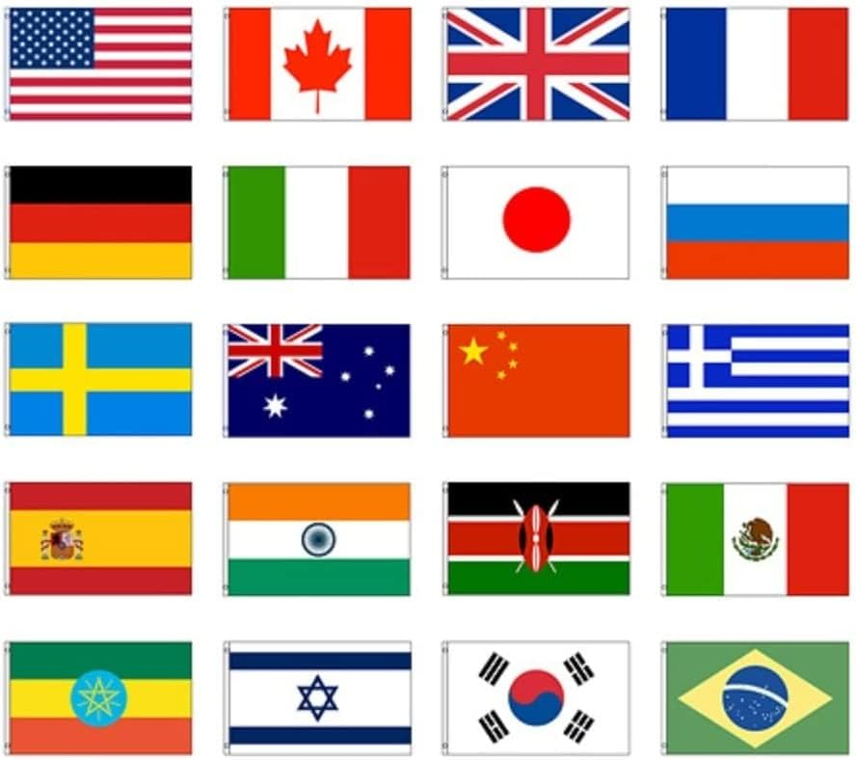
Illustration
What countries have a legal drinking age that is lower than in the U.S.?
Notes:
https://www.amazon.com/International-Countries-Polyester-grommets-Resistant/dp/B06X9NCZWM

Slide 21
Discussion Questions
How do international comparisons of legal drinking ages illustrate the role of cultural factors in shaping alcohol-related behaviors?
Can you think of any famous individuals or events that highlight the differences in alcohol culture between countries with varying legal drinking ages?
Can you identify specific countries with lower drinking ages that have successfully minimized alcohol-related harm among young people, and what lessons can be learned from their approaches?

Slide 22
Responding to Concerns
Concerns related to public safety and underage alcohol abuse
Matthew 22:39
Alternative strategies, such as stricter penalties for furnishing alcohol to minors and effective enforcement

Slide 23
Illustration
How can stricter penalties for providing alcohol to minors address concerns related to public safety?
Notes:
What else can this be applied to?
Ex. Gun laws?
Mental health and school shootings
Drugs?
TREAT the CAUSE not the SYMPTOMS
Image: Icons representing public safety and law enforcement.
Example: Discuss Discussion Questions:

Slide 24
Discussion Questions
What are some valid concerns related to public safety and underage alcohol abuse, and how might alternative strategies like stricter penalties address these concerns?
Can you provide examples of regions or communities where stricter enforcement of alcohol-related laws has been effective in curbing underage drinking?
What potential challenges or unintended consequences could arise from implementing stricter penalties for furnishing alcohol to minors, and how can these be mitigated?

Slide 25
Conclusion
Lowering the legal drinking age from 21 resonates with evangelical Christian principles, emphasizing personal responsibility, individual choice, and the guidance of faith and family.

Slide 26
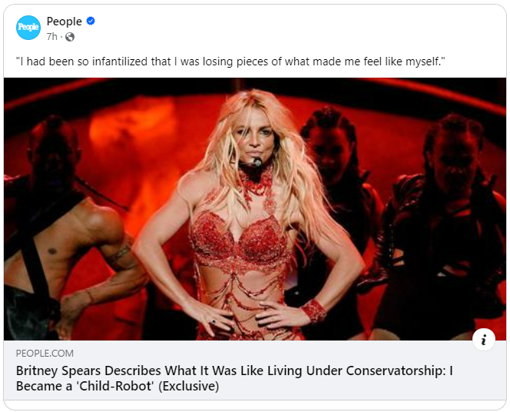
Illustration
How do you think personal agency or lack thereof impacted the life of Britney Spears and her family?
Do we judge others who sin differently from us?
Notes:
How can anyone expect anything different when a person’s choice and free will is stripped away from them?!
Don’t judge someone because they sin differently than you do. We ALL need Jesus.
https://people.com/britney-spears-felt-like-child-robot-under-conservatorship-exclusive-8362488?utm_campaign=peoplemagazine&utm_content=manual&utm_medium=social&utm_source=facebook.com&utm_term=652e83cff3ab4f00019d2774&fbclid=IwAR2F-idSGzzXxYr-Qudgq9wku-J6x84eltxQiTxmeJth7y_7JcOXpL1-Dz0

Slide 27
Discussion Questions
How can the values of personal responsibility, family, faith, and education be integrated into policy changes regarding the legal drinking age?
Can you think of famous leaders or movements that have advocated for changes in alcohol regulations, considering the values discussed in this presentation?
How might a reconsideration of the legal drinking age in the United States from the perspective of evangelical Christian values impact the broader discourse on alcohol regulation and individual rights in society?

