Slide 1
CONTRIBUTIONS AND CRITICISMS OF DEVELOPMENTAL THEORIST LEV VYGOTSKY
Sarah Grunblatt, MPH, MS, MS, MEd, MEd, MA

Slide 2
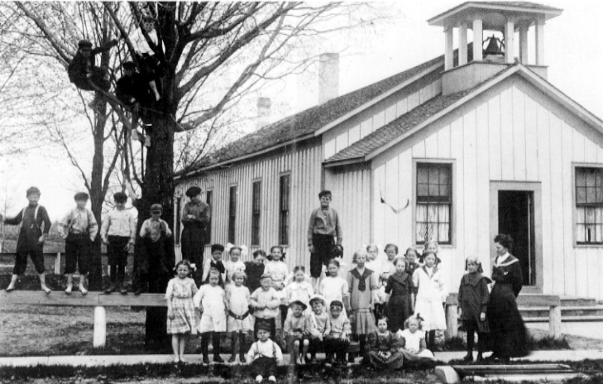
Do you believe that children's development is influenced by their interactions with others? Why or why not?
https://www.cmich.edu/research/clarke-historical-library/explore-collection/explore-online/michigan-material/one-room-schools

Slide 3
1. Introduction
Quotes by Vygotsky
Questions to Consider
"Through others, we become ourselves."
"What a child can do with assistance today, they will be able to do by themselves tomorrow."
"Play is the leading source of development, as it is a self-initiated, active, and dynamic process.“
How do you interpret these quotes?
What impact might these beliefs have on a child’s identity and/or development?
How can they be applied to educational settings?
Have you ever personally experienced or observed these circumstances either as a student or as an educator yourself?
Can you think of practical ways to incorporate play into learning environments to enhance development, especially in today's technology-driven world?
Notes:
"Through others, we become ourselves."
This quote emphasizes the significance of social interaction and the role it plays in cognitive development.
"What a child can do with assistance today, they will be able to do by themselves tomorrow."
Vygotsky's Zone of Proximal Development (ZPD) theory is encapsulated in this quote, highlighting the importance of scaffolding and guidance in learning.
"Play is the leading source of development, as it is a self-initiated, active, and dynamic process."
Vygotsky recognized the importance of play in a child's development and how it fosters cognitive growth.

Slide 4
2. Vygotsky Unveiled: A Brief Biography
Early Life
Academic Pursuits
Research and Contributions
Legacy
Relevance to Christian Education
Questions to Consider
What aspects of Vygotsky's life and work inspire you?
Share your thoughts on the importance of social and cultural aspects in learning.
How can Vygotsky's work be applied in Christian education and ministry to better serve learners?

Slide 5
3. The Vygotskian Lens: A Summary of His Theory
Challenge to Piaget
Zone of Proximal Development (ZPD)
Social Learning
Cultural Significance
Scaffolding
Private Speech - children talk to themselves while engaged in a cognitive task
Sociocultural Theory by Lev Vygotsky
Questions to Consider
Do you think that children learn better when they work together with their peers or when they learn on their own?
How can educators effectively identify and utilize the ZPD to enhance learning experiences?
Imagine you're teaching a child to ride a bicycle. How might the concept of the ZPD apply in this situation?

Slide 6
3. The Vygotskian Lens: A Summary of His Theory
Applications in Education
Collaborative Learning
Peer Tutoring
Cultural Relevance
Scaffolding Strategies
Language Development
Questions to Consider
Share experiences where collaborative learning has been successful.
In a peer tutoring context, what are the potential benefits for both the tutor and the learner?
Do you think where you grow up and your culture can influence the way you learn and think?
Can you provide examples of scaffolding strategies that have supported your own learning or that of your students?
Why do you think it's important for educators to understand how children learn?
Notes:
Cultural Influence:
-
Educational Applications:
-

Slide 7
4. Navigating the Vygotskian Seas: My Opinion on the Validity of His Theory
Validity Assessment
Social Interaction
Cultural Relevance
Zone of Proximal Development (ZPD)
Language as a Cognitive Tool
Questions to Consider
Do you agree with the assertion that social interaction is a primary driver of cognitive growth, as proposed by Vygotsky? Why or why not?
How have you observed social interaction benefiting student learning and development?
How do you incorporate cultural relevance in your teaching, particularly in diverse educational settings?
In what ways can educators effectively implement the Zone of Proximal Development to cater to the diverse readiness levels of students?
How can Vygotsky's sociocultural theory be integrated into Christian education to enhance holistic development and the integration of faith, culture, and social interaction?

Slide 8
5. Critiquing Vygotsky: Contra-Positions in Current Research
Critics' Perspectives
Overemphasis on Social Interaction
Universality Challenge
Empirical Evidence Gap
Questions to Consider
What is your perspective on the balance between social interaction and individual cognitive processes in cognitive development?
Can you share instances where cultural variations have influenced learning outcomes?
Are there alternative theories or perspectives that address the criticisms mentioned?
How might the criticisms of Vygotsky's theory influence instructional practices in education?

Slide 9
5. Critiquing Vygotsky: Contra-Positions in Current Research
Contra-positions in Current Research
Contrasting Developmental Theories
Cross-Cultural Insights
Neuroscience Advancements
Questions to Consider
How can educators strike a balance between theories like Vygotsky's sociocultural perspective and Piaget's cognitive development theory in teaching and curriculum design?
How can educators leverage cultural diversity as a resource in the classroom?
How might an understanding of the neural aspects of learning inform teaching methods and classroom environments?
How can educators encourage critical thinking and open discussions among students about contrasting perspectives in developmental theories?
In what ways can Christian educators adapt ministry practices to the specific needs and contexts of their students, considering both the insights and criticisms of Vygotsky's theory?

Slide 10
6. Real-World Vygotsky: Five Christian Education Cases
Case 1: Sunday School Peer Learning
Case 2: Youth Group Discussions
Case 3: Christian Preschool Cultural Integration
Case 4: College Ministry Mentoring
Case 5: Family Devotion Reflection
Questions to Consider
How does peer support enhance understanding, especially in faith-related contexts?
How can youth groups create environments where adolescents learn from one another's perspectives?
What are some effective strategies for making faith accessible to young learners through cultural tools?
How can mentors gradually reduce support as students mature in their faith?
How does encouraging children to articulate their thoughts impact their faith development?

Slide 11
7. Nurturing Faith Through Vygotsky: Facilitating Spiritual Growth
Home Environment
Scaffolding in Family Devotions
Peer Interaction in Homeschooling
Private Speech in Personal Devotion
Questions to Consider
How can parents effectively apply scaffolding in family devotions?
How can parents facilitate opportunities for their children to engage with peers and explore spiritual concepts together?
How does the practice of using private speech to verbalize thoughts and reflections enhance the spiritual experience?

Slide 12
7. Nurturing Faith Through Vygotsky: Facilitating Spiritual Growth
Church Environment
Interactive Sunday School Curriculum
Spiritual Mentoring by Church Leaders
Cultural Relevance in Worship
Questions to Consider
How can interactive activities like group discussions and role-playing enhance the understanding of biblical principles in Sunday school?
How can church leaders effectively apply the scaffolding concept in guiding students on their spiritual journey?
Why is it important for church leaders to ensure cultural relevance in worship practices and materials?

Slide 13
8. Conclusion
Vygotsky’s Relevance for Christian Educators
Debates in Developmental Psychology
Christian Education Cases
Questions to Consider
How can Christian educators effectively integrate Vygotsky's emphasis on social interaction, cultural context, and language with the principles of faith and learning?
How can Christian educators navigate these debates while promoting spiritual development in students?
How can educators use Vygotsky's concepts, such as the Zone of Proximal Development (ZPD) and cultural tools, to support students' spiritual growth effectively?

Slide 14
SELECTED BIBLIOGRAPHY
Gelman, Susan A. 2009. "Learning from Others: Children’s Construction of Concepts." Annual Review ­of Psychology 60 , no. 1: 115–40. https://doi.org/10.1146/annurev.psych.59.103006.093659.
Hattie, John, and Helen Timperley. 2007. “The Power of Feedback.” Review of Educational Research 77, no. 1: 81–112. https://doi.org/10.3102/003465430298487.
Nasir, Na'ilah S., and Victoria Suad. 2008. “From the Exotic to the Mundane: A Qualitative Analysis of African American High School Students’ Science-Related Interests.” Journal of Research in Science Teaching 45, no. 8: 955–80.
Ormrod, Jeanne. 2011. Educational Psychology: Developing Learners. Ingram.
Rogoff, Barbara. 2003. The Cultural Nature of Human Development. London, England: Oxford University Press.
Roseth, Cary J., David W. Johnson, and Roger T. Johnson. 2008. “Promoting Early Adolescents’ Achievement and Peer Relationships: The Effects of Cooperative, Competitive, and Individualistic Goal Structures.” Psychological Bulletin 134, no. 2: 223–46. https://doi.org/10.1037/0033-2909.134.2.223.
Tomasello, Michael. 2003. Constructing a Language: A Usage-Based Theory of Language Acquisition. Cambridge, MA: Harvard University Press.
Van Der Veer, Rene, and Jaan Valsiner. 1994. Understanding Vygotsky: A Quest for Synthesis. Blackwell.
Vygotsky, Lev S. 1978. Mind in Society: The Development of Higher Psychological Processes. Harvard University Press.
Wertsch, James V. 1988. Vygotsky and the Social Formation of Mind. London, England: Harvard University Press.

