Slide 1
(Hidden slide)
Summary of Eco-Walk Findings at NOBTS Campus
SEE NOTES on this and ALL slides
Notes:
Summary of Eco-Walk Findings at NOBTS Campus
The New Orleans Baptist Theological Seminary (NOBTS) campus serves as a vibrant urban ecosystem nestled in the Gentilly neighborhood of New Orleans, Louisiana, spanning over 70 acres that were originally a pecan orchard. This subtropical environment, characterized by high humidity, frequent rainfall, and temperatures averaging 60-90°F year-round, supports a diverse array of native flora and fauna while facing significant challenges from climate events like hurricanes and flooding. The campus integrates built structures with extensive green spaces, including manicured lawns, courtyards, mature trees (such as live oaks draped in Spanish moss, which indicate good air quality and provide habitat for epiphytes), hedges, and open fields that promote biodiversity. These areas act as urban heat sinks, reducing temperatures by up to 5-10°F through shade and evapotranspiration, and support local wildlife like birds (e.g., cardinals, mockingbirds), squirrels, pollinators (bees, butterflies), and insects. Native plants, including shrubs and grasses, help with stormwater absorption in this flood-prone region, where the campus elevation is near sea level and historically impacted by events like Hurricane Katrina in 2005, which caused widespread inundation and necessitated resilient rebuilding efforts such as elevated landscaping and tree pruning for wind resistance.
Ecologically, the campus exemplifies a balanced human-nature interface: green corridors connect residential, academic, and recreational zones, fostering carbon sequestration (estimated at 10-20 tons per acre annually for similar urban forests) and soil health through natural mulching from leaf litter. However, invasive species (e.g., Chinese tallow or water hyacinth in nearby wetlands) pose threats, as noted in broader Louisiana ecosystem discussions. Sustainability efforts align with theological principles of "creation care," emphasizing stewardship of God's creation as outlined in Genesis 1:26-30: "Then God said, 'Let us make man in our image, after our likeness. And let them have dominion over the fish of the sea and over the birds of the heavens and over the livestock and over all the earth and over every creeping thing that creeps on the earth.' So God created man in his own image, in the image of God he created him; male and female he created them. And God blessed them. And God said to them, 'Be fruitful and multiply and fill the earth and subdue it, and have dominion over the fish of the sea and over the birds of the heavens and over every living thing that moves on the earth.' And God said, 'Behold, I have given you every plant yielding seed that is on the face of all the earth, and every tree with seed in its fruit. You shall have them for food. And to every beast of the earth and to every bird of the heavens and to everything that creeps on the earth, everything that has the breath of life, I have given every green plant for food.' And it was so.“ and Psalm 24:1: "The earth is the LORD’s and the fullness thereof, the world and those who dwell therein." Additional scriptures underscore humanity's role in tending to the earth, such as Genesis 2:15: "The LORD God took the man and put him in the garden of Eden to work it and keep it." and the hope for creation's renewal in Romans 8:19-22: "For the creation waits with eager longing for the revealing of the sons of God. For the creation was subjected to futility, not willingly, but because of him who subjected it, in hope that the creation itself will be set free from its bondage to corruption and obtain the freedom of the glory of the children of God. For we know that the whole creation has been groaning together in the pains of childbirth until now." NOBTS promotes environmental concern through curricula on ecological issues in biology and theology courses, encouraging Christians to address pollution, habitat loss, and climate change as acts of loving God and neighbors. Campus features like walking tracks, playgrounds, and permeable pathways enhance resilience, reducing runoff and supporting groundwater recharge. Overall, the ecosystem reflects a harmonious blend of faith-based community and environmental stewardship, but ongoing adaptations are needed for rising sea levels and extreme weather, potentially through expanded native plantings and green infrastructure.

Slide 2
Eco-Walk Presentation: Exploring the Ecosystem of New Orleans Baptist Theological Seminary (NOBTS) Campus
Sarah Kimball Grunblatt, ThM, MPH, MS, MS, MEd, MEd, MA, BS
School of Divinity, Liberty University
Spiritual Formation in the Digital Age: CLCM-520
Dr. Matthew Vander Wiele
July 13, 2025
Notes:
Hi everyone. Thank you for joining today. The presentation is titled 'Eco-Walk Presentation: Exploring the Ecosystem of New Orleans Baptist Theological Seminary (NOBTS) Campus.' This is based on findings from a guided walk on the seminary's beautiful 70-acre tree-covered site in suburban New Orleans. As shown on this title slide, there's a lush image of the campus paths lined with trees—imagine starting the journey right there under those sprawling branches. The presentation will share a summary of what was observed, some photos and recordings that were captured, and key references to deepen understanding. Let's dive in.
Slide 1: Title Slide
Title Text: "Eco-Walk Presentation: Exploring the Ecosystem of New Orleans Baptist Theological Seminary (NOBTS) Campus"
Subtitle Text: "Findings from a Guided Walk on the 70-Acre Tree-Covered Campus in Gentilly, New Orleans"
Additional Text: "Presented by [Your Name] | Date: [Insert Date]"
Suggested Visuals: Background image of a lush, tree-lined path on the NOBTS campus (e.g., a wide-angle photo of live oaks and greenery near Lake Pontchartrain). Include the NOBTS logo in the corner if available.
Layout Suggestion: Centered text with semi-transparent overlay for readability over the image.

Slide 3
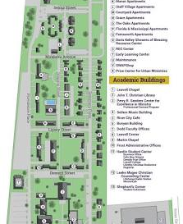
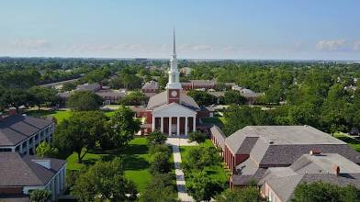
Introduction - Overview of the Eco-Walk
Aerial Overview of the Campus: Drone view showing expansive green lawns, tree canopies, and building layouts, illustrating the 70+ acre scale and biodiversity hotspots.
Notes:
The route around the 70-acre campus in Gentilly, New Orleans included shaded paths under ancient oaks. The purpose was to observe and document the local ecosystem—focusing on biodiversity, how humans interact with nature, and tying it all back to biblical principles of stewardship.
Image: Aerial Overview of the Campus & Campus map
An overhead drone shot shows the chapel as the focal point, surrounded by red-brick buildings, expansive green lawns, tree-lined pathways, and open fields extending into a suburban landscape under a clear blue sky. This broad perspective illustrates the campus's layout, with ample vegetated areas and minimal urban sprawl. In the eco-walk context, it demonstrates the seminary's commitment to preserving green corridors that promote biodiversity, stormwater management, and recreational walking paths, allowing visitors to appreciate how the 70+ acre campus balances built structures with natural habitats for birds, insects, and small mammals, echoing Genesis 1:28 (ESV): "And God blessed them. And God said to them, 'Be fruitful and multiply and fill the earth and subdue it, and have dominion over the fish of the sea and over the birds of the heavens and over every living thing that moves on the earth.'"

Slide 4
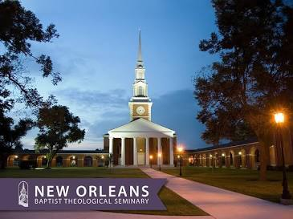
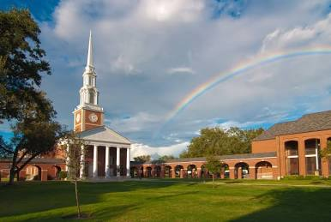
Summary of Findings - Ecosystem Overview
Chapel with Rainbow: Post-rain scene with a rainbow over the steeple, symbolizing weather resilience and natural beauty in a subtropical climate.
Notes:
Now, shifting to the summary of findings, starting with the ecosystem overview. New Orleans boasts a subtropical humid climate—think warm temperatures, high humidity, and plenty of seasonal rainfall that nurtures a blend of urban and wetland-influenced habitats right on the NOBTS campus. The seminary's main campus sits on that picturesque 70-acre tree-covered site in suburban New Orleans, offering a serene backdrop for study and reflection.
Image: Chapel with Rainbow
Similar to the first image, this ground-level view of the chapel includes a vibrant rainbow arching across the sky behind the steeple, with green lawns, trees, and pathways in the foreground under dramatic clouds. The rainbow adds a symbolic touch of hope and natural wonder. For the eco-walk, it illustrates the campus's exposure to Louisiana's dynamic weather, prompting discussions on climate resilience, such as how the grounds handle rainfall through permeable surfaces and vegetation, while celebrating the beauty of natural phenomena that inspire environmental care, as in Psalm 19:1 (ESV): "The heavens declare the glory of God, and the sky above proclaims his handiwork."
Image: Nighttime View of the Chapel
A dusk or evening shot of the chapel illuminated by warm lights, with the steeple and columns glowing against a twilight sky, pathways lit by lamps, and surrounding trees silhouetted. Text overlay reads "New Orleans Baptist Theological Seminary" in purple. This atmospheric image highlights the campus after dark. In the eco-walk presentation, it suggests potential for evening tours focusing on nocturnal ecology, such as observing bats or owls in the trees, while discussing energy-efficient lighting and the campus's role in reducing light pollution to preserve night skies and wildlife rhythms.

Slide 5
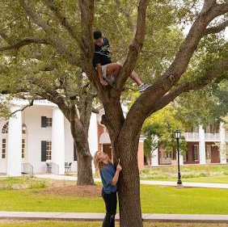
Summary of Findings - Flora Observations
Students Interacting with a Mature Tree: Individuals climbing and touching a live oak, demonstrating human engagement with keystone species that support wildlife.
Notes:
Here on the flora observations slide, the dominant plant life noted during the walk includes majestic live oaks with their sprawling branches, southern magnolias blooming beautifully, various palms swaying in the breeze, and iconic cypress trees dotting the landscape. On the ground, there were ferns, mosses, and even some invasive species creeping in. Tying this to the broader region, the coastal wetlands around New Orleans—part of the Mississippi River Delta—feature plants like cattails, swamp rose, spider lilies, and those same cypress trees, all providing essential habitat for local wildlife.nwf.org Take a moment to appreciate this collage of photos; that close-up of the live oak acorns is one captured during the walk.
Image: Students Interacting with a Mature Tree
This vibrant photo shows two young individuals engaging with a large, leafy tree on the NOBTS campus: one person perched high in the branches, smiling down, while another stands at the base, pointing upward or touching the bark. In the background, a white-columned building with balconies overlooks a grassy lawn under a sunny sky. For the eco-walk presentation, this image captures the joy of connecting with nature, highlighting the campus's ancient live oaks that provide habitat for birds and squirrels, shade for energy conservation, and opportunities to discuss tree health, carbon sequestration, and the role of urban forests in mitigating climate impacts in subtropical New Orleans, resonating with Proverbs 12:10 (ESV): "Whoever is righteous has regard for the life of his beast, but the mercy of the wicked is cruel."

Slide 6
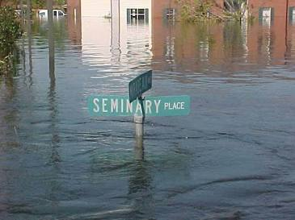
Summary of Findings - Environmental Dynamics and Human Impact
Flooding on Seminary Place: Submerged street sign amid floodwaters, emphasizing vulnerability to inundation and the need for adaptive green spaces.
Notes:
Urban development affects wetlands; post-Hurricane Katrina recovery on campus; pollution from roads vs. benefits of tree canopy for shade and habitat.
Wetland Importance: Louisiana's coastal wetlands are vital for breeding/spawning of over 75% of commercially harvested fish and shellfish.
This slide delves into environmental dynamics and human impact. Observations revealed how urban development encroaches on wetlands, the ongoing recovery from Hurricane Katrina on campus, some pollution from nearby roads, but also positives like the tree canopy offering shade and vital habitat. Louisiana's coastal wetlands are crucial—they act as nursery grounds for over 75% of commercially harvested fish and shellfish species, supporting breeding, spawning, feeding, and refuge.lacoast.gov They also host five million wintering waterfowl, serve as stopovers for migratory birds, provide nesting sites for waterbirds like the brown pelican, and support threatened species including at least 70 pairs of bald eagles.lacoast.gov Plus, they're key for fur harvests like nutria and muskrat, and over 25,000 wild alligators annually.lacoast.gov The diagram here illustrates those interactions—see how the arrows show the balance between human activity and nature?
Image: Flooding on Seminary Place
This dramatic image depicts floodwaters submerging a street sign reading "SEMINARY PLACE," with campus buildings partially reflected in the murky water under overcast skies, evoking post-storm inundation. No people are visible, highlighting the severity. In the eco-walk presentation, it serves as a stark reminder of climate resilience, illustrating discussions on historical floods like Hurricane Katrina's impact, and how the campus has adapted with elevated landscaping, native plantings for absorption, and green infrastructure to mitigate future flooding while preserving ecological balance, reflecting the call in Genesis 1:26 (ESV): "Then God said, 'Let us make man in our image, after our likeness. And let them have dominion over the fish of the sea and over the birds of the heavens and over the livestock and over all the earth and over every creeping thing that creeps on the earth.’”

Slide 7
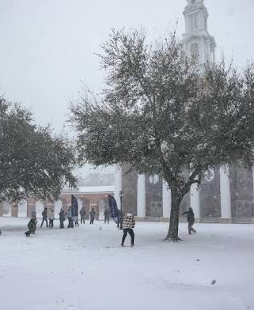
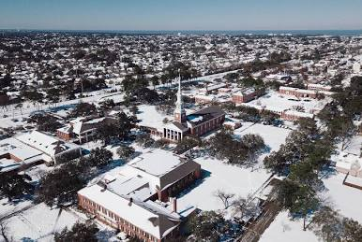
Snow @ NOBTS! 2009 & 2024
Winter Snow Play in Front of the Chapel: Rare snow-covered grounds with people enjoying the scene, underscoring climate variability and tree endurance.
Notes:
Image: Winter Snow Play in Front of the Chapel
A rare snowy landscape blankets the campus, with the chapel's steeple rising in the background amid falling snowflakes. Groups of people, bundled in coats, gather on the white-covered lawn, some throwing snowballs or building figures, under snow-dusted trees. This unusual scene emphasizes Louisiana's vulnerability to extreme weather. In the eco-walk context, it illustrates discussions on climate variability, how the campus's tree canopy withstands freezes (though rare), and adaptive strategies like planting resilient species to enhance ecosystem stability and protect against increasingly erratic weather patterns, evoking Romans 8:19-22 (ESV): "For the creation waits with eager longing for the revealing of the sons of God. For the creation was subjected to futility, not willingly, but because of him who subjected it, in hope that the creation itself will be set free from its bondage to corruption and obtain the freedom of the glory of the children of God. For we know that the whole creation has been groaning together in the pains of childbirth until now."

Slide 8
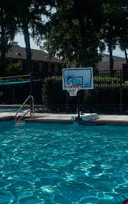
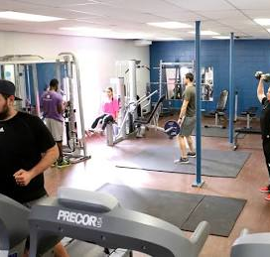
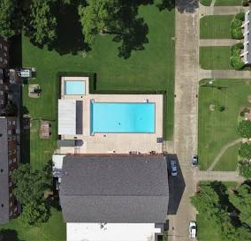
The Gym – I used to work here!
Overhead View of Campus Pool Area: Aerial of the pool integrated with lawns and trees, highlighting water features with evaporation control via vegetation.
Notes:
1st master’s degree. Missiology
Image: Campus Fitness Center in Action
An indoor gym scene depicts several individuals exercising on equipment like treadmills, weights, and machines in a well-lit room with blue walls, mirrors, and fitness gear scattered around. The focus is on physical activity in a communal space. In the eco-walk context, this represents the integration of wellness facilities that encourage outdoor transitions, such as post-workout walks through campus trails, emphasizing how the seminary promotes holistic health by connecting indoor fitness with nearby green spaces that enhance air quality and mental restoration through nature exposure, echoing Job 37:14-16 (ESV): "Hear this, O Job; stop and consider the wondrous works of God. Do you know how God lays his command upon them and causes the lightning of his cloud to shine? Do you know the balancings of the clouds, the wondrous works of him who is perfect in knowledge?"
Image: Overhead View of Campus Pool Area
An aerial drone shot captures a rectangular swimming pool nestled between red-brick buildings, green lawns, pathways, and trees, with lounge areas and a small adjacent structure under a clear sky. The layout emphasizes integrated open spaces. For the eco-walk, this broad perspective showcases how aquatic features are embedded in green corridors, allowing tour groups to explore permeable surfaces around the pool that aid in stormwater infiltration, reducing runoff and supporting groundwater recharge in flood-prone New Orleans, as in Isaiah 43:20 (ESV): "The wild beasts will honor me, the jackals and the ostriches, for I give water in the wilderness, rivers in the desert, to give drink to my chosen people."
Image: Poolside Basketball Hoop
A close-up of a swimming pool's edge shows a portable basketball hoop mounted on the deck, overlooking clear blue water with a fence, hedges, and distant buildings under a sunny sky. The setup suggests recreational fun in an aquatic setting. In the presentation, this illustrates recreational amenities that blend with eco-friendly water management, prompting talks on how the campus maintains pools with efficient filtration systems to conserve water, while surrounding vegetation helps with evaporation control and habitat for local insects in a water-scarce future, reflecting Deuteronomy 22:6 (ESV): "If you come across a bird’s nest in any tree or on the ground, with young ones or eggs and the mother sitting on the young or on the eggs, you shall not take the mother with the young."

Slide 9
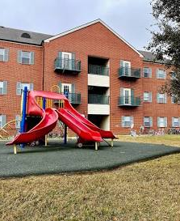
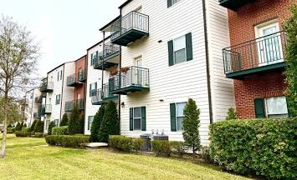
Housing – I used to live here!
Landscaped Hedges and Building Facade: Neatly trimmed native shrubs fronting a brick building, showcasing low-water landscaping for conservation.
Notes:
The Oaks
The Manors
Image: Multi-Unit Housing with Landscaped Frontage
A side view of a row of two-story apartment buildings in varying brick and siding colors, complete with balconies, shutters, and neatly trimmed hedges and trees in a grassy foreground under a cloudy sky. The design appears modern and family-oriented. For the eco-walk, this highlights sustainable housing design with vegetative barriers that filter pollutants, provide wildlife corridors, and shade buildings to lower energy costs, offering a stop to examine how such features contribute to carbon sequestration and urban heat island reduction, as encouraged in Deuteronomy 11:12 (ESV): "a land that the Lord your God cares for. The eyes of the Lord your God are always upon it, from the beginning of the year to the end of the year."
Image: Children's Playground Area
An outdoor playground features colorful slides, a play structure, and rubberized surfacing in front of a red-brick apartment building with balconies and a large tree, set on a mix of grass and mulch under an overcast sky. Bicycles are parked nearby, suggesting family use. In the eco-walk context, this represents child-friendly green spaces that incorporate recycled materials in play equipment, where participants can discuss the benefits of shaded play areas for sun protection, mulch for water retention, and how these zones foster environmental education for younger community members, as in Jeremiah 2:7 (ESV): "And I brought you into a plentiful land to enjoy its fruits and its good things. But when you came in, you defiled my land and made my heritage an abomination."

Slide 10
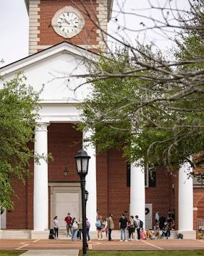
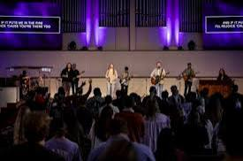
Worship – Get your Jesus on!
Notes:
Image: Worship Gathering in the Chapel
A vibrant indoor worship event features a band on stage with guitars, drums, and singers under purple lighting, performing before an engaged audience raising hands, with lyrics displayed on screens reading "IF IT PUTS ME IN THE MIDDLE / AND IF IT PUTS ME THERE TOO." The atmosphere is energetic and communal. For the eco-walk, this image ties to spiritual reflections on creation care, where participants might pause after the walk for discussions inside, linking biblical stewardship to campus sustainability efforts like energy-efficient lighting in buildings to minimize environmental impact, as in Psalm 104:24-25 (ESV): "O Lord, how manifold are your works! In wisdom have you made them all; the earth is full of your creatures. Here is the sea, great and wide, which teems with creatures innumerable, living things both small and great."

Slide 11
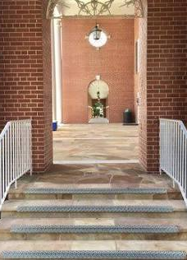
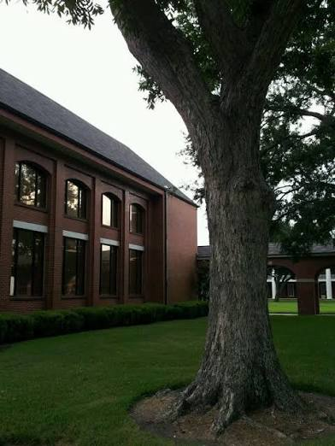
Library – Reading is my favorite!
Notes:
Image: Interior Archway and Staircase View
Looking through a brick archway, the image reveals a set of stone steps with white railings leading into an indoor space, featuring a chandelier, lamp, and distant memorial or altar under warm lighting. The perspective draws the eye inward from the exterior. Though more architectural, for the eco-walk presentation, it can transition to indoor-outdoor connections, illustrating how buildings open to green spaces for natural ventilation and light, reducing energy use, and encouraging walks that explore sustainable design features like permeable pathways outside, in harmony with Numbers 35:33-34 (ESV): "You shall not pollute the land in which you live, for blood pollutes the land, and no atonement can be made for the land for the blood that is shed in it, except by the blood of the one who shed it. You shall not defile the land in which you live, in the midst of which I dwell, for I the Lord dwell in the midst of the people of Israel."

Slide 12
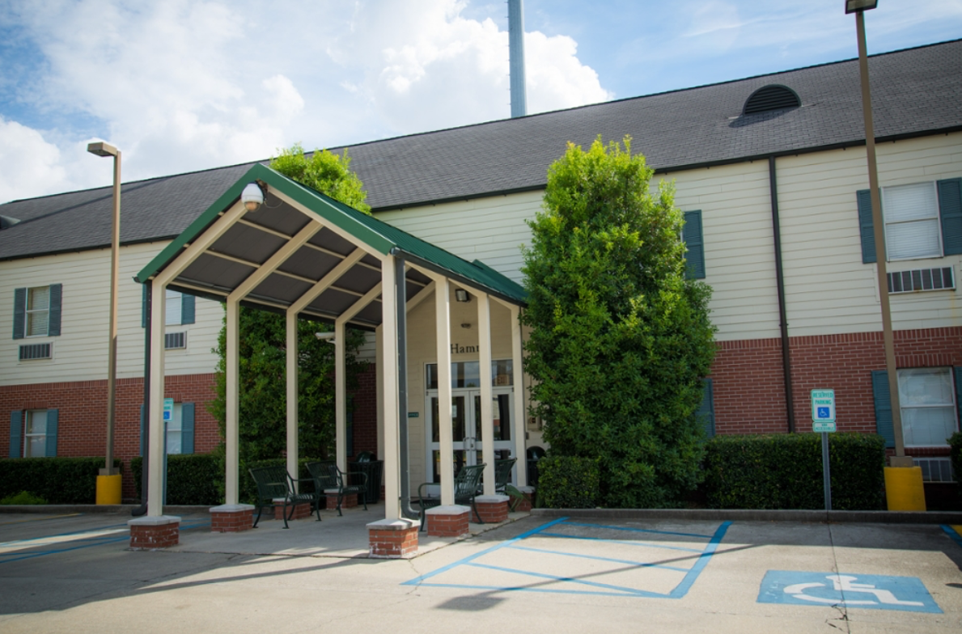
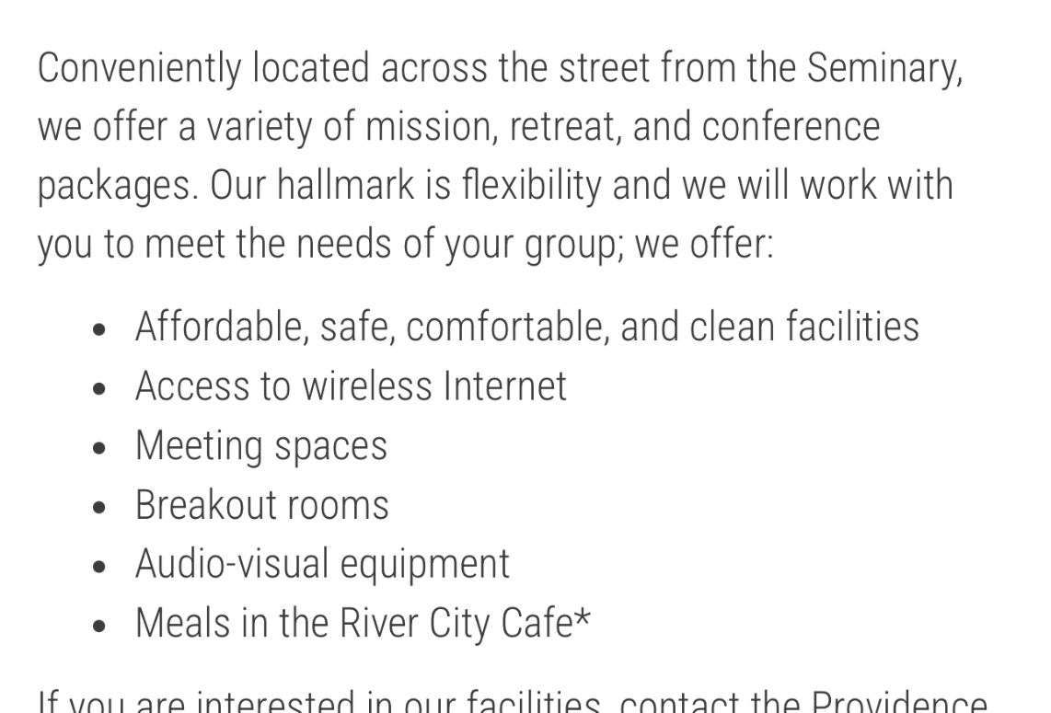
Providence Guest House – Our hotel
Notes:
Image : Entrance to Providence Guest House
The photo captures the covered entrance to Providence Guest House, a beige and brick building with green roof accents, tall shrubs, benches, and accessible parking spaces marked for handicapped use under a blue sky with clouds. Lampposts and greenery frame the welcoming portal. For the presentation, this showcases accessible, landscaped entryways that integrate native plants for low-water needs, encouraging eco-walk stops to explore how such designs promote inclusivity while enhancing biodiversity and natural stormwater management through permeable paving, as in Psalm 95:4-5 (ESV): "In his hand are the depths of the earth; the heights of the mountains are his also. The sea is his, for he made it, and his hands formed the dry land."
Image: Providence Guest House Facade
Similar to the previous, this image focuses on the "Providence Guest House" entrance with a green-canopied porch, surrounded by lush bushes, benches, and disability parking under sunny conditions. The structure blends brick and siding with ample vegetation. In the eco-walk, it emphasizes guest accommodations that prioritize green surroundings for visitor comfort, highlighting features like shade trees for passive cooling and hedgerows that support pollinators, tying into broader campus efforts in sustainable hospitality and habitat preservation, as in Deuteronomy 20:19 (ESV): "When you besiege a city for a long time, making war against it in order to take it, you shall not destroy its trees by wielding an axe against them. You may eat from them, but you shall not cut them down. Are the trees in the field human, that they should be besieged by you?"
Image: Screenshot of Providence Guest House Webpage
A mobile screenshot from nobts.edu displays the "Providence Guest House" page, detailing its location across from the seminary, offerings like affordable facilities, wireless internet, meeting spaces, breakout rooms, audio-visual equipment, and meals at the River City Cafe. It includes contact info for MissionLab and a photo of the building's entrance. For the eco-walk presentation, this informational graphic can introduce the guest house as a rest stop, noting its role in supporting eco-conscious events with flexible spaces that minimize travel emissions, and how its proximity encourages walking tours focused on environmental theology and campus sustainability initiatives, grounded in Genesis 2:15 (ESV): "The Lord God took the man and put him in the garden of Eden to work it and keep it."

Slide 13
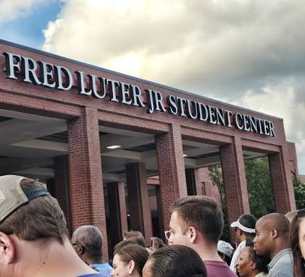
Gathering at the Fred Luter Jr. Student Center
Notes:
Image: Gathering at the Fred Luter Jr. Student Center
A crowd of diverse individuals, viewed from behind, faces the entrance of the "FRED LUTER JR STUDENT CENTER," a modern red-brick building with columns under a partly cloudy sky. The group appears attentive, possibly for an event. This image represents community hubs on campus. In the eco-walk, it can highlight how such centers incorporate green building practices, like energy-efficient design and surrounding landscaping that supports pollinators, encouraging participants to explore nearby paths for observing sustainable features that foster social and environmental responsibility, aligned with Ezekiel 34:18 (ESV): "Is it not enough for you to feed on the good pasture, that you must tread down with your feet the rest of your pasture; and to drink of clear water, that you must muddy the rest of the water with your feet?"

Slide 14
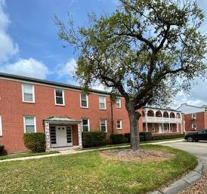
Academic Building with Curbside Tree
Notes:
Image: Academic Building with Curbside Tree
This photo shows a low-rise red-brick apartment building on the NOBTS campus, featuring a central entrance and windows flanked by hedges, with a prominent mature tree in the foreground casting shade over a grassy median and a concrete curb scattered with fallen leaves under a partly cloudy sky. A curved driveway and parked car are visible in the background. For the eco-walk presentation, this image highlights residential green buffers that promote urban biodiversity, where participants can observe how leaf litter contributes to natural mulching for soil health, reducing water usage and supporting decomposers in the ecosystem, while discussing tree placement for natural cooling in New Orleans' humid climate, in line with Leviticus 25:23-24 (ESV): "The land shall not be sold in perpetuity, for the land is mine. For you are strangers and sojourners with me. And in all the country you possess, you shall allow a redemption of the land."

Slide 15
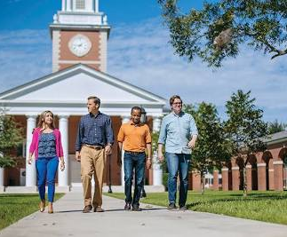
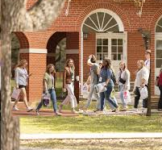
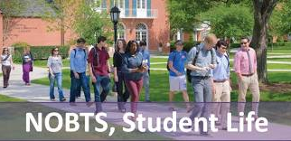
Student Life! Campus Tours! People!
Group Tour Walking on Campus Grounds: Participants strolling paths, representing eco-walks that educate on sustainability.
Notes:
Image: Group of Students Walking Toward the Chapel
Four diverse individuals (a woman in pink and blue, three men in casual attire) stroll along the pathway toward the chapel, with the building's steeple and columns in the background amid trees and grass on a sunny day. This lively scene conveys community and movement on campus. For the eco-walk, it represents how students and visitors can engage in guided nature tours, discussing sustainable practices like the campus's tree canopy that reduces heat islands and enhances air quality, while fostering mindfulness in outdoor settings that connect spirituality with environmental stewardship, as in Psalm 95:5 (ESV): "The sea is his, for he made it, and his hands formed the dry land."
Image: Group Tour Walking on Campus Grounds
A line of people, dressed casually with name tags and bags, walks along a grassy path beside a red-brick building with arched windows and trees, under a sunny sky. The group seems engaged in conversation, possibly a guided tour. This dynamic scene embodies communal exploration. In the eco-walk context, it directly represents participants on a nature-focused tour, discovering sustainable initiatives like rainwater harvesting or wildlife-friendly zones, fostering education on environmental theology and hands-on appreciation of the campus's 70-acre green oasis, reflecting Psalm 96:11-12 (ESV): "Let the heavens be glad, and let the earth rejoice; let the sea roar, and all the things that fill it; let the field exult, and everything in it! Then shall all the trees of the forest sing for joy."
Image: Students Assembled Before the Chapel
A cluster of students stands and chats in front of the chapel's white columns and clock tower, with backpacks and casual attire, under trees and a lamppost on a clear day. The gathering suggests informal socializing or an event start. For the presentation, this image ties to the eco-walk's central meeting point, where groups can begin tours emphasizing the chapel lawn's role in stormwater absorption, tree diversity for habitat creation, and how such spaces inspire reflection on creation care and sustainability within a faith-based community, as in Romans 1:20 (ESV): "For his invisible attributes, namely, his eternal power and divine nature, have been clearly perceived, ever since the creation of the world, in the things that have been made. So they are without excuse."

Slide 16
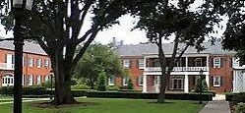
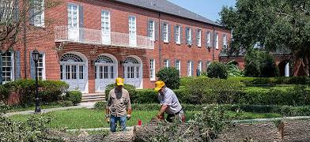
Groundskeeping
Tree Maintenance: Workers clearing fallen logs, depicting post-hurricane recovery and sustainable tree management.
Notes:
Image: Tree Maintenance Two workers wearing yellow hard hats and casual clothing are actively sawing or clearing a large fallen tree trunk in front of a red-brick building with balconies and arched doorways, surrounded by debris and greenery. The sunny day highlights the manicured lawn and hedges. For the presentation, this depicts post-hurricane or storm recovery efforts, underscoring the seminary's proactive tree management for safety and sustainability, including pruning to prevent future damage, recycling wood into mulch for soil health, and replanting natives to maintain biodiversity and reduce erosion in flood-prone areas, as warned in Revelation 11:18 (ESV): "The nations raged, but your wrath came, and the time for the dead to be judged, and for rewarding your servants, the prophets and saints, and those who fear your name, both small and great, and for destroying the destroyers of the earth."
???
Image: Side View of a Residential or Academic Building
This photo depicts a red-brick building with white trim, columns, and a balcony, viewed from a pathway lined with large trees, hedges, and vibrant green grass under an overcast sky. The composition emphasizes the manicured landscape and mature foliage. In the presentation, use this to spotlight residential areas along the eco-walk route, where participants can learn about the seminary's efforts in native plant landscaping that conserves water and supports pollinators, creating tranquil spots for reflection on ecological theology, aligned with Genesis 2:15 (ESV): "The Lord God took the man and put him in the garden of Eden to work it and keep it."
Image: Landscaped Hedges and Building Facade
A close-up view of neatly trimmed hedges and shrubs in front of a historic red-brick building with white-shuttered windows and arched doorways, under a clear sky with a large tree partially visible. The layered greenery creates a formal garden aesthetic. For the eco-walk, this showcases the campus's commitment to low-maintenance, water-wise landscaping using native plants that conserve resources, attract beneficial insects, and enhance soil quality, providing a stop to discuss horticultural practices that align with ecological stewardship, as in Exodus 23:10-11 (ESV): "For six years you shall sow your land and gather in its yield, but the seventh year you shall let it rest and lie fallow, that the poor of your people may eat; and what they leave the beasts of the field may eat. You shall do likewise with your vineyard, and with your olive orchard."
Image: Prominent Tree Beside Academic Building
A massive, gnarled tree stands foregrounded against a red-brick building with tall arched windows and a sloped roof, bordered by hedges and green lawn on an overcast day. The tree's thick trunk and exposed roots dominate the scene. This photo emphasizes the integration of nature with architecture. In the presentation, it serves to spotlight heritage trees as keystone elements in the campus ecosystem, offering shade, oxygen production, and wildlife corridors, while prompting talks on preservation efforts amid urban development and their contribution to mental well-being during eco-walks, reflecting Deuteronomy 20:19 (ESV): "When you besiege a city for a long time, making war against it in order to take it, you shall not destroy its trees by wielding an axe against them. You may eat from them, but you shall not cut them down. Are the trees in the field human, that they should be besieged by you?"
Image 7: Historic Building with Spanish Moss-Draped Trees
An older, slightly faded image of a long red-brick dormitory-style building with white trim and a central portico, flanked by tall trees covered in hanging Spanish moss, on a grassy area with a pathway. The scene evokes a timeless Southern charm. For the eco-walk, this highlights the cultural and ecological significance of Spanish moss as an epiphyte that indicates air quality, supporting discussions on historical campus greening, biodiversity in subtropical habitats, and how these elements create microclimates that buffer against heat and promote native flora, as in Job 12:7-10 (ESV): "But ask the beasts, and they will teach you; the birds of the heavens, and they will tell you; or the bushes of the earth, and they will teach you; and the fish of the sea will declare to you. Who among all these does not know that the hand of the Lord has done this? In his hand is the life of every living thing and the breath of all mankind."

Slide 17
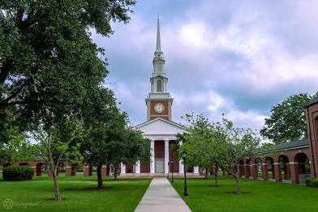

Frontal Ground-Level View of the Chapel
Notes:
Frontal Ground-Level View of the Chapel
This image captures the iconic chapel building at the heart of the New Orleans Baptist Theological Seminary (NOBTS) campus, featuring a tall white steeple with a clock and pointed spire, flanked by white columns at the entrance. A straight concrete pathway leads directly to the doors, bordered by lush green lawns, mature trees, and shrubs under a partly cloudy sky. For the eco-walk presentation, this scene highlights the campus's central green space, where participants can start their tour, observing native Louisiana trees like live oaks that provide shade and support local wildlife, emphasizing the seminary's integration of natural elements with architectural beauty for a serene, environmentally harmonious environment, as reminded in Psalm 24:1 (ESV): "The earth is the Lord’s and the fullness thereof, the world and those who dwell therein."
NOBTS Logo
The official seal of the New Orleans Baptist Theological Seminary features a black circular emblem with a white fleur-de-lis at the center, encircled by text "New Orleans Baptist Theological Seminary" and "NOBTS" prominently displayed, along with the website "www.nobts.edu." This graphic represents the institution's identity. For the presentation, incorporate it as an introductory or branding element, tying into the eco-walk by noting how the fleur-de-lis symbolizes Louisiana's natural heritage (inspired by wetlands and rivers), aligning with the seminary's mission to steward the environment as part of theological education.

Slide 18
Additional Links and References
Official NOBTS Website: For campus maps, virtual tours, and student resources on outdoor spaces. https://www.nobts.edu/
NOBTS Student Handbook (PDF): Details recreation areas like walking tracks and fields, tying into ecosystem use. https://www.nobts.edu/_resources/pdf/studentservices/nobtshandbook.pdf
Why Christians Should Be Concerned with Environmental Issues (NOBTS Article): Theological perspective on creation care, relevant for faith-based eco-walks. https://www.nobts.edu/geauxtherefore/articles/2015/why-christians-should-be-concerned-with-environmental-issues.html
Evangelical Environmental Network: Broader resources on Christian stewardship and initiatives that align with NOBTS values. https://creationcare.org/
Wikipedia Entry on NOBTS: Overview of campus history and layout for contextual background. https://en.wikipedia.org/wiki/New_Orleans_Baptist_Theological_Seminary
Christian Stewardship to Natural Resources (Research Paper): Biblical insights on sustainability (SDG 14/15), applicable to campus ecology. https://www.researchgate.net/publication/391545251_Christian_Stewardship_to_God-given_Natural_Resources_for_Sustainability_A_Biblical_Perspective_Genesis_126-30_and_Psalm_241_and_Sustainable_Development_Goal_SDG_14_15

