Slide 1
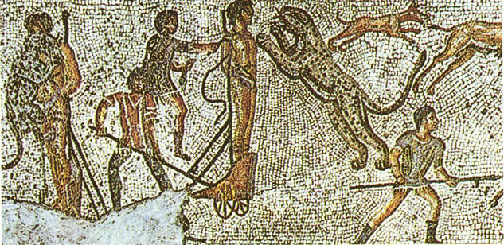
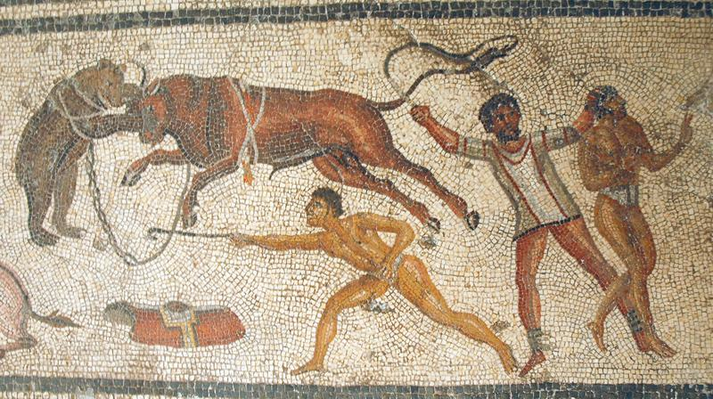
Notes:
What can you see?
Roman mosaics depicting – execution (tops) and beast hunts (bottom)
What does this tell us?
Familiar images for intended audience / popular culture

Slide 2
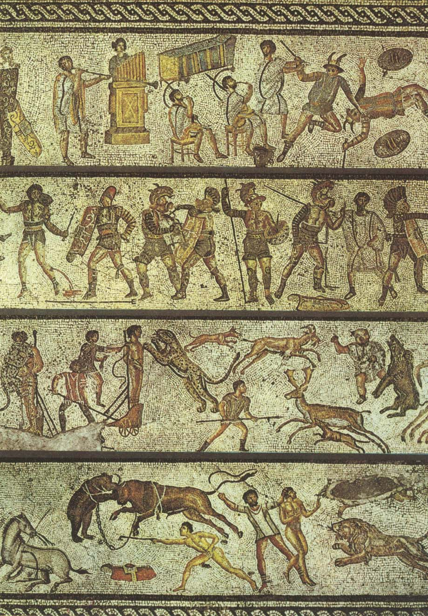
Notes:
Mosaic in full – Day at the games
2nd row is gladiator fight

Slide 3
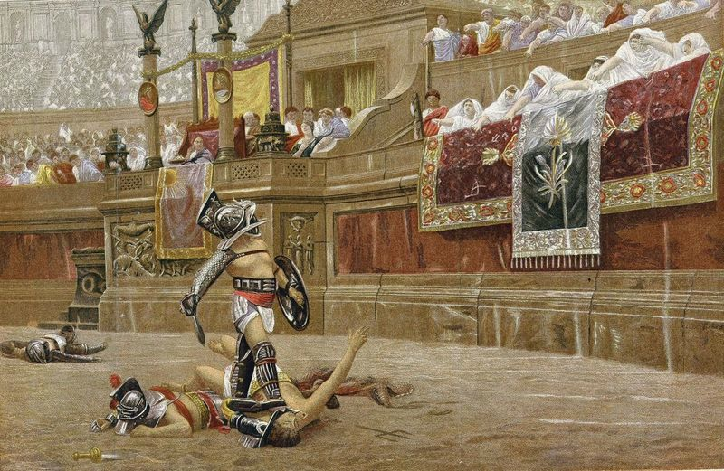
Bread and Circuses:
Why did Rome have gladiator games?
Objective 1:
Find out about the gladiator games and the gladiators.
Objective 2:
Find out what some Romans thought about the games.

Slide 4
Ancient Rome began life as a small community in the 9th century BC.
Rome was originally run by a monarchy.
This all changed in 509 BC when last king was exiled and the Republic was created.
The Republic lasted 500 years before it was overthrown by the first emperor, Augustus.

Slide 5
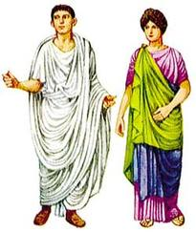
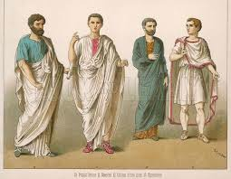
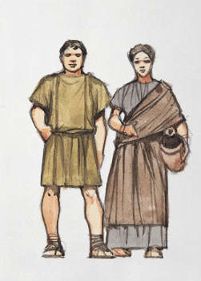
Patricians
Roman society was split into 3 main social groups:
Equites
3% super-rich. The Patricians were the group in charge of the Republic.
7% mainly traders – Increasingly important and wanted a say in how the Republic was run.
Plebs
90% - Working class Romans. Plebs could vote so politicians put on entertainments or gave out food to boost their popularity.

Slide 6
One way to get quick popularity with the people (plebs) was to put on Gladiator games in Rome.
Bread and circuses
Panem et Circenses
Have you ever heard this phrase before?

Slide 7
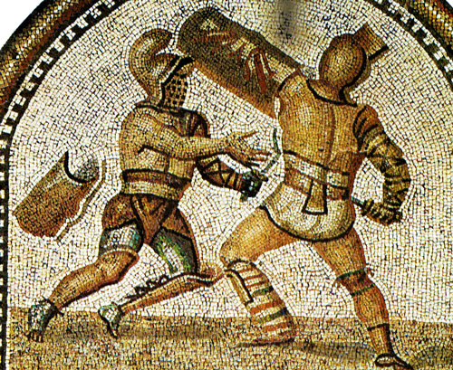
Who were the Gladiators?
Slaves, criminals, prisoners of war or paid professional fighters.
The gladiators would train/exercise every day to help prepare them for fights.
If they won a lot of fights they would earn money which they could use to buy their freedom.
If you were a successful gladiator and won a lot of fights you would become quite famous in the Roman Empire.
Gladiator school = Ludus / Ludi
Owner = Lanista

Slide 8
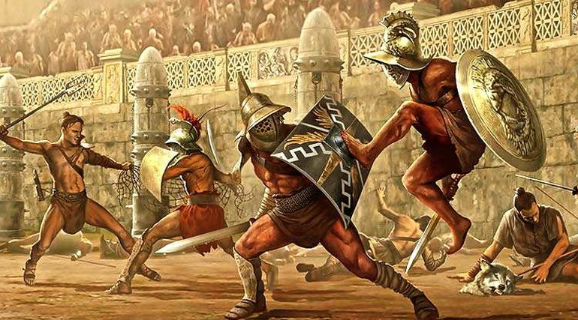
Task one: Match the gladiator to the description

Slide 9
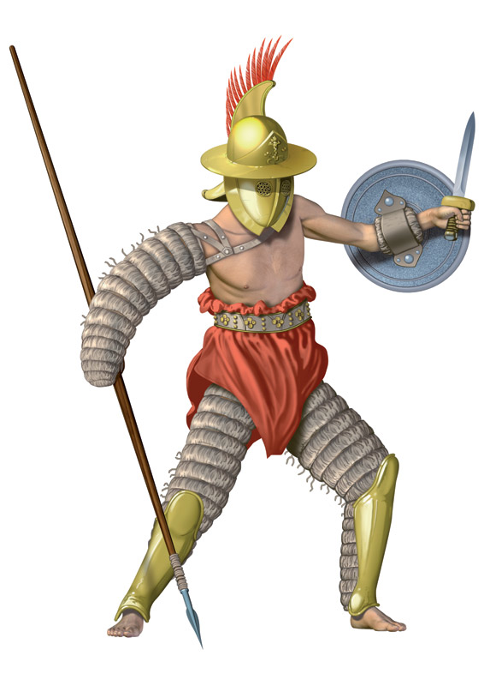
Andabatae
Helmets with NO slits – blindfolded!

Slide 10
These gladiators fought with hapless criminals only, with a sword as the only weapon. They also fought with bare chests, although they wore body armor and a helmet with no eye holes.

Slide 11
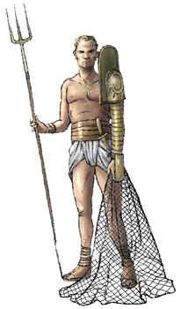
Retiarii

Slide 12
These fighters carried a trident, a net and a dagger.
Their fighting strategy was to entangle their challengers in the net and finish them with the trident.
In addition to that, these fighters stood on a raised platform with stairs while having a pile of stones to throw at his opponent.

Slide 13
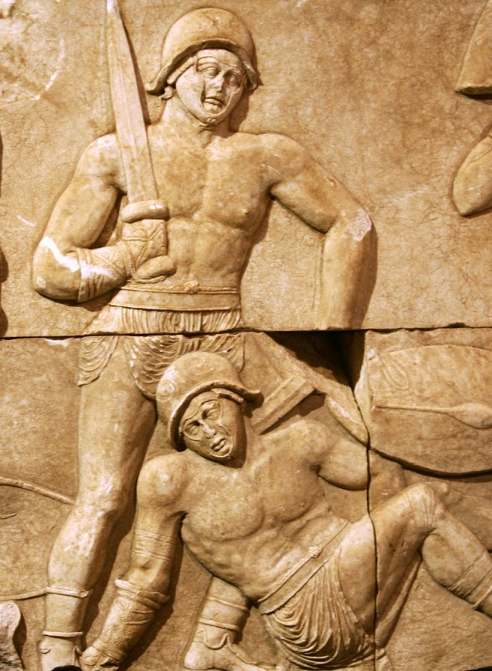
Dimacheri

Slide 14
These were Roman gladiators who fought using two swords. They usually fought against heavily armored gladiators such as Mirmillones or Hoplomachi. The used two curved swords called sica or siccae, which had a blade of about 16 to 18 inches.
They did not use a shield, although they wore a light visored helmet which fitted the head tightly. Their legs and arms were protected with leather wrappings. These gladiators had skills and ability to wield a sword with both hands.

Slide 15
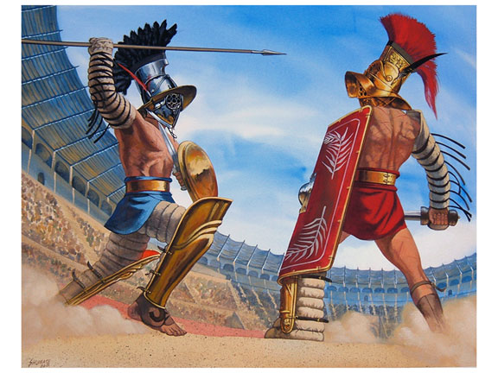
Hoplomachi

Slide 16
These gladiators were well built and heavily armored gladiators. They fought with a gladius which was 27 inches long.
They also carried a lance called hasta, which was six feet long.
In addition to that, they wore a Galea visored helmet with a heavy crest ridge. The right arm is protected by a manica of tied leather, while the lower left foot was protected by a metal greave.
They fought with similarly armored gladiators, however; due to their heavy armors, their fighting speed was slow.

Slide 17
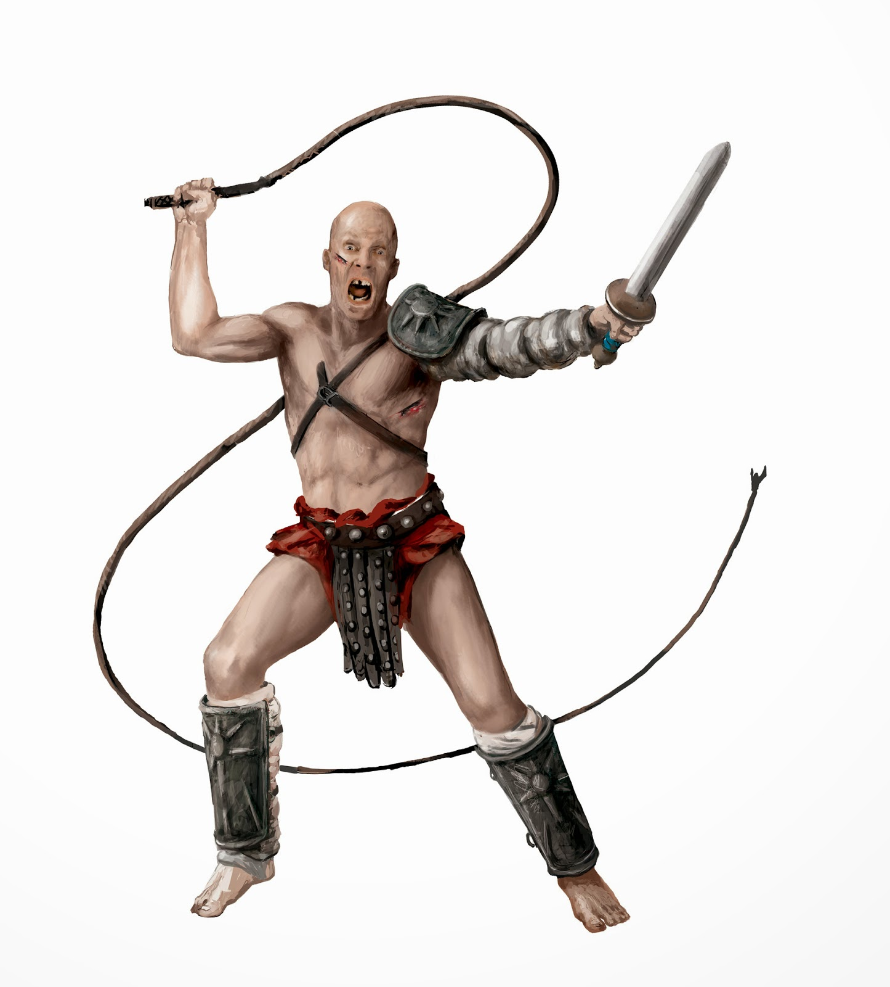
Laqueatores

Slide 18
These gladiators were similar to the retiarius, in that they looked to ensnare their foes and then attack.
They were armed with a rope lasso and then a bladed weapon either a spear, sword or a pointard which was a shorter dagger like weapon.
The laquearius could throw their lasso from distance, and look to wrap it round a head, limb or the whole body of their foe.

Slide 19
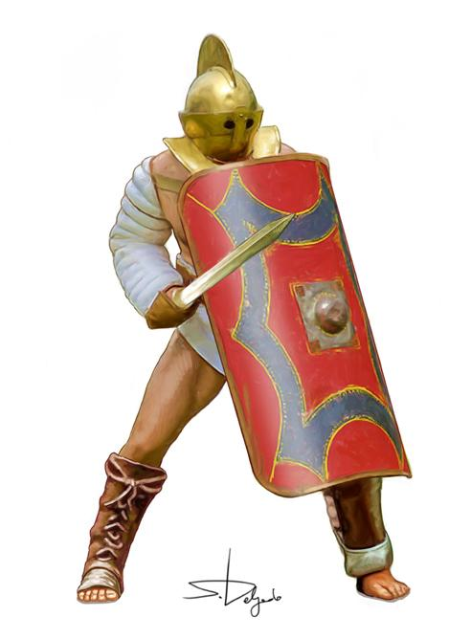
secutores
Sword and shield!

Slide 20
These gladiators wore a smooth, round, close-fitting helmet that minimized it being caught by the Retiarius' net. The helmet also had two small round eye holes.
Weapons: This type of gladiator fought with a sword.
Body Armor worn by this type of gladiator: He wore an Ocrea, or metal greave, on the lower left leg. His right arm and wrist was protected by a manica of tied linen or leather
The purpose of the small eye-holes in the helmets of the opponents of the Retarius was to prevent the narrow prongs of the Retiarius' trident from penetrating to the eyes.
This gladiator carried a large, rectangular, semi-cylindrical body shield called a scutum.

Slide 21
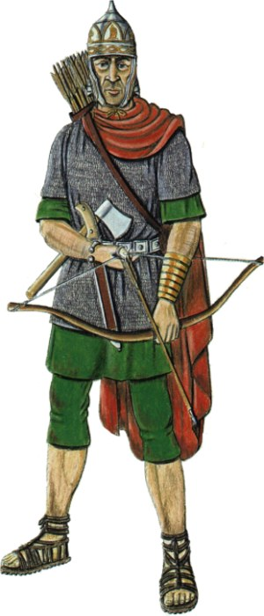
Sagittarii
Archer gladiator!

Slide 22
These were skilled archers equipped with short, powerful war bow of the Barbarians who lived in current Russia and Ukraine.
When they fought, the arena was filled with bushes, rocks and trees to give cover to the fighters, forcing them to stalk each other through natural scenery.
Generally, they participated in mock battles reflecting Roman victories against noxii gladiators. They did not use any shield, but they wore a scaled armor and pointed helmets.

Slide 23
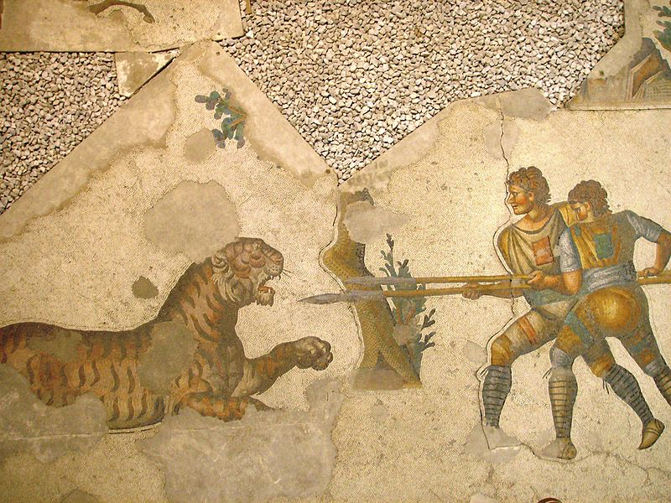
Bestiarii

Slide 24
Opponent: This type of gladiator only fought with wild animals including tigers, leopards and lions.
Weapons: This type of gladiator fought with a spear and/or a knife and sometimes a whip.
Body Armor and helmet worn by this type of gladiator: The Galea, a visored helmet, with decorative crests and basic leather arm and legs wraps.
Shield: None or small shield
Clothing worn: Canvas Loin Cloth (subligaculum) worn in a variety of colors, sandals or barefoot.

Slide 25
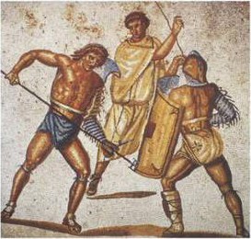
Noxii

Slide 26
These fighters were often criminals or prisoners of war, who offered little opportunity to become a skilled gladiator in another class.
They were typically used in battle where they were not expected to win, almost cannon fodder for the more refined and skillful gladiators of ancient Rome.

Slide 27
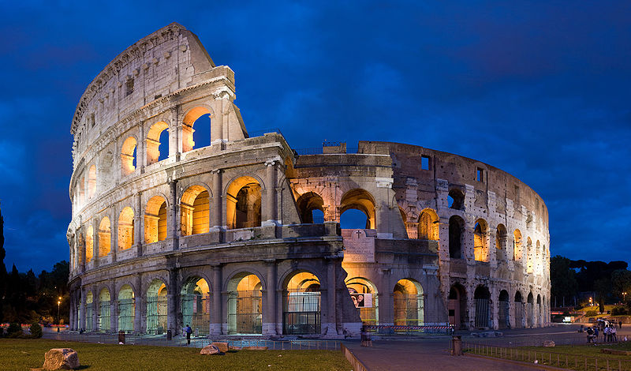
The Colosseum
50,000 people could watch the games.
In the morning there would be ‘Beast Hunts’ and animal fights.
In the afternoon gladiators would fight against animals and then finally it would be time for gladiator fights.

Slide 28
Sex, drugs, rock ’n’ roll…
And gladiators?????
“uri, vinciri, verberari, ferroque necari.”
The Gladiators’ oath:
"I will endure to be burned, to be bound, to be beaten, and to be killed by the sword."
Gladiators were the sex symbols of their time.
Gladiators were seen as symbols of virility and masculinity.
Rich Roman women would often pay for their “company”.
Ordinary Romans would have their favourites to cheer on in the games… you could even buy merchandise!

Slide 29
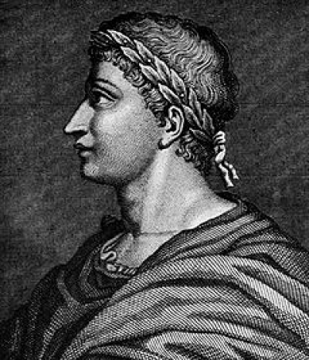
Priscus vs Verus
Task 2
The Roman poet, Martial, wrote about a fight in the Colosseum. It is the only account that survives.
What was the result?
What did they both receive?
Clip
Notes:
5 mins – read poem – answer to each other – watch clip – 38 mins

