Slide 1
True OR False???
Pharaohs wore fake beards
The Ancient Egyptian civilisation lasted 3000 years
All pharaohs are buried in pyramids
Words protected you in the after life
Pharaohs married their sisters

Slide 2
What do you know about Ancient Egypt?
List at least 3 facts on your table.

Slide 3
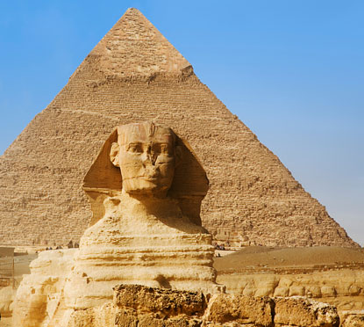
Why Ancient Egypt?
Learning Objectives:
To learn why a great civilisation developed in Egypt.
To learn importance of the Nile in Egyptian history.
To learn about the Black land and the Red land.

Slide 4
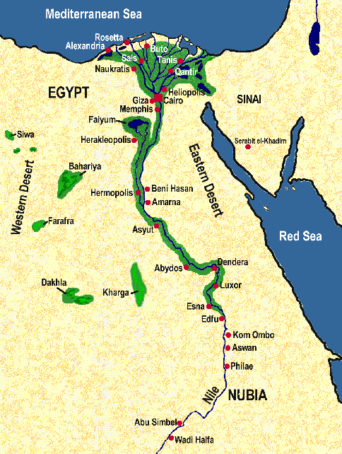
Why Egypt? Make a list of possible reasons

Slide 5
What were the 2 main factors in the development of Egypt?
Make a list of reasons why the Nile was vital to the Egyptians.
Why is the mouth of a river called the delta?
What is the significance of the lotus flower?

Slide 6
Explain the importance of the flood level for Egyptian agriculture

Slide 7
Why was Egypt called Kemet?
Explain the characteristics of Upper Egypt
Explain the characteristics of Lower Egypt
What was the Red Land and how important was it to the ancient Egyptians?

Slide 8
Why Ancient Egypt?
Learning Objectives:
To learn why a great civilisation developed in Egypt.
To learn importance of the Nile in Egyptian history.
To learn about the Black land and the Red land.

Slide 9
Upper or Lower Egypt?
Shaped like the 4th letter of the Greek alphabet
The Nile and sun shaped their civilisation
The capital was Memphis
The chief god was the vulture goddess, Nekhbet
Their emblem was the bee

