Slide 1
Draw the crowns of upper, lower and all Egypt.

Slide 2
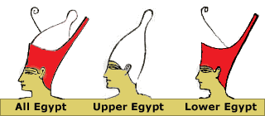

Slide 3
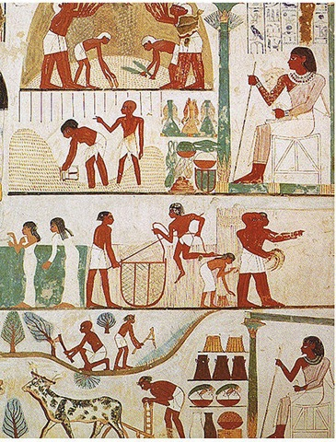
Live like an Egyptian?
Learning Objectives:
To learn how the geography of Egypt effected life
To learn about how ancient Egyptian life was organised

Slide 4
The ancient Egyptians developed a distinctive lifestyle and belief systems because:
They lived in a long, narrow valley and marshy delta enclosed by barren, inhospitable deserts
They were totally dependent on the life giving Nile
They enjoyed a climate where the sun shone constantly and where there was virtually no rain

Slide 5
Describe the 3 seasons in ancient Egypt
Season | Key features
Akhet
Perit
Shemu

Slide 6
What jobs needed doing with regards to the flood?
How could an unusual flood be a disaster for Egypt?
What is a nilometre?

Slide 7
Why was the Nile so important for communication?
How did the natural resources of Egypt dictate their civilisation?
Ancient Worlds – episode 1 – 33 mins to 39.40

Slide 8
Live like an Egyptian?
Learning Objectives:
To learn how the geography of Egypt effected life
To learn about how ancient Egyptian life was organised

Slide 9
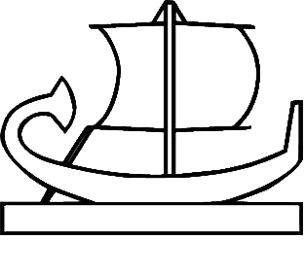
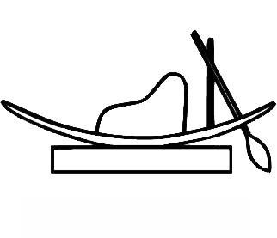
Upstream or downstream?

