Slide 1
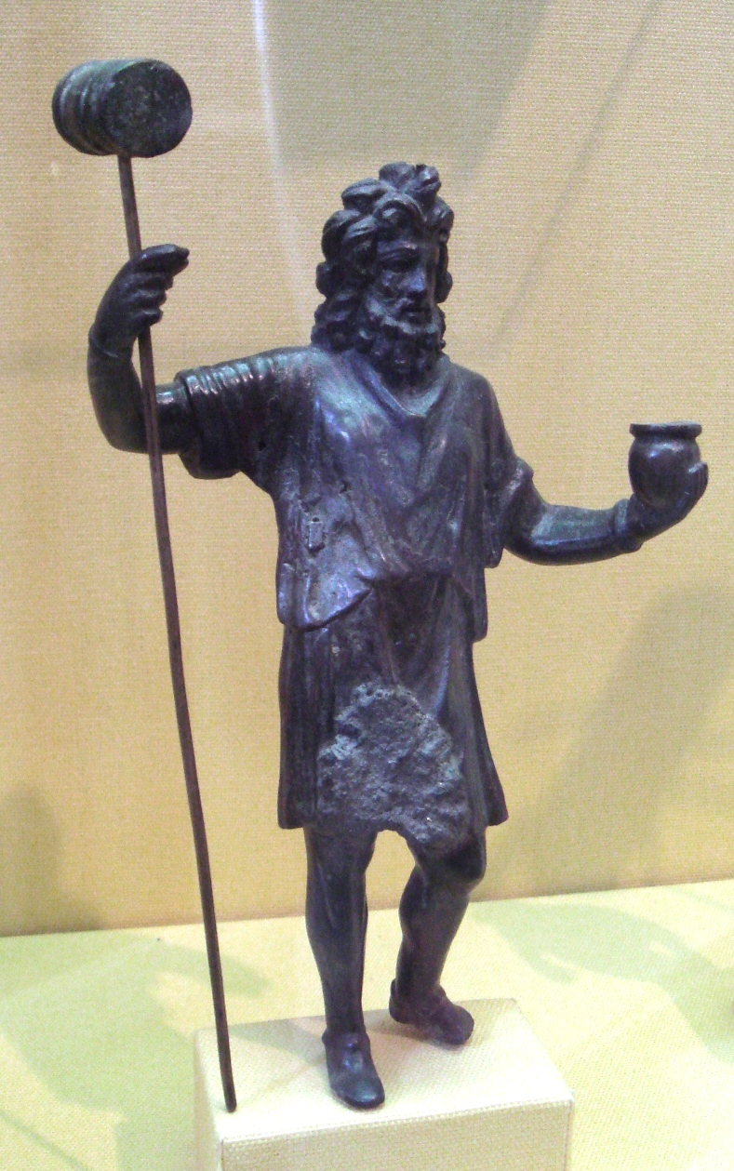
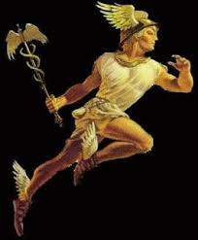
Talking point…
Dis, the god of the dead, smashed your head with a hammer!
How do you check if a gladiator is
dead?
Mercury stuck a red hot poker in you!

Slide 2
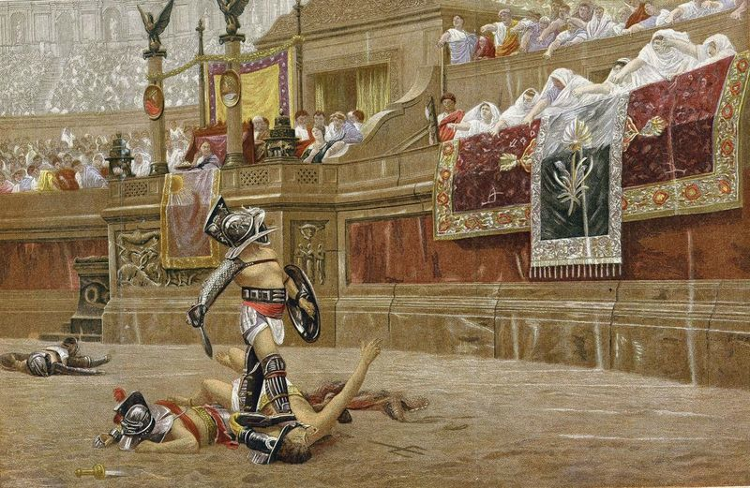
Bread and Circuses:
Why did Rome have gladiator games?
Objective 1:
Understand the pros and cons of the Roman Republic.
Objective 2:
Find out what some Romans thought about the games.

Slide 3
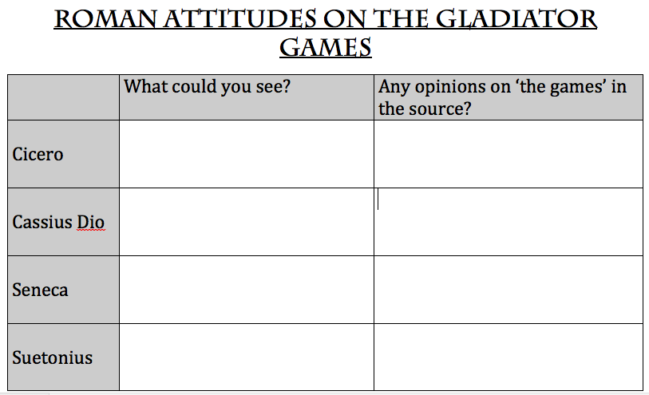

Slide 4
Gladiator clip
Elagabalus Romo lottery millions!

Slide 5
Bread and Circuses:
Why did Rome have gladiator games?
Objective 1:
Understand the pros and cons of the Roman Republic.
Objective 2:
Find out what some Romans thought about the games.

Slide 6
True or false?
It was considered good manners to throw up after dinner.
True! Rich Romans would do this in order to eat more at a feast!

Slide 7
True or false?
Both! The food of the poor and the army certainly was! Rich aristocrats would show off their wealth by hosting fabulous feasts – swans, peacocks… roasted door mice ☹.
Roman food was boring.

Slide 8
True or false?
The Romans invented the calendar.
Yes – all the months have a Latin meaning too!

Slide 9
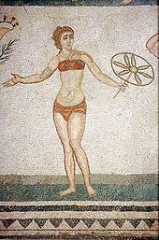
True or false?
Yes – simple loin cloths for men and strophiae for women.
Romans did not wear underwear.
A mosaic from the Piazza Armerina in Sicily showing a woman wearing a strophium.

Slide 10
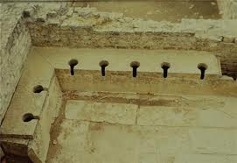
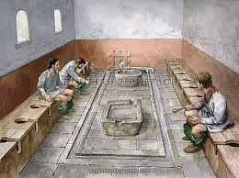
True or false?
No – for many it was a social occasion where some people completed business deals!
Romans thought going to the toilet was disgusting.

Slide 11
True or false?
No – The Romans fought against the Celts – who fought naked and painted themselves in blue paint!
All soldiers fought in armour.

Slide 12
True or false?
The Romans thought it was important to clean your teeth.
Absolutely… although they used powdered mouse brains as toothpaste!

Slide 13
True or false?
The Romans paid their teachers and doctors well.
No – nearly all doctors and teachers were well educated slaves!

