Slide 1
How did the Nile shape Egyptian civilisation?

Slide 2
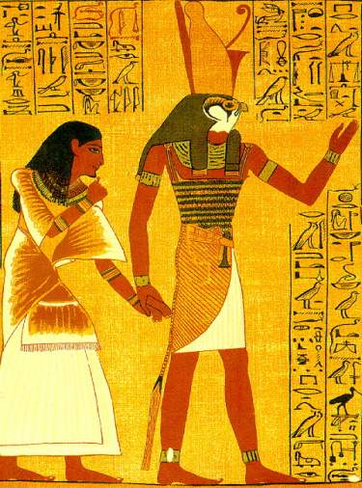
Egyptian Gods and Goddesses
Learning Objectives
1. To learn how and why religion developed in ancient Egypt
2. To learn about the myths and characteristics of the main gods

Slide 3
Egyptian religious beliefs were partly inspired by the nature of the land and its climate. The physical environment was reflected in:
Their view of creation
The nature of the Gods
Their belief in life after death and the nature of the afterlife

Slide 4
Using the information in the booklet and the internet, research these Gods and others of your choice
Name of God/Goddess | Image | Myths/stories
Re/Ra
Horus
Hapi
Osiris
Seth
Isis

Slide 5
Talking point:
If you were an Egyptian god, who would you be? Why?

Slide 6
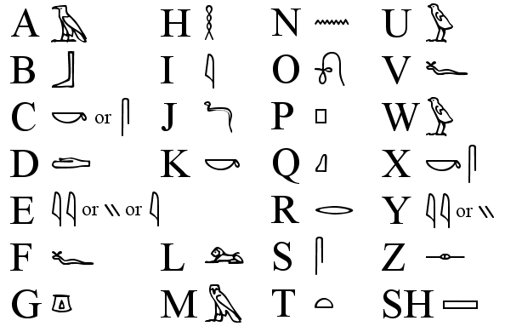
Write your name in hieroglyphs!

Slide 7
Egyptian Gods and Goddesses
Learning Objectives
1. To learn how and why religion developed in ancient Egypt
2. To learn about the myths and characteristics of the main gods

Slide 8
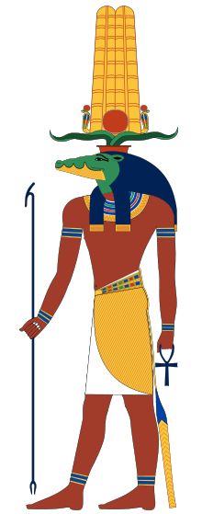
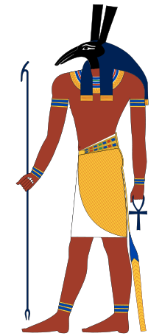
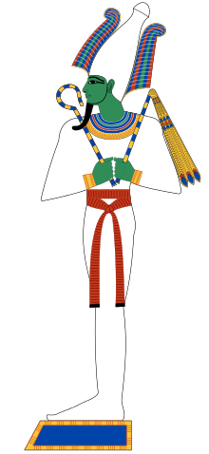
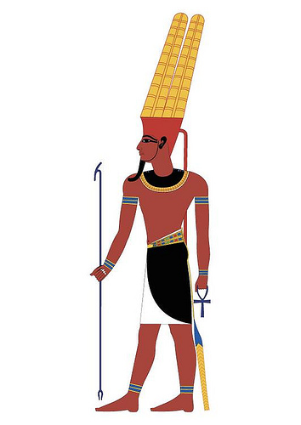
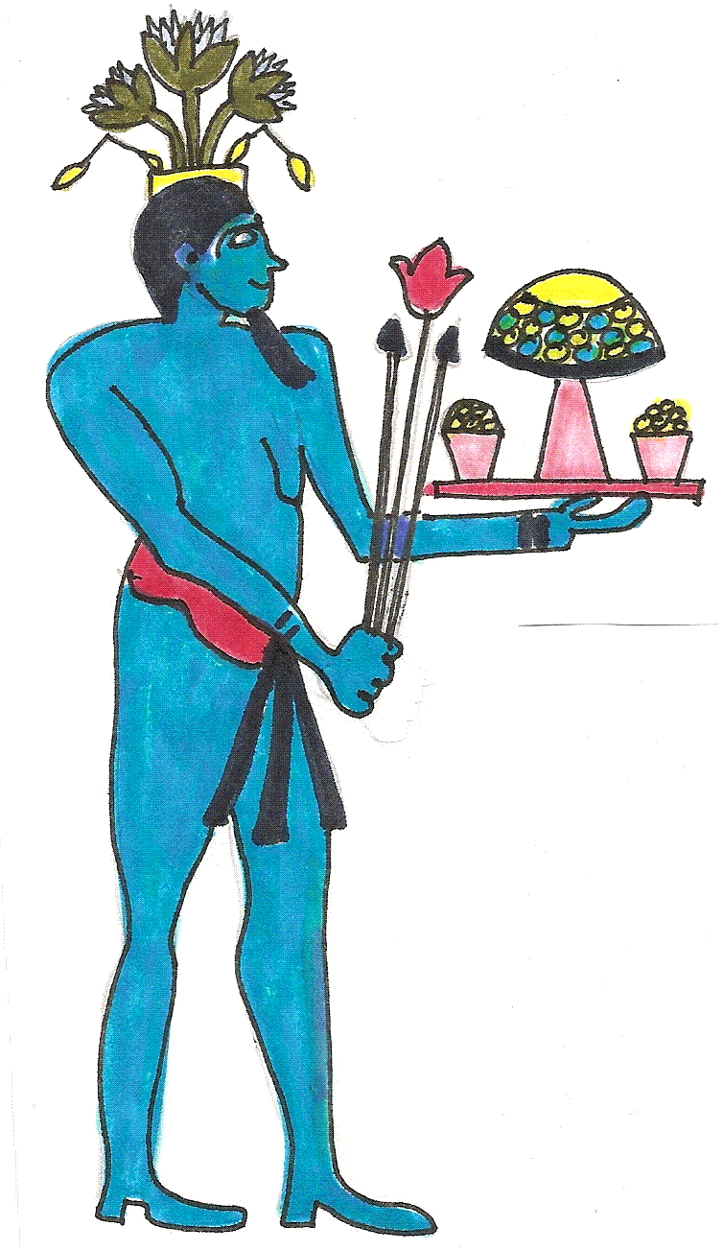
Who’s who?
Notes:
The croc is Sobek
Blue man with belly- Hapi
Jackel head- Seth

