Slide 1
How were Upper and Lower Egypt different?
Make a list of comparable points

Slide 2
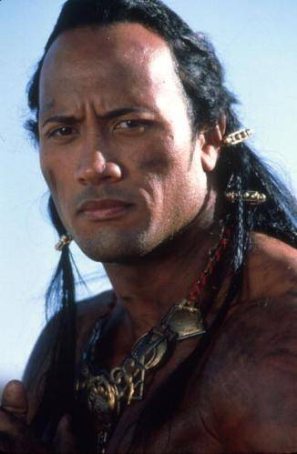
How did Upper and Lower Egypt unite?
I kicked some ass
Learning Objectives:
1. To learn about the unification of Upper and Lower Egypt
2. To learn about the Scorpion King
3. To learn about the powers of the Pharaoh

Slide 3
Why was the Archaic Period important for Egyptian development? Make a list

Slide 4
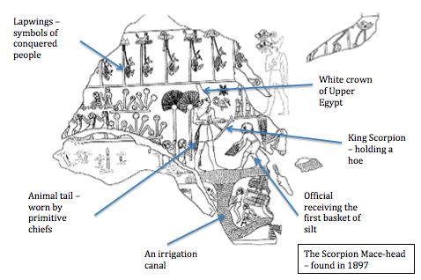

Slide 5
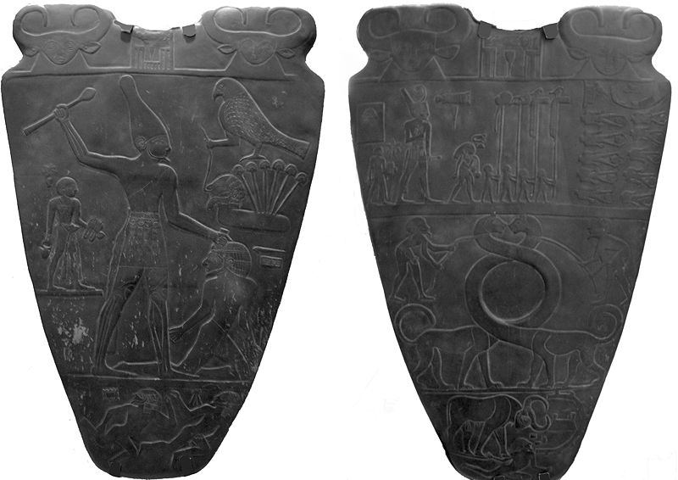

Slide 6
List the key points with the Scorpion Mace-head.
Why is the first king of Upper Egypt, of which we know of, called the ‘Scorpion king’?
Describe the images and their associated messages on the Narmer Palette

Slide 7
Why was the Falcon so important to the Pharaoh and other Egyptians? Make 2 points
What did the Falcon God, Horus, represent?
Complete this table:
What was ma’at and why was it important?
At the beginnings of Egyptian civilisation what could only kings achieve?
King’s dress | Reason
Double Crown
Artificial beard
Tail of a bull or lion
shemset girdle with an apron and a crook staff

Slide 8
How did Upper and Lower Egypt unite?
I kicked some ass
Learning Objectives:
1. To learn about the unification of Upper and Lower Egypt
2. To learn about the Scorpion King
3. To learn about the powers of the Pharaoh

Slide 9
What’s going on? List 3 messages…

