Slide 1
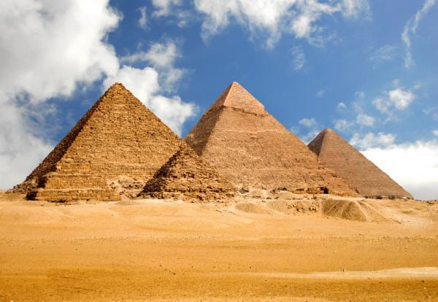
Why pyramids???
Discuss reasons / symbols as to why this shape was chosen…

Slide 2
The beginning of the pyramid age
Learning Objectives:
To learn about the pyrmaid complex of King Djoser
To learn about the construction of Djoser’s pyramid
To learn the importance of pyramids to the early Egyptian kings

Slide 3
The Third Dynasty (2649-2575 BC) marked the beginning of a new era. With the reign of its second king, Djoser (Netjerykhet), the age of the pyramids began.
Djoser’s vizier (chief official) and architect, the famed Imhotep, began the experimentation in pyramid building which culminated in the magnificent Giza pyramids of the Fourth Dynasty.
These pyramids provide evidence of the growing power and status of the king/pharaoh.
The great Pyramid complex at Sakkara was built for Djoser. The design of the complex was unique.
The design emphasised the Two Lands of Upper and Lower Egypt over which the king ruled. The 15 hectare sire was selected as it was on the edge of the western desert and overlooked the capital of Memphis.

Slide 4
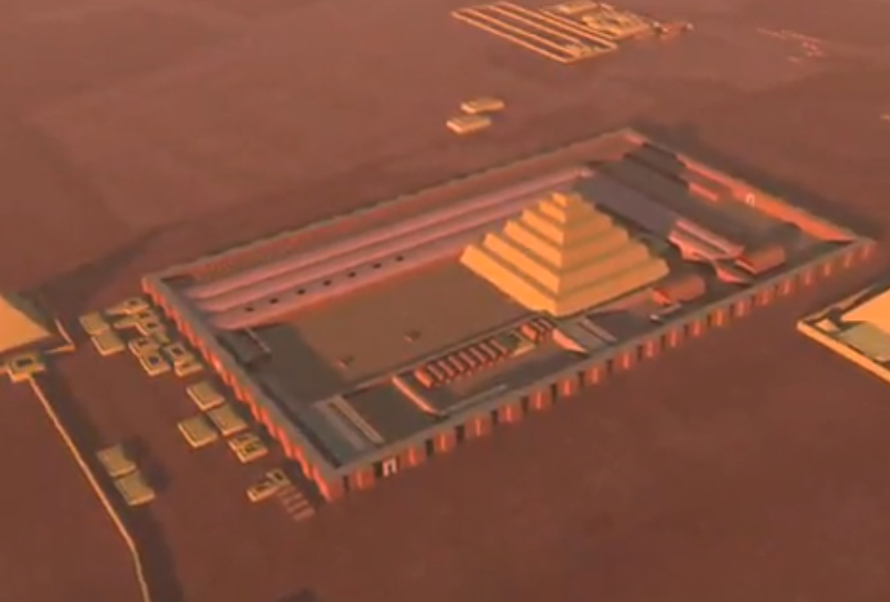

Slide 5
List the main features of Djoser’s pyramid complex
What was unusual about the pyramid? List 2 points
Why was a pyramid important for getting the king to the after life?

Slide 6
How many underground rooms were in Djoser’s pyramid
Why do you think there were so many cups and bowls in his pyramid?
What was the Ka?
Explain why the rest of Djoser’s pyramid complex was probably a copy of his palace at Memphis

Slide 7
Watch – Exploring the step pyramid, Ancient Egypt’s “stairway to heaven” by Dr. Zahi Hawass
http://www.youtube.com/watch?v=t5VsldNp83s
http://www.youtube.com/watch?v=RiCK1k_qWQw&NR=1&feature=endscreen
Notes:
6 minutes long

Slide 8
The beginning of the pyramid age
Learning Objectives:
To learn about the pyrmaid complex of King Djoser
To learn about the construction of Djoser’s pyramid
To learn the importance of pyramids to the early Egyptian kings

