Slide 1
3 buildings in Djoser’s pyramid complex
2 new features of the buildings
1 architect of Djoser’s pyramid complex

Slide 2
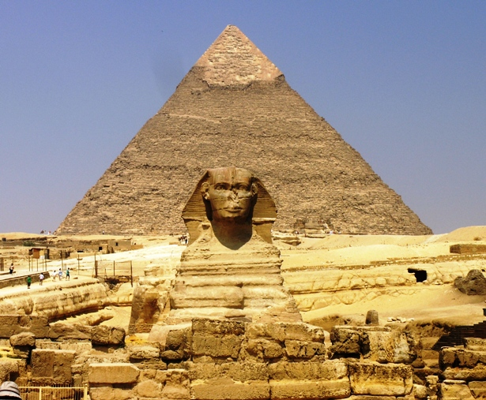
One of the seven wonders of the Ancient World. But how did they do it?
Learning Objectives:
To learn about King Khufu and the importance of the king to ordinary Egyptians
To learn how the Great Pyramid at Giza was built

Slide 3
Which king is it believed the Great Pyramid was built for?
How did Herodotus view him? List 3 some points
Why can we not trust Herodotus' account? Make 2 points
List 4 reasons why may ordinary Egyptians have been happy to build this pyramid for their king?

Slide 4
Awesome vid
http://www.history.com/topics/ancient-egypt/videos#deconstructing-history-the-great-pyramid

Slide 5
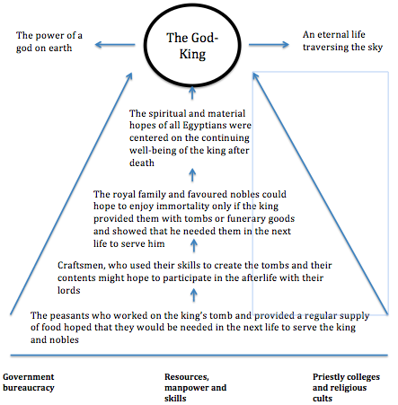

Slide 6
Where is the Great Pyramid located?
Why was this site chosen? List 4 reasons
What problems did the architects have to overcome?
How many cubic metre blocks of limestone were used for the Great Pyramid core?
How may the Egyptians have transported this amount of stone from the quarries to the pyramid sites?
How may the blocks have been lifted into place?

Slide 7
One of the seven wonders of the Ancient World. But how did they do it?
Learning Objectives:
To learn about King Khufu and the importance of the king to ordinary Egyptians
To learn how the Great Pyramid at Giza was built

Slide 8
T or F
Slave labour was used to build the Great Pyramid.

Slide 9
T or F
If you helped build the pyramid you may get into the next life

Slide 10
T or F
The pyramid was built on the East Coast of the Nile

Slide 11
T or F
The worlds oldest paved road at Lisht in the Faiyum area was 12 kilometres long and up to 11 metres wide

