Slide 1
Which of these are Roman jobs?
Name rememberer
Poo collector
Funeral Clown
Balloon maker
Armpit Plucker
Curse-Tablet Maker
Fast-Food Seller
Professional mourner
Ghost-buster
Have you seen
my balloon maker?
Notes:
1 = nomenclator
9 = psychopompus / soul conductor – either to remove spooks or check people were dead in the arena (dressed as mercury with a red hot poker)

Slide 2
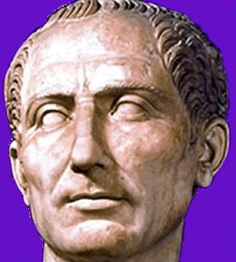
Why was Caesar assassinated?
Objectives:
Investigate the assassination Caesar.
Assess the motives of the assassins.
Analyse the views of three Roman historians to the assassination.
.
.
“Crap.”

Slide 3
Ancient Rome began life as a small community in the 9th century BC.
Rome was originally run by a monarchy..
This all changed in 509 BC when last king was exiled and the Republic was created.

Slide 4
The Ruthless Roman Republic
The Roman Empire began life as a Republic.
Its founding principle was that power should never be in the hands of one man.
Like all democracies there were splits:
The Populares:
Used games, food and money to gain popularity with the plebs.
Wanted to challenge the power of the Senate.
The Optimates
A group of aristocrats who wanted to stop the Senate (parliament) losing power to the plebs.

Slide 5
Pompey vs Caesar
Wanted the senate to
Name him dictator perpetus.
2. Decided to let plebs and
Soldiers into the senate.
3. Started a building program
Which helped the plebs.
4. Decided to free many slaves
To boost the economy.
These tensions erupted in 50 BC and resulted in a civil war.
The Populares were led by Gaius Julius Caesar and the Optimates by Pompey the Great.
Following Caesar’s victories he made a series of changes to how Rome worked. These changes were viewed negatively by some Romans in the Senate.

Slide 6
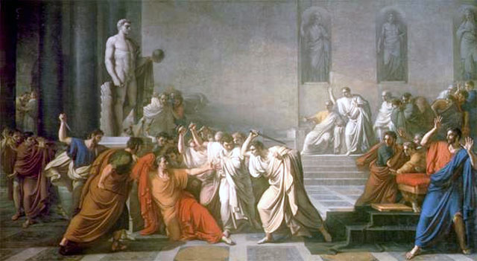
The Ides of March, 44 BC
15/03/44 BC
WhY WAS CAESAR KILLED?

Slide 7
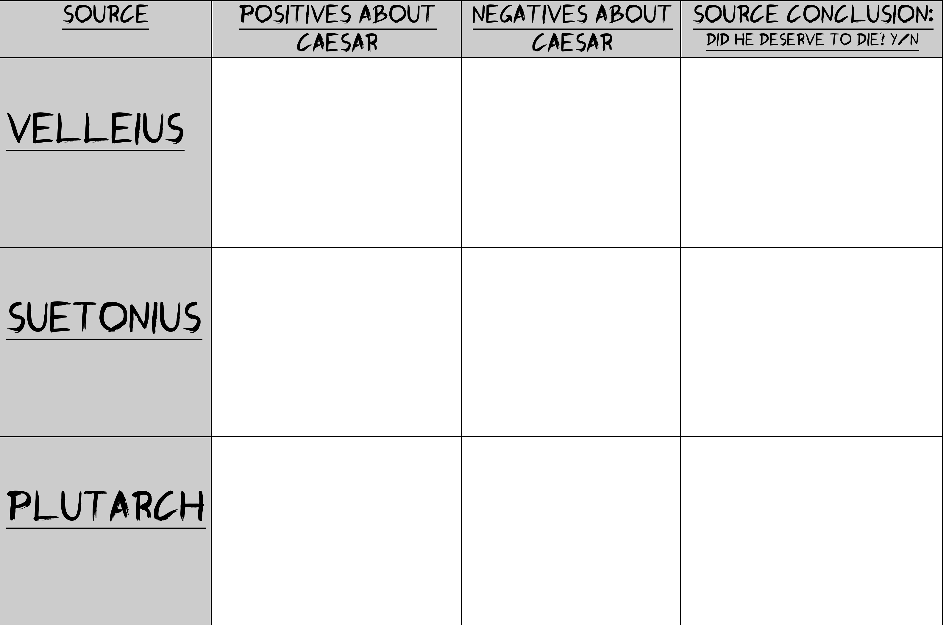

Slide 8
Assassination clip

