Slide 1
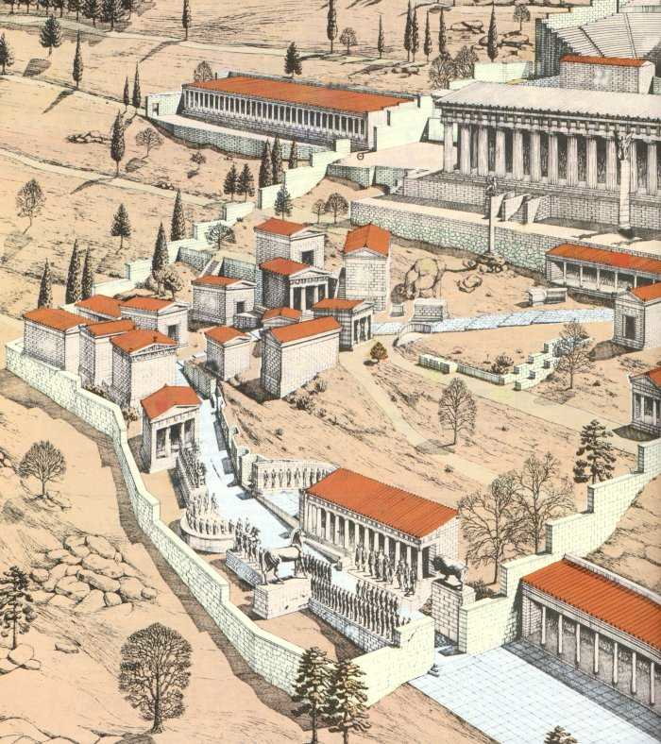
The Great Stoa of the Aitolians
10. What was an ancient Stoa used for?
Treasury of the Athenians
6. When was it built? What did it commemorate?
7. What was the inscription?
8. Give two examples of figures from the friezes.
The Asclepieion
9. Who was Asclepius?
Siphnian Treasury
4. What was special about this building?
5. Where did the Siphnians get their wealth from?
Spartan Monument of the Admirals
Who put it there?
What did it commemorate?
Philopoemen statue
3. Who was he?

Slide 2
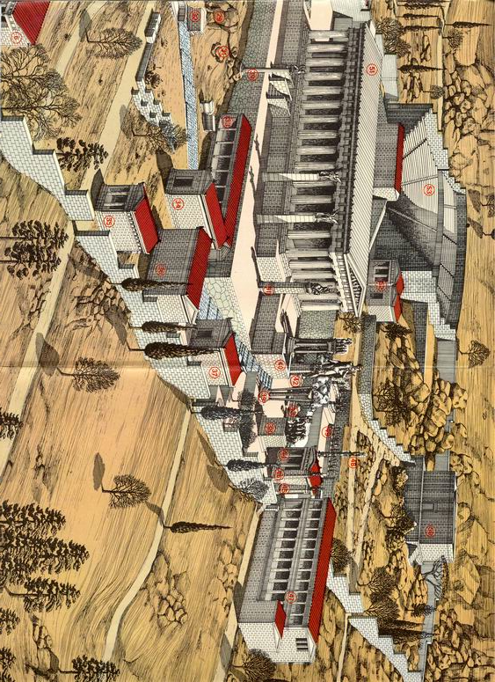
Theatre of Delphi
14. Which Roman Emperor performed here?
The Serpent Column
11. What did this commemorate?
12. What was written on it?
Apollo statue
13. What was Apollo the god of?

