Slide 1
Thunder and lightning
Very very frightening?
Notes:
How would you explain this without access to Science?
Ancient Greece = very religious

Slide 2
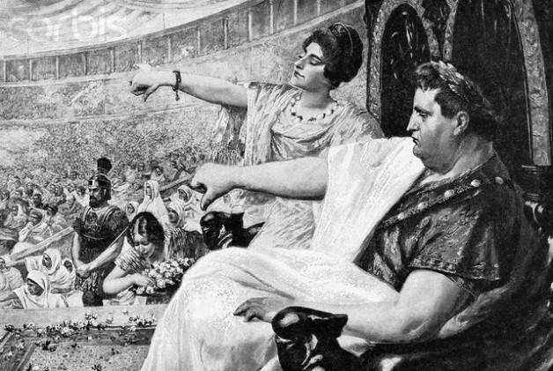
What do these figures have in common?
Lysander
Alexander the Great
Sulla
Nero
Hadrian
Plutarch

Slide 3
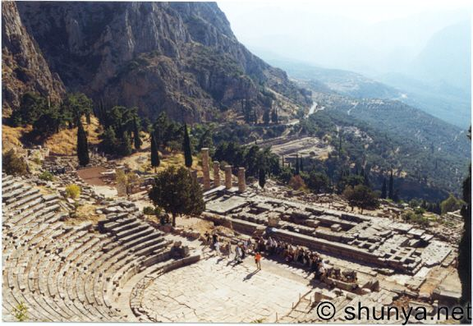
They all visited… Delphi

Slide 4
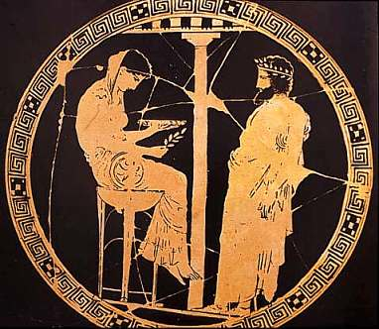
Delphi – home of the Oracle of Apollo
Objectives:
Investigate the origins of Delphi.
Learn about key locations on the site.

Slide 5
Infallible
What does this mean?

Slide 6
Delphi was the site of the Oracle of Apollo – the most important oracle in the ancient world.
Rulers, ambassadors and visitors flocked to Delphi for prophecies and the advice of the Gods.
When the Athenians were being invaded by the Persians they asked the Delphic Oracle for advice – the response was…
“…Put your trust in wooden walls…”

Slide 7
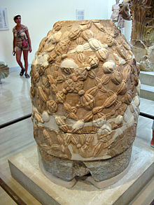
Mythical origins - Delphi
Zeus sent out two eagles to fly across the world to meet at its center, the "navel" or bellybutton of the world – marked by an Omphalos stone.
Omphalos stones were said to allow direct communication with the gods.
Apollo slew a dragon that protected the Omphalos and he established a sacred precinct. Another myth was that Apollo arrived in the form of a Dolphin.

Slide 8
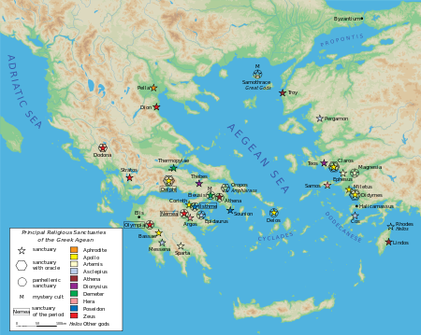

Slide 9
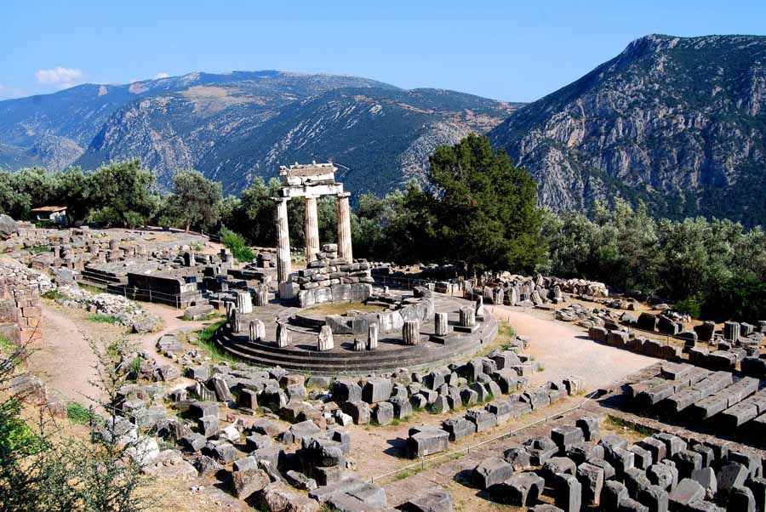
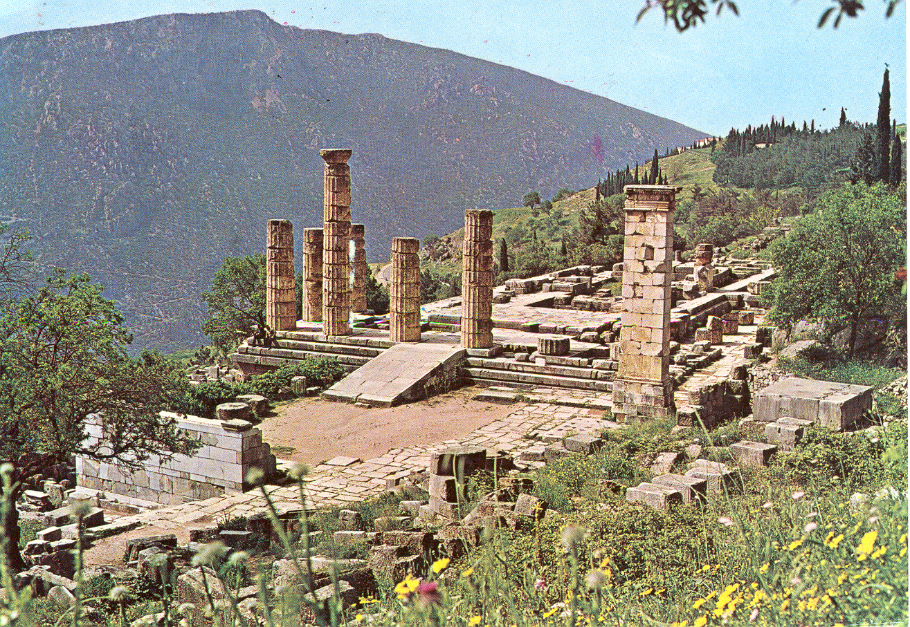
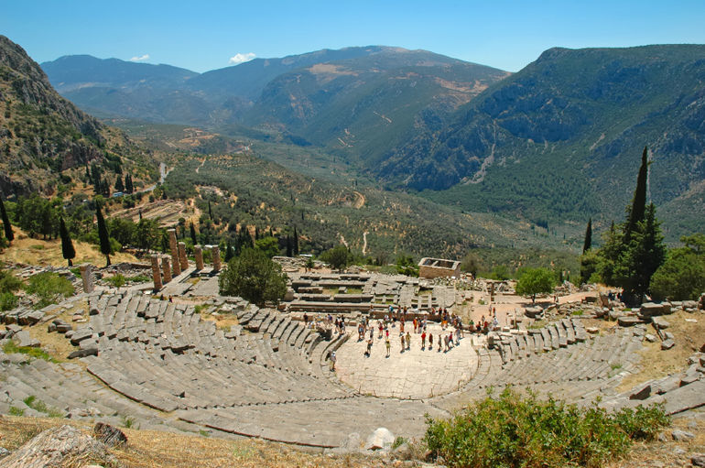

Slide 10
The Pythia
Apollo spoke through his oracle: the Pythia.
The Pythia had to be an older woman of blameless life.
She sat on a tripod over an opening in the earth.
While in a trance the Pythia "raved” and her ravings were "translated" by the priests of the temple into elegant verses.

Slide 11
γνῶθι σεαυτόν
μηδέν άγαν
gnōthi seautón = Know thyself
mēdén ágan = Nothing in excess

Slide 12
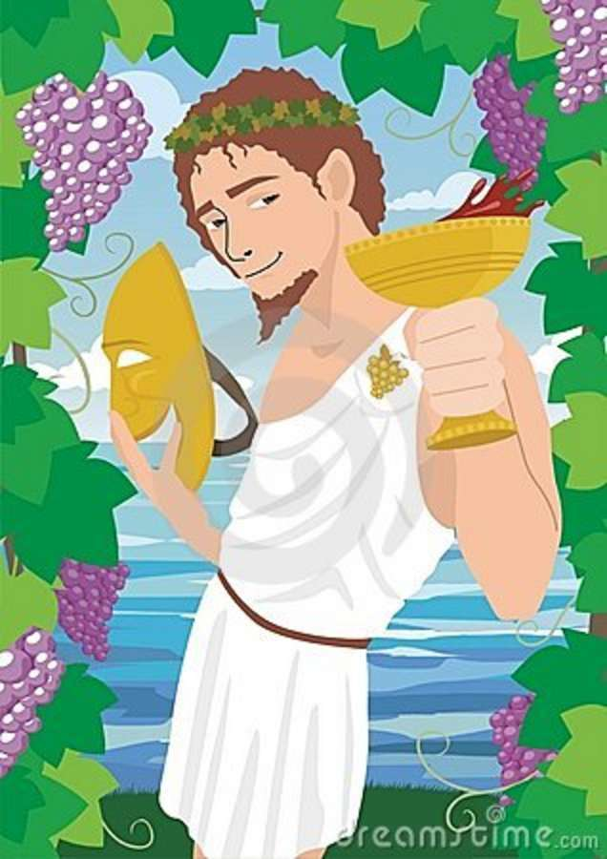
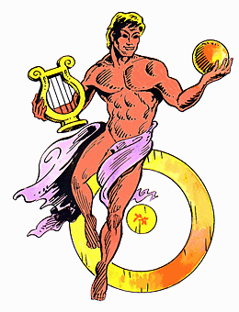
Why Apollo and Dionysus?
Talking point:

Slide 13
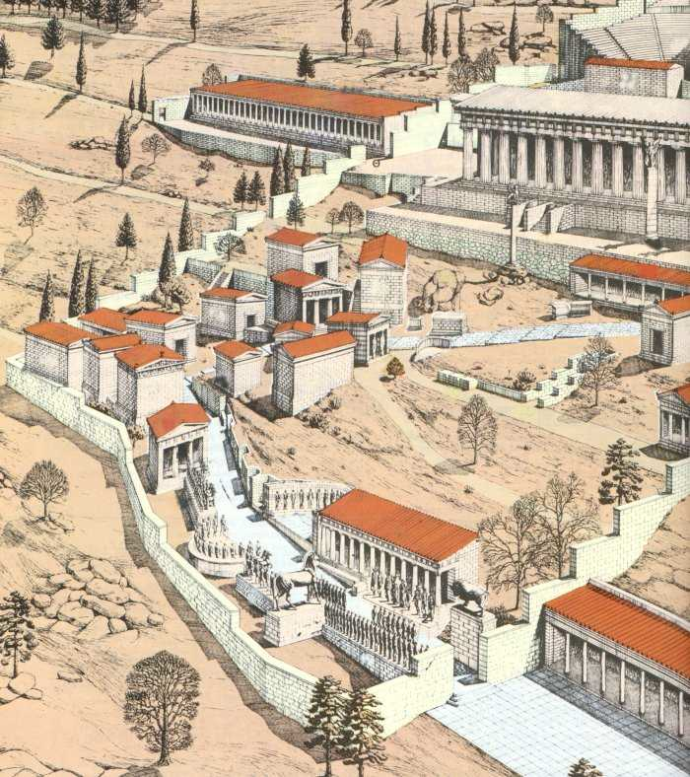
The Great Stoa of the Aitolians
10. What was an ancient Stoa used for?
Treasury of the Athenians
6. When was it built? What did it commemorate?
7. What was the inscription?
8. Give two examples of figures from the friezes.
The Asclepieion
9. Who was Asclepius?
Siphnian Treasury
4. What was special about this building?
5. Where did the Siphnians get their wealth from?
Spartan Monument of the Admirals
Who put it there?
What did it commemorate?
Philopoemen statue
3. Who was he?

Slide 14
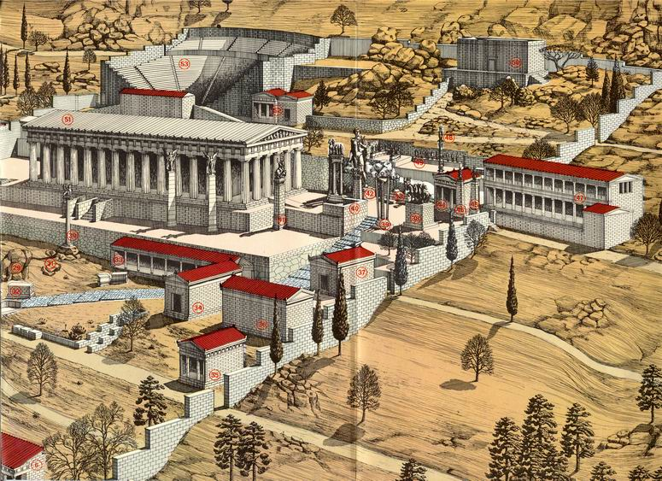
Theatre of Delphi
14. Which Roman Emperor performed here?
Apollo statue
13. What was Apollo the god of?
The Serpent Column
11. What did this commemorate?
12. What was written on it?

Slide 15
horrible histories clip

Slide 16
Extension task
Plutarch’s ‘Life of Alexander’ – read about his visit to the oracle verse 14

Slide 17
Michael Scott doc - 50 mins
Delphi – Bellybutton of the Ancient World docu

Slide 18
Delphi – home of the Oracle of Apollo
Objectives:
Investigate the origins of Delphi.
Learn about key locations on the site.

