Slide 1
How do we honour the dead?
Notes:
Funerals, obituaries, cenotaphs, grave stones, poems, stories, public holidays, parades etc.

Slide 2
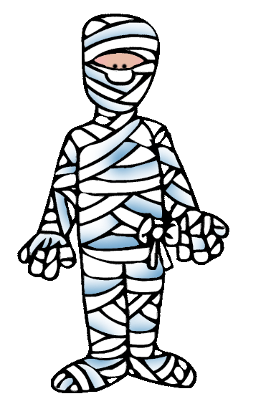
Oh mummy!
Objectives:
Investigate the process of mummification.
Use a Herodotus extract to gain further information.

Slide 3
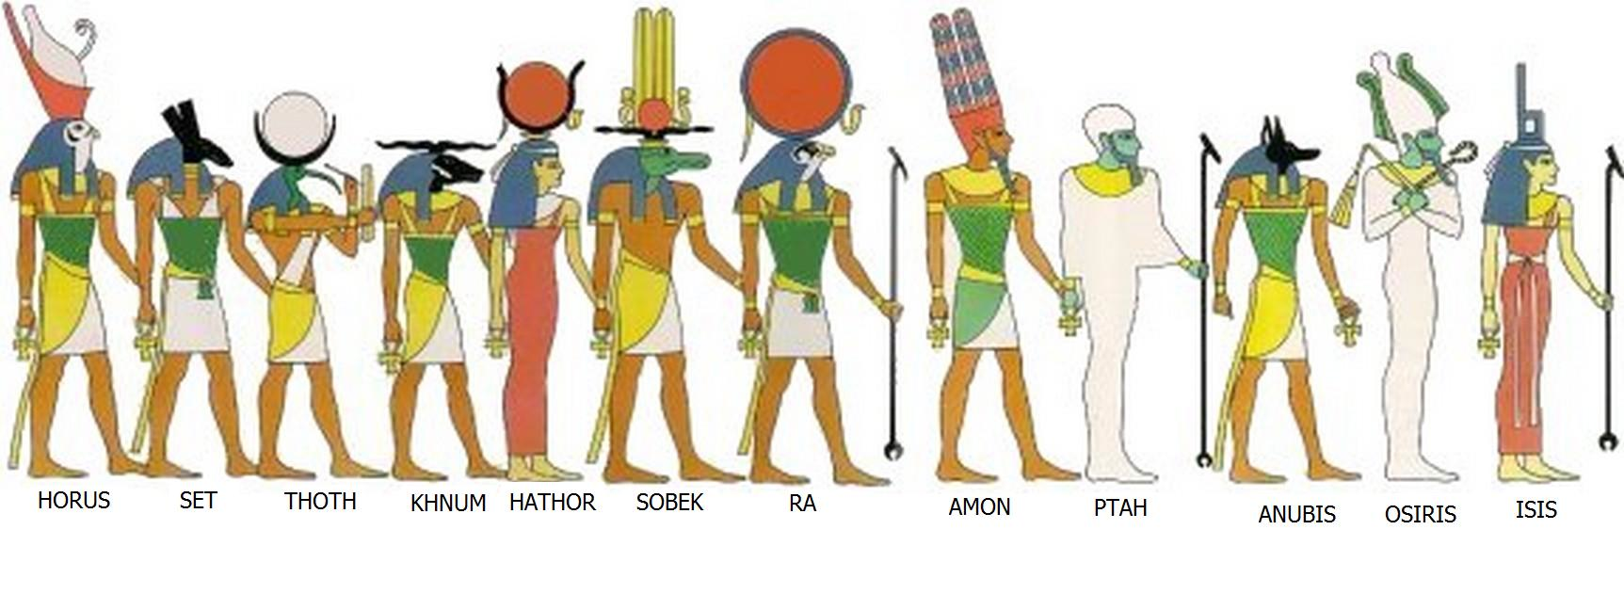

Slide 4
List 3 points on your table…
What do you know about Egypt mummification and attitudes towards the afterlife?

Slide 5
The Egyptians mummified bodies from 4,500 years ago until about 1,500 years ago.
The earliest Egyptians buried their dead in shallow pits in the desert. The hot, dry sand quickly removed moisture from the dead body and created a natural mummy. However, the Egyptians discovered that if the body was first placed in a coffin, it would not be preserved.
In order to ensure that the body was preserved the Ancient Egyptians began to use a process called mummification. This involved embalming the body and then wrapping it in thin strips of linen.
Ancient Egyptians often placed food and even beloved pets (also mummified) into the coffins to travel to the afterlife with the dead people.

Slide 6
Canopic Jars
Shabtis
Scarab amulets
Notes:
Each table use ipad to research on common grave goods

Slide 7
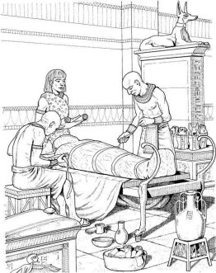
Mummification card sort!
Notes:
Extension: Use phones / ipads to research differences in mummification for rich and poor.

Slide 8
What the flip is natron?
Notes:
Use phones / ipads
The mineral was used in Egyptian mummification because it absorbs water and behaves as a drying agent.
Salt mixture from dry lake beds in Ancient Egypt and has been used for thousands of years as a cleaning product for both the home and body. Blended with oil, it was an early form of soap. It softens water while removing oil and grease. Undiluted, natron was a cleanser for the teeth and an early mouthwash. The mineral was mixed into early antiseptics for wounds and minor cuts. Natron can be used to dry and preserve fish and meat. It was also an ancient household insecticide, was used for making leather and as a bleach for clothing.

Slide 9
Horrible Histories - how to make a mummy

Slide 10
Use ipads/ phones…
Egyptian after-life test – what was it?

Slide 11
What did the Emperor Augustus do when he visited the mummy of Alexander the Great?
Order one for himself?
Knock it over?
Steal it?
Snap the nose off?

Slide 12
Herodotus extract
What were the differences in mummification for rich and poor?
What was there evidence of one embalmer doing?

Slide 13
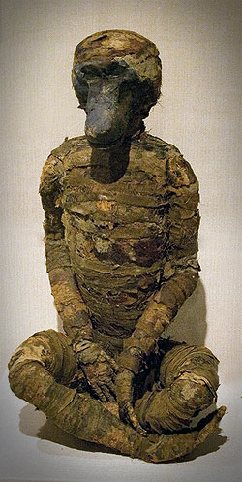
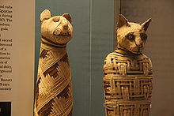
Animal Mummies!
Although humans have been the main subjects for mummification, animals were also mummified too. Many of the mummies found were animals that were cherished pets or mummies used as offerings to the gods. Such animals included cats, monkeys and hawks.
he pets were depicted on tomb walls and were shown eating food or sitting under the chair of the deceased owner.

Slide 14
The mummy maker game

Slide 15
Animal mummies????
Egyptians often mummified other animals, such as cats and dogs. Also point out that the cat sarcophagus is similar to a coffin that we might use today.
Why do people in ancient and modern times like to preserve the bodies of their pets. How do we honor our pets today when they die?

Slide 16
Oh mummy!
Objectives:
Investigate the process of mummification.
Use a Herodotus extract to gain further information.

